Slide 1
BER vs SNR analysis of MIMO systems for different diversity schemes and spatial multiplexing S.M. Haider Ali Shuvo Student ID: 0422062512 Grad Student, Dept of EEE,BUET
EEE 6207 Broadband Wireless Communication

Slide 2
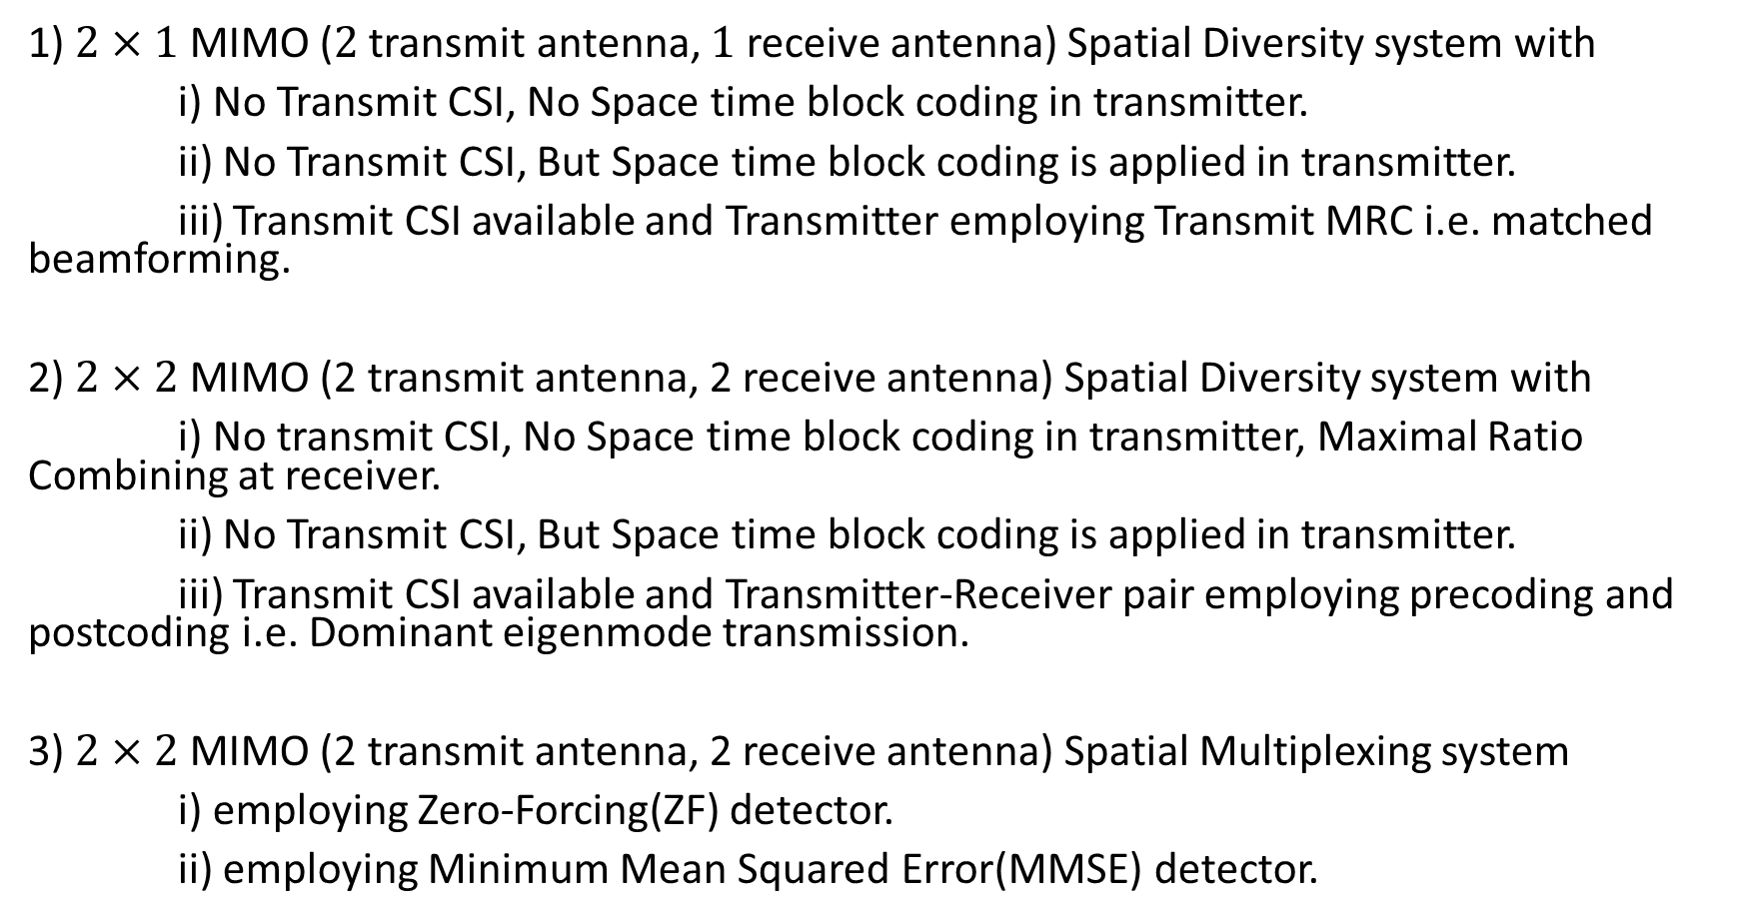
Outline
1) $2×1$ MIMO ($2$ transmit antenna, $1$ receive antenna) Spatial Diversity system with
i) No Transmit CSI, No Space time block coding in transmitter.
ii) No Transmit CSI, But Space time block coding is applied in transmitter.
iii) Transmit CSI available and Transmitter employing Transmit MRC i.e. matched beamforming.
2) $2×2$ MIMO (2 transmit antenna, 2 receive antenna) Spatial Diversity system with
i) No transmit CSI, No Space time block coding in transmitter, Maximal Ratio Combining at receiver.
ii) No Transmit CSI, But Space time block coding is applied in transmitter.
iii) Transmit CSI available and Transmitter-Receiver pair employing precoding and postcoding i.e. Dominant eigenmode transmission.
3) $2×2$ MIMO (2 transmit antenna, 2 receive antenna) Spatial Multiplexing system
i) employing Zero-Forcing(ZF) detector.
ii) employing Minimum Mean Squared Error(MMSE) detector.

Slide 3
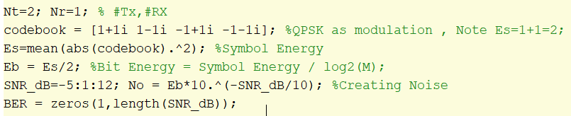
2x1 MIMO, No TX CSI, NO STBC

Slide 4
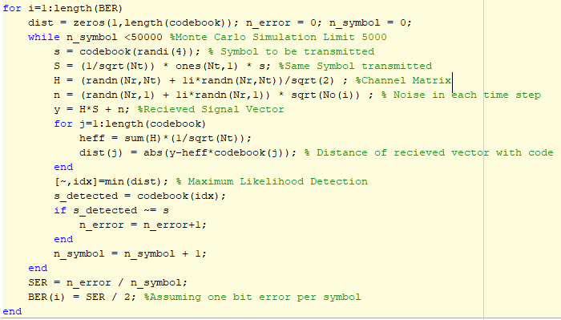

Slide 5
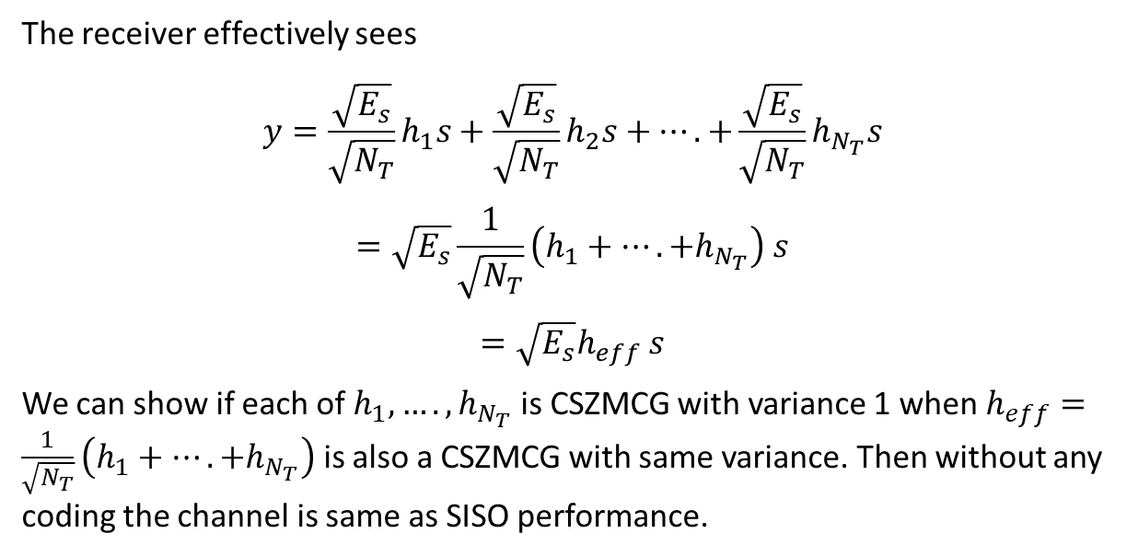
The receiver effectively sees
$$y=\frac{\sqrt{E_{s}}}{\sqrt{N_{T}}}h_{1}s+\frac{\sqrt{E_{s}}}{\sqrt{N_{T}}}h_{2}s+….+\frac{\sqrt{E_{s}}}{\sqrt{N_{T}}}h_{N_{T}}s$$
$$=\sqrt{E_{s}}\frac{1}{\sqrt{N_{T}}}\left(h_{1}+….+h_{N_{T}}\right) s$$
$$=\sqrt{E_{s}}h_{eff} s$$
We can show if each of $h_{1},….,h_{N_{T}}$ is CSZMCG with variance 1 when $h_{eff}=\frac{1}{\sqrt{N_{T}}}\left(h_{1}+….+h_{N_{T}}\right)$ is also a CSZMCG with same variance. Then without any coding the channel is same as SISO performance.

Slide 6
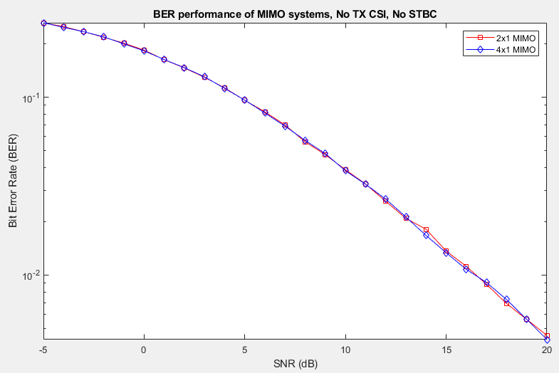

Slide 7
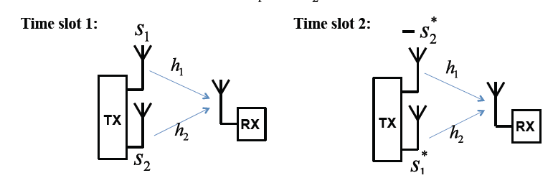
2x1 MIMO, No TX CSI, Alamouti STBC

Slide 8
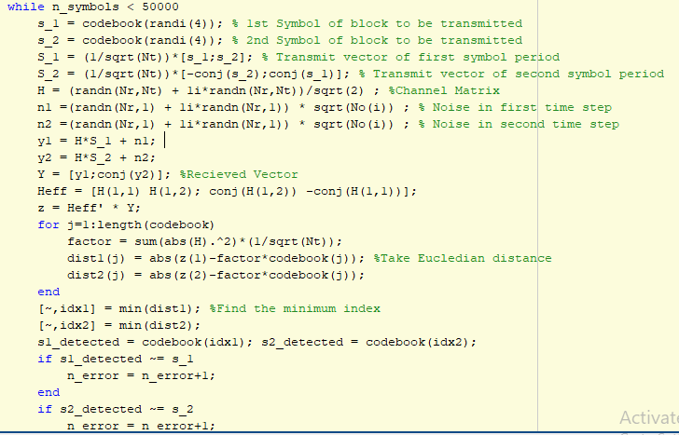
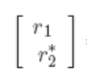


Slide 9
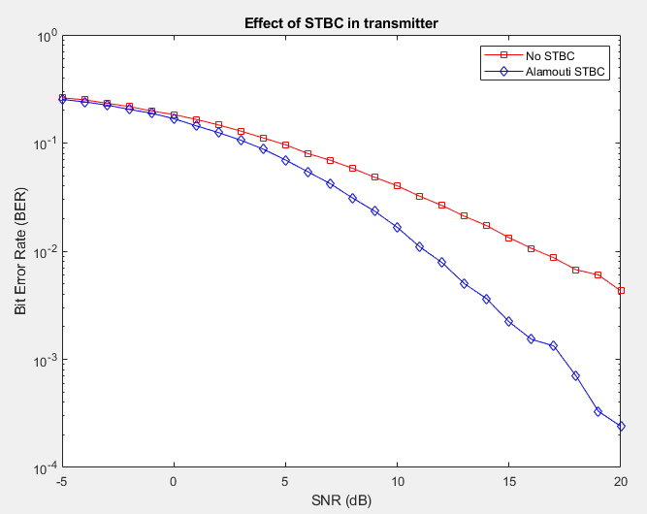
STBC can achieve full diversity. The diversity increases the slope of BER vs SNR curve.

Slide 10
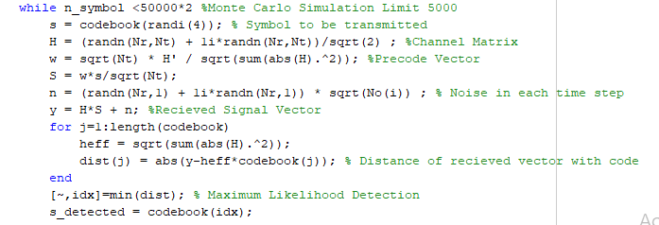
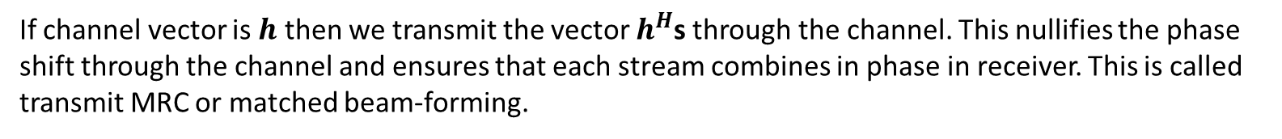
2x1 MIMO, TX CSI, Transmit MRC
If channel vector is $h$ then we transmit the vector $h^{H}$s through the channel. This nullifies the phase shift through the channel and ensures that each stream combines in phase in receiver. This is called transmit MRC or matched beam-forming.

Slide 11
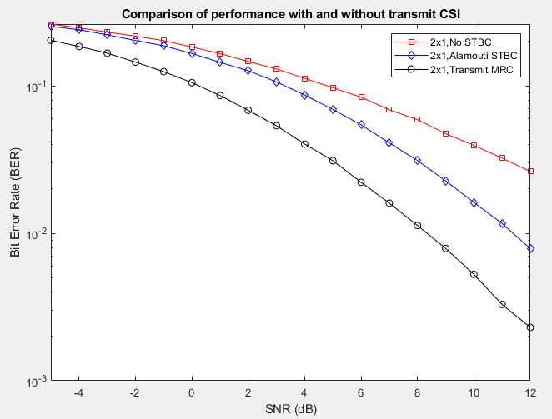
Fig.3 : If Transmitter CSI is available then array gain in addition to diversity gain is extractable as well. The addition of array gain doesn’t affect slope but makes a shift in the bit error rate curve.

Slide 12
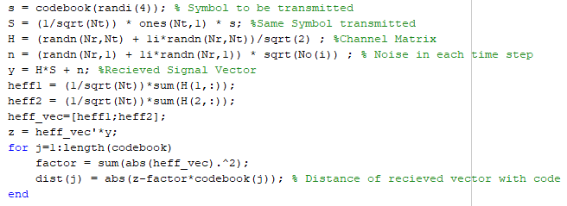
2x2 MIMO, No TX CSI, NO STBC
Receiver does MRC

Slide 13
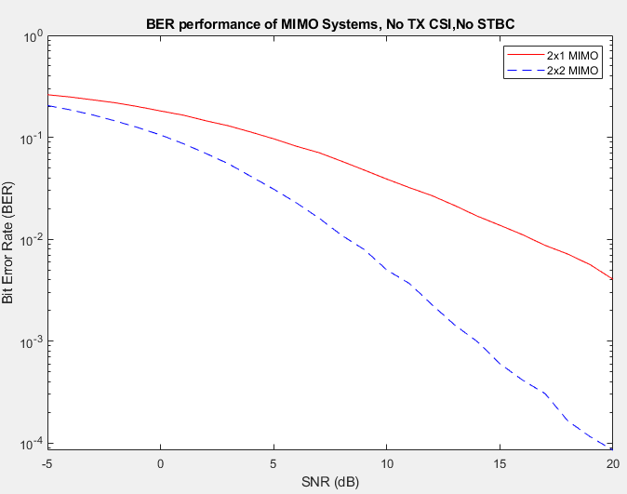
$2×2$ case has receive diversity and receive array gain available. The array gain shifts the curve while the diversity gain changes the slope.

Slide 14
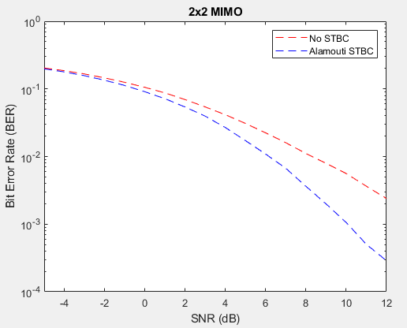
2x2 MIMO, No TX CSI, STBC

Slide 15
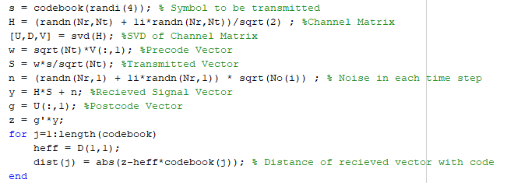
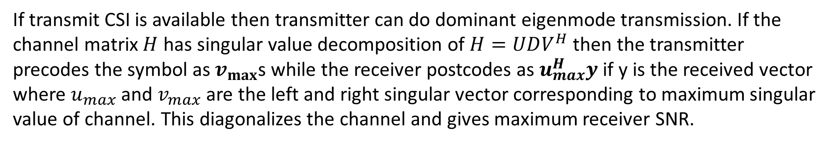
2x2 MIMO, TX CSI, Dominant Eigenmode Transmission
If transmit CSI is available then transmitter can do dominant eigenmode transmission. If the channel matrix $H$ has singular value decomposition of $H=UDV^{H}$ then the transmitter precodes the symbol as $v_{max}$s while the receiver postcodes as $u_{max}^{H}y$ if y is the received vector where $u_{max}$ and $v_{max}$ are the left and right singular vector corresponding to maximum singular value of channel. This diagonalizes the channel and gives maximum receiver SNR.

Slide 16
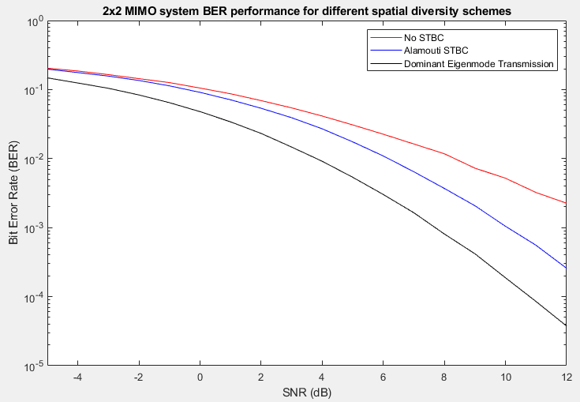

Slide 17
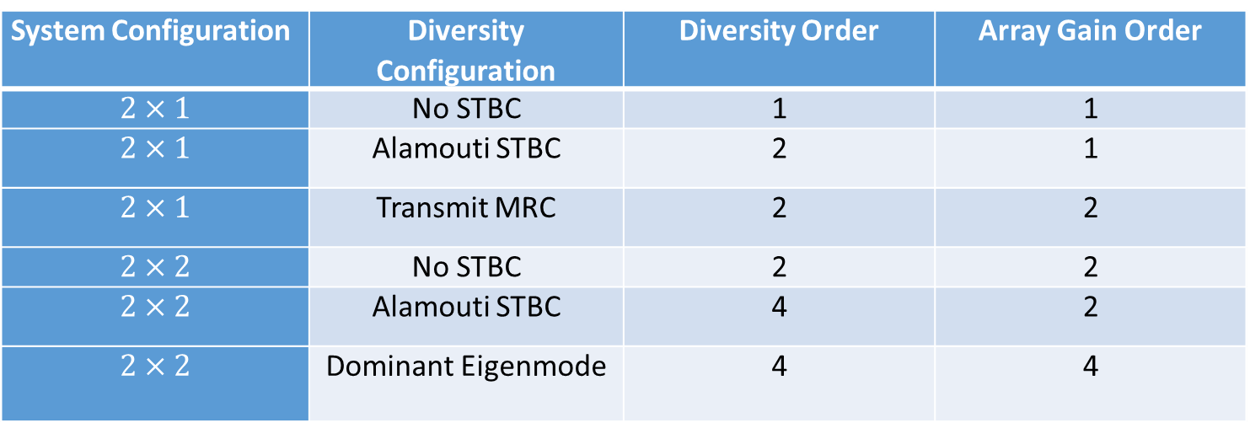
System Configuration | Diversity Configuration | Diversity Order | Array Gain Order
$$2×1$$ | No STBC | 1 | 1
$$2×1$$ | Alamouti STBC | 2 | 1
$$2×1$$ | Transmit MRC | 2 | 2
$$2×2$$ | No STBC | 2 | 2
$$2×2$$ | Alamouti STBC | 4 | 2
$$2×2$$ | Dominant Eigenmode | 4 | 4

Slide 18
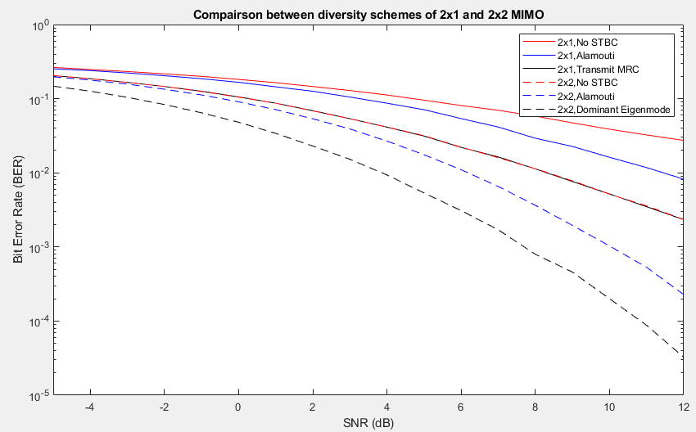

Slide 19




2x2 MIMO Spatial Multiplexing
$$\left[\begin{matrix}y_{1} \\ y_{2}\end{matrix}\right]=\left[\begin{matrix}h_{11} & h_{12} \\ h_{21} & h_{22}\end{matrix}\right]\left[\begin{matrix}s_{1} \\ s_{2}\end{matrix}\right]+\left[\begin{matrix}n_{1} \\ n_{2}\end{matrix}\right]$$
$$y=Hs+n$$
. $s_{detected}=Wy$.
$$W_{ZF}={{(H}^{H}H)}^{−1}H^{H}$$
$$W_{MMSE}={{(H}^{H}H+σ^{2})}^{−1}H^{H}$$

Slide 20
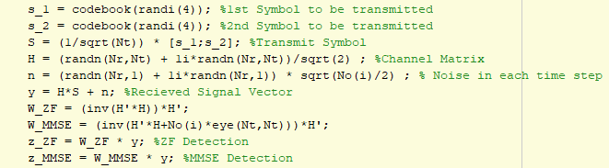

Slide 21
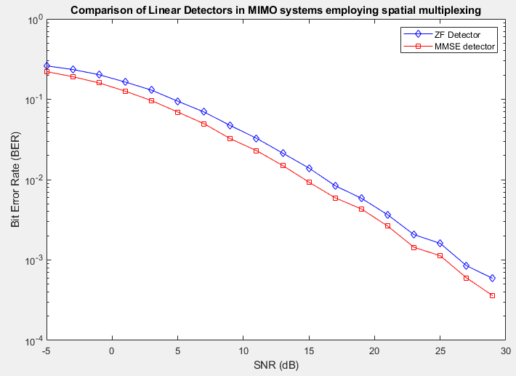
In spatial multiplexing system, MMSE detector overperforms ZF detector.

