Slide 1
Tkinter Showcase
Presented by: Haidar Ali
Notes:
Standard title slide

Slide 2
Session objectives
This session is suitable for:
Beginners to Intermediate in Python
Novices, as a showcase of the power of Python.
This session will cover:
What is tkinter and it’s uses
The basics of tkinter
Applications of tkinter
Notes:
Plain slide with subhead and bullets

Slide 3
What is tkinter?
tkinter is a standard Python interface to the Tk GUI toolkit.
It is included with most Python installations, making it readily available.
tkinter provides a simple way to create graphical user interfaces (GUIs) for Python applications.

Slide 4
Why Use tkinter?
Ease of Use:
tkinter is intuitive and easy to learn, especially for beginners.
Simple syntax and a wide range of built-in widgets make GUI development straightforward.
Integration with Python:
tkinter seamlessly integrates with Python, allowing developers to leverage Python's power for GUI development.
Access to Python's extensive libraries and tools for data processing, web scraping, machine learning, etc.
Customization:
tkinter offers a variety of widgets and styling options to create custom and visually appealing interfaces.
Easily customize widgets, fonts, colors, and layouts to suit your application's needs.
Community Support and Resources:
tkinter has a large community of users and developers.
Abundance of tutorials, documentation, and online resources available for learning and troubleshooting.

Slide 5
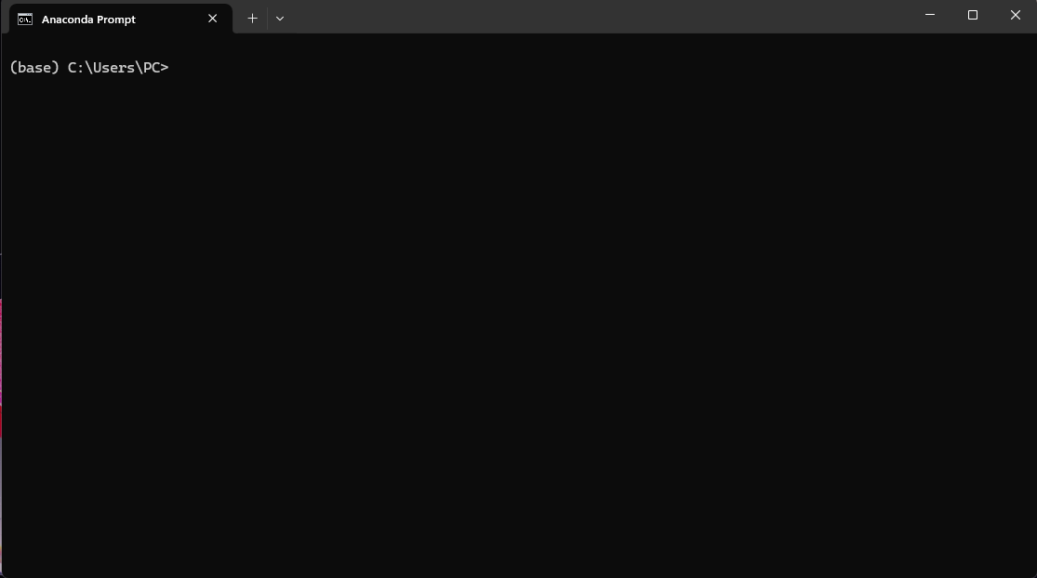
This can be intimidating

Slide 6
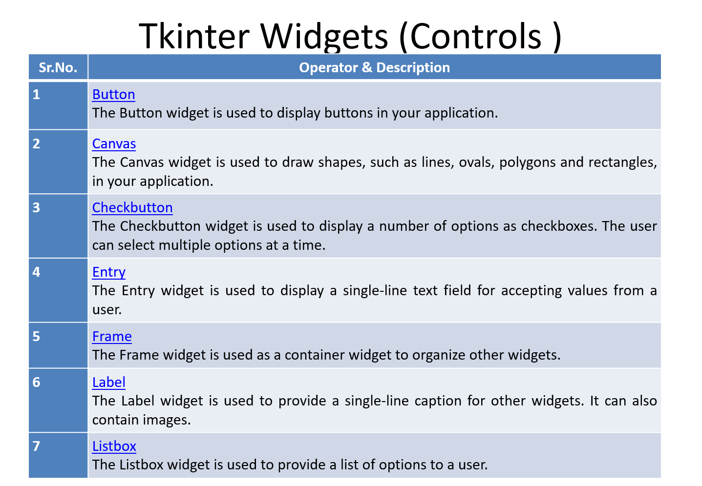

Slide 7
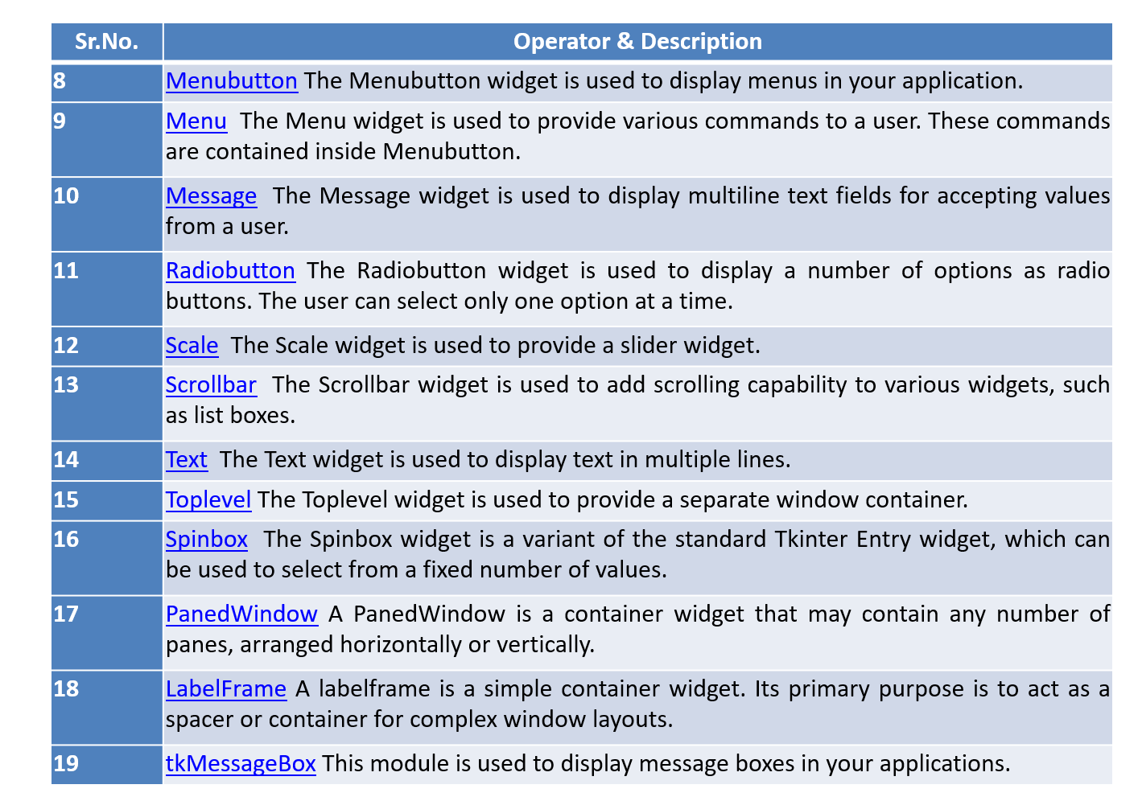

Slide 8
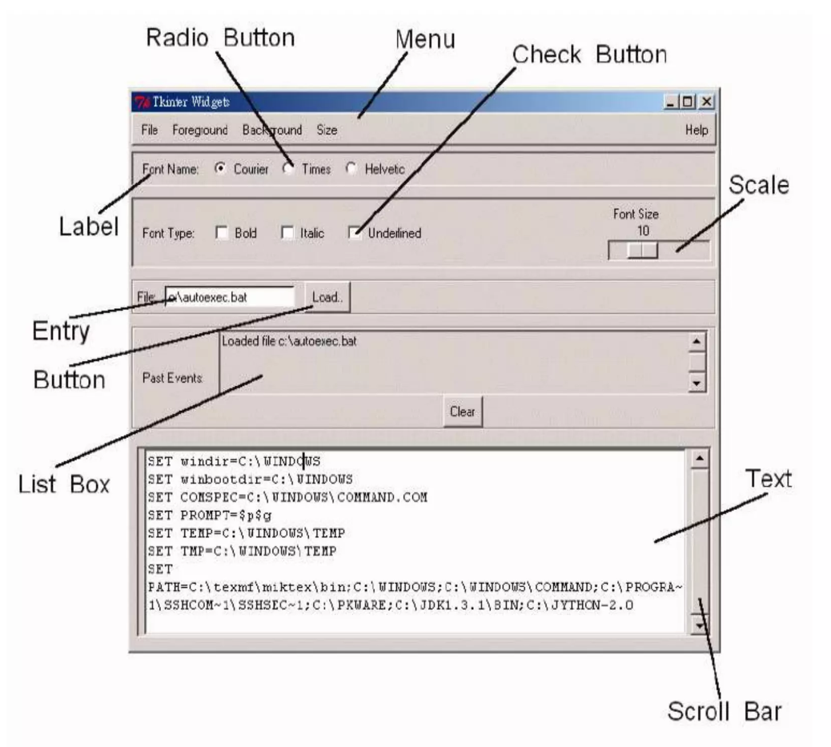

Slide 9
pack() : A type of manager class. Organizes the widgets in blocks before placing in the parent widget. (Other types include grid() and place() ).

Slide 10
Recap of the lecture
A
Any questions?

Slide 11
Extra guidance
NHS RAP community of practice: Project structure and packaging - RAP Community of Practice (nhsdigital.github.io)

Slide 12
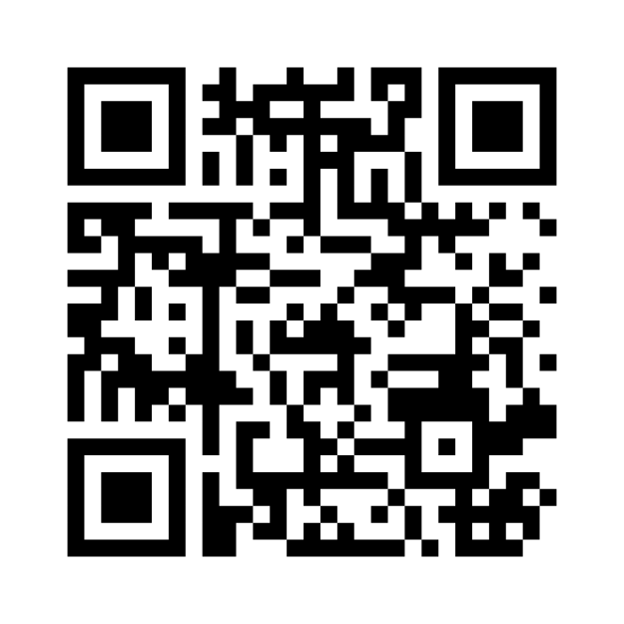
Feedback
Thank you for joining this session – we would love to hear some feedback from you so we can continue to provide good training and improve future sessions!
Go to:
www.menti.com
Enter the Access code:
2695 4237

