Slide 1
Python Pipelines
Presented by: Haidar Ali
Notes:
Standard title slide

Slide 2
Session objectives
This session is suitable for:
Complete Python novices / beginners
Refresher course for moderate python users
This session will cover:
The basics of what is a pipeline and why we use them
How to set up a pipeline
How to improve pipelines
How to publish pipelines
Notes:
Plain slide with subhead and bullets

Slide 3
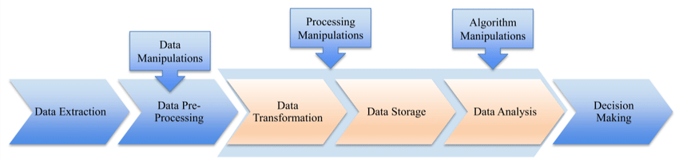
What is a pipeline?
A Python pipeline is a sequence of data processing components that are connected together to perform a specific task or workflow.
Each component in the pipeline takes some input data, processes it, and produces output data that is passed to the next component in the sequence.
Python pipelines are commonly used for tasks such as data preprocessing, feature engineering, model training, and inference.

Slide 4
Why Use Python Pipelines?
Modularity: Pipelines enable modular design, allowing components to be easily added, removed, or modified without affecting the overall workflow.
Reproducibility: By encapsulating data processing steps in a pipeline, it becomes easier to reproduce results and share workflows with others.
Automation: Pipelines automate the execution of repetitive tasks, reducing manual intervention and minimizing human error.
Scalability: Python pipelines facilitate scaling of data processing tasks by distributing workload across multiple computing resources.
Maintenance: Centralizing data processing logic in a pipeline simplifies maintenance and debugging, enhancing code readability and maintainability.

Slide 5
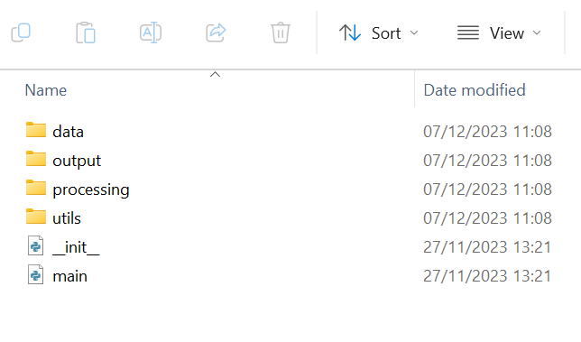
An example of a python pipeline
This example is from the learning disabilities and health check publication pipeline.
Data – Contains codes that loads all required data needed from job (csv, excel, json, SQL).
Processing – Contains codes that processes the raw data into a suitable form.
Utils – Contains useful functions that are used across different steps.
Output – Takes the processed data and produces the desired output files (csv, excel, txt, word etc…)
Main.py – Is the commander of the pipeline which executes the codes in the right order.

Slide 6
What does the __init__.py file do?
The __init__.py file is a special Python file used to define a package in a directory. It can be an empty file or can contain Python code that initializes the package. The presence of this file indicates to Python that the directory should be treated as a package.
Package Initialization: It initializes the package and enables importing modules and sub-packages.
Namespace Organization: Helps in organizing namespaces and improving code clarity.
Simplified Imports: Facilitates simplified import statements within the package.
Initialization Code: Can contain setup tasks that execute when the package is imported.

Slide 7
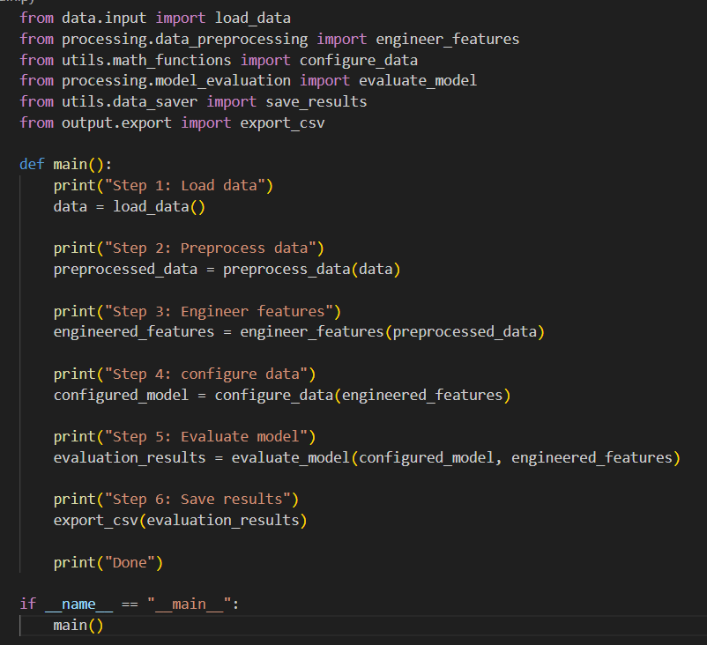
A deeper dive into main.py
This imports all the required functions from our difference processes into the main file. We do not need to call all functions as these are called if they are used in one of the functions that we have called.
The main function is defined here with empty brackets as it should not require variables to be defined.
A print is present which will tell us in the command prompt on what step the job is on when it is being run, which is highly useful for debugging and general ease of worry.

Slide 8
A deeper dive into main.py
The functions are called in the correct steps, from data loading -> data processing -> data visualisation and/or output. We can easily see here on what the code is doing with a nice step by step format and appropriately named function names.
The Job receives all the processed data and produces the outputs. Usually, outputs and inputs take the longest time to run so the print statements are handy to show if they have been completed or now. We have another print statement which prints if the code is done as well.
if __name__ == “__main__”: ensures that certain code is only executed when the Python script is run directly, not when it's imported as a module into another script. This promotes modular design, reusability, and facilitates testing/debugging.

Slide 9
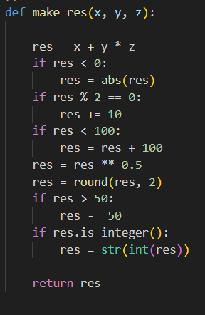
A badly written function
What does make_res mean and do? What is x, y and z?
I assume res means result?
Way too many if statements. Will make code slower and is hard to read
Why are we doing all these maths operations? What’s the point??
It is checking is it’s an integer and if it is, we try to turn it into an integer then string?

Slide 10
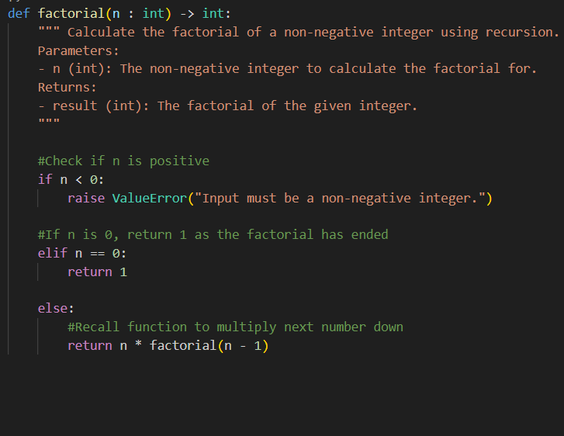
A well written function (RAP standard)
From function name, instantly can tell on what it does. The input and output variables are well defined
Contains a docstring, which explains in detail what the code does.
Contains nice simple comments to help the reader understand each line (or lines)
Prints an error message which is very useful for debugging
If statements are correctly used here. Can be written better for performance but is great for readability.

Slide 11
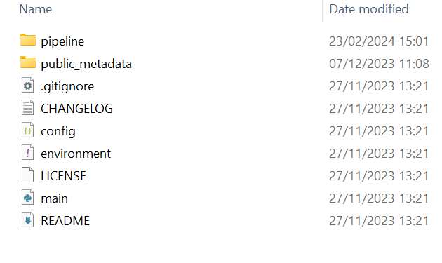
Extra steps for publishing a pipeline
When our pipeline is required to be published (either privately within NHSE on Gitlab or publicly on Github), extra files are required.
Config.json – A file that contains settings to the code. It acts as the key to our lock.
README.md – This is a basic instruction file that tells the user on how to run the code.
LICENSE - specifies the terms and conditions under which the software in that repository is distributed and used.
Environment.yml / requirements.txt – A file that tells the code on what python packages to install into the virtual environment.
Public_metadata (optional) – A folder than contains sample/synthetic input files. Mainly for the public.
.gitignore – A git file which controls what files gets uploaded on to Gitlab/Github.
Changelog (optional) – A text file that showcase what updates have occurred in different versions of the code.

Slide 12
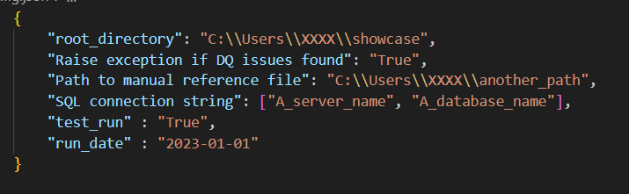
Why do we use a config file?
It is highly likely that the pipeline requires sensitive information in some sort. This can be directories to where certain input files are located, or names of SQL servers and databases which cannot be given to the public.
It is also likely that the pipeline is a part of a structured job which may require multiple runs (aka for a monthly publication), so some input variables from the user will require changing for every run like the date so it can select the right data.
It can also contain other helpful inputs like whether the user wants to run a test run to not override live data in important folders.
The config is written as a dictionary data type which is directly loaded into the code.

Slide 13
Why do we have a readme file?
Documentation:
README.md files provide essential documentation about the software, including how to install, configure, and use it.
Project Overview:
They offer a high-level overview of the project, including its purpose, features, and benefits.
Getting Started:
README.md files typically include instructions for getting started with the project, such as installation steps and usage examples.
Contributing Guidelines:
They often contain guidelines for contributing to the project, including how to report issues, submit pull requests, and adhere to coding standards.
Contact Information:
README.md files may include contact information for the project maintainer or community channels for support and collaboration.

Slide 14
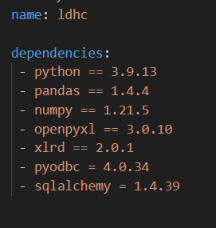
environment.yml / requirements.txt
The python pipeline will most likely use a python package. An image on the right is one of a few ways to represent these.
Packages have different versions in which they add and remove different functions and features, so it is vital that users have the same version.
You can think of them a tools shopping list for the program.
These are used when creating a virtual environment (the toolbox)

Slide 15
Recap of the lecture
A Python pipeline is a way of writing code in a sequence of steps.
They contain a main python file which incorporates the all the steps into one file.
We looked at how a main.py file is written.
How to ensure each function is RAP standard, best practices of writing code.
How to publish code correctly on Gitlab/Github.
The uses of a config, readme and environment files.
Any questions?

Slide 16
Extra guidance
NHS RAP community of practice: Project structure and packaging - RAP Community of Practice (nhsdigital.github.io)

Slide 17

Feedback
Thank you for joining this session – we would love to hear some feedback from you so we can continue to provide good training and improve future sessions!
Go to:
www.menti.com
Enter the Access code:
2695 4237

