Slide 1
Up And Running
With NodeJs
Notes:
Title Slide: Used for the beginning of a movie and should contain only the title of the movie. Use this slide for one or two-line titles. Please cap each letter of every significant word. Do not cap such words as “a”, “and”, or “for.” Please be concise with title naming and eliminate as many small words as possible.

Slide 2

Haider Malik
Blog: fullstackhour.com
Twitter: @haidermalik504
Email: haider@fullstackhour.com

Slide 3
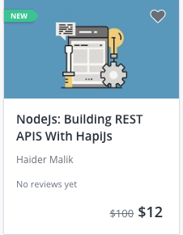
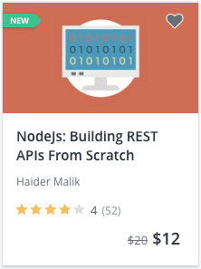
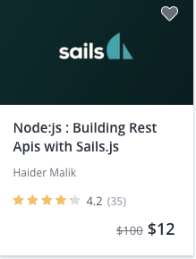
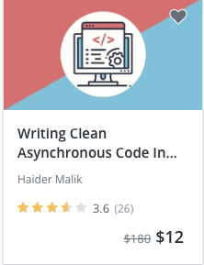
Nodejs Courses
Notes:
Image Slide with Header: This template is used for full-screen images that need a title. Please use high quality .jpg or .png images. This will reduce the file size but keep the image quality high.

Slide 4
Javascript Runtime
Notes:
Single Line Slide: Used for one line of text and to emphasize a point. This slide should not be used as a title slide since it is specifically for text within the body of movie, so a smaller font size is used. It should be used for longer phrases or sentences.

Slide 5









Who uses Node.js
Notes:
Image Slide with Header: This template is used for full-screen images that need a title. Please use high quality .jpg or .png images. This will reduce the file size but keep the image quality high.

Slide 6
Synchronous programming
$file = fopen('info.txt', 'r');
//wait until file is open
$contents = fread($file, 100000);
//wait until contents are read

Slide 7
Asynchronous Programming
fs.readFile(‘info.txt’, function(err, data){
if (err) throw err;
console.log(data);
});
//You will not block
console.log(‘Execute other tasks’);

Slide 8
Features of Node.js
Very Fast
Single Threaded
No Buffering
Notes:
Header with Bullets Slide: This slide is used for one-line bullet points. The bullets themselves should be as short as possible, phrases only. Refrain from using full sentences. This slide template should not be used with sub-bullets. Use only 5 bullets per page. If more bullets are needed, copy this slide and make another set of 5 or less bullet points.

Slide 9
Javascript Code
V8(C/C++)
Machine Code
Notes:
Object Slide without Header: This slide template can be used to hold objects that can then be moved and sized as necessary.

Slide 10
Where to use Node.js
I/O bound Applications
Data Streaming Applications
Data Intensive Real-time Applications (DIRT)
JSON APIs based Applications
Notes:
Header with Bullets Slide: This slide is used for one-line bullet points. The bullets themselves should be as short as possible, phrases only. Refrain from using full sentences. This slide template should not be used with sub-bullets. Use only 5 bullets per page. If more bullets are needed, copy this slide and make another set of 5 or less bullet points.

Slide 11
Where Not to use Node.js
CPU intensive applications
Notes:
Header with Bullets Slide: This slide is used for one-line bullet points. The bullets themselves should be as short as possible, phrases only. Refrain from using full sentences. This slide template should not be used with sub-bullets. Use only 5 bullets per page. If more bullets are needed, copy this slide and make another set of 5 or less bullet points.

Slide 12
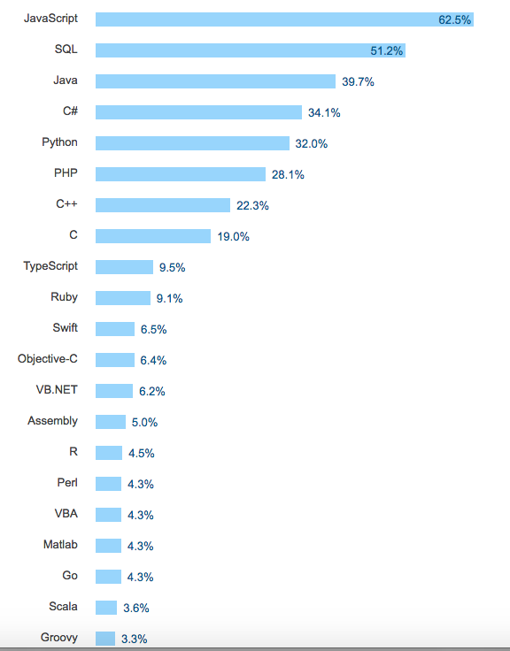
Most Popular Technologies

Slide 13
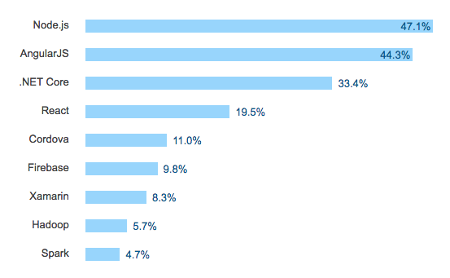
Most Popular Frameworks

Slide 14
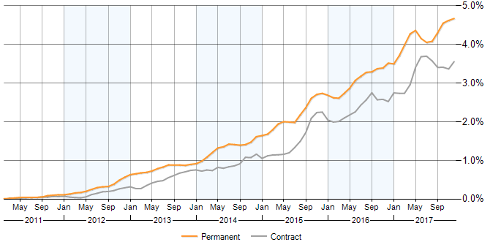
Node.js Job Vacancy Trend

Slide 15
Javascript runs everywhere
Notes:
Single Line Slide: Used for one line of text and to emphasize a point. This slide should not be used as a title slide since it is specifically for text within the body of movie, so a smaller font size is used. It should be used for longer phrases or sentences.

Slide 16
Demo
Notes:
Single Line Slide: Used for one line of text and to emphasize a point. This slide should not be used as a title slide since it is specifically for text within the body of movie, so a smaller font size is used. It should be used for longer phrases or sentences.

Slide 17
Source Code
https://github.com/HaiderMalik12/node-devconf

