Slide 1
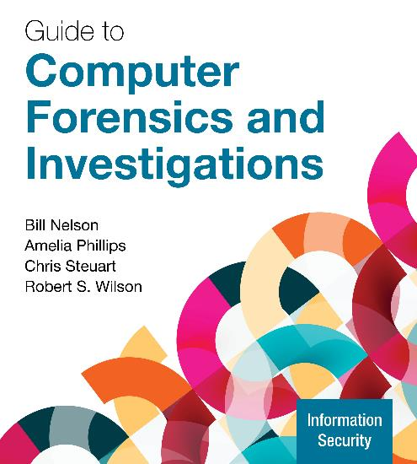
Guide to Computer Forensics and Investigations, 7e
Module 7: Linux and Macintosh File Systems
Nelson/Phillips/Steuart/Wilson, Guide to Computer Forensics and Investigations, 7th Edition. ©2025 Cengage Learning, Inc. All Rights Reserved. May not be scanned, copied or duplicated, or posted to a publicly accessible website, in whole or in part.

Slide 2
Module Objectives
By the end of this module, you should be able to:
Describe Linux file structures
Describe Macintosh file structures
Use Linux forensics tools

Slide 3
Linux Distributions
UNIX distributions
Silicon Graphics, Inc. (SGI) IRIX, Santa Cruz Operation (SCO) UnixWare, Sun Solaris, IBM AIX, and HP-UX, most are no longer available.
Linux distributions
Ubuntu, CentOS, Mint, Fedora, and Gentoo
Linux is only the core of the OS, packed with GUI and applications
All UNIX-like OSs have a kernel
So do all Windows OSs

Slide 4
File Structures in ext4 (1 of 3)
The early file system standard was Second Extended File System (Ext2)
Third Extended File System (Ext3) replaced Ext2 in most Linux distributions
Fourth Extended File System (Ext4) is backward compatible with ext2/ext3
It improved management of large files and offered more flexibility
It is now considered the standard file system for most distributions

Slide 5
File Structures in ext4 (2 of 3)
Advantages of the ext4 file system include the following:
The Linux system ext4 will automatically mount an ext3 drive
The ext4 file system allows for larger file sizes, longer file names, and unlimited subdirectories
The ext4 file system introduced extents to replace the indirect pointers. Eextents that uses a contiguous areas of physical storage used to reduce file fragmentation, store the first and the last block and if needed, add an extent inode to link to the additional data for larger files
Flexible group blocks allow several block groups to be one logical group

Slide 6
File Structures in ext4 (3 of 3)
UNIX/Linux file system consists of the following four components:
Boot Block: contains the bootstrap code (code that loads the operating system at startup.)
A UNIX/Linux computer has only one boot block, located on the main hard disk
Super Block: specifies disk geometry, available space, and keeps track of all inodes and manages the file system
Inode Block: Stores metadata (file size, ownership, permissions, timestamps, pointers to data). Located after the superblock.
Data Block: Stores actual file and directory contents. Inodes point to these blocks for data retrieval.

Slide 7
Inodes (1 of 5)
An Inode contains file and directory metadata and provides a mechanism for linking data stored in data blocks
An assigned inode contains the following information:
Mode and type of file or directory
Number of links to a file or directory
UID and GID of the file’s or directory’s owner
Number of bytes in the file or directory
File’s or directory’s last access time and last modified time
Inode’s last file status change time

Slide 8
Inodes (2 of 5)
An assigned inode contains the following information (continued):
Block address for the file data
Indirect, double-indirect, and triple-indirect block addresses for the file data
Current usage status of the inode
Number of actual blocks assigned to a file
File generation number of version number
The continuation inode’s link
Inodes contain modification, access, and creation (MAC) times

Slide 9
Inodes (3 of 5)
The only pieces of metadata not in an inode are the file name and path
An assigned inode has 13 pointers that link to data blocks and other pointers where files are stored
As the file grows, the OS provides up to three layers of inode pointers

Slide 10
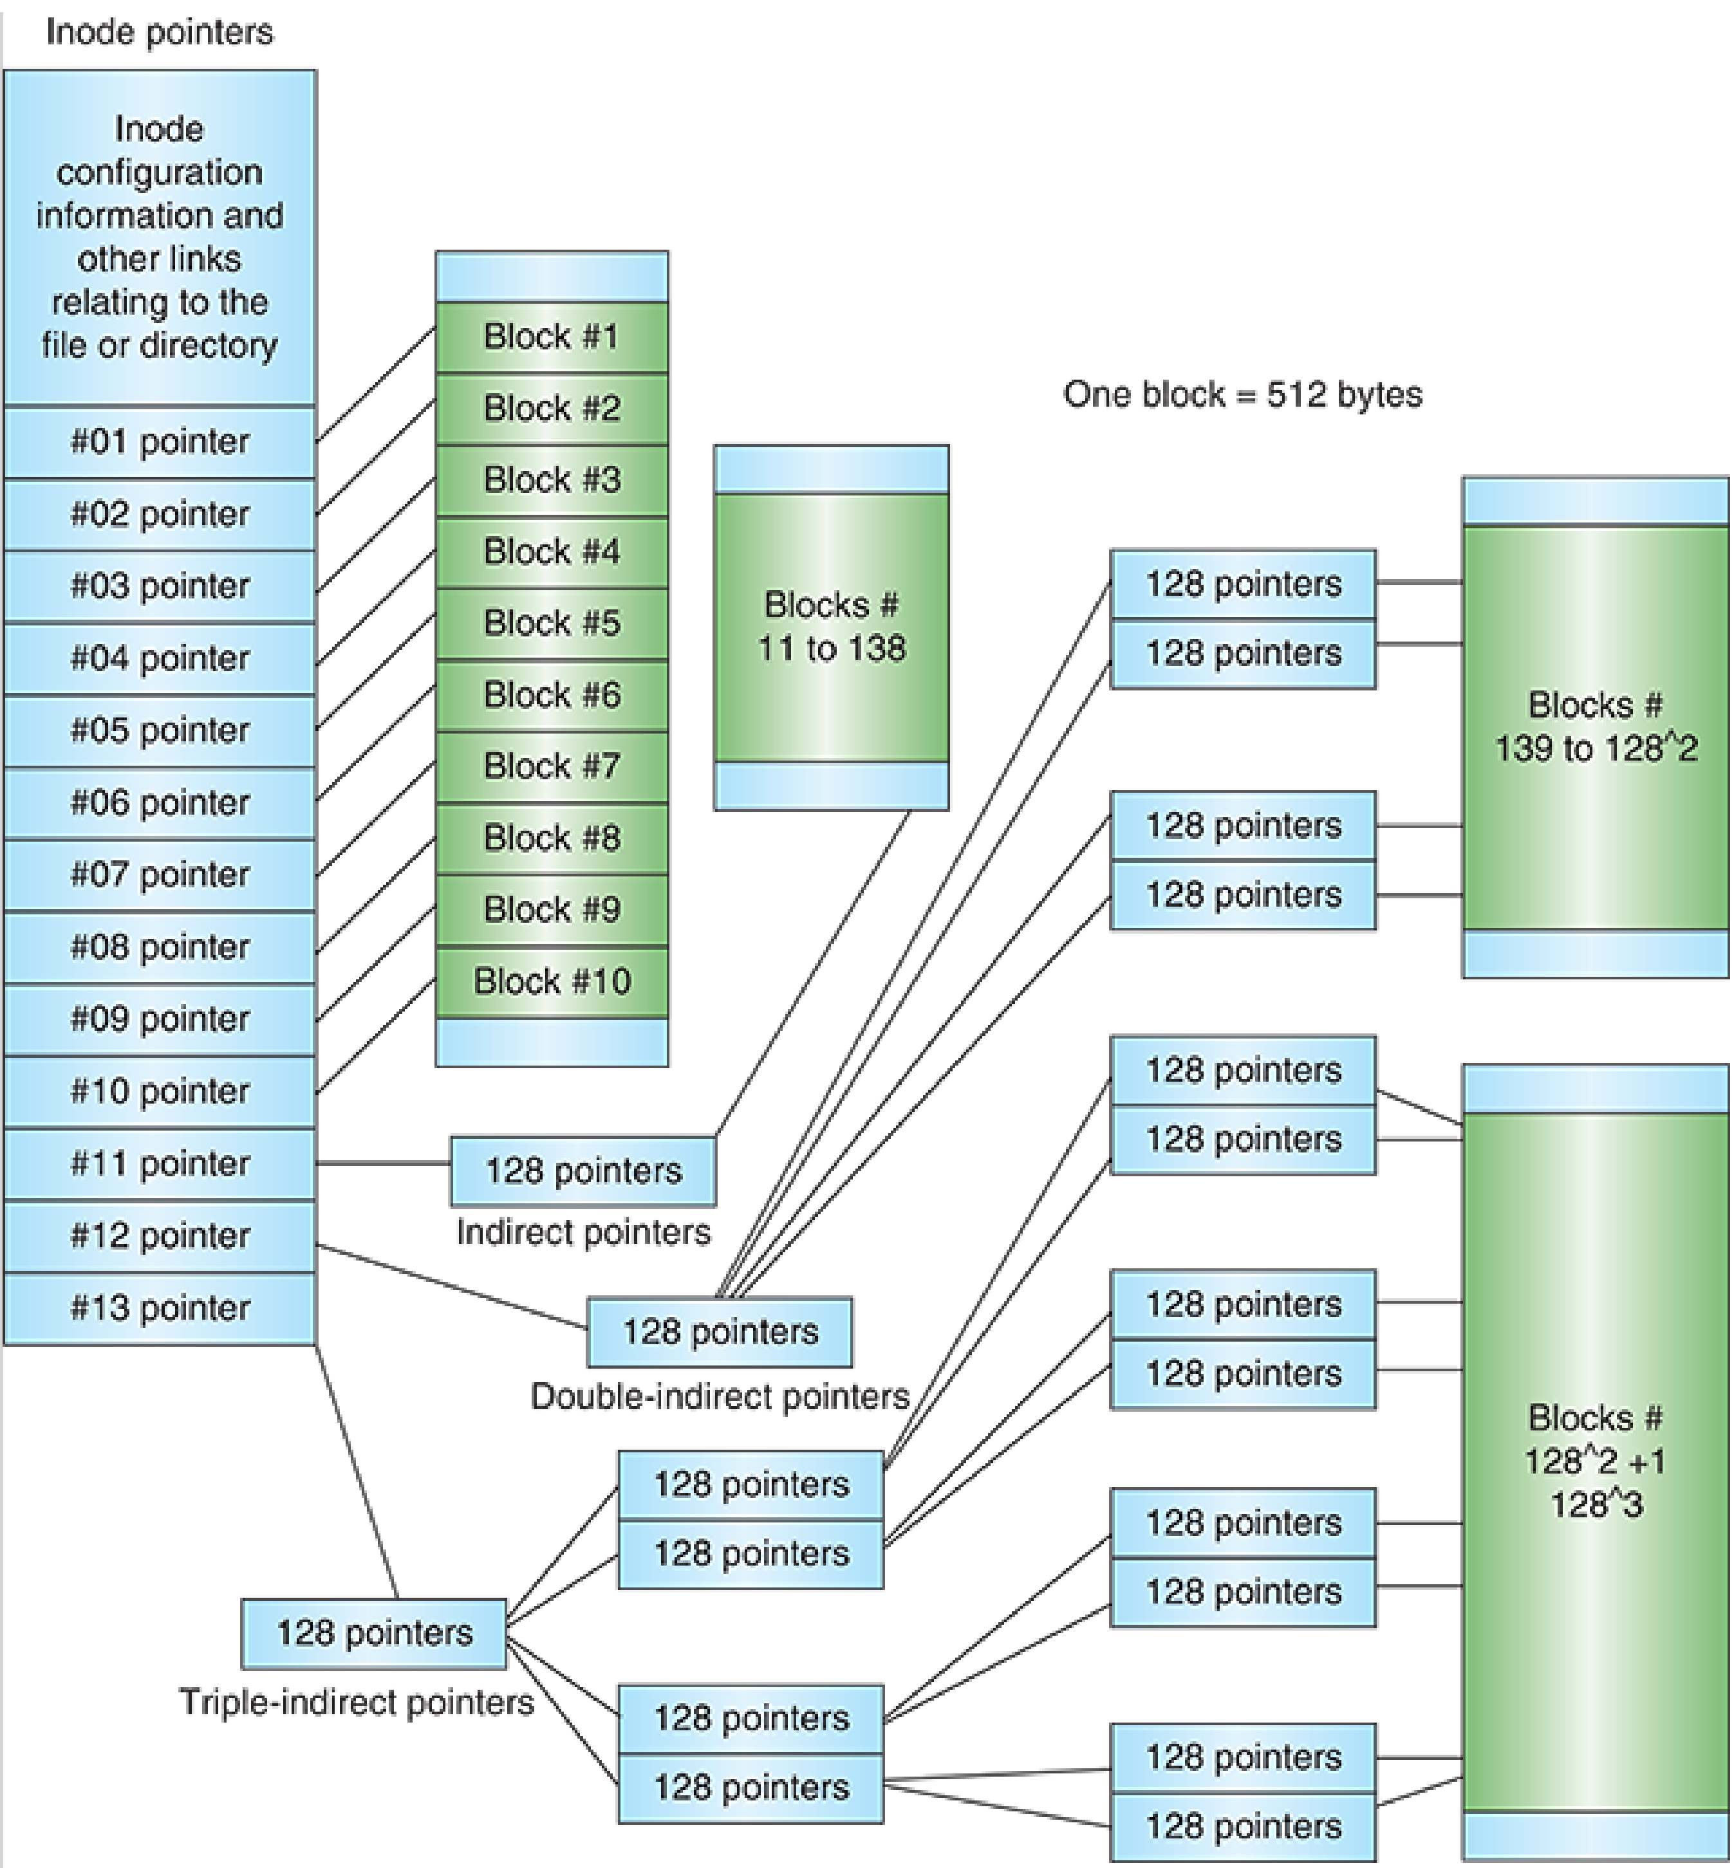
Inodes (4 of 5)
Each of the first 10 pointers is called an indirect pointer*
Each pointer in the second layer is called a double-indirect pointer
Each pointer in the third layer is called a triple-indirect pointer
____________________________________
* indirect pointer, also known as a single indirect pointer, is a basic pointer that stores the memory address of a variable
Figure 7-5 Inode pointers in the Linux file system

Slide 11
Inodes (5 of 5)
Windows does not keep track of bad sectors, but Linux does in an inode called the the bad block
Some forensics tools ignore the bad block but It is possible to hide information in these supposedly “bad” sectors.
To find bad blocks on a Linux computer, use the badblocks command (you must log in as root to use)
Linux includes two other commands that supply bad block information:
mke2fs and e2fsck – they include safeguards that prevent them from overwriting important information

Slide 12
Hard Links and Symbolic Links (1 of 2)
A hard link is a pointer that allows accessing the same file by different file names
Use the ln command to create a hard link, it must be in the same volume
A link count is a field inside each inode that specifies the number of hard links
A symbolic link is a pointer to another file, and they aren’t included in the link count
Also known as soft links or symlinks
Can point to items on other drives or other parts of the network

Slide 13
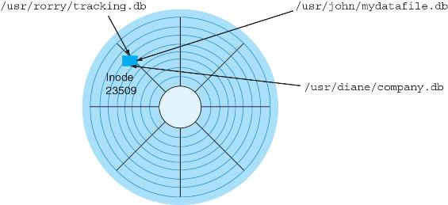
Hard Links and Symbolic Links (2 of 2)
Figure 7-8 Hard linked files with different file names

Slide 14
Knowledge Check Activity 7-1
Inodes contain everything except which of the following?
UID and GID
Node number
Name of the file and its path
Access time and change time

Slide 15
Knowledge Check Activity 7-1: Answer
Inodes contain everything except which of the following?
Answer: c. Name of the file and its path
Inodes in the Linux file system contain extensive information, including the GID, UID, the number of links, access time, created time, change time, and other information. The only items not stored in the inode are the name of the file and its path.

Slide 16
Understanding Macintosh File Structures (1 of 2)
At the time of this writing, the current OS for Apple laptops and desktops is macOS 12 Monterey
With OS X, Macintosh moved to the Intel processor and become UNIX based
In 2020, Apple released macOS 11 Big Sur, which provided support for Apple’s native silicon, the M1 processor

Slide 17
Understanding Macintosh File Structures (2 of 2)
Before OS X, the Hierarchical File System (HFS) was used
In HFS, files are stored in nested directories (folders)
The Mac OS Extended Format (HFS+) file system was introduced with Mac OS 8.1
HFS+ supports smaller file sizes on larger volumes, resulting in more efficient disk use
Apple File System (APFS) was introduced in macOS 10.13 High Sierra
Users can still mount HFS+ drives with macOS Monterey

Slide 18
An Overview of Mac File Structures (1 of 8)
In older versions of macOS, a file consists of two parts:
Data fork and resource fork
The data fork typically contains data the user creates, such as text or spreadsheets
Applications read and write to the data fork
When working with an application file, the resource block contains additional information
Such as menus and dialog boxes

Slide 19
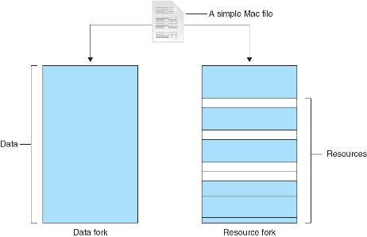
An Overview of Mac File Structures (2 of 8)
Figure 7-10 The resource fork and data fork in a macOS file

Slide 20
An Overview of Mac File Structures (3 of 8)
A volume is any storage medium used to store files
It can be all or part of the storage media for hard disks
Volumes have allocation and logical blocks
A logical block is a fundamental unit of storage that can hold up to 512 bytes of data (if file size is 11 bytes it will occupy 512 byte on a disk)
An allocation block is a group of consecutive logical blocks

Slide 21
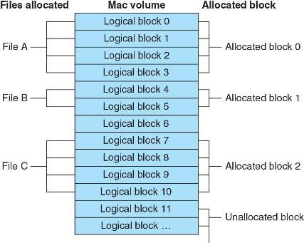
An Overview of Mac File Structures (4 of 8)
Figure 7-11 Logical and allocation block structures

Slide 22
An Overview of Mac File Structures (5 of 8)
The HFS and HFS+ file systems have two end of file (EOF) descriptors
The logical EOF is the actual ending of the file
The physical EOF is the number of bytes allotted on the volume for a file
A clump is a group of contiguous allocation blocks, used to reduce fragmentation
Volume fragmentation is kept to a minimum by adding more clumps to larger files

Slide 23
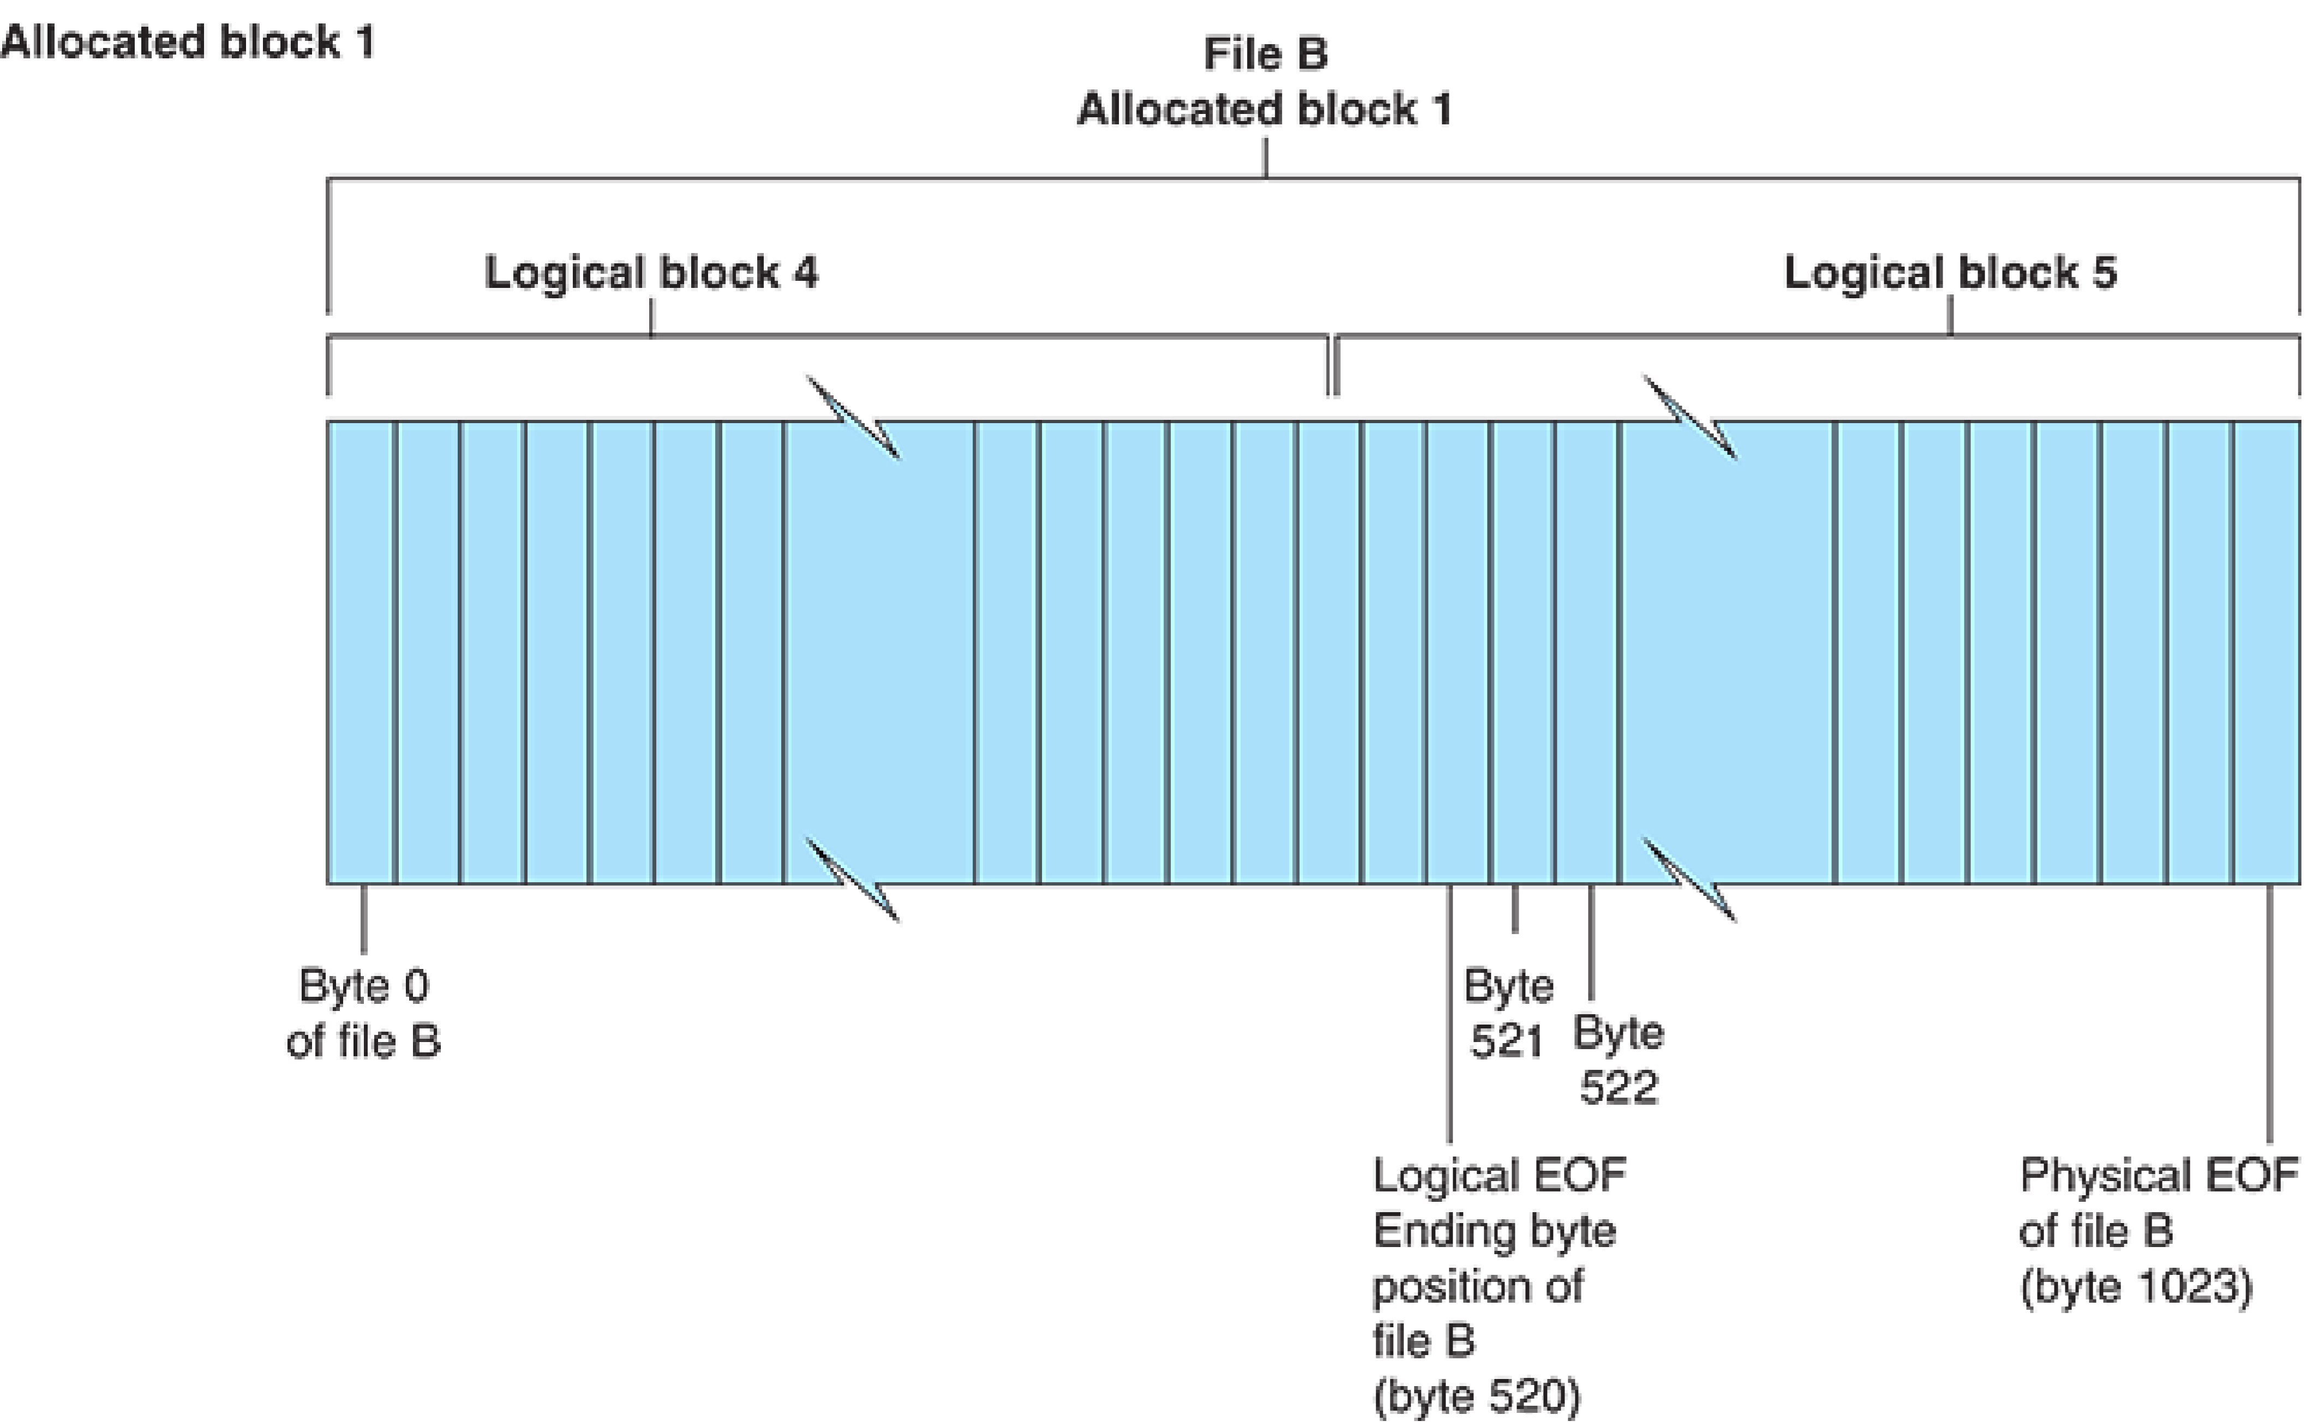
An Overview of Mac File Structures (6 of 8)
Figure 7-12 Logical EOF and physical EOF

Slide 24
An Overview of Mac File Structures (7 of 8)
All information about a volume is stored in:
Master Directory Block (MDB) for old Mac OSs that uses HFS
Volume Information Block (VIB) for new Mac OSs that uses HFS+
When the OS mounts a volume, some information from the MDB/VIB is written to a Volume Control Block (VCB) that is stored on system memory, and it is removed from memory when the volume unmounts
The extents overflow file is used to store extra file information that is not in the MDB or a VCB

Slide 25
An Overview of Mac File Structures (8 of 8)
The catalog is a listing of all files and directories on the volume
Maintains relationships between files and directories
Volume Bitmap, tracks each block on a volume, to determine which blocks are in use and which ones are available to receive data
It has information about the blocks’ use but not about their content
Apple file systems utilize a B-tree file system
Files are nodes containing file data and are called leaf nodes

Slide 26
Apple File System (1 of 2)
APFS has the following characteristics and features:
A 64-bit file system, support up to 2⁶³ files
Improved timestamp resolution, down to 1 nano seconds
Encryption to protect data from unauthorized access
A snapshot features that takes a “picture” of the file system at a particular point in time for data recovery purposes, without significant storage penales
File cloning, which allows users to make identical copies of files without incurring significant storage penalties

Slide 27
Apple File System (2 of 2)
APFS has the following characteristics and features (continued):
Efficient space utilization of the storage device with multiple user volumes
Optimization for flash memory or SSDs
Copies of metadata that are made when any data is written
APFS provides additional useful digital forensics artifacts that can be used to establish a timeline of what was occurring on a computer

Slide 28
Forensics Procedures in macOS (1 of 3)
There are some differences between Linux and macOS file systems
Linux has the /home/username and /root directories
In macOS, the folders are /users/username and /private/var/root
The /home directory exists in the macOS but it is empty
macOS users have limited access to other user accounts’ files and the guest account is disabled by default

Slide 29
Forensics Procedures in macOS (2 of 3)
For forensics procedures in macOS, you must know where file system components are located and how files and file components are stored
Application settings are in three formats:
Plaintext, plist files, and the SQLite database
Plist files are preference files for installed applications on a system
Contain setting the applicatio, without it application will not work
FileVault is used to encrypt and decrypt a user’s /users directory
FileVault2 improved the encryption by encrypting full volumes with 128-bit AES encription

Slide 30
Forensics Procedures in macOS (3 of 3)
Keychain Access has been used to manage passwords for applications, websites, and other system files (Since Mac OS 8.6)
You can restore passwords using the Mac application Keychain Access or System Preferences/Passwords
Deleted files are in the Trash folder
If a file is deleted at the command line, however, it doesn’t show up in the trash

Slide 31
Acquisition Methods in macOS (1 of 2)
To examine a macOS you need to make an image of the drive
Apple products can use nonstandard or soldered-on components for storage and may have data encrypted with Apple’s T2 Security Chip or native Secure Enclave platform.
You need a macOS-compatible forensic boot disk to make a forensics image, which then must be written to an external drive or USB drive
Collect username, and password as well as the system administrator username and password to enable the boot from USB

Slide 32
Acquisition Methods in macOS (2 of 2)
When using the macOS Recovery mode, you can disable secure boot or boot to an external device to conduct the acquisition
After making an acquisition, examine the image of the file system
The tool you use depends on the image file format
Cellebrite Digital Collector and Sumuri Recon ITR have a function for disabling and enabling Disk Arbitration
Disk Arbitration is a macOS feature for disabling and enabling automatic mounting when a drive is connected via a USB or FireWire device

Slide 33
Using Linux Forensics Tools
Most commercial computer forensics tools can analyze Linux Ext2, Ext3, Ext4, ReiserFS, and Reiser4 file systems
Freeware tools include Sleuth Kit and its web browser interface, Autopsy Forensic Browser
Foremost is a freeware carving tool that can read many image file formats
It has a configuration file, foremost.conf, which lists the most common file headers, footers, and data structures
Paladin Edge is an Ubuntu-based forensics tool

Slide 34
Using the dc3dd Command (1 of 2)
The dc3dd utility is a command-line method to acquire a disk image
To install dc3dd on a Kali Linux, start a terminal shell window and type the following command:
dc3dd --help
This command will return a message that it is not installed and will ask if you would like to install, type y to initiate the installation
After dc3dd is installed, type dc3dd -- help again to review its options

Slide 35
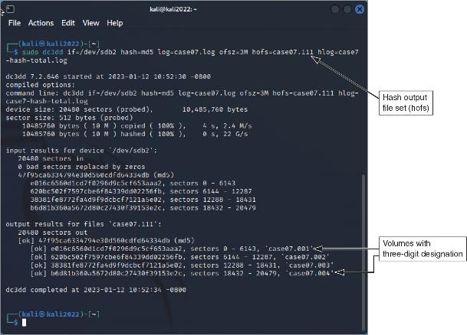
Using the dc3dd Command (2 of 2)
Figure 7-14 dc3dd acquisition

Slide 36
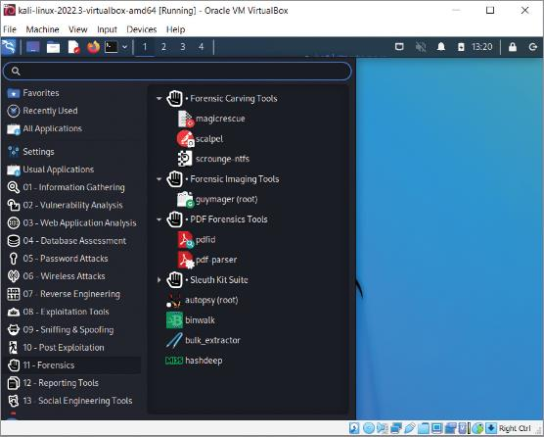
Using the Kali Linux Forensics Tools
To access the forensics tools in Kali Linux, when you launch the Kali VM, click the Kali image in the upper-left corner
In the pane on the left, select “11 - Forensics”
Some notable tools include the following:
Forensics Carving Tools, Forensics Imaging Tools, PDF Forensics Tools, the Sleuth Kit Suite, Autopsy, binwalk, bulk-extractor, and hashdeep
Figure 7-15 Kali Linux forensics tools

Slide 37
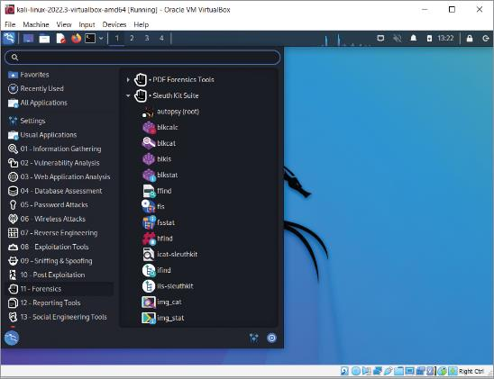
Exploring Sleuth Kit
Figure 7-16 Kali Linux Sleuth Kit Suite

Slide 38
Knowledge Check Activity 7-2
Which mode does a macOS device need to be in to set up the computer for acquisition?
macOS Rescue mode
macOS Recovery mode
macOS Regenerate mode
macOS Restore mode

Slide 39
Knowledge Check Activity 7-2: Answer
Which mode does a macOS device need to be in to set up the computer for acquisition?
Answer: b. macOS Recovery mode
When conducting an acquisition, the digital forensics examiner may need to boot up into macOS Recovery mode to adjust system settings, such as disabling secure boot, or booting to external media, to conduct the acquisition of the Mac device. Refer to Apple’s documentation to set the computer in macOS Recovery mode.

Slide 40
Self Assessment
How does macOS reduce file fragmentation?

Slide 41
Guide to Computer Forensics and Investigations, 7e
Module 6: Working with Microsoft File Systems and the Windows Registry
Nelson/Phillips/Steuart/Wilson, Guide to Computer Forensics and Investigations, 7th Edition. ©2025 Cengage Learning, Inc. All Rights Reserved. May not be scanned, copied or duplicated, or posted to a publicly accessible website, in whole or in part.

Slide 42
Module Objectives
By the end of this module, you should be able to:
Explain the purpose and structure of file systems
Describe Microsoft file structures
Explain the structure of FAT disks
Explain the structure of NTFS disks
Describe whole disk encryption
Explain how the Windows Registry works
Identify Windows artifacts

Slide 43
Understanding File Systems
A file system provides an OS a road map to data on a disk
The type of file system an OS uses determines how data is stored on the disk
When you need to access a suspect’s computer to acquire or inspect data, you should be familiar with both the computer’s OS and file systems

Slide 44
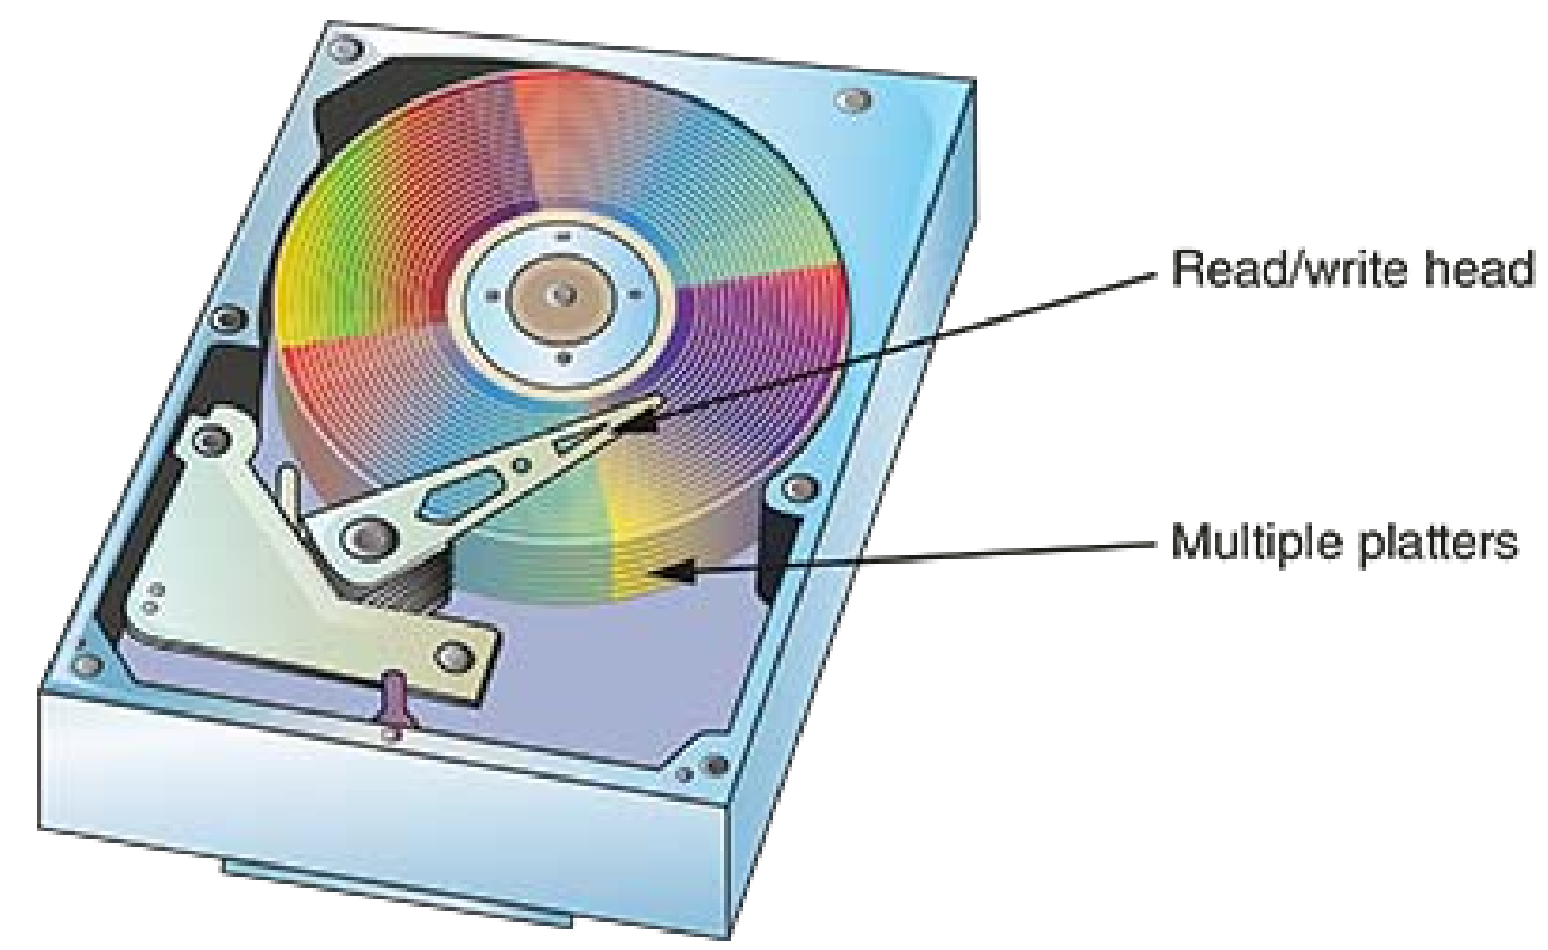
Understanding Disk Drives (1 of 4)
Disk drives are made up of one or more platters coated with magnetic material
Disk drive components include the following
Geometry: refers to a disk’s logical structure of platters, tracks, and sectors.
Head: The is the device that reads and writes data to a drive. There are two heads per platter that read and write the top and bottom sides.

Slide 45
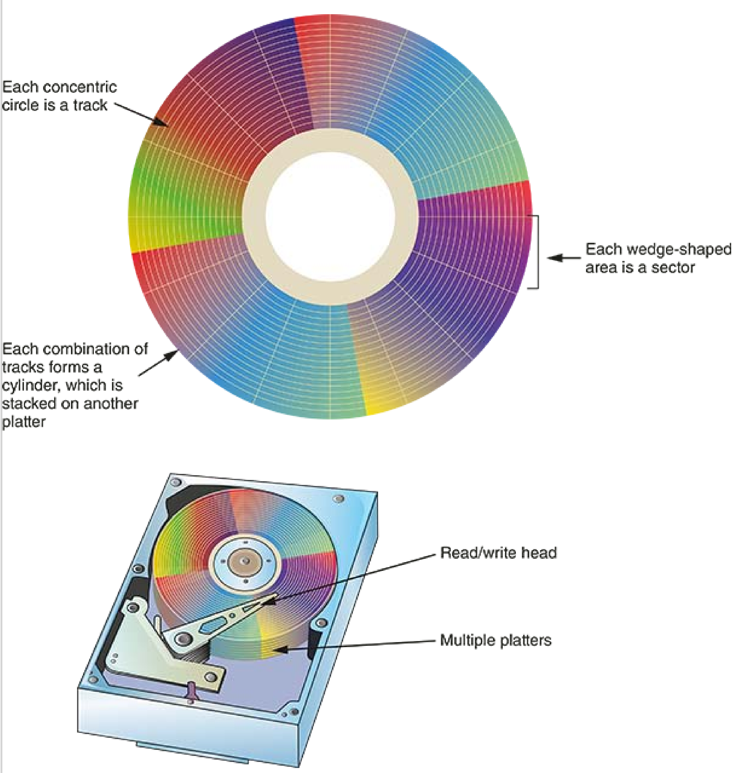
Understanding Disk Drives (2 of 4)
Tracks: A is one of the concentric circles on a disk platter where data is located.
Cylinders: A is a column of tracks on two or more disk platters. Typically, each platter has two surfaces: top and bottom.
Sectors: A is a section on a track; it typically ranges from 512 to 4096 bytes.

Slide 46
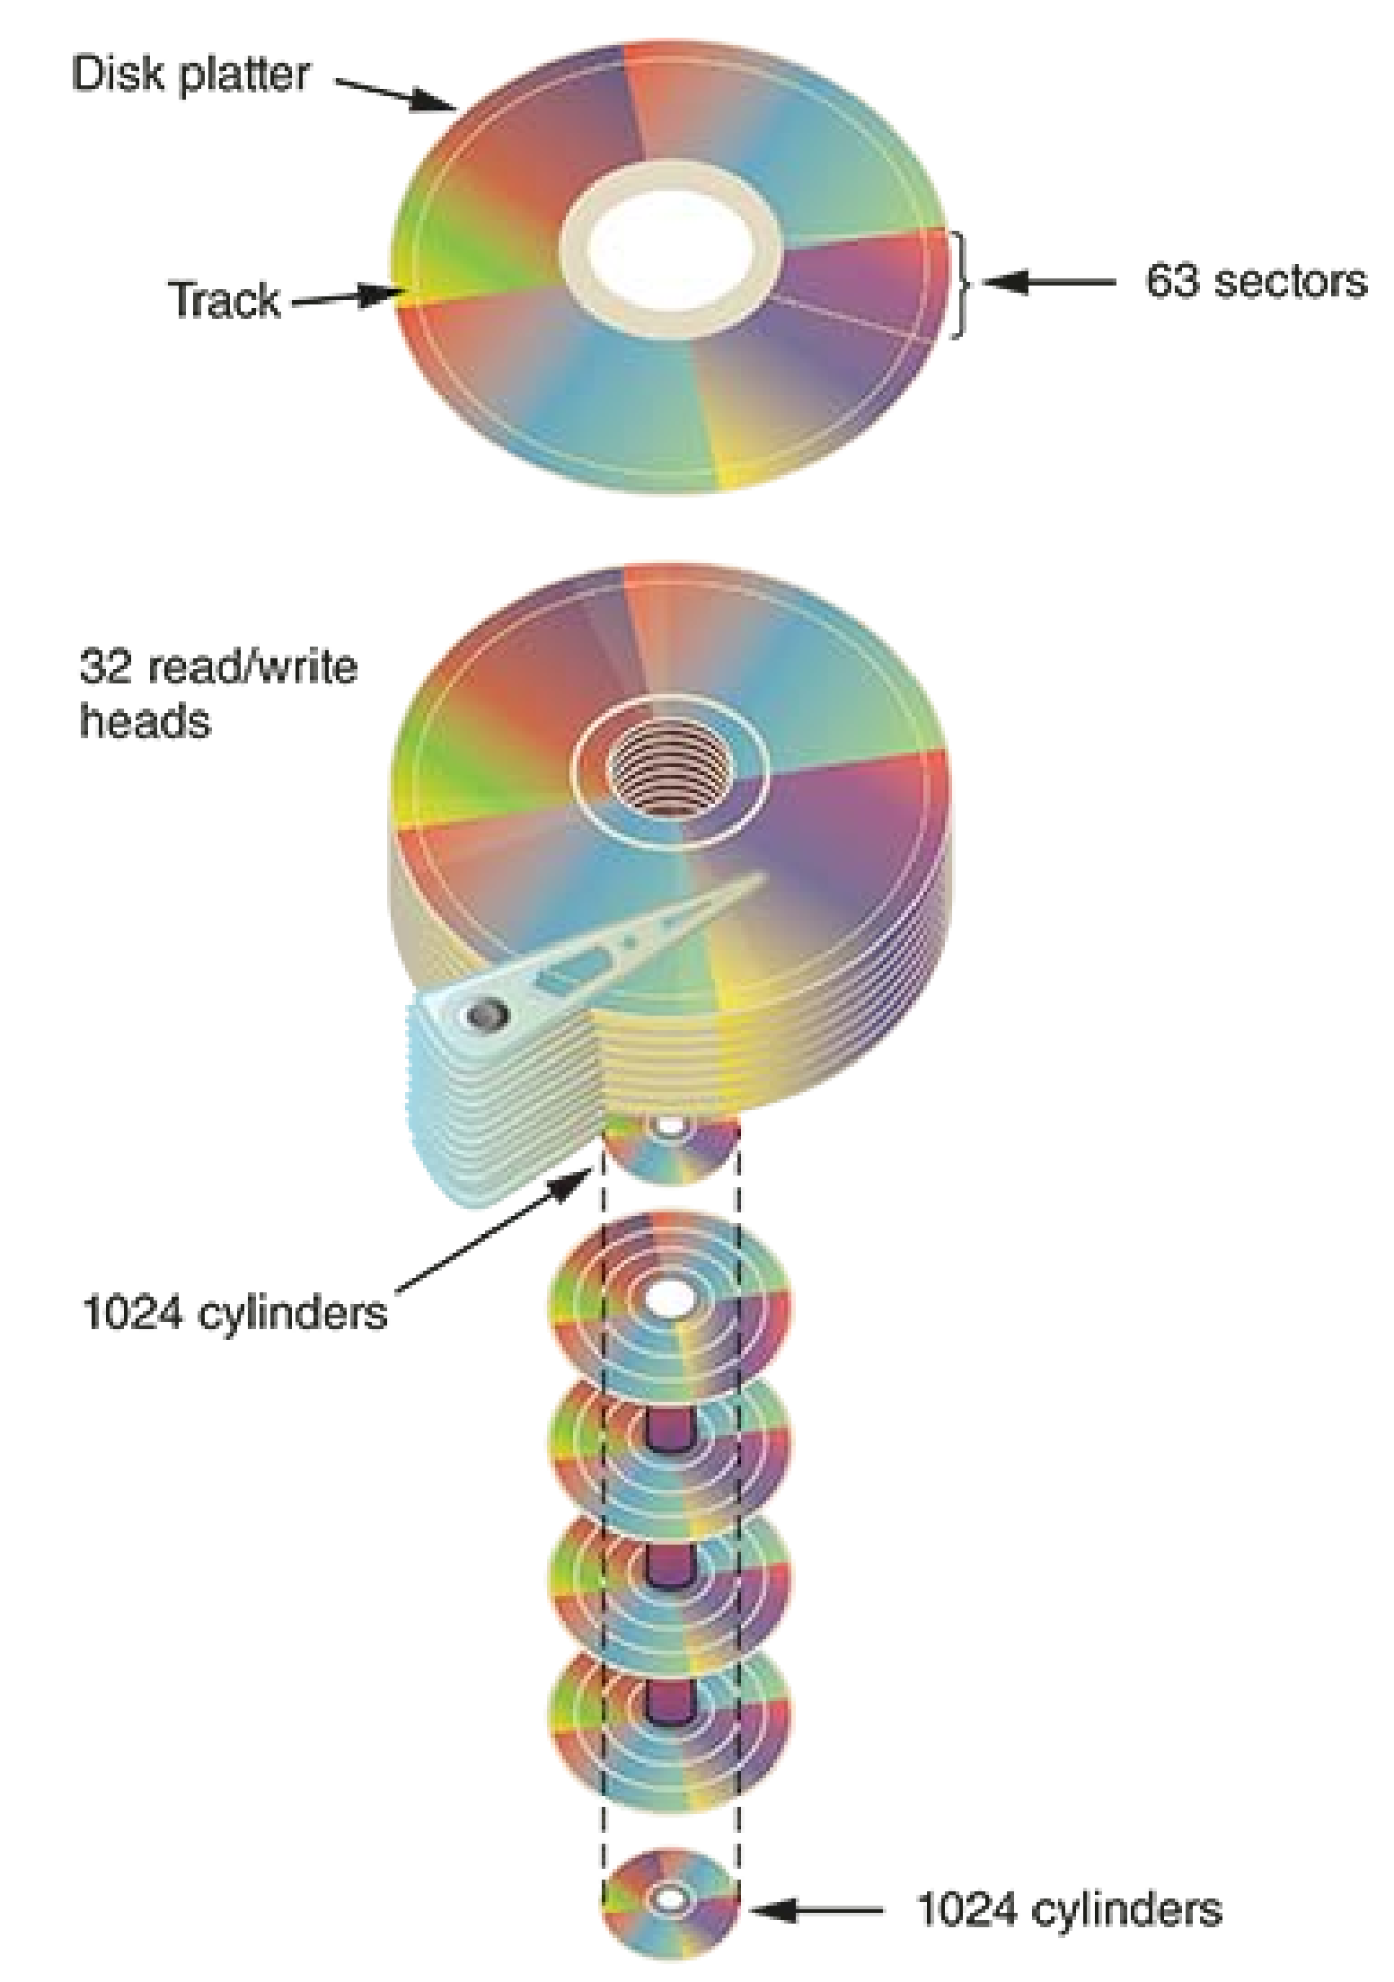
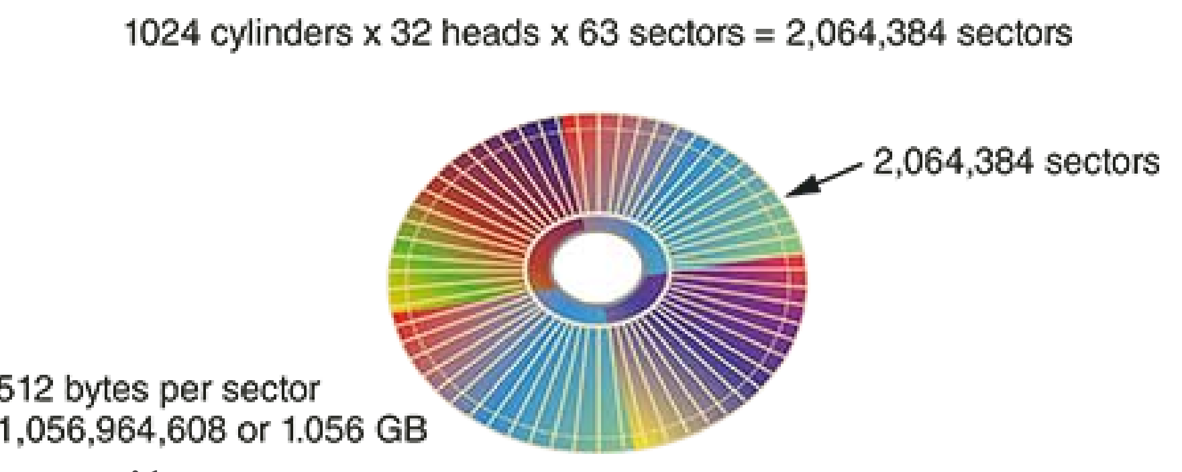
Understanding Disk Drives (3 of 5)

Slide 47
Understanding Disk Drives (3 of 4)
Properties handled at the drive’s hardware or firmware level include the following:
Zone bit recording (ZBR) is how most manufacturers deal with the fact that a platter’s inner tracks have a smaller circumference (therefore store less data)
Track density is the space between each track (less space = more storage)
Areal density is the number of bits in one square inch of a disk platter
Head and cylinder skew are used to improve disk performance (to compensate offset while disk is spinning)

Slide 48
Understanding Disk Drives (4 of 4)
The Master Boot Record (MBR) and GUID Partition Table (GPT) are two file system programs that define the logical partition volume
Both are located in sector 0 of a disk drive
GPT formatted drives convert the CHS (Cylinder-Head-Sector) addressing scheme into
A logical block address (LBA) is the physical sector on a GPT drive that is typically 4096 bytes
LBA address numbering starts at 0, and counts up sequentially to the last sector on the disk drive.
Can be used on drives larger than 2.2 TB

Slide 49
Exploring Microsoft File Structures
In Microsoft file structures, sectors are grouped to form clusters
Which is storage allocation units of one or more sectors
Clusters are numbered sequentially starting at 0 in NTFS and 2 in FAT
The OS assigns each cluster a number, called logical addresses
Sector numbers are called physical addresses
Clusters and their addresses are specific to a logical disk drive, which is a disk partition

Slide 50
Disk Partitions (1 of 4)
On disk drives with multiple partitions, there are small unused spaces between partitions called the partition gap
A partition gap can be used to hide data on a disk drive
Data can also be hidden at the end of a disk by declaring a smaller number of bytes for the disk less than the actual drive size
To access a hidden partition or the ending section of a drive, a disk editor can activate the hidden partition by updating the partition table, or a Hex editor can be used to read hidden areas

Slide 51
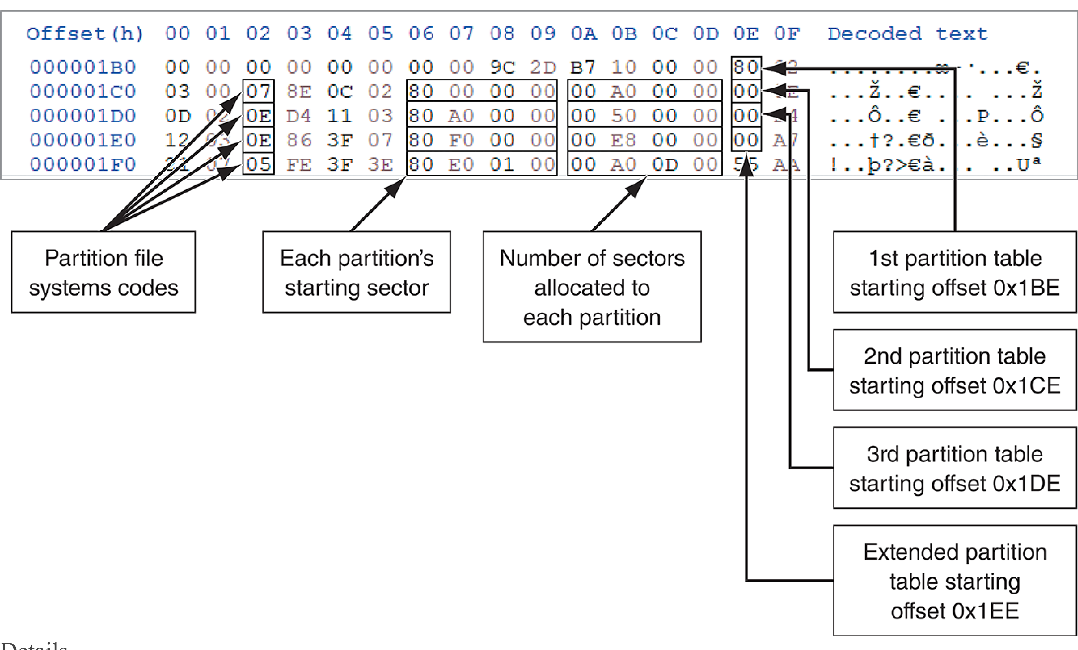
Disk Partitions (2 of 4)
Figure 6-4 A closeup of the partition table section of the MBR

Slide 52
Disk Partitions (3 of 4)
The GUID GPT utility was developed to replace the MBR
A GPT drive can access up to 18 EB per partition
The partition boot sector 0 is the first sector of the first cluster, which consists of one or more sectors of the partition
In sector 0 of the boot partition’s cluster 0 is information that contains the number of bytes per sector, how many sectors are assigned to a cluster, and the number of sectors allotted to the partition

Slide 53
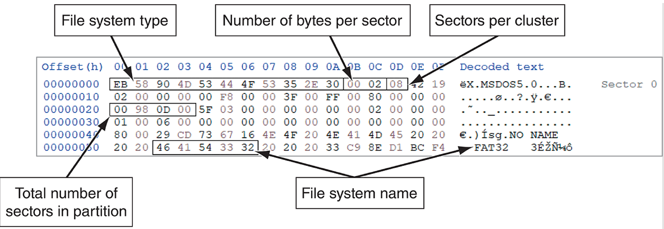
Disk Partitions (4 of 4)
In addition to the primary boot sector located at sector 0 of a disk drive, each partition volume has its own boot sector 0.
This first cluster that starts has a logical address starting at zero.
Figure 6-7 FAT32 partition boot sector

Slide 54
Examining FAT Disks
The File Allocation Table (FAT) is the file structure database that Microsoft originally designed for floppy disks
The FAT database is typically written to a disk’s outermost track and contains file names, directory names, date and time stamps, the starting cluster number, and file attributes
There are three current FAT versions
FAT16, FAT32, and exFAT (used for mobile personal storage devices)
Cluster sizes vary according to the hard disk size and file system

Slide 55
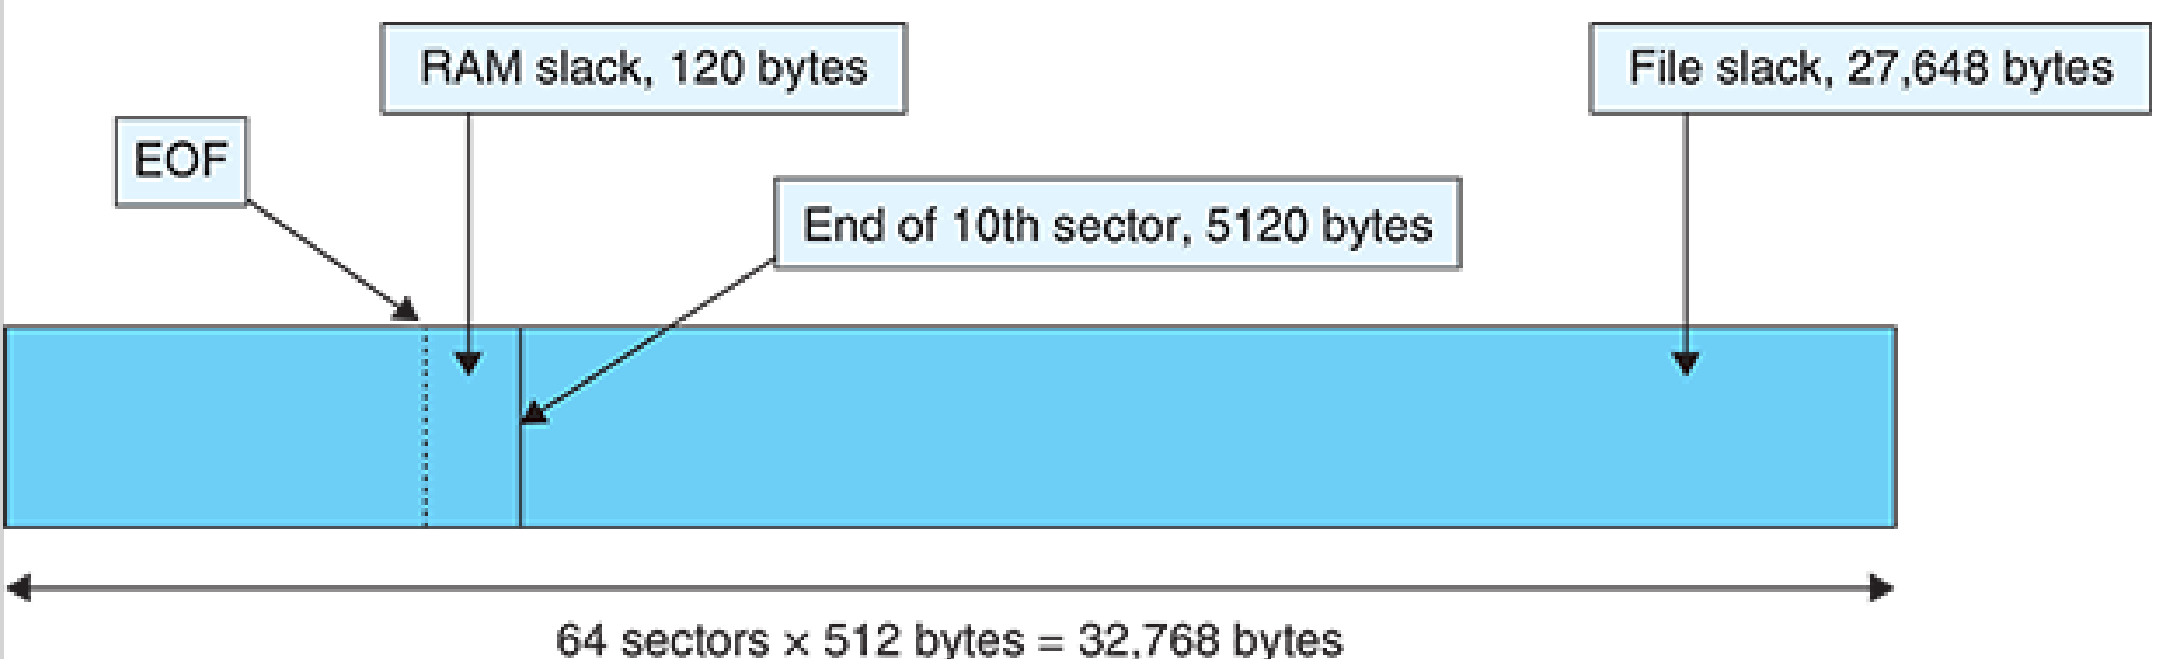
Drive Slack Space
Microsoft OSs allocate disk space for files by clusters, resulting in drive slack
Drive slack is unused space in a cluster between the end of an active file’s content and the end of the cluster
Drive slack includes the following:
RAM slack: the gap between the end of the logical file and the rest the sector, in newer Windows OSs, before data is written to disk, the RAM slack is zeroed out and contains no data
File slack – the remaining sectors the end of the cluster.

Slide 56
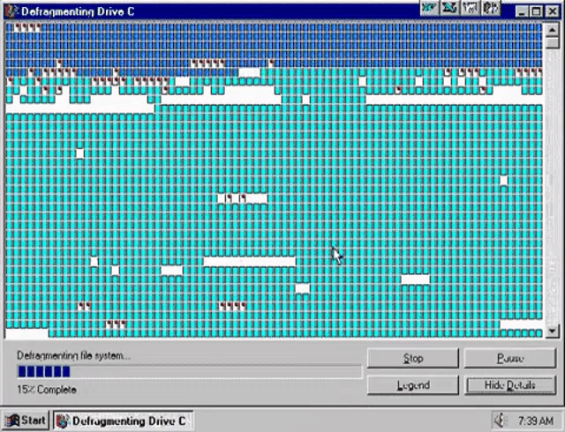
File Fragmentation
An unintentional side effect of FAT16 allowing large clusters was that it reduced fragmentation as cluster size increased
When you run out of room for an allocated cluster, the OS allocates another cluster for your file
As files grow and require more disk space, assigned clusters are chained together
As some files are created and deleted, the chain can be broken or fragmented (one way pointer)

Slide 57
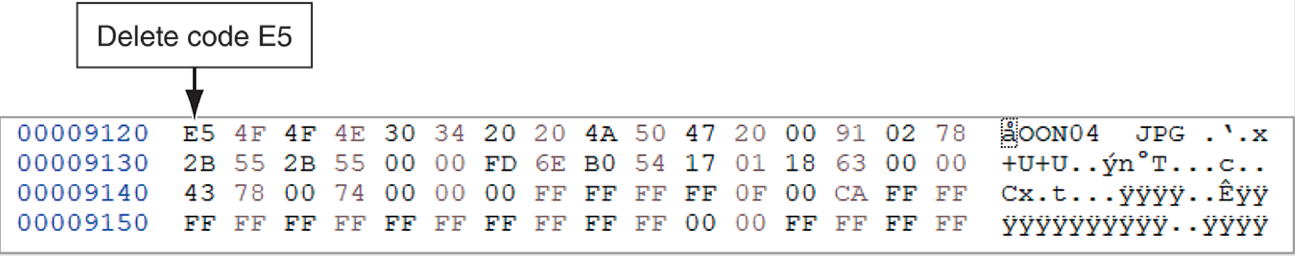
Deleting FAT Files
In a FAT file system, when a file is deleted, the OS inserts a HEX E5 value replacing the first letter of the filename
This value tells the OS that the file is no longer available and a new file can be written to the same cluster location
Data in the file remains on the disk drive
The area of the disk where the deleted file resides becomes unallocated disk space
It is now available to receive new data from newly created files or other files needing more space

Slide 58
Exploring NTFS Disks (1 of 2)
NT File System (NTFS) was introduced with Windows NT
It is still the primary file system for Windows 10 and 11
Carried improvements over FAT file systems include the following:
NTFS provides more information about a file
NTFS gives more control over files and folders
NTFS was Microsoft’s move toward a journaling file system
It records a transaction before the system carries it out
In NTFS, everything written to the disk is considered a file

Slide 59
Exploring NTFS Disks (1 of 2)
NTFS results in much less file slack space
Clusters are smaller for smaller disk drives
NTFS also uses Unicode, a useful feature that is useful when conducting keyword searches for evidence on a disk
NTFS stores critical information in special system files, most of which start with $. These files are hidden files, it play a crucial part system operations and forensic investigations
On an NTFS disk, the first data set is the Partition Boot Sector, Next is Master File Table (MFT) also referred to as $MFT

Slide 60
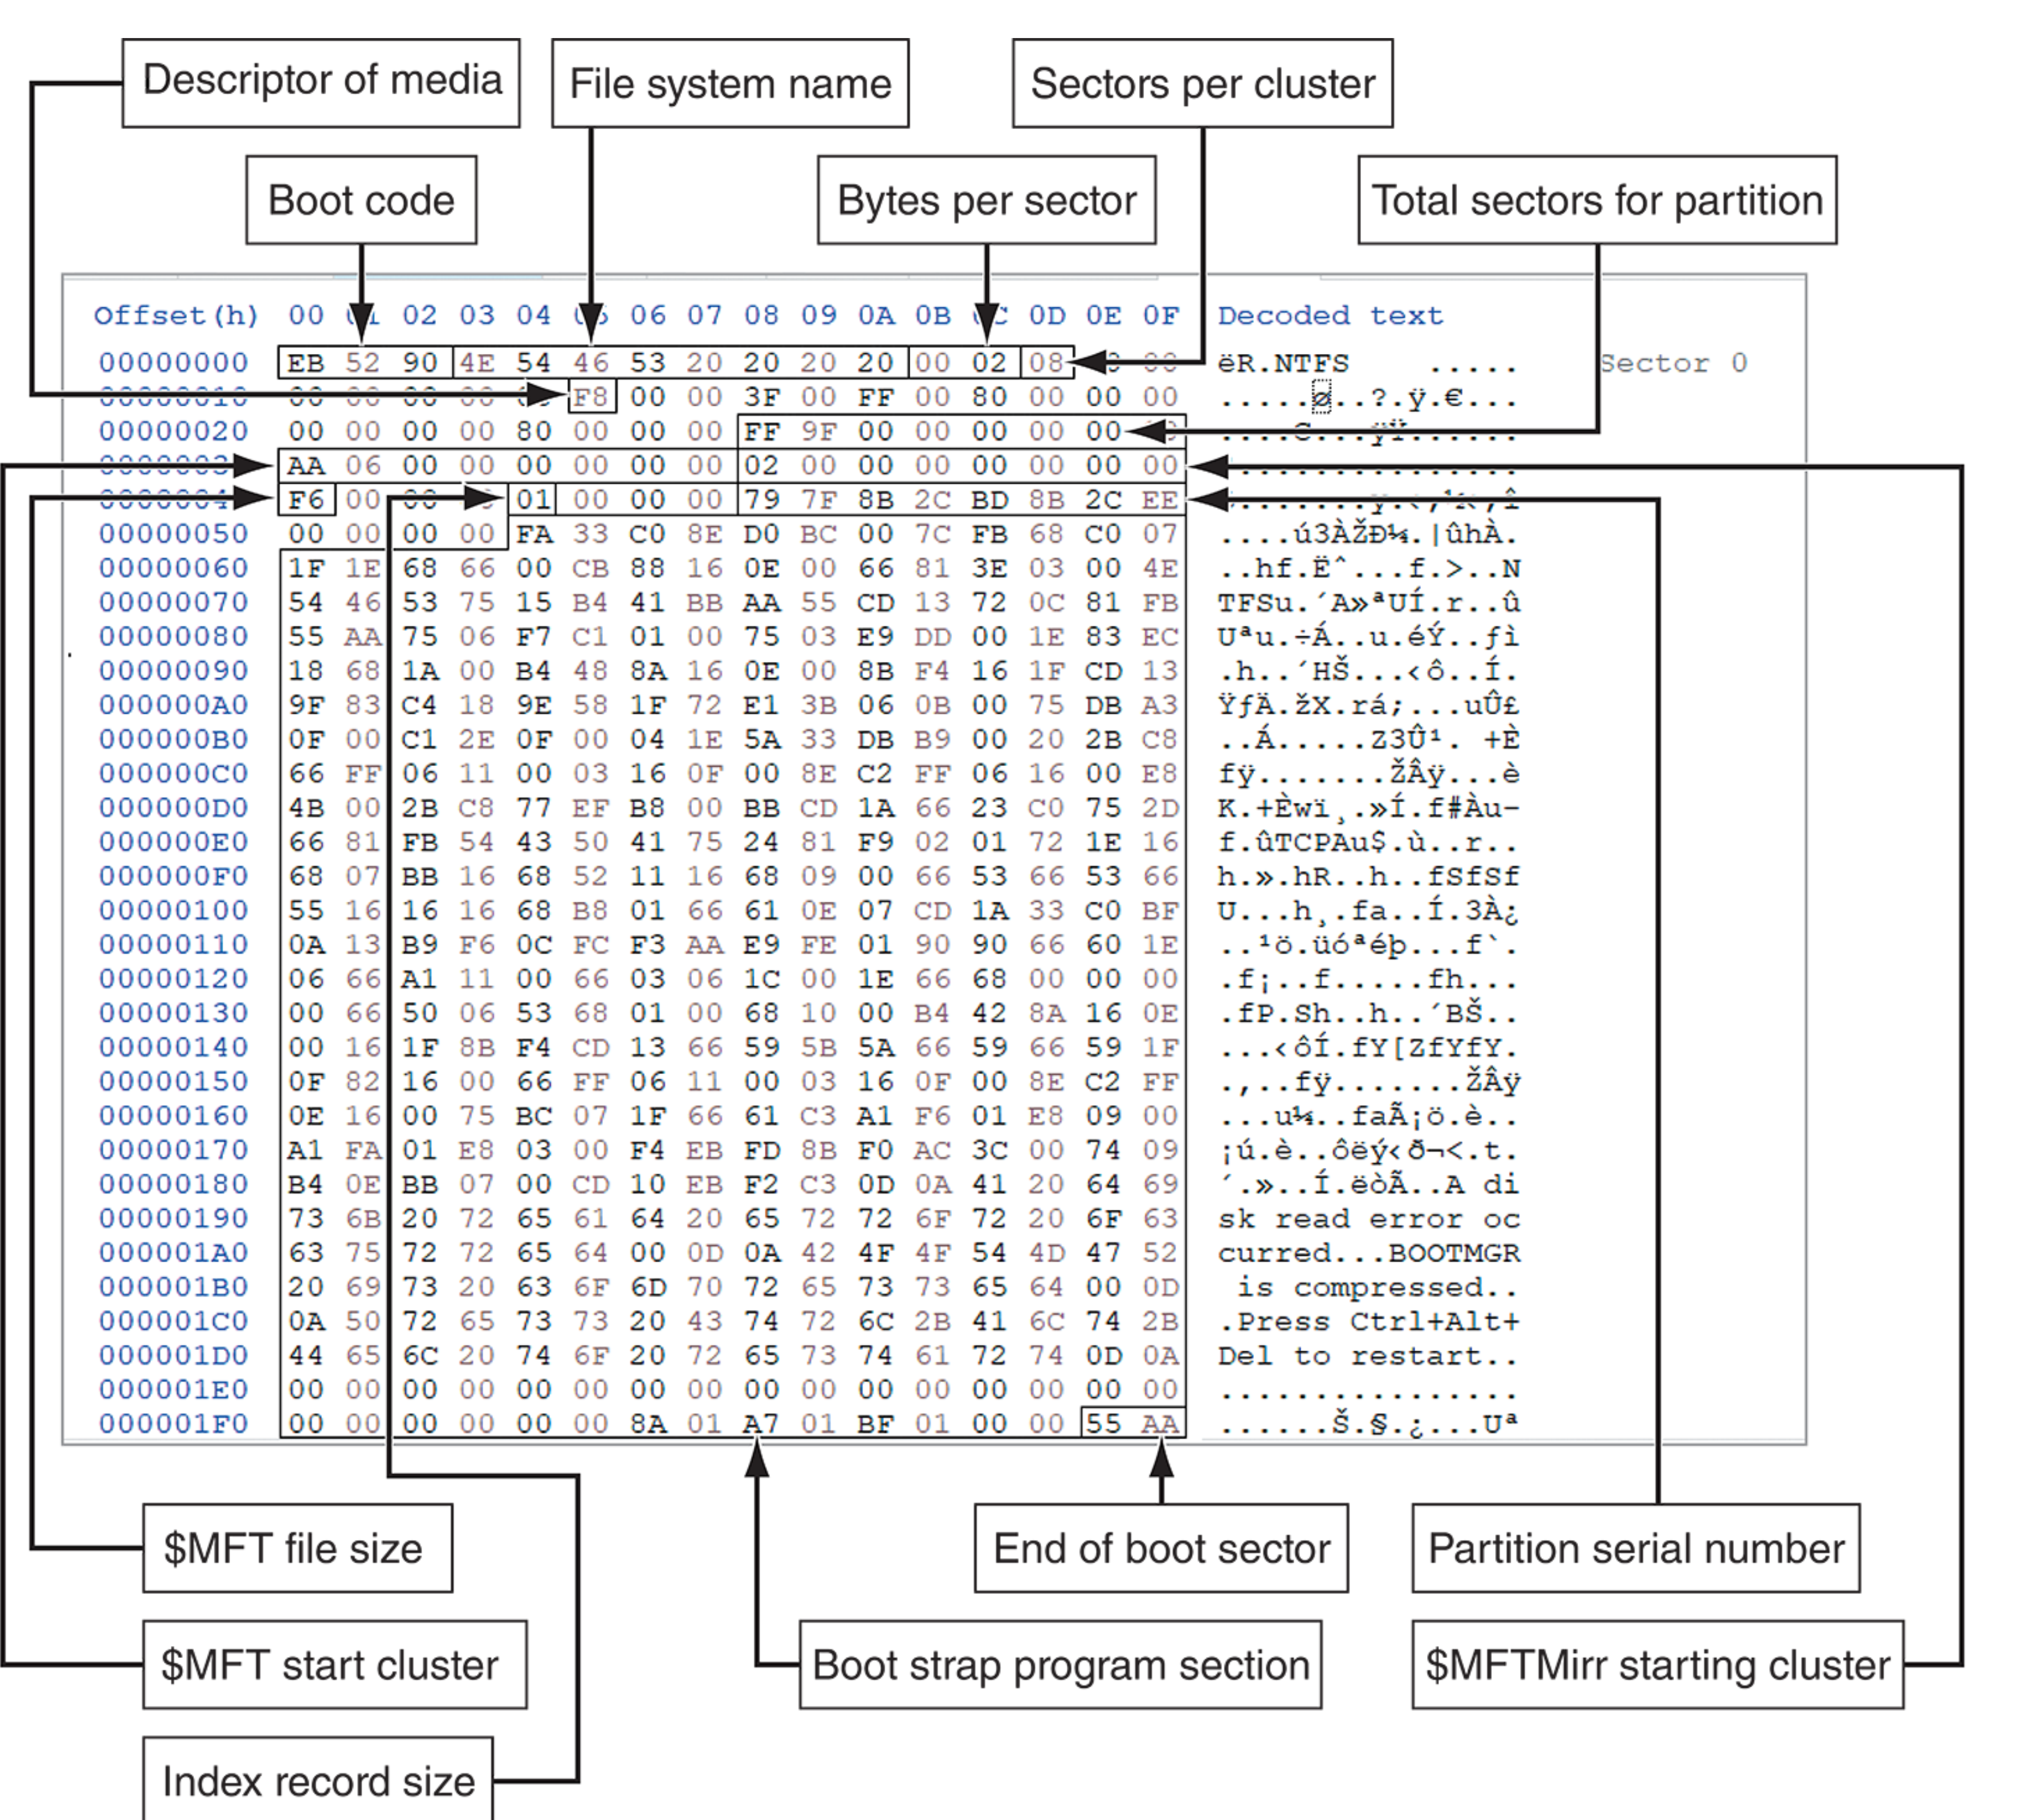
Disk Partitions (4 of 4)
Figure 6-9 NTFS partition boot sector

Slide 61
Logical Cluster Numbers (LCNs)
Logical Cluster Number (LCN):
Represents the address of each cluster on a disk partition.
LCNs are sequentially numbered from the beginning to the end of a partition.
The first LCN starts at 0.
VCN (Virtual Cluster Number):
Once the first LCN is written to the $DATA attribute, it becomes the file's VCN(0).
VCN(0) represents the starting point of the data run for a file.

Slide 62
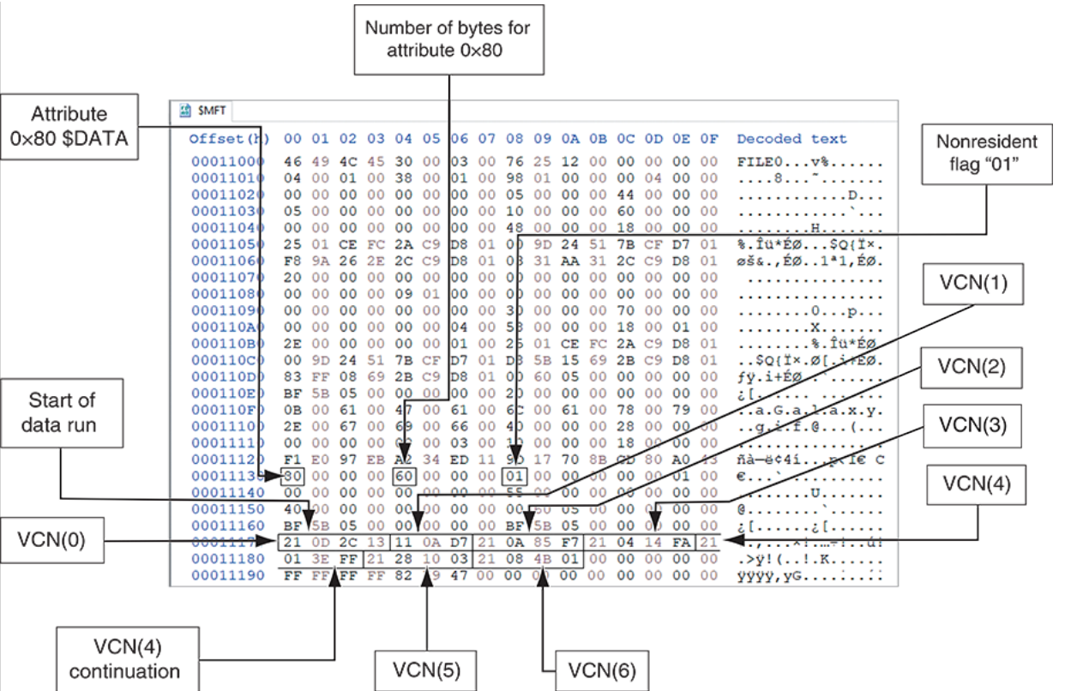
Logical Cluster Numbers (LCNs)
VCN Sequence:
New data runs are added as VCN(1), VCN(2), and so on, indicating the continuation of the data in different clusters.
This process is common in fragmented disk partitions, where data is split into multiple runs across different areas.
Figure 6-16: $Data Run of a Fragmented File

Slide 63
$MFT (Master File Table)
• $MFT contains information about all files on the disk, including the system files the OS uses (including the MFT itself).
Acts as the central index for all files and directories on an NTFS volume.
The first 15 records are reserved for system files
Records in the $MFT are called metadata,
In the NTFS $MFT, all files and folders are stored in separate records of 1024 bytes each
Each record contains file or folder information like timestamps, permissions, file locations, ect.

Slide 64
$MFT (Master File Table)
A field within $MFT is referred to as an attribute ID
File or folder information is typically stored in one of two ways in an $MFT record: resident and nonresident
Resident are Small files (<512 bytes) may reside entirely within the MFT.
Nonresident areLarger files are stored outside the MFT, with pointers in the MFT.
Each cluster on a partition has its own unique address

Slide 65
Table 6-8: Attributes in $MFT
Att. ID | Purpose
0x00 | Header Data
0x10 | $Standard Information: contains data on file creation, alterations, $MFT changes, read dates and times, and file permissions.
0x20 | $Attribute_List: Attributes that don’t fit in $MFT (nonresident attributes) are listed here along with their locations
0x30 | $File_Name: The long and short names for a file are contained here. Up to 255 Unicode bytes are available for long file names. For POSIX requirements, additional names or hard links can also be listed. Files with short file names have only one attribute ID 0x30. In older Windows OSs, long file names have two ID 0x30s in the $MFT record: one for the short name and one for the long name. In Windows 10, there’s only one 0x30 that combines the short and long file names.
0x40 | $Object_ID: ($Volume_Version in Windows NT)Ownership and who has access rights to the file or folder are listed here. Every $MFT record is assigned a unique GUID. Depending on your NTFS setup, some file records might not contain this attribute ID.
0x50 | $Security_Descriptor: Contains the ACL for the file.
0x60 | $Volume_Name: The volume-unique file identifier is listed here. Not all files need this unique identifier.
0x70 | $Volume_Information: This field indicates the version and state of the volume.
0x80 | $DataFile: data for resident files or data runs for nonresident files.
0x90 | $Index_Root: Implemented for use of folders and indexes (this is internal to the $MFT record).
0xA0 | $Index_Allocation: Implemented for use of folders and indexes (associated with $I30).
0xB0 | $Bitmap: A bitmap indicating cluster status, such as which clusters are in use and which are available.
0xC0 | $Reparse_Point: This field is used for volume mount points and Installable File System (IFS) filter drivers. For the IFS, it marks specific files used by drivers.
0xD0 | $EA_lnformation: For use with OS/2 HPFS.
0xE0 | For use with OS/2 HPFS.
0x100 | $Logged_Utility_Stream: This field is used by the Encrypting File System in Windows 2000 and later.

Slide 66
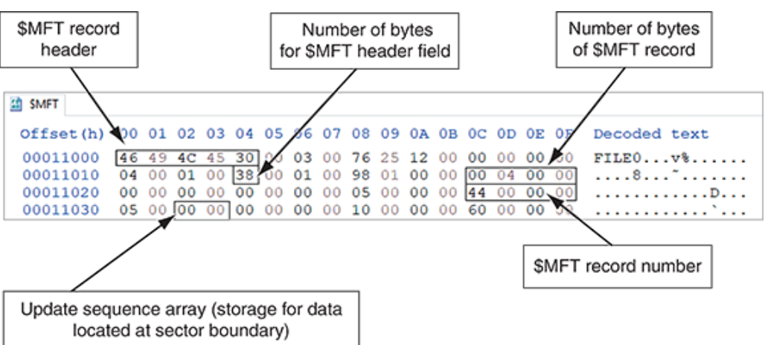
MFT Structures for File Data (1 of 4)
For the header of all $MFT records, the record fields of interest are as follows:
At offset 0x00 - the $MFT record identifier FILE
At offset 0x1C to 0x1F - size of the $MFT record
At offset 0x14 - length of the header (indicates where the next attribute starts)
At offset 0x32 and 0x33 - the update sequence array, which stores the last 2 bytes of the first sector of the $MFT record
Figure 6-17 A $MFT header

Slide 67
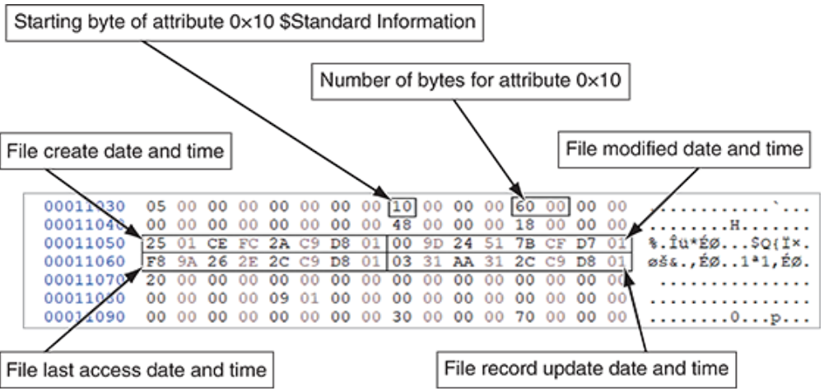
MFT Structures for File Data (2 of 4)
Standard Information (0x10)
File Metadata: Stores essential information about a file or directory, such as creation time, last modified time, last access time, and entry modified time.
File Attributes: Defines key file properties like read-only, hidden, system, and archive status.
Tracking Changes: Helps track file activity, such as creation, access, modification, and metadata changes, useful in forensic investigations.
Figure 6-18 Attribute 0x10: Standard Information (Newer version of NTFS)
Forensic Value: Provides a timeline of file activity and insights into file handling, helping to trace user actions, detect hidden files, and recover deleted files.

Slide 68
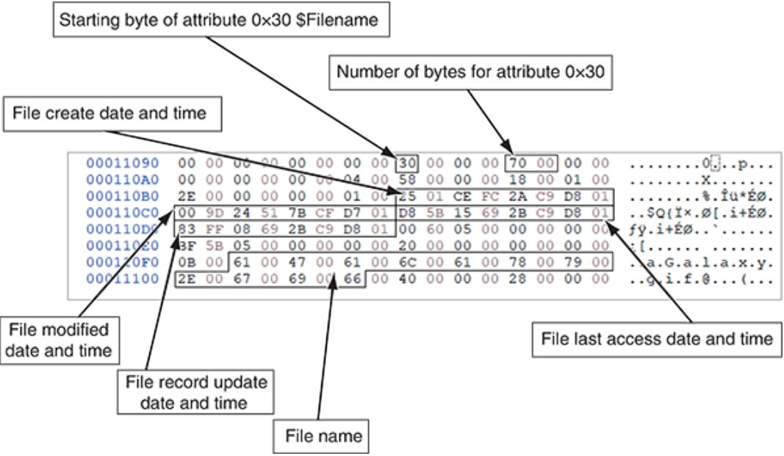
MFT Structures for File Data (3 of 4)
Figure 6-19 Attribute 0x30: $Filename (older versions of NTFS)

Slide 69
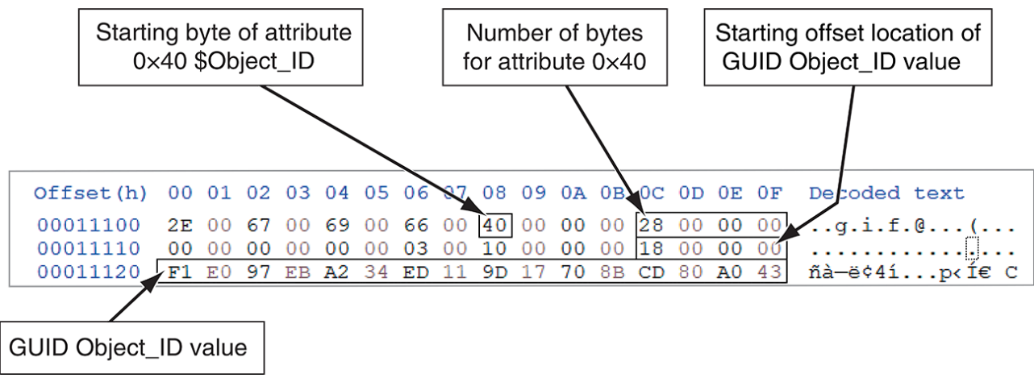
MFT Structures for File Data (4 of 3)
$Object_ID (0x40)
The $Object_ID attribute is used to uniquely identify files, directories, and other NTFS objects across the entire system.
This ID is not affected by the name of the object or its location within the file system.
It allows the operating system and applications to reference objects in a way that is independent of the file name or path.
Figure 6-20 Attribute 0x40: $Object_ID

Slide 70
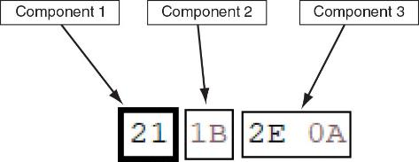
Interpreting Data Runs (1 of 2)
Data runs have the following components:
The first component: on byte declares how many bytes in the attribute field are needed to store the values for the second and third components
The second component: stores the number of clusters assigned to the data run
The third component: contains the starting cluster address value, VCN(0)

Slide 71
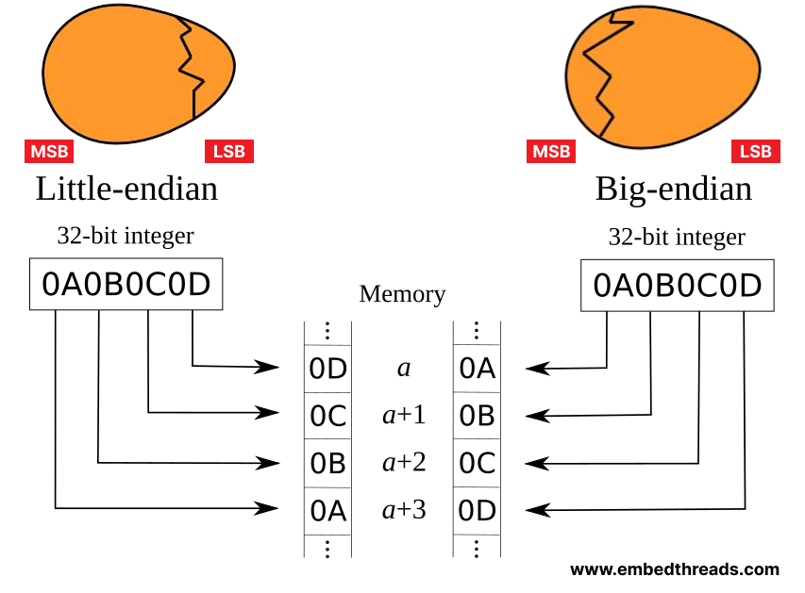
Side Note (little endian vs big endian)
The terms "big-endian" and "little-endian," referring to byte order in computer science, originate from Jonathan Swift's "Gulliver's Travels."
In the story, a conflict arises over whether eggs should be broken at the big end or the little end.
Danny Cohen used these terms to describe the opposing conventions of byte ordering in computer systems.

Slide 72
Interpreting Data Runs (2 of 2)
For the first component: the value 21 is the data run’s starting position
The second digit, 1, means that the next byte contains the number of clusters assigned to this data run.
The first digit, 2, means that the next two bytes (after the number of assigned clusters) contain the cluster address for VCN(0).
VCN(0) is the first data run, which is the LCN address of where the file’s first cluster is located in the partition.

Slide 73
Interpreting Data Runs (2 of 2)
The second component: contain 1 byte that is needed to store the hexadecimal value (in little endian) for the number of clusters assigned to this data run.
The number of clusters assigned to this data run is 1B (hexadecimal) or 27 in decimal.
Third component: the starting assigned cluster address is A2E (in little endian hexadecimal),or 2606 in decimal.
Because it’s the first data run of the file, this address is the LCN.

Slide 74
The $I30 System File (1 of 2)
When the number of new files or subfolders increases in a folder, Windows creates an $I30 file to store the additional new files’ or folders’ information
When a new file is added to a folder, Windows reclaims the INDX slack space and allocates it to the new file.
The process of updating the $I30 file is automatic as part of Windows' data management.
It contain data like $MFT record number, Index record length, Create date and time, Modified date and time, Last access date and time, Change date and time, Allocated size for file, File Size, File Name

Slide 75
The $I30 System File (2 of 2)
The $I30 files contain useful artifacts for an investigation
The $I30 file may contain residual information of its name, byte size, and date-time values for a deleted file
Listings for deleted files are relocated to the end of the $I30 file
Deleted files are labeled as index slack (INDX slack) and relocated to the end of the $I30 file.
Deleted files have the hexadecimal value “00 00 00 00 00 00 00 00 10 00 00 00 02 00 00 00” in the first field.
The sooner a forensic acquisition is performed after file deletion, the better, as it preserves residual data in the $I30 file, which could aid in recovery and investigation.

Slide 76
$UsnJrnl System File
$UsnJrnl provides a log of actions performed on a file, such as when data was added to a file or if a file was renamed.
Each change is recorded with a unique update sequence number (USN).
The $UsnJrnl file is a link file that coordinates information between other files, and it is located in the C:\$Extend folder.
$UsnJrnl links to the following files
$J: is the primary log file that records changes to files and directories, including creation, modification, renaming, and deletion
$J.fileSlack: Contains slack space left over from previous journal entries
$Max: Defines the maximum size of the $UsnJrnl log, when the journal reaches this limit, older records are overwritten.

Slide 77
Prefetch (1 of 2)
To help reduce the time it takes to load an application into memory in Windows, Microsoft has implemented the Prefetch function
The first time an application is run, the OS will create a prefetch file for it
The next time the application is run, Windows preloads the necessary links to other data or executable files into memory
The contents of a prefetch file can reveal the following:
When an application was installed, how many times the application had been run, dates and time it was run, and data that was accessed by the application

Slide 78
Prefetch (2 of 2)
PECmd.exe tool can examine the contents of a prefetch file
PECmd.exe will display the following information:
Source file path, creation, modified, and last access date and time
Source file’s executable name and hash
Byte size of the source file
Windows OS version of the computer
The number of times and when the application has run
Volume information

Slide 79
NTFS Alternate Data Streams (1 of 2)
Alternate data streams are methods by which data can be appended to existing files
Enables files to store extra information (e.g., metadata, thumbnails) while remaining a single data unit.
When you’re examining a disk, be aware that alternate data streams can obscure valuable evidentiary data, intentionally or by coincidence
In NTFS, an alternate data stream becomes an additional file attribute and allows the file to be associated with different applications
An alternate data stream isn’t displayed when you open a file in a hex or text editor.

Slide 80
NTFS Alternate Data Streams (1 of 2)
Transferring files with ADS to non-NTFS volumes (e.g., FAT) results in loss of the alternate streams.
One way you can tell whether a file has an alternate data stream attached is by examining the file’s $MFT record entry.
Can store executable code or malicious content without being obvious.

Slide 81
NTFS Compressed Files
NTFS provides compression similar to FAT DriveSpace 3 (a Windows 98 compression utility)
With NTFS, files, folders, or entire volumes can be compressed
Most forensics tools can uncompress and analyze compressed Windows data
Forensics tools might have difficulty with third-party compression utilities, such as the .rar format

Slide 82
NTFS Encrypting File System (1 of 2)
Encrypting File System (EFS) was introduced with Windows 2000
Uses public key and private key methods of encrypting files, folders, or disk volumes (partitions)
When EFS is used in Windows 2000 and later, a recovery certificate is generated and sent to the local Windows administrator account
The purpose of the recovery certificate is to provide a mechanism for recovering files encrypted with EFS if there’s a problem with the user’s original private key.
Users can apply EFS to files stored on their local workstations or a remote server

Slide 83
NTFS Encrypting File System (2 of 2)
EFS Recovery Key Agent
The recovery Key Agent implements the recovery certificate, which is in the Windows administrator account
Windows administrators can recover a key in two ways: through Windows or from a command prompt
Commands available from a command prompt include the following:
Cipher (works only on NTFS systems running Windows 2000 Professional or later)
Copy (works in both FAT and NTFS)

Slide 84
NTFS Encrypting File System (2 of 2)
If you copy an encrypted file from an EFS-enabled NTFS disk or folder to a non-EFS storage media or folder, it’s unencrypted automatically.
To recover an encrypted EFS file, a user can email it or copy the file to the administrator, who can then run the Recovery Key Agent function to restore the file.

Slide 85
Deleting NTFS Files (1 of 2)
You can also use the del (delete) MS-DOS command
This method eliminates the file from the MFT listing in the same way FAT
When you delete a file in File Explorer, you can restore it from the Recycle Bin.
Shift + Delete or emptying the bin permanently deletes the data.

Slide 86
Deleting NTFS Files (2 of 2)
When a user empties the Recycle Bin the OS performs the following:
The associated clusters are designated as free
The $Bitmap file attribute in $MFT is updated to reflect the file’s deletion, showing that this space is available.
The file’s record in $MFT is marked as being available.
VCN/LCN cluster locations linked to deleted nonresident files are then removed from the original $MFT record.
A run list is maintained in $MFT of all cluster locations on the disk for nonresident files. When the list of links is deleted, any reference to the links is lost.

Slide 87
Resilient File System Overview
Resilient File System (ReFS)
Designed to address very large data storage (can handle millions of terabytes without negatively impacting performance)
Used file for cloud storage
The following features are incorporated into ReFS’s design:
Maximized data availability
Improved data integrity
Designed for scalability
ReFS uses disk structures similar to the MFT in NTFS

Slide 88
Understanding Whole Disk Encryption
Loss of Personal identity information (PII) and trade secrets caused by computer theft has become more of a concern
Whole disk encryption tools offer the following features:
Preboot authentication, such as a single sign-on password, fingerprint scan, or token (USB device)
Full or partial disk encryption with secure hibernation, such as activating a password-protected screen saver
Advanced encryption algorithms such as Advanced Encryption Standard
Key management function that uses a challenge-and-response method to reset passwords
To examine an encrypted drive, decrypt it first

Slide 89
Examining Microsoft BitLocker
BitLocker is Microsoft’s utility for protecting drive data
BitLocker can only encrypt NTFS drives
Hardware and software requirements are as follows:
A computer capable of running Windows Vista or later
The TPM microchip, version 1.2 or newer
A computer BIOS compliant with Trusted Computing Group (TCG)
The BIOS configured so that the hard drive boots first before checking other bootable peripherals

Slide 90
Examining Third-Party Disk Encryption Tools
If you want to encrypt a FAT drive, you need a third-party solution
Available third-party WDE utilities include the following:
BROADCOM
Endpoint Encryption
Jetico BestCrypt Volume Encryption

Slide 91
Understanding the Windows Registry
Registry is a database that stores hardware and software configuration information, network connections, user preferences, and setup information
The Registry can contain valuable evidence for an investigation
Viewing the Registry files from a static acquisition requires special tools such as FTK Registry Viewer or forensics applications such as Autopsy, X-Ways Forensics, and others

Slide 92
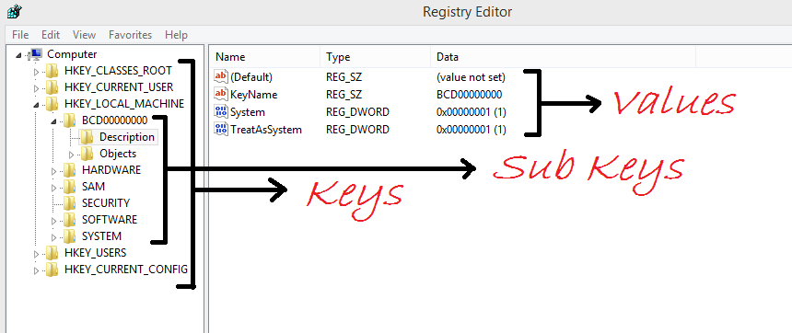
Windows Registry Structure
The Registry is a hierarchical structured database that contains the following data types:
Keys that are like folders on a disk partition
Subkeys that contain values like data and reference to files
Value stores the actual configuration data.

Slide 93
Exploring the Organization of the Windows Registry
Table 6-12 Registry file locations and purposes
File name and location | Purpose of file
Users\user-account\Ntuser.dat | User-protected storage area; contains the list of most recently used files and desktop configuration settings
Windows\system32\config\Default.dat | Contains the computer’s system settings
Windows\system32\config\SAM.dat | Contains user account management and security settings
Windows\system32\config\Security.dat | Contains the computer’s security settings
Windows\system32\config\Software.dat | Contains installed programs’ settings and associated usernames and passwords
Windows\system32\config\System.dat | Contains additional computer system settings
Windows\system32\config\systemprofile | Contains additional ntuser information

Slide 94
Windows Forensics Artifacts (1 of 4)
In addition to the $I30, $MFT, $UsnJrnl, and Prefetch files used by Windows, the following are other data files that might contain digital evidence:
hiberfile.sys
When the lid is closed, Windows suspends its processing and writes all volatile data from RAM to the hiberfile.sys file
When the laptop lid is opened, Windows automatically copies the stored data in the hiberfile.sys file back into RAM, allowing the user to resume their previous activities

Slide 95
Windows Forensics Artifacts (2 of 4)
Internet history files: Web browsers collect extensive user data for tracking and advertising like
Automated login data
Bookmarks and favorites
Browser add-ons or extensions
Browser saved forms information
Cache data from websites Downloads
Web access history
Web browser autocomplete information
Most digital forensics tools can collect and interpret these

Slide 96
Windows Forensics Artifacts (3 of 4)
pagefile.sys
Acts as an extension of RAM when physical memory is full, Temporarily stores inactive memory sections (swapping).
Located in C:\ root or a separate drive for performance optimization.
Contains fragments of RAM data, including running processes.
Useful for recovering passwords, encryption keys, and program artifacts.

Slide 97
Windows Forensics Artifacts (4 of 4)
Recycle.Bin
File Deletion: Deleted files and folders are moved to $Recycle.Bin for potential recovery.
When a file or folder is deleted, Windows creates two files:
Metadata file: Starts with $I (e.g., $IXNIAC2.txt).
Data file: Starts with $R (e.g., $RXNIAC2.txt).
Both files have a unique 6-character alphanumeric ID, followed by the original file extension if present.

Slide 98
Deleted Files Recovery Tools (1 of 2)
WinFR
General file recovery tool from microsoft
Recovers deleted files from various storage devices
Supports multiple file systems (NTFS, FAT, exFAT, ReFS)
Command-line interface with different recovery modes
RBCmd.exe
Specialized Recycle Bin artifact parser
Extracts metadata and outputs it in CSV or JSON formats
Primarily used for digital forensics
Key Difference: WinFR recovers actual files, while RBCmd.exe analyzes Recycle Bin metadata.
ShareExportRewrite

Slide 99
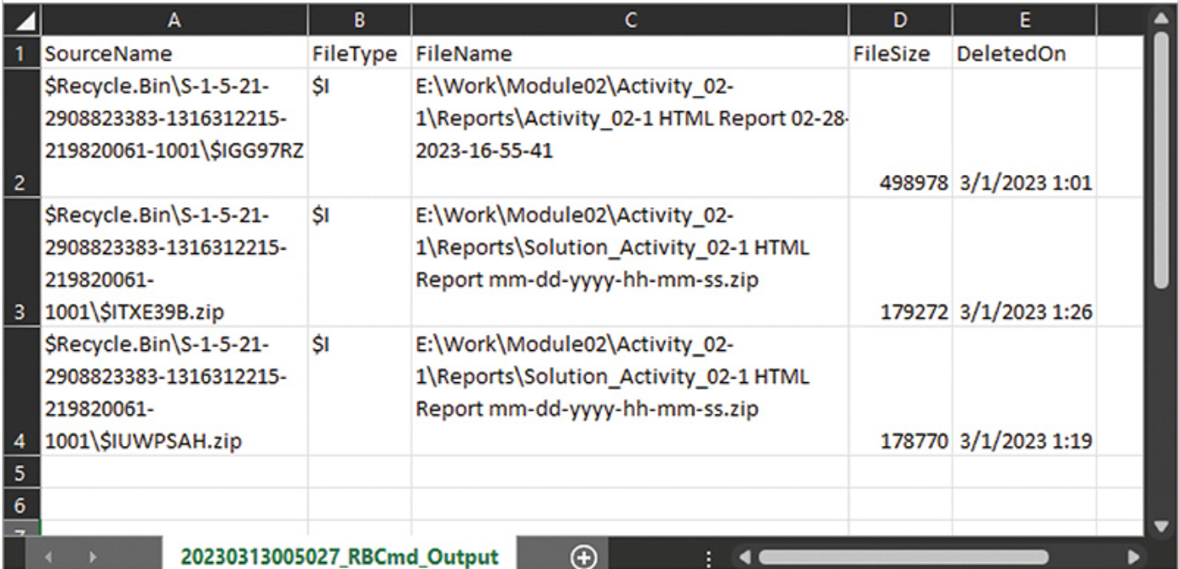
Deleted Files Recovery Tools (2 of 2)
Figure 6-37 RBCmd.exe metadata output

Slide 100
Knowledge Check Activity 6-2
What type of data is stored in Ntuser.dat?
Account management and security settings
A list of the most recently used files
Security setting for the OS
A list of installed programs and associated user account information

Slide 101
Knowledge Check Activity 6-2: Answer
What type of data is stored in Ntuser.dat?
Answer: b. A list of the most recently used files.
Ntuser.dat contains the list of the most recently used files and desktop configuration settings.

Slide 102
Self Assessment
What are the differences between a resident and nonresident record in an $MFT file?
Which data files contain RAM data?

Slide 103
Summary
Now that the lesson has ended, you should be able to:
Explain the purpose and structure of file systems
Describe Microsoft file structures
Explain the structure of FAT disks
Explain the structure of NTFS disks
Describe whole disk encryption
Explain how the Windows Registry works
Identify Windows artifacts

Slide 104
Guide to Computer Forensics and Investigations, 7e
Module 5: Processing Crime and Incident Scenes
Nelson/Phillips/Steuart/Wilson, Guide to Computer Forensics and Investigations, 7th Edition. ©2025 Cengage Learning, Inc. All Rights Reserved. May not be scanned, copied or duplicated, or posted to a publicly accessible website, in whole or in part.

Slide 105
Module Objectives (1 of 2)
By the end of this module, you should be able to:
Explain how to identify digital evidence
Describe how to collect evidence at private-sector incident scenes
Explain guidelines for processing law enforcement crime scenes
List the steps in preparing for an evidence search
Describe how to secure a computer incident or crime scene

Slide 106
Module Objectives (2 of 2)
By the end of this module, you should be able to (continued):
Explain guidelines for seizing digital evidence at the scene
List procedures for transporting and storing digital evidence
Explain how to obtain a digital hash
Understand employee compliance investigations

Slide 107
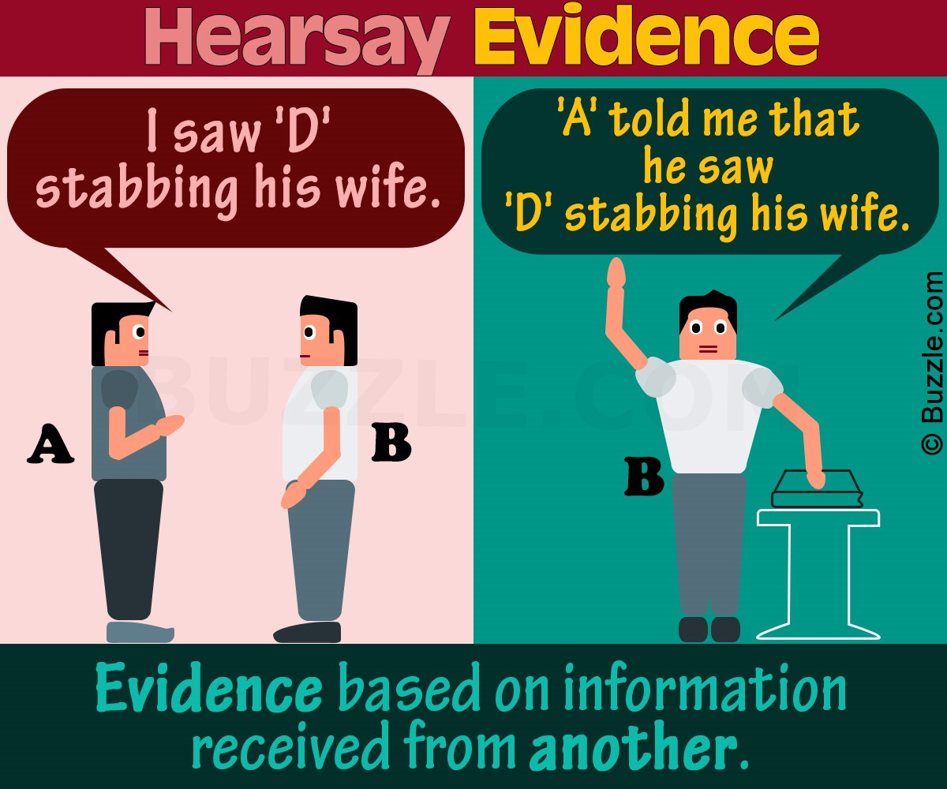
Identifying Digital Evidence
Digital evidence can be any information stored or transmitted in digital form
There is a distinction between "real computer evidence" and "hearsay computer evidence“, while you can prove an email being sent or opened by a logged in use user, you cannot always verify the email's contents.

Slide 108
Understanding Rules of Evidence (3 of 4)
Computer-generated records are data the system maintains such as system log files and proxy server logs
Computer-stored records are data that a person creates and saves on a digital device
Computer-generated records are considered authentic if the program that created the output is functioning correctly
A computer programmer doesn't need to testify to authenticate records. The witness must have firsthand knowledge of relevant facts and understand the purpose of the tools used, like MD5, but not their inner workings.

Slide 109
Understanding Rules of Evidence (1 of 3)
One test to prove that computer-stored records are authentic is to demonstrate that a specific person created the records
Identifying the creator of digital evidence can be challenging, as records from slack space or unallocated disk space often lack metadata, and the same applies to anonymous emails or text messages.

Slide 110

Understanding Rules of Evidence (2 of 3)
In February 2005, the BTK strangler sent a floppy disk to FOX News, claiming police couldn’t trace him. Forensic analysis revealed the name of a church and a user named Dennis, leading to Dennis Rader, the church president.
With enough evidence, he was arrested, confessed to 10 murders, and was sentenced to 10 life terms.

Slide 111
Understanding Rules of Evidence (3 of 3)
To prove the content of a written document, recording, or photograph, ordinarily the original file is required
A duplicate can be used instead of the original when it is produced by the same impression as the original
As long as bit-stream copies of data are created and maintained properly, the copies can be admitted in court
Although they aren’t considered the best evidence

Slide 112
Collecting Evidence at Private-Sector Incident Scenes (1 of 3)
Private-sector organizations include small to medium businesses, large corporations, and non-government organizations (NGOs)
NGO must comply with country laws
Internet service providers (ISPs) and communication companies fall in a special category
They can investigate computer abuse committed by their employees, but not by customers
In certain emergency situations, such as discovering a bomb threat in an email, ISPs may be required to investigate customer activities.

Slide 113
Collecting Evidence at Private-Sector Incident Scenes (2 of 3)
Investigating and controlling evidence is much easier than crime scenes
A corporate policy allows to conduct covert surveillance with little or no cause,

Slide 114
Collecting Evidence at Private-Sector Incident Scenes (3 of 3)
If you discover evidence of a crime during a company policy investigation, take the following steps:
Determine whether the incident meets the elements of criminal law
Inform management of the incident
Stop your investigation to make sure you don’t violate restrictions on obtaining evidence
Work with the corporate attorney on how to respond to a police request for more information

Slide 115
Knowledge Check Activity 5-1
Which of the following file types are considered computer-generated records? (Choose all that apply.)
A database file that contains customer addresses
System user login data
Files created using Microsoft Office
Internet proxy logs

Slide 116
Knowledge Check Activity 5-1: Answer
Which of the following file types are considered computer-generated records? (Choose all that apply.)
Answer: b. System user login data; d. Internet proxy logs
Any data file (such as a system log file or a proxy server log) produced and maintained by the computer’s operating system is a computer-generated record. These types of files are output generated from a computer process or algorithm, not usually data a person creates.

Slide 117
Preparing to Acquire Digital Evidence
Ask your supervisor or senior forensics examiner in your organization the following questions:
Do you need to take the entire computer and all peripherals and media in the immediate area?
How will you protect the computer and media while transporting them to your lab?
Is the computer powered on when you arrive?
Is the suspect you’re investigating in the immediate area of the computer?
Is it possible the suspect damaged or destroyed the computer, peripherals, or media?

Slide 118
Processing Incident or Crime Scenes (1 of 4)
The following guidelines offer suggestions on how to process a scene:
Keep a journal to document your activities
Secure the scene
Remove people who are not part of the investigation
Take video and still recordings of the area around the computer
Sketch the incident or crime scene
Check the state of computers as soon as possible

Slide 119
Processing Incident or Crime Scenes (2 of 4)
The following guidelines offer suggestions on how to process a scene (continued):
Save data from current applications as safely as possible
Record all active windows or shell sessions
Make notes of everything you do when copying data from a live suspect computer
Close applications and shut down the computer

Slide 120
Processing Incident or Crime Scenes (3 of 4)
Complete processing the scene, following these steps:
Assign one person to collect and log all evidence
Tag all evidence you collect with the current date and time, serial numbers or unique features, make and model, and the name of the person who collected it
Maintain two separate logs of collected evidence
Maintain constant control of the collected evidence and the crime or incident scene

Slide 121
Processing Incident or Crime Scenes (4 of 4)
Look for information related to the investigation
Passwords, passphrases, PINs, bank accounts
Collect as much personal information as possible about the suspect or victim
Collect documentation and media related to the investigation
Hardware, software, backup media, documentation, manuals

Slide 122
Special Situation Needs
When seizing digital evidence from a crime or incident scene it may be necessary to keep a suspect’s computer powered on before processing it and shutting it down
There is a special device that will allow you to disconnect power and allow a computer to continue running
The device is WiebeTech HotPlug Field Kit
WiebeTech also sells the Mouse Jiggler MJ-3, which will prevent the screen saver that might be password protected from starting

Slide 123
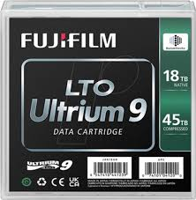
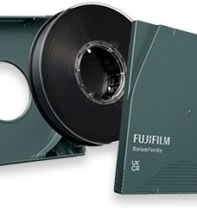
Archiving of Digital Evidence (1 of 2)
The media you use to store digital evidence usually depends on how long you need to keep it
CDs, DVDs have a shelf-life of 5 to 10 years
For large quantities of digital evidence, use magnetic tapes
4-mm DAT, DLT, and Super DLT tape cartridges
The typical life span of a DLT is over 50 years
Low cost
A disadvantage of tape is slow read and write speeds

Slide 124
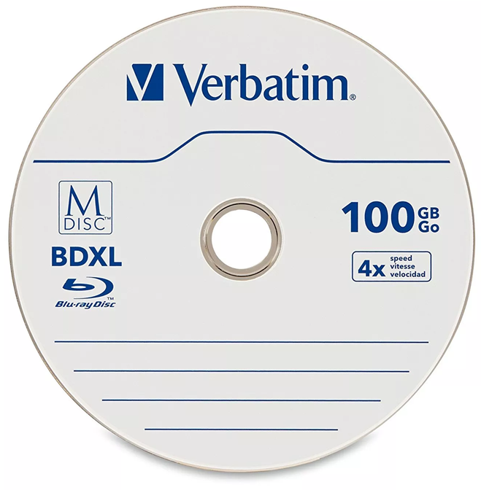
Archiving of Digital Evidence (2 of 2)
M-Disc optical media is an option for digital evidence that needs to be stored for a very long time
Storage capacity ranges from 4.7 to 100 GB
Manufacturer states that it has a shelf-life of over 1,000 years
For all data preservation needs, be sure to make two copies of every image to prevent data loss
If practical, use different tools to create the two images

Slide 125
Obtaining a Digital Hash
In both MD5 and SHA-1, collisions have occurred, despite flaws in MD5 and SHA, both are still used for validating digital evidence
nonkeyed hash set used by most digital forensics tools
It can identify known files such as executable programs or viruses that hide themselves by changing their names (even if a file’s name and extension change, the hash value doesn’t )
A keyed hash set is created by an encryption utility’s secret key
You can use the secret key to create a unique hash value for a file
Hashing offers a fast way to compare files (rather than byte-by-byte comparison)

Slide 126
Knowledge Check Activity 5-2
For cases that might require retention of digital evidence longer than 10 years, which of the following media types should you consider using?
Optical media such as CDs or DVDs
Secondary memory media such as hard disk drives
Flash-based media such as solid-state drives
Magnetic tape media such as DLT

Slide 127
Knowledge Check Activity 5-2: Answer
For cases that might require retention of digital evidence longer than 10 years, which of the following media types should you consider using?
Answer: d. Magnetic tape media such as DLT
Of all data storage media, magnetic tapes, such as DLT, can maintain data integrity the longest. The typical lifespan of a DLT tape is over 50 years, which makes this media ideal for saving important case data. Optical media, such as CDs and DVDs, can deteriorate after 5 to 10 years. Most manufacturers will warranty solid-state drives for 10 years; however, the manufacturers will only replace the drive, not the data, if the drive fails

Slide 128
Guide to Computer Forensics and Investigations, 7e
Module 4: Data Acquisition
Nelson/Phillips/Steuart/Wilson, Guide to Computer Forensics and Investigations, 7th Edition. ©2025 Cengage Learning, Inc. All Rights Reserved. May not be scanned, copied or duplicated, or posted to a publicly accessible website, in whole or in part.

Slide 129
Module Objectives (1 of 2)
By the end of this module, you should be able to:
Describe digital evidence storage formats
Understand how to plan for a digital forensics acquisition
Describe contingency planning for data acquisitions
Explain how to use acquisition tools
Describe how to validate data acquisitions

Slide 130
Module Objectives (2 of 2)
By the end of this module, you should be able to (continued):
Describe RAID acquisition methods
List other forensic tools available for data acquisitions

Slide 131
Understanding Storage Formats for Digital Evidence (1 of 2)
Data in a forensics acquisition tool is stored as an image file
The following are possible storage formats:
Open-source
Advanced Forensics Format (AFF)
Proprietary formats

Slide 132
Understanding Storage Formats for Digital Evidence (2 of 2)
Raw image files can be created using
Linux tools: dd , dcddfl , or dc3dd
Commercial tools: FTK Imager, X-Ways Imager, or OSFClone.
Several tools can perform a validation check by prod using hash value:
Cyclic Redundancy Check (CRC)
Message Digest 5 (MD5)
Secure Hashing Algorithm (SHA-1, SHA-256)
Hash value is a hexadecimal value that determines whether data has been altered or not

Slide 133
Open-Source Imaging Formats (1 of 2)
Raw Format
Advantages
Fast data transfers
Ignores minor data read errors on source drive
Most computer forensics tools can read raw format
Disadvantages
Requires as much storage as original disk or data
Some tools might not collect marginal (bad) sectors

Slide 134
Open-Source Imaging Formats (2 of 2)
Advanced Forensic Format
AFF has the following design goals
Provides compressed or uncompressed image files
No size restriction for disk-to-image files
Space in the image file or segmented files for metadata
Simple design with extensibility
Open source for multiple platforms and OSs
Internal consistency checks for self-authentication
File extensions include .afd for segmented image files and .afm for AFF metadata

Slide 135
Proprietary Formats
Most forensics tools have their own formats for collecting evidence
The following are some features offered by proprietary formats:
The option to compress or not compress image files
The capability to split an image into smaller segmented files (2GB/FAT compatible)
It can integrate metadata into the image file(checksum, examiner, HDD info)
Disadvantages
Inability to share an image between different tools
File size limitation for each segmented volume

Slide 136
Developing an Acquisition Action Plan
Create a general action plan and include the following:
Resources required
An outline showing how the acquisition will be executed
Preservation of the evidence
Security of the evidence before, during, and after the acquisition
Review any available technical specification about a disk drive’s data storage media before you arrive

Slide 137
Determining the Best Acquisition Method (1 of 4)
There are two types of acquisitions: static acquisitions and live acquisitions
For both static and live, there are four methods of data collection:
Creating a physical disk-to-image file
Creating a physical disk-to-disk copy
Creating a partition-to-partition copy
Creating a partition-to-data file (a simple file or folder copy)
Determining the best method depends on the circumstances of the investigation

Slide 138
Determining the Best Acquisition Method (2 of 4)
Creating a physical disk-to-image file is the most common method and offers most flexibility
You can make more than one copy
Copies are bit-for-bit replications of the original drive
Compatible with many commercial forensics tools
You might have to create a disk-to-disk copy when a disk-to-image copy is not possible because of HW or SW errors.
Tools include EnCase, X-Ways Forensics for Windows systems, and Guymager for Linux systems (these Apps. can change disk geometry like a cylinder, track, head configuration)

Slide 139
Determining the Best Acquisition Method (3 of 4)
If your time is limited, consider using a logical acquisition or a sparse acquisition data copy method
A logical acquisition captures only specific files of interest to the case
A sparse acquisition collects fragments of unallocated (deleted) data
Use this method only when you
don’t need to examine the entire drive
don’t have enough time
When collecting evidence for exabytes of data Raid, Storage array network SAN (1 exabyte = 1,000 petabytes = 1,000,000 terabytes = 1,000,000,000 gigabytes.)

Slide 140
Determining the Best Acquisition Method (4 of 4)
To determine which acquisition method to use for an investigation, consider the following:
Size of the source (suspect) disk
Whether you can retain the source disk as evidence
How much time you have to perform the acquisition
Where the evidence is located

Slide 141
Calculating Acquisition Times
The time to transfer data from one device to an image file or other device can vary based on the following factors:
Source drive’s data transfer read speed
Controller interface speed, such as a SATA and a USB controllers
Target drive’s data transfer write speed
Other variables of influence include CPU speed, the number of threads available to transfer data simultaneously on the motherboard, and the quality and reliability of the cables connecting the devices

Slide 142
Approximate Acquisition Times
Other variables that can also influence the speed are:
CPU speed
The number of threads available to transfer data simultaneously on the motherboard
The quality and reliability of the cables connecting the devices.
Device/Bus | Speed (bps) | Time to Copy 1TB
Ethernet (Gigabit) | 1 Gbps (1,000,000,000 bps) | ~2 days 9 hours
USB 2.0 | 480 Mbps (480,000,000 bps) | ~23 hours 3 minutes
FireWire 400 | 400 Mbps (400,000,000 bps) | ~28 hours 57 minutes
SATA III | 6 Gbps (6,000,000,000 bps) | ~10 hours 26 minutes
USB 3.0 | 5 Gbps (5,000,000,000 bps) | ~2 hours 18 minutes
FireWire 800 | 800 Mbps (800,000,000 bps) | ~17 hours 8 minutes
USB 3.1 (Gen 2) | 10 Gbps (10,000,000,000 bps) | ~1 hour 9 minutes
SCSI (Ultra-320) | 320 MB/s (2.56 Gbps) | ~3 hours 55 minutes
USB 3.2 (Gen 2x2) | 20 Gbps (20,000,000,000 bps) | ~34 minutes
Thunderbolt 2 | 20 Gbps (20,000,000,000 bps) | ~34 minutes
PCIe 3.0 (x4) | 8 Gbps (8,000,000,000 bps) | ~7 hours 50 minutes
PCIe 4.0 (x4) | 16 Gbps (16,000,000,000 bps) | ~3 hours 54 minutes
Thunderbolt 3 | 40 Gbps (40,000,000,000 bps) | ~17 minutes
NVMe (PCIe 3.0 x4) | 32 Gbps (32,000,000,000 bps) | ~1 hour 57 minutes
NVMe (PCIe 4.0 x4) | 64 Gbps (64,000,000,000 bps) | ~58 minutes

Slide 143
Contingency Planning for Image Acquisitions (1 of 3)
You should create a duplicate copy of your evidence image file
Make at least two images of digital evidence
Use different tools or techniques
Some tools don’t copy host protected area (HPA)
The HPA is an area of a disk drive that is reserved for booting utilities and diagnostic programs, Not visible to OS
To capture HPA use tools that access the drive at the BIOS level, such as Belkasoft, ILookIX IXImager, or XWays Imager with a write-blocker, or use the hardware device Image MASSter

Slide 144
Contingency Planning for Image Acquisitions (2 of 3)
The whole disk encryption feature in Windows called BitLockerM
Perfom encryption of data sector by sector making it unreadable when copied with a static acquisition method.
Most whole disk encrypted drives currently involves decrypting the drives, which requires the user’s cooperation in providing the decryption key.
Most whole disk encryption tools at least have a manual process for decrypting data, which is converting the encrypted disk to an unencrypted disk. This process can take several hours depending on the disk size.

Slide 145
Contingency Planning for Image Acquisitions (2 of 2)
The whole disk encryption feature in Windows called BitLockerM
Both allocated and unallocated data can be retrieved when the drive is decrypted.
You can recover the disk key with a tool such as Elcomsoft Forensic Disk Decryptor

Slide 146
Using Acquisition Tools (1 of 2)
Acquisition tools for Windows and Linux have an advantage of acquiring evidence from a suspect drive more convenient
Especially when used with hot-swappable devices
OS can easily contaminate an evidence drive when it’s mounted, change boot files by updating metadata, such as the most recent access time.
You must protect acquired data with a well-tested write-blocking hardware device or software application

Slide 147
Using Acquisition Tools (2 of 2)
Some a laptop’s design make removing the disk drive difficult, or you might not have the right connector for a drive.
In these situations, a forensic bootable CD/DVD or USB drive gives you a way to acquire data from a suspect computer and write-protect the disk drive using a software write-blocker application

Slide 148
Using Linux Live CD/DVD and USB Distributions (1 of 3)
A few Linux ISO images are specifically designed for digital forensics
They contain additional utilities that typically aren’t installed in normal Linux distributions
Some are configured not to mount or to mount as read-only
When using a shell command to mount a drive, type mount –help at the shell prompt to learn what options are available
Linux can copy data from a physical device without having to mount it

Slide 149
Using Linux Live CD/DVD and USB Distributions (2 of 3)
The following are some well-designed Linux Live CDs for digital forensics:
CAINE (caine-live.net)
Kali Linux (kali.org)
Knoppix (knopper.net/knoppix/index-en.html)
SANS Investigate Forensic Toolkit (SIFT) (sans.org/tools/sift-workstation/?msclkid=59d623c8ce5511ecb0acc088ebd3258d)
You can download these ISO images to any computer, and burn them into CD, DVD, or USB using tools like Etcher, Rufus, or ISO to USB

Slide 150
Using Linux Live CD/DVD and USB Distributions (3 of 3)
After creating a Linux Live CD/DVD or USB drive, test it on your workstation
Check your workstation’s BIOS to see whether it boots first from the CD or DVD in the system
Place it in the CD or DVD drive or inset the USB and reboot your system, OS will be loaded on computer RAM (Might affect performance)
If successful, Linux loads into your computer’s memory, and a common GUI for Linux is typically displayed, Some show Linux shell
If you have problems with the Linux GUI display, try another computer with a different video card

Slide 151
Mini-WinFE Boot CDs and USB Drives
Mini-WinFE enables you to build a Windows forensic boot CD/DVD or USB drive so that connected drives are mounted as read-only
It can access the suspect’s Windows Registry files
Before booting a suspect’s computer, connect your target drive, such as a larger USB drive
After Mini-WinFE is booted, it can list all connected drives and alter your target USB drive to read-write mode so you can run an acquisition program

Slide 152
Kali Linux Live Features
Kali Linux, funded and managed by Offensive Security,
Kali Linux comes in several ISO configurations ranging from a light version, which is only 856 MB, to a full-featured version
It comes in 32-bit, 64-bit, ARM, Mobile, Apple MI, and VM. versions
It is designed for penetration testing and contains many network security assessment and forensics acquisition tools, along with the Linux version of Autopsy
When Kali Live is started, it displays a boot menu that includes a forensic mode option that will skip mounting drives(No need for write blocker)

Slide 153
FTK Imager Features
Exterro’s FTK Imager can perform a bit-by-bit acquisition of storage media devices or copy selected files and folders from most media devices
It calculates the MD-5 and SHA-1 hashes of the original source drives and then verifies the image files to see if they match as it performs the acquisition, metadata is saved in a separate file
FTK Imager easily fits on a CD or flash drive and can be integrated into a Mini-WinFE boot CD or flash drive
It requires a hardware write-blocker to perform static acquisitions

Slide 154
Preparing a Target Drive for a Forensic Acquisition (1 of 3)
Take the following steps to prepare a target drive:
Use only new or freshly wiped and formatted drives
Record drive information, serial number, manufacturer, size in bytes, and partition label names
Secure the prepared target drive so that it remains ready for use in an investigation

Slide 155
Preparing a Target Drive for a Forensic Acquisition (2 of 3)
The following commands can wipe data from partitions and drives:
In Win 10 format work on partitions less than 2GB format k: /fs:fat32 /v:target02 /p:0 p:0 fill partition with zeros p:n fill with random numbers followed by zero n times for help with in command format /?
For larger sizes use Diskpart with the clean all function to delete all partitions (can take several hours, will delete boot sector, no chance to recover files) for details open this link (computerhope.com/diskpart.htm)
Many applications including Hex editors have a wiping option

Slide 156
Preparing a Target Drive for a Forensic Acquisition (3 of 3)
Create a journal to keep track of the following information:
Type of media
Media manufacturer name, model name or number, and serial #
Size of media
Purpose
Number of partitions and the file system format of partition(s)
Forensic boot media
Disposition of media

Slide 157
Understanding the Boot Sequence (1 of )
To avoid contamination of data on a suspect’s system, you must know how to access and modify CMOS, BIOS, EFI, and UEFI settings
CMOS stores system configuration and date and time information when power is off,
To access a computer’s CMOS, watch for which key or keys to press and when to press them from the display while the computer is booting
You will be able to change the computer’s boot sequence from the CMOS setup screen

Slide 158
Understanding the Boot Sequence (2 of 3)
CMOS (Complementary Metal-Oxide-Semiconductor): Stores system settings with a battery.
BIOS (Basic Input/Output System): Older firmware that initializes hardware and boots the OS.
EFI (Extensible Firmware Interface): More advanced firmware, replacing BIOS, with better hardware support.
UEFI (Unified Extensible Firmware Interface): Modern replacement for BIOS/EFI, offering faster boot, security, and larger drive support.

Slide 159
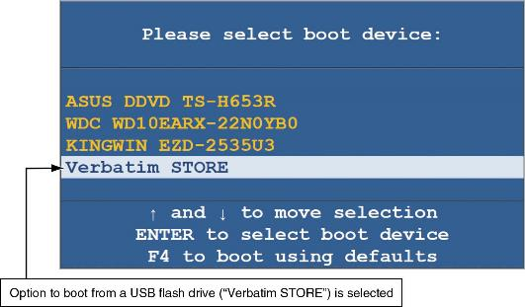
Understanding the Boot Sequence (3 of 3)
Figure 4-1 CMOS boot menu

Slide 160
Using xcopy to Collect Evidence
If you need specific files, the DOS xcopy command is more useful than copy command.
provides more control, such as copying entire directories and preserving file attributes
Will not collect residual data from free space.
Table 4-1 xcopy command features
Switch | Description
/a | Copies only files that have the attribute set on.
/d:date | Copies only files last updated on and after the date specified.
/e | If errors are encountered, it continues to copy data.
/f | Lists file name source and its destination name.
/h | Copies all files that have the hidden attribute set.
/s | Copies all folders that contain data and ignores empty folders.
/u | Updates existing files from the source in the destination folders.

Slide 161
Using robocopy to Collect Evidence
The robocopy command is an extremely powerful utility
can manipulate large amounts of data.
Some of the features in robocopy will delete copied data from the source
Feature | Description
/bytes | Displays the number of bytes copied
/ia:[RASHCNETO] | Copies only files with a specific attribute set, such as r for read-only files or c for compressed file
/fp | Displays the full pathname of files
/v | Creates a verbose output showing files that have been skipped
/r:n | If a file is locked by another user, it retries n number of time
/tee | Creates a status report that is sent to the console and to a log file
/w:n | If a file is locked by another user, it waits n value of seconds before retrying; the default is 30 seconds
/xa: [RASHCNETO] | Excludes files with a specific attribute, such as r for read-only files or c for compressed file
/xc | Excludes files that have changed
/xd <directory> [...] | Excludes specific paths
/xf <filename> [...] | Excludes specific files and paths

Slide 162
Knowledge Check Activity 4-1
Which acquisition method would be appropriate for collecting only fragments of unallocated data?
Physical acquisition
Logical acquisition
Sparse acquisition
Partition acquisition

Slide 163
Knowledge Check Activity 4-1: Answer
Which acquisition method would be appropriate for collecting only fragments of unallocated data?
Answer: c. Sparse acquisition
A sparse acquisition, besides collecting allocated data, is capable of collecting the fragments of unallocated or deleted data.

Slide 164
Validating Data Acquisitions
The hashing algorithm creates a hexadecimal number that represents the uniqueness of a data set, such as a file or disk drive.
This unique number is referred to as a “digital fingerprint.”
With a few exceptions, changing one letter from uppercase to lowercase will produce a completly different hash value.
Validating evidence may be the most critical aspect of computer forensics
It requires using a hashing algorithm utility
Validation techniques include the following:
CRC-32, MD5, and SHA-1 to SHA-512

Slide 165
Linux Validation Methods
You can run md5sum, sha1sum, sha256sum, sha384sum, sha512sum, utilities on all suspect disks and volumes or segmented volumes
The dd command will perform a bit-stream copy of a file, folder, partition, or disk into a raw file
The split command can be added to the dd command with the pipe function to split the raw file into segmented volumes
The dcfldd (legacy)command was designed to create raw forensic binary files
The dc3dd has added improvements over dcfldd (error log, wipe data, progress bar, verification during copy, multiple output)

Slide 166
Windows Validation Methods
Windows PowerShell version 2.0 has the get-filehash hashing algorithm command
It can generate MD5, SHA-1, SHA-256, SHA-384, and SHA-512 hashes
Third-party hashing tools can be cataloged into two groups:
The first group includes tools that provide hashing features as part of their product (like Autopsy, FTK imager)
The second group includes tools that are stand-alone and only perform hashing (like the free GUI Hash tool)

Slide 167
Solid-State Drive Concerns
Modern solid-state drive (SSD) devices use NAND flash memory chips to store data
NAND memory is more complicated than magnetic media
The erasing of memory makes it harder to recover deleted data from SSDs
The erasing of unallocated space will alter the SSD’s hash values
Before securing SSDs into evidence, it might be worth disabling the TRIM function to preserve the data and to ensure that the drive’s hash value doesn’t change

Slide 168
Media Failure Concerns
All media storage devices have a mean time to failure (MTTF), which is typically defined in the number of hours before a device will most likely fail
There may be an occasion where mismatched hashes from the original data to the copied data
This could indicate that the original media is faulty
Another source of failure is cables and connectors
When replacing a cable, use new ones when possible

Slide 169
Using Compare Functions to Validate Data (1 of 3)
The DOS command comp will compare two files and display information about the differences between the files
The fc command has a few more features than the comp command
The PowerShell cmdlet compare-object combined with get-content can compare files similar to the DOS commands
The Linux command diff is similar to the DOS fc command, with some unique features not available in the DOS and PowerShell commands

Slide 170
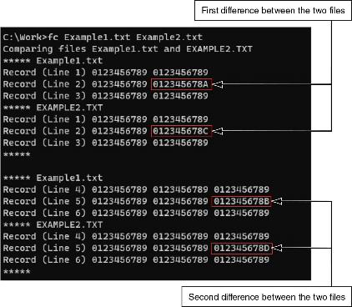
Using Compare Functions to Validate Data (2 of 3)
Figure 4-4 The fc command showing the difference between two files

Slide 171
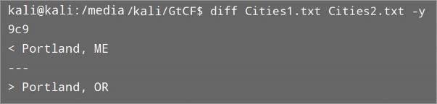
Using Compare Functions to Validate Data (3 of 3)
Figure 4-7 The Linux diff command

Slide 172
Understanding RAID (1 of 5)
Redundant array of independent disks (RAID) is a computer configuration involving two or more physical disks
Originally developed as a hardware-redundancy measure
RAID 0 provides rapid access and increased storage
Two disks become one large volume
Biggest disadvantage is lack of redundancy
RAID 1 is designed for data recovery
The content of two disks is identical (mirroring)

Slide 173
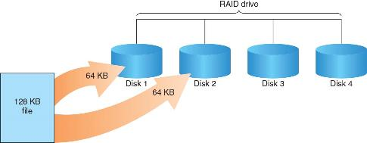

Understanding RAID (2 of 5)
Figure 4-10 RAID 0: Striping
Figure 4-11 RAID 1: Mirroring

Slide 174
Understanding RAID (3 of 5)
RAID 2 is similar to RAID 1 except data is written to a disk on a bit level
Has better data integrity checking than RAID 0
RAID 3 uses data stripping and dedicated parity
It requires at least three disks
RAID 5 is similar to RAIDs 0 and 3
It places parity recovery data on each disk

Slide 175
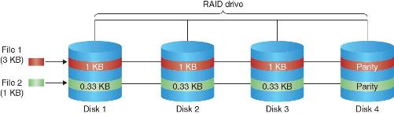
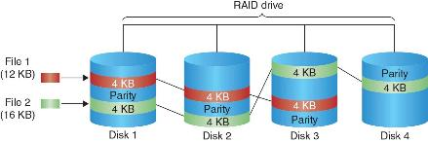
Understanding RAID (4 of 5)
Figure 4-12 RAID 2: Striping (bit level)
Figure 4-13 RAID 5: Block-level striping with distributed parity

Slide 176
Understanding RAID (5 of 5)
RAID 6 is similar to RAID 5, but with double parity (two disks for parity)
Can handle two disk failures without data loss
Requires at least 4 disks
RAID 10 combines RAID 1 (mirroring) and RAID 0 (striping)
Can handle one disk failure per mirrored pair
Requires at least 4 disks
Raid 15 combines RAID 1 (mirroring) and RAID 5 (striping with parity)
Can tolerate one disk failure per mirrored pair
Requires at least 6 disks, Rarely used

Slide 177
Acquiring RAID Disks (1 of 2)
You need to address the following concerns:
How much data storage is needed?
What type of RAID is used?
Do you need to have all drives connected?
Do you have the right acquisition tool?
Can the tool read a forensically copied RAID image?
Can the tool read split data saves of each RAID disk?
Copying small RAID systems to one large disk is possible

Slide 178
Acquiring RAID Disks (2 of 2)
Vendors offering RAID acquisition functions include Runtime Software and R-Tools Technologies
Occasionally, a RAID system is too large for a static acquisition
Retrieve only the data relevant to the investigation with the sparse or logical acquisition method

Slide 179
Using Other Forensics Acquisition Tools (1 of 2)
ASR Data SMART is a Linux forensics analysis tool that can make image files of a suspect drive
Capabilities include the following:
Robust data reading of bad sectors
Mounting of drives in write-protected mode
Mounting of target drives in read/write mode
Compression schemes to speed up acquisition or reduce amount of storage needed

Slide 180
Using Other Forensics Acquisition Tools (2 of 2)
IxImager runs from a bootable Floppy or CD and is designed to work only with ILookIX, can work with Raid, proprietary format, row format
PassMark Software offers a bootable ISO image named OSFClone, which can create raw, Expert Witness, and AFF acquisitions
Runtime Software offers compact shareware programs for data acquisition and recovery including DiskExplorer for FAT and NTFS, support Raid, network drives
ForensicSoft SAFE Boot Disk is a bootable Windows CD or USB drive
X-Ways Imager, require write blocker, reconstruct Raid system

Slide 181
Knowledge Check Activity 4-2
Which acquisition method would be most appropriate for collecting email files from a server that uses a RAID storage array?
Physical acquisition
Logical acquisition
Tape archive
Sparse acquisition

Slide 182
Knowledge Check Activity 4-2: Answer
Which acquisition method would be most appropriate for collecting email files from a server that uses a RAID storage array?
Answer: b. Logical acquisition
To perform an acquisition of a RAID will require as much or almost as much disk storage as the size of the RAID. Since it is only email that is needed, forensically imaging an entire RAID is impractical and of no use for an investigation. In addition, it will take too much resources, such as a target disk drive, and time to collect the data. As such, a logical acquisition of just the email data would be ideal for this scenario.

Slide 183
Summary (1 of 2)
Now that the lesson has ended, you should be able to:
Describe digital evidence storage formats
Understand how to plan for a digital forensics acquisition
Describe contingency planning for data acquisitions
Explain how to use acquisition tools
Describe how to validate data acquisitions

Slide 184
Summary (2 of 2)
Now that the lesson has ended, you should be able to (continued):
Describe RAID acquisition methods
List other forensic tools available for data acquisitions

Slide 185
Guide to Computer Forensics and Investigations, 7e
Module 3: The Investigator’s Laboratory and Digital Forensics Tools
Nelson/Phillips/Steuart/Wilson, Guide to Computer Forensics and Investigations, 7th Edition. ©2025 Cengage Learning, Inc. All Rights Reserved. May not be scanned, copied or duplicated, or posted to a publicly accessible website, in whole or in part.

Slide 186
Module Objectives (1 of 2)
By the end of this module, you should be able to:
Describe certification requirements for digital forensics labs
List physical requirements for a digital forensics lab
Explain the criteria for selecting a basic forensic workstation
Describe components used to build a business case for developing a forensics lab

Slide 187
Module Objectives (2 of 2)
By the end of this module, you should be able to (continued):
Explain how to evaluate needs for digital forensics tools
Describe available digital forensics software tools
List some considerations for digital forensics hardware tools
Describe methods for validating and testing forensics tools

Slide 188
Understanding Forensics Lab Accreditation Requirements
A digital forensics lab is where you conduct investigations, store evidence, and do most of your work
The ANSI-ASQ National Accreditation Board (ANAB) provides accreditation of crime and forensics labs worldwide
This accreditation includes forensics labs that analyze digital evidence
ANAB audits lab functions and procedures

Slide 189
Identifying Duties of the Lab Manager and Staff
Some lab manager duties include the following:
Set up processes for managing cases
Facilitate collaborative decision-making.
Maintain financial responsibility for lab needs
Enforce ethical standards among lab staff members
Plan updates for the lab
Establish and promote quality-assurance processes
Set reasonable production schedules
Estimate how many cases an investigator can handle

Slide 190
Lab Budget Planning (1 of 2)
Expenses for a lab include the following:
Hardware, software, facility space, travel costs, and personnel training
Estimate the number of cases your lab expects to examine
Identify types of computers you’re likely to examine (OS, HDD size..)
Take into account changes in technology (filesystem, OS, Game console, mobile phone)
Use statistics to determine what kind of computer crimes are more likely to occur and use that to plan your equipment purchases

Slide 191
Lab Budget Planning (2 of 2)
Check statistics from the Uniform Crime Report (an FBI program that collects and publishes crime data from law enforcement agencies across the U.S)
Identify crimes committed with specialized software
When setting up a lab for a private company, check:
Hardware and software inventory
Problems reported last year
Future developments in digital technology
Time management is a major issue when choosing software and hardware to purchase

Slide 192
Acquiring Certification and Training (1 of 2)
Update your skills through appropriate training
Thoroughly research the requirements, cost, and acceptability in your area of employment
International Association of Computer Investigative Specialists (IACIS)
Candidates who complete the IACIS test are designated as a Certified Forensic Computer Examiner (CFCE) (require recertificate every 3 years)
High-Tech Crime Network (HTCN) (experience, training hours, cases)
Certified Computer Crime Investigator, Basic and Advanced Level
Certified Computer Forensic Technician, Basic and Advanced Level

Slide 193
Acquiring Certification and Training (2 of 2)
EnCase Certified Examiner (EnCE) Certification
Open to the public and private sectors and is specific to the use and mastery of EnCase forensics analysis software
Exterro Forensic Certification
Formerly AccessData (provide training and certificates)
Exterro Ace (AccessData Certified Examiner)
Exterro Ace for Enterprise
Many other training and certifications are available

Slide 194
Determining the Physical Requirements for a Digital Forensics Lab
Your lab facility must be secure so that evidence is not lost, corrupted, or destroyed
Provide a safe and secure physical environment
Keep inventory control of your assets
Know when to order more supplies

Slide 195
Access and Security
The lab should function and be treated as an evidence locker, making it a secure facility
The following are minimum requirements for a lab:
A room with true floor-to-ceiling walls
Door access with a locking mechanism
Secure container, such as a safe or heavy-duty file cabinet
Visitor’s log
Brief your staff about security policy

Slide 196
Security for High-Risk Investigations
High-risk investigations demand more security than the minimum lab requirements
TEMPEST qualified lab requires lining the walls, ceiling, floor, and doors with specially grounded conductive metal sheets
Electromagnetic Radiation (EMR) proofed
TEMPEST facilities are very expensive and requires routine inspection and testing
You can use low-emanation workstations instead, which are less expensive than a TEMPEST lab

Slide 197
Evidence Storage Containers (1 of 2)
Evidence storage containers are also known as evidence lockers
They must be secure so that no unauthorized person can easily access your evidence
Recommendations for securing storage containers are as follows:
Locate them in a restricted area
Limit the number of authorized people who access the container
Maintain records on who is authorized to access each container
Containers should remain locked when not in use

Slide 198
Evidence Storage Containers (2 of 2)
The container should be made of steel with an internal cabinet lock or external padlock
If possible, purchase a media safe
When possible, build an evidence storage room in your lab
Maintain an evidence log listing every time an evidence container is opened and closed

Slide 199
Facility Maintenance
Immediately repair physical damages
Escort cleaning crews as they work
Minimize the risk of static electricity by using antistatic pads
Clean floor and carpets
Maintain two separate trash containers
Materials unrelated to an investigation
Sensitive materials
When possible, hire specialized companies for disposing sensitive materials

Slide 200
Auditing a Digital Forensics Lab
Auditing ensures proper enforcing of policies
Audits should include inspecting the following facility components and practices:
Ceiling, floor, roof, and exterior walls of the lab
Doors and locks
Visitor logs
Evidence container logs
At the end of every workday, secure any evidence that’s not being processed in a forensic workstation

Slide 201
Floor Plans for Digital Forensics Labs (1 of 4)
How you configure the work area will depend on the following:
Your budget
The amount of available floor space
The number of computers you assign to each computing investigator
An ideal configuration will have:
Two forensic workstations plus one non-forensic workstation with Internet access

Slide 202
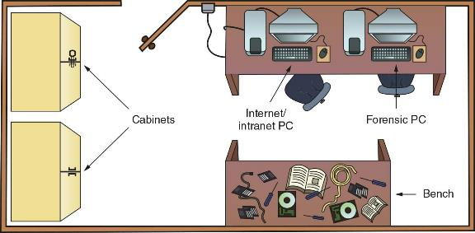
Floor Plans for Digital Forensics Labs (2 of 4)
Figure 3-2 Small or home-based lab

Slide 203
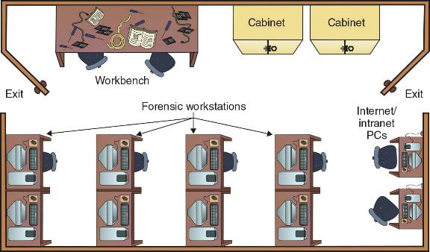
Floor Plans for Digital Forensics Labs (3 of 4)
Figure 3-3 Mid-size digital forensics lab

Slide 204
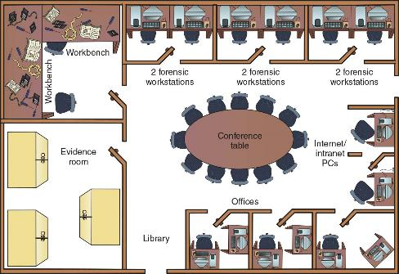
Floor Plans for Digital Forensics Labs (4 of 4)
Figure 3-4 Regional digital forensics lab

Slide 205
Selecting Workstations for a Lab
Police labs have the most diverse set of requirements for digital investigation tools
A lab might need legacy systems and software to match what’s used in the community
A small lab might have one multipurpose forensic workstation with one or two basic workstations or high-end laptops
You can now use a laptop PC with USB 3.0/4.0 SATA, or SSD hard disks to create a lightweight, mobile forensic workstation

Slide 206
Selecting Workstations for Private-Sector Labs
Commercial businesses providing forensics analysis can tailor their services to specific markets
Their equipment needs depend on their specialty, if any; for general forensics facilities, a multipurpose workstation is sufficient
For companies doing internal investigations, their forensic workstations will be based on the types of computers they use internally
With some digital forensics programs you can work from a Windows PC and examine both Windows and Mac disk drives

Slide 207
Stocking Hardware Peripherals (1 of 2)
Consider stocking your lab with the following:
Digital camera
Assorted antistatic bags
External CD/DVD drive
IDE cables
Ribbon cables for floppy disks
Extra USB 3.0 or newer cables and SATA cards
SCSI cards
Graphics cards, both PCI and AGP types

Slide 208
Stocking Hardware Peripherals (2 of 2)
Consider stocking your lab with the following (continued):
Assorted FireWire and USB adapters
Hard disk drives and USB drives
At least two 2.5-inch Notebook IDE hard drives to standard IDE/ATA or SATA adapter
Computer hand tools

Slide 209
Maintaining Operating Systems and Software Inventories
Maintain licensed copies of software such as the following:
Microsoft Office (current and older version)
Hexadecimal editor
Programming languages (Visual Studio, Perl, or Python)
Specialized viewers (ACDSee, Thumbsplus, or IrfanView)
WPS Office, and a third-party or open-source office suite
Quicken and QuickBooks accounting applications

Slide 210
Using a Disaster Recovery Plan
A disaster recovery plan ensures that you can restore your workstation and investigation files to their original condition
Includes backup tools such as Paragon Backup & Recovery
Keep track of software and hardware upgrades (Belarc Advisor is a tool that inventories a workstation's apps, hardware, and system configurations)
For labs using high-end RAID servers or a private cloud:
You must consider methods for restoring large data sets
Large servers must have adequate data backup systems in case of a major failure of more than one drive

Slide 211
Planning for Equipment Upgrades
Risk management involves assessing risks and determining how much risk is acceptable for any process or operation
Identify equipment your lab depends on so it can be periodically replaced
Identify equipment you can replace when it fails
Computing components last 18 to 36 months under normal conditions
Schedule upgrades at least every 18 months
Preferably every 12 months

Slide 212
Preparing a Business Case for a Digital Forensics Lab (1 of 5)
A business case provides justification for establishing or upgrading a lab and its equipment
Investigators must plan ahead to ensure that money is available for facilities, tools, supplies, and training for your forensics lab
Justification
You need to justify to the person controlling the budget or the fund provider the reason why the lab is needed.
Requires constant efforts to market the lab’s services to previous, current, and future customers and clients

Slide 213
Preparing a Business Case for a Digital Forensics Lab (2 of 5)
Budget Development – The proposed budget needs to include:
Facility costs
Hardware requirements
Software requirements
Other budget requirements

Slide 214
Preparing a Business Case for a Digital Forensics Lab (3 of 5)
Approval and acquisition
You must present a business case with a budget to upper management for approval
Implementation
As part of your business case, describe how implementation of all approved items will be processed
A timeline showing expected delivery or installation dates and expected completion dates must be included
Make sure you schedule inspection dates

Slide 215
Preparing a Business Case for a Digital Forensics Lab (4 of 5)
Acceptance Testing - consider the following tasks:
Inspect the facility to make sure it meets security criteria for containing and controlling digital evidence
Test all communications
Test all hardware to verify it is operational
Install and start all software tools

Slide 216
Preparing a Business Case for a Digital Forensics Lab (5 of 5)
Correction for Acceptance
Your business case must anticipate problems that can cause delays in lab production
Production
After all essential corrections have been made the lab can go into production
Implement lab operations procedures

Slide 217
Knowledge Check Activity 3-1
A digital forensics lab manager is responsible for which of the following? (Choose all that apply.)
Quality assurance processes
Case activities and scheduling
Process and procedures related to securing evidence
Review of casework by digital forensics examiners

Slide 218
Knowledge Check Activity 3-1: Answer
A digital forensics lab manager is responsible for which of the following? (Choose all that apply.)
Answer: a. Quality assurance processes; b. Case activities and scheduling; c. Process and procedures related to securing evidence; d. Review of casework by digital forensics examiners
To maintain a lab’s ANAB accreditation, lab managers are required to ensure that policies, procedures, and quality processes, case activities and schedules, secure evidence storage, and review of casework by digital forensics examiners are consistent for all investigations.

Slide 219
Evaluating Digital Forensic Tools
Consider open-source tools; the best value for as many features as possible
Some questions to ask when evaluating tools include the following:
On which OS does the forensics tool run?
Is the tool versatile?
Can the tool analyze more than one file system?
Can a scripting language be used with the tool to automate repetitive functions and tasks?
Does it have automated features?
What is the vendor’s reputation for providing product support?

Slide 220
Types of Digital Forensics Tools
Hardware forensic tools range from simple, single-purpose components to complete computer systems and servers
Software forensic tools can be grouped into the following:
Command-line applications
GUI applications
Software tools are commonly used to copy data from a suspect’s disk drive to an image file

Slide 221
Tasks Performed by Digital Forensics Tools (1 of 6)
Acquisition involves making a copy of the original drive
Two types of data-copying methods are used in software acquisitions:
Physical copying of the entire drive
Logical copying of a disk partition
The formats for disk acquisitions vary from raw data to vendor-specific proprietary
You can view a raw image file’s contents with any hexadecimal editor

Slide 222
Tasks Performed by Digital Forensics Tools (2 of 6)
Validation is the process of confirming that a tool is functioning as intended
Verification proves that two sets of data are identical by calculating hash values or using another similar method
A related process is filtering, which involves sorting and searching through investigation findings to separate good data and suspicious data
Many forensics programs include a list of common header values
With this information, you can see whether a file extension is incorrect for the file type

Slide 223
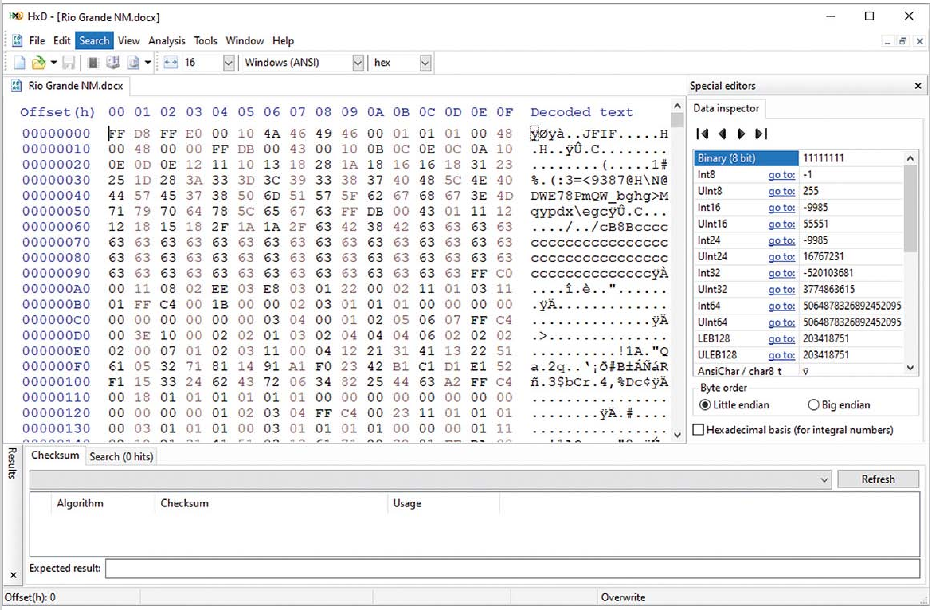
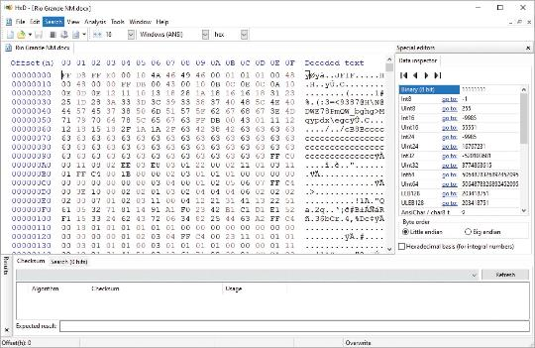
Tasks Performed by Digital Forensics Tools (3 of 6)
Figure 3-7 The file header indicates a .jpeg file

Slide 224
Tasks Performed by Digital Forensics Tools (4 of 6)
Extraction is the recovery task in a digital investigation and is the most challenging of all tasks to master
Recovering data is the first step in analyzing an investigation’s data
Include: viewing, searching, decompressing, carving, decrypting, tagging, etc.
From an investigation perspective, encrypted files and systems are a problem
Many password recovery tools have a feature for generating potential password lists for a password dictionary attack
If a password dictionary attack fails, you can run a brute-force attack

Slide 225
Tasks Performed by Digital Forensics Tools (5 of 6)
Reconstruction is to re-create a suspect drive to show what happened during a crime or an incident
Methods of reconstruction include the following:
Disk-to-disk copy
Partition-to-partition copy
Image-to-disk copy
Image-to-partition copy
Disk-to-image copy
Rebuilding files from data runs and carving

Slide 226
Tasks Performed by Digital Forensics Tools (6 of 6)
Reporting
To perform a forensics disk analysis and examination, you need to create a report
Subfunctions of reporting
Bookmarking or tagging
Log reports
Timelines
Report generator
Use this information when producing a final report for your investigation

Slide 227
Command-Line Forensics Tools
The first tools that analyzed and extracted data from floppy disks and hard disks were MS-DOS tools for IBM PC file systems
Norton DiskEdit was one of the first MS-DOS tools used for computer investigations
Command-line tools require few system resources and are designed to run in minimal configurations

Slide 228
Linux Forensics Tools
UNIX has been mostly replaced by Linux, however, you might still encounter systems running UNIX
Kali Linux, formerly known as BackTrack, includes a variety of tools and has an easy-to-use KDE (K Desktop Environment) interface
Autopsy and Sleuth Kit
Sleuth Kit is a Linux forensics tool
Autopsy was the browser interface used to access Sleuth Kit’s tools

Slide 229
Other GUI Forensics Tools
GUI forensics tools can simplify digital forensics investigations and have also simplified training for beginning examiners
Most of them are put together as groups of tools
Advantages include the following:
Ease of use, multitasking, and no need to learn older OSs
Disadvantages include the following:
Excessive resource requirements, inconsistent results, and they create tool dependencies

Slide 230
Forensic Workstations (1 of 2)
Forensic workstations are divided into the following categories:
Stationary workstation
Portable workstation
Lightweight workstation
Balance what you need and what your system can handle
Remember that RAM and storage need updates as technology advances

Slide 231
Forensic Workstations (2 of 2)
Advantages of building your own workstation include the following:
You can customize to your needs and save money
Disadvantages include:
It can be hard to find support for problems and it can become expensive if careless
Also need to identify what you intend to analyze

Slide 232
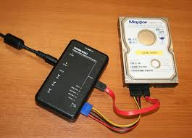
Using a Write-Blocker
Write-blockers prevents data from being written to a hard disk
Software-enabled blockers have been developed to change the Windows Registry so that selected disk drives connected to a workstation are set to read-only
Hardware write-blockers act as a bridge between the suspect drive and the forensic workstation
They are ideal for GUI forensic tools
Write-blocking devices that connect to a computer through FireWire, USB 2.0 and 3.0, SATA, PATA, and SCSI controllers.

Slide 233
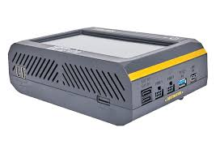
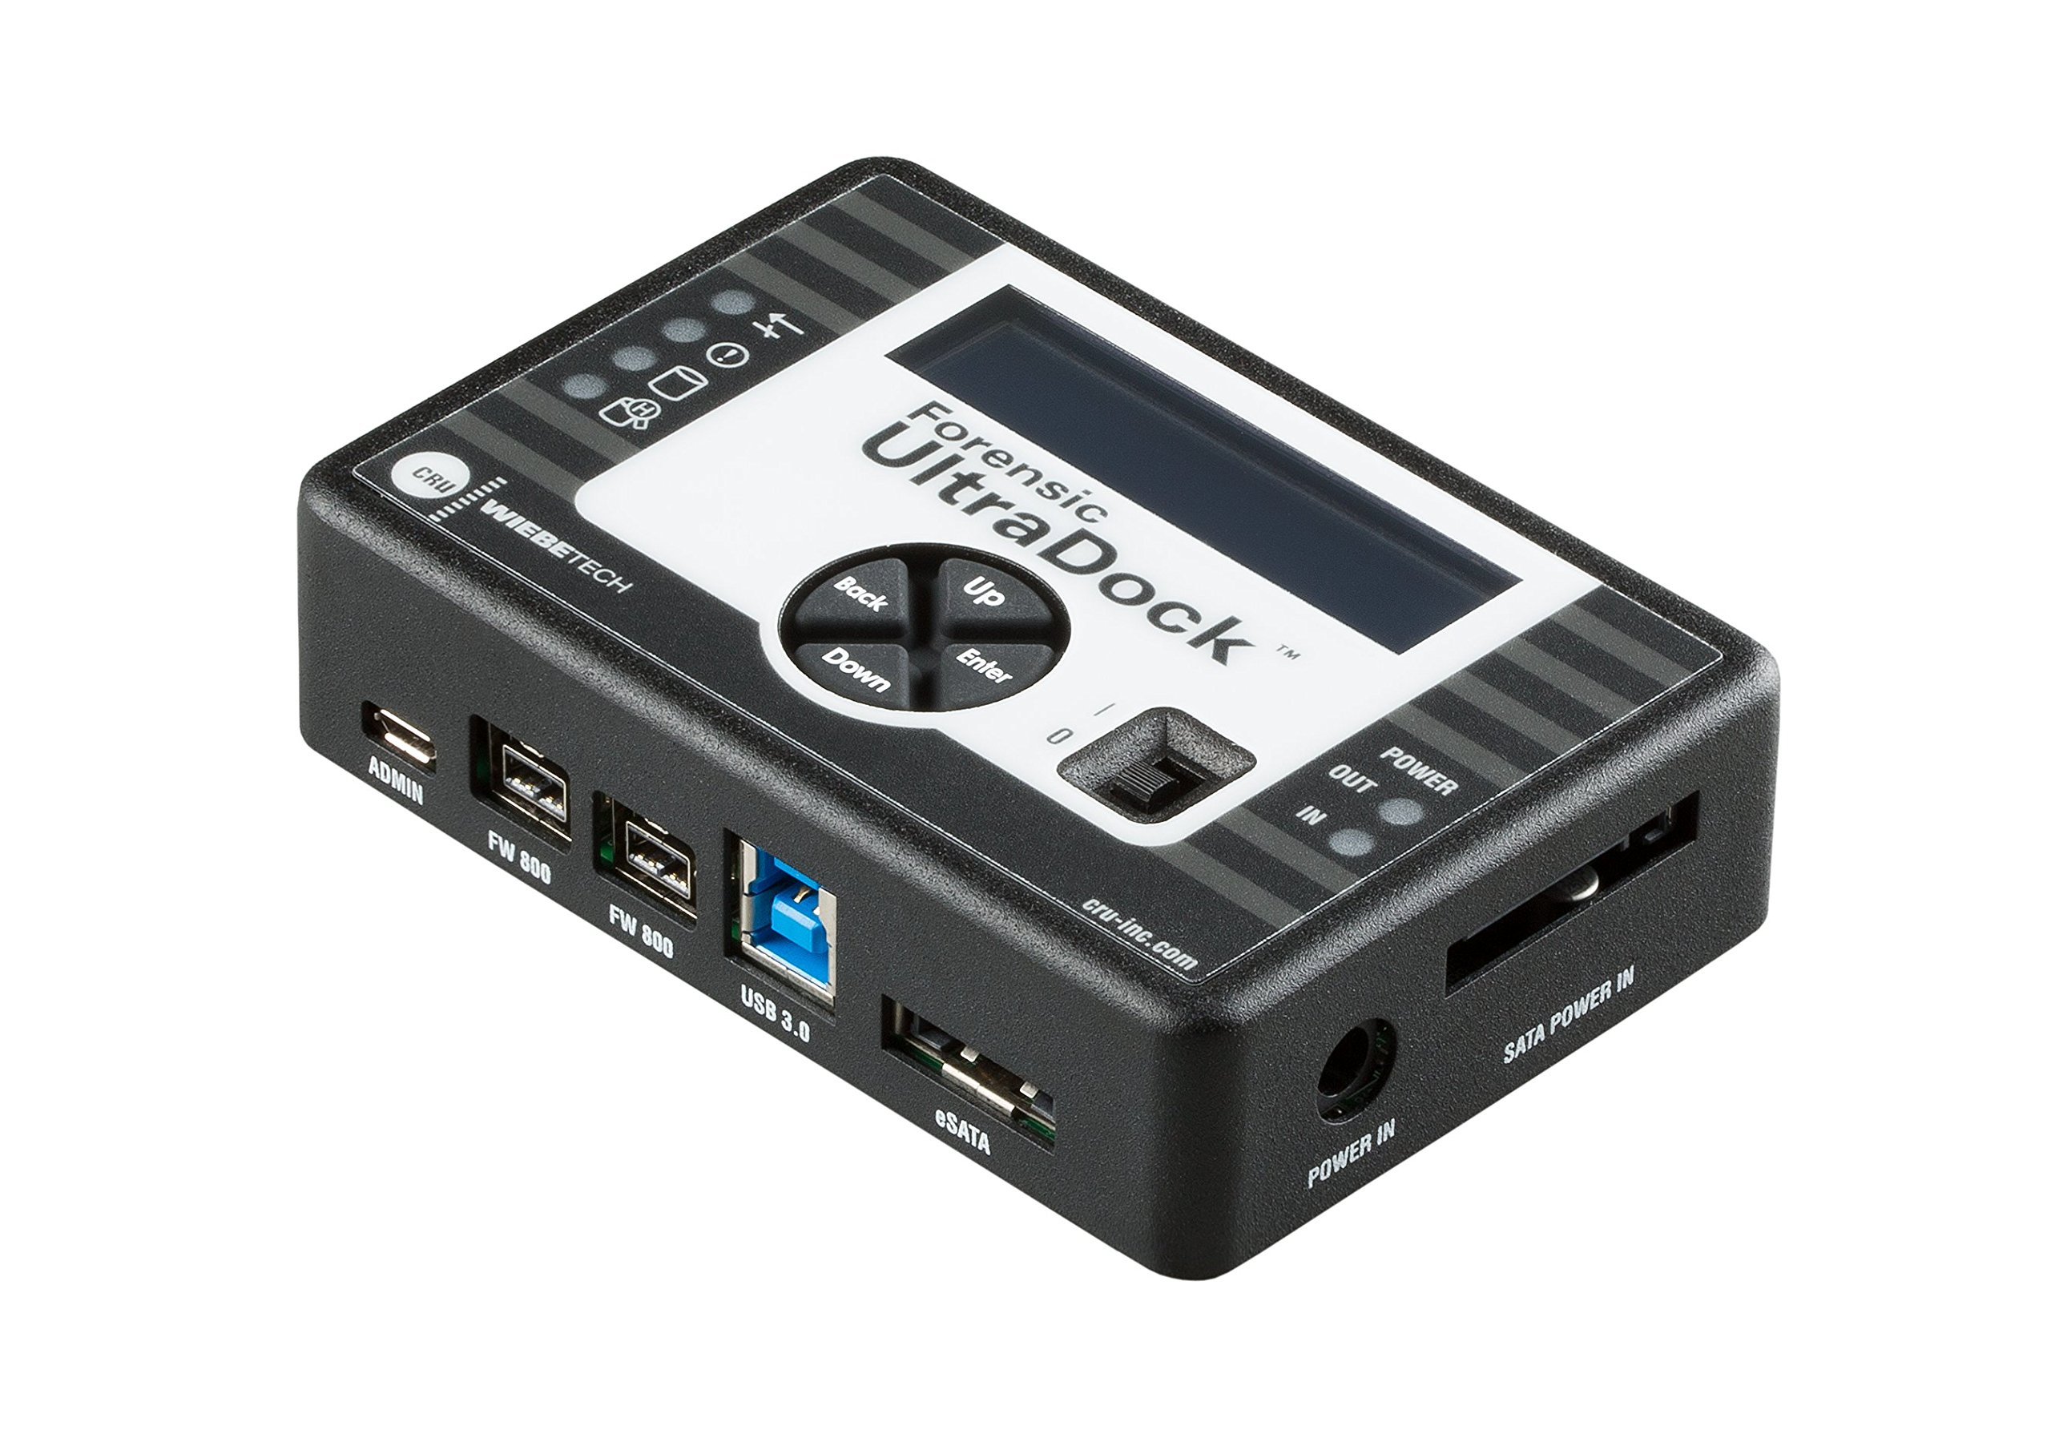
Recommendations for a Forensic Workstation
Determine where data acquisitions will take place
With Firewire and USB write-blocking devices you can acquire data easily with Tableau write-blocker and a laptop
If you want to reduce hardware to carry, consider WiebeTech Forensic UltraDock or the Logicube Talon
If you have a limited budget, one option for outfitting your lab is to use high-end game PCs

Slide 234
Using National Institute of Standards and Technology Tools (1 of 2)
NIST publishes articles, provides tools, and creates procedures for testing/validating forensics software
The Computer Forensics Tool Testing (CFTT) project manages research on forensics tools
NIST has created criteria for testing forensics tools based on:
Standard testing methods
ISO 17025 criteria for testing items that have no current standards

Slide 235
Using National Institute of Standards and Technology Tools (2 of 2)
Your lab must meet the following criteria
Establish categories for digital forensics tools
Identify forensics category requirements
Develop test assertions
Identify test cases
Establish a test method
Report test results
ISO 5725 specifies results must be repeatable and reproducible

Slide 236
Using Validation Protocols (1 of 2)
Always verify your results by performing the same tasks with other similar forensics tools
Use at least two tools to verify your work
One way to compare results and verify a new tool is by using a disk editor, such as HxD, Hex Workshop, or WinHex
Digital Forensics Examination Protocol
Conduct the investigation with a GUI tool
Perform the same investigation with a disk editor for verification
Compare hash values obtained with both tools

Slide 237
Using Validation Protocols (2 of 2)
Digital Forensics Tool Upgrade Protocol
You should test all new releases and OS patches and upgrades
If you find a problem, report it to forensics tool vendor
Do not use the forensics tool until the problem has been fixed
Use a test hard disk for validation purposes
Check the Web for new editions, updates, patches, and validation tests for your tools

Slide 238
Knowledge Check Activity 3-2
What are the features and limitations of command-line digital forensics tools? (Choose all that apply.)
a. They can only be run from a Windows GUI booted computer.
b. They work with any desktop, laptop, or mobile computing device.
c. They only work with Linux computers.
d. They are compact and require very few resources on a suspect’s computer.

Slide 239
Knowledge Check Activity 3-2: Answer
What are the features and limitations of command-line digital forensics tools? (Choose all that apply.)
Answer: d. They are compact and require very few resources on a suspect’s computer.
Command-line tools require few system resources because they are designed to run in minimal configurations. Most tools fit on bootable media (USB drives, CDs, and DVDs). These tools work well for conducting an initial inquiry for a suspect’s computer. The digital forensics examiner can boot a suspect’s computer and access its data drives in read-only mode. The examiner can easily copy data from a suspect’s computer to an externally mounted USB drive for follow-up examination.

Slide 240
Self Assessment
Why is configuration management important?
Where can you go to learn more about validation methods for digital forensics tools?

Slide 241
Summary (1 of 2)
Now that the lesson has ended, you should be able to:
Describe certification requirements for digital forensics labs
List physical requirements for a digital forensics lab
Explain the criteria for selecting a basic forensic workstation
Describe components used to build a business case for developing a forensics lab

Slide 242
Summary (2 of 2)
Now that the lesson has ended, you should be able to (continued):
Explain how to evaluate needs for digital forensics tools
Describe available digital forensics software tools
List some considerations for digital forensics hardware tools
Describe methods for validating and testing forensics tools

