Slide 1
Synopsis Presentation
ON
FEE MANAGEMENT SYSTEM

Slide 2
BY>
HAIDERGAUR
APOORVGUPTA

Slide 3
CONTENTS
• INTRODUCTION
• OBJECTIVES
• HARDWARE AND SOFTWARE REQUIREMENT
• MODULE DESCRIPTION
• SYSTEM DESIGN
DFD (Data Flow Diagram)
ERD (Entity Relationship Diagram)
• CONCLUSION
• REFERENCES

Slide 4
INTRODUCTION
• This project is a Desktop System that enables efficient storage of student records to properly manage the fee records of the students.
• The system is designed for fee management of a college administration department. It makes searching records easier and faster.

Slide 5
OBJECTIVES
• To reduce paperwork.
• To make storage of record more secure & efficient.
• To have a user friendly interface.
• To operate it easily and with minimum Experience
• To save time and energy of Admin.
#

Slide 6

HARDWARE AND SOFTWARE REQUIREMENT
Hardware Requirements
• Hard Disk- 200 GB
• RAM - 2 GB
Software Requirements
• Operating System: Windows/Linux
• IDE: NetBeans/Eclipse
• Language Java (Jdk1.5/1.6)
• Server: Glasssfish 5.
• Web Technology: Html 5, CSS.
• Database (Back End): MySQL8.

Slide 7
MODULE DESCRIPTION
• LOGIN (ADMIN , ACCOUNTANT,STUDENT)
• STUDENT DETAILS
• FEE DETAILS
• ADD/DELETE ACCOUNTANT(BY ADMIN)
• ADD/DELETE STUDENTS (BY ACCOUNTANT)
• DUES(BY STUDENT)
• PAY FEE
• SHOW DEFAULTERS

Slide 8
DIFFERENCE BETWEEN DFD & ERD
• Main objective of DFD is to represent the processes and data flow between them.
• Main objective of ERD is to represent the data object or entity and relationship between them.
• DFD explains the flow and process of data input, data output, and storing data
• ERD explains and represent the relationship between entities stored in a database.
• DFD models the flow of data through a system.
• ERD model entities like people, objects, places and events for which data is stored in a system.

Slide 9
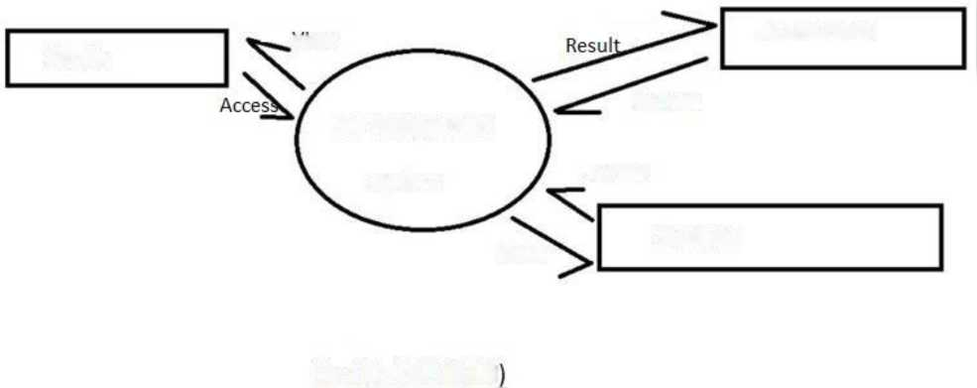
view
Accountant
Admin
Manage
Fee mangement
system
Access
Student
View
Fig 1.0 : DFD (Ivl 0
Fig1 : DFD Level 0

Slide 10
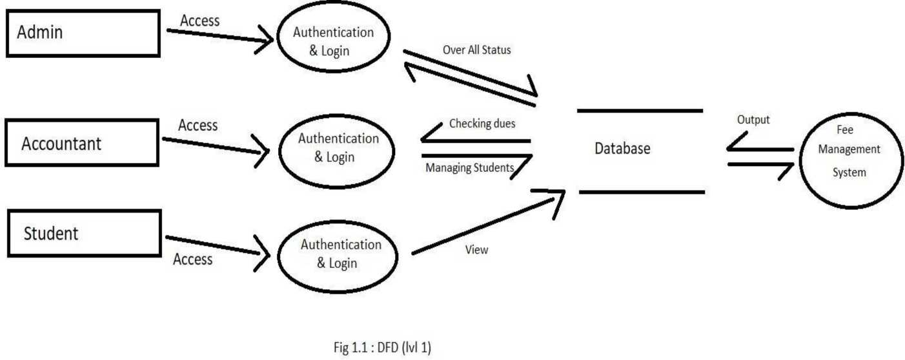
Fig2 : DFD Level 1

Slide 11
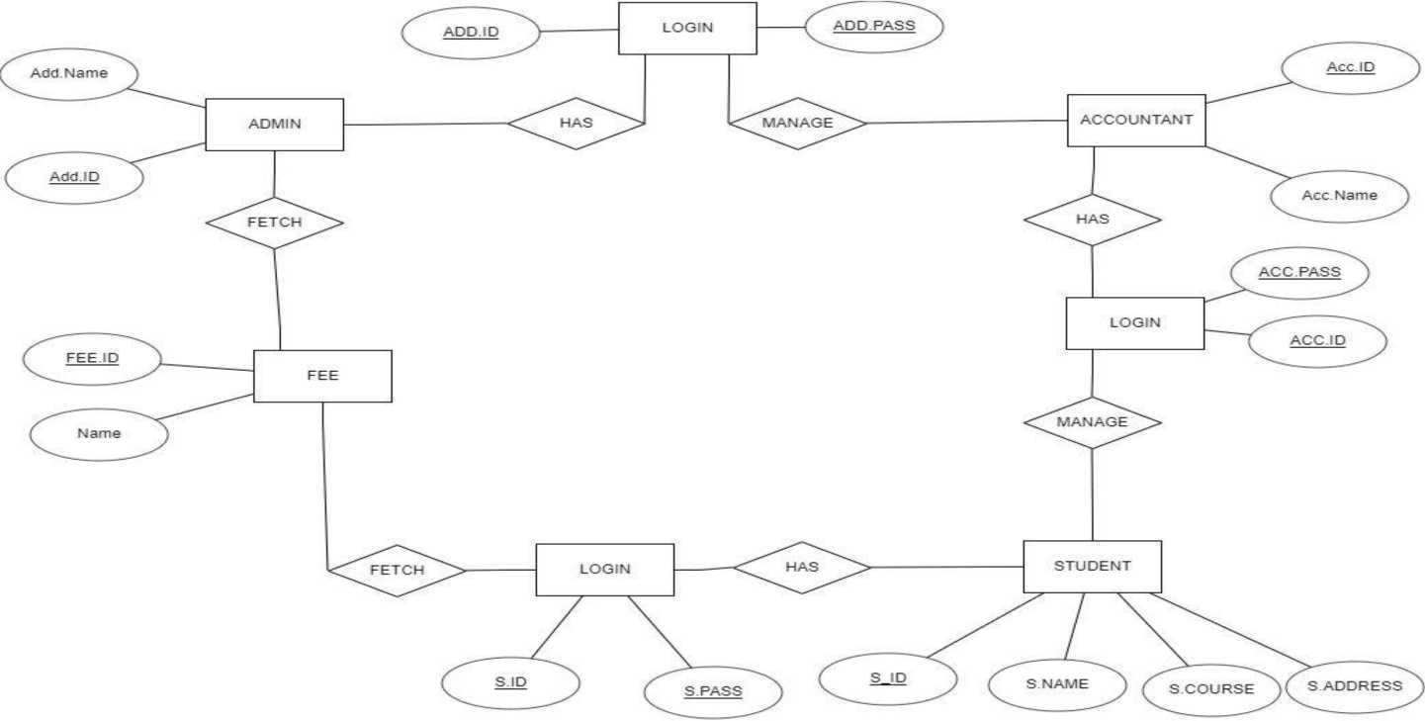
Fig 1.3 : ERD

Slide 12
CONCLUSION
• We have successfully learnt about basic concepts of Java Servlets and HTML.
• This projects is the small step towards real world application development.
• The learning outcomes of this projects would be beneficial in future development

Slide 13
REFERENCES
• https://1000projects.org/projects/project-ideas (24/09/2020)
• https://projectsgeek.com/javaprojects (24/09/2020)
• https://www.javatpoint.com/fee-management-project-in-servlet (25/09/2020)
• https://www.javatpoint.com/html-with-css (26/09/2020)
• https://www.visual-paradigm.com/tutorials/how-to-create-data-flow-diagram (27/09/2020)

Slide 14
THANK YOU !

