Slide 1
STUDENT SURPLUS

Slide 2
CONTENT
Team
Project Description
Each team member’s responsibilities
Core requirements of the project
Implementation Detail
Testing
Feedback from peer review and Code Inspection
Limitations
Project demo

Slide 3
ABOUT TEAM
Team Name: DASH
Team Members:
Sri Sravya Tirupachur Comerica
Amisha Gadhia
Aboubakar Mountapmbeme
Haidi Chen

Slide 4
Project Description
The goal of the project is to develop a student surplus website which helps students to buy or sell items that they no longer need such as tables, beds, books and furniture just by posting a picture of the item on-site. It’s like a market place where students have the option to select the product, add them to the cart and checkout. Overall, the website provides students the ease of exchanging the unused items efficiently with added security.

Slide 5
Web Technologies: HTML 5, CSS3, JavaScript, JQuery and Bootstrap.
IDE: Eclipse
Operating System: Windows
Database: MySQL
Programming Language: Java
Server: Tomcat 9

Slide 6
Member name | Contribution description | Overall Contribution
Sri Sravya Tirupachur Comerica | Coding: Registration Module, Profile Update Module, Front End Pages for posting a product, home page posted products, Search bar, Email Module, Front End Pages for updating product and sending an email. Report: User manual and requirements review for all the reports. | 25%
Amisha Gadhia | Coding: Home Front End view, Login View, Front page for user to view his/her products, Front page for cart functionality and View details functionality. Report: Compile and run instructions and updated plan for next phase for all the reports | 25%
Aboubakar Mountapmbeme | Coding: Registration Front- End View, Profile View, Profile Update view, Product posting module, search module, update product module and cart module. Report: UML diagrams for all the reports. | 25%
Haidi Chen | Coding: Login Module, Session Maintenance Module, product order module and unit tests for all phases. Report: Test cases and unit test for all the reports. | 25%

Slide 7
Core Requirements
Registration: The registration feature enables the user to successfully register into the website using his email.
Profile Update and Maintenance: The profile maintenance and update enables user to update their details that they entered during the registration.
Login: Login feature enables user to successfully login into the site after successful registration
Search: Search enables the user to search for a product he/she is looking for by keyword.

Slide 8
Post a product: This feature enable user to post a product that he/she is wishing to sell on the website.
View Details: This feature enables the user to view the full details of the product and add to cart or send an email to its seller.
Cart: The cart feature enables the user to add or remove products from his/her cart.
Modify/Edit products: This feature enable the seller of a product to modify his product, delete it or set it to sold on the website.
Message: The message feature enables a user to send an email to seller of the product from the website.

Slide 9
Implementation Details
Java, JavaScript and CSS programming languages
Java Spring Web MVC framework
Hibernate Framework
MySQL Database engine
Bootstrap Framework
Apache Tomcat Server
Eclipse IDE
Junit Test
Client-Server Architecture
Web Application

Slide 10
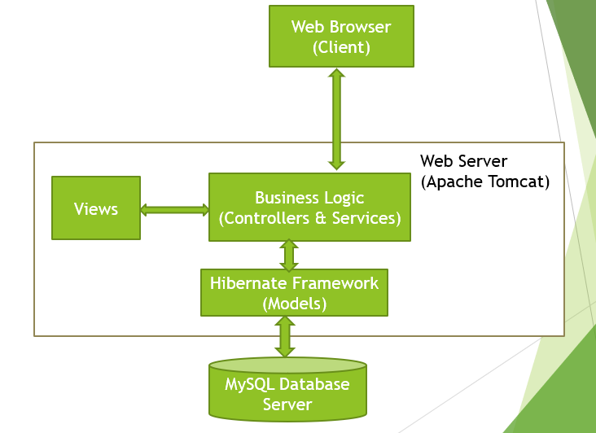

Slide 11
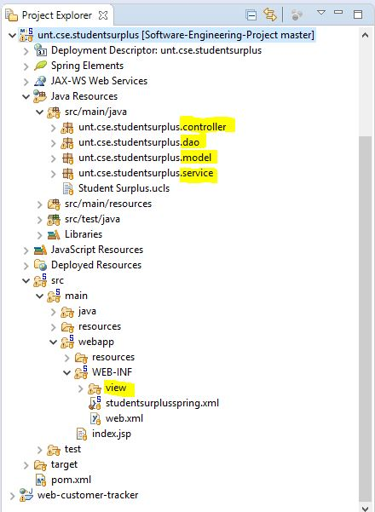
Project Structure

Slide 12
Testing
Goal:
-find bugs/defects of your system
Process:
-Long-time effort
-Repeat testing

Slide 13
Code inspection and feedback
Peer Review:
A message feature to communicate to each other,
An option where the seller can set his product status to sold
Feedback:
Add comments and author names.
Actions:
Added the comments and the author
names in the classes

Slide 14
Limitations
Payment
Delivery
Security

Slide 15
Project Demo

Slide 16
Thanks!
Any questions?

