Slide 1
Key point
1 Member_Total - Total number of member (-)
4 KP_Total - Total number of key point (-)
1 4

Slide 2
Key point
2 Member_Total - Total number of member (-)
6 KP_Total - Total number of key point (-)
4
3

Slide 3
Other
Modules
Root reaction loads
ElastoDyn
Root motion
FAST 8 Driver
Drives time-domain solution forward
Calls individual modules
Derives module inputs from outputs
AeroDyn
Aerodynamic loads
Blade motion
Root reaction force
BeamDyn
Blade motion
Root motion
Aerodynamic applied loads

Slide 4
Floating blade reference frame at instant t
Z_{rt}
Initial blade reference frame
Z
X_{r0}
X_{rt}
Z_{r0}
O_{r0}
Y_{rt}
r_{t}
r₀ (GlbPos)
Y_{r0}
O
Y
Global frame
X

Slide 5
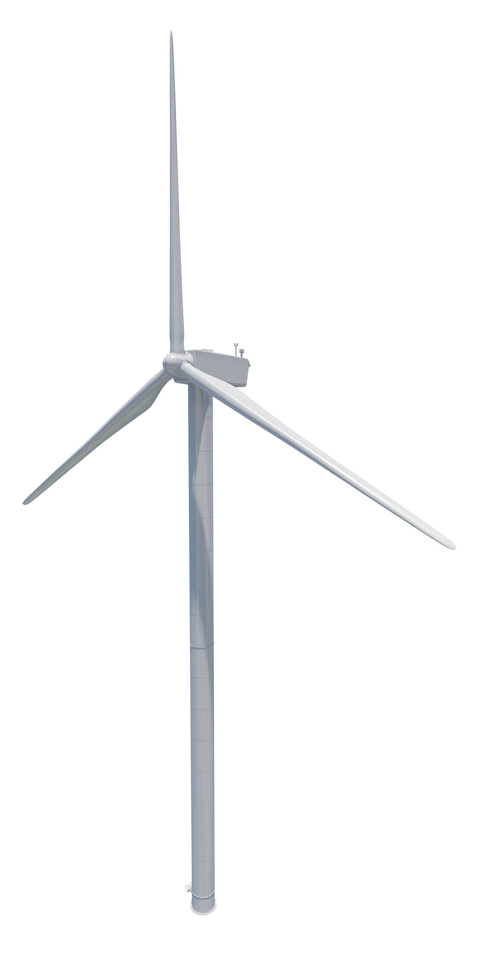
Z
Y
X

Slide 6
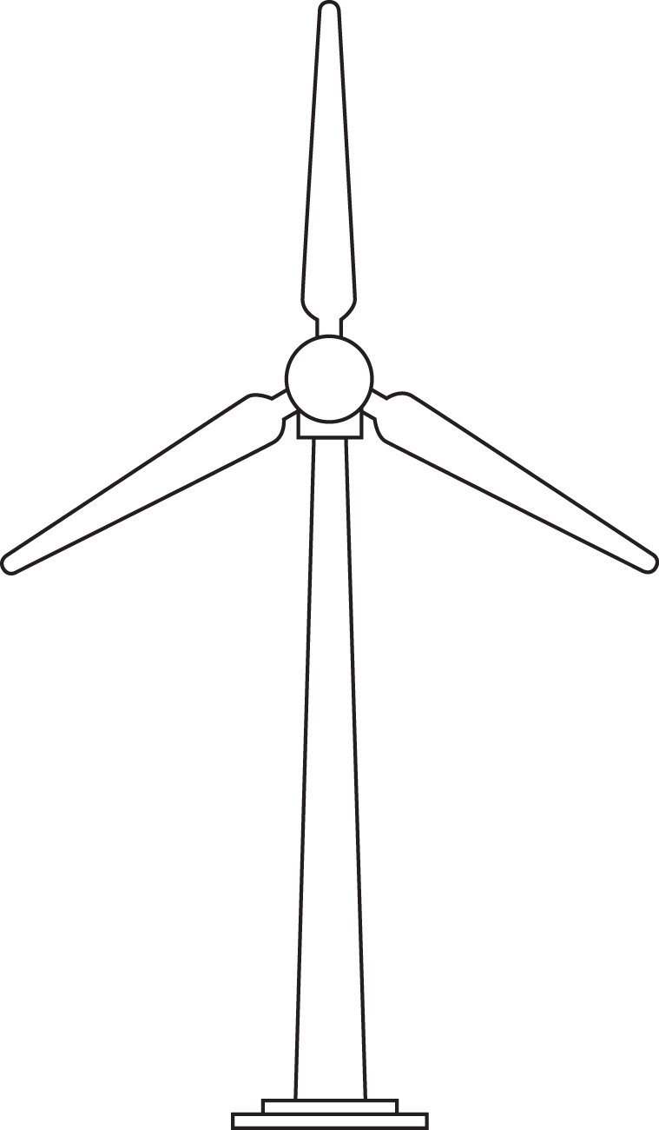
Y_{r} at t
Y_{r0} (x₃)
3
2
Z_{r0} (x₁)
Z_{r} at t
Z
1
Y

