Slide 1

Input & Output Files
Required
Required
Optional
WAMIT Output
Airfoil(s) (.dat)
Wind
(.wnd,.bts)
Tower (.dat)
Blade(s)
(.dat)
ADAMS-Spec.
(.dat)
Linear
(.dat)
Added-mass and Damping (.1)
Excitation Force (.3)
Primary (.ipt)
Primary (.fst)
Furling
(.dat)
Platform (.dat)
Hydrostatic Data (.hst)
Time Simulation
AeroDyn
FAST
Linearization
FAST-to-ADAMS Preprocessor
Time
Series
(.out, .outb)
ADAMS
Input Files
(.acf,.adm)
Periodic Matrices
(.lin)
Summary
(.opt)
Element
(.elm)
Summary(.fsm)

Slide 2

Additional HydroDyn input files
Furling
(.dat)
Airfoil(s) (.dat)
Wind
(.wnd,.bts)
FAST
Driver
Tower (.dat)
Blade(s)
(.dat)
AeroDyn
Aerodynamics
HydroDyn
Hydrodynamics
ServoDyn
Control & Electrical Drive
ElastoDyn
Structural Dynamics
BeamDyn
Nonlinear FE
Blade Dynamics
SubDyn Multi-Member
Substruct. Dyn.
MAP
Mooring Statics
& Dynamics
Primary (.ipt)
Primary (.dat)
Primary (.dat)
Primary (.dat)
Primary (.dat)
Primary (.dat)
Primary (.dat)
Summary (.opt)
Element (.elm)
Summary (_HydroDyn .sum)
Time Series (_ HydroDyn .out)
Summary (_ServoDyn .sum)
Time Series (_ServoDyn .out)
Summary (_ElastoDyn .sum)
Time Series (_ElastoDyn .out)
Primary (.fst)
In FAST v8.1
Summary (.fsm)
Time Series (.out, .outb)
Not yet implemented
Input file
Output file

Slide 3
Additional HydroDyn input files
Furling
(.dat)
Additional AeroDyn input files
Wind
(.wnd,.bts)
FAST
Driver
Tower (.dat)
Blade(s)
(.dat)
AeroDyn
Aerodynamics
HydroDyn
Hydrodynamics
ServoDyn
Control & Electrical Drive
ElastoDyn
Structural Dynamics
BeamDyn
Nonlinear FE
Blade Dynamics
SubDyn Multi-Member
Substruct. Dyn.
MAP
Mooring Statics
& Dynamics
Primary (.ipt)
Primary (.dat)
Primary (.dat)
Primary (.dat)
Primary (.dat)
Primary (.dat)
Primary (.dat)
Summary (.opt)
Element (.elm)
Summary (_HydroDyn .sum)
Time Series (_ HydroDyn .out)
Summary (_ServoDyn .sum)
Time Series (_ServoDyn .out)
Summary (_ElastoDyn .sum)
Time Series (_ElastoDyn .out)
Summary ( _SD .sum)
Time Series ( _SD .out)
Summary (summary .map)
Time Series (map.out)
Primary (.fst)
Summary (.sum)
Time Series (.out, .outb)
Not yet implemented
Input file
Output file

Slide 4
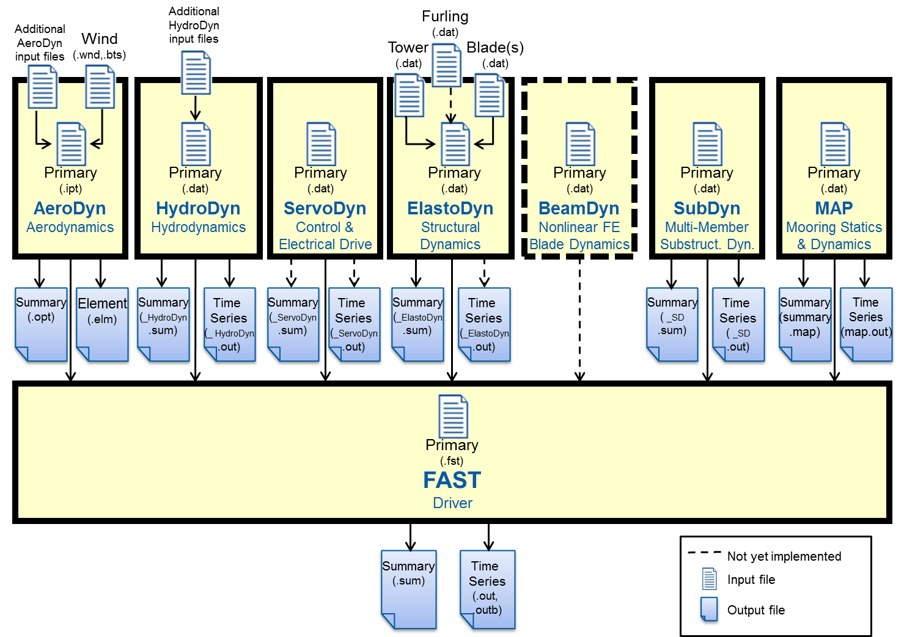

Slide 6
FAST
Driver
InflowWind
AeroDyn
Aerodynamics
HydroDyn
Hydrodynamics
ServoDyn
Control & Electrical Drive
ElastoDyn
Structural Dynamics
BeamDyn
Nonlinear FE
Blade Dynamics
SubDyn Multi-Member
Substruct. Dyn.
MAP
Mooring Statics
& Dynamics

Slide 7
InflowWind
FAST
Driver
DWM
InflowWind
AeroDyn
Aerodynamics
HydroDyn
Hydrodynamics
ServoDyn
Control & Electrical Drive
ElastoDyn
Structural Dynamics
BeamDyn
Nonlinear FE
Blade Dynamics
SubDyn Multi-Member
Substruct. Dyn.
MAP
Mooring Statics
& Dynamics

