Slide 1

Input & Output Files
Required
Required
Optional
WAMIT Output
Airfoil(s) (.dat)
Wind
(.wnd,.bts)
Tower (.dat)
Blade(s)
(.dat)
ADAMS-Spec.
(.dat)
Linear
(.dat)
Added-mass and Damping (.1)
Excitation Force (.3)
Primary (.ipt)
Primary (.fst)
Furling
(.dat)
Platform (.dat)
Hydrostatic Data (.hst)
Time Simulation
AeroDyn
FAST
Linearization
FAST-to-ADAMS Preprocessor
Time
Series
(.out, .outb)
ADAMS
Input Files
(.acf,.adm)
Periodic Matrices
(.lin)
Summary
(.opt)
Element
(.elm)
Summary(.fsm)

Slide 2

Additional HydroDyn input files
Furling
(.dat)
Airfoil(s) (.dat)
Wind
(.wnd,.bts)
FAST
Driver
Tower (.dat)
Blade(s)
(.dat)
AeroDyn
Aerodynamics
HydroDyn
Hydrodynamics
ServoDyn
Control & Electrical Drive
ElastoDyn
Structural Dynamics
BeamDyn
Nonlinear FE
Blade Dynamics
SubDyn Multi-Member
Substruct. Dyn.
MAP
Mooring Statics
& Dynamics
Primary (.ipt)
Primary (.dat)
Primary (.dat)
Primary (.dat)
Primary (.dat)
Primary (.dat)
Primary (.dat)
Summary (.opt)
Element (.elm)
Summary (_HydroDyn .sum)
Time Series (_ HydroDyn .out)
Summary (_ServoDyn .sum)
Time Series (_ServoDyn .out)
Summary (_ElastoDyn .sum)
Time Series (_ElastoDyn .out)
Primary (.fst)
In FAST v8.1
Summary (.fsm)
Time Series (.out, .outb)
Not yet implemented
Input file
Output file

Slide 3
Additional HydroDyn input files
Furling
(.dat)
Additional AeroDyn input files
Wind
(.wnd,.bts)
FAST
Driver
Tower (.dat)
Blade(s)
(.dat)
AeroDyn
Aerodynamics
HydroDyn
Hydrodynamics
ServoDyn
Control & Electrical Drive
ElastoDyn
Structural Dynamics
BeamDyn
Nonlinear FE
Blade Dynamics
SubDyn Multi-Member
Substruct. Dyn.
MAP
Mooring Statics
& Dynamics
Primary (.ipt)
Primary (.dat)
Primary (.dat)
Primary (.dat)
Primary (.dat)
Primary (.dat)
Primary (.dat)
Summary (.AD.sum)
Element
Time
Series (.AD.out)
Summary (.HD.sum)
Time Series (.HD.out)
Summary (.SrvD.sum)
Time Series
(.SrvD.out)
Summary (.ED.sum)
Time Series (.ED.out)
Summary (.SD.sum)
Time Series (.SD.out)
Summary (.MAP.sum)
Time Series (.MAP.out)
Primary (.fst)
Summary (.sum)
Time Series (.out, .outb)
Not yet implemented
Input file
Output file

Slide 4
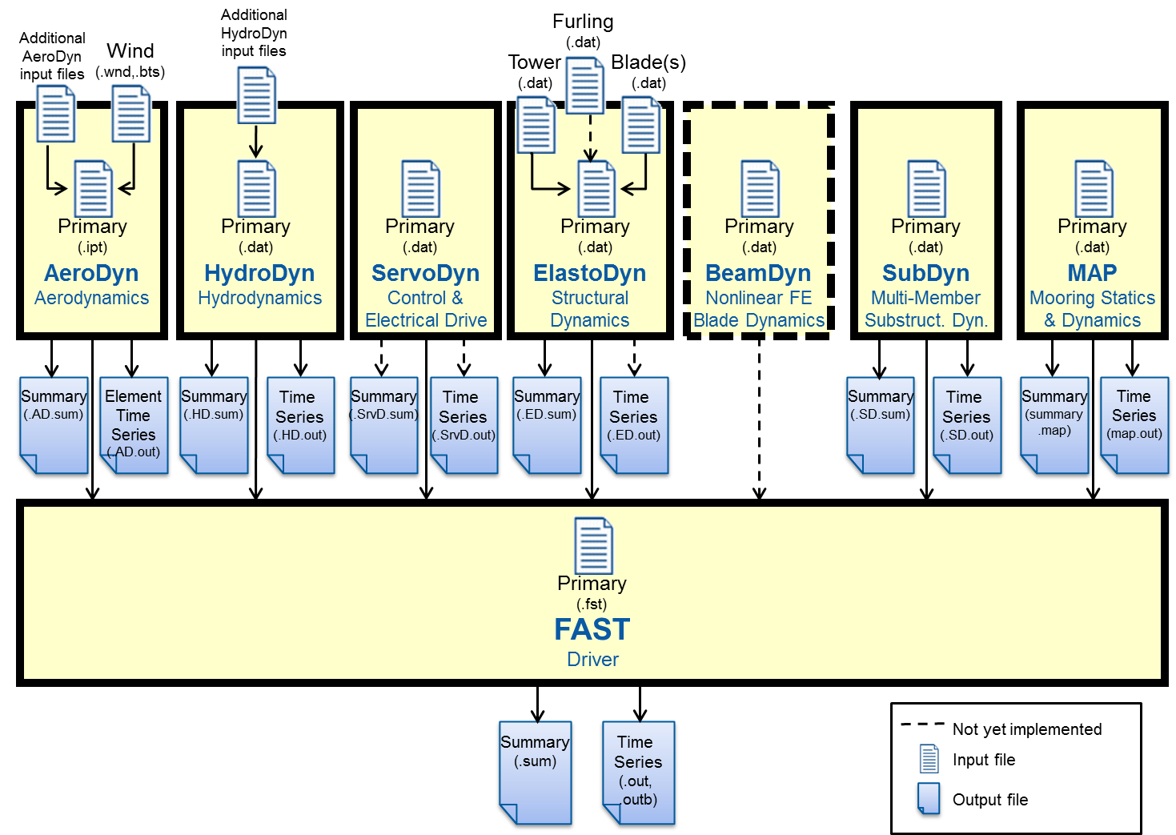

Slide 6
FAST
Driver
InflowWind
AeroDyn
Aerodynamics
HydroDyn
Hydrodynamics
ServoDyn
Control & Electrical Drive
ElastoDyn
Structural Dynamics
BeamDyn
Nonlinear FE
Blade Dynamics
SubDyn Multi-Member
Substruct. Dyn.
MAP
Mooring Statics
& Dynamics

Slide 7
InflowWind
FAST
Driver
DWM
InflowWind
AeroDyn
Aerodynamics
HydroDyn
Hydrodynamics
ServoDyn
Control & Electrical Drive
ElastoDyn
Structural Dynamics
BeamDyn
Nonlinear FE
Blade Dynamics
SubDyn Multi-Member
Substruct. Dyn.
MAP
Mooring Statics
& Dynamics

