Slide 1

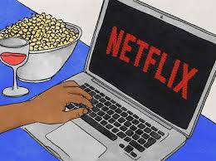
The Chill Crew:
April Lagnevall
Haifa Najdawi
Julia Headlee
Melanie Nolker
Machine Learning Application
Predictive analysis of genre & rating of tv show or movie based on input of a description
Trained with Netflix movie & tv show data

Slide 2

Data Analysis
Research & analytics of data used to train ML model

Slide 3
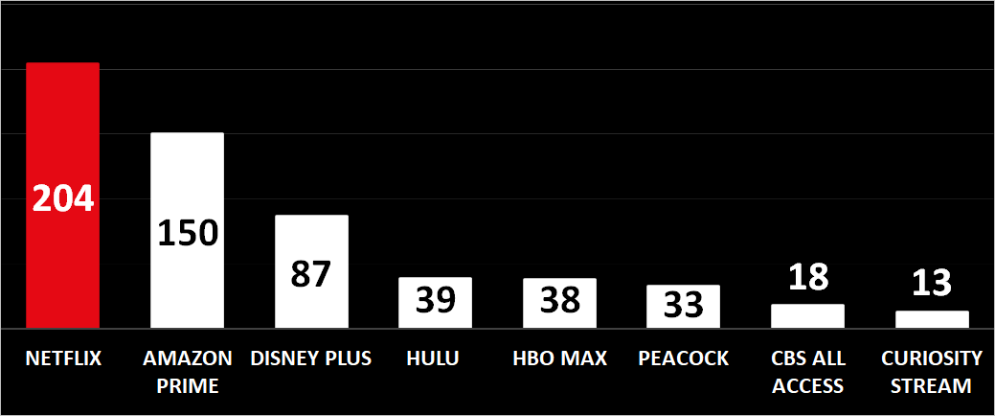
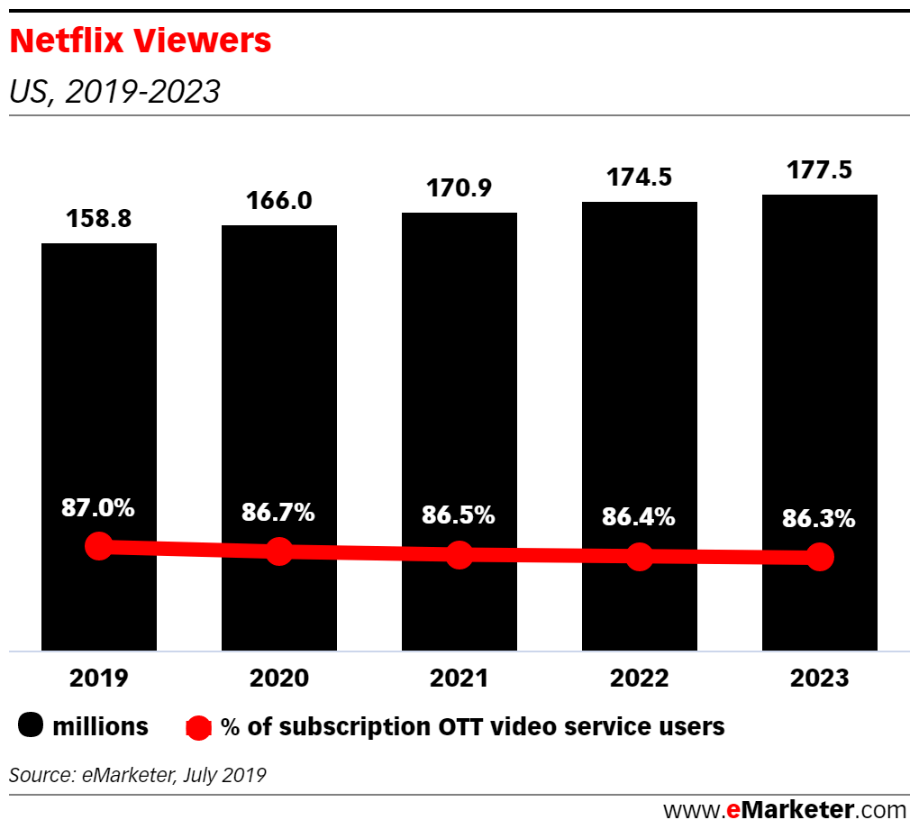
Why Netflix TV shows & Movies?
World’s biggest streaming services by subscribers, millions
US Netflix market share, 2019 – 2023
85% of Americans who spend money on digital video services are Netflix users. (Source: Statista)
50% Netflix subscribers are Hulu subscribers also
An over-the-top (OTT) media service is a media service offered directly to viewers via the Internet.
As of Dec-2020
Source: https://www.businessofapps.com/data/netflix-statistics/
In 2014 this figure stood at 90%, according to these Netflix stats

Slide 4
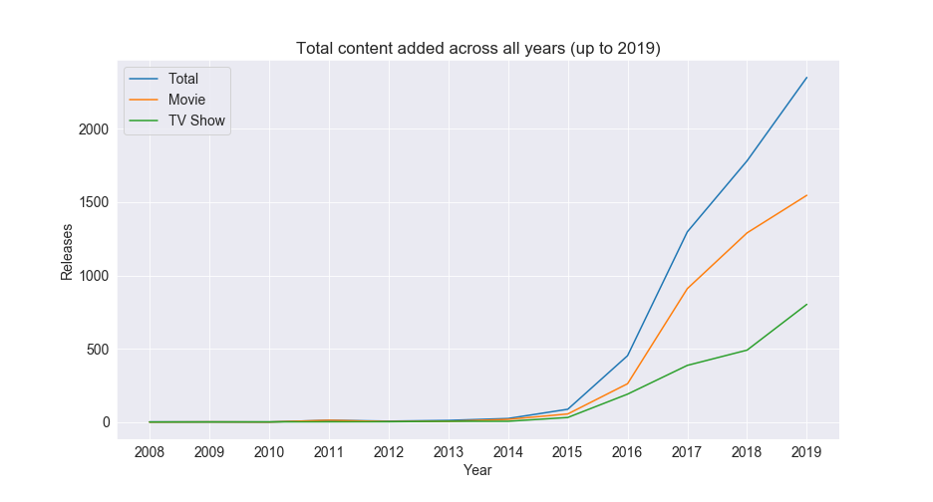
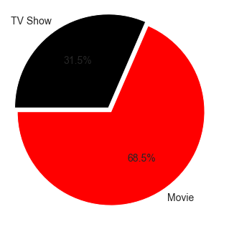
Netflix TV shows vs Movies
Netflix content added over the years:
split of all Titles between Movies & TV shows:
31.5%

Slide 5
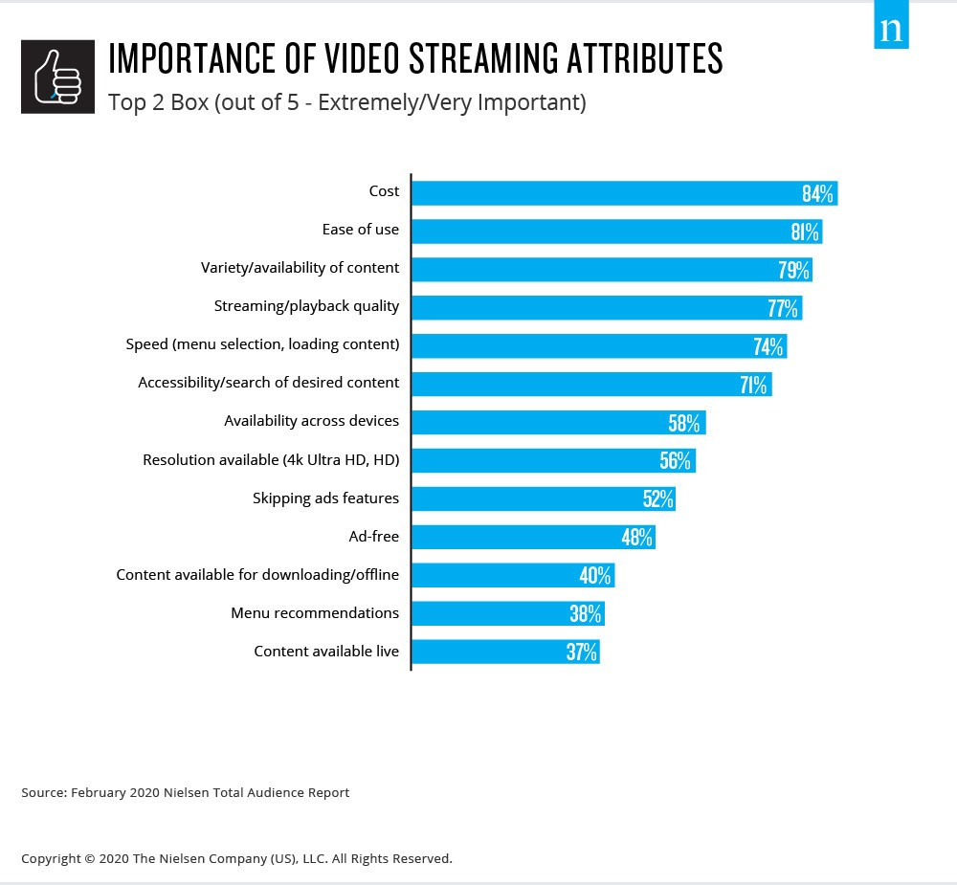
Why is a TV Show / Movie description important?
Ease of use is an important attribute of video streaming
Important to describe TV show or Movie to best associate with identifying genre & rating

Slide 6
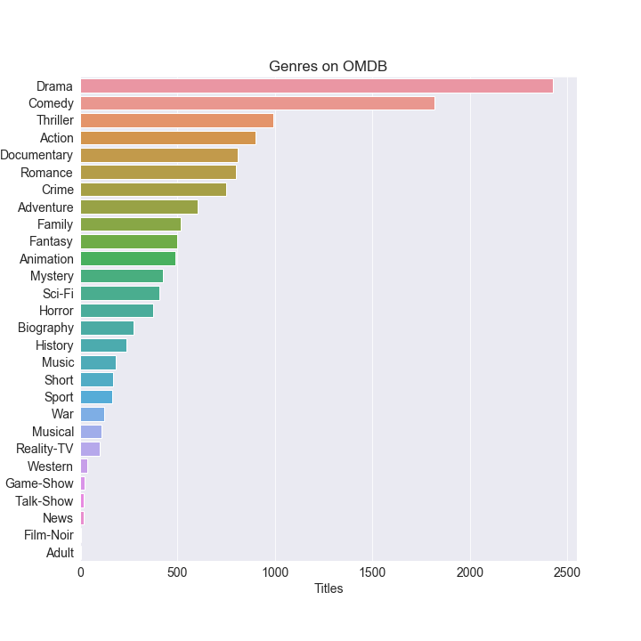
Netflix Title’s Rating & OMBD Genre
We found a total of 28 genres in this dataset to train against.
The most common genre is Drama, which causes our predictions to be a bit unbalanced

Slide 7
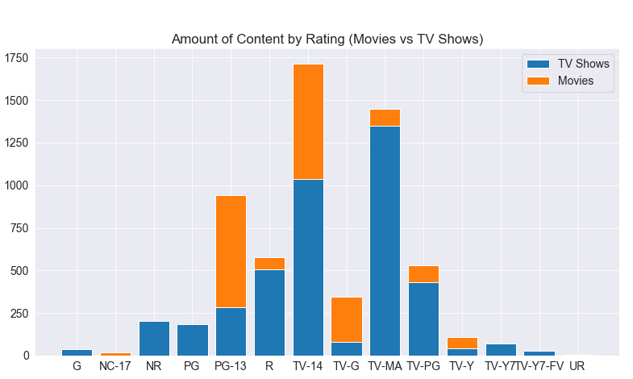
Netflix Title’s Rating & OMBD Genre
There are a massive amounts of options presented on Netflix….
Our prediction model can help navigate towards the right rating for your TV show or movie
To improve predictive results… model
Grouped to G: ‘TV-Y7’,’TV-G’,’TV-Y’,’TV-Y7-FV’
Grouped to R: 'TV-MA': 'R'

Slide 8
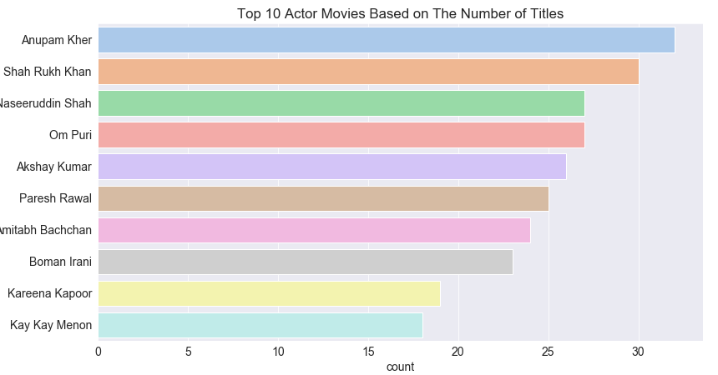
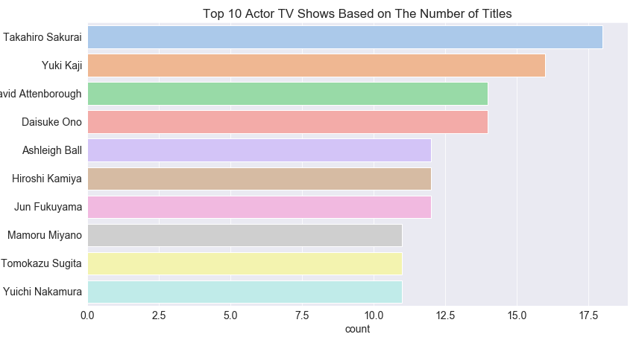
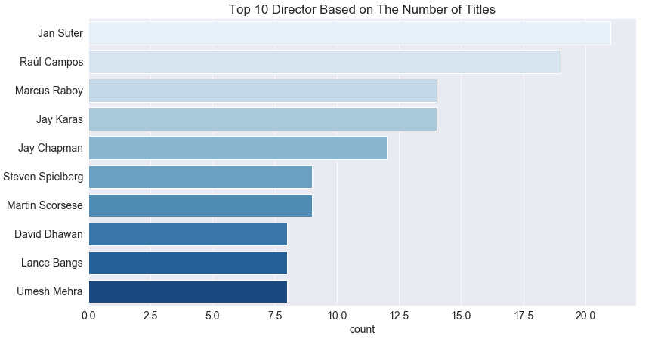
Other Top Details of Netflix Titles

Slide 9
Machine Learning
Detail behind the Machine Learning model

Slide 10
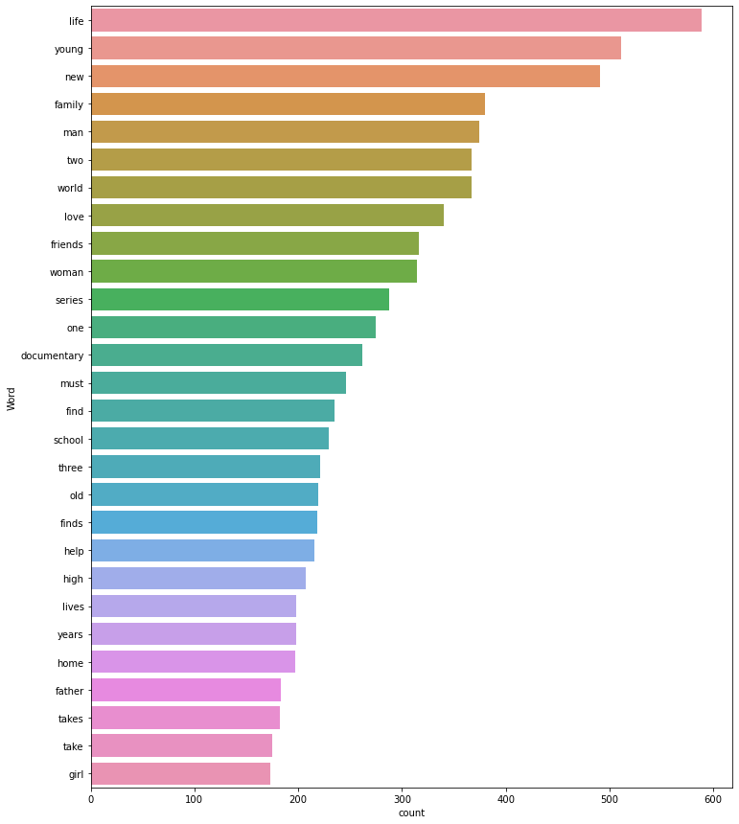
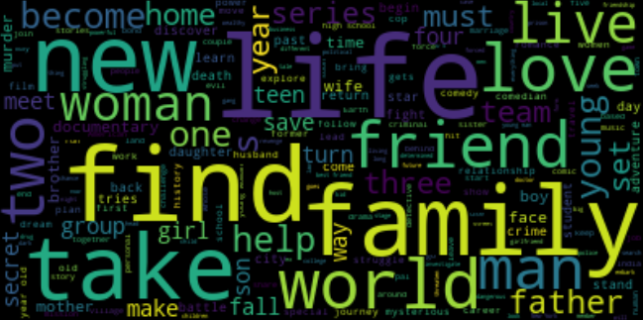
Description – Common Description Words
Finding the right words to train your model on is key

Slide 11
Machine Learning
Add other content here

Slide 12

Demo Time!!
https://the-big-chill.herokuapp.com/deep_dive

Slide 13

Future Project Enhancement Ideas
If given more time / scope to develop this app, what would the Chill team do?

Slide 14
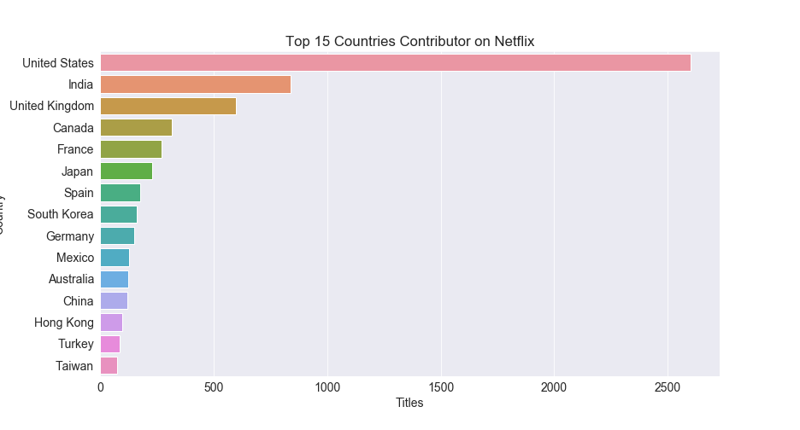
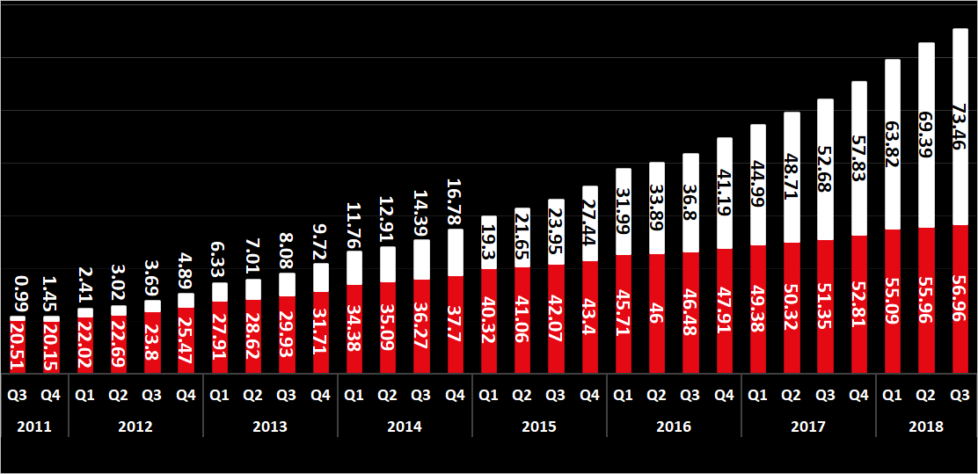
Netflix TV shows & Movies - US vs International
Current model Constraint: Descriptions & predictions are currently in English only
Future Modeling Consideration: How will language International growth in Netflix subscriptions has far outpaced domestic growth in recent years?
Netflix users by region, US vs international, 2011 – 2018, millions
Source Data: Project Database of Netflix movies & shows
Source: https://www.businessofapps.com/data/netflix-statistics/

Slide 15
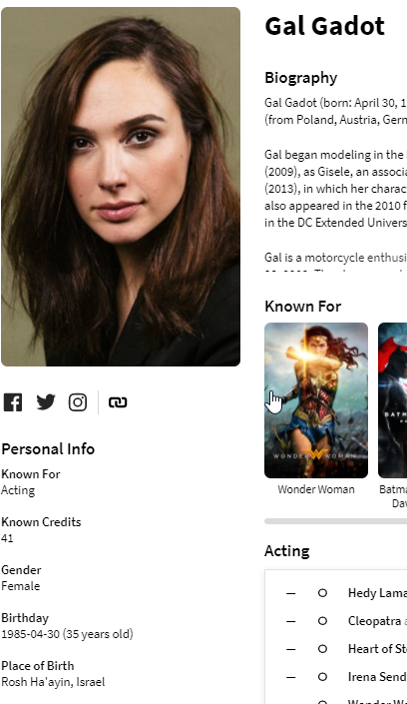
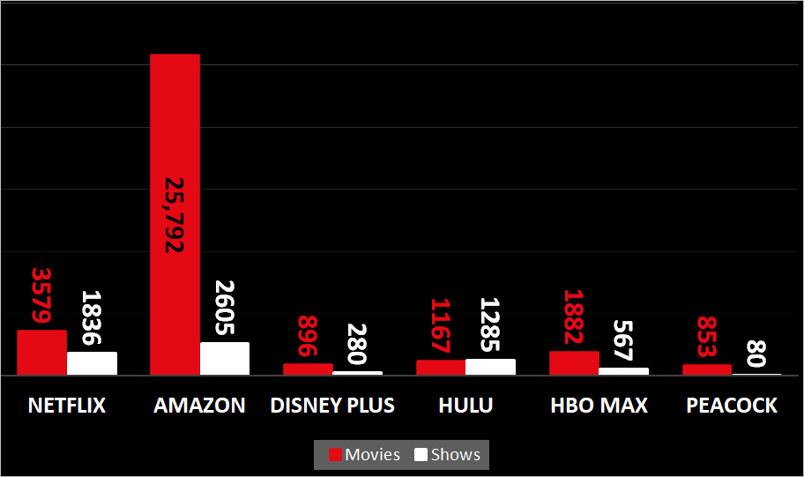
OMDB rating predictive model
Current model Constraint: Too few input variables to create model to predict
Future Model Enhancement: Pull more data to increase the amount of data to train the model
Idea #1:
Pull more movies/tv shows from other streaming services
Idea #2:
Using the TMDB API for People
Add to Cast table to categorize Cast by gender and/or age
Create a Director table to categorize the same
stats were pulled February 2021
Source: https://www.businessofapps.com/data/netflix-statistics/

