Slide 1

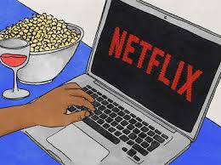
The Chill Crew:
April Lagnevall
Haifa Najdawi
Julia Headlee
Melanie Nolker
Machine Learning Application
Predictive analysis of genre & rating of tv show or movie based on input of a description
Trained with Netflix movie & tv show data
Notes:
Melanie

Slide 2

Data Analysis
Research & analytics of data used to train ML model
Notes:
Melanie

Slide 3
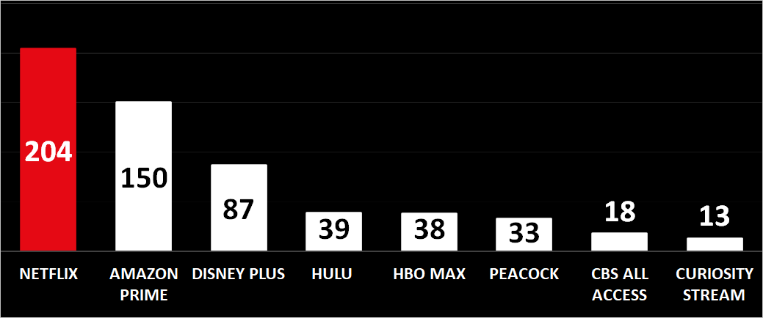
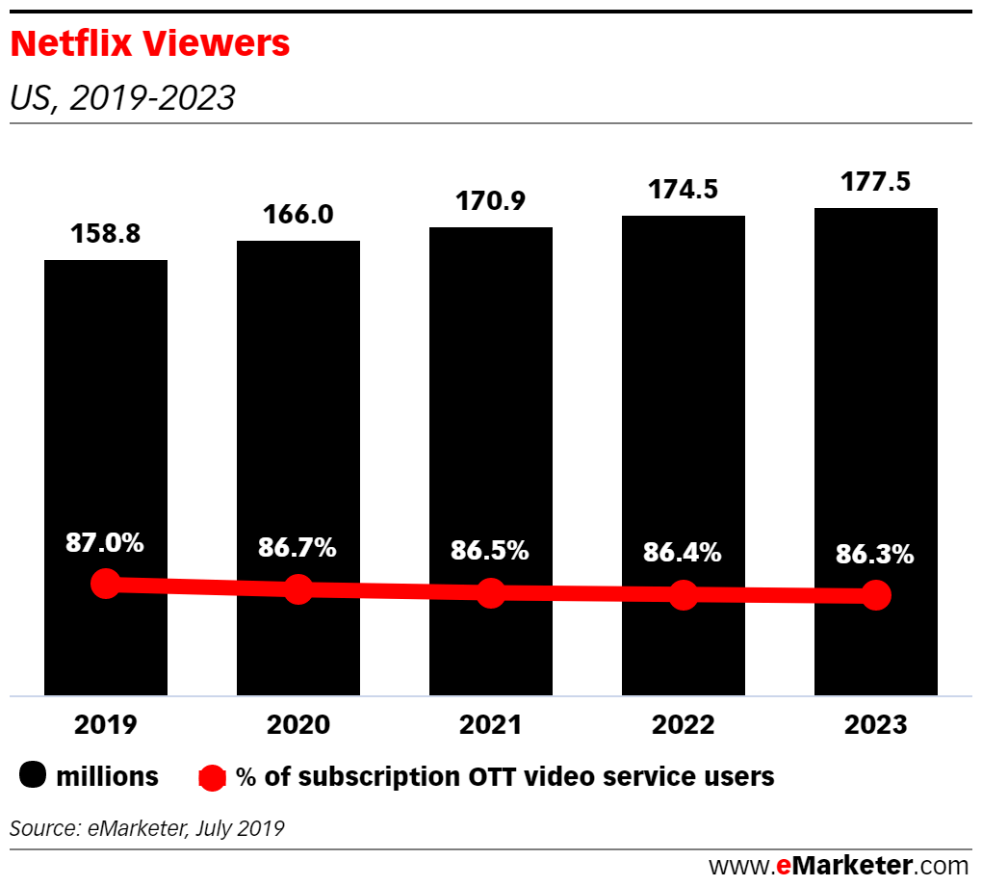
Why Netflix TV shows & Movies?
World’s Top streaming services by subscribers, millions
US Netflix market share, 2019 – 2023
85% of Americans who spend money on digital video services are Netflix users. (Source: Statista)
50% Netflix subscribers are Hulu subscribers also
An over-the-top (OTT) media service is a media service offered directly to viewers via the Internet.
As of Dec-2020; Source: https://www.businessofapps.com/data/netflix-statistics/
In 2014 this figure stood at 90%, according to these Netflix stats
Notes:
Melanie

Slide 4
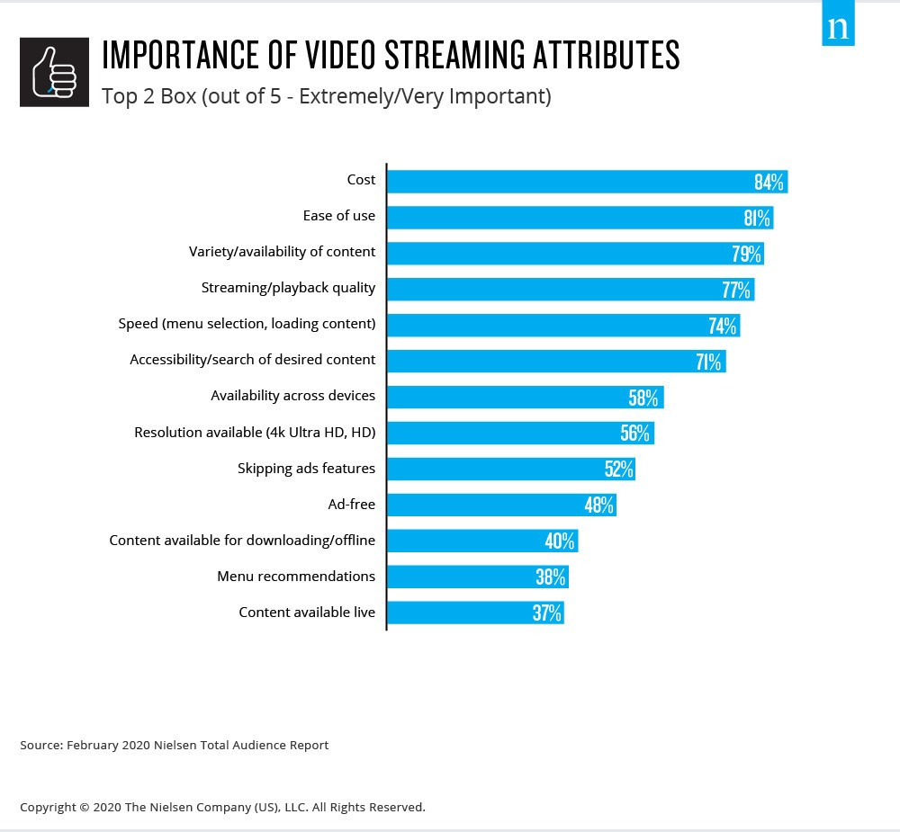
Why is a TV Show / Movie description important?
Ease of use is an important attribute of video streaming to describe TV show or Movie to best associate with identifying genre & rating
Notes:
Melanie

Slide 5
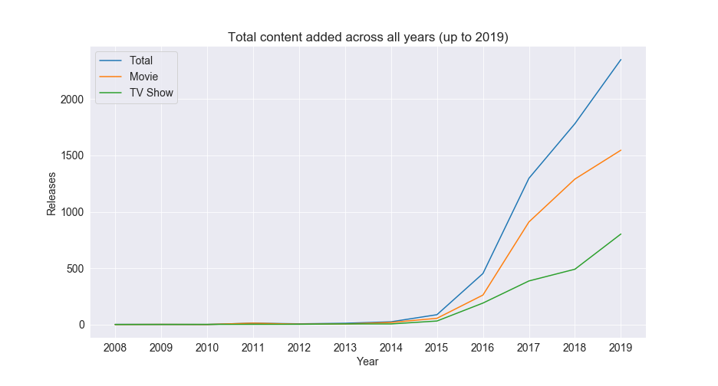
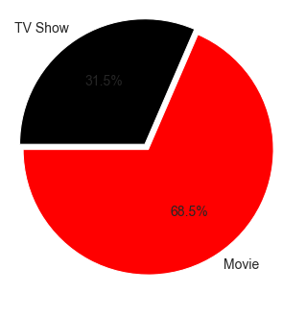
Netflix TV shows vs Movies
Netflix content added over the years:
Split of all Titles between Movies & TV shows:
31.5%
Notes:
Haifa

Slide 6
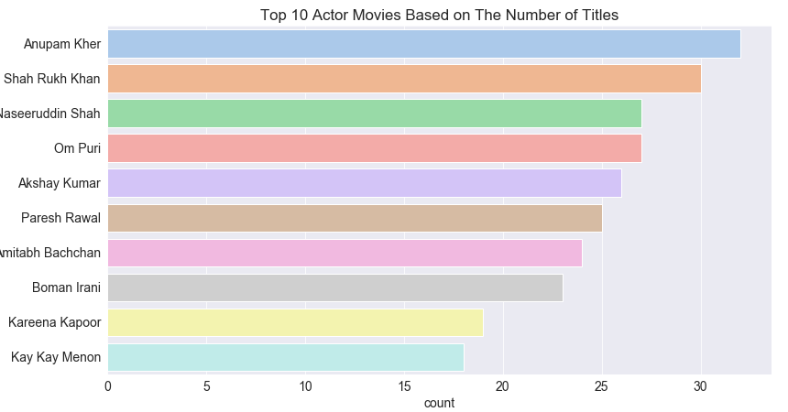
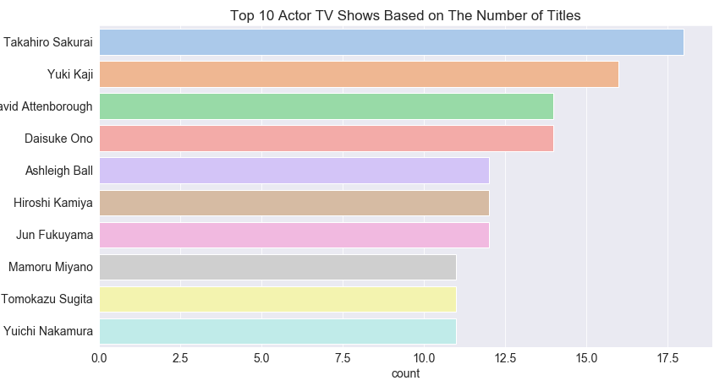
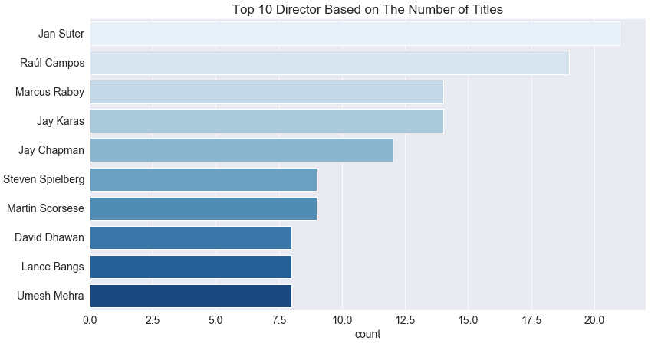
Other Top Details of Netflix Titles
Will discuss ideas later (in future enhancement ideas) of how to add additional information to this data in the database
This additional detail could improve the predictive capabilities of the current model
Notes:
Haifa

Slide 7
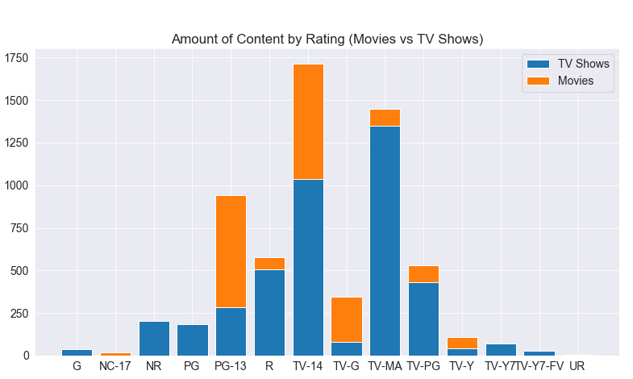
Netflix Title’s Rating
There are a massive amounts of options presented on Netflix….
Our prediction model can help navigate towards the right rating for your TV show or movie
To improve predictive results…
Grouped to 5 ratings = G, PG, PG-13, R, NC-17
Grouped to G: ‘TV-Y7’ , ’TV-G’ , ’TV-Y’ , ’TV-Y7-FV’
Grouped to R: 'TV-MA’ & 'R'
Notes:
Julie

Slide 8
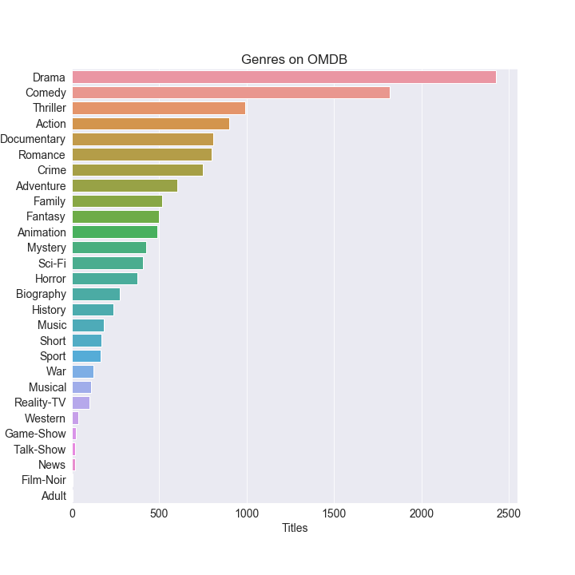
Netflix Title’s OMBD Genre
We found a total of 28 genres in this dataset to train against.
The most common genre is Drama, which causes our predictions to be a bit unbalanced
Notes:
April

Slide 9


Machine Learning
Detail behind the model
Notes:
April

Slide 10

Machine Learning Model - Train
Title Descriptions:
What are the most used words for different title’s genre & rating description?
Notes:
April

Slide 11
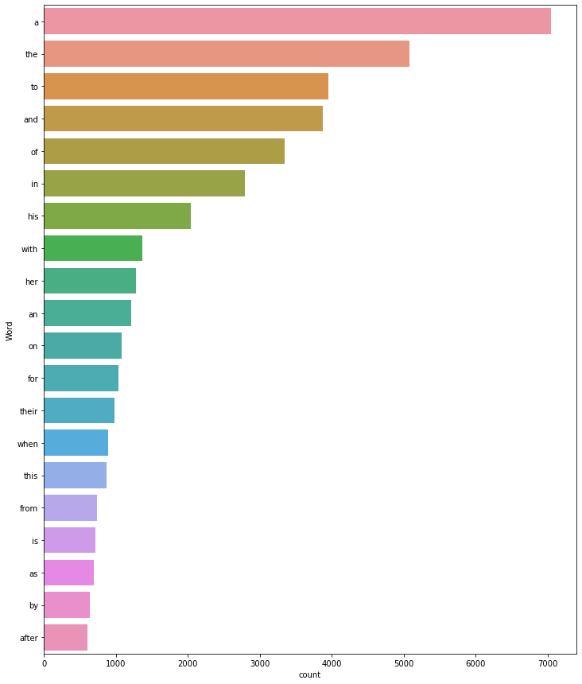
Description - Stopwords
Picking valuable words like "young" will give more desirable results rather than "the"
Removed ‘standard’ stopwords
Notes:
April

Slide 12
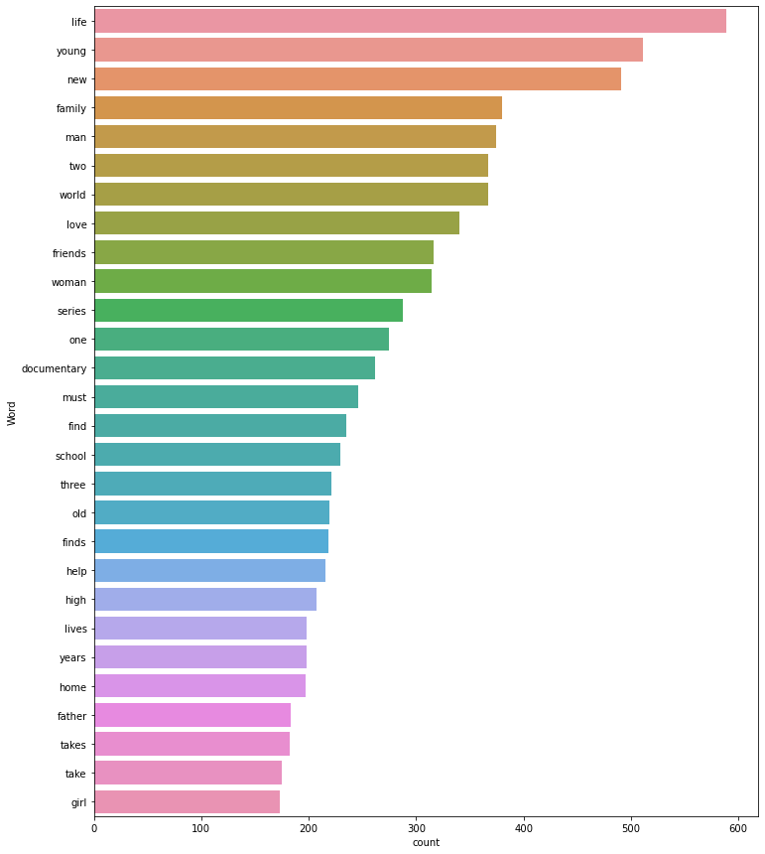

Description – Common Description Words
Finding the right words to train your model on is key
Notes:
April

Slide 13

Machine Learning Model - Test
Model’s Predictive accuracy:
Genre = 43.5% accurately identifies one of the 28 genre in test
Rating = 35.2% accurately identifies one of the 5 grouped ratings in test
Notes:
April / Julie

Slide 14

Demo Time!!
https://the-big-chill.herokuapp.com/deep_dive
Notes:
Julie

Slide 15

Future Project Enhancement Ideas
If given more time / scope to develop this app, what would the Chill team do?
Notes:
Melanie

Slide 16
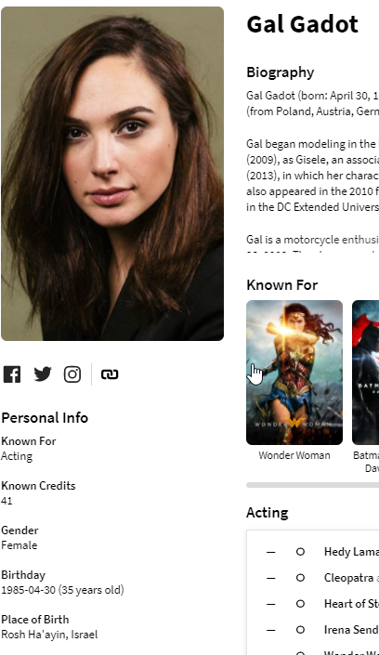
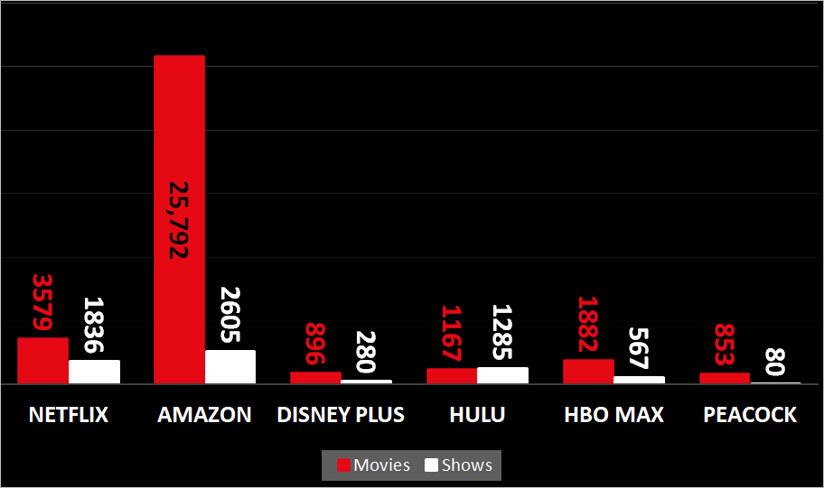
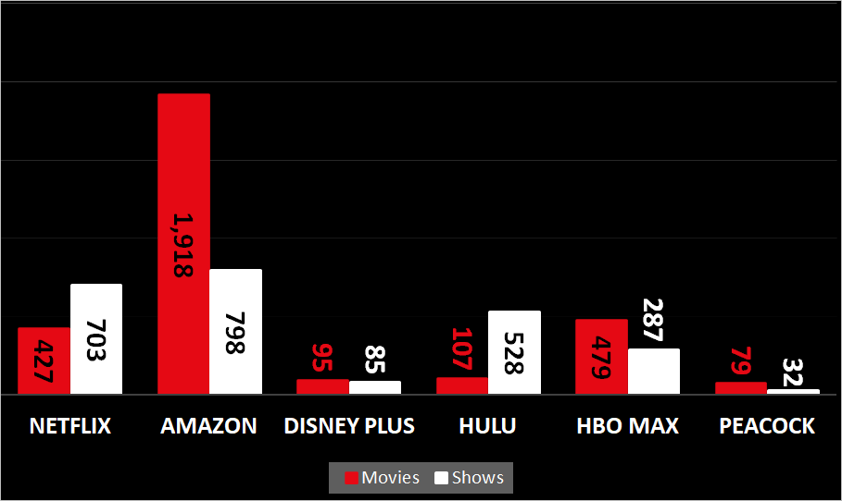
Further predictive model enhancements
Current model Constraint: Too few records & input variables to create model to predict IMDb rating or increase accuracy of current model’s predictive accuracy
Future Model Enhancement: Pull more data to increase the amount of data to better train the model
Idea #1:
Pull more movies/tv shows from other streaming services to predict IMDb rating
Idea #2:
Using the TMDB API for People
Add to Cast table to categorize Cast by gender and/or age
Create a Director table to categorize the same
Netflix US libraries
Netflix US content rated 7.5+ on IMDb vs rivals
stats were pulled February 2021
Source: https://www.businessofapps.com/data/netflix-statistics/ from JustWatch
Notes:
Melanie

Slide 17
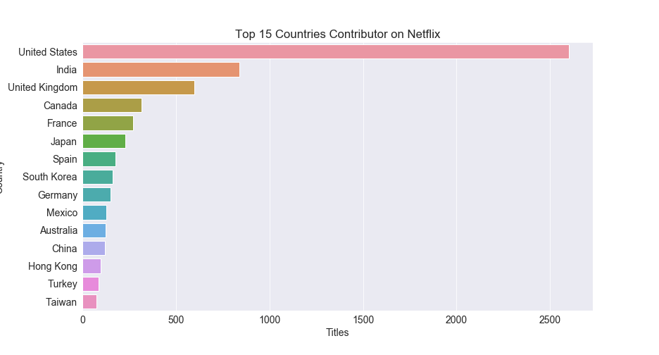
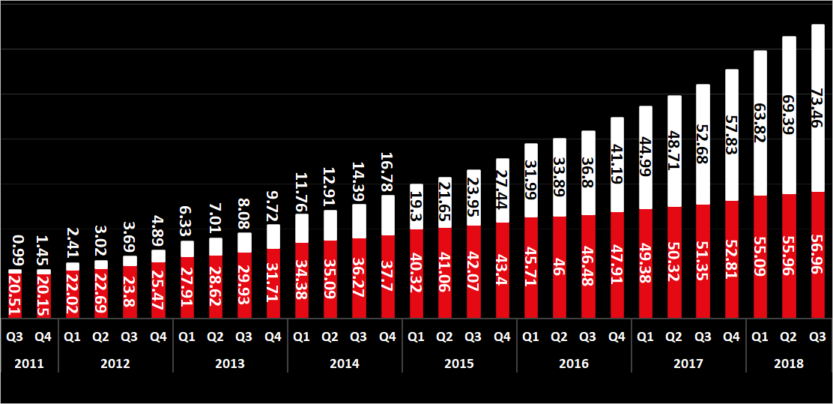
Netflix TV shows & Movies - US vs International
Current model Constraint: Descriptions & predictions are currently in English only
Future Modeling Consideration: How will International growth in Netflix subscriptions impact language as international users have far outpaced domestic growth in recent years?
Netflix users by region, US vs international, 2011 – 2018, millions
Source Data: Project Database of Netflix movies & shows
Source: https://www.businessofapps.com/data/netflix-statistics/
Notes:
Haifa

Slide 18
Other Lessons Learned
Heroku Deployment:
10,000 row limited database load
Need to limit to only needed libraries in requirement text
Create environment link to Heroku instead of visible postgres link
AWS RDS: Able to create multiple user accounts
Develop API: Use Firefox! It really helps to develop valid APIs!
SQLalchemy: Difficult joining database tables; used pandas to merge tables
Notes:
Haifa

