Slide 1
Graph Neural Network:
For Node or graph classification
OUEDRAOGO Fidèle
Pr. Christine Largerona · Dr. Haifei Zhang
Presentation — July 07, 2026
Master’s degree (2nd year) in DataScale/ Jean Monnet University

Slide 2
Context and Motivation
Traditional Graph Learning
Their Limitations
Spectral clustering
Label propagation
Random Walk (DeepWalk, Node2Vec)
Matrix Factorization
Kernel Methods (Weisfeiler–Lehman Kernel)
Require handcrafted features
Limited use of node attributes
Cannot jointly exploit topology and features
Poor generalization to unseen graphs
Limited performance on complex graph learning tasks
GNNs

Slide 3
Objectives
Reproductibility
Evaluation
Harmonisation
Reproduce the original GCN, GAT, and GIN models.
Evaluate the models on both original and new graph datasets.
Harmonize selected datasets to improve data quality
GNNs

Slide 4
01
Method overview
Node Classification (GNN) & Evaluation & Harmonisation

Slide 5
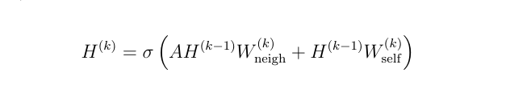


GNNs
Definition
Types of GNNs
Graph Neural Networks (GNNs) are deep learning models designed to learn from graph-structured data by aggregating information from neighboring nodes.
Graph Convolutional Network
Graph Attention Network
Graph Isomophism Network
GraphSage etc
🟦 Idea
🟩Formula
Message Passing
:
AGGREGATE
UPDATE
GNNs

Slide 6
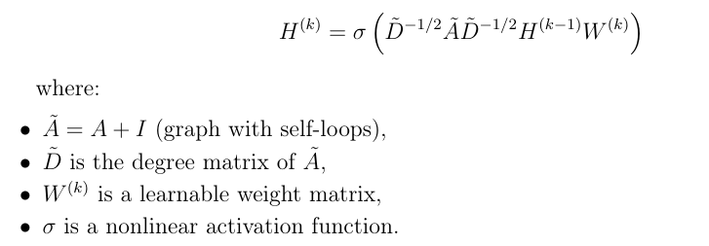
GCN
Definition
Formula
GCN extends GNNs by performing convolution operations on graph structures.
It aggregates information from neighboring nodes using a normalized adjacency matrix.
Each node representation is updated by combining its own features with neighborhood information.
Modeling
message passing
self-loop aggregation
degree normalization
feature transformation}
GNNs

Slide 7
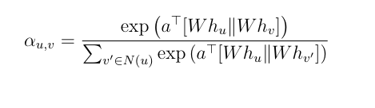
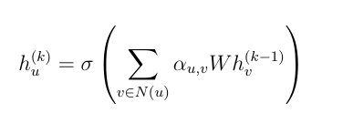
GAT
Definition
Formula
GAT extends GCN by introducing a learnable attention mechanism.
Each neighbor receives an importance weight during message aggregation.
Unlike GCN, all neighbors are not treated equally.
Node update:
Key difference with GCN
• GCN: fixed normalization weights based on graph structure,
• GAT: adaptive weights learned through attention
GNNs

Slide 8
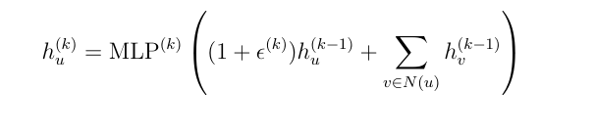

GIN
Definition
Node update rule:
GIN aims to maximize the expressive power of Graph Neural Networks.
It uses sum aggregation to better distinguish different graph structures.
Unlike GCN/GAT, GIN combines neighborhood aggregation with an MLP.
Graph representation:
Key idea
GIN approximates the discriminative power of the Weisfeiler-Lehman graph isomorphism test.
GNNs

Slide 9
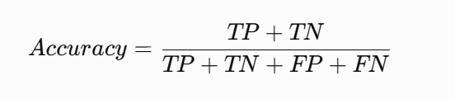
Datasets & Metric
Citation Networks (Node Classification — GCN & GAT)
Graph Classification Benchmarks (GIN)
Additional Real-world and Heterophilic Datasets (GCN & GAT)
Cora (2708 nodes, 5278 edges, 1433 features, 7 classes)
CiteSeer (3327 nodes, 4552 edges, 3703 features, 6 classes)
PubMed (19717 nodes, 44324 edges, 500 features, 3 classes)
IMDB-BINARY (1000 graphs, 2 classes, 19.8 avg. nodes)
IMDB-MULTI (1500 graphs, 3 classes, 13.0 avg. nodes)
REDDIT-BINARY (2000 graphs, 2 classes, 429.6 avg. nodes)
REDDIT-MULTI-5K (5000 graphs, 5 classes, 508.5 avg. nodes)
COLLAB (5000 graphs, 3 classes, 74.5 avg. nodes)
MUTAG (188 graphs, 2 classes, 17.9 avg. nodes)
PROTEINS (1113 graphs, 2 classes, 39.1 avg. nodes)
PTC (344 graphs, 2 classes, 25.5 avg. nodes)
NCI1 (4110 graphs, 2 classes, 29.8 avg. nodes)
Cornell (183 nodes, 280 edges, 5 classes)
Texas (183 nodes, 295 edges, 5 classes)
Wisconsin (251 nodes, 466 edges, 5 classes)
Chameleon (2277 nodes, 31421 edges, 5 classes)
Squirrel (5201 nodes, 198493 edges, 5 classes)
Actor (7600 nodes, 26752 edges, 5 classes)
Roman-Empire (22662 nodes, 32927 edges, 18 classes)
Amazon-Ratings (24492 nodes, 93050 edges, 5 classes)
Minesweeper (10000 nodes, 39402 edges, 2 classes)
Tolokers (11758 nodes, 519000 edges, 2 classes)
Questions (48921 nodes, 153540 edges, 2 classes)
Metric
GNNs For the reproductibility we use Docker

Slide 10
02
Evaluation & Results
23 datasets · node classification models (GAT/GCN/GIN) · 1 metric

Slide 11
Results — Accuracy ↑-GCN
Model | Cora | Citeseer | PubMed | Cornell | Texas | Wisconsin | Chameleon | Squirrel | Actor | Roman-Empire | Amazon | Question | Minesweeper | Tokolers
GCN-P | 81.5 | 70.3 | 79 | - | - | - | - | - | - | - | - | - | - | -
GCN-O-I | 81.6 | 71.3 | 78.6 | 76.69 | 70.83 | 66.36 | 48.94 | 32.30 | 36.81 | 25.59 | 38.17 | 97.03 | 80.13 | 78.2
GCN-O-I-H | - | - | - | - | 71.86 | - | 44.76 | 31.59 | - | - | - | - | - | -
.The same results for the reproducibility , Duplicates overestimate performance,Single-node classes reduce performance
GNNs

Slide 12
Results — Accuracy ↑-GAT
Model | Cora | Citeseer | PubMed | Cornell | Texas | Wisconsin | Chameleon | Squirrel | Actor | Roman-Empire | Amazon | Question | Minesweeper | Tokolers
GCN-P | 83 | 72.5 | 79 | - | - | - | - | - | - | - | - | - | - | -
GCN-O-I | 83.1 | 78.6 | OUT | 45.40 | 55.36 | 54.38 | 57.45 | 35.28 | 26.18 | OUT | OUT | OUT | OUT | OUT
GCN-O-I-H | - | - | - | - | 55.69 | - | 55.52 | 35.46 | - | - | - | - | - | -
.The same results for the reproducibility ; H: after harmonization
GNNs

Slide 13
Results — Accuracy ↑-GIN
Model | IMDB-B | IMDB-M | REDDIT-B | REDDIT-M5K | COLLAB | MUTAG | PROTEINS | PTC | NCI1
GIN-Paper (GIN-0) | 75.1 | 52.3 | 92.4 | 57.5 | 80.2 | 89.4 | 76.2 | 64.6 | 82.7
GIN-Paper (GIN-ϵ) | 74.3 | 52.1 | 92.2 | 57 | 80.1 | 89 | 75.9 | 63.7 | 82.7
GIN-O-I-H | 77 | 52.7 | 79.5 | 52.4 | 67 | 94.7 | 79.6 | 80 | 82.7
.The same results IS Not same for the all reproducibility ; H: after harmonization
GNNs

Slide 14
Strengths & Limitations of the GNNs
Limitations
Strengths
Black-box models with limited interpretability
Performance degradation on heterophilic graphs
Over-smoothing in deep GNN architectures
High computational cost on large-scale graphs
Sensitive to graph quality (noise, duplicates, missing links)
Exploits graph topology and node features
Captures neighborhood dependencies
High performance on graph learning tasks
Generalizes across diverse graph domains
Automatic feature learning
GNNs are black-box · Use Graphsag
GNNs

Slide 15
Conclusion & Perspectives
1
We reproducted the severals implementations
2
We trained GNNs model
3
We evaluate by their performance with the accuracy
4
Certains dataset are harmonized
Perspectives
Short term : Study the Graphsag
Medium term : Others GNNs, local explanations of their predictions
Long term : Move the local explanation to global explanation
GNNs

Slide 16
Thank you for your attention
Questions ?

