Slide 1
Graph Neural Network:
For Node or graph classification
OUEDRAOGO Fidèle
Pr. Christine Largeron · Dr. Haifei Zhang
Presentation — July 15, 2026
Master’s degree (2nd year) in DataScale/ Jean Monnet University

Slide 2
Objectives
Reproductibility
Evaluation
Harmonisation
Reproduce the original GCN, GraphSAGE, GAT, and GIN models.
Evaluate the models on both original and new graph datasets with accuracy, micro average f1 et macro average f1
Harmonize selected datasets to improve data quality
GNNs 1

Slide 3
01
Method overview
Node Classification (GNN) & Evaluation & Harmonisation

Slide 4
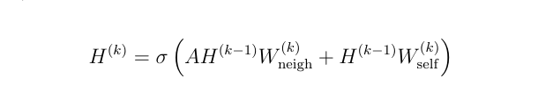


GNNs
Definition
Types of GNNs
Graph Neural Networks (GNNs) are deep learning models designed to learn from graph-structured data by aggregating information from neighboring nodes.
Graph Convolutional Network
Graph Attention Network
Graph Isomophism Network
GraphSage ...
🟦 Idea
🟩Formula of Nodes representation
Relies on the message-passing paradigm
Each node passes messages to its neighborin
AGGREGATE
UPDATE
2
GNNs

Slide 5
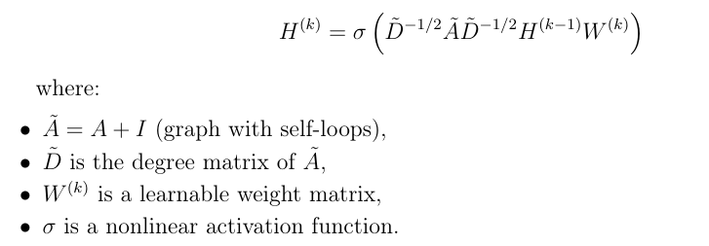
GCN
Definition
Formula of nodes representation
GCN extends GNNs by performing convolution operations on graph structures.
It aggregates information from neighboring nodes using a normalized adjacency matrix.
Each node representation is updated by combining its own features with neighborhood information.
Modeling
message passing
self-loop aggregation
degree normalization
feature transformation
+
+
+
GNNs 3

Slide 6
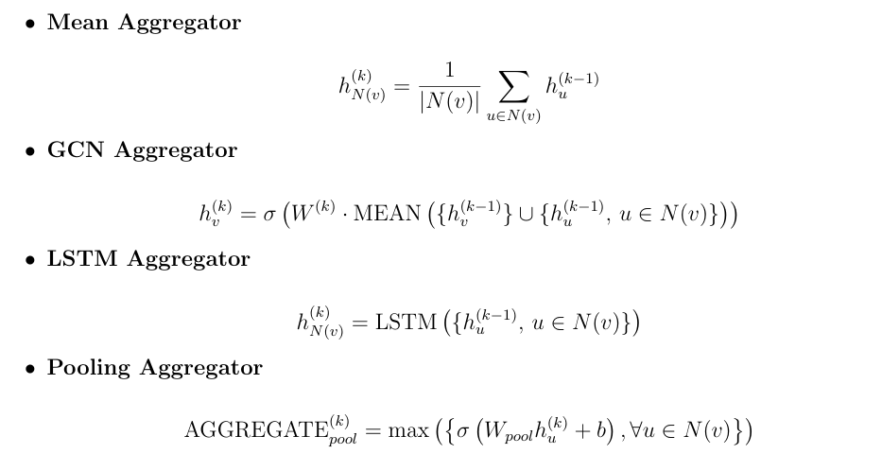
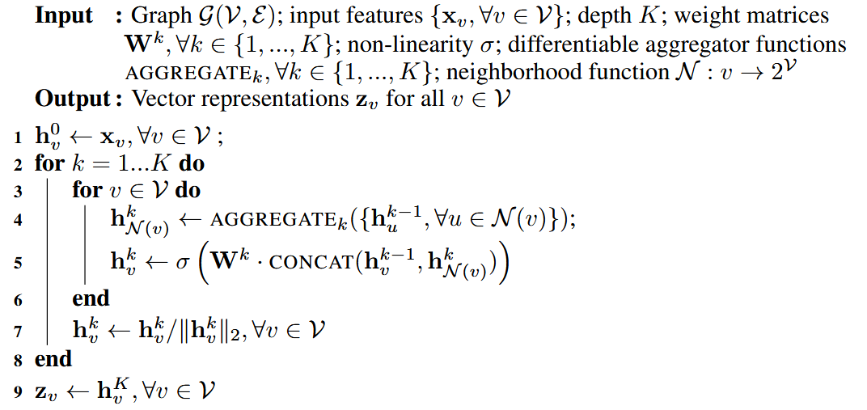
GraphSAGE
Definition
Aggregator variants
GraphSAGE (Graph Sample and Aggregate) is an inductive Graph Neural Network proposed by Hamilton et al. that learns a function to generate node embeddings by aggregating information from local neighborhoods, instead of learning a unique embedding for each node
Embedding generation algorithm
GraphSAGE vs. GCN: Key Differences
Inductive representation learning
scalable to large graphs through neighborhood sampling
supports unseen nodes and unseen graphs
flexible aggregation architectures
GNNs 4

Slide 7
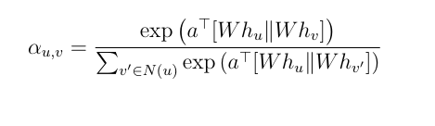
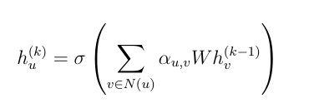
GAT
Definition
Attention coefficient formula
GAT extends GCN by introducing a learnable attentionmechanism.
Each neighbor receives an importance weight during message aggregation.
Unlike GCN, all neighbors are not treated equally.
Node representation computation
GAT vs. GCN: Key Differences
• GCN: fixed normalization weights based on graph structure,
• GAT: adaptive weights learned through attention
where N(u) includes node u itself
GNNs 5

Slide 8
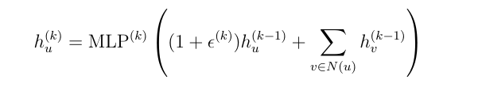

GIN
Definition
Node representation computation
GIN aims to maximize the expressive power of Graph Neural Networks.
It uses sum aggregation to better distinguish different graph structures.
Unlike GCN/GAT, GIN combines neighborhood aggregation with an MLP.
ε controls the relative importance of the node's own features and its neighbors' features.
Graph representation computation
GIN VS others GNNs : Key Differences
Injective aggregation: Sum aggregation enables GIN to match the discriminative power of the Weisfeiler-Lehman test.
MLP-based update: An MLP improves the expressiveness of node representations after aggregation.
Multi-layer readout: Combines representations from all layers to capture local and global graph structures.
READOUT: aggregates the node embeddings of a graph using summation.
CONCAT: concatenates the graph representations from all GIN layers to capture both local and global structural information.
GNNs 6

Slide 9
Datasets
Citation Networks (Node Classification — GCN & GAT)
Graph Classification Benchmarks (GIN)
Additional Real-world and Heterophilic Datasets (GCN & GAT)
Cora (2708 nodes, 5278 edges, 1433 features, 7 classes)
CiteSeer (3327 nodes, 4552 edges, 3703 features, 6 classes)
PubMed (19717 nodes, 44324 edges, 500 features, 3 classes)
IMDB-BINARY (1000 graphs, 2 classes, 19.8 avg. nodes)
IMDB-MULTI (1500 graphs, 3 classes, 13.0 avg. nodes)
REDDIT-BINARY (2000 graphs, 2 classes, 429.6 avg. nodes)
REDDIT-MULTI-5K (5000 graphs, 5 classes, 508.5 avg. nodes)
COLLAB (5000 graphs, 3 classes, 74.5 avg. nodes)
MUTAG (188 graphs, 2 classes, 17.9 avg. nodes)
PROTEINS (1113 graphs, 2 classes, 39.1 avg. nodes)
PTC (344 graphs, 2 classes, 25.5 avg. nodes)
NCI1 (4110 graphs, 2 classes, 29.8 avg. nodes)
Cornell (183 nodes, 280 edges, 5 classes)
Texas (183 nodes, 295 edges, 5 classes)
Wisconsin (251 nodes, 466 edges, 5 classes)
Chameleon (2277 nodes, 31421 edges, 5 classes)
Squirrel (5201 nodes, 198493 edges, 5 classes)
Actor (7600 nodes, 26752 edges, 5 classes)
Roman-Empire (22662 nodes, 32927 edges, 18 classes)
Amazon-Ratings (24492 nodes, 93050 edges, 5 classes)
Minesweeper (10000 nodes, 39402 edges, 2 classes)
Tolokers (11758 nodes, 519000 edges, 2 classes)
Questions (48921 nodes, 153540 edges, 2 classes)
GNNs For the reproductibility we use Docker 7

Slide 10
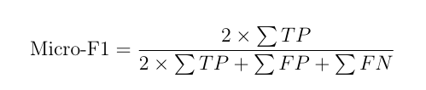
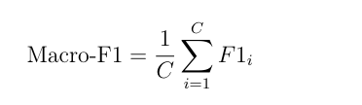
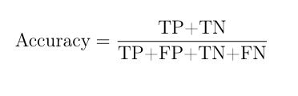
Metrics
Accuracy
f1-micro average
f1-macro average
where C is the number of classes and F1i denotes the F1-score of class i.
GNNs For the reproductibility we use Docker 8

Slide 11
02
Evaluation & Results
23 datasets · node classification models (GAT/GCN/GIN/GraphSAGE) · 3 metric

Slide 12
Results — Accuracy&f1-micro&f1-macro ↑-GCN
Dataset | GCN1 (%) | GCN2 (%)
 | Accuracy | Accuracy | F1-micro | F1-macro
Cora | 81.50 | 81.60 | 81.60 | 80.63
Citeseer | 70.30 | 71.70 | 71.70 | 68.96
PubMed | 79.00 | 78.60 | 78.60 | 78.21
Cornell | -- | 78.20 | 78.20 | 46.14
Texas | -- | 70.83 | 70.83 | 39.35
Wisconsin | -- | 66.36 | 66.36 | 54.42
Chameleon | -- | 48.94 (46.84) | 48.94 (46.84) | 47.10 (46.26)
Squirrel | -- | 32.30 (31.96) | 32.30 (31.96) | 31.66 (31.14)
Actor | -- | 36.81 | 36.81 | 33.05
Roman-Empire | -- | 25.59 | 25.59 | 15.29
Amazon-Ratings | -- | 38.17 | 38.17 | 17.80
Minesweeper | -- | 80.13 | 80.13 | 45.91
Tolokers | -- | 78.20 | 78.20 | 46.14
Questions | -- | 97.03 | 97.03 | 49.25
GCN1: Results reported by Kipf and Welling (2017)). And GCN2: results obtained from our implementation
Values in parentheses correspond to results after removing near-duplicate nodes for Chameleon and Squirrel.
GNNs 9

Slide 13
Results — f1-micro&f1-macro ↑-GraphSAGE
Dataset | Agg | GraphSAGE1 (%) | GraphSAGE2 (%)
 |  | f1-micro | f1-micro | f1-macro
PPI | GCN | 50.00 | 51.13 | 30.33
 | Mean | 59.80 | 57.62 | 41.19
 | LSTM | 61.20 | 60.29 | 45.40
 | Pool | 60.00 | 59.11 | 43.35
Cora | GCN | -- | 81.40 | 80.12
 | Mean | -- | 83.20 | 82.54
 | LSTM | -- | 80.20 | 78.24
 | Pool | -- | 81.20 | 80.85
Citeseer | GCN | -- | 73.00 | 67.25
 | Mean | -- | 70.00 | 64.74
 | LSTM | -- | 68.80 | 63.77
 | Pool | -- | 69.00 | 63.85
PubMed | GCN | -- | 86.40 | 85.58
 | Mean | -- | 90.00 | 89.78
 | LSTM | -- | 89.60 | 89.14
 | Pool | -- | 88.80 | 88.37
Cornell | GCN | -- | 67.80 | 49.87
 | Mean | -- | 71.19 | 52.16
 | LSTM | -- | 77.97 | 57.39
 | Pool | -- | 64.41 | 48.33
Texas | GCN | -- | 64.41 | 35.55
 | Mean | -- | 79.66 | 48.23
 | LSTM | -- | 81.36 | 56.97
 | Pool | -- | 66.10 | 38.85
GraphSAGE1: results reported by Hamilton et al. (2017). And GraphSAGE2: results obtained from our implementation
GNNs 10

Slide 14
Results — f1-micro&f1-macro ↑-GraphSAGE
Dataset | Agg | GraphSAGE1 (%) | GraphSAGE2 (%)
 |  | f1-micro | f1-micro | f1-macro
Wisconsin | GCN | -- | 61.25 | 35.53
 | Mean | -- | 75.00 | 44.05
 | LSTM | -- | 77.50 | 48.37
 | Pool | -- | 55.00 | 28.28
Actor | GCN | -- | 27.84 | 23.80
 | Mean | -- | 33.43 | 30.70
 | LSTM | -- | 33.35 | 30.49
 | Pool | -- | 34.05 | 28.43
Roman-Empire | GCN | -- | 44.84 | 35.23
 | Mean | -- | 71.24 | 62.88
 | LSTM | -- | 71.37 | 63.60
 | Pool | -- | 73.65 | 67.20
Amazon-Ratings | GCN | -- | 43.43 | 34.44
 | Mean | -- | 45.47 | 36.94
 | LSTM | -- | 43.21 | 35.54
 | Pool | -- | 42.58 | 27.33
Minesweeper | GCN | -- | 80.00 | 44.44
 | Mean | -- | 81.48 | 65.86
 | LSTM | -- | 81.60 | 64.00
 | Pool | -- | 82.04 | 65.79
Tolokers | GCN | -- | 77.82 | 46.20
 | Mean | -- | 78.53 | 57.31
 | LSTM | -- | 78.22 | 52.70
 | Pool | -- | 78.26 | 44.36
GraphSAGE1: results reported by Hamilton et al. (2017). And GraphSAGE2: results obtained from our implementation
GNNs 11

Slide 15
Results — f1-micro&f1-macro ↑-GraphSAGE
Dataset | Agg | GraphSAGE1 (%) | GraphSAGE2 (%)
 |  | f1-micro | f1-micro | f1-macro
Questions | GCN | -- | 97.05 | 53.32
 | Mean | -- | 96.25 | 58.42
 | LSTM | -- | 96.35 | 58.67
 | Pool | -- | 96.84 | 56.87
Chameleon | GCN | -- | 40.60 (47.78) | 40.68 (46.14)
 | Mean | -- | 52.81 (51.78) | 52.48 (50.00)
 | LSTM | -- | 49.38 (55.92) | 47.99 (55.47)
 | Pool | -- | 42.94 (46.89) | 41.83 (44.84)
Squirrel | GCN | -- | 32.81 (34.84) | 30.23 (33.58)
 | Mean | -- | 37.20 (37.61) | 36.77 (37.45)
 | LSTM | -- | 34.38 (35.74) | 33.77 (35.33)
 | Pool | -- | 35.64 (38.76) | 33.87 (36.40)
GraphSAGE1: results reported by Hamilton et al. (2017). And GraphSAGE2: results obtained from our implementation
Values in parentheses for Chameleon and Squirrel correspond to the results obtained after removing near-duplicate nodes
GNNs 12

Slide 16
Results — Accuracy &f1-micro&f1-macro ↑-GAT
Dataset | GAT1 (%) | GAT2 (%)
 | acc | acc | f1-micro | f1-macro
Cora | 83.00 | 83.40 | 83.40 | 82.35
Citeseer | 72.50 | 73.20 | 73.20 | 67.38
PubMed | 79.00 | -- | -- | --
Cornell | -- | 45.40 | 45.40 | 15.37
Texas | -- | 55.36 | 55.36 | 14.25
Wisconsin | -- | 52.99 | 52.99 | 20.61
Chameleon | -- | 57.40 (57.20) | 57.40 (57.20) | 55.53 (55.45)
Squirrel | -- | 36.03 (36.95) | 36.03 (36.95) | 31.05 (35.56)
Actor | -- | 26.96 | 26.96 | 13.59
GAT1: results reported by Veličković et al. (2018). And GAT2: results obtained from our implementation
Values in parentheses correspond to results after removing near-duplicate nodes for Chameleon and Squirrel.
GNNs 13

Slide 17
Results — Accuracy&f1-micro&f1-macro ↑-GIN
Dataset | GIN1 (%) | GIN2 (%)
 | Accuracy | Accuracy | F1-micro | F1-macro
MUTAG | 89.4 ± 5.6 | 93.04 ± 4.90 | 93.04 ± 4.90 | 92.39 ± 5.17
PTC | 64.6 ± 7.0 | 72.08 ± 4.93 | 72.08 ± 4.93 | 69.69 ± 6.83
NCI1 | 82.7 ± 1.7 | 78.03 ± 1.48 | 78.03 ± 1.48 | 78.01 ± 1.48
PROTEINS | 76.2 ± 2.8 | 79.51 ± 3.31 | 79.51 ± 3.31 | 78.49 ± 2.94
IMDBBINARY | 75.1 ± 5.1 | 74.80 ± 2.44 | 74.80 ± 2.44 | 74.59 ± 2.29
IMDBMULTI | 52.3 ± 2.8 | 50.73 ± 1.59 | 50.73 ± 1.59 | 48.57 ± 2.84
REDDITBINARY | 92.4 ± 2.5 | 78.20 ± 1.95 | 78.20 ± 1.95 | 78.15 ± 1.96
COLLAB | 80.2 ± 1.9 | -- ± -- | -- ± -- | -- ± --
REDDIT-MULTI5K | 57.5 ± 1.5 | -- ± -- | -- ± -- | -- ± --
GIN1: results reported by Xu et al. (2019) using GIN-ε with ε = 0
GIN2: results obtained from our implementation using 10-fold cross-validation.
Reported values correspond to the mean performance ± standard deviation over the folds
GNNs 14

Slide 18
Comparative Study of Three GNNs
Criterion | GCN | GraphSAGE | GAT | GIN
Original learning setting | Transductive | Inductive | Transductive | Graph and Node classification
Aggregation | Normalized mean | Mean / Max / LSTM | Attention | Injective sum
Attention mechanism | ✗ | ✗ | ✓ | ✗
MLP after aggregation | ✗ | ✗ | ✗ | ✓
Scalability | Medium | High | Low | Medium
Training speed | Fast | Very fast | Slow | Medium
Expressive power | Medium | Medium | High | Highest (1-WL)
GNNs 15

Slide 19
Thank you for your attention
Questions ?

