Slide 1
XAI:
Explainability for Graph Neural Networks
OUEDRAOGO Fidèle
Pr. Christine Largerona · Pr. Haifei Zhang
Presentation — July 21, 2026
Master’s degree (2nd year) in DataScale/ Jean Monnet University

Slide 2
Context and Motivation
The Challenge of GNNs
Limitations of Existing Explainers
High-performing GNN models but black boxes
Difficulty understanding why a prediction is made
Need for trust and explainability in critical domains
Gradient-based methods: designed for Euclidean data (images, text); ineffective on graph structures
Attention-based methods: architecture-dependent (mainly applicable to attention-based GNNs)
Need for graph-specific explainability methods that identify the structural reasons behind GNN predictions
Difficulty capturing (attribute + topology interactions)
Predictions depend on graph topology, not on isolated nodes or edges
XAI for GNNs 1

Slide 3
Project Objectives
Understanding GNN Explainability
Study and Reproduction of GNNExplainer
Explore existing methods for explaining GNN predictions Identify the limitations of traditional XAI approaches on graphs
Analyze the GNNExplainer methodology Reproduce the original experiments Compare results with the paper benchmarks
XAI for the GNNs 2

Slide 4
01
Two main levels of explanation
Local and Global methods

Slide 5
Comparison
Local
Global
Explains individual node/graph predictions
Provides explanations for specific instances
Requires multiple explanations to understand a class
Human interpretation: analyzing 1 explanation at a time
Class-level understanding requires manual aggregation of explanations
Explains the general behavior of the model
Learns patterns and rules for entire classes
One explanation can summarize a class behavior
Human interpretation: understanding many predictions through general rules
Directly targets class-level understanding
XAI for GNNs 3

Slide 6
02
GNNExplainer: Local Explainability for GNNs
Node Classification (GNNs) & Explanation & Evaluation

Slide 7
GNNExplainer (2019)
Definition
Types of Explanations
First general method for explaining GNN predictions
Post-hoc and model-agnostic approach
Applicable to any trained GNN architecture (GCN, GAT, GraphSAGE, GIN...)
Identifies important graph structures and node features behind a prediction
Single-instance explanation
Explains one specific prediction
Multi-instance explanation
Aggregates multiple local explanations
Extracts representative patterns of a class
Provides a first step toward global interpretability
GNNExplainer 4

Slide 8
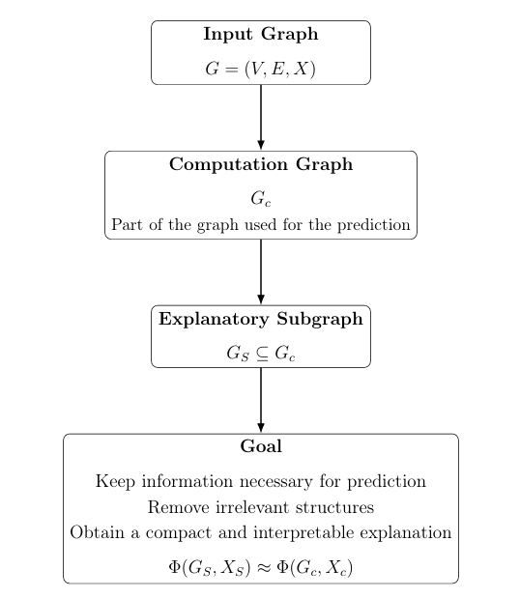
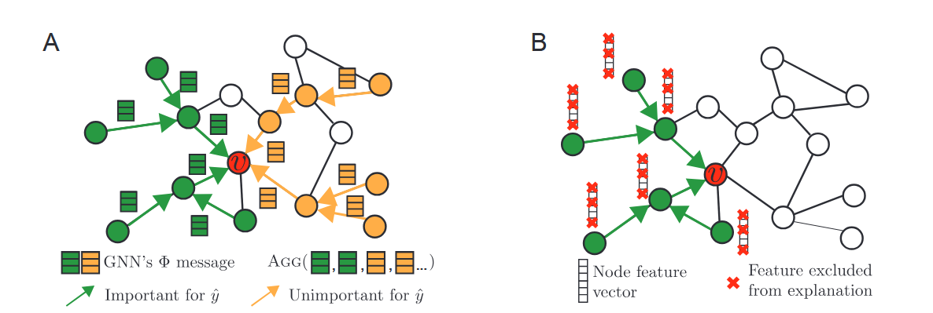
GNNExplainer : Ideas
GNNExplainer 5

Slide 9
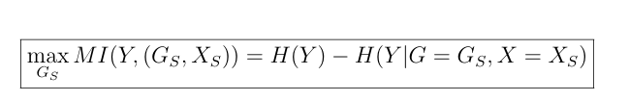


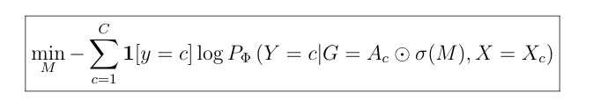


GNNExplainer Optimization Objective
Maximize Mutual Information:
Minimize Prediction Uncertainty:
Continuous Relaxation of the Optimization Problem:
Surrogate Objective for Practical Optimization:
Optimize Explanation Masks :
Final Goal: Preserve the GNN prediction with a compact and interpretable explanation
GNNExplainer 6

Slide 10
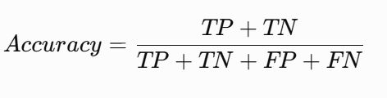


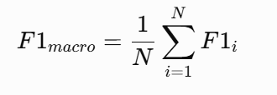
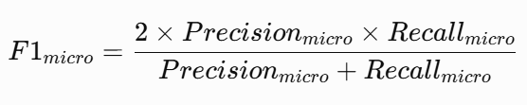
Evaluation
Accuracy
Macro average ROC-AUC
Micro average ROC-AUC
Macro average f1-score
Micro average f1-score
GNNEplainer 7

Slide 11
Datasets ↑
Dataset | Structure | Nodes | Edges | Classes
syn1 BA-Shapes | House motifs | 700 | 4110 | 4
syn2 BA-Community | Communities | 871 | 4288 | 8
syn3 Tree-Cycles | Cycle motifs | 871 | 1950 | 2
syn4 Tree-Grid | Grid motifs | 1229 | 2181 | 2
GNNExplainer 8

Slide 12
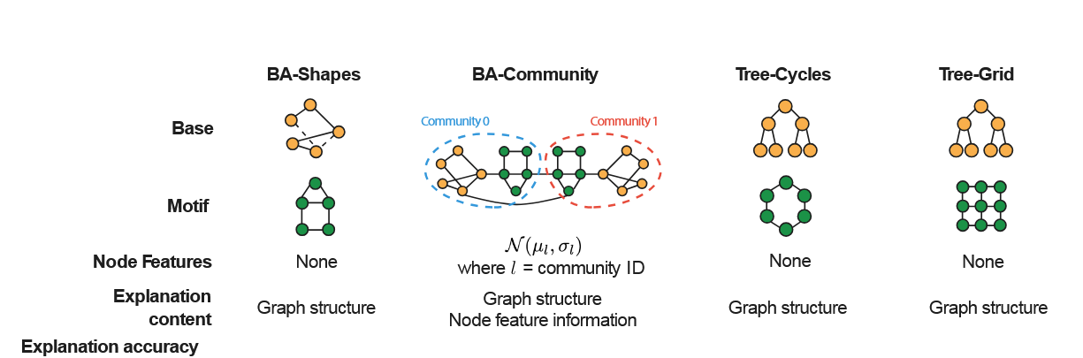
Datasets ↑
GNNExplainer 9

Slide 13
03
Results
3 datasets · node classification models (GCN) · 5 metrics · 2 baselines

Slide 14
Results ↑ metrics
Dataset | GNNExplainer1 | GNNExplainer2
 | Accuracy | Accuracy | ROC-AUC micro | ROC-AUC macro | F1-score micro | F1-score macro
syn1 (BA-Shapes) | 0.9250 | 0.9927 | 0.9964 | 0.9956 | 0.7259 | 0.7260
syn2 (BA-Community) | 0.8820 | 0.9885 | 0.9814 | 0.9798 | 0.5352 | 0.5368
syn3 (Tree-Grid) | 0.8750 | 0.9914 | 0.8326 | NaN | 0.2131 | 0.1738
syn4 (Tree-Cycles) | 0.8750 | 0.8472 | 0.8049 | NaN | 0.3422 | 0.2790
GNNExplainer1: Results reported in the original paper by Ying et al. (2019) (Accuracy metric only).
GNNExplainer2: Results obtained from our implementation evaluated over 60 node explanations.
NaN values in ROC-AUC macro reflect single-class .
GNNExplainer 10

Slide 15
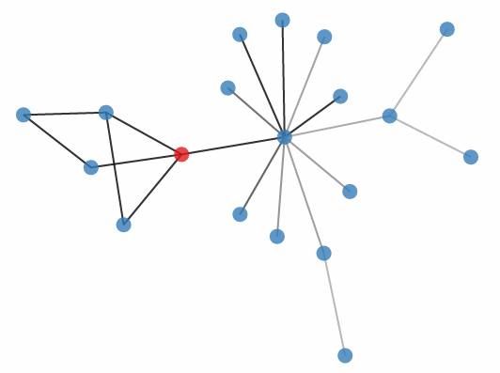
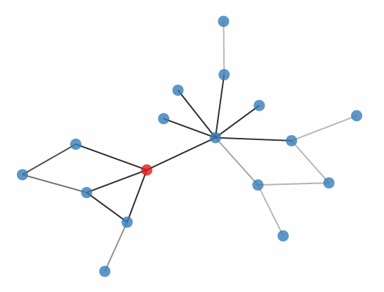
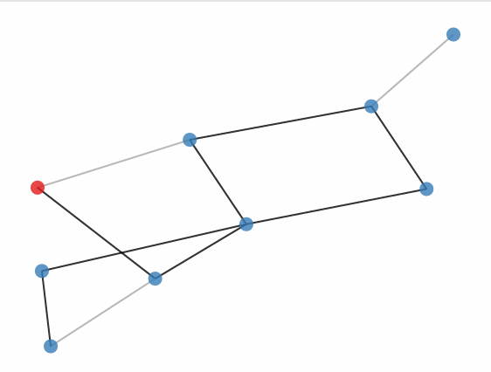
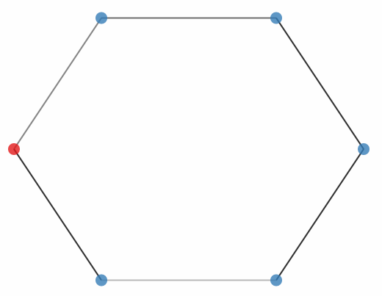
Results: Subgraph explanation
House motif (syn1)
house motif (syn2)
Grid motifs
Cycle motif
GNNExplainer 11

Slide 16
Strengths & Limitations of the GNNExplainer
Strengths
Limitations
Model-agnostic approach
Provides compact explanatory subgraphs
General framework for different graph tasks
Primarily provides local explanations
Limited global interpretability
Computational cost for large graphs
Subgraph explanations may require human interpretation
GNNExplainer 12

Slide 17
Thank you for your attention
Questions ?

