Slide 1
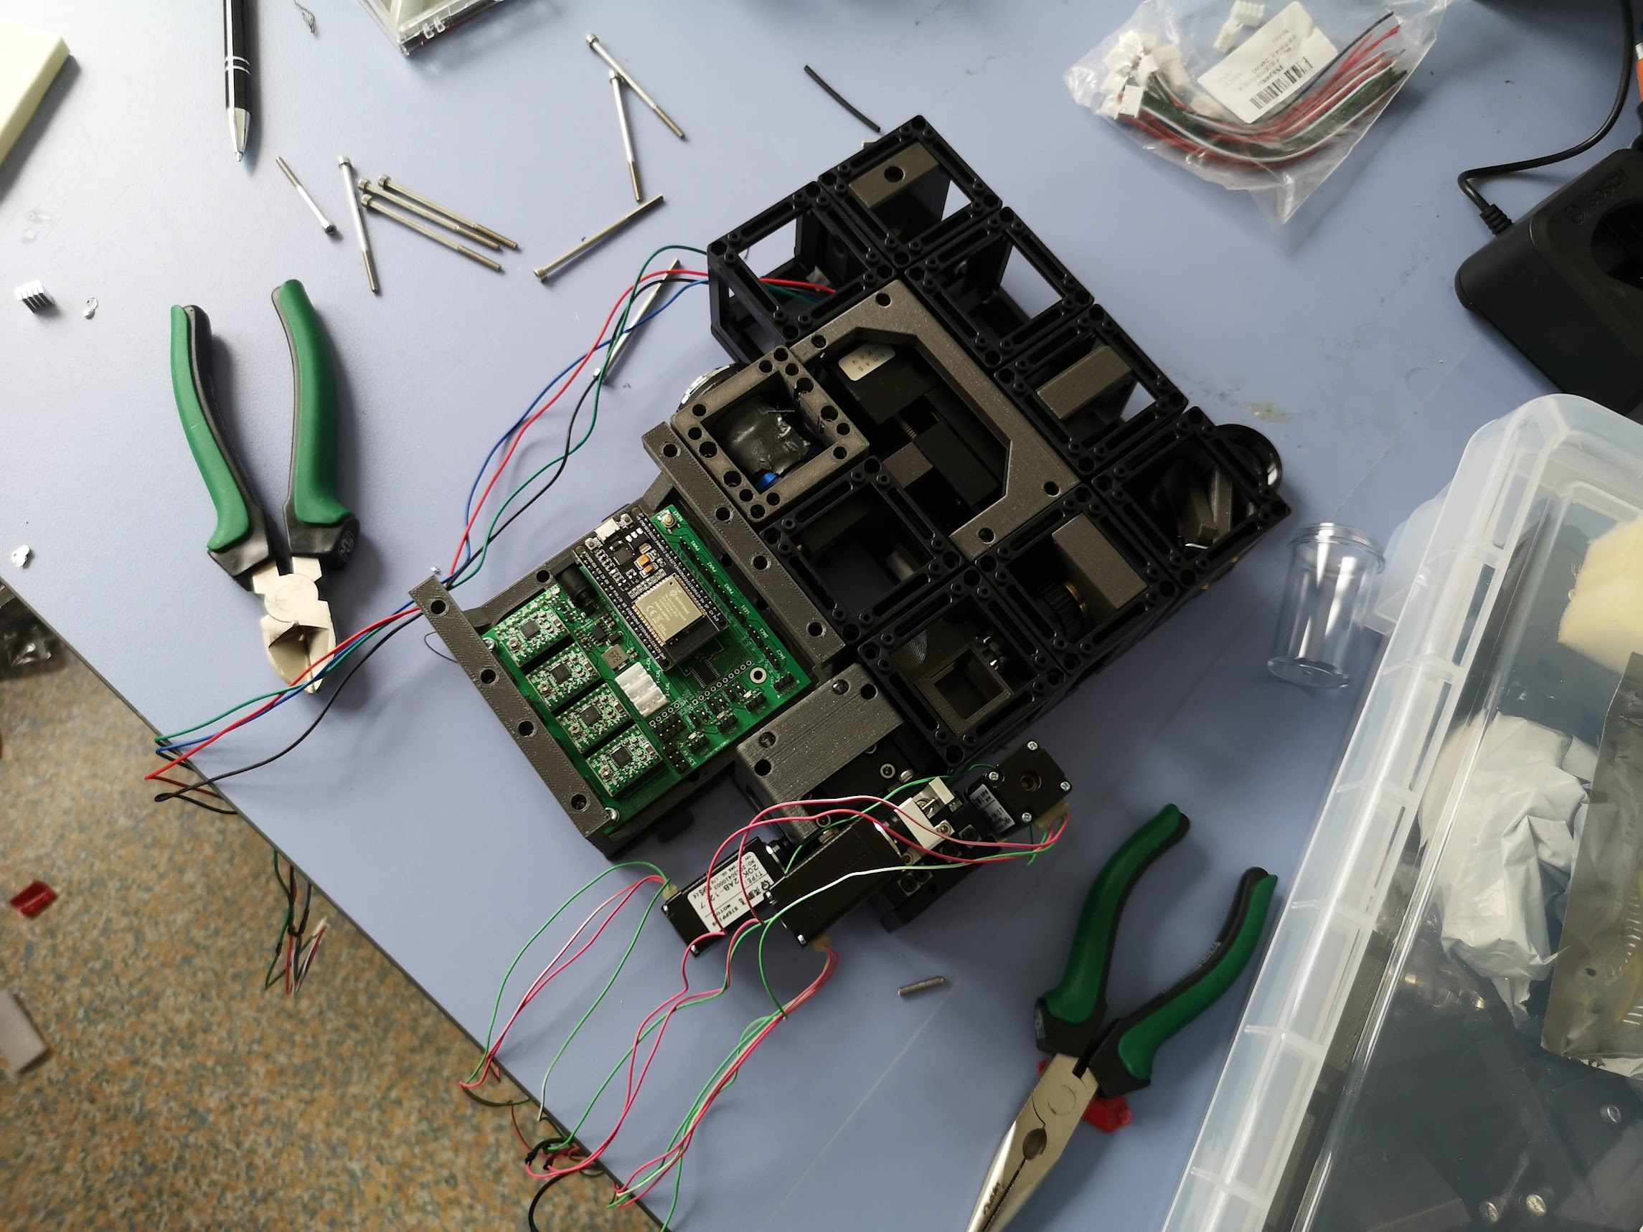
MO, 4x, 0.1
F= 50mm
M
XYZ Stage
10x, 0.25, LWD
MO
CL
F=100mm
Filter
505nm
L1
TL
100mm
CAM
Fiber (6µm, 488)

Slide 2
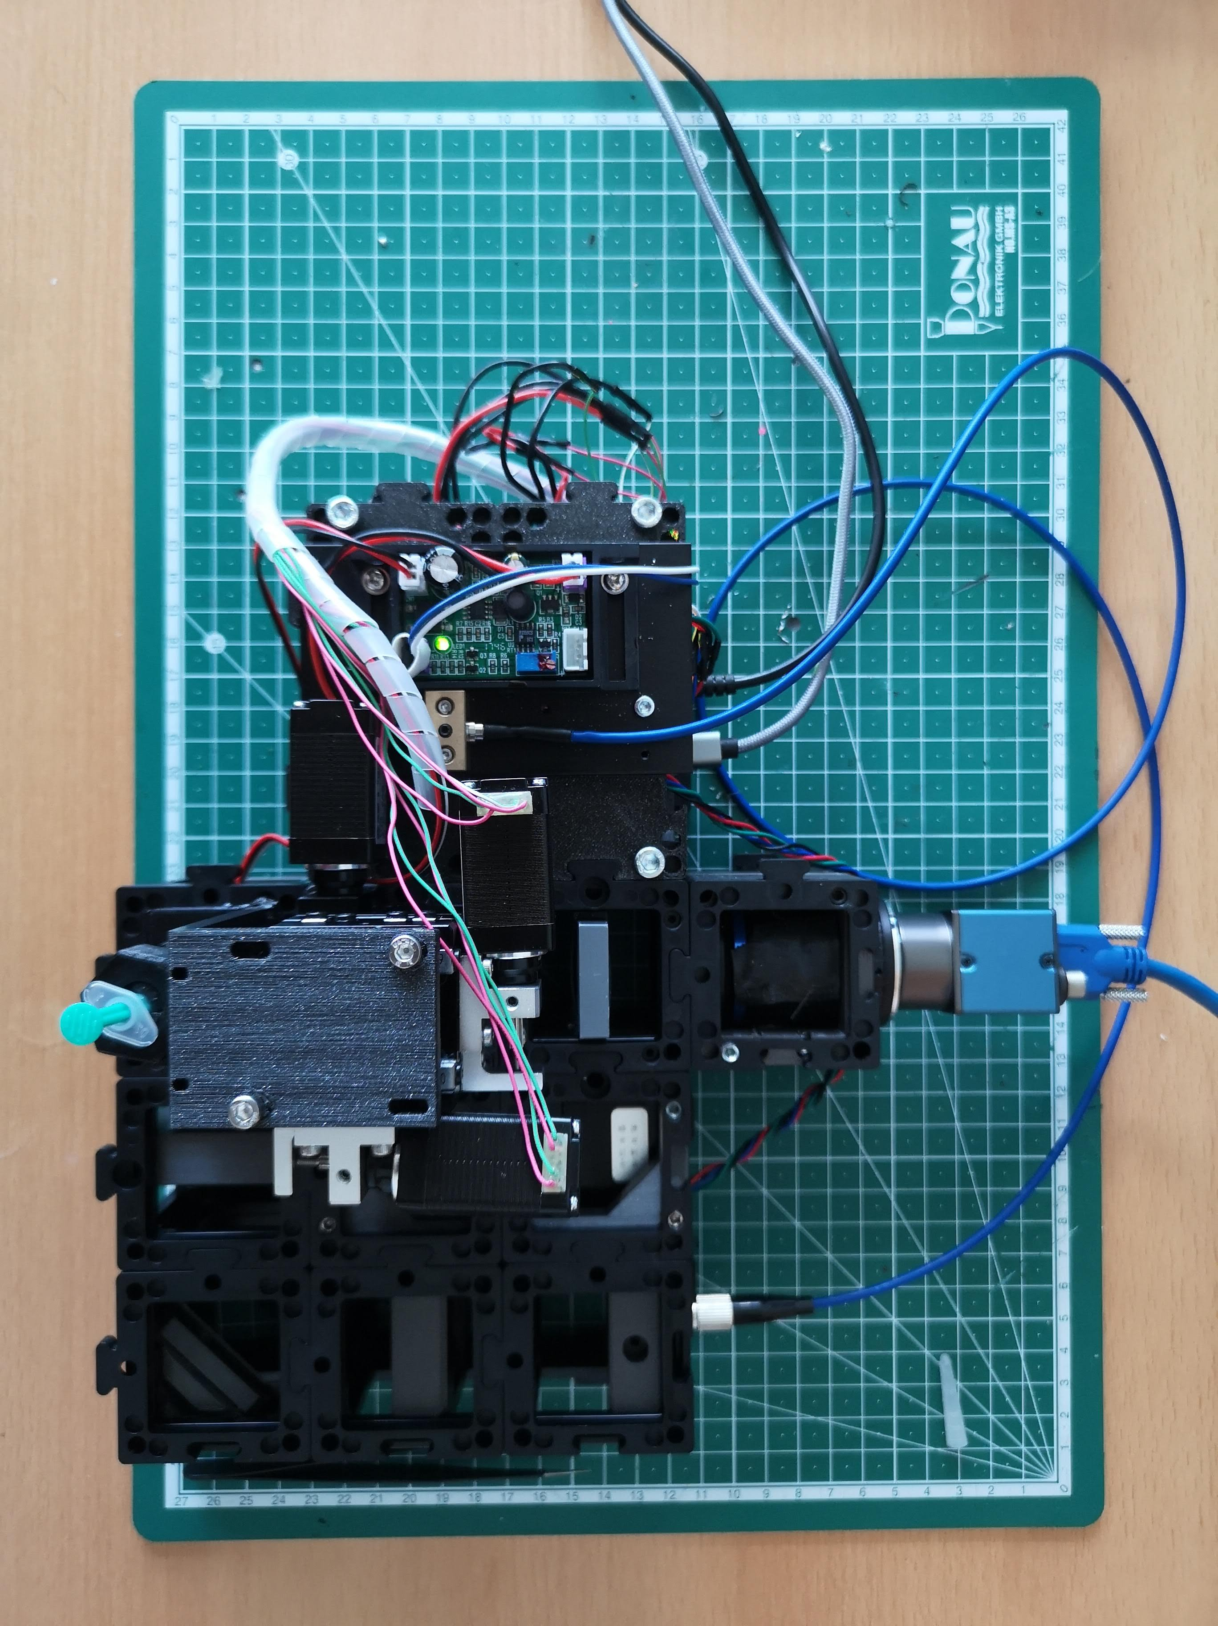
USB3 Cable
USB for UC2e
Laser Driver
Fluorescence Filter
Electronic
Objecitve lens
Tubelens
Sample
Camera
XYZ Stage
Kinematic mirror
Cylindrical Lens
Collimator
Fiber-coupled Laser

