Slide 1
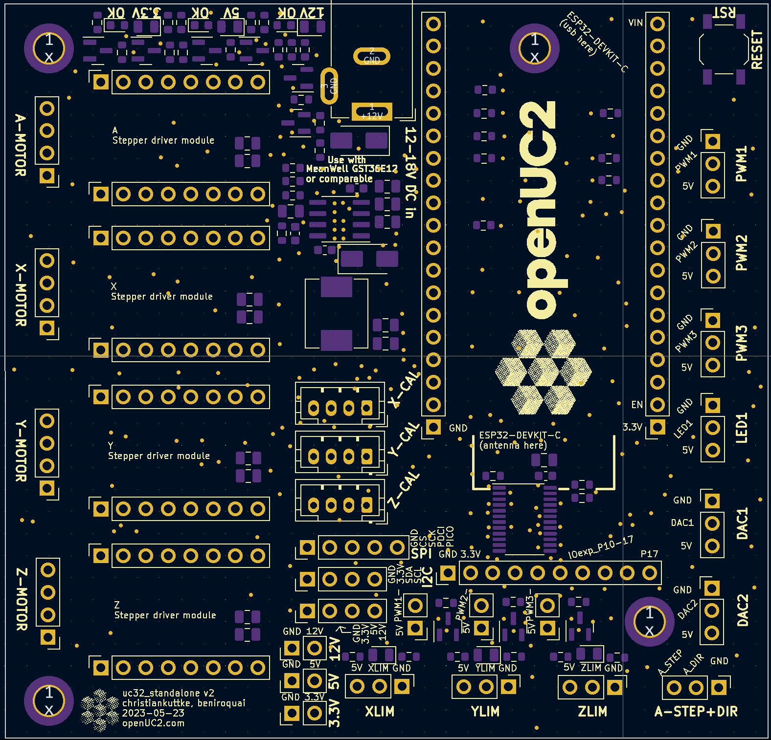
Encoder (e.g. X-CAL)
Xcal_CLK
Xcal_Data
3V3
GND

