Slide 1
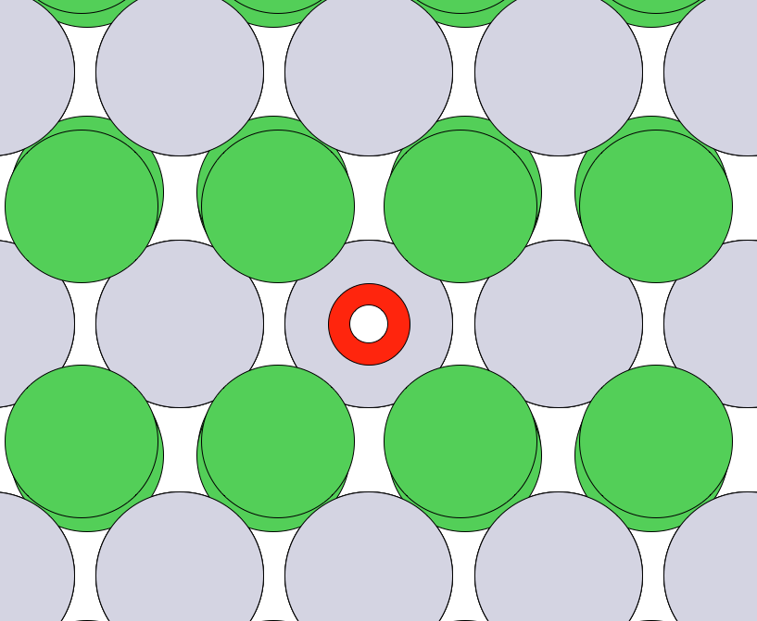
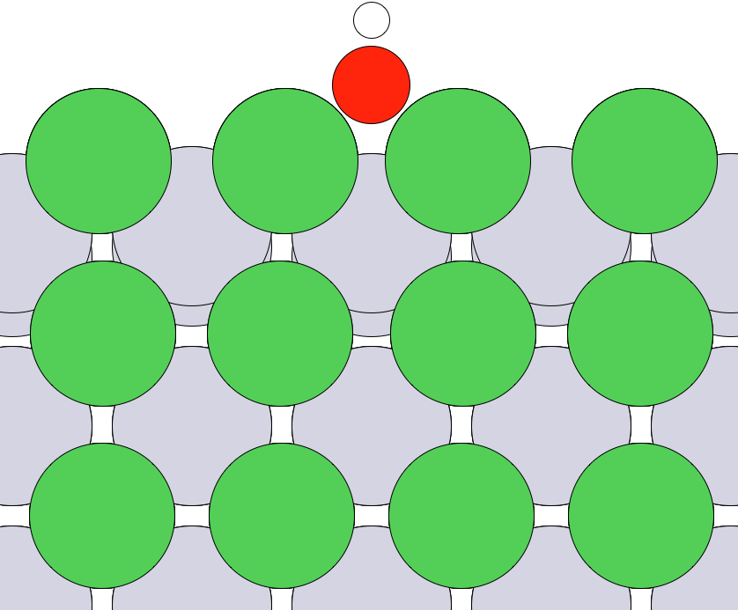
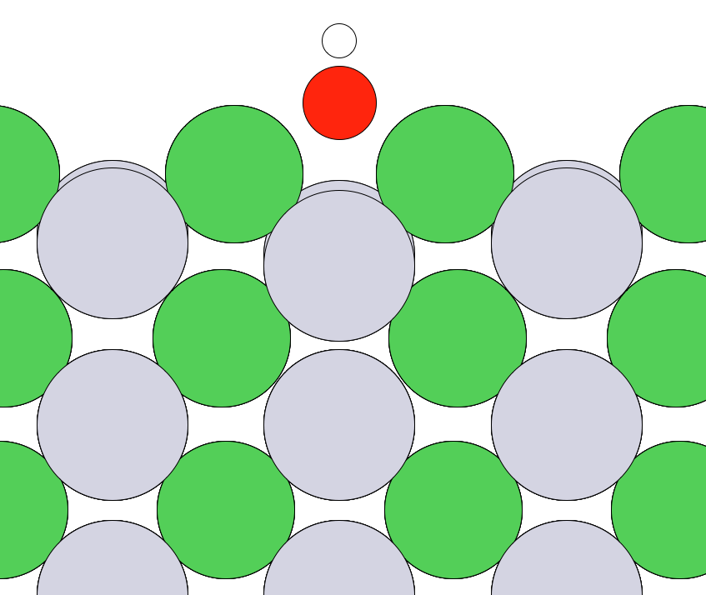
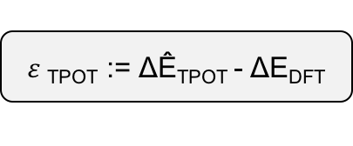


a
coordination
b
Pt Ni
[1 4]
Pt Ni
Pt [ 3 8
Ni 16 12]
TPOT
ΔÊ_{TPOT}
neighbors’ coordination
$ε$_{TPOT} := ΔÊ_{TPOT} - ΔE_{DFT}
ΔÊ_{TPOT} + $\hat{ε}$_{TPOT}
ΔÊ_{X}
Gaussian process regressor
$\hat{ε}$_{TPOT}

