Slide 1
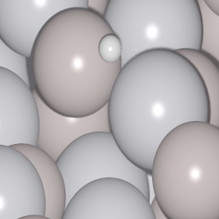
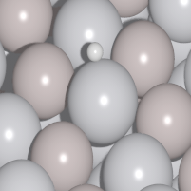
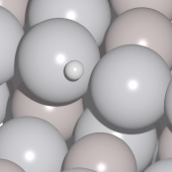
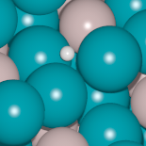
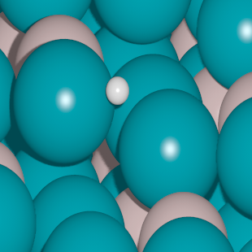
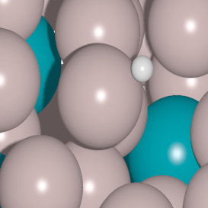
SiV
NiSi
AlPd
PdV
AlRh
PdSi
AlPt
PdIn
PtGa
CuGe
InRh
PdSn
AlNi
ΔE_{H}
PdGa
< -0.47
-0.27
> -0.07
optimal

Slide 2
SiV
NiSi
AlPd
PdV
AlRh
PdSi
AlPt
PdIn
PtGa
CuGe
InRh
PdSn
AlNi
ΔE_{H}
PdGa
< -0.47
-0.27
> -0.07
optimal

