Slide 1
Difference between:
# Get the length-frequency data (length in millimeters)
lfmm <- read.lfmmdata.f(raw_data_dir,"LengthMM2000-2021.txt")
# Get the grouped length-frequency output
lfgrpd <- read.lengthfreq.f(raw_data_dir,"LengthFreq2000-2021.txt")

Slide 2
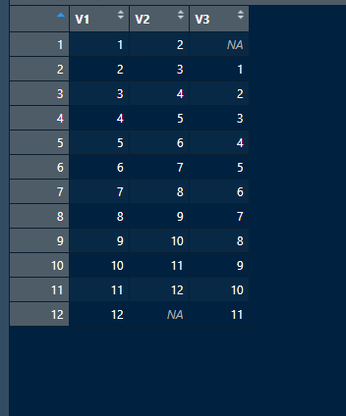
What is month.substitution.mat?

Slide 3
substitute.f = function(strat.defns,unloads.bystrat.miss,lfgrpd.all.frm,lfgrpd.stratflg,lfmm.all.frm,gear.sub,area.sub,month.sub,min.subsize,growth.increments.array)
{
# this function computes catch species and size composition for strata with unloads (ie, cae+idm) but no sample data
# edited version of stratum.estimates.f (see that function for documentation details of equations)
#
# lfgrpd.stratflg is output of create.strat.flg.f applied to lfgrpd.all.frm
#
# strat.defns and unloads.bystrat.miss are the parts output by get.strat.unloads.f
# but subsetted for missing data strata using output of stratum.estimates.f
# lfgprd.all.frm is output from read.lengthfreq.f; subsetted for specific year
# min.subsize is the minimum number of samples per stratum required to make an estimate
#
# this function uses the following functions: get.sub.f, well.miss.f
#
# edited December 2021 to fix bug in code that searches for a substitution (bug was that number of rows of lfgrpd.all.frm for a cell was used as number of samples,
# which is not correct because records in that data frame are unique tripno x wellsampleno x species (and possibly x sampno if sorted sample)
#
# start of code added Jan 25 2022
# column 1 of fo.fishery.submat is the fishery seeking a sub, and columns 2-5 are the possible subs
fo.fishery.submat<-matrix(c("FO.A1","FO.A3","FO.A2","FO.A4","FO.A5","FO.A2","FO.A4","FO.A5","FO.A1","FO.A3","FO.A3","FO.A1","FO.A4","FO.A5","FO.A2","FO.A4","FO.A5","FO.A2","FO.A3","FO.A1","FO.A5","FO.A4","FO.A2","FO.A3","FO.A1"),ncol=5,byrow=T)
# end of code added Jan 25 2022
#
# get number of strata
nstrats<-length(unloads.bystrat.miss)

Slide 4
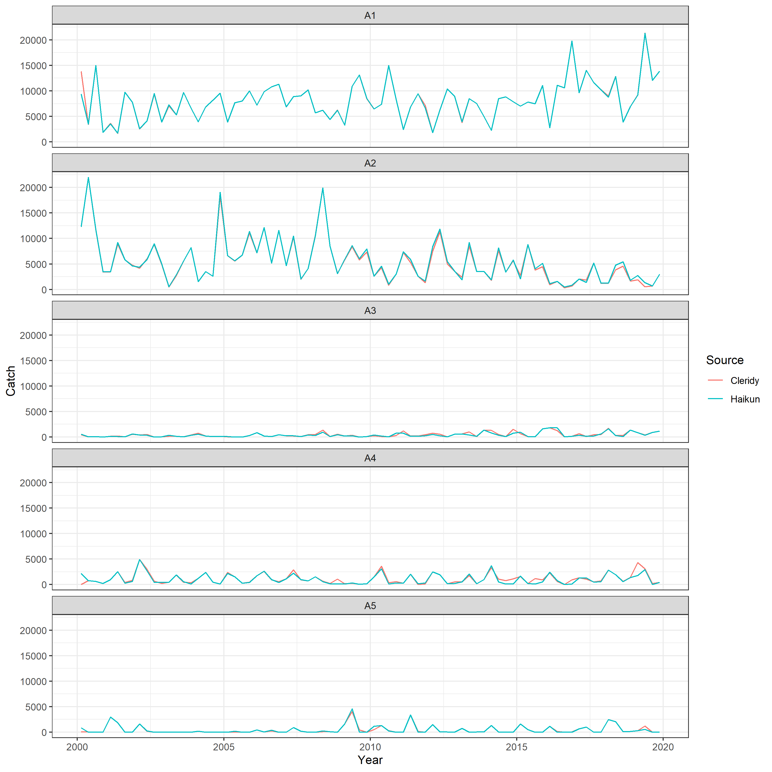
# November 30 2021
# Updated January 26 2022 using corrected programs (corrected for substitution bug) and additional fishery-level substitution rules
SAC 12
Corrected

Slide 5
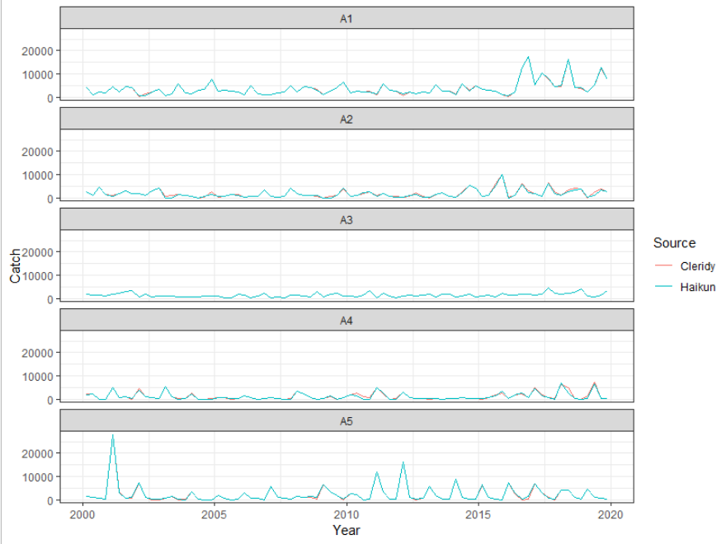

Slide 6
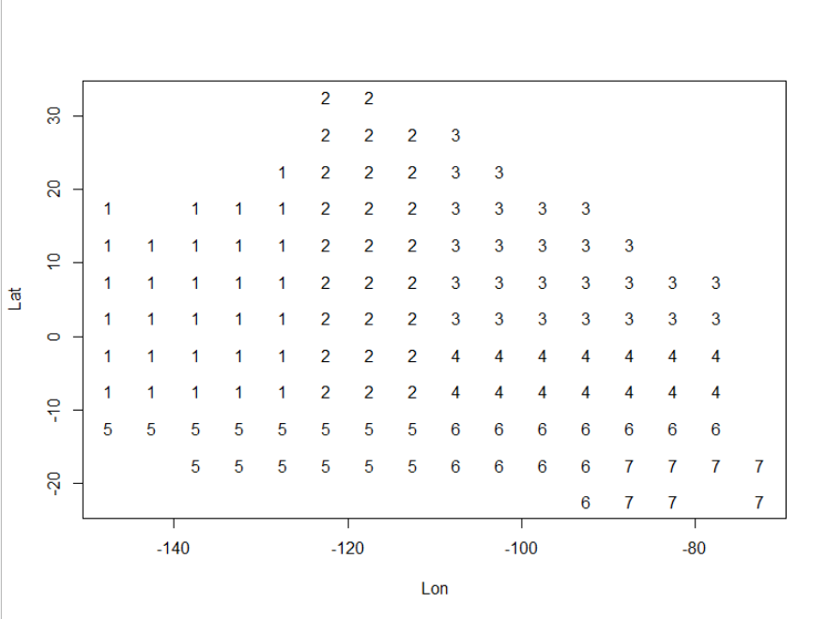
BET OBJ

