Slide 1
Spatial Assessment Modeling Workshop – progress update
3/10/2022

Slide 2
Simulated data (100 replicates) are available for various degree of aggregation
1-area SS data file (ESS=5)
4-area SS data file (ESS=5)
221-cell raw data file (ESS=5)
1-area SS data file (ESS=25)
4-area SS data file (ESS=25)
221-cell raw data file (ESS=25)

Slide 3
Three models are compared for the 1st replicate
Similarity:
single-stock assessment models using the areas-as-fleets approach;
include a longline survey fleet;
the index of abundance and associated length compositions are based on fitting VAST to cell-level cpue and lf data, respectively;
comp data are weighted using the Francis approach;
index CV is time-varying with a mean of 0.075 (based on RMSE of residuals)
Survey fleet is assumed to have asymptotic selectivity; all fishery fleets are assumed to have dome-shaped selectivties (could still be asymptotic through)
All biology parameters are fixed at their true values

Slide 4
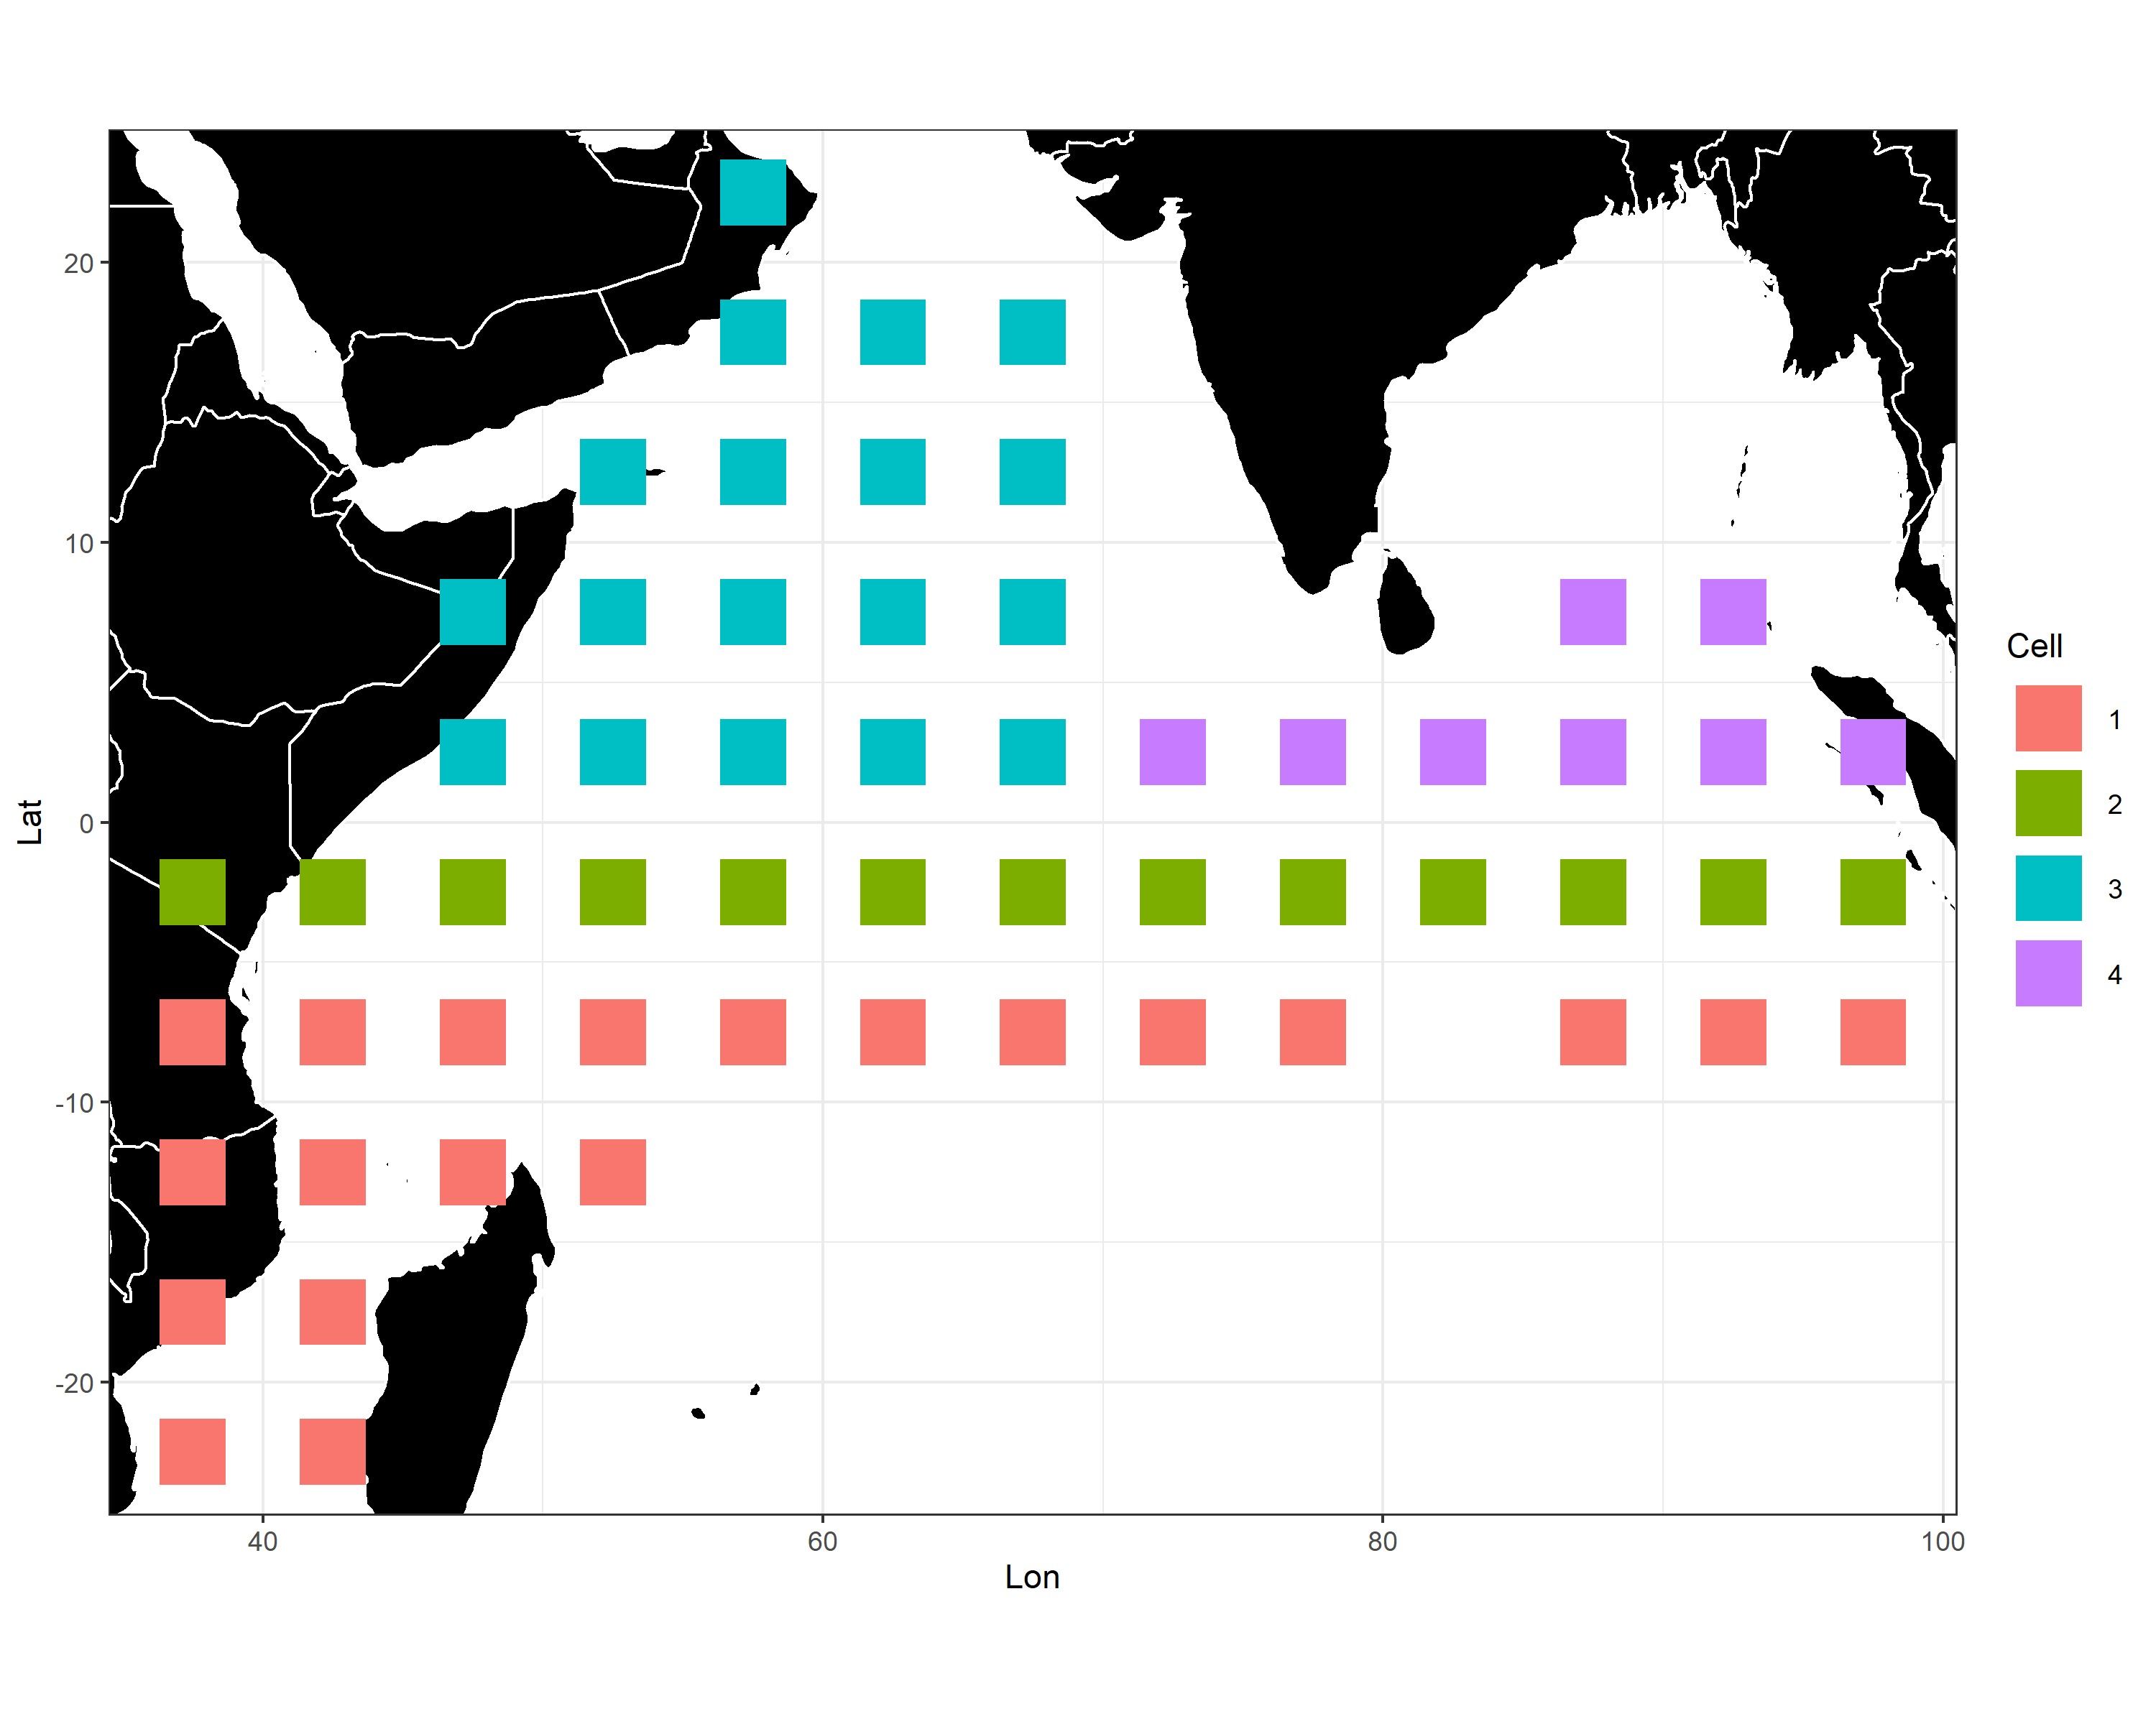
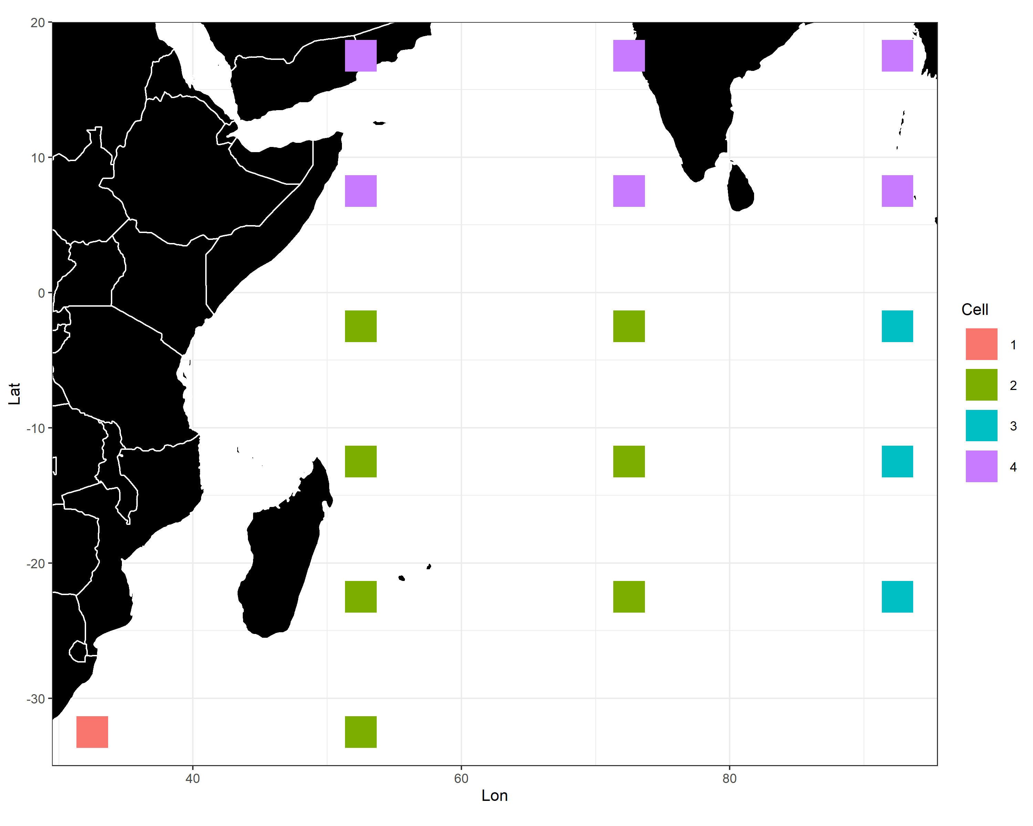
Three models are compared for the 1st replicate
Difference:
Model1 | Model2 | Model3
Pre-defined (default) fisheries | Regression tree-defined PS and fisheries | Regression tree-defined PS fisheries
All fisheries’ comps are sample weighted | All fisheries’ comps are sample weighted | PS fisheries’ comps are catch weighted
PS

Slide 5
SS runs
Each model is run for three times:
Run with LF weight = 1
Run with LF weight = Francis
Run with LF weight = Francis and suggested recruitment bias adjustment

Slide 6
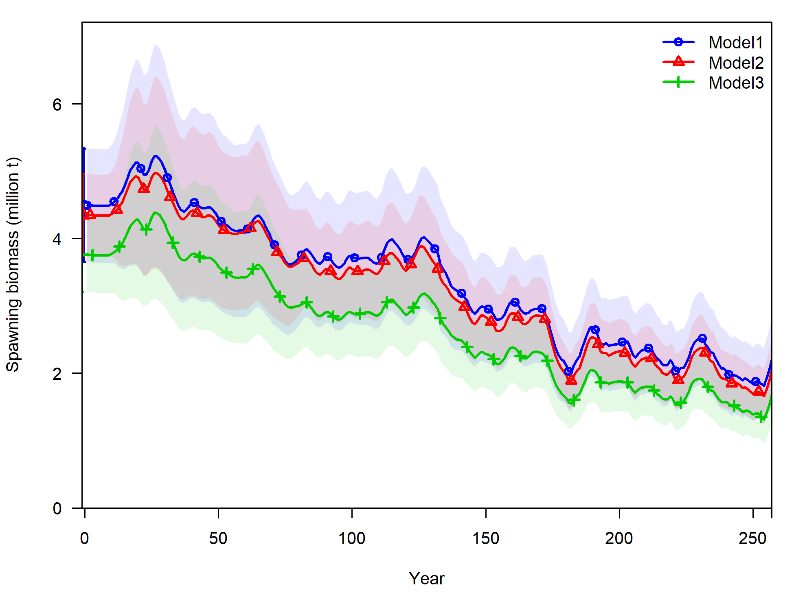
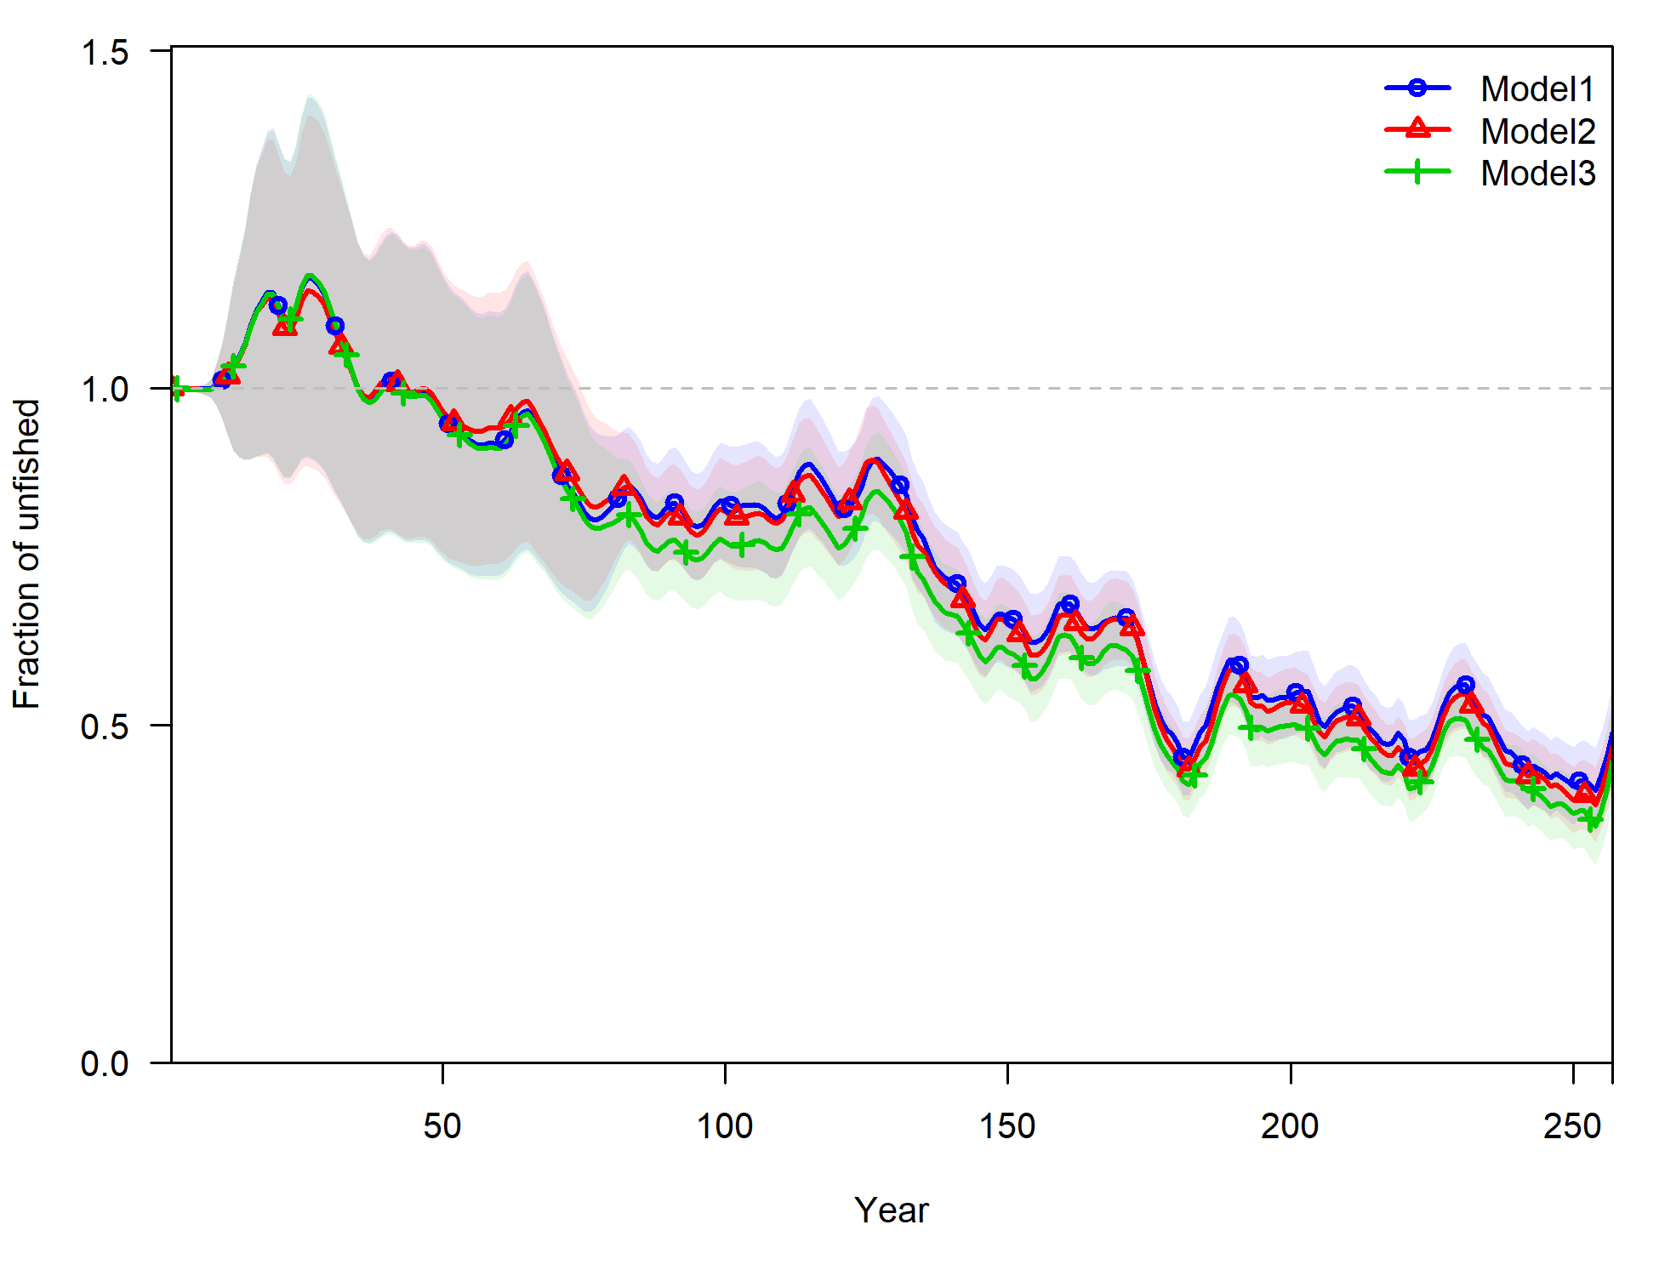
Model1 | Model2 | Model3
Pre-defined (default) fisheries | Regression tree-defined PS and fisheries | Regression tree-defined PS fisheries
All fisheries’ comps are sample weighted | All fisheries’ comps are sample weighted | PS fisheries’ comps are catch weighted

Slide 7
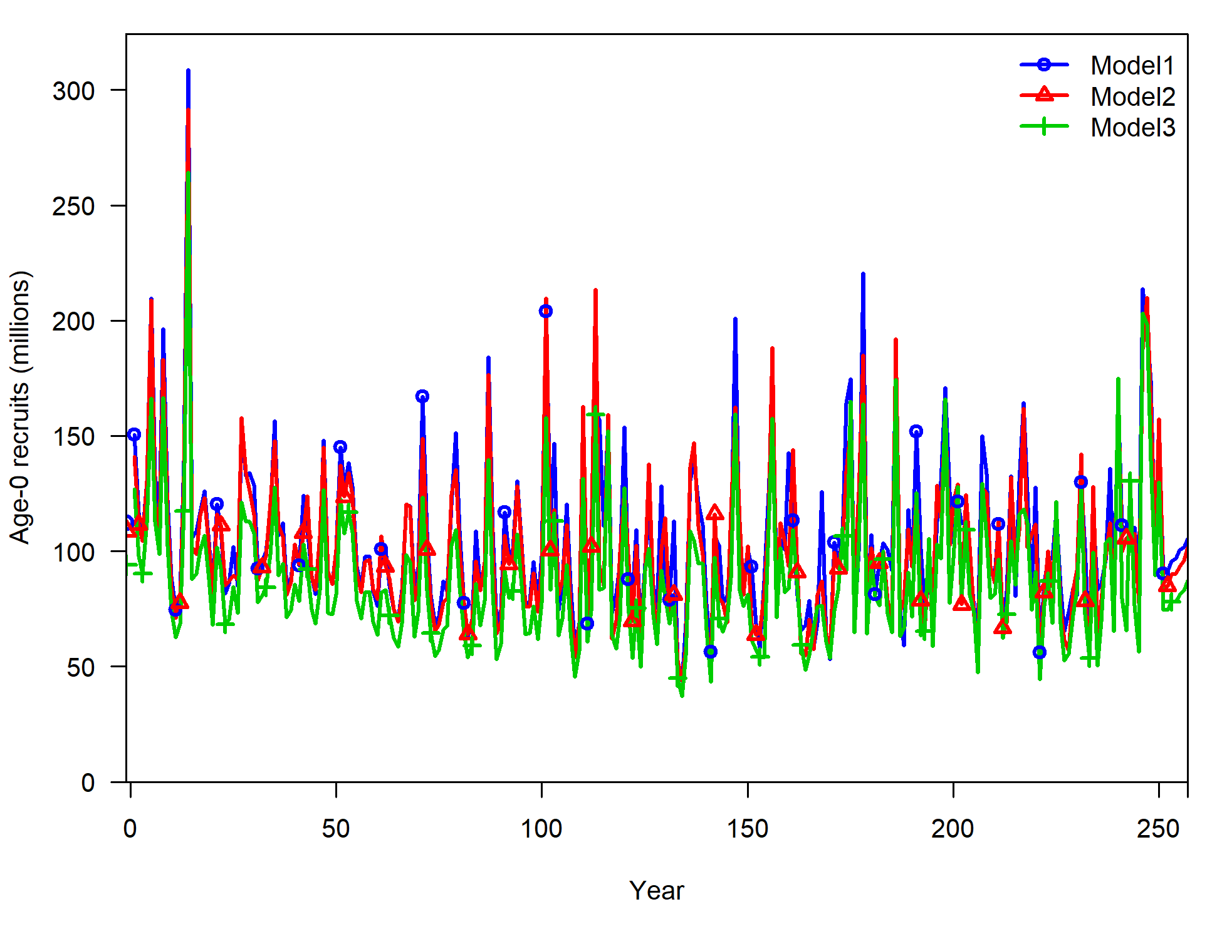
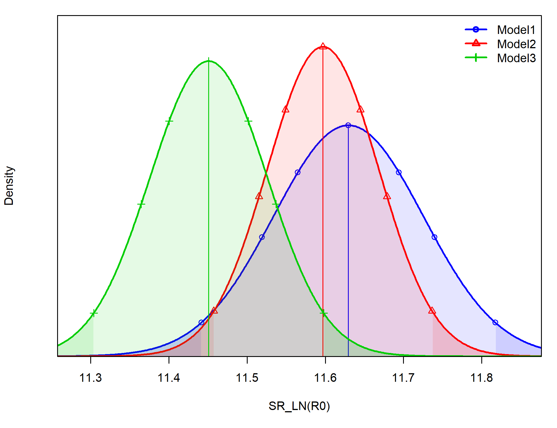
Model1 | Model2 | Model3
Pre-defined (default) fisheries | Regression tree-defined PS and fisheries | Regression tree-defined PS fisheries
All fisheries’ comps are sample weighted | All fisheries’ comps are sample weighted | PS fisheries’ comps are catch weighted
TRUE

Slide 8
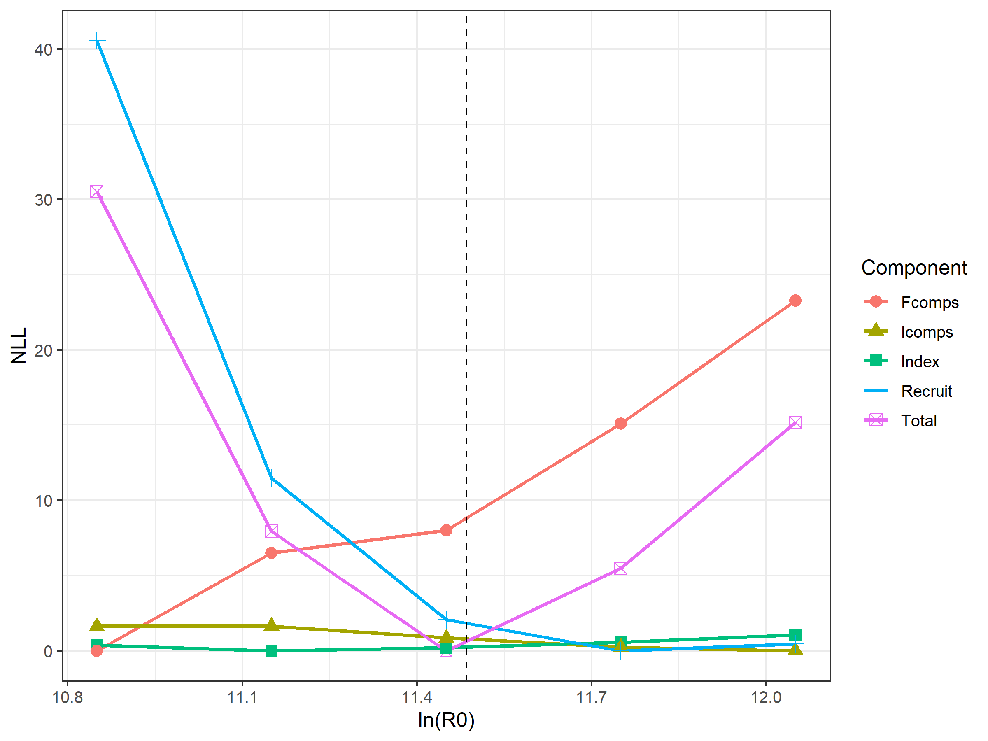
Some diagnostics for model 3

Slide 9
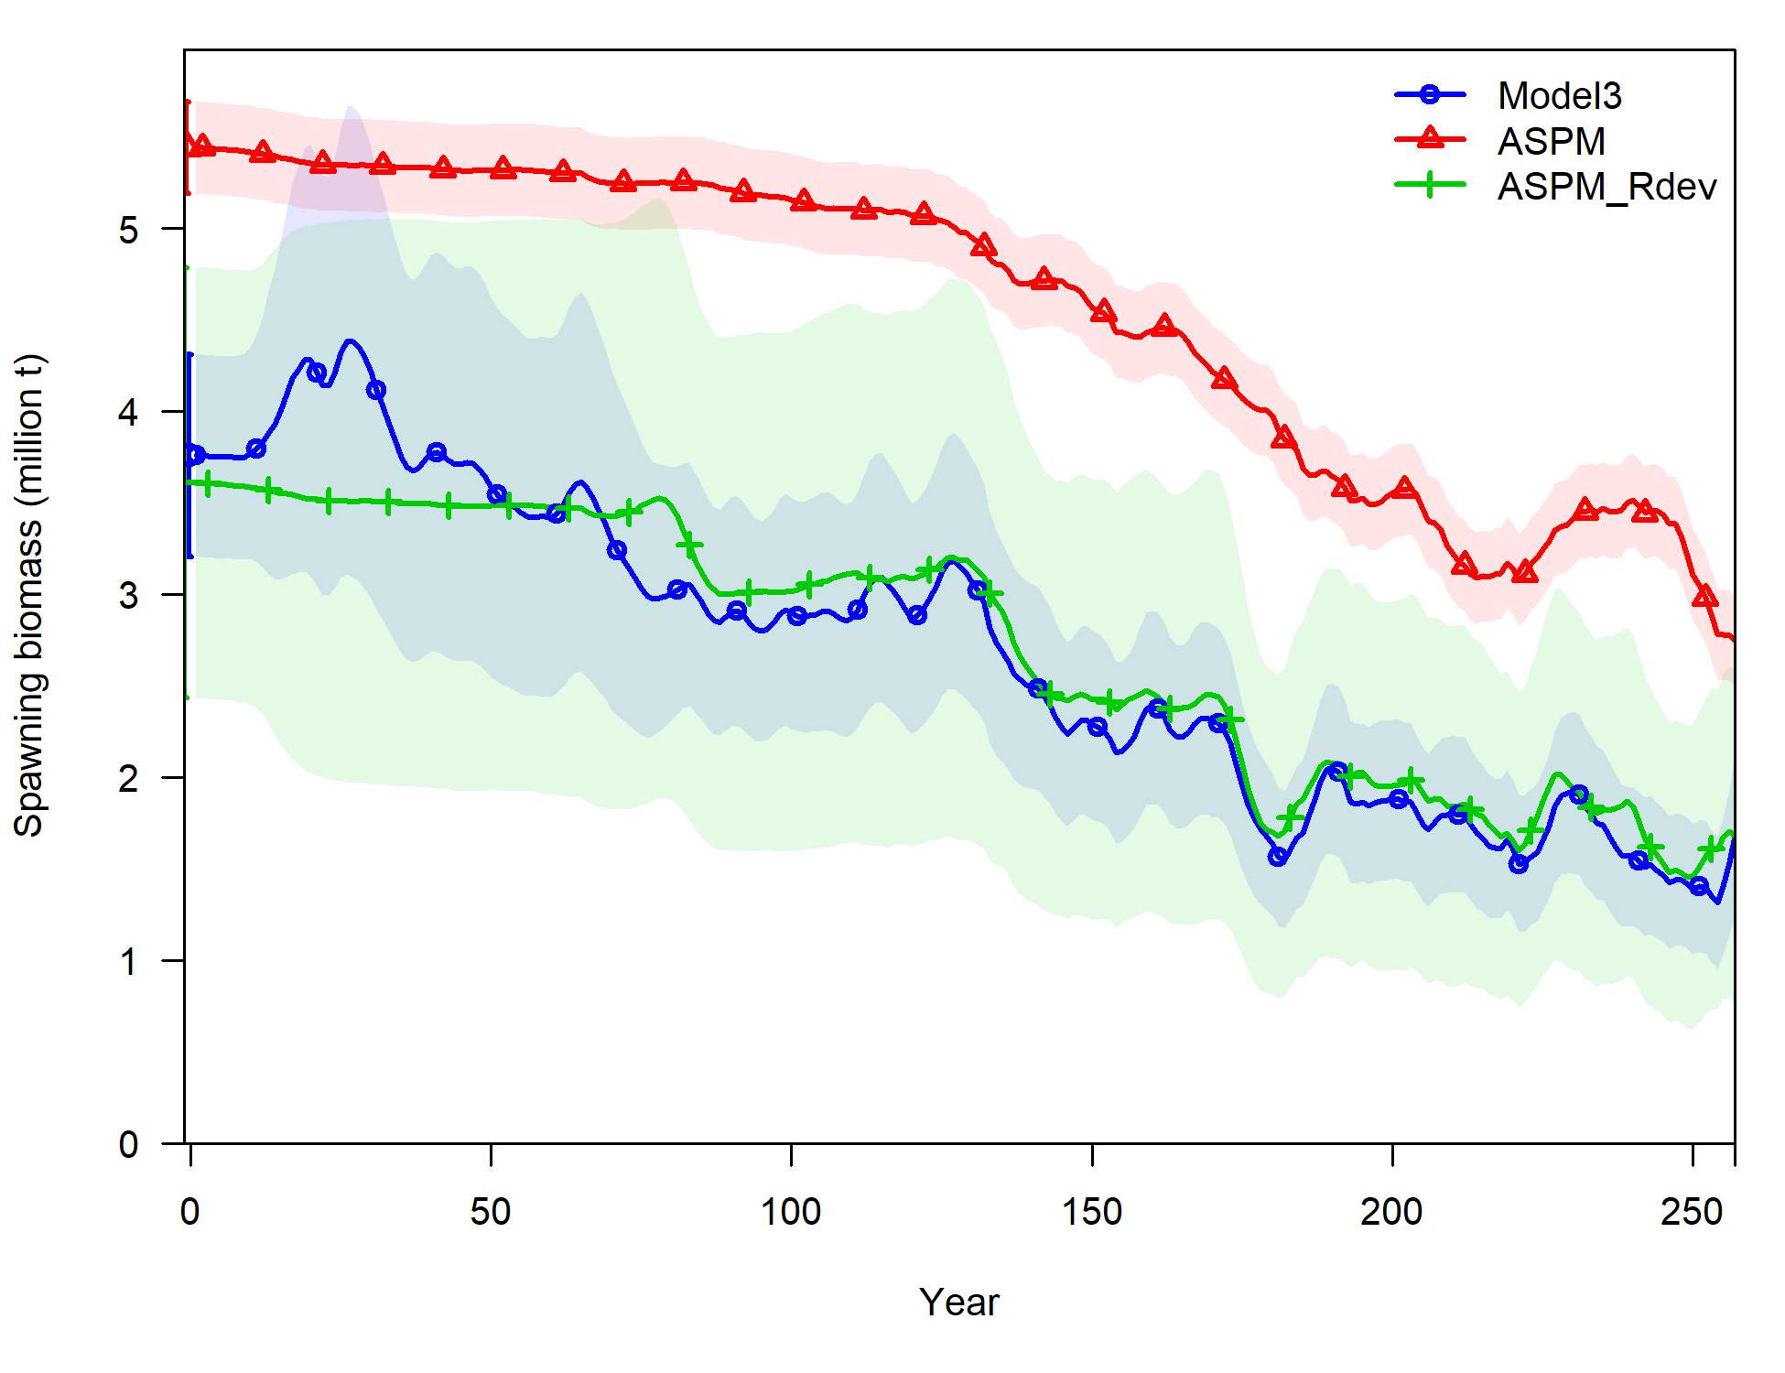
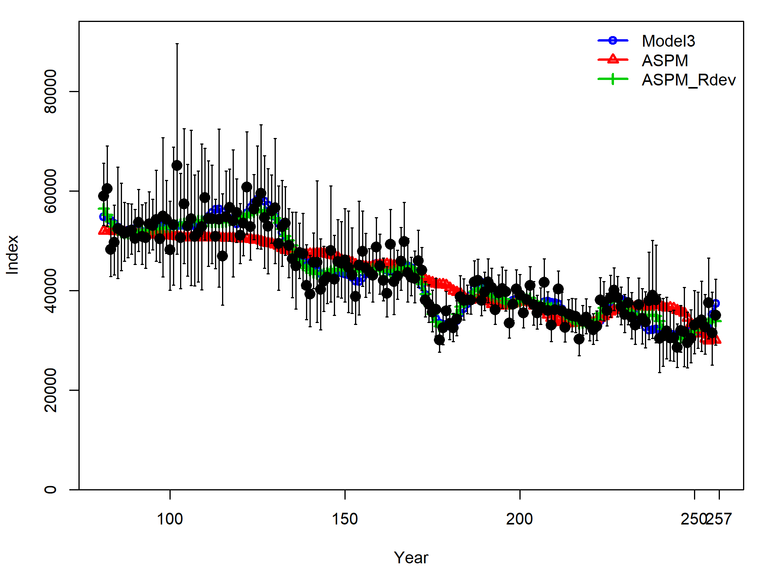
Some diagnostics for model 3

Slide 10
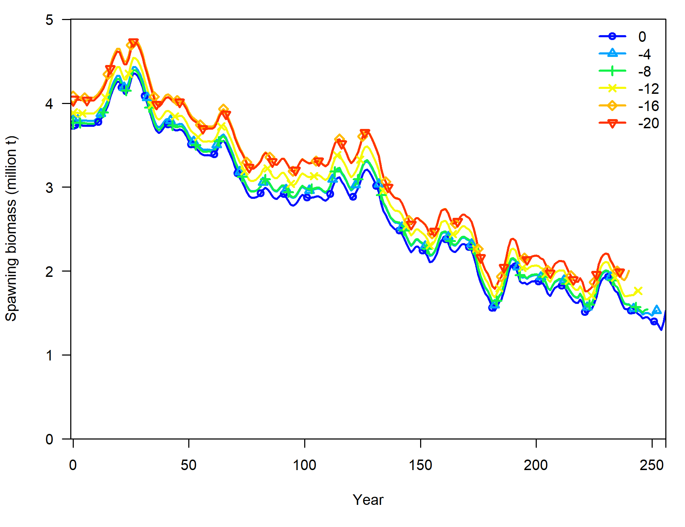
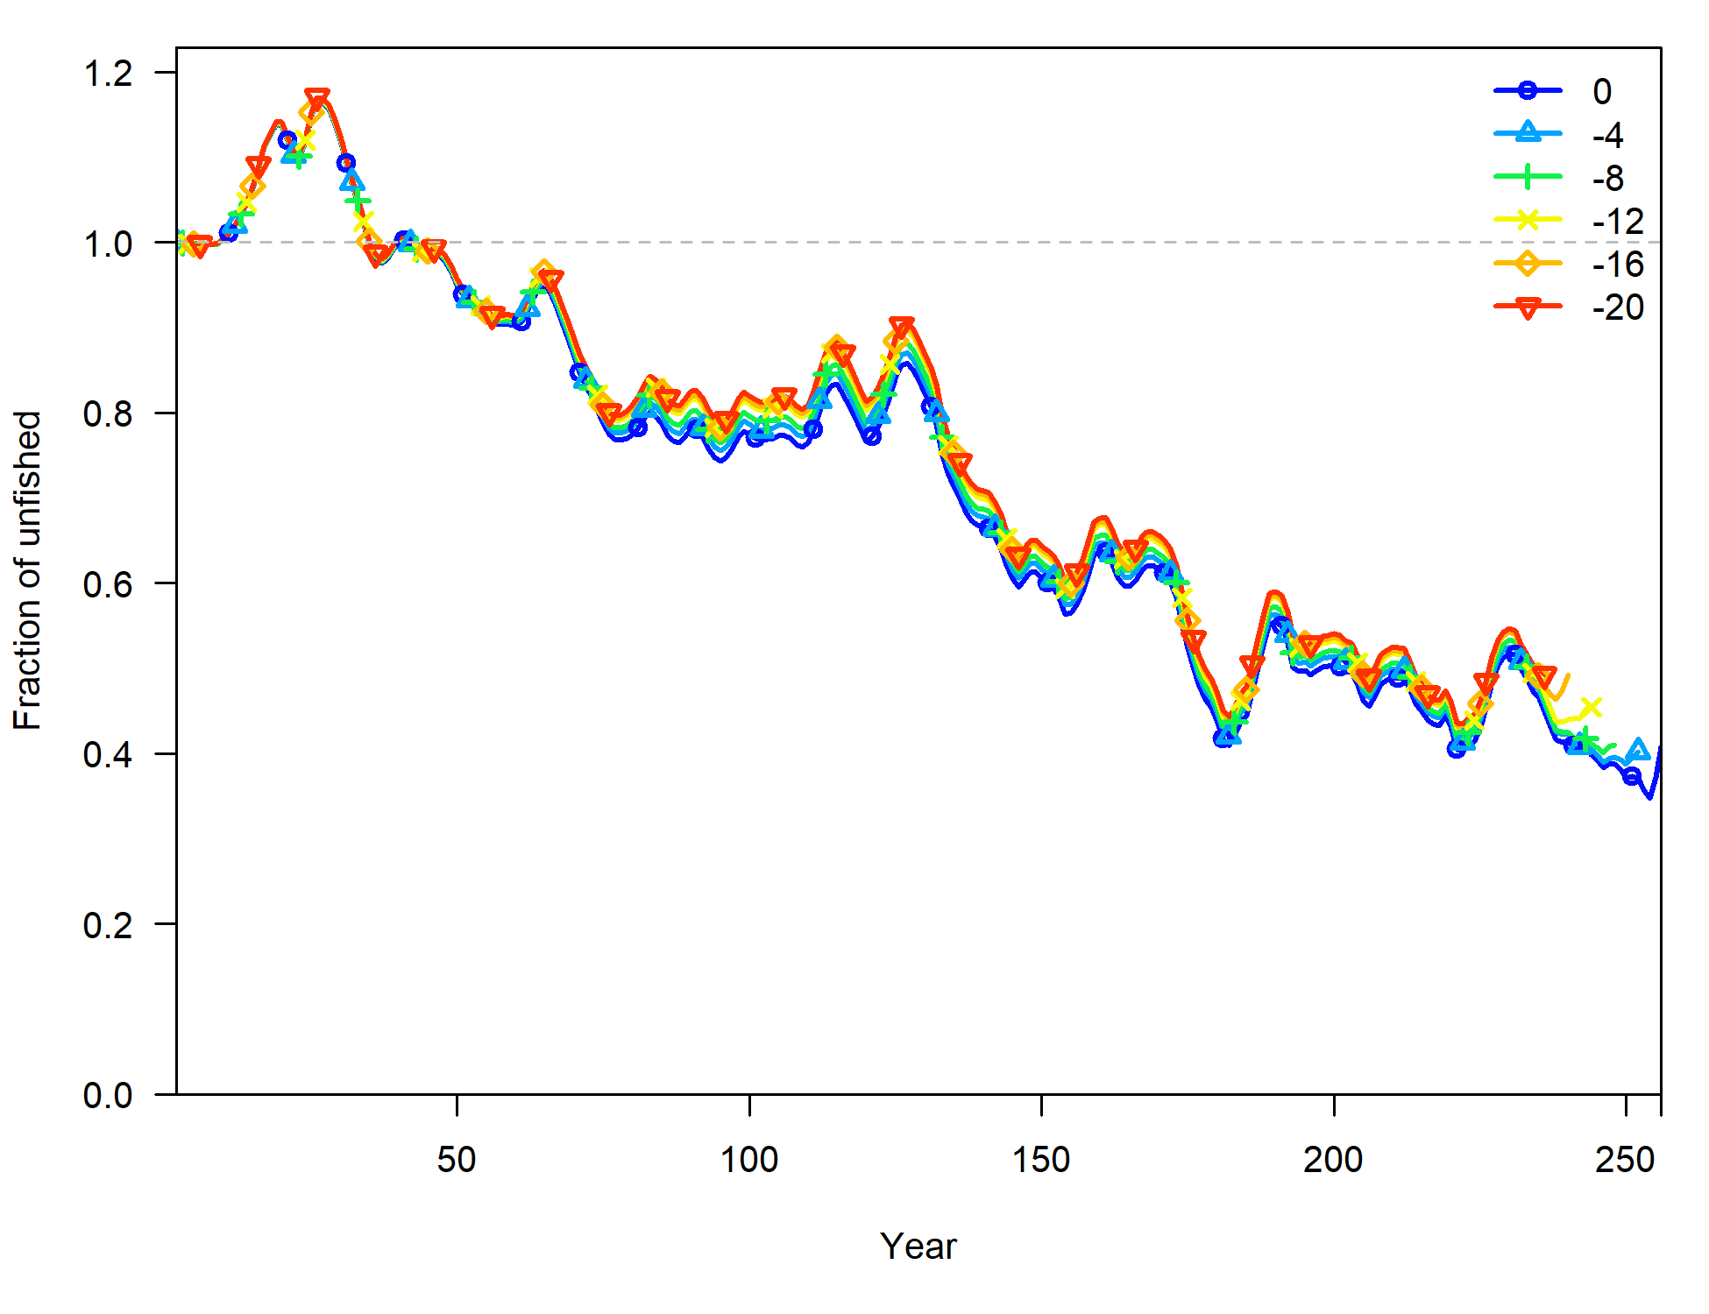
Some diagnostics for model 3

Slide 11
Issues
How to specify index CV? (sd(dev/se)=0.89; RMSE=0.064)

Slide 12
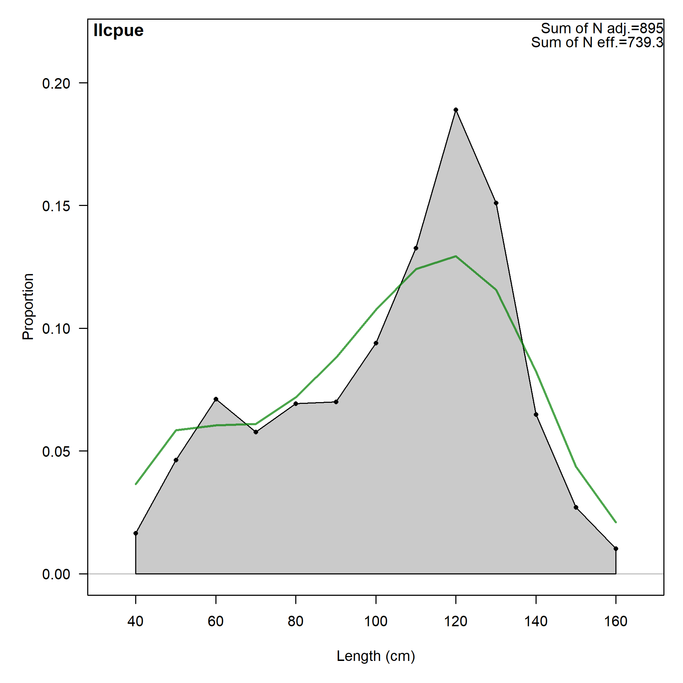
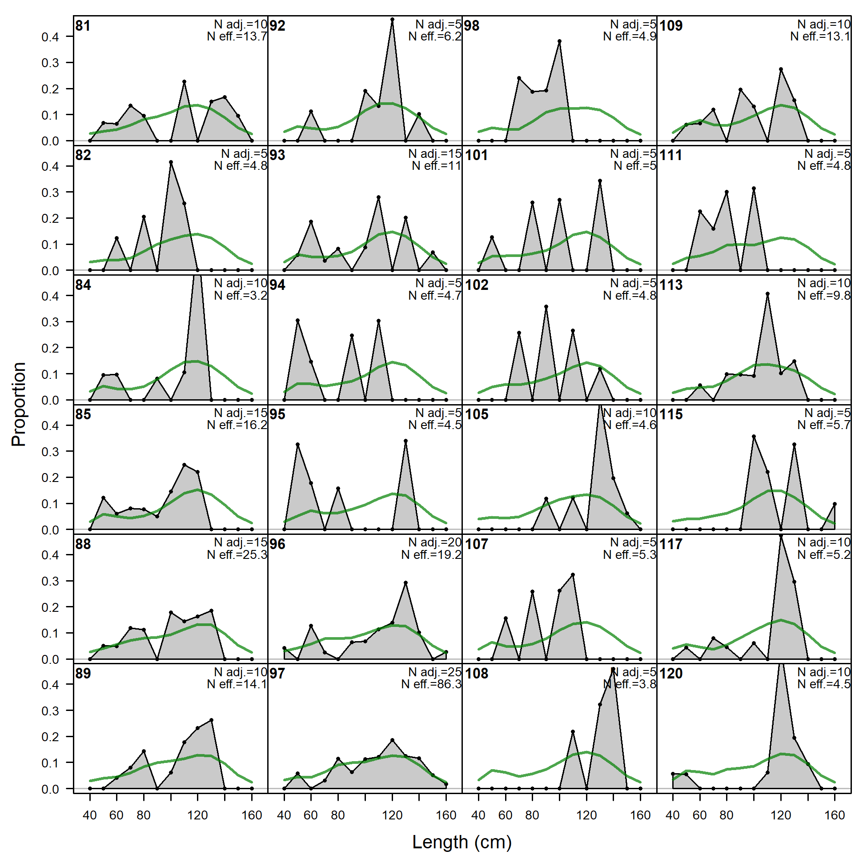
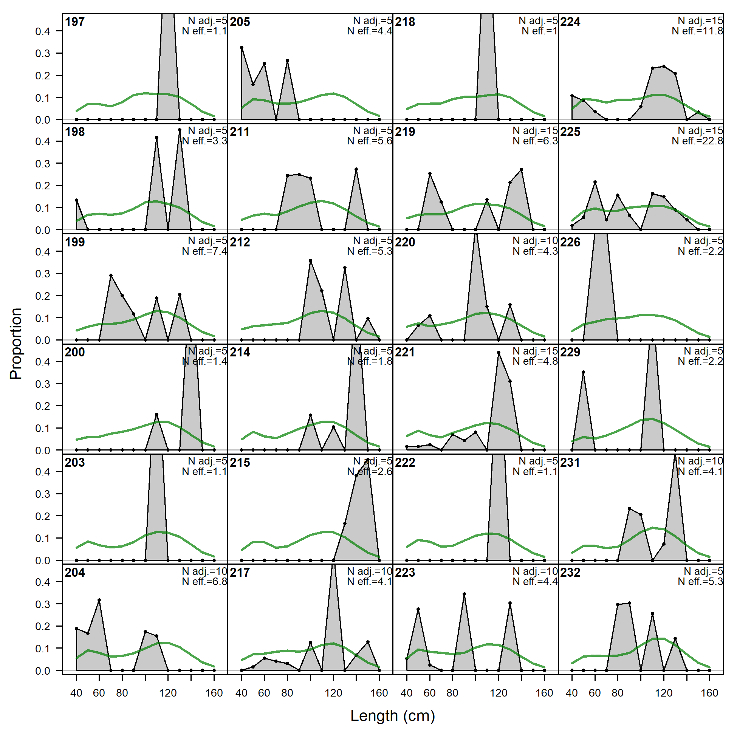
Issues
How to specify index CV? (sd(dev/se)=0.89; RMSE=0.064)
ESS is very small for the length-specific VAST model

Slide 13
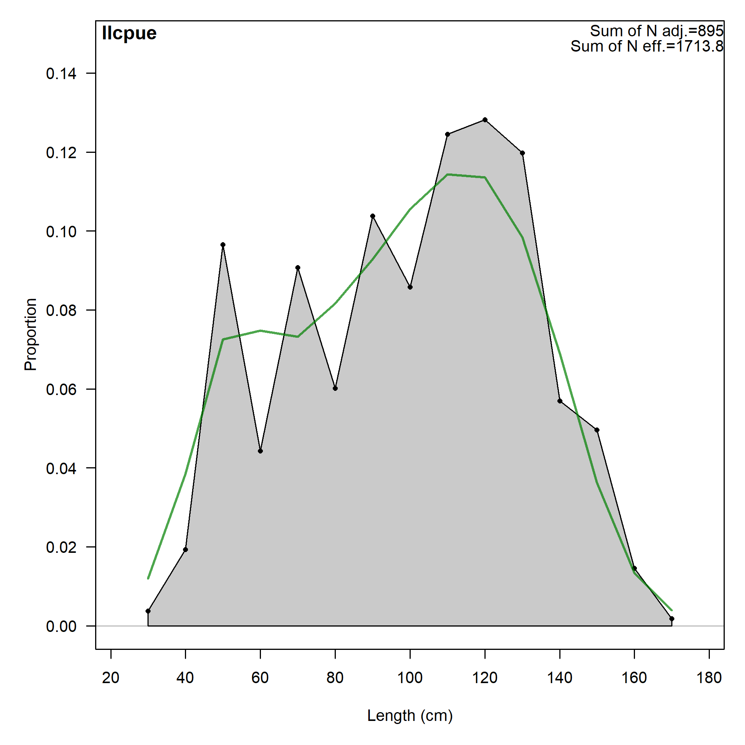
Issues
How to specify index CV? (sd(dev/se)=0.89; RMSE=0.064)
ESS is very small for the length-specific VAST model
ESS=5 ESS=25

