Slide 1
EDES 301
Project Proposal
LIGHTSABER
Hailey Adams
March 2, 2025

Slide 2
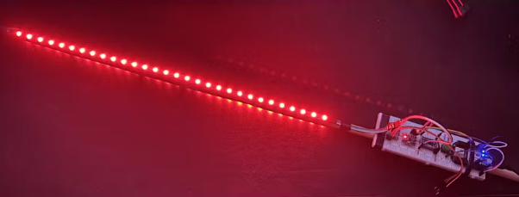
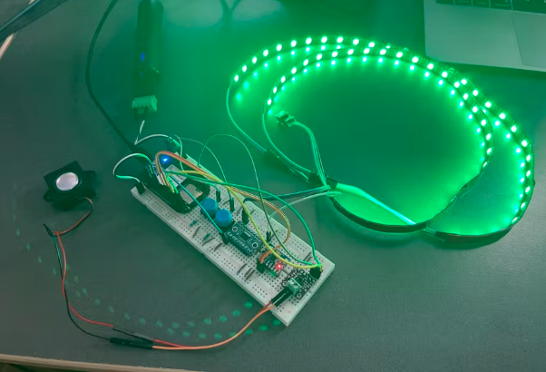
Previous Attempts
Current Features
EDES 301 Replica Lightsaber
https://www.hackster.io/lm65/edes-301-replica-lightsaber-62714d
EDES301 Lightsaber
https://www.hackster.io/mustafa-latif/edes301-lightsaber-2d389d
Animated Activation / ON
Light turns on bottom to top when button is pressed
Color Options
Can flip through several colors by pressing a button
Animated Deactivation / OFF
Light turns off top to bottom when button is pressed
Page #

Slide 3
I have been a huge fan of Star Wars since I was a child. My keys have a millennium falcon on them and I have a Star Wars Poster in my room. Making a lightsaber in this class would just be so cool.
My improvements would mainly be software and deal with the power issue faced by both projects on previous slide.
1. Integrate more LED strands
To make the Lightsaber brighter
2. Flash White with Contact
When the lightsaber hits something, it should flash white
3. Flicker when Moving/Swinging
As Lightsaber is swung, part of lights should flicker
Inspiration:
Background and Improvements
https://www.youtube.com/watch?v=ycwE73o-8YE
Page #

Slide 4
System Block Diagram
50 mA
1 microA?
GPIO
3.3 V
Level Shifter (MAX98357)
5 V
LED (WS2812B)
Pocket Beagle
(OSD335x-SM SiP)
Small LEDs
5V Portable USB Battery
5 V
1.8 V
Motion Sensor (MPU-6050)
I2C
3.9 mA
Note: Having a lot of trouble finding data sheets and current ratings for components

Slide 5
Software Block Diagram
PocketBeagle Off
Press B1
PocketBeagle on Standby (S LED ON Based on last color)
Hold B2
Lightsaber ON (Animated)
Press B2
Cycle Through Colors (Each Press)
Hold B2
Swing Saber
Press B1
GPIO
Lightsaber OFF (Animated)
Motion State: Flickering
Make
Contact
Contact State: White Flash
I2C
Note: Lightsaber stays in color it was last in even if turned off and back on

Slide 6
Parts List
Component EDES301 Buy? Cost
Level Shifter (on parts list)
LED Lights (on parts list - ASK)
IME Motion Sensor (on parts list MPU-6050)
5V battery pack
YES - https://www.amazon.com/EPLZON-Converter-Bi-Directional-Compatible-Raspberry/dp/B09R1QG957
YES - TBD
YES - https://www.amazon.com/MPU-6050-MPU6050-Accelerometer-Gyroscope-Converter/dp/B09Q2SGF3R
YES - https://www.amazon.com/EnergyQC-Portable-Ultra-Compact-Compatible-More-Black/dp/B09Z6T7FQ8/
1.60
TBD
2.10
12.99
Questions: Is the motion sensor sufficient to sense swinging of blade? I can’t find voltage requirements for IME Component.

Slide 7
Data Sheets
IMU: chrome-extension://efaidnbmnnnibpcajpcglclefindmkaj/https://invensense.tdk.com/wp-content/uploads/2015/02/MPU-6000-Datasheet1.pdf
Level Shifter:
https://www.digikey.com/en/htmldatasheets/production/196075/0/0/1/txs0108epwr
LED:
https://www.digikey.com/htmldatasheets/production/2371852/0/0/1/ws2812b-led.html?gclsrc=aw.ds&&utm_adgroup=xGeneral&utm_source=google&utm_medium=cpc&utm_campaign=Dynamic%20Search_EN_Product&utm_term=&utm_content=xGeneral&utm_id=go_cmp-120565755_adg-7526266635_ad-398891859094_dsa-19959388920_dev-c_ext-_prd-_sig-Cj0KCQiAoJC-BhCSARIsAPhdfSh_j0Vf4T5okhv3wosD7Y0CxYhuCVlwoh6u6arbclJizTClgeZ6XmcaAhafEALw_wcB&gad_source=1&gclid=Cj0KCQiAoJC-BhCSARIsAPhdfSh_j0Vf4T5okhv3wosD7Y0CxYhuCVlwoh6u6arbclJizTClgeZ6XmcaAhafEALw_wcB&gclsrc=aw.ds
Page #

