Slide 1
Gender Gap in Self-Promotion
Group 9 - Quantitative Data Analysis, MSE 609
Aria Zhou, Jayachithra Thamizhmani, Srikirthi Srihari, Sri Sangeetha Sivashanmugam, Xiaohui Li

Slide 2
INTRODUCTION
Introduction
We often hear that self-confidence is highly valued in the workplace. The paper “The Gender Gap in Self-Promotion” by Exley and Kessler examines this through a gender lens and finds that women tend to underestimate their performance compared to equally capable men.
We replicate the main finding to verify that the pattern holds, after confirming the result we extend the analysis in two directions…
Extensions
Extension 1 – PIAAC (Canada): External dataset whether this gap appears among working adults
Extension 2 – Original Experimental Dataset: to test whether factors beyond gender — such as age ,education level — help explain the gap.
Topic Relevance : Management Sciences
It demonstrates how psychological biases, such as confidence gaps, influence organizational outcomes.
Shows how combining behavioral insights + quantitative analysis helps explain gender inequalities.

Slide 3
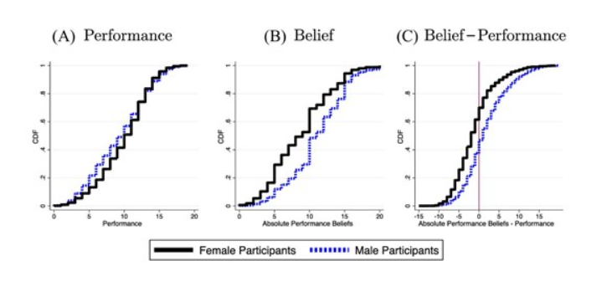
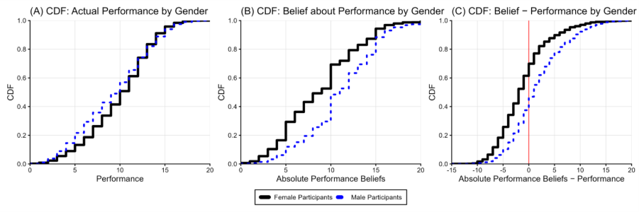
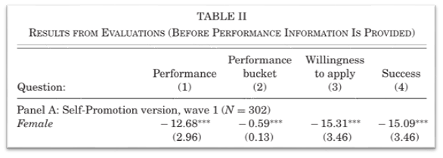
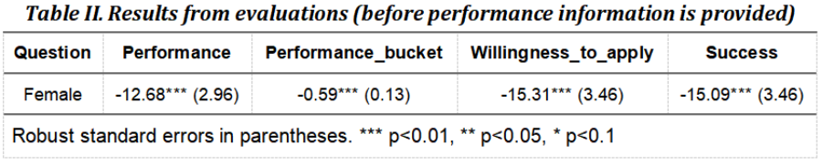

REPLICATION – APPROACH & RESULTS
Wave 1 sample (n = 3,892)
Constructed: performance, belief, belief–performance gap, application/success outcomes.
OLS model: $Y=β_{0}+β_{1}\left(\text{Female}\right)+β_{2}\left(\text{Performance}\right)$
Women rate themselves lower, self-rank lower, apply less, and succeed less despite equal ability.
Published Results (Exley & Kessler, 2022)
Replication Output - Using Wave 1 Self-Promotion data

Slide 4
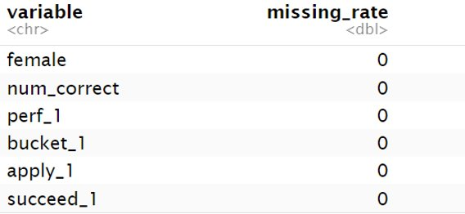
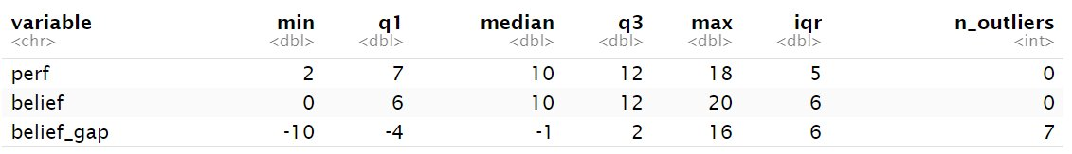
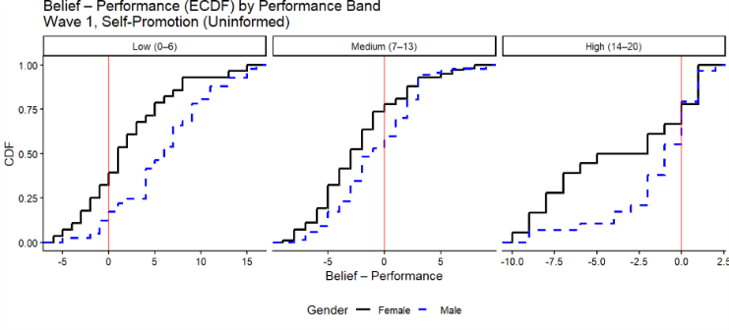
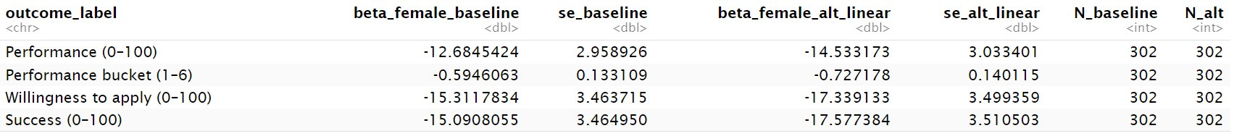
DIAGNOSTICS & CHECKS
Missingness
Heterogeneity in the Gender Confidence Gap Across Performance Levels​
Both men and women overestimate themselves in the low group, but women underestimate more strongly in the medium and high groups. The pattern suggests that the gender gap widens with ability or education level.​
Outliers
Robustness

Slide 5
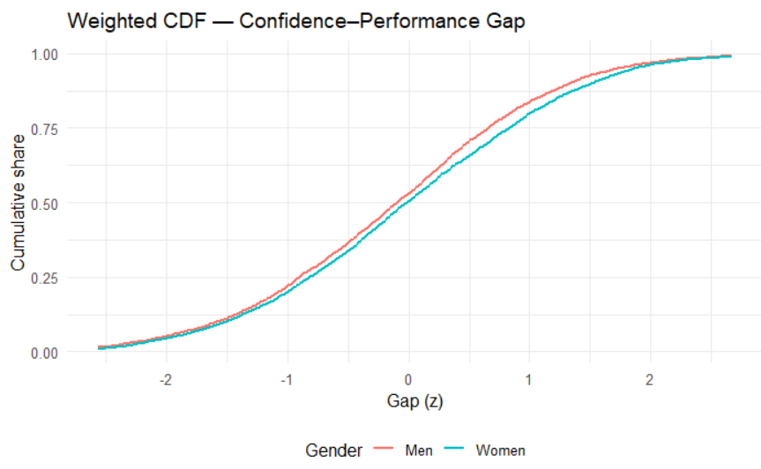
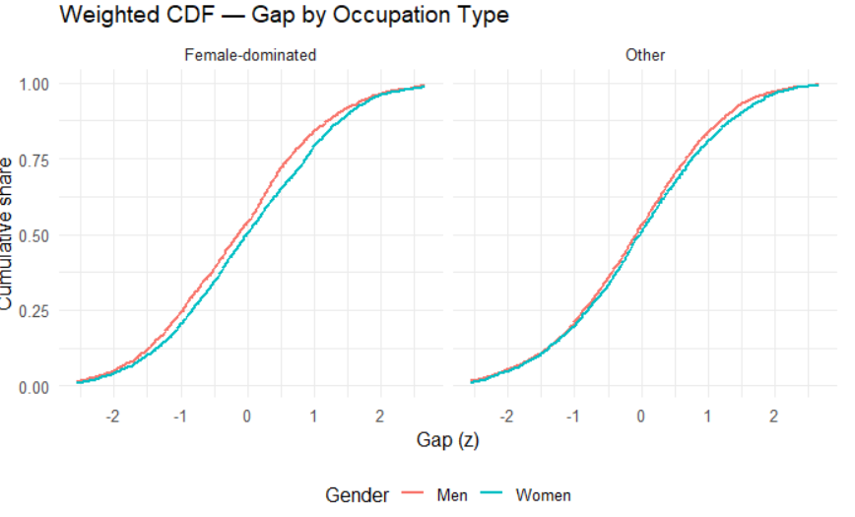
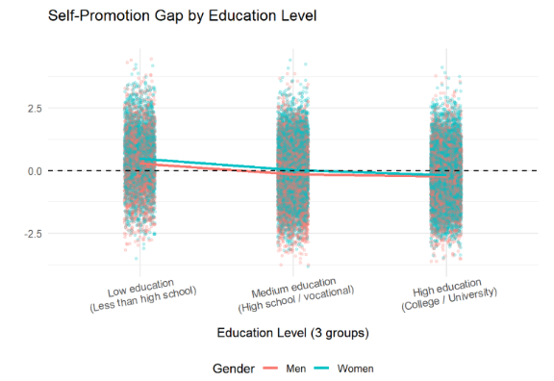

EXTENSION 1 – DATA, MEASURES & MODEL SPECIFICATION
Used PIAAC Canada ~26,683 adults (Balanced Repeated Replication-weighted),
Includes valid numeracy performance and numeracy-use responses; key subgroups: education, age, occupation.
Calculated: perf_z, use_z, and gap_z = use_z − perf_z.
Model Specifications
Model 1: Gender only gap_z = β0 + β1(Female)
Model 2: Gender × Education gap_z = β0 + β1(Female) + β2(Education) + β3(Female × Education)
Model 3: Gender × Age gap_z = β0 + β1(Female) + β2(Age) + β3(Female × Age)
Graph – Key Insights
At low education, women self-promote slightly more than men
Gap shrinks at medium education
At high education, gender gap is near zero (lines overlap).

Slide 6
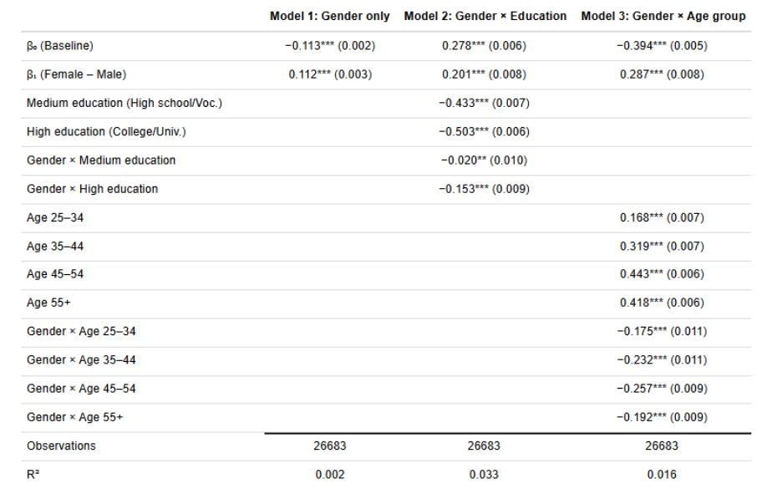
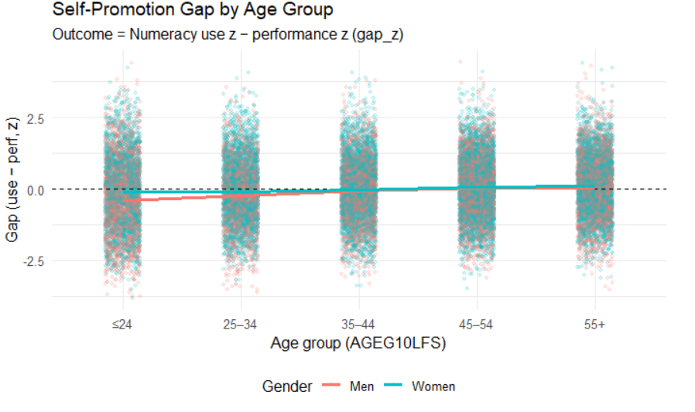
EXTENSION 1 – KEY RESULTS & CONCLUSION
Regression Table – Key Findings
Model 1 (Gender only): Women self-promote ~0.11 SD more (small positive gap).
Model 2 (Gender × Education):
Gap largest at low education: 0.20 SD
Gap shrinks at medium: 0.18 SD
Gap near zero at high: 0.05 SD
Model 3 (Gender × Age):
Gap highest at ages below 24: 0.20 SD
Gap shrinks at older age : around 0.03–0.10 SD

Slide 7
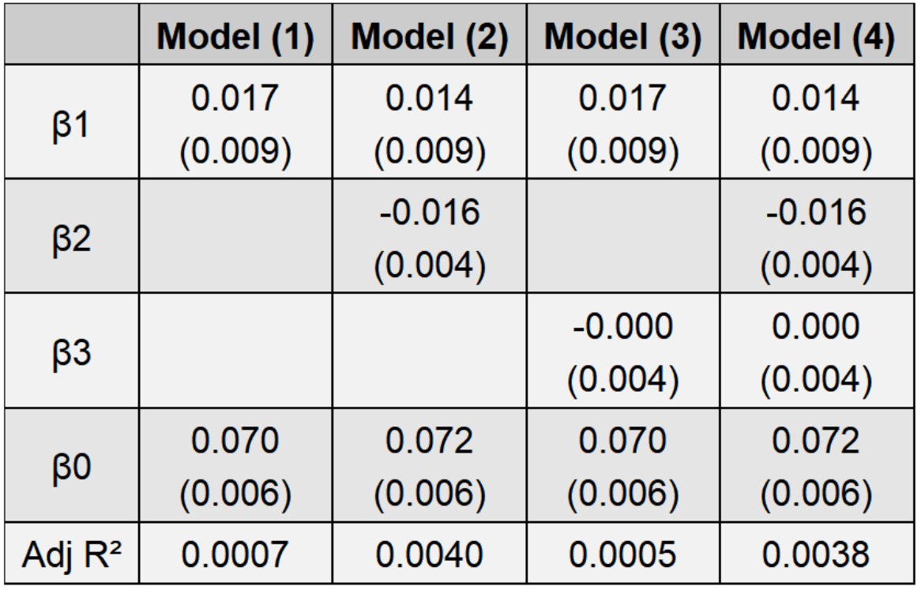
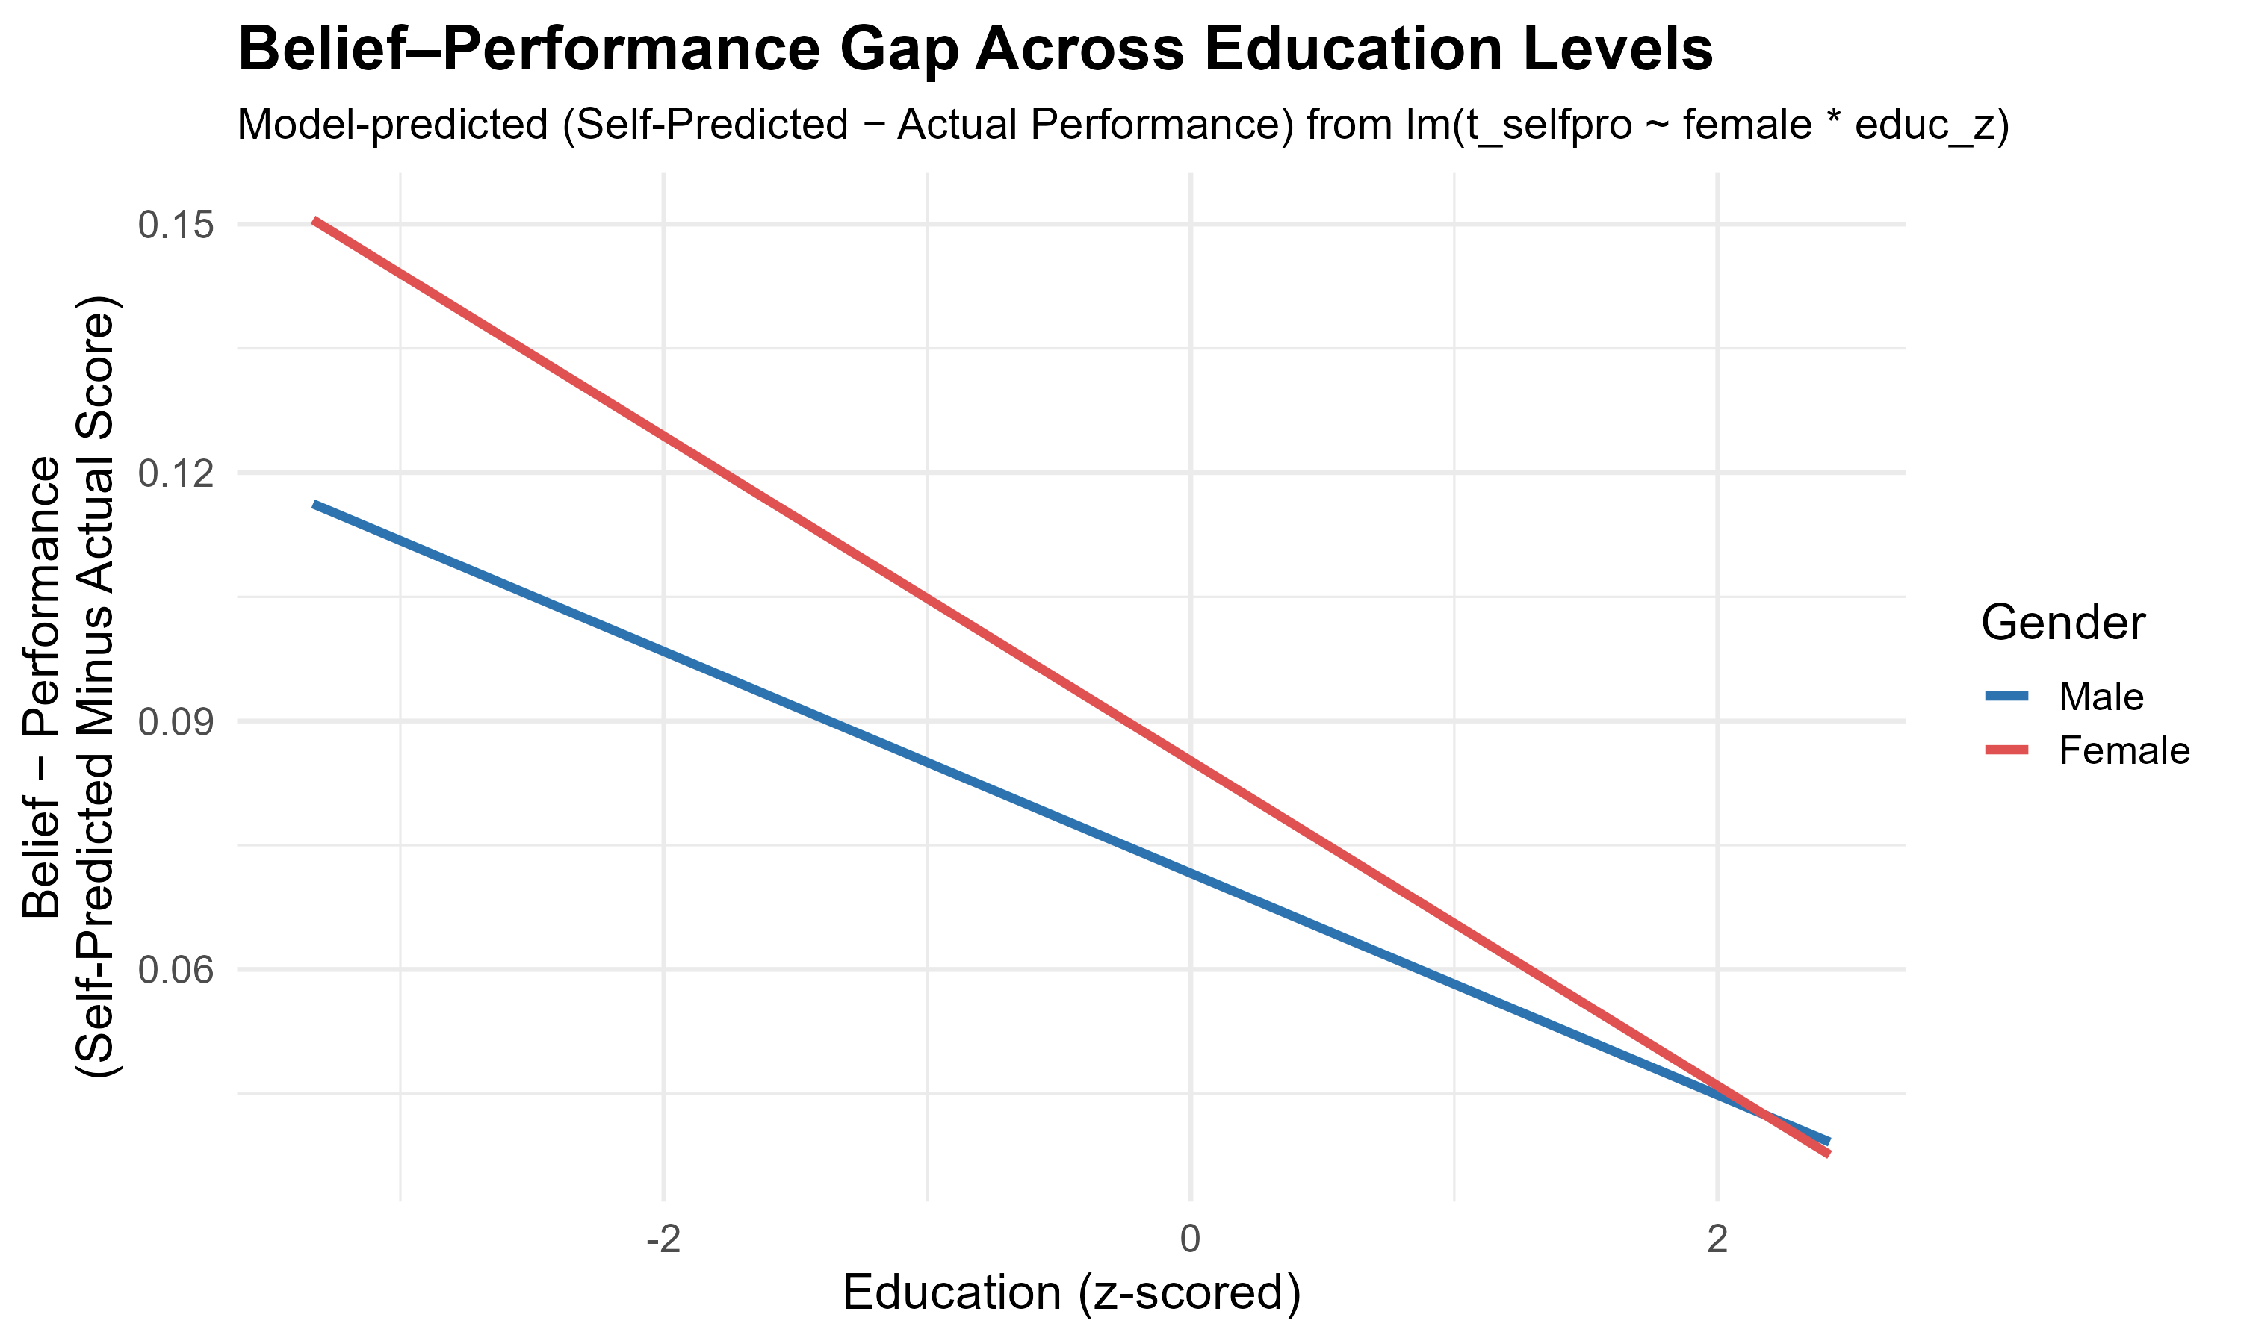
EXTENSION 2 - How Education and Age Shape the Gender Gap
Step 1 - Multiple Linear Regression Models with Different Specifications
Model 1 (Gender only): Y =β0 +β1 Female +ε Women show a small positive gap (β₁ ≈ 0.017).
Model 2 (Gender + Education): Y =β0 +β1 Female+ β2 Edu+ ε Gap shrinks when education is added (β₁ drops to ≈ 0.014). Education reduces the gap (β₂ ≈ –0.016, R² rises from 0.0007 to 0.004).
Model 3 (Gender + Age): Y =β0 +β1 Female+ β3 Age+ ε Age has no effect (β₃ ≈ 0, R² decreases from 0.0007 to 0.0005).
Model 4 (Gender + Education + Age): Y=β0 +β1 Female+ β2 Edu+ β3 Age+ ε Gender gap remains ≈ 0.014, driven by education, not age.
Step 2 – Linear Interaction Model: How Education Modifies the Gender Gap
Model (Gender × Education): Y= β0 + β1 Female+ β2 Edu + β3(Female× Edu) (Education is continuous.)
Graph Insights
Higher education reduces the belief–performance gap for both men and women.
The gender gap(male–female difference) narrows as education increases.

Slide 8
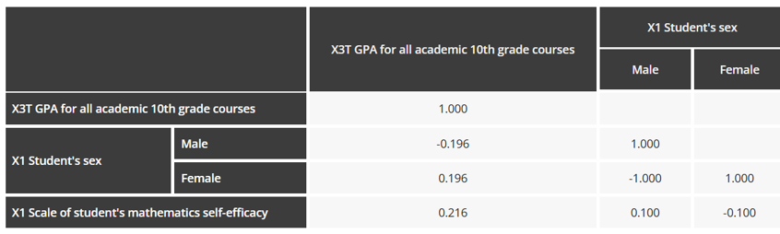
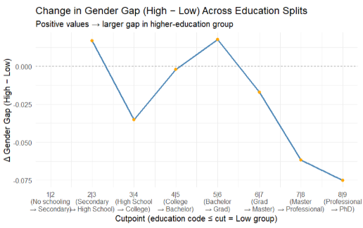
EXTENSION 2 & 3 – Deepening the Analysis of Education
Extension 3 - HSLS:09(U.S. High School Longitudinal Study of 2009) data
Model: Y=β0 + β1 x1(Gender) +β2 x2(Performance) + ε (Performance : GPA , Y = Math self-efficacy)
Graph Insights
Female students have higher math GPAs (+0.196 vs −0.196). But they show slightly lower self-efficacy (r = −0.10), far smaller than the ≈12.7-point gap in our experiment.
Step 3 - Gender Gap Across Education Splits: High-School Turning Point
Two simple regressions: Low group (Y= β0L + β1L Female + ε) & High group ( Y = β0H + β1H Female + ε) Low-Education group: Edu_ci ≤c, High-Education group: Edu_ci >c, c∈ {1,…,8}
Compare gender gaps: ΔGap = B1H - B1L Gap (High-education grp) - Gap (Low-education grp)
Graph Insights
The gender gap is smallest in High School, similar with our HSLS:09 result (≈0.1).
The gap increases at college entry, then gradually narrows as education rises. (Possible explanation: College entry may reduce women’s confidence due to social evaluation, while higher education later rebuilds clarity and confidence.)

Slide 9
REFLECTION & CONCLUSION
Reflection
Replication confirmed the original finding: women underrate their performance even with equal ability.
PIAAC analysis showed the gap is small overall but varies by education and age.
Extension using the original dataset found education reduces the gap, while age adds no explanatory power.
Conclusion
Gender confidence gaps exist but are not uniform — they depend on context, education level, and age.
Across datasets, gaps shrink at higher education levels and are largest among younger/less-educated adults.
Combining replication with real-world data shows how behavior + quantitative analysis helps explain patterns relevant to promotion, leadership, and workplace equity.

