Slide 1
ALL THREE
BioImage Hackathon BEH
A point mutation that tries harder and fails more
Cell migration analysis pipeline + cross-batch validation
on 60 GFP-Arp2/3 time-lapse recordings
🧬 Badeer Ummat · biology
🛠 Edward Offord · CS
📈 Haili Yuan · CS
Warwick CAMDU · 2026-04-29 to 05-01

Slide 2
🧬 BADEER
The biology: a gene that coordinates pushing and gripping
Cell migration is a four-step process:
Three conditions, 30 cells:
1. Push the front edge forward (lamellipodium).
WT
wild type. The gene works.
2. Anchor the leading edge to the surface.
KO
knock-out. The gene is fully deleted.
3. Generate pulling force.
4. Release the rear.
KI
knock-in. The gene is replaced by a single-amino-acid point-mutation version.
The gene we perturb coordinates steps 1 and 2: it links protrusion to substrate adhesion. Without it, the cell can still try to push, but the push and the grip stop happening together.
The question:
Does the KI point mutation behave the same as a complete deletion (KO), or does swapping one amino acid produce a phenotype of its own?
The marker: GFP fused to Arp2/3, the protein complex that builds the lamellipodium. Brighter pixels at the cell edge = more push machinery being recruited.
2D epifluorescence · 0.318 µm/px · 60 s/frame · single channel · 16-bit · two imaging sessions per condition

Slide 3
🛠 EDWARD
Pipeline journey: 75× reduction in segmentation failures
Stage | What changed | Empty mask rate
v1 | Cellpose cyto, raw images | 9.7%
v2 | cyto3 + 1-99 percentile normalize on every frame | 7.9% (high-batch regression)
v3 | Adaptive normalize: per-stack p99 detector decides whether to stretch | 2.83%
fine-tuned | Self-trained cyto3 on 586 filtered v3 outputs (no hand-drawn data) | 0.13%
How the self-training works:
12 min
1. Run v3 on all frames.
fine-tune on RTX A5000
2. Filter: keep frames where mask area ≥ 30% of per-cell median AND IoU ≥ 0.5 with previous frame.
10 min
3. Drop the 2 worst files (ko1/4 95% empty, ko1/8 50% empty).
re-run inference on 30 cells
4. Treat the surviving 586 (frame, mask) pairs as pseudo-ground-truth.
5. Fine-tune cyto3 for 100 epochs on those pairs.
26 MB
final weights file (shipped on GitHub)

Slide 4
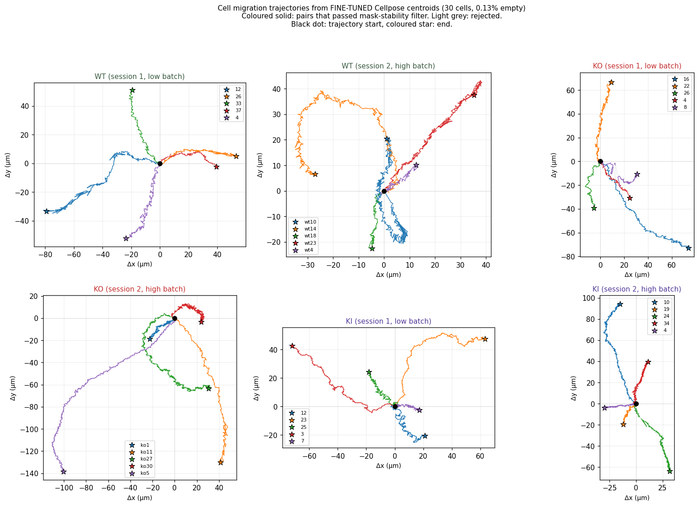
📈 HAILI
Finding 1: KI cells migrate 35% slower
Condition | mean speed (µm/min)
WT (N=10) | 1.03 ± 0.33
KO (N=10) | 1.06 ± 0.29
KI (N=10) | 0.68 ± 0.08
Cohen's d: KI vs WT −1.40, KI vs KO −1.68
(both very large effects)
KO migrates at WT speed. Only KI slows down. The point mutation breaks something the complete deletion does not.
Two filters that matter:
• Mask-stability filter rejects per-pair frames with IoU < 0.3 or sudden area drops. Caught a fragmentation artefact in wt1/33 that had inflated speed by 5×. • Persistence capped at 1.0 (geometric upper bound).
Per-cell trajectories, 30 cells across 6 folders. KI panels (right column) cover noticeably less ground.

Slide 5
📈 HAILI
Finding 2: KI over-polarises Arp2/3 at the leading edge
Condition | lam / cyto intensity ratio
WT | 1.53 ± 0.29
KO | 1.47 ± 0.45
KI | 1.83 ± 0.33
Combined biology reading:
KI cells push the front edge harder (more Arp2/3 polarisation, finding 2) yet move 35% less (finding 1). Effort goes in, locomotion does not come out.
Cohen's d: KI vs WT +0.90, KI vs KO +0.85
(both large effects)
This is what "broken protrusion-adhesion coordination" predicts: the lamellipodium activates, but the cell cannot anchor or generate traction, so the push wastes energy.
Per cell, brighter pixels inside the mask (above the per-frame median) are treated as lamellipodia. KI cells push more Arp2/3 to the edge than WT or KO.
Dominant-negative reading: a broken-coordination mutation is functionally MORE costly than completely deleting the gene.

Slide 6
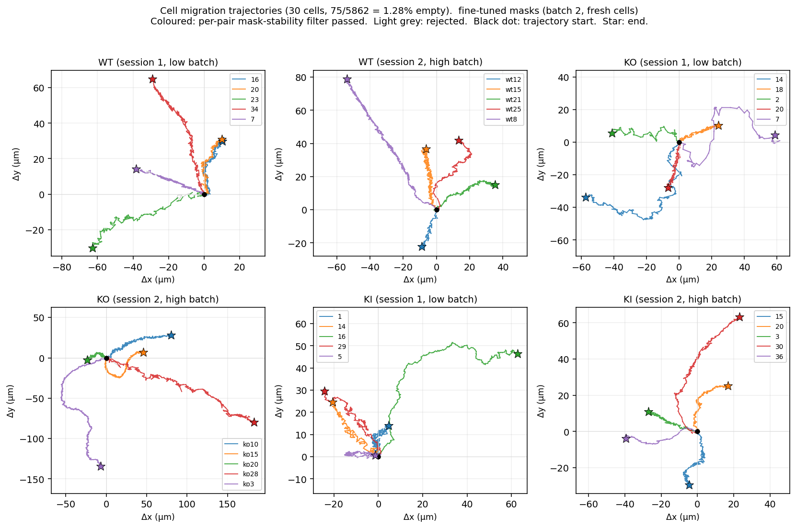
EDWARD + HAILI
Same model, fresh batch of 30 cells: pipeline and findings both hold up
Mid-hackathon a second upload arrived: 30 fresh cells, 5,862 frames, same 6 categories. The fine-tuned model has never seen these cells. We re-ran the entire pipeline (segmentation, centering, migration, lamellipodia) with no retraining and no parameter changes.
Metric | Batch 1 | Batch 2
Empty-mask rate | 0.13% | 1.28%
KI migration speed | 0.68 ± 0.08 | 0.72 ± 0.10
KI lam/cyto mean | 1.827 | 1.830
Cohen's d KI vs WT (mig) | −1.40 | −1.22
Both findings reproduce on independent cells.
KI lam/cyto means agree within 0.003 across batches. Pipeline + fine-tuned weights generalise; data-processing decisions (adaptive normalize, mask-stability filter, percentile=50 split) carry over without tuning.
Batch 2 trajectories. KI cells (last two panels) again cover noticeably less ground than WT or KO. Same pattern, fresh cells.

Slide 7
🛠 EDWARD
Drop-in pieces for future projects
Adaptive normalize
per-stack p99 detector decides whether to stretch. Fixes low-batch failure without breaking high-batch images. 100% concordance with the dataset's 1/2 folder labels.
Self-training pipeline
filter v3 outputs by mask area + IoU, retrain cyto3 on the surviving pairs. No hand-drawn labels required.
Mask-stability filter
rejects per-pair frames where IoU < 0.3 or area drops below 30% of per-cell median. Caught the wt1/33 fragmentation artefact.
Generic compare_masks.py
IoU, Dice, boundary IoU, Hausdorff 95, centroid distance. Drop in any reference masks (hand-drawn or otherwise).
Generic plot_trajectories.py
2×3 panel figure from any trajectories.json. Same script ran on batch 1 and batch 2.
Reproducible: all code, manifests, processed CSV outputs, and the 26 MB fine-tuned weights are in the public repo.
github.com/Haili321/bioimage-hackathon-beh

Slide 8
ALL THREE
Honest caveats + next steps
Caveats
Next steps
Sample size
N=10 cells per condition per batch. Effect sizes are large but a formal mixed-effects ANOVA with batch as a random effect is still pending.
•
Mixed-effects model with batch as random effect (deliver p-values, not just effect sizes).
No hand-drawn ground truth
the fine-tuned model learned the v3 consensus shape, not a real reference. compare_masks.py is ready to swap in real annotations.
•
Photobleaching correction for absolute intensity.
One stubborn case
ko1/7 still failed at 28.3% empty (30 of 106 frames) on the fresh batch. Worth a manual look: bad recording, or genuine phenotype?
•
Three-layer split (body / transition / lamellipodia) if biology team wants finer granularity.
Photobleaching
not corrected. Absolute intensities should be read with caution. Ratios (lam/cyto) are partially robust because both populations decay together.
•
napari interactive viewer for the biology team to browse cells frame-by-frame.

Slide 9
ALL THREE
Thank you
Briefing: www.dcs.warwick.ac.uk/~u1898019/hackathon-beh/
GitHub: github.com/Haili321/bioimage-hackathon-beh
17+ commits · 3 contributors · fine-tuned weights and slides shipped
Questions?

