Slide 1
Pocket Synth
Mako Issakhoja
Gabe Perez

Slide 2
The purpose of the project
Its small size makes it convenient for on-the-go music creation.
Musicians can use it to jot down musical ideas wherever they are, without the need for bulky equipment.
Also, it could be a tool for making music more accessible to people who might not have access to traditional instruments or expensive music production software.
Notes:
Mako

Slide 3
Some of the components include:
STM32 Nucleo board ~11 $;
1 Speaker ~1$;
2 Potentiometers ~1$;
3 Batteries ~1.2$;
1 Audio Amplifier ~2.5$;
13 Buttons ~0.54$;
2 breadboards ~4.5$;
Overall, cost of the product is : ~22.74$
Notes:
Mako

Slide 4
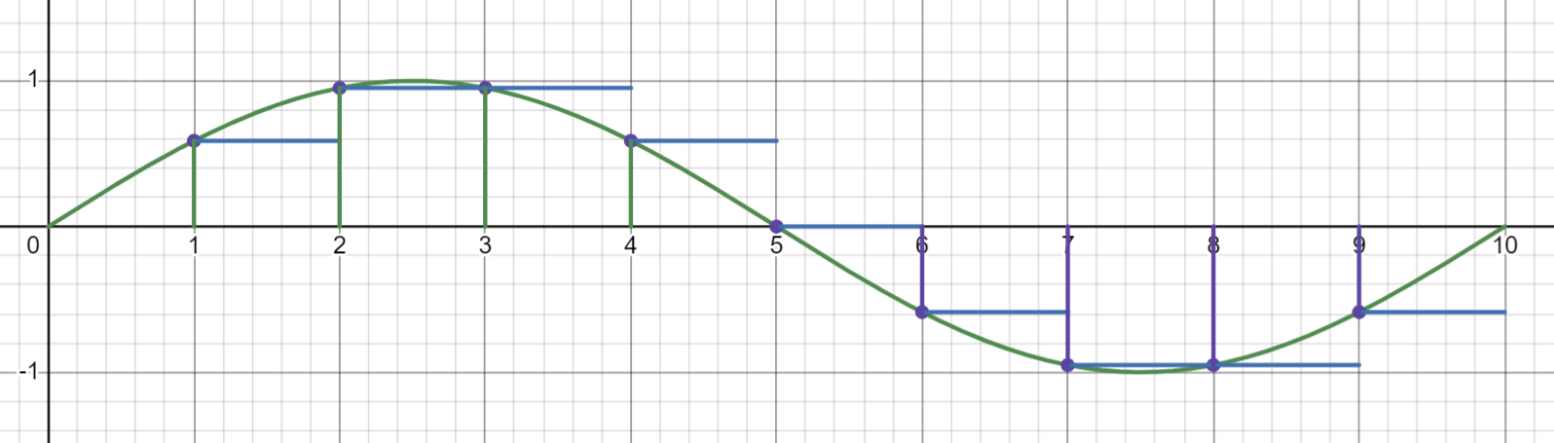
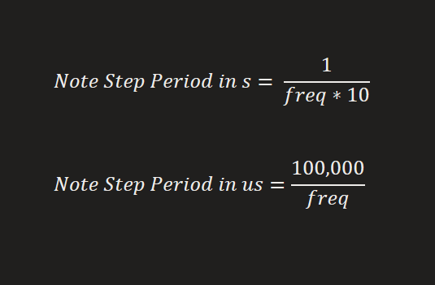
Working Principle - Wave Output
DAC outputs sine wave with 10 samples
Frequency is determined by the period in between each step
Poll buttons for input, play single wave
0V-0.3V DAC signal amplified to 3.6V-5V

Slide 5
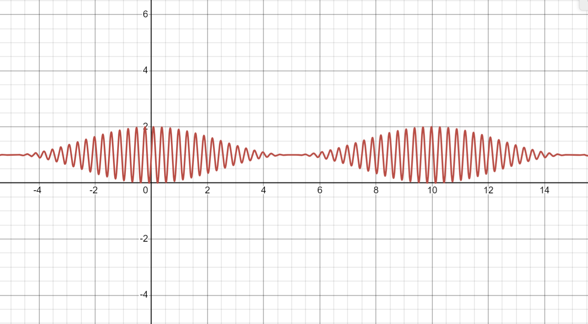
Working Principle - Tremolo Effect
Global volatile variable stores sine amplitude modification amount
Timer interrupt reads potentiometers from ADC and modifies Depth and Rate values

Slide 6
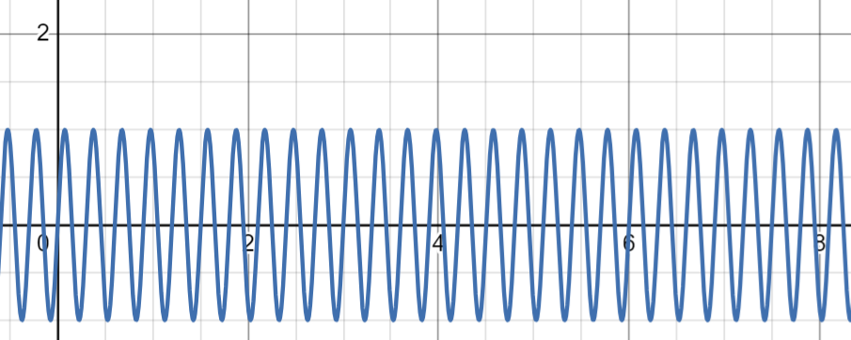
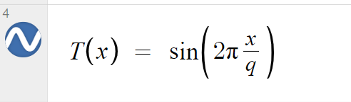
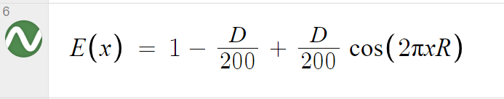
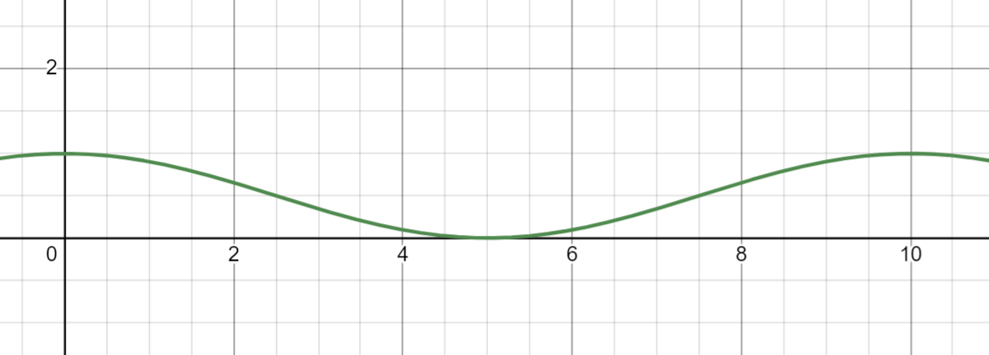
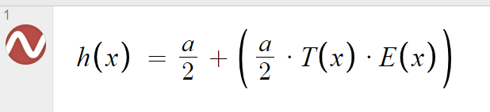
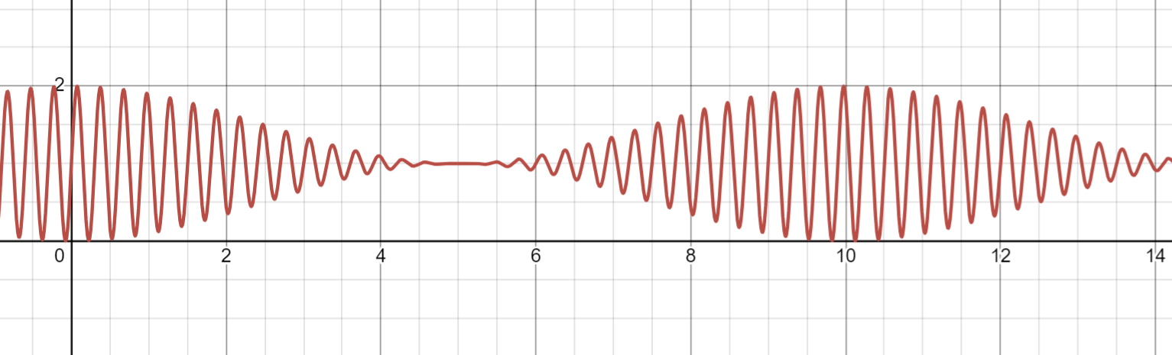
Working Principle - Calc Output Wave
q - wave period in s
D - Tremolo depth
0 - 100
R - Tremolo rate
1Hz - 5Hz
a - max amplitude

Slide 7
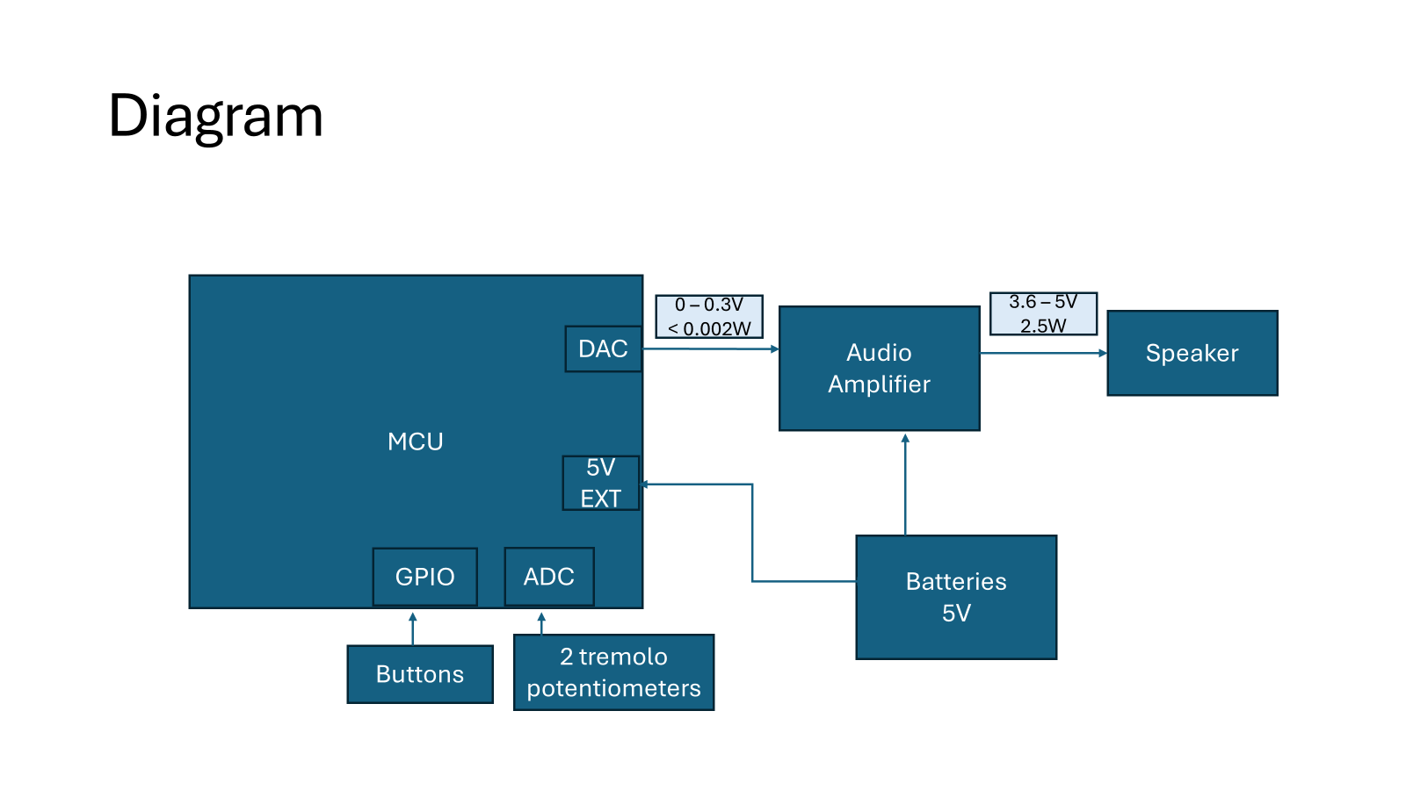

Slide 8
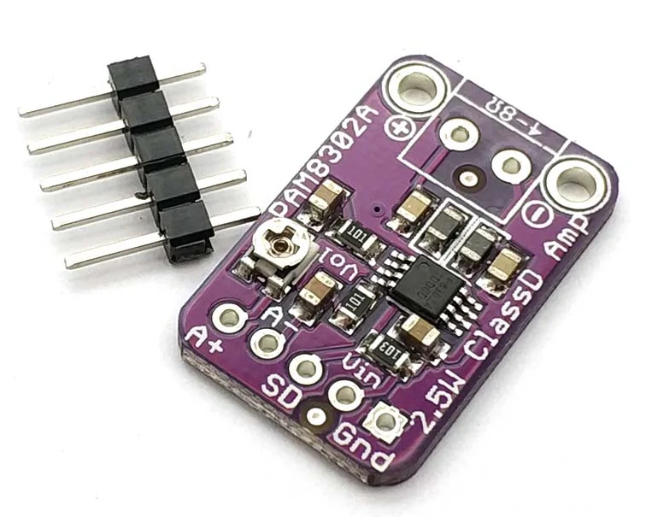
PAM8302A Audio Amplifier
Input voltage range
0 - 0.3V
Supply voltage range
2.6 - 5.5V
Output power - 8Ω speaker
0.6 - 2.5W

Slide 9
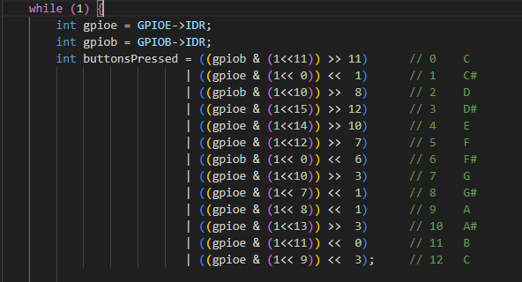
Main Loop Code
Stores the information from the Input Data Registers of GPIOB and GPIOE in variables where the keyboard buttons are connected. This is to prevent needing to read from the registers over and over again.
The two variables “gpiob” and “gpioe” are then organized to where each key on the keyboard is mapped to a bit in the variable “buttonsPressed”.
C -> bit 0,
C# -> bit 1,
D -> bit 2, etc.

Slide 10
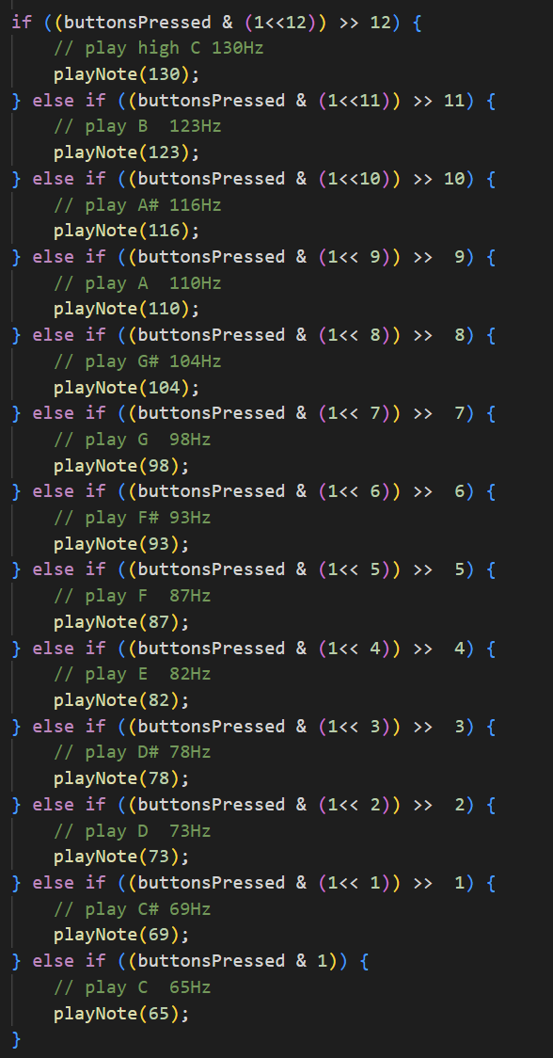
The variable “buttonsPressed” is then checked from the highest note downwards to check what button is pressed.
If/else is used in order to only play the highest most button pressed when multiple buttons are being held down. Because there is only one oscillator, only one note can be played at a time.

Slide 11
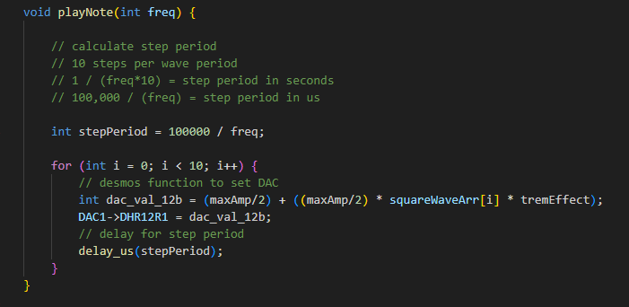
Using the equation built in Desmos and the step period equation, the playNote function is able to take frequency as a parameter and output one wave period to the DAC.

Slide 12
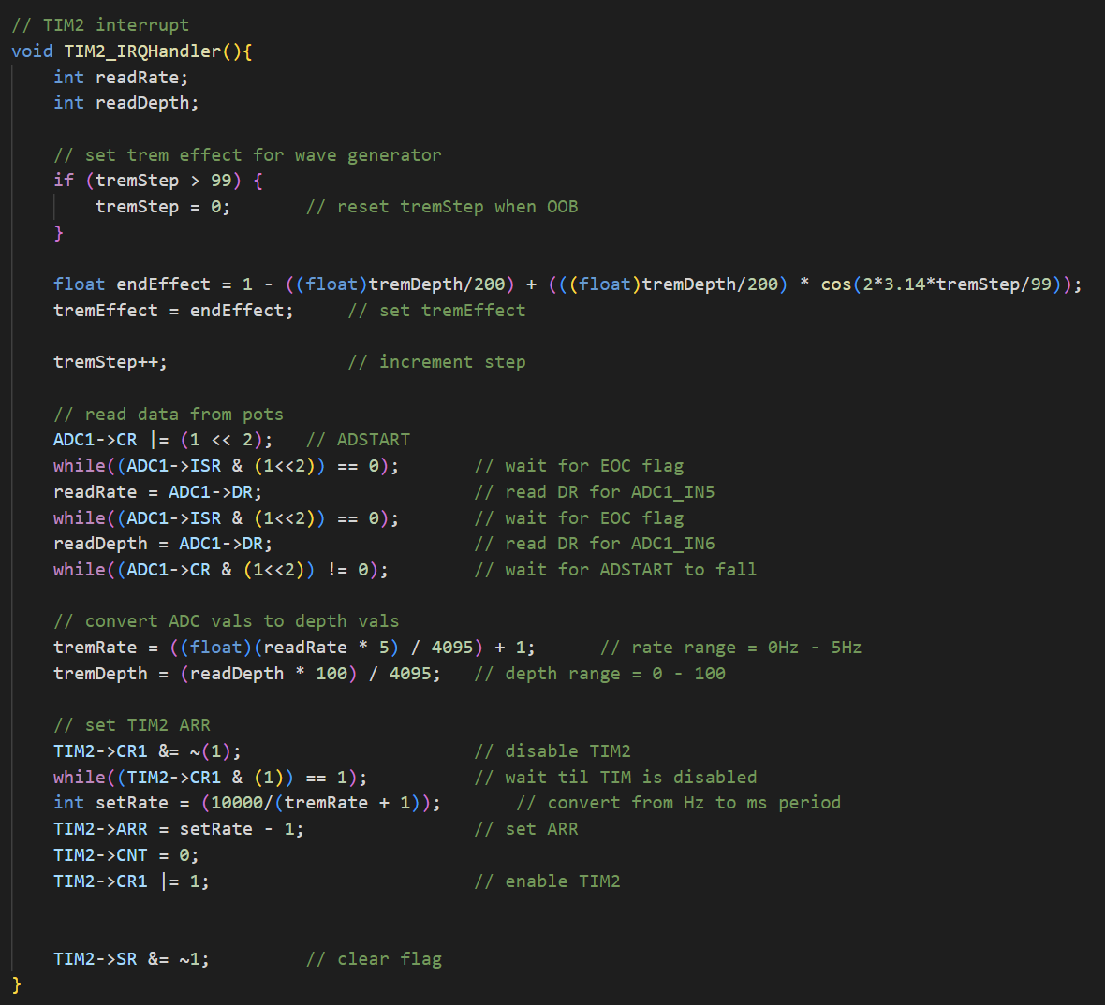
TIM2 Interrupt
TIM2 is setup to interrupt at a rate set by the tremRate potentiometer.
A 100 sample cos wave is able to be used for the tremolo effect because it will be oscillating much slower than the tone wave.
The interrupt calculates the tremEffect variable using the Desmos equation, reads the ADC to set new depth and rate values, and restarts TIM2.

Slide 13
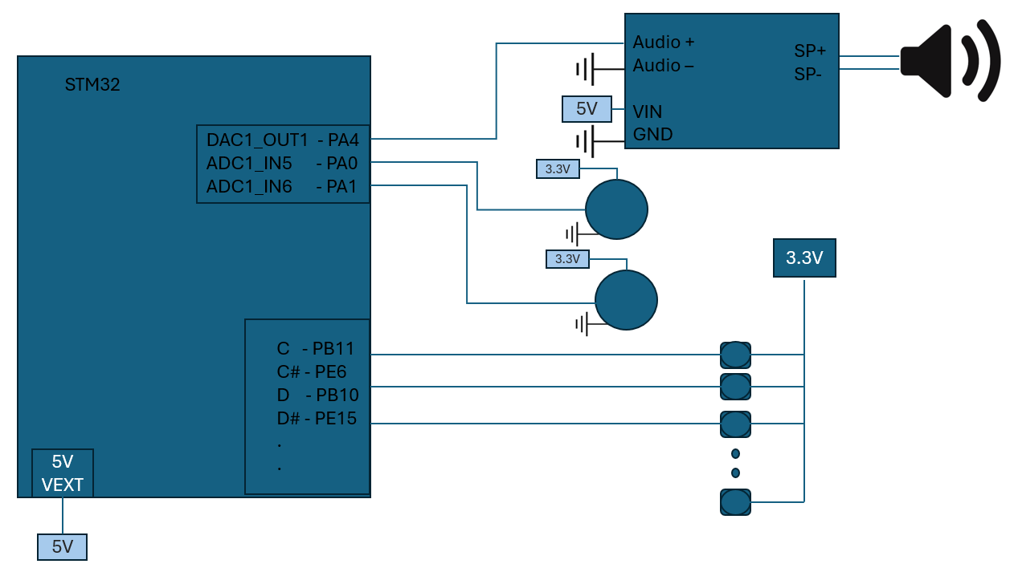
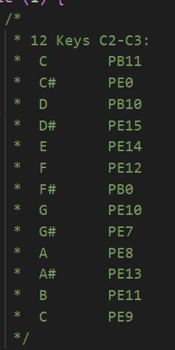
Schematic

Slide 14
Challenges
Wave generation method
Equation calculation
GPIO port selection
ADC sequence sampling
TIM2 interrupt

Slide 15

Questions

