Slide 1
Exactive Series API Introducing functionalities
Andreas Kühn
<erstellt von>

Slide 2
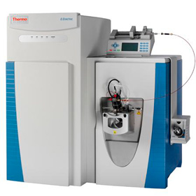
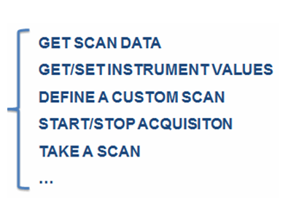
Exactive Series API – What is it?
Application Programming Interface ( A P I )
This software component defines the communication between an
Exactive based instument and an user defined application.
As an interface between both, it exposes all accessible properties and functionalities of the instrument with the corresponding syntax of calls.
API

Slide 3
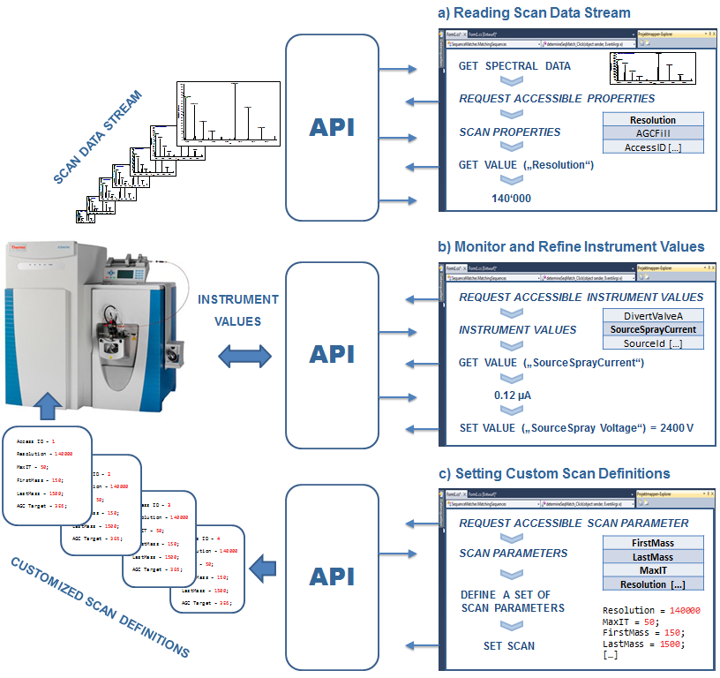


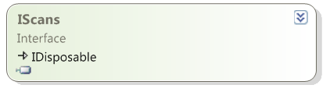
Exactive Series API – What can you do with it?
Corresponding Interfaces

Slide 4
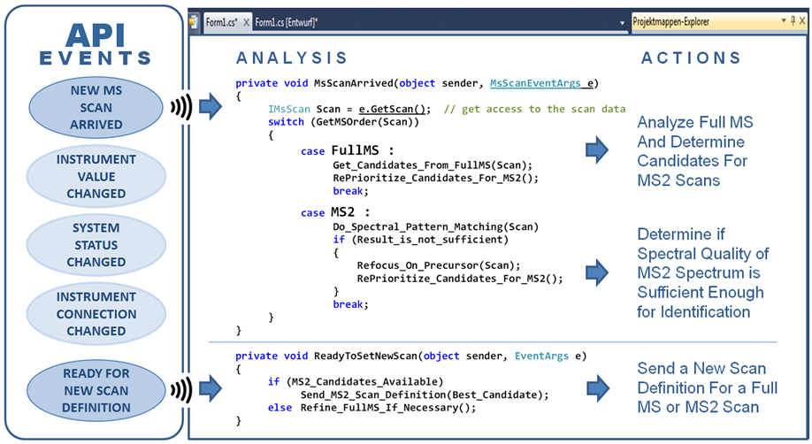
Exactive Series API – What can you do with it?

Slide 5
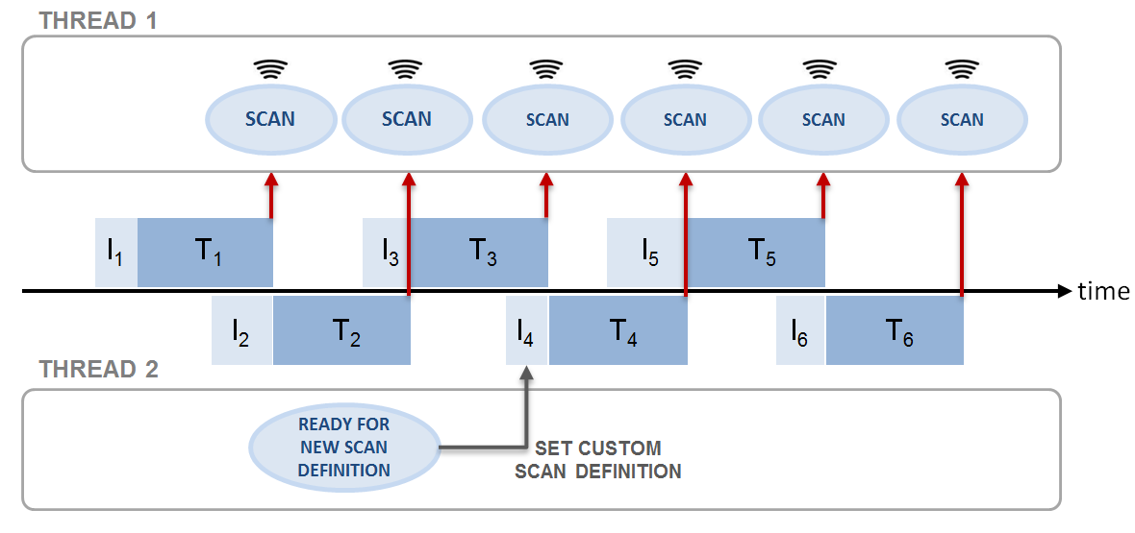
Exactive Series API – What can you do with it?

Slide 6


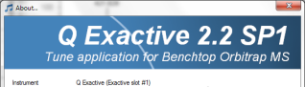
Getting started
To run your first application you will need:
+ Microsoft .NET ≥ 3.5
+ Development environment, like Visual Studio 2010/2012 (Express)
+ Latest Exactive Series Installation 2.3 (build 1765)
API-1.0.dll
ESAPI-1.0.dll
(ESAPI-1.1.dll) – for offline method modification
C:\Xcalibur\system\Exactive\bin
Notes:
Diffrences between VS 2010 Pro and express

Slide 7
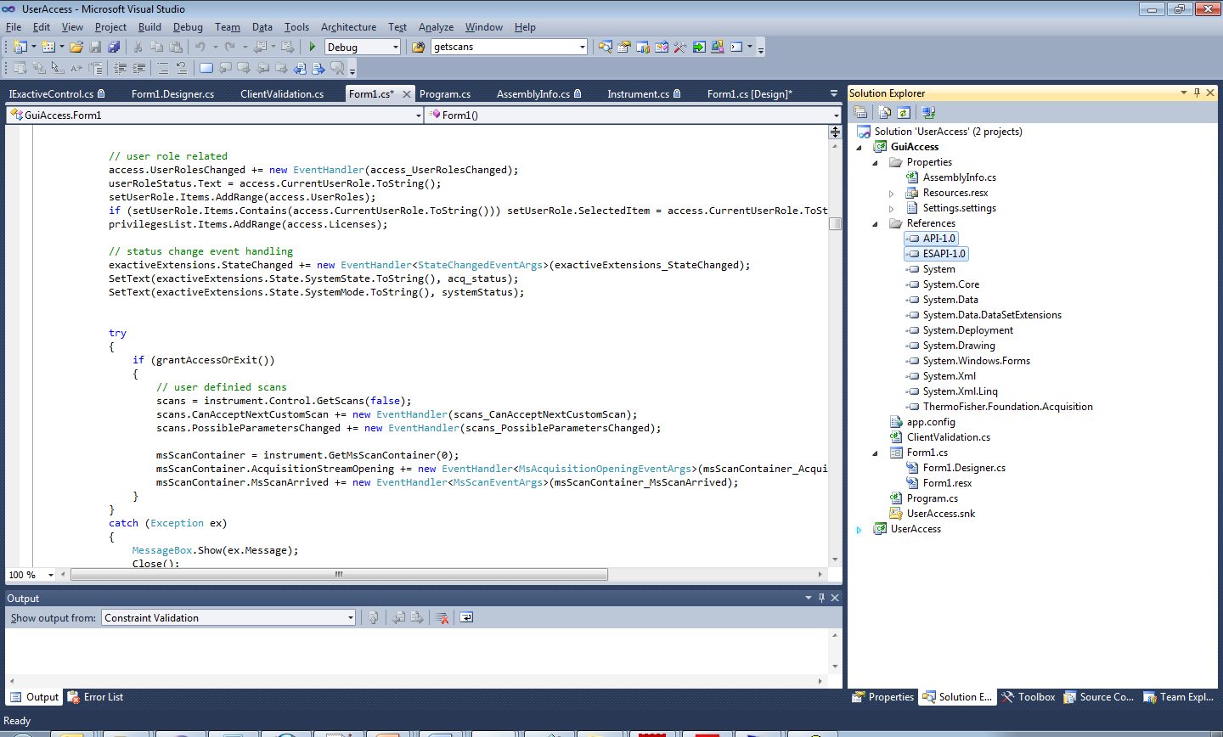
Getting started
Include the interface by adding the two dlls to your references (VS)
Notes:
Two dlls: 1) common functionalities, that are valid for all instruments 2) instrument specific functionalities

Slide 8

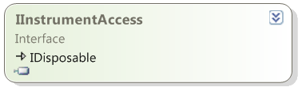
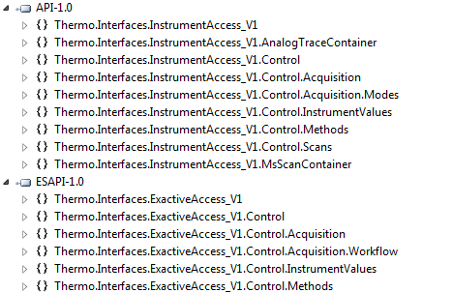


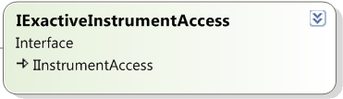
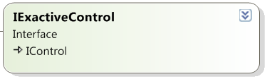
Getting started
Central Access Point
Common Interface
Exactive Series extension
Notes:
Two dlls: 1) common functionalities, that are valid for all instruments 2) instrument specific functionalities

Slide 9
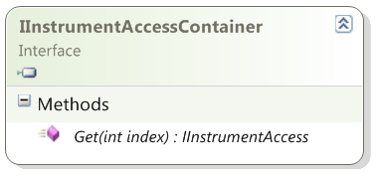
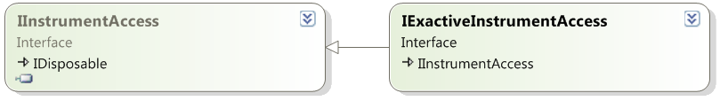
This
Exactive Series API – Get connected (COM)
// Connect to the instrument
Type type = Type.GetTypeFromProgID("Thermo Exactive.API_Clr2_32_V1", true);
object o = Activator.CreateInstance(type);
IInstrumentAccessContainer container = (IInstrumentAccessContainer) o;
Central Access Point
The central access point is the IInstrumentAccessContainer which serves as a master to get access to all other interfaces in this namespace and all contained namespaces.
IInstrumentAccess instrumentAccess = container.Get(1);
Instrument Number
IExactiveInstrumentAccess exactiveAccess =
instrumentAccess as IExactiveInstrumentAccess
Different access for SW > 2.6, please check ExactiveApiUsageExample 1.0 for details.
Notes:
The string Thermo Exactive.API_Clr2_32_V1 is the ProgId in terms of COM to access the implementing class type.
The use of the Activator is the .NET way to create an instance of the implementing class and in the next line the desired interface IInstrumentAccessContainer is
pulled out of the implementing class. Of course, standard COM techniques can also be used with COM's IUnknown::QueryInterface and so on.

Slide 10
Getting started
Central Access Point
Basic access to the instrument
Scan Data/Information
Analog Traces like from UV-Detectors
Contol of the instrument

Slide 11
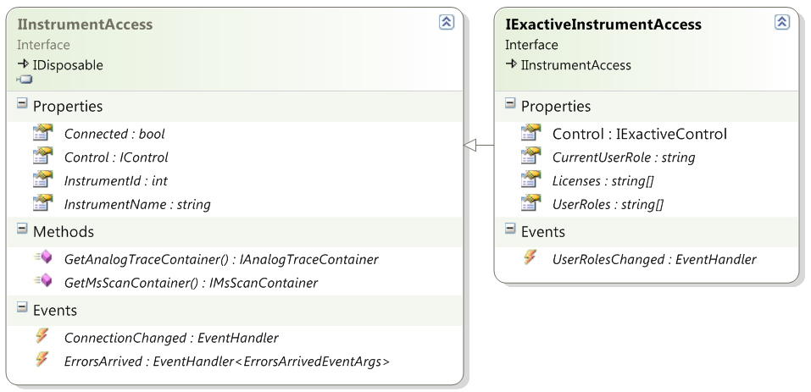
InstrumentAccess
Control Interface
Acquisition
SetScans
Method
Data Container
Access rights; what user role is currently set and what user roles are accessible
Still connected?
Error Messages from instrument
Notes:
Two dlls: 1) common functionalities, that are valid for all instruments 2) instrument specific functionalities

Slide 12
ExactiveAccess
Namespaces
using Thermo.Interfaces.InstrumentAccess_V1;
using Thermo.Interfaces.ExactiveAccess_V1;
IExactiveInstrumentAccess exactiveAccess;
Register to an event, that is fired if
the CurrentUserRole is changing
exactiveAccess.UserRolesChanged += new EventHandler(access_UserRolesChanged);
Reacting on event (e.g. output new user role to a GUI)
private void access_UserRolesChanged(object sender, EventArgs e)
{
SetText(exactiveAccess.CurrentUserRole.ToString(), userRoleStatus);
}
Notes:
Two dlls: 1) common functionalities, that are valid for all instruments 2) instrument specific functionalities

Slide 13
Getting started
Central Access Point
Basic access to the instrument
Scan Data/Information
Analog Traces like from UV-Detectors
Contol of the instrument
Notes:
Two dlls: 1) common functionalities, that are valid for all instruments 2) instrument specific functionalities

Slide 14
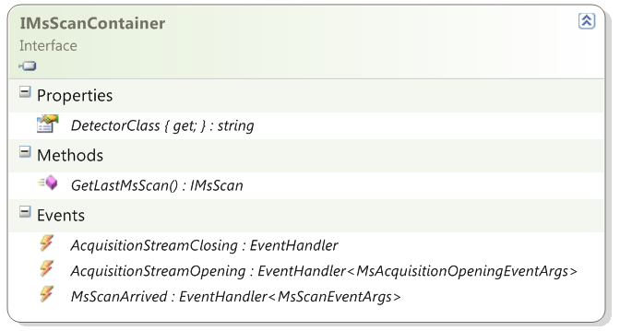
MsScanContainer
Where is it coming from
Last Scan Information
RAW file Acquisition
Started or stopped
(EVENT)
NEW scan has arrived (EVENT)
Notes:
Two dlls: 1) common functionalities, that are valid for all instruments 2) instrument specific functionalities

Slide 15
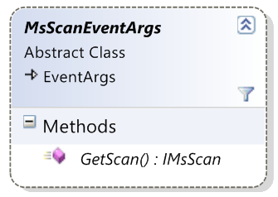
MsScanArrived (EVENT)
Register To MsScanArrived EVENT
msScanContainer = instrument.GetMsScanContainer(0);
msScanContainer.MsScanArrived += new EventHandler<MsScanEventArgs>(MsScanArrived);
Get direct access to scan data, when event is fired
private void msScanContainer_MsScanArrived(object sender, MsScanEventArgs e)
{
AnalyzeScan(e.GetScan()); // will analyze the scan data of the arriving scan
}
Without influencing the scan speed of the instrument, you can access the data of each arriving scan directly via the passed event arguments. The obtainable IMsScan interface will let you access all the data (using a link to the corresponding location in shared memory)
Multiple Instances can register to the same events and will be all notified
Notes:
Two dlls: 1) common functionalities, that are valid for all instruments 2) instrument specific functionalities

Slide 16
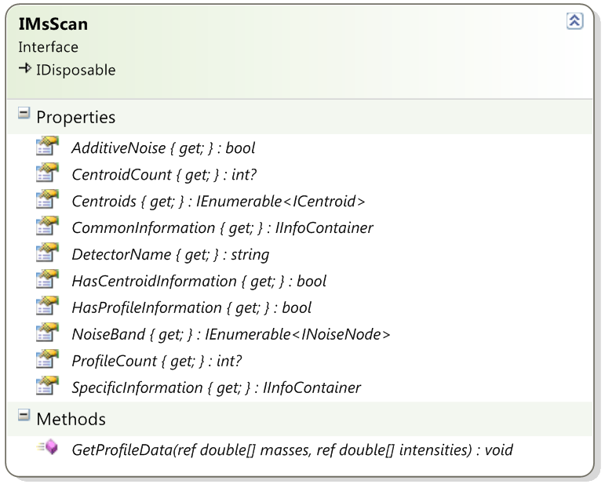
IMsScan
Are there Centroids at all? (NULLABLE)
Spectral Data (Centroids)
ScanProperties
(common)
ScanProperties
(specific)
Access To Profiles
Notes:
Two dlls: 1) common functionalities, that are valid for all instruments 2) instrument specific functionalities

Slide 17
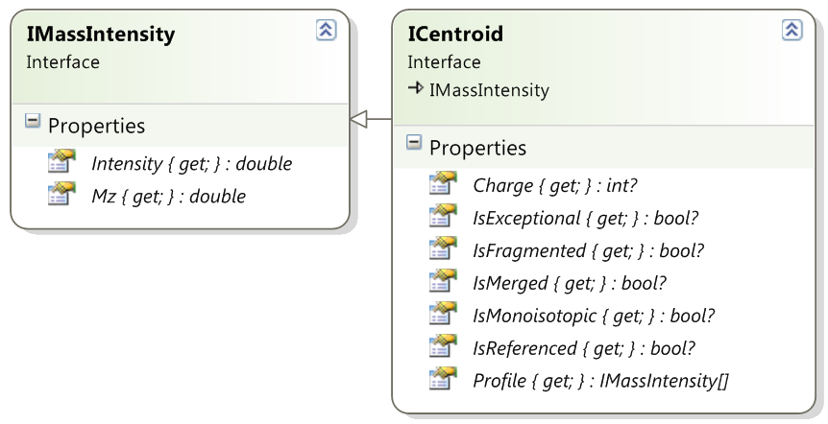
ICentroid
Notes:
Two dlls: 1) common functionalities, that are valid for all instruments 2) instrument specific functionalities

Slide 18
Getting started
Central Access Point
Basic access to the instrument
Scan Data/Information
Analog Traces like from UV-Detectors
Contol of the instrument
Notes:
Two dlls: 1) common functionalities, that are valid for all instruments 2) instrument specific functionalities

Slide 19
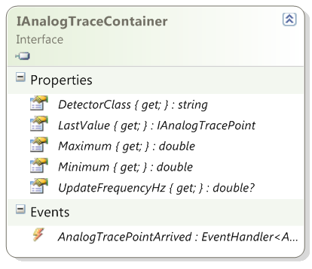
IAnalogTraceContainer
e.g. UV Trace
Last Data Point
Last Scan Information
Update Frequency (nullable)
NEW Trace Point has arrived
Notes:
Two dlls: 1) common functionalities, that are valid for all instruments 2) instrument specific functionalities

Slide 20
Getting started
Central Access Point
Basic access to the instrument
Scan Data/Information
Analog Traces like from UV-Detectors
Contol of the instrument
Notes:
Two dlls: 1) common functionalities, that are valid for all instruments 2) instrument specific functionalities

Slide 21
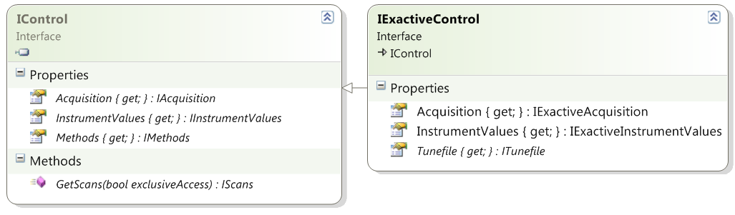
IControl
Create an instance of the IScans Interface to take over the instrument control e.g. to set customized scan definitions
This can be done exclusively (no other instrance is allowed) or non-exclusively.
Notes:
Two dlls: 1) common functionalities, that are valid for all instruments 2) instrument specific functionalities

Slide 22
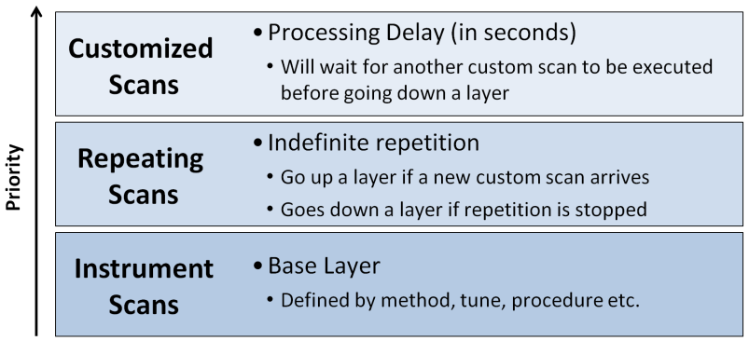
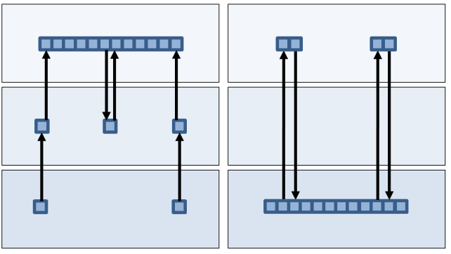
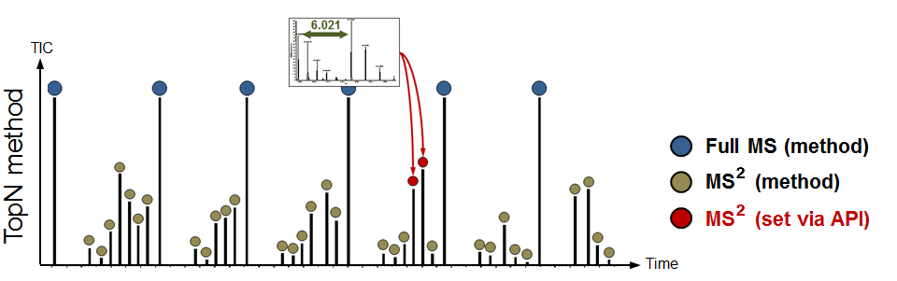
Scanning Level
Notes:
Two dlls: 1) common functionalities, that are valid for all instruments 2) instrument specific functionalities

Slide 23
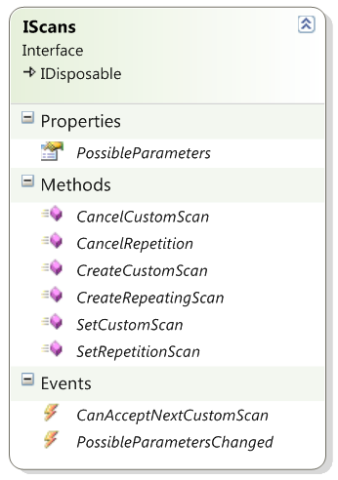
IScans
Scanning Level
Create a Customized Scan Definition
Tells you, when the instrument is ready to
take another scan definition to execute.
Event timing is coordinated to keep the
instrument doing ion injection and transient
acquisition in parallel
Notes:
Two dlls: 1) common functionalities, that are valid for all instruments 2) instrument specific functionalities

Slide 24
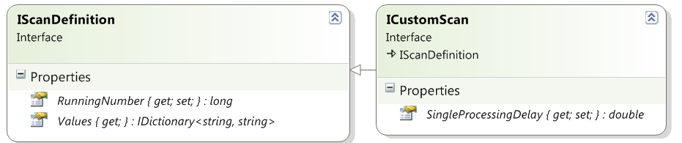
IScans – Example to define a scan
private void SetMS2Scan(double mz)
{
ICustomScan cs = scansControl1.CreateCustomScan();
cs.RunningNumber = 4000;
// Allow an extra delay of 500 ms, we will answer as fast as possible
cs.SingleProcessingDelay = 0.50D;
cs.Values["IsolationRangeLow"] = (mz - 2).ToString();
cs.Values["IsolationRangeHigh"] = (mz + 2).ToString();
cs.Values["FirstMass"] = "50";
cs.Values["LastMass"] = "1000";
cs.Values["Polarity"] = "0";
cs.Values["NCE"] = "27";
cs.Values["Resolution"] = "17500";
scans.SetCustomScan(cs)
}
Notes:
Two dlls: 1) common functionalities, that are valid for all instruments 2) instrument specific functionalities

Slide 25
IScans
Wait up to „ProcessingDelay“ for new customized scan definition (e.g. up to 500ms). CancelRepetition can cancel wait state
Notes:
Two dlls: 1) common functionalities, that are valid for all instruments 2) instrument specific functionalities

Slide 26
Scanning Level – set a repeating scan def.
private void setRepScanDef()
{
IRepeatingScan repS = scans.CreateRepeatingScan();
repS.RunningNumber = 2;
repS.Values.Add(“Resolution", “140000");
try
{
scans.SetRepetitionScan(repS))
}
}
Notes:
Two dlls: 1) common functionalities, that are valid for all instruments 2) instrument specific functionalities

Slide 27
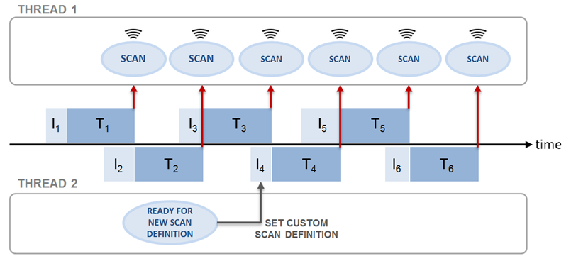
API – Example: asynchronous approach of analyse and contol
CANDIDATES
829.43359
415.22165
732.38275
.
.
.
Analyze Full MS scan and fill candidate list
Get best candidate

Slide 28
API – Example – TopN (extract)
Namespaces
using Thermo.Interfaces.InstrumentAccess_V1;
using Thermo.Interfaces.InstrumentAccess_V1.MsScanContainer;
using Thermo.Interfaces.InstrumentAccess_V1.Control;
using Thermo.Interfaces.InstrumentAccess_V1.Control.Scans;
Access to instrument, Listen to data stream, synchronize scan deployment
// connect to instrument
Type type = Type.GetTypeFromProgID("Thermo Exactive.API_Clr2_32_V1", true);
object o = Activator.CreateInstance(type);
IInstrumentAccessContainer container = (IInstrumentAccessContainer) o;
IInstrumentAccess instrumentAccess = container1.Get(1);
// get the scan container
IMsScanContainer msScanContainer = instrumentAccess.GetMsScanContainer(0);
// create a IScans instance (non-exclusively) to execute customized scans
IScans scansControl = instrumentAccess1.Control.GetScans(false);
// register to events…
// listen to the scan data stream
msScanContainer.MsScanArrived += new EventHandler<MsScanEventArgs>(checkScans1);
// syncronize the deployment of scan definitions to stay in parallel (inject, transient)
scansControl1.CanAcceptNextCustomScan += new EventHandler(scans_CanAcceptNextCustomScan);

Slide 29
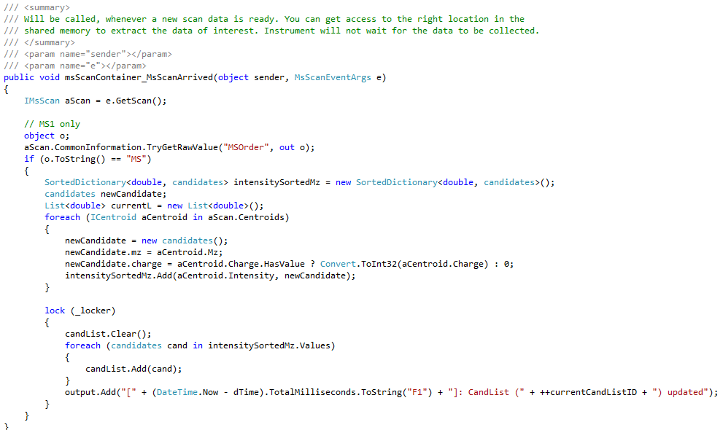
API – Example – TopN – get candidates out of MS1 scans

Slide 30
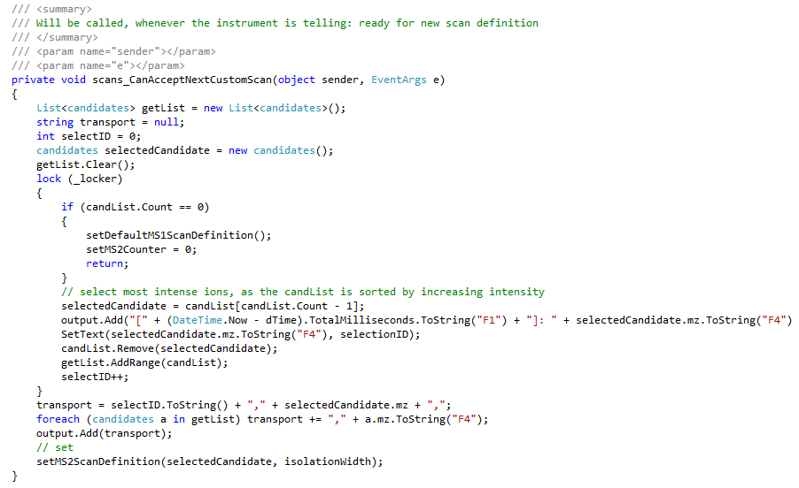
API – Example –TopN -select a candidate for a scan or do MS1

Slide 31
Icontrol – Acquire Raw Files
Acquire Raw Files
Notes:
Two dlls: 1) common functionalities, that are valid for all instruments 2) instrument specific functionalities

Slide 32
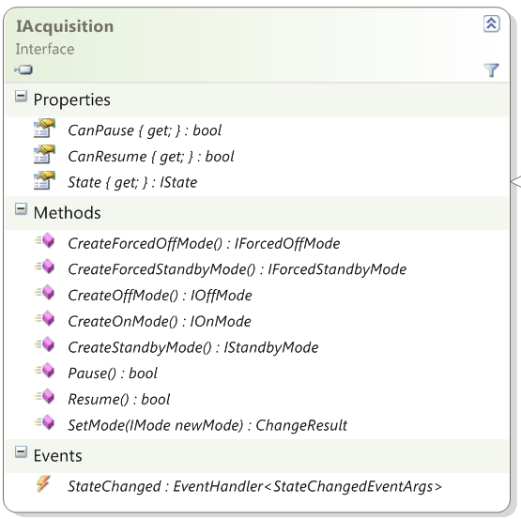
IControl
Notes:
Two dlls: 1) common functionalities, that are valid for all instruments 2) instrument specific functionalities

Slide 33
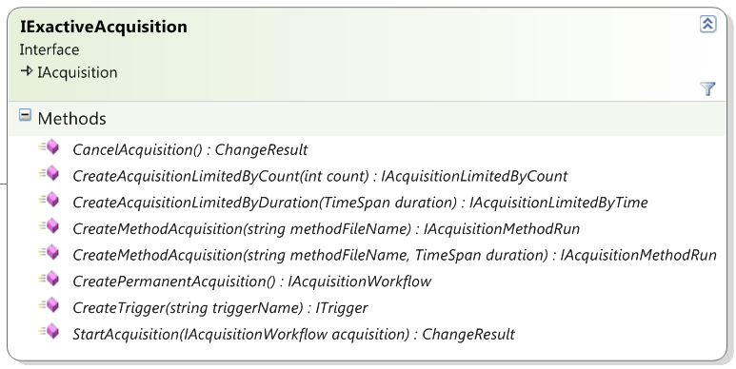
IControl

Slide 34
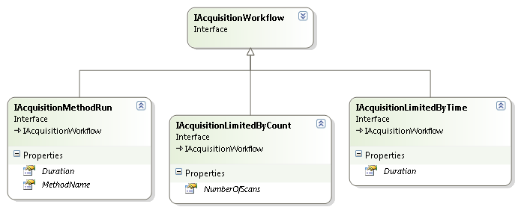
Acquisition

Slide 35
Icontrol – Acquire Raw Files
Method related functionality
Notes:
Two dlls: 1) common functionalities, that are valid for all instruments 2) instrument specific functionalities

Slide 36
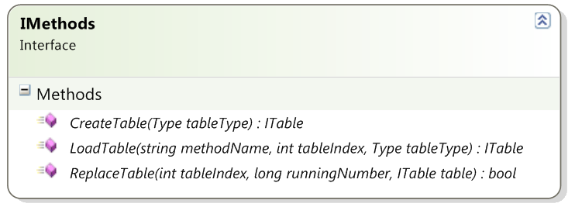
IControl – modify tables at runtime
Create a table of the passed type. (IInclusionTable, IExclusionTable)
The created table can be used to call ReplaceTable(Int32, Int64, ITable).
Notes:
Two dlls: 1) common functionalities, that are valid for all instruments 2) instrument specific functionalities

Slide 37
IControl – modify tables at runtime
Load a table of the passed type with the specified table index
from a named method file.
Returns null if the table was not found, otherwise the table filled with found items.
Notes:
Two dlls: 1) common functionalities, that are valid for all instruments 2) instrument specific functionalities

Slide 38
IControl – modify tables at runtime
Replace a table currently used by the instrument.
Returns true if the command has been sent to the instrument, false otherwise
Notes:
Two dlls: 1) common functionalities, that are valid for all instruments 2) instrument specific functionalities

Slide 39
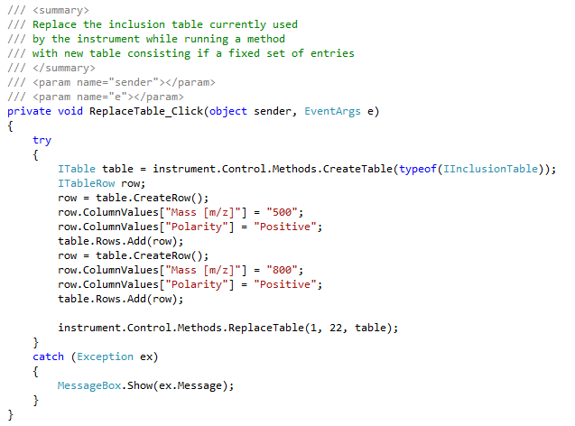
IControl – Example (extract)
Notes:
Two dlls: 1) common functionalities, that are valid for all instruments 2) instrument specific functionalities

Slide 40
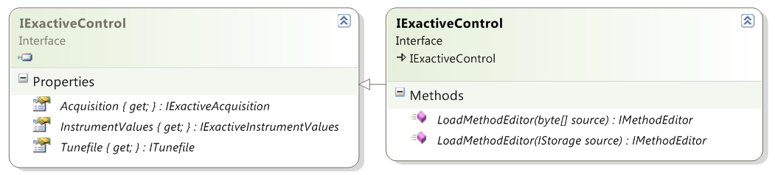
IControl – IExactiveControl
ESAPI-1.0.dll
ESAPI-1.1.dll
Additional functionality for IExactiveControl interface. (Exactive Series specific)
The returned IMethodEditor instance allows direct manipulation of a method.
Method's content can be stored back to an IStorage interface or byte buffers
Notes:
Two dlls: 1) common functionalities, that are valid for all instruments 2) instrument specific functionalities

Slide 41
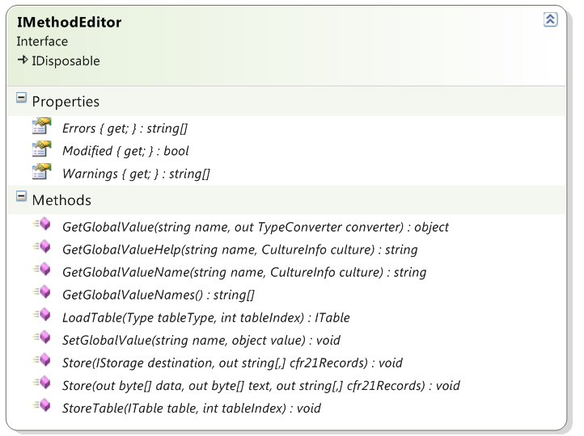
IControl – Manipulate methods
Currently we are allowing
only the manipulation of
tables and changing of the
method‘s runtime.
Available global properties
Get a specific table of
the method
Store the method‘s content
Store modified table

Slide 42
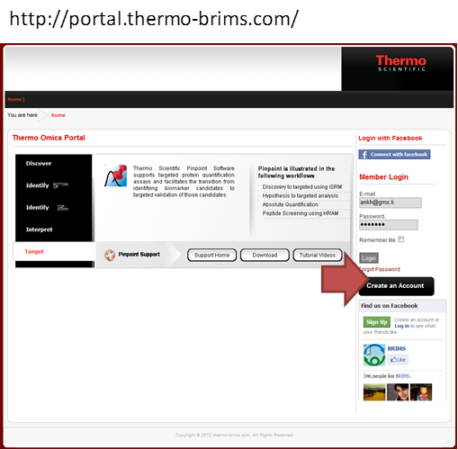
API - Portal
1. Create an account by entering the website shown below and click “Create an account”.

Slide 43
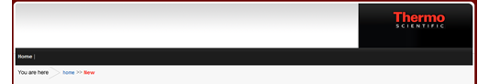
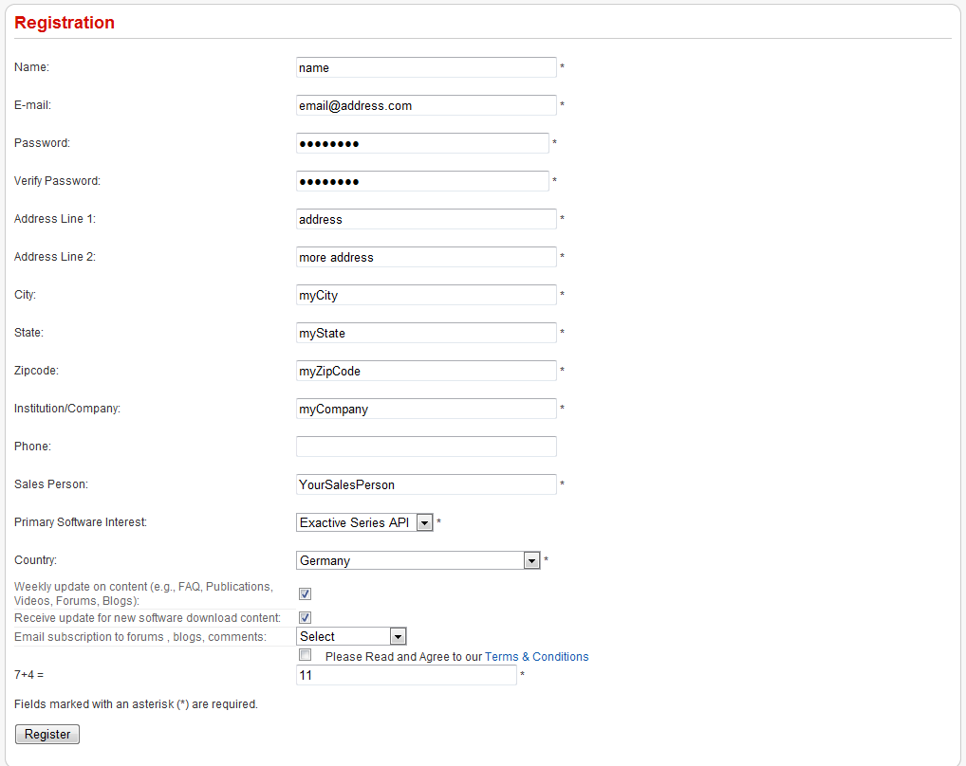
API - Portal
2. Please fill out the “Registration” form and use “Exactive Series API” as “Primary Software Interest”. Please use a valid and traceable email address and don’t forget to accept the “Terms & Conditions”.

Slide 44
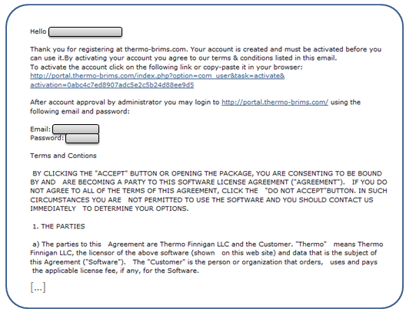
API - Portal
3. Wait for an registration email and use the corresponding activation link to for this portal.

Slide 45
API - Portal
4. You will receive another email, that your account has been approved and you are promoted to the IAPI area. As we need to check the contact data and compare it with a list of people that have been defined as potential users:
THIS COULD TAKE SOME HOURS - UP TO SOME DAYS (at weekends).
NO RESPONSE AFTER 3 WORKING DAYS -> PLEASE CONTACT ME AGAIN

