Slide 1
Prototype
Two Cubed Studios

Slide 2
Features Implemented
One playable level
Main character functionality
Game world
Welcome screen
Player life system
Exit screen
Clear game objective
Some aspects of RNG

Slide 3
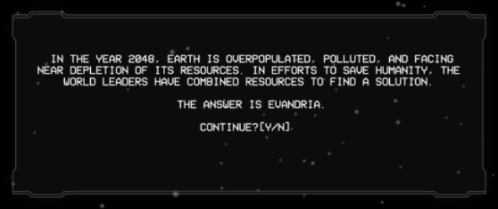
Story introduction
After starting the game from the main menu, the user will be told the story and their purpose in the game.

Slide 4
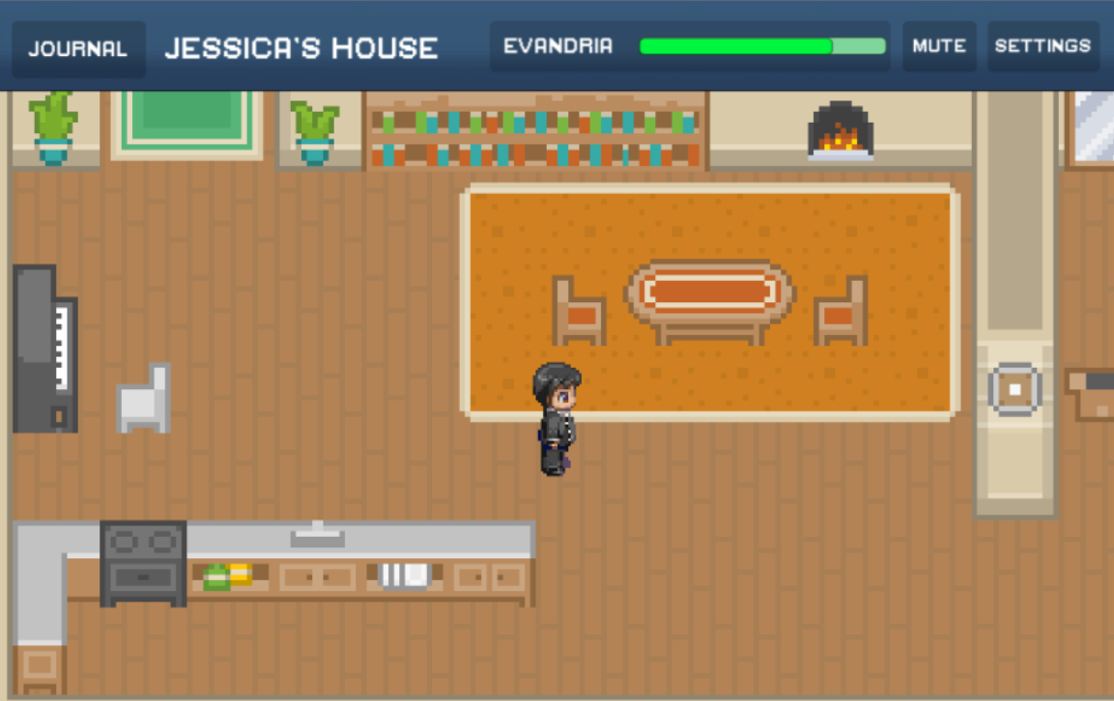
Game World & HUD
Various locations are available for the player to visit. The heads-up display (HUD) shows a button to view the journal, the current location, the health of Evandria and the various settings buttons.
The health of Evandria will rise or fall based on the player’s final decision of which candidate to send in each level.

Slide 5
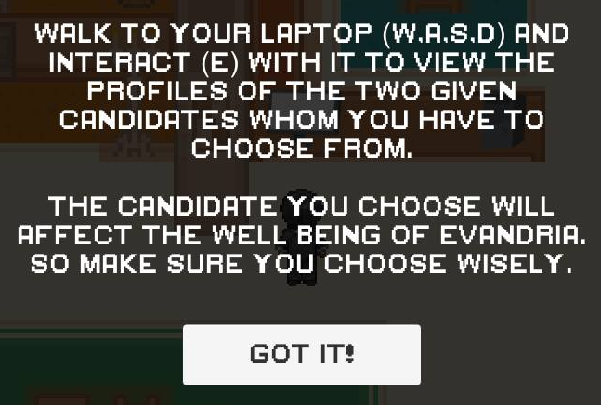
Player mechanics
- This pop up shows the user how to control the main character. Interaction occurs between the player and characters or objects.
-The game objective is also revealed to player.

Slide 6
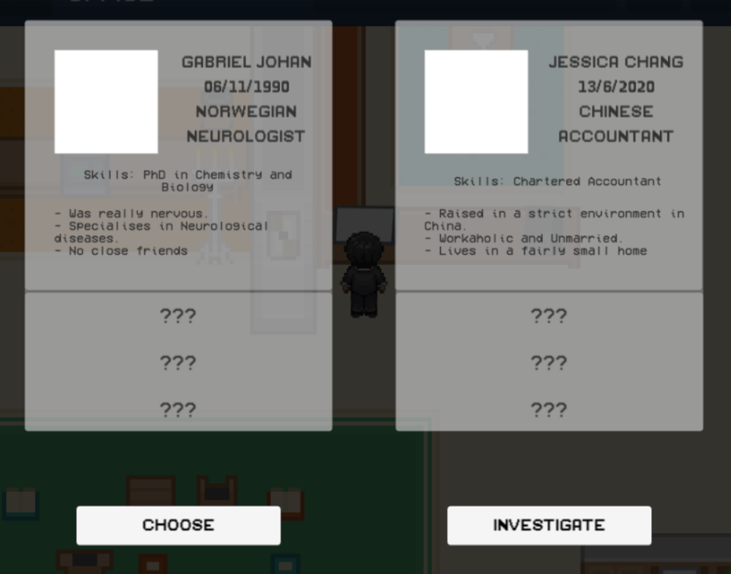
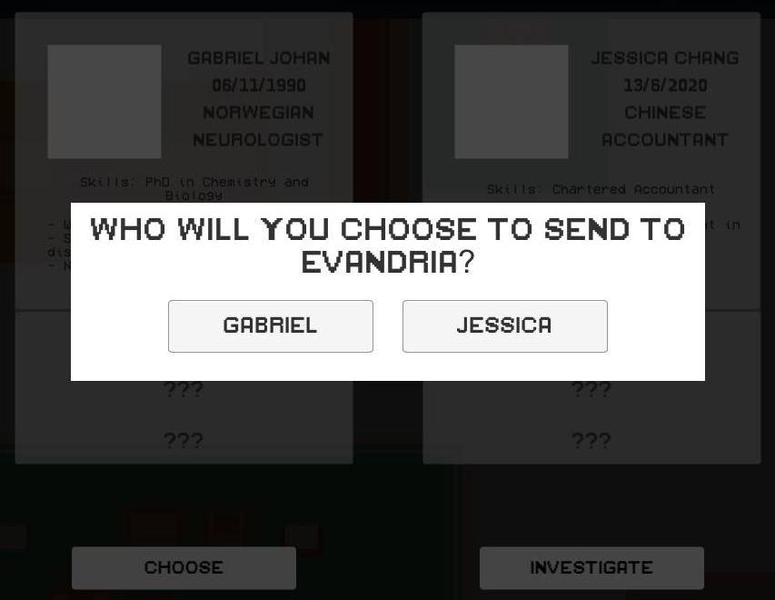
Candidate Information
-Player is presented with initial information of two candidates.
-They will need to investigate by finding clues and talking to people to learn more about the candidates.
-The player can come back and make a final decision once they are happy with the clues they have found during their investigation.

Slide 7
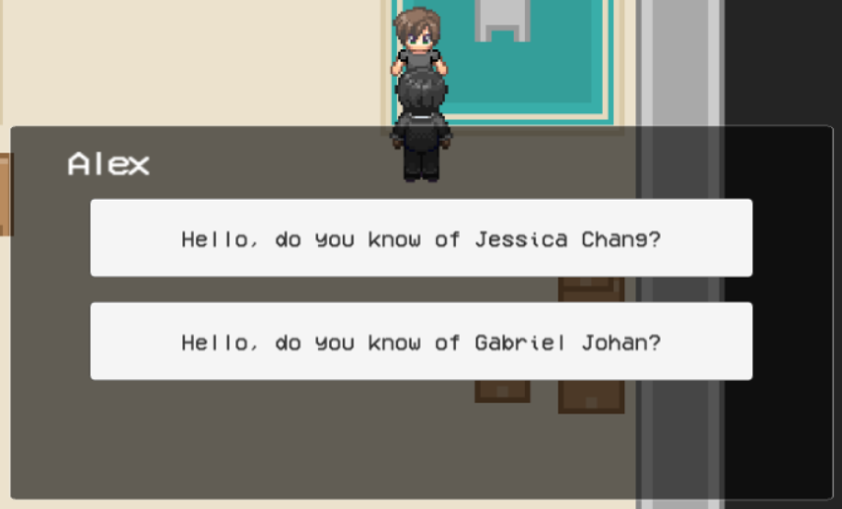
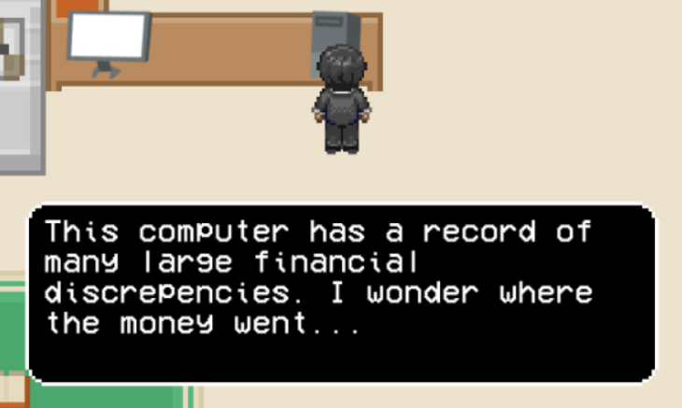
Object and NPC interaction
The player can have conversations with various NPCs to obtain information about candidates.
The player can interact with various objects and obtain clues about the candidates from them.

Slide 8
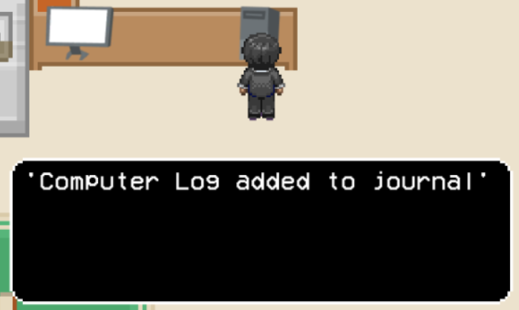
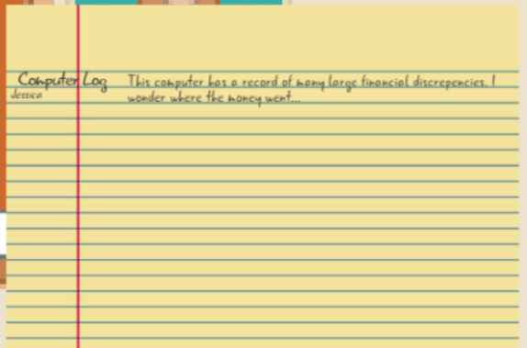
Adding clues to journal
-Once the player has found an object or talked to an NPC, a corresponding clue will be added to the journal which the player can look at.

Slide 9
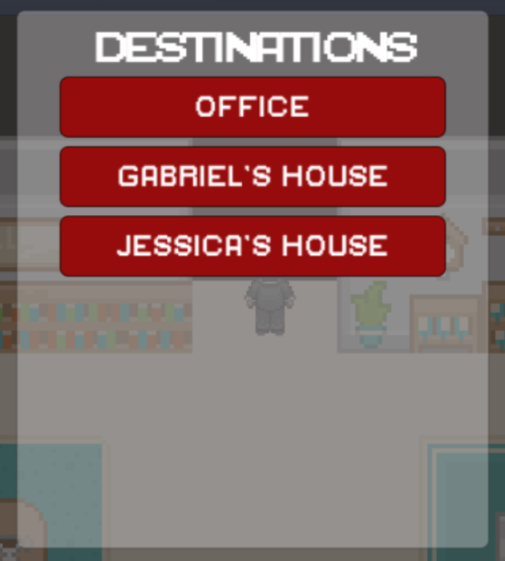
Choosing Destinations
The player can visit various locations available to them by walking towards a door and choosing the corresponding location.

Slide 10
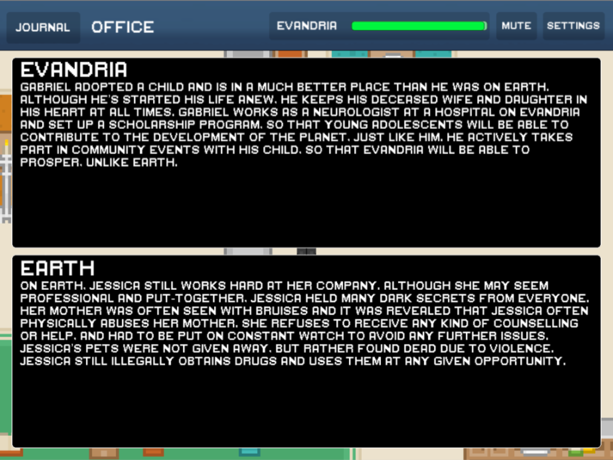
Final outcome
Upon choosing a candidate, the immediate effect of the player’s decision is shown, both on Evandria and on Earth.
The well-being of Evandria will change depending on the decision made by the player.
RNG is used here to determine how much of an effect the candidate has on the well-being of Evandria.

