Slide 1
功率柜输出回路功率分配架构方案

Slide 2
System Architecture

Slide 3
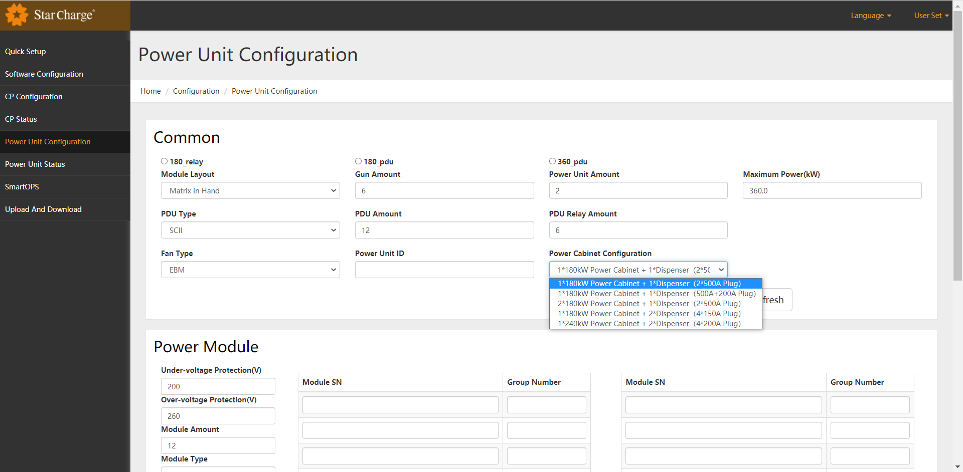
Web Set
Power Cabinet Configuration 配置项

Slide 4
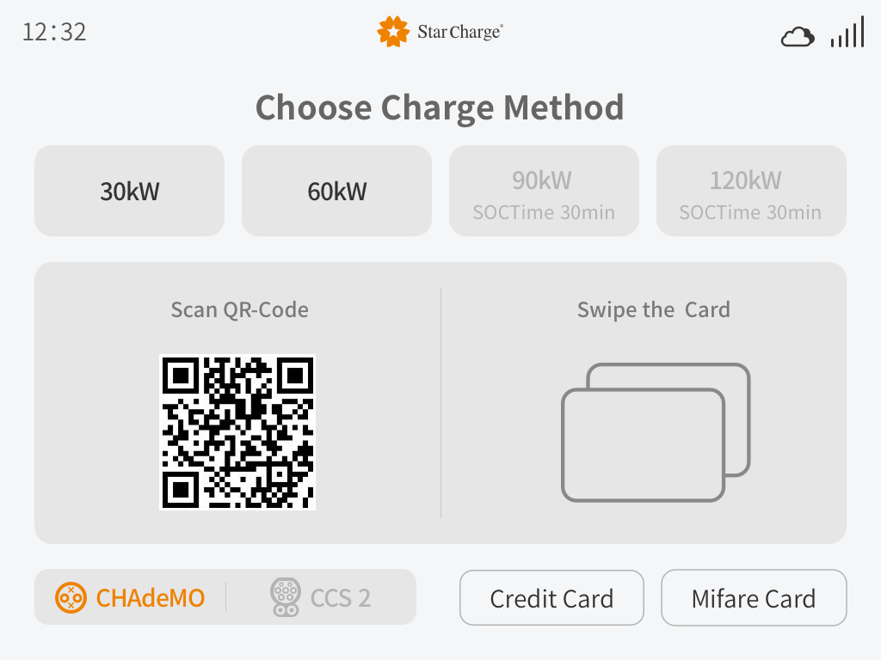
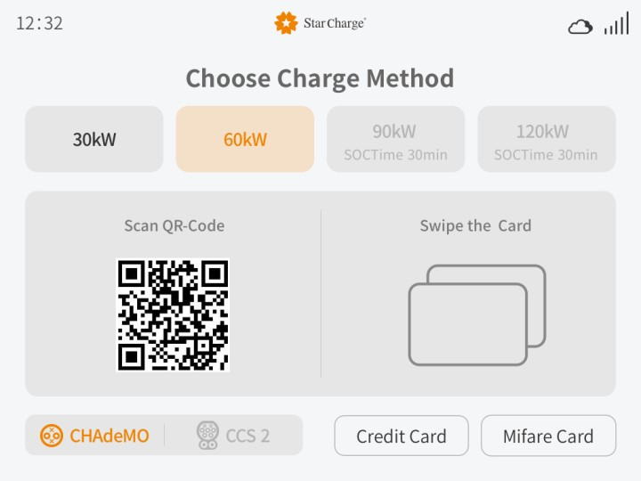
Screen(UI) to Select
双枪终端，1#枪：60KW，2#枪：30KW和60KW可选
选择前
选择后

Slide 5
1*180kW Power Cabinet + 1*Dispenser（2*500A Plug）
Reserved
Liquid cooling
Type | Lmax | Rmax
Take tunes | 180 | 0
 | 0 | 180
(Unit : kW)

Slide 6
1*180kW Power Cabinet + 1*Dispenser（500A+200A Plug）
Reserved
Liquid + Natural cooling
Type | Lmax | Rmax
Take tunes | 180 | 0
 | 0 | 180
(Unit : kW)

Slide 7
1*180kW Power Cabinet + 1*Dispenser（2*500A Plug）
Reserved
Liquid cooling
Type | Lmax | Rmax
Simultaneously | 180 | 180
(Unit : kW)

Slide 8
1*180kW Power Cabinet + 1*Dispenser（500A+200A Plug）
Reserved
Liquid+ Natural cooling
Type | Lmax | Rmax
Simultaneously | 180 | 180
(Unit : kW)

Slide 9
2*180kW Power Cabinet + 1*Dispenser（2*500A Plug）
Reserved
Reserved
Liquid cooling
Type | Lmax | Rmax
Take tunes | 360 | 0
 | 0 | 360
(Unit : kW)

Slide 10
2*180kW Power Cabinet + 1*Dispenser（500A+200A Plug）
Reserved
Reserved
Liquid + Natural cooling
Type | Lmax | Rmax
Take tunes | 360 | 0
 | 0 | 200
(Unit : kW)

Slide 11
1*180kW Power Cabinet + 2*Dispenser（4*150A Plug）
Reserved
1#-Natural cooling
2#-Natural cooling
Type | 1#-Lmax | 1#-Rmax | 2#-Lmax | 2#-Rmax
Choice | 90 | Waiting | 90 | Waiting
 | 60 | 30/Waiting | 60 | 30/Waiting
 | 30 | 30/60/Waiting | 30 | 30/60/Waiting
 | Waiting | 30/60/90 | Waiting | 30/60/90
(Unit : kW)

Slide 12
1*180kW Power Cabinet + 3*Dispenser（6*125A Plug）
Reserved
1#-Natural cooling
2#-Natural cooling
3#-Natural cooling
Type | 1#-Lmax | 1#-Rmax | 2#-Lmax | 2#-Rmax | 3#-Lmax | 3#-Rmax
Average | 30 | 30 | 30 | 30 | 30 | 30
(Unit : kW)

Slide 13
1*240kW Power Cabinet + 2*Dispenser（4*200A Plug）
1#-Natural cooling
2#-Natural cooling
Type(Daytime) | 1#-Lmax | 1#-Rmax | 2#-Lmax | 2#-Rmax
Choice | 120 | Waiting | 120 | Waiting
 | 90 | 30/Waiting | 90 | 30/Waiting
 | 60 | 30/60/Waiting | 60 | 30/Waiting
 | 30 | 30/60/90/Waiting | 30 | 30/60/90/Waiting
 | Waiting | 30/60/90/120 | Waiting | 30/60/90/120
(Unit : kW)

Slide 14
1*240kW Power Cabinet + 2*Dispenser（4*200A Plug）
1#-Natural cooling
2#-Natural cooling
Type（night） | 1#-Lmax | 1#-Rmax | 2#-Lmax | 2#-Rmax
Average | 60 | 60 | 60 | 60
(Unit : kW)

Slide 15
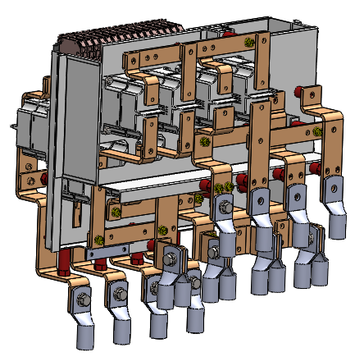
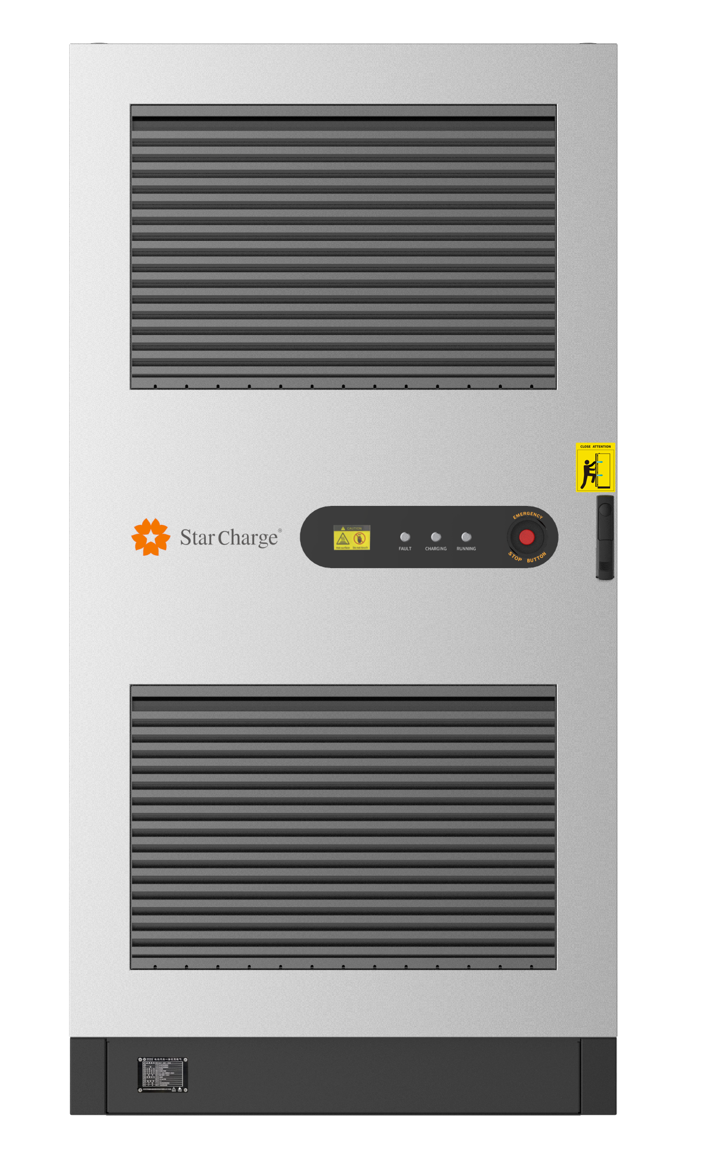
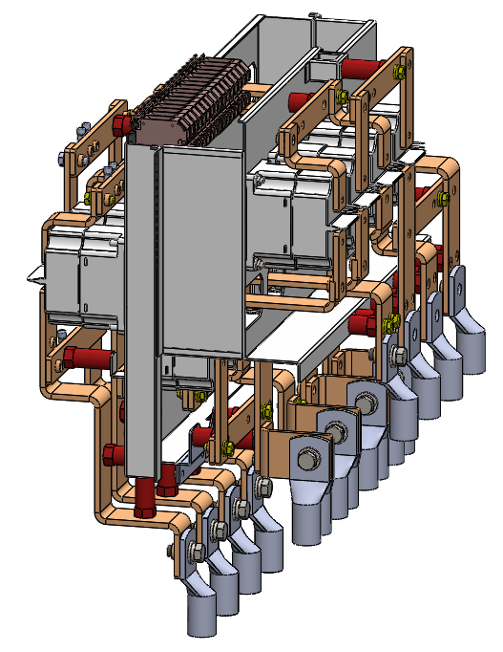
Contactor Module

