Slide 1
Power Distribution Cabinet (240kW)
Output Circuit & Power Distribute Scheme

Slide 2
System Architecture
Relay：16 pcs

Slide 3
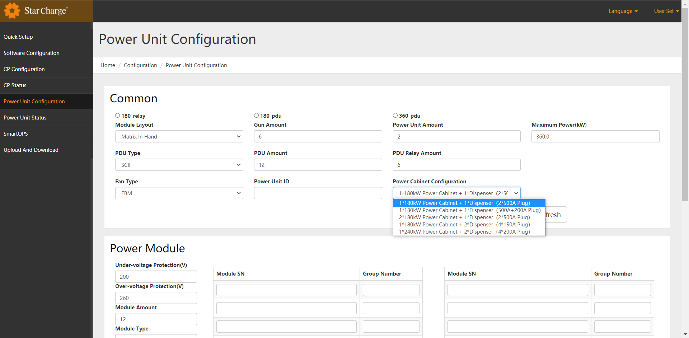
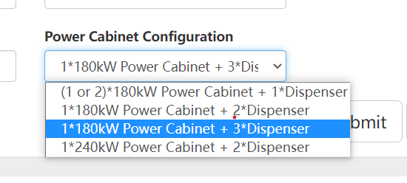
Web Set
Power Cabinet Configuration item Wb配置需与启动充电指令配合，否则待机状态下功耗很高

Slide 4
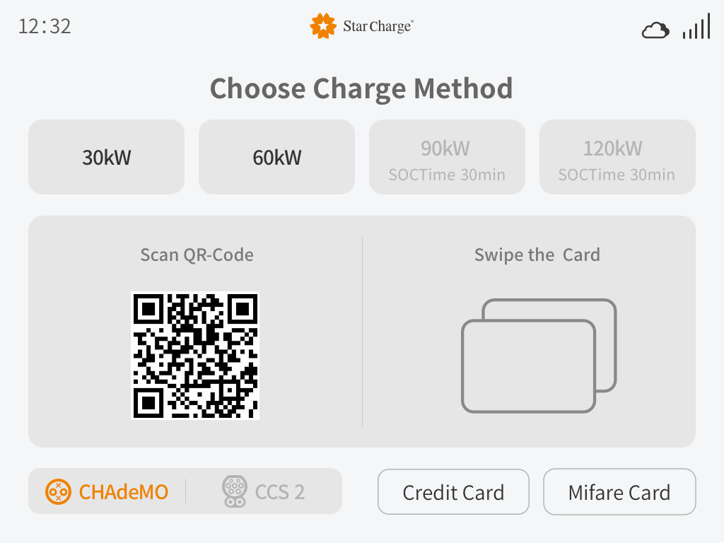
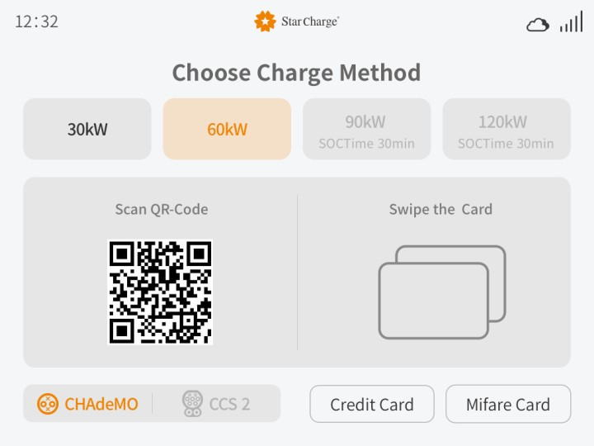
Screen(UI) to Select
Dispenser*2 guns，gun_1#: 60kW，gun_2#: 30kW & 60kW(optional)
Before
After

Slide 5
1*180kW Power Cabinet + 1*Dispenser（2*500A Plug）
Reserved
Reserved
Relay：16 pcs
Liquid cooling
Charging Mode | Lmax | Rmax
Alternative | 180 | 0
 | 0 | 180
(Unit : kW)

Slide 6
1*180kW Power Cabinet + 1*Dispenser（500A+200A Plug）
Reserved
Reserved
Relay：16 pcs
Liquid + Natural cooling
Charging Mode | Lmax | Rmax
Alternative | 180 | 0
 | 0 | 180
(Unit : kW)

Slide 7
1*180kW Power Cabinet + 1*Dispenser（2*500A Plug）
Reserved
Reserved
Relay：16 pcs
Liquid cooling
Charging Mode | Lmax | Rmax
Simultaneous | 90 | 90
Alternative | 180 | 0
 | 0 | 180
(Unit : kW)

Slide 8
1*180kW Power Cabinet + 1*Dispenser（500A+200A Plug）
Reserved
Reserved
Relay：16 pcs
Liquid+ Natural cooling
Charging Mode | Lmax | Rmax
Simultaneous | 90 | 90
Alternative | 180 | 0
 | 0 | 180
(Unit : kW)

Slide 9
2*180kW Power Cabinet + 1*Dispenser（2*500A Plug）
Reserved
Reserved
Reserved
Reserved
Relay：16 pcs+16 pcs
Liquid cooling
Charging Mode | Lmax | Rmax
Alternative | 360 | 0
 | 0 | 360
(Unit : kW)

Slide 10
2*180kW Power Cabinet + 1*Dispenser（500A+200A Plug）
Reserved
Reserved
Reserved
Reserved
Relay：16 pcs+16 pcs
Liquid + Natural cooling
Charging Mode | Lmax | Rmax
Alternative | 360 | 0
 | 0 | 200
(Unit : kW)

Slide 11
1*180kW Power Cabinet + 3*Dispenser（6*125A Plug）
Reserved
Reserved
Relay：16 pcs
1#-Natural cooling
2#-Natural cooling
3#-Natural cooling
Distribution Mode | 1#-Lmax | 1#-Rmax | 2#-Lmax | 2#-Rmax | 3#-Lmax | 3#-Rmax
Equal | 30 | 30 | 30 | 30 | 30 | 30
(Unit : kW)

Slide 12
1*180kW Power Cabinet + 2*Dispenser（4*150A Plug）
Reserved
Reserved
Relay：16 pcs
1#-Natural cooling
2#-Natural cooling
Distribution Mode | 1#-Lmax | 1#-Rmax | 2#-Lmax | 2#-Rmax
Optional | 90 | Waiting | 90 | Waiting
 | 60 | 30/Waiting | 60 | 30/Waiting
 | 30 | 30/60/Waiting | 30 | 30/60/Waiting
 | Waiting | 30/60/90 | Waiting | 30/60/90
(Unit : kW)

Slide 13
1*240kW Power Cabinet + 2*Dispenser（4*200A Plug）
Relay：16 pcs
1#-Natural cooling
2#-Natural cooling
Distribution Mode (Daytime) | 1#-Lmax | 1#-Rmax | 2#-Lmax | 2#-Rmax
Optional | 120 | Waiting | 120 | Waiting
 | 90 | 30/Waiting | 90 | 30/Waiting
 | 60 | 30/60/Waiting | 60 | 30/Waiting
 | 30 | 30/60/90/Waiting | 30 | 30/60/90/Waiting
 | Waiting | 30/60/90/120 | Waiting | 30/60/90/120
(Unit : kW)

Slide 14
1*240kW Power Cabinet + 2*Dispenser（4*200A Plug）
Relay：16 pcs
1#-Natural cooling
2#-Natural cooling
Distribution Mode （night） | 1#-Lmax | 1#-Rmax | 2#-Lmax | 2#-Rmax
Equal | 60 | 60 | 60 | 60
(Unit : kW)

Slide 15
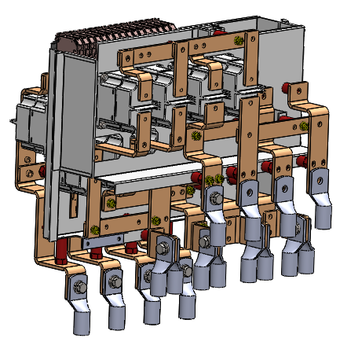
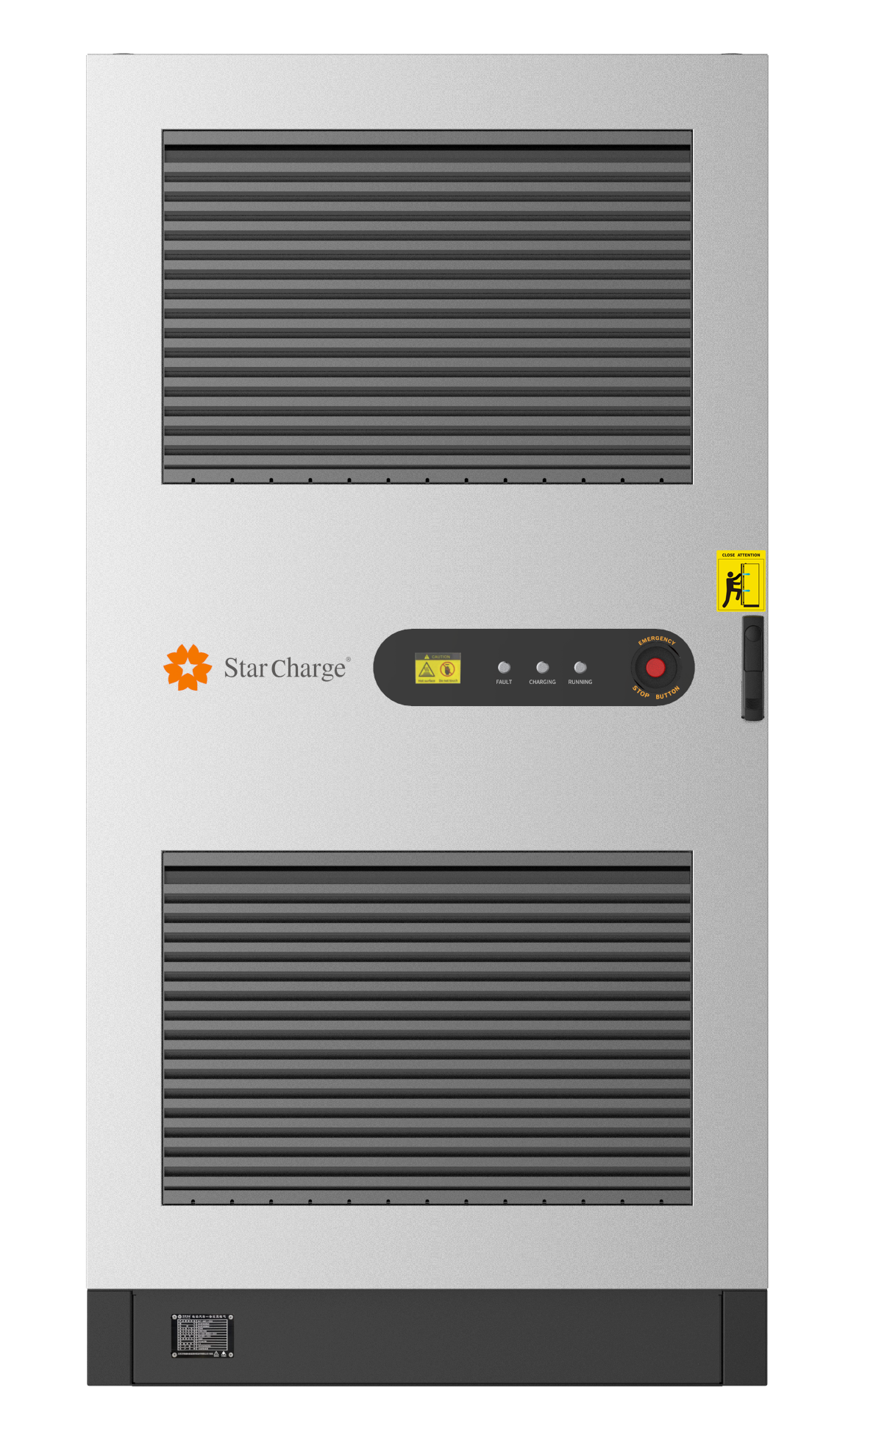
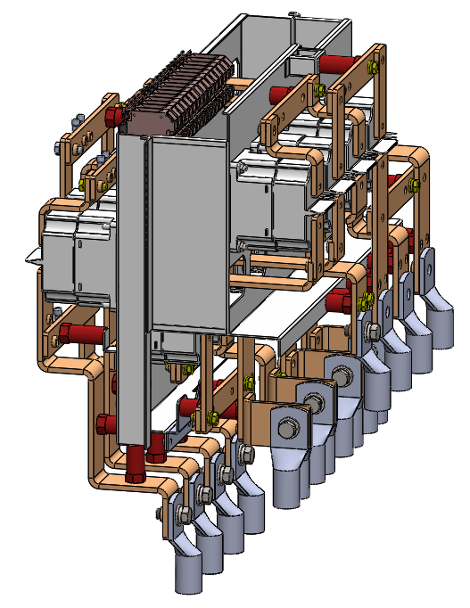
Distribution Module

