Slide 1




Slide 2
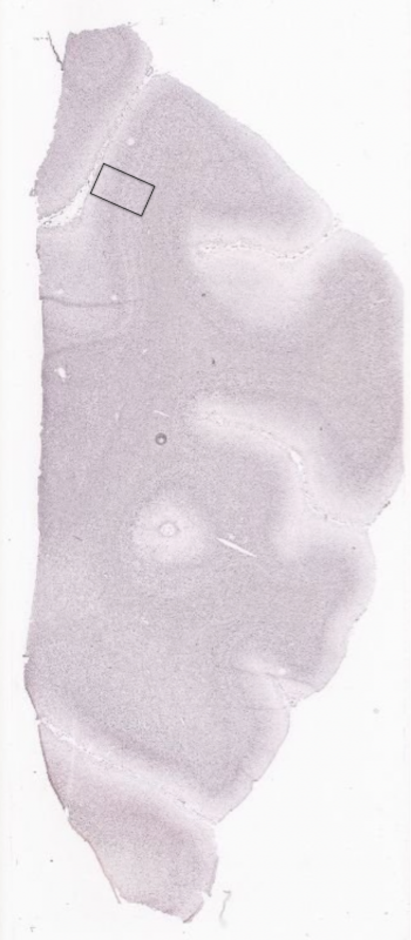

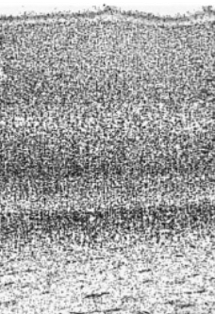
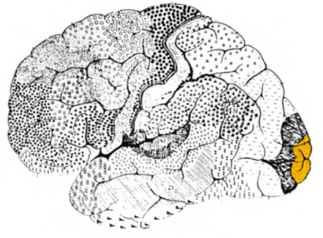
Introduction
Problem of concern: The spatial arrangement of Myelin basic protein in the human primary visual cortex (V1).
V1
An example of primary visual cortex (V1)
How we get the data

Slide 3
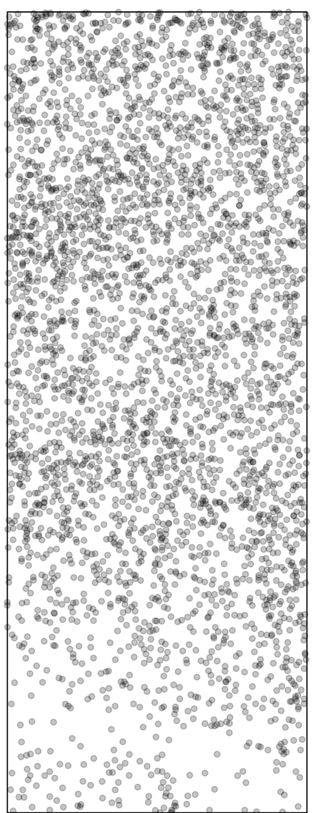
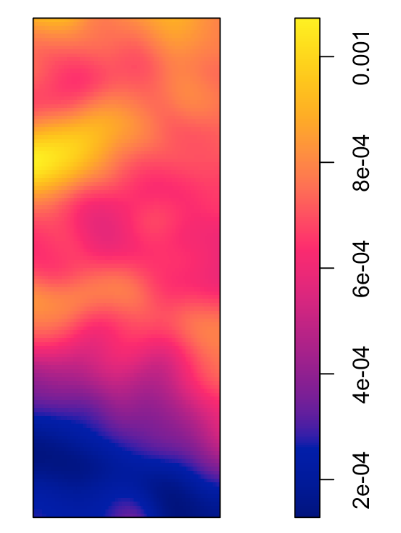
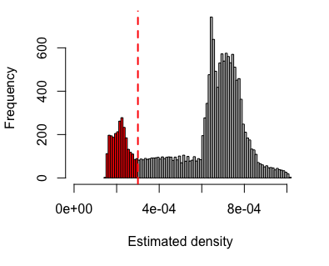
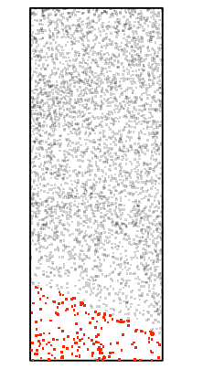
Methods
Apply the following methods to
the entire point pattern and segmented point pattern:
Nearest neighbor distance
Ripley’s K function
Paired correlation function*
L function*
- Convert the dataframe to a ppp object.
- Kernel density estimation of cells with edge correction.
Generate histogram of estimated intensity.
Vertical line denotes the threshold used to identify layers.
spatstat::ppp or
SpatialExperiment
spatstat::density
* Not presented in the slides

Slide 4
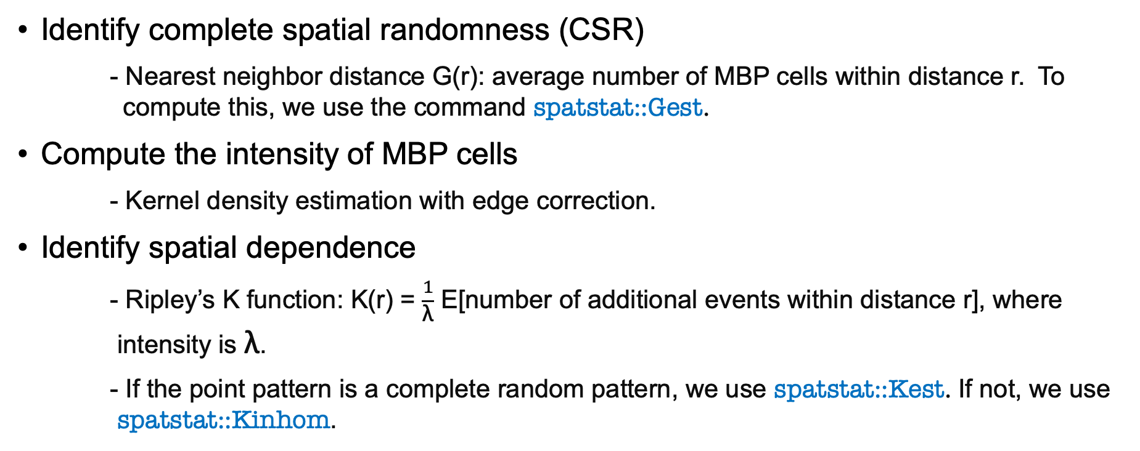
Methods
Identify complete spatial randomness (CSR)
- Nearest neighbor distance G(r): average number of MBP cells within distance r. To compute this, we use the command spatstat::Gest.
Compute the intensity of MBP cells
- Kernel density estimation with edge correction.
Identify spatial dependence
- Ripley’s K function: K(r) = $\frac{1}{\text{λ}}$ E[number of additional events within distance r], where intensity is $\text{λ}$.
- If the point pattern is a complete random pattern, we use spatstat::Kest. If not, we use spatstat::Kinhom.

Slide 5
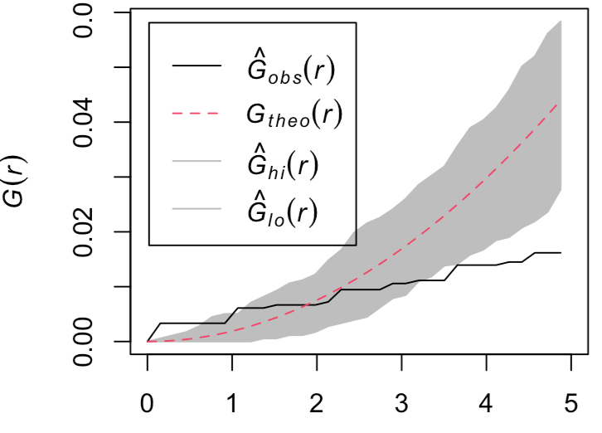
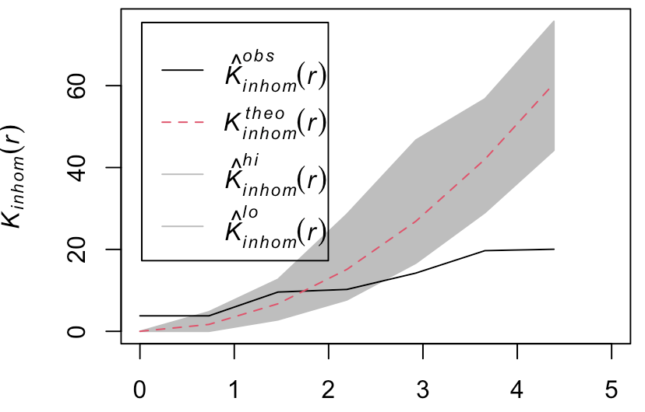
Results
We plot the observed values along with the theoretical values.
Black line – Observed G(r) or K(r) function are computed based on the observed point pattern.
Envelope – the simulation-based envelope is generated under the assumption of homogeneous Poisson process (HPP).
Red line – the average value of G(r) or K(r) under the assumption of HPP.
Distance(scaled)
Distance(scaled)
If there are clustering trend, we expect excess of small r compared to the envelope. We also have a similar expectation for K(r).

Slide 6
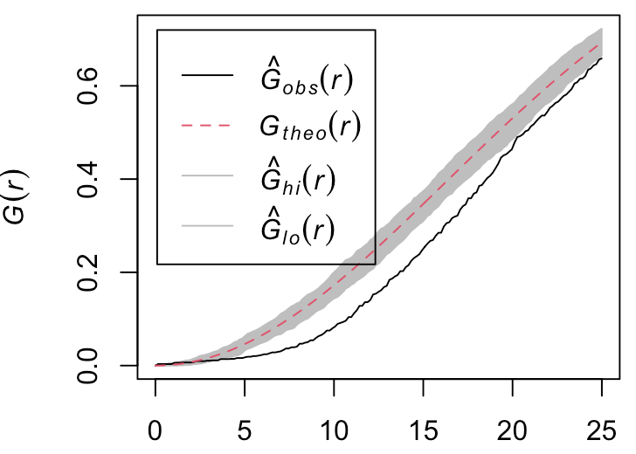
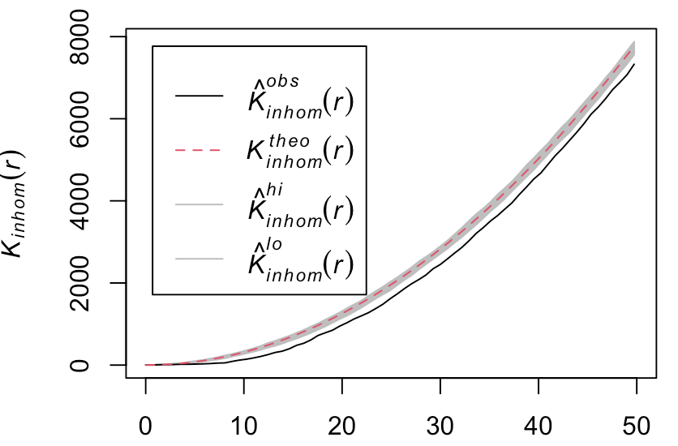
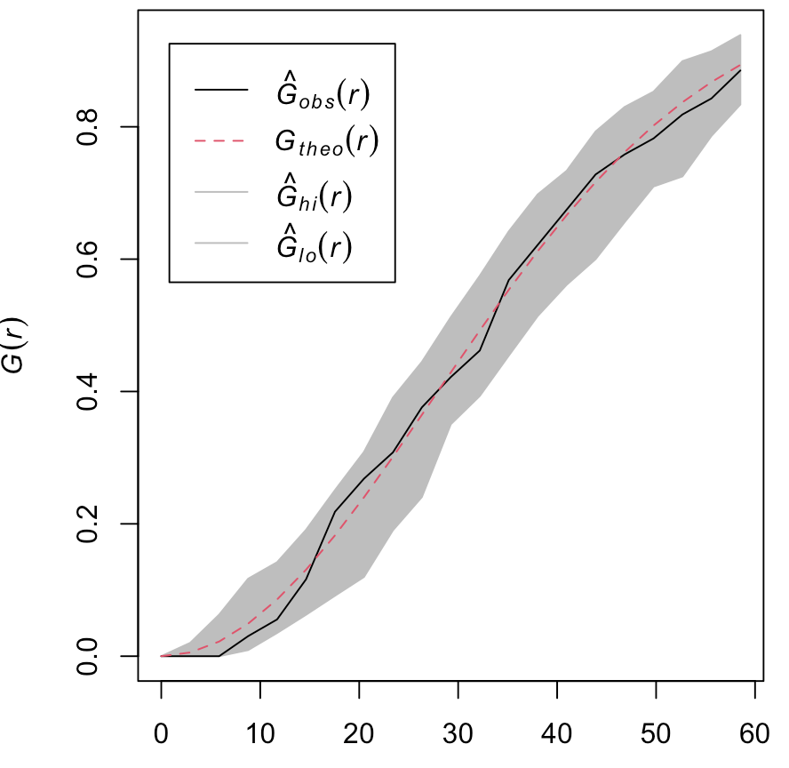
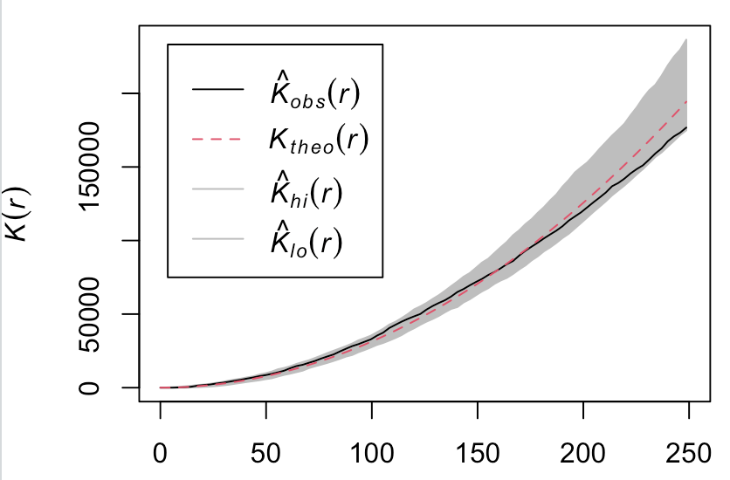
Results & Summary
Point pattern of the entire observation window:
G function shows that the point pattern is not CSR at some distances.
K function shows there are spatial dependence at some distances.
Distance(scaled)
Distance(scaled)
Point pattern of the selected layer:
G function shows that the selected layer is CSR
K function shows that there is no spatial dependency.
Summary:
Some parts of the point pattern are complete spatial randomness (CSR).
Thus, we can make compact window for other parts. And this would improve the computational efficiency for statistical modeling.
We integrate R/Bioconductor packages to understand spatial arrangement of the primary visual cortex V1.
Distance(scaled)
Distance(scaled)

Slide 7
Acknowledgement
Natural Sciences and Engineering Research Council of Canada (NSERC)
James Stewart Research Award, Department of Mathematics & Statistics, McMaster University.

