Slide 1

SMART INDIA HACKATHON 2026
TITLE PAGE
Problem Statement ID – SIH26196
Problem Statement Title- Student Innovation-Ideas that can boost fitness activities and assist in keeping fit.
Theme- Fitness & Sports
PS Category- Software
Team ID- SIH26-A0H-T264
Team Name - penguin.exe

Slide 2








FitVision
Penguin.exe
Why We Stand Out
Problem at Hand
Outcome
Hardware-Free Tracking
Smart Image Framing
•
Lack of Guidance: beginners perform workouts with incorrect posture, increasing the risk of physical injury.
Safety First: Real-time computer vision powered tool that ensures correct exercise form without needing a personal trainer.
Visual Motivation: Time-lapse video showcase visually prove to users that their efforts are yielding real results.
Unified Ecosystem: Gamified streaks, tracking micronutrients & macronutrients, within a single platform.
No expensive wearables required. Achieves precision posture correction using standard smartphone cameras.
The "Body Outline" overlay solves the common problem of misaligned progress photos, ensuring perfect time-lapse generation.
•
Poor Tracking: Keeping consistent manual logs of diets, weights,nutrients and actual physical changes is tedious.
Visual Progress AI
Centralized database
•
Motivation Drop: Without a clear visual representation of their hard work over time, students easily lose their fitness streaks.
Moves beyond basic BMI numbers. Our AI correlates high/low progress periods directly to visible body transformation data.
Seamlessly integrates authentication, streak logic, and relational logging data in a scalable cloud backend.
1. Form Check
2. Guided Timelapse
3. Micro and macro nutrients track
4. Friendly battle
Utilizes advanced Computer Vision models with trained data to map skeletal points and verify exercise posture in real-time.
Capture transformation logs assisted by a smart "body outline" UI. Auto-generates motivational progress slideshows.
pvp for workout (pushup, dumbell, etc., ) (with friends, online, pr)
quick-log daily weight, food taken and view gamified workout streaks.

Slide 3
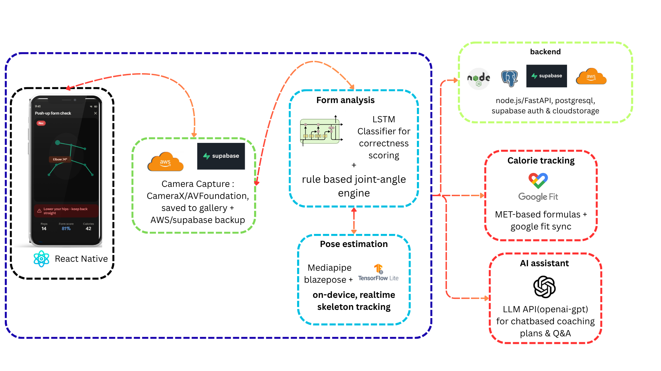
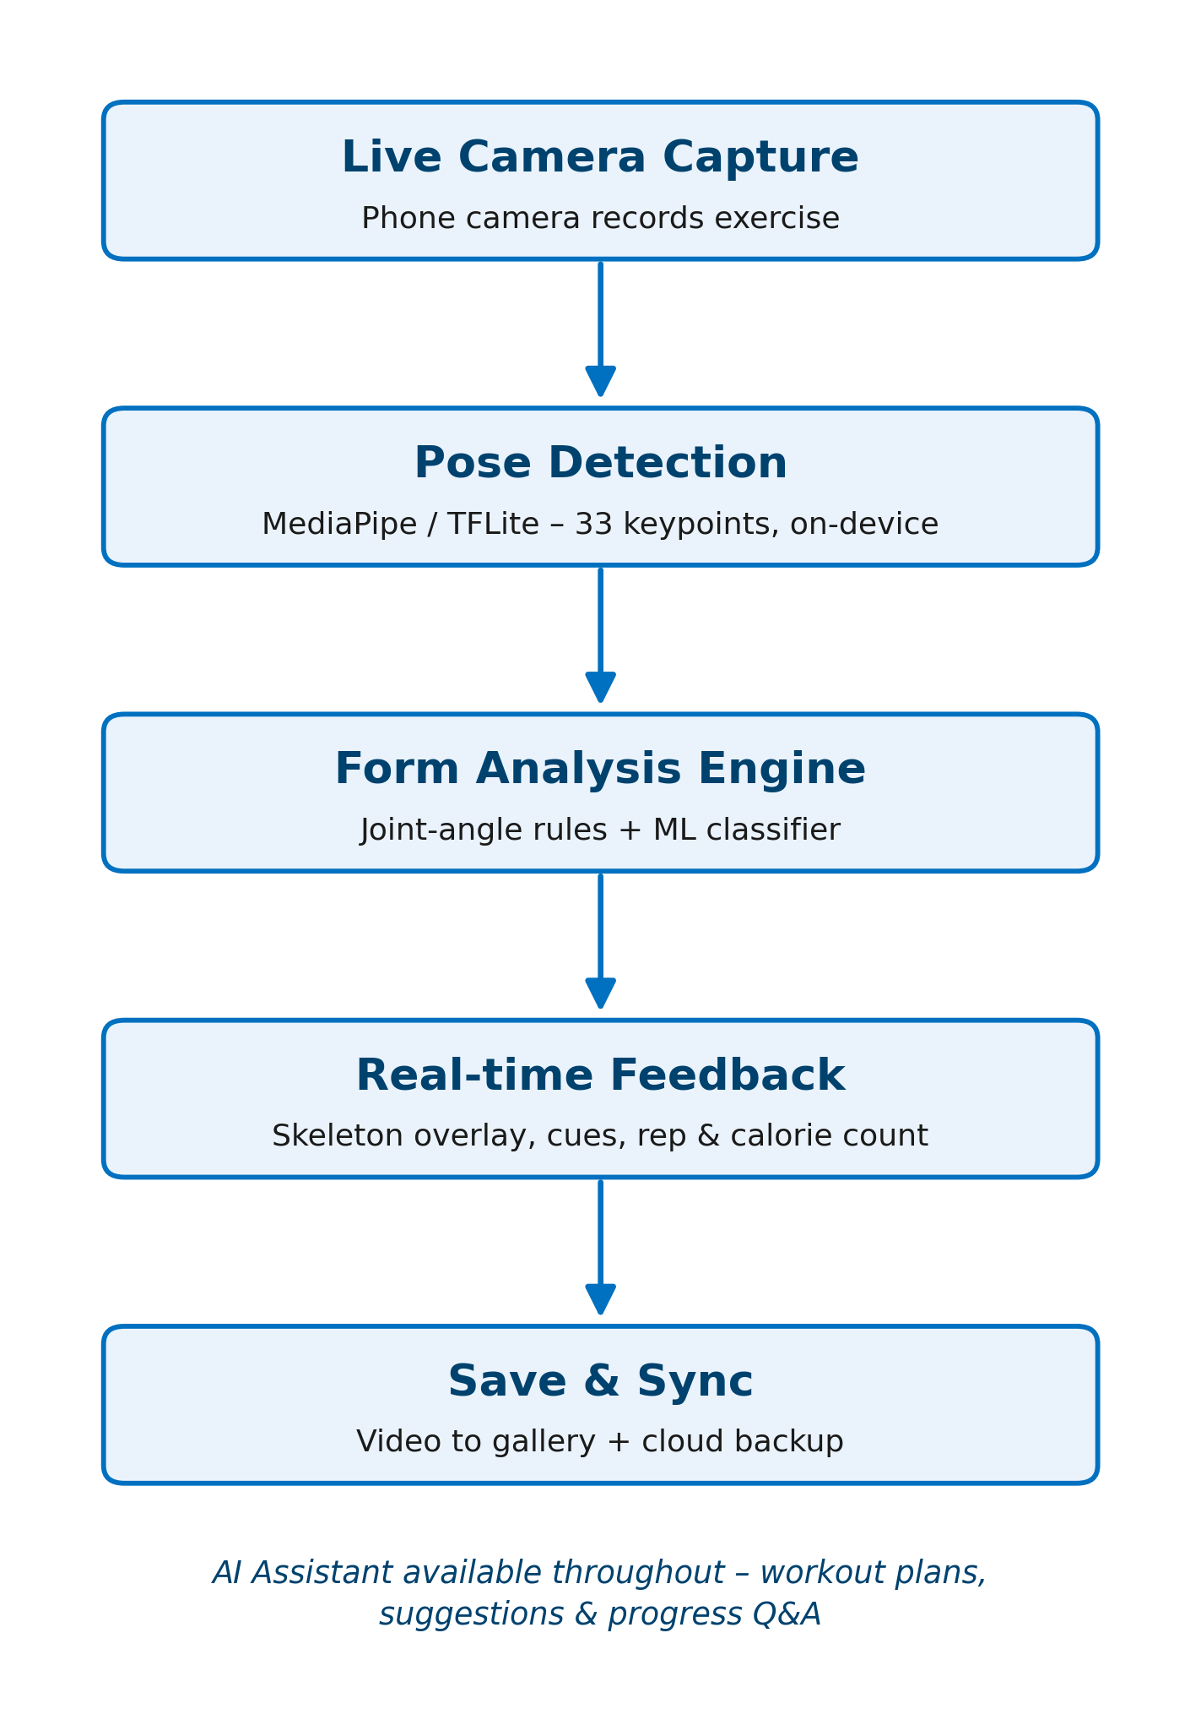
TECHNICAL APPROACH
Penguin.exe
Backend
Node.js (Express) or Python (FastAPI)
PostgreSQL (supabase)
Supabase-auth
Calorie & Fitness Tracking
MET-based calorie calculation formulas
Google Fit / Apple HealthKit
Edamam / USDA FoodData Central API — nutrition/food logging
Storage
Local video save
Supabase Storage / AWS S3
Tech Stack to be used :
Pose Estimation & Form Analysis
MediaPipe BlazePose — real-time skeletal keypoint detection (33 landmarks)
TensorFlow Lite — on-device model inference (low latency, offline-capable)
Rule-based joint-angle engine — computes angles (elbow, hip, knee, etc.) against per-exercise correct-form thresholds
LSTM / 1D-CNN classifier — form correctness classification,
Mobile App
React Native
Vision Camera / CameraX (Android) & AVFoundation (iOS)
AI Assistant
LLM API (GPT)
(Optional) Vector DB (Pinecone)

Slide 4
FEASIBILITY AND VIABILITY
Penguin.exe
Analysis of Feasibility
Potential Challenges and Risks
Strategies to overcome challenges
Core pose-estimation tech (MediaPipe/TFLite) is mature, open-source, and runs on-device — no expensive infra needed for MVP
React Native lets one team build both Android and iOS within hackathon/sprint timelines
Similar apps (Freeletics, Kemtai) validate market demand for AI form-correction fitness apps
Cloud services (Firebase) offer free tiers sufficient for prototype and early users
LLM APIs are plug-and-play for the AI assistant — no need to train a custom model
Add on-screen positioning guides so users frame themselves correctly before starting
Optimize model size (quantized TFLite models) and offer adjustable frame-rate for low-end devices
Launch with 2–3 well-tuned exercises (e.g., push-up, lat pulldown), expand iteratively
Make cloud video backup opt-in, with local-only storage as default
Encrypt stored videos and let users delete them anytime; process pose data locally, don't upload raw video for analysis
Continuously refine thresholds using real user feedback and a "flag incorrect feedback" button to improve the model over time
Pose detection accuracy drops with poor lighting, loose clothing, or partial body visibility
Device performance variance — real-time inference may lag on low-end phones
Exercise coverage — every new exercise needs its own angle thresholds/training data
Video storage costs scale with users if cloud backup is enabled by default
User privacy concerns around storing workout videos with visible body data
False positives/negatives in form feedback could frustrate users or reduce trust

Slide 5
IMPACT AND BENEFITS
Penguin.exe
Potential Impact on the Target Audience
Encourages healthier lifestyle habits and long-term behavior change
Reduces exercise-related injuries from improper form
Saves users the recurring cost of personal trainers or premium gym memberships
Creates opportunity for a freemium/subscription business model (advanced plans, detailed analytics)
Helps beginners exercise with correct form from day one, reducing injury risk without needing a personal trainer
Makes structured, guided fitness accessible to people who can't afford gyms or trainers
Builds consistency through tracking, feedback, and AI-driven motivation — reducing workout dropout rates
Empowers home-workout users (students, working professionals, homemakers) with gym-level guidance
Supports people in remote/underserved areas with no access to fitness coaching
social
economic
Benefits
Promotes home workouts, reducing commute-related travel to gyms
Reduces dependency on physical infrastructure (gym equipment, buildings)
Early detection of poor form reduces musculoskeletal injuries
Encourages regular physical activity, contributing to better long-term public health outcomes
environmental
health

Slide 6
RESEARCH AND REFERENCES
Penguin.exe
Van Every, Derrick & Lees, Matthew & Wilson, Brandan & Nippard, Jeff & Phillips, Stuart. (2025). Load-induced human skeletal muscle hypertrophy: Mechanisms, myths, and misconceptions. Journal of Sport and Health Science. 15. 101104. 10.1016/j.jshs.2025.101104.
Androulakis Korakakis, Patroklos & Wolf, Milo & Coleman, Max & Burke, Ryan & Piñero, Alec & Nippard, Jeff & Schoenfeld, Brad. (2023). Optimizing Resistance Training Technique to Maximize Muscle Hypertrophy: A Narrative Review. Journal of Functional Morphology and Kinesiology. 9. 10.3390/jfmk9010009.
Khugshal, Dr. (2021). The Need for Gym Exercises and the Imminent Benefits.
Krzysztofik, M., Wilk, M., Wojdała, G., & Gołaś, A. (2019). Maximizing Muscle Hypertrophy: A Systematic Review of Advanced Resistance Training Techniques and Methods. International journal of environmental research and public health, 16(24), 4897. https://doi.org/10.3390/ijerph16244897

