Slide 1

SMART INDIA HACKATHON 2026
TITLE PAGE
Problem Statement ID – 26101
Problem Statement Title- AI-Enabled Personalized Learning Platform for Official Statistics through iGOT Karmayogi
Theme- Smart Education
PS Category- Software
Team ID- SIH26-A0H-T264
Team Name- Penguin.exe

Slide 2



GyanSetu
Penguin.exe
Why We Stand Out
Problem at Hand
Outcome
Explainable Recommendations
Every course suggestion comes with a plain-language reason, not a black-box AI match.
Generic Training: Officials get the same static iGOT course list, with no matching to their actual role or skill level.
Invisible Skill Gaps: No structured way exists to assess what an official already knows versus what their job actually requires.
Unverified Learning: Course completion doesn't confirm real understanding — there's no built-in way to test if the skill was actually gained.
Personalized Pathways: AI matches each official's profile to the exact iGOT/TPAC course needed to close their specific gap.
Verified Competency: Auto-generated quizzes from any uploaded material instantly confirm real understanding, not just attendance.
Data-Driven Workforce: Admins get org-wide visibility into skill gaps and training effectiveness for smarter planning.
Hallucination-Free Quizzes
Questions are RAG-grounded strictly to uploaded content, with trainer approval before publishing.
Career-Linked Learning
Shows how each completed course moves an official toward promotion-readiness, not just a certificate.
Data-Sovereign AI
Self-hosted open-source models keep sensitive government data fully within government infrastructure.

Slide 3
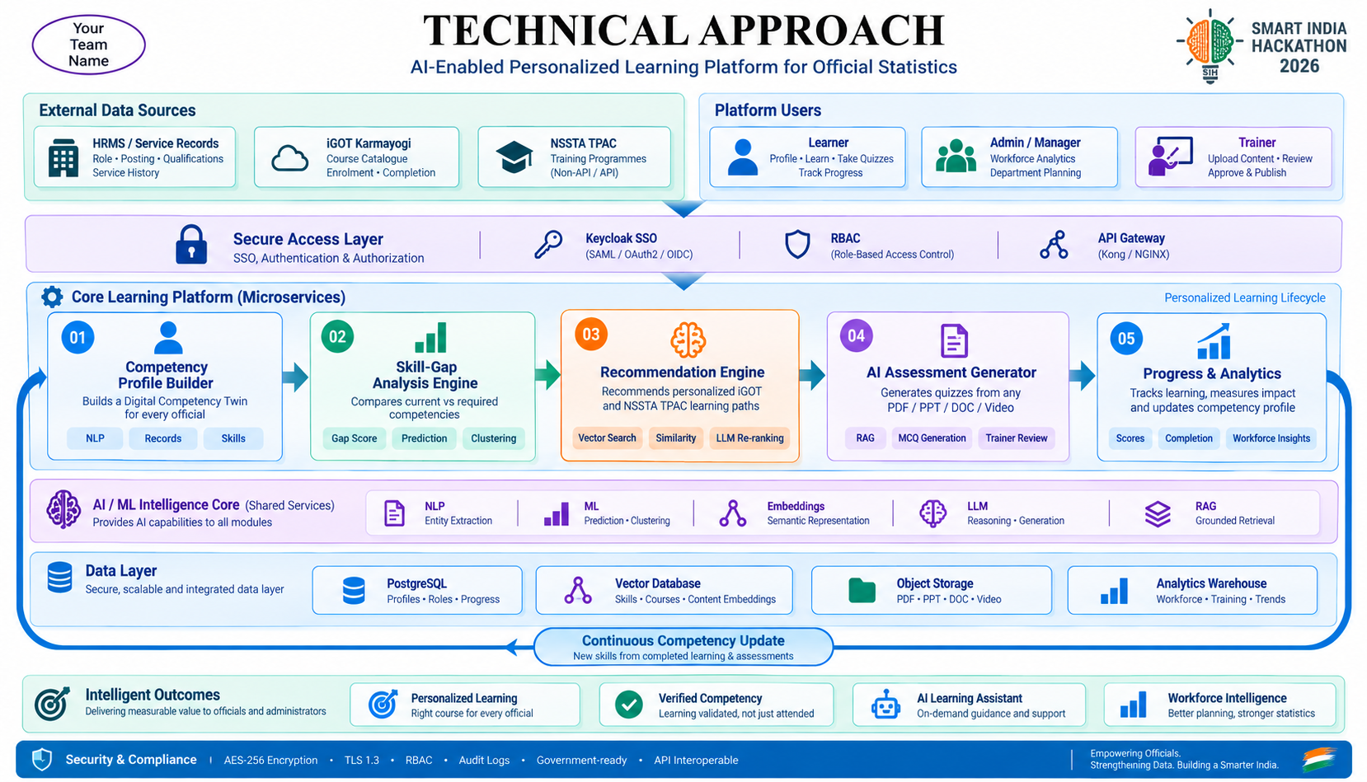
TECHNICAL APPROACH
Penguin.exe
Tech Stack
React.js / Next.js — Frontend
FastAPI — Backend
spaCy + Sentence-Transformers — NLP & embeddings
Scikit-learn — ML / skill-gap prediction & clustering
Llama 3 / Mistral — LLM
Whisper — Video speech-to-text
Docker + Kubernetes — Deployment & scalability
Kafka — Asynchronous iGOT synchronization / jobs
Prometheus + Grafana — Monitoring

Slide 4
FEASIBILITY AND VIABILITY
Penguin.exe
Analysis of Feasibility
Potential Challenges and Risks
Strategies to overcome challenges
Use NLP-based auto-extraction from existing records, plus a manual verification step to fill and correct gaps.
Maintain an admin-curated fallback list for uncovered competencies, flagged for manual TPAC recommendation.
Ground every quiz question strictly in the uploaded material (RAG) and route through a trainer-approval queue before publishing.
Offer a multilingual UI and assistant (via Bhashini) with simple onboarding tutorials and micro-learning nudges.
Use asynchronous, queue-based syncing (Kafka) with local caching so external system downtime never blocks the user experience.
Mature core tech: Sentence-embedding and vector search (Sentence-Transformers, pgvector) are proven, open-source, and run efficiently — no expensive infra needed for an MVP.
iGOT integration already exists: iGOT Karmayogi exposes APIs for course catalogue, enrolment, and completion — we're integrating with a live system, not building one from scratch.
Validated pattern: AI-driven recommendation and RAG-based quiz generation are proven in ed-tech (Coursera, Duolingo) — the approach is de-risked, not experimental.
Plug-and-play AI: Self-hosted open-source LLMs (Llama/Mistral via Ollama) work out-of-the-box — no need to train a custom model.
Bounded scope with experts: Competency-framework mapping can be co-developed with MoSPI/NSSTA within a known, manageable timeframe.
Incomplete profile data — many officials' service/training records are inconsistent across HRMS systems.
Course coverage gaps — iGOT's catalogue may not cover every niche statistical competency.
AI quiz reliability — auto-generated MCQs could be inaccurate if not properly grounded in source material.
Digital literacy variance — officials across states/departments differ widely in digital comfort and language.
Integration complexity — two-way sync with iGOT and non-API sources (NSSTA TPAC) can introduce latency or sync failures.

Slide 5
IMPACT AND BENEFITS
Penguin.exe
Potential Impact on the Target Audience
Builds a culture of continuous, merit-based learning across the statistical workforce.
Increases officials' confidence and career mobility through verified competency.
Cuts training costs by targeting only genuine skill gaps instead of blanket training programme.
Reduces time-to-competency, so officials become productive in new roles/technologies faster.
Gives every official a personalized learning path instead of generic, one-size-fits-all courses.
Makes skill-gap identification instant and objective, removing guesswork from training planning.
Builds consistency through progress tracking and AI-driven nudges, reducing course drop-off.
Empowers officials in smaller/remote offices with the same quality of guided learning as those in major departments.
Gives administrators real-time, org-wide visibility into workforce competency for smarter planning.
social
economic
Benefits
Better-trained officials produce higher-quality statistical data, strengthening evidence-based policymaking.
Improves compliance with data-quality and digital-governance standards nationwide.
Higher iGOT Karmayogi utilization and course-completion rates.
Predictive analytics let administrators plan capacity-building before shortages become critical.
environmental
health

Slide 6
RESEARCH AND REFERENCES
Penguin.exe
Government of India, Department of Personnel & Training. (2026). Karmayogi Classroom: AI-driven capacity building on the iGOT Karmayogi platform — official launch of AI Saarthi, AI Tutor, and AI-based Capacity Building Plans, confirming the government's own roadmap toward AI-personalized civil service training.
Zhang, X., Liu, S., & Wang, H. (2023). Personalized Learning Path Recommendation for E-Learning Based on Knowledge Graph and Graph Convolutional Network. International Journal of Software Engineering & Knowledge Engineering, 33(1), 109.
National Programme for Civil Services Capacity Building (Mission Karmayogi) — Policy Framework Document, Government of India, approved 2nd September 2020; iGOT Karmayogi platform (https://igotkarmayogi.gov.in).
Hukkeri, G. S., & Goudar, R. H. (2022). Machine Learning-Based Personalized Recommendation System for E-Learners. IEEE Conference Proceedings.

