Slide 1
Multiplayer Game Platform
Integration Team Design Demo
Architecture · User Flows · Project Plan
Bogo Solutions

Slide 2
Agenda
01
High-Level Architecture
Component breakdown, layers, and design principles
02
Complete User Flow
Sequence diagrams for all major platform flows
03
Project Plan
Three-sprint breakdown and product backlog
Multiplayer Game Platform · Bogo Solutions

Slide 3
High-Level Architecture
Component Overview
UI & NAVIGATION LAYER
LoginPage
WelcomePage
HomePage
MainGameDashboard
PlayGame
GameGUI
ChatboxGUI
ProfileDashboard
Settings
ClientCore → TCP Network → ServerCore
PLATFORM CORE & SERVICES
PlatformCore
GameSessionManager
MatchMaking
Leaderboard
EventBus
Chat
Lobby
SessionManager
GAME LAYER
PLAYER & STATS
STUBS
Game (interface)
Player
Database
RuleValidator (interface)
GeneralStats
Networking
PlayerAction (abstract)
PlayerStats
CredentialsDatabase
TicTacToeGame
Rank (enum)
GameServer
ConnectFourGame
Settings

Slide 4
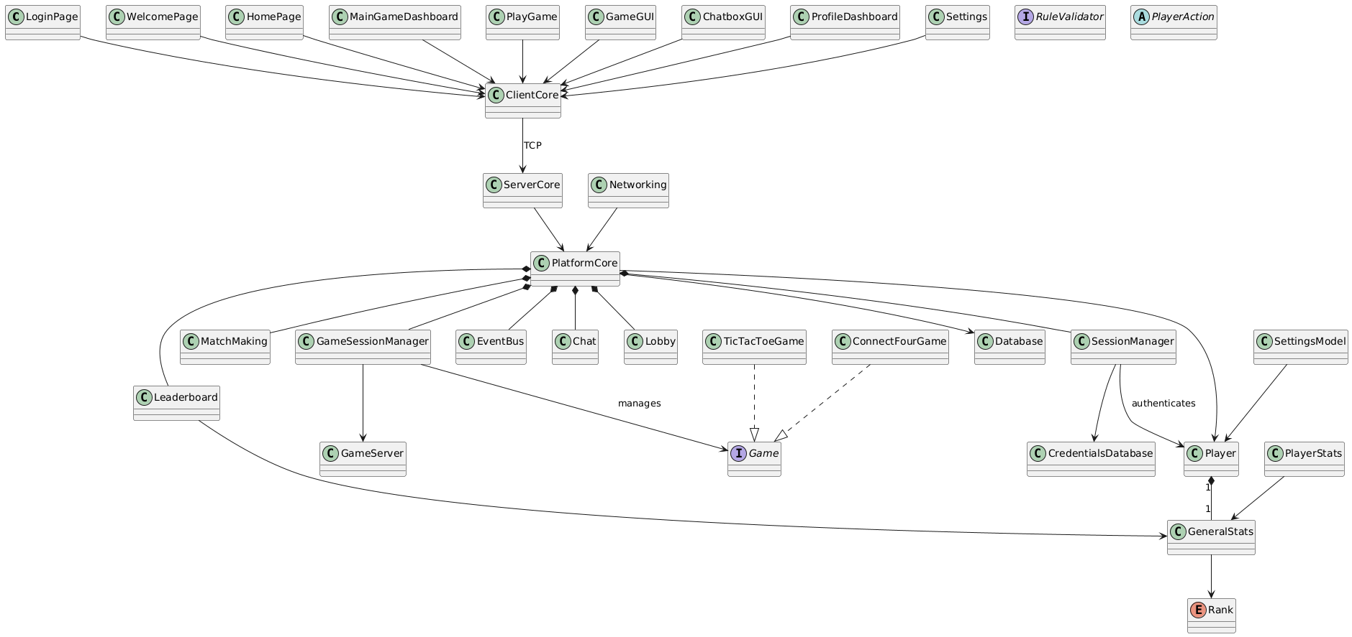
High-Level Architecture
Component Overview

Slide 5
Architectural Principles
1. Platform owns notifications
2. Game returns state only
GameSessionManager emits GameStateUpdate events. PlatformCore decides who to notify and how — regardless of where the player currently is.
Game implementations return state or deltas only. They never call UI or platform notification methods directly.
3. UI calls PlatformCore APIs
4. Platform Core Bridge
The UI layer calls PlatformCore APIs (submitMove, joinQueue, joinLobby). It never touches GameEngine internals.
GameStateUpdate is the contract between game logic and everything else. No direct calls from game layer to UI.
5. Stub boundaries
Database, Networking, and GameServer are stubs with clean interfaces — swappable with real implementations without structural changes.

Slide 6
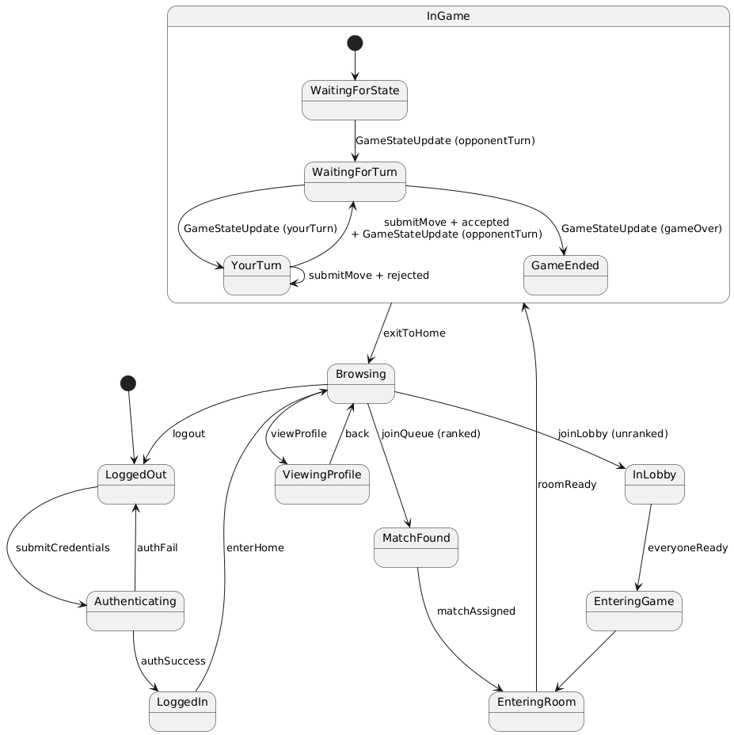
Player Session State Machine

Slide 7
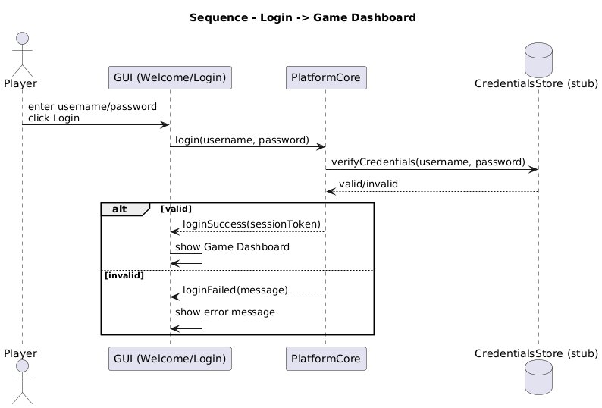
User Flow Sequence Diagrams
Authentication & Account
Login — Original Design
ORIGINAL

Slide 8
User Flow Sequence Diagrams
Authentication & Account
Login — Design Critique
CRITIQUE
1. Plaintext password. verifyCredentials(username, password) passes the raw password, which is a security design flaw. Even in a stub, hashing should be reflected in the architecture.
2. No SessionManager. Session creation is collapsed into PlatformCore, violating Single Responsibility. A dedicated SessionManager should own session lifecycle.
3. No local session storage. After login, there is no defined step to persist the session token locally, leaving the platform with no way to maintain authenticated state between screens.
4. No loading/feedback states. The diagram moves directly from click to response with no intermediate UI state, omitting expected loading behaviour.
5. Missing userID in success response. loginSuccess(sessionToken) gives the GUI no way to know which user just logged in without an additional lookup.

Slide 9
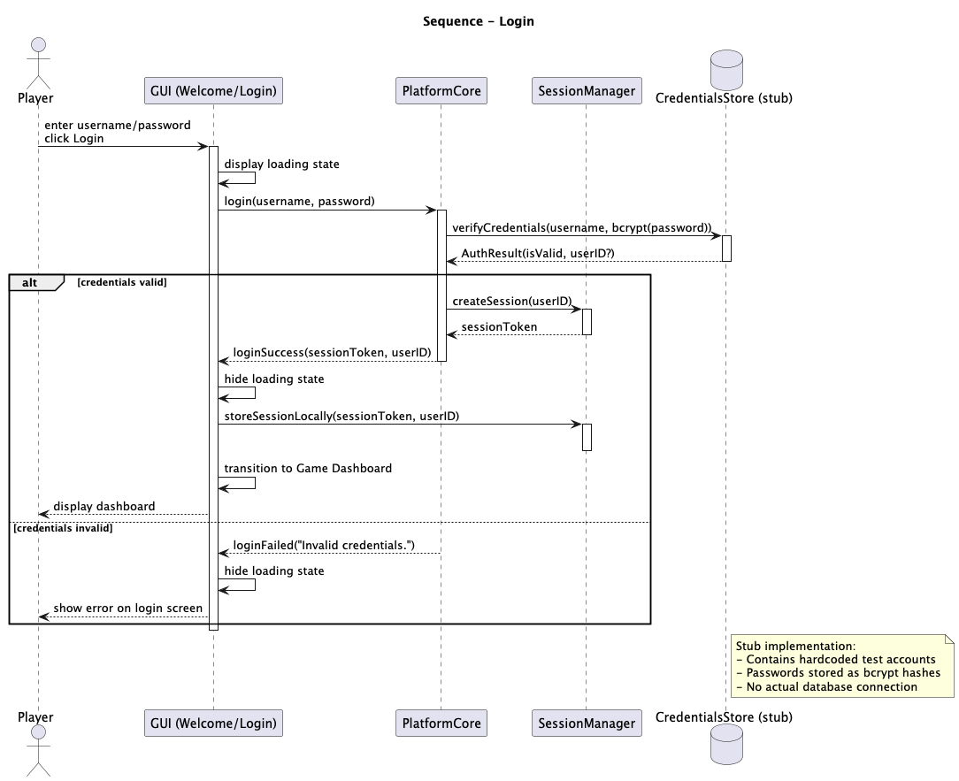
User Flow Sequence Diagrams
Authentication & Account
Login
6.2 Sign Up
6.3 Logout

Slide 10
User Flow Sequence Diagrams
Authentication & Account
Sign Up — New Flow Addition
NEW FLOW
Why it was added. Account registration was entirely absent from the original design. Without a registration flow, there is no defined path for new users to enter the system.
Username availability check. PlatformCore checks CredentialsStore before creation, preventing duplicate accounts — a gap the original design had no mechanism for.
bcrypt storage from registration. Storing bcrypt(password) at registration grounds the Login diagram's hashing assumption, ensuring consistency across the auth subsystem.
Auto-login after sign up. A session is created immediately after successful registration so new players do not need a separate login step.
Failure paths defined. Both duplicate username and general creation failure are explicitly modelled, covering the gaps the original left undefined.

Slide 11
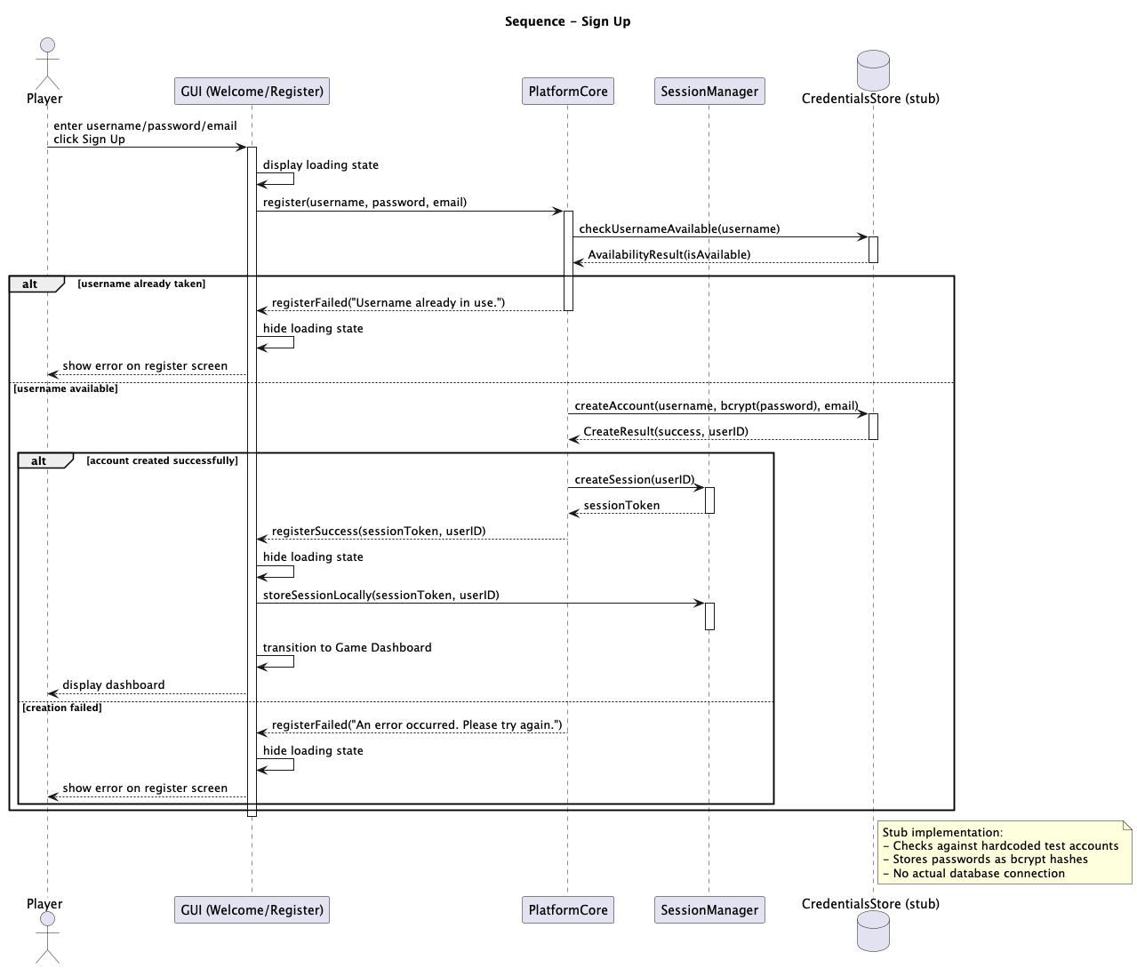
User Flow Sequence Diagrams
Authentication & Account
Sign Up
6.2 Sign Up
6.3 Logout

Slide 12
User Flow Sequence Diagrams
Authentication & Account
Logout — New Flow Addition
NEW FLOW
Why it was added. The logout flow was entirely absent from the original design. Without it, session tokens persist indefinitely and there is no defined way to invalidate a session.
SessionManager.clearSession(). Calls clearSession(sessionToken) which invalidates the token server-side and clears any locally stored session data.
Security correctness. A complete authentication system requires a defined logout path. This makes the auth subsystem complete and architecturally sound.
Return to Welcome/Login. After session is cleared, the player is explicitly navigated back to the Welcome/Login screen, completing the session lifecycle.

Slide 13
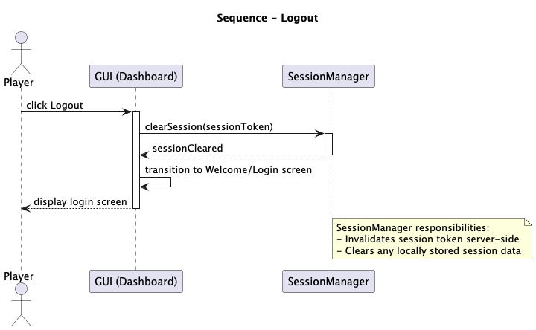
User Flow Sequence Diagrams
Authentication & Account
Log Out
6.2 Sign Up
6.3 Logout

Slide 14
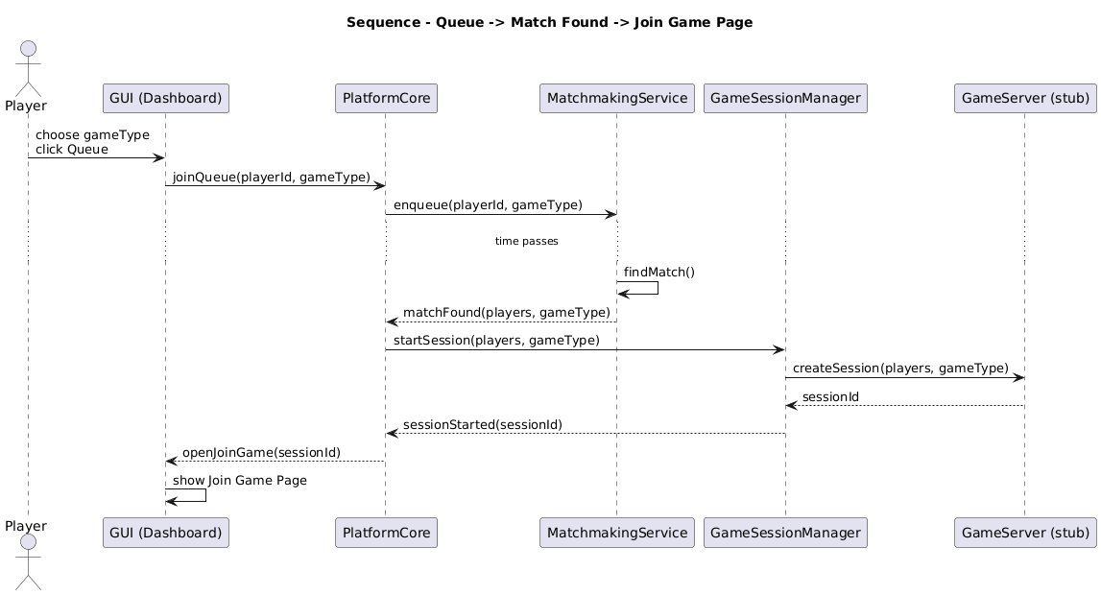
User Flow Sequence Diagrams
Matchmaking & Game Session
Join Game — Original Design
ORIGINAL

Slide 15
User Flow Sequence Diagrams
Matchmaking & Game Session
Join Game — Design Critique
CRITIQUE
1. No eligibility check. Any player can enter the queue unconditionally. There is no verification of ban status, rank requirements, or other access conditions — a significant matchmaking gap.
2. No failure path. The diagram only shows the happy path. There is no defined behaviour for what happens when a player cannot join — no error returned, no message shown.
3. No database interaction. Player eligibility data lives in persistent storage, but the original has no DB stub connection — the design does not specify where this data comes from.
4. Single diagram conflates concerns. Eligibility, queuing, and session creation are distinct responsibilities combined in one undifferentiated flow, making ownership unclear.

Slide 16
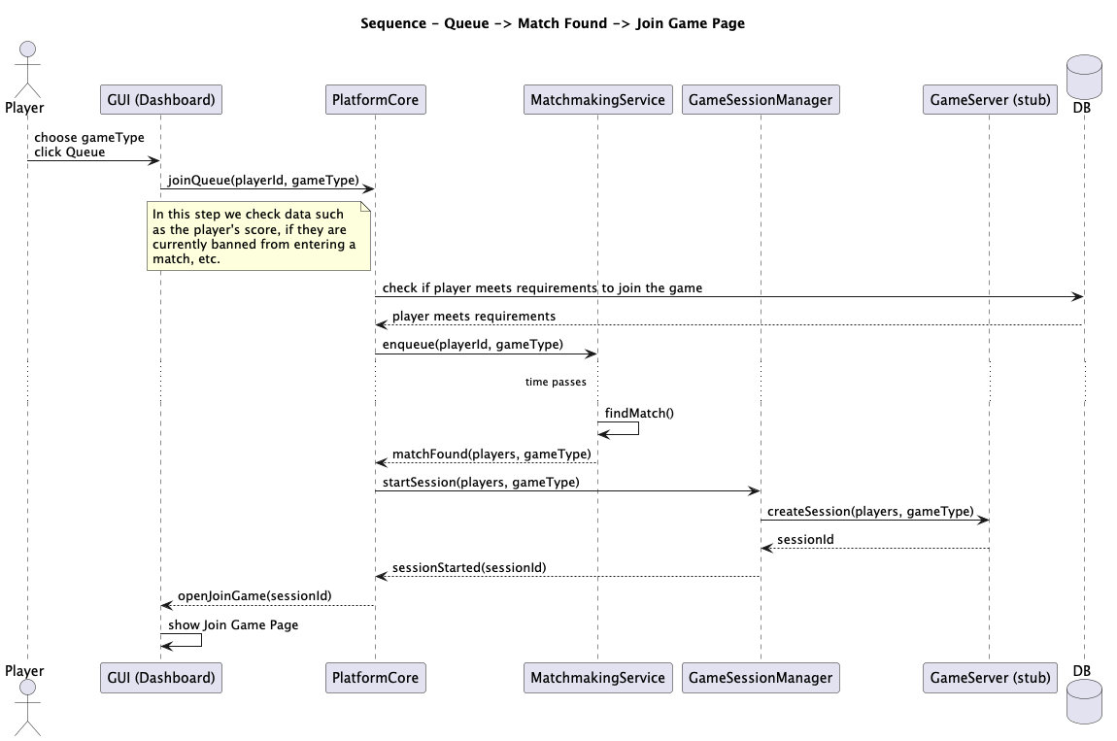
User Flow Sequence Diagrams
Matchmaking & Game Session
Join Game (Requirements Met)

Slide 17
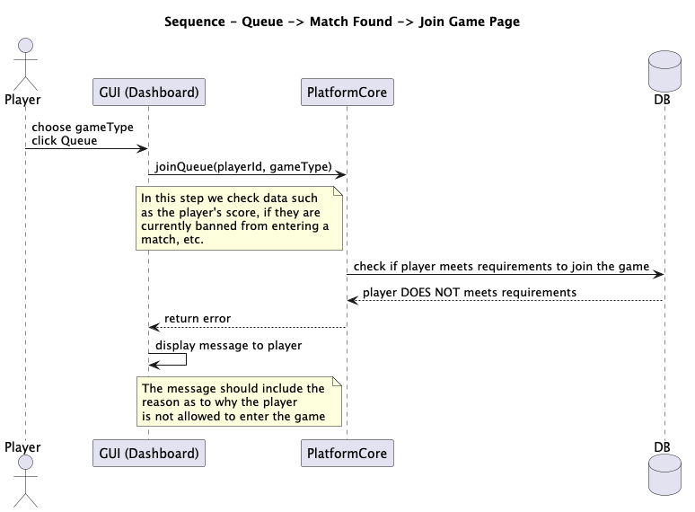
User Flow Sequence Diagrams
Matchmaking & Game Session
Join Game (Requirements Not Met)

Slide 18
User Flow Sequence Diagrams
Matchmaking & Game Session
Submit Move — Design Improvements
IMPROVED
clientStateVersion added. The optional clientStateVersion parameter supports optimistic concurrency control, preventing stale move submissions in multi-client environments.
Immediate acknowledgement. PlatformCore now returns ack(moveReceived) before validation completes, preventing duplicate submissions and improving perceived responsiveness.
GameEnded vs GameStateUpdate. The revised design correctly distinguishes a terminal game-over event from an in-progress state update, enabling downstream consumers to handle each case appropriately.
Formal architectural doc. An accompanying .md file provides rationale for each step, documenting design properties, correctness guarantees, and engineering justifications expected for P1.

Slide 19
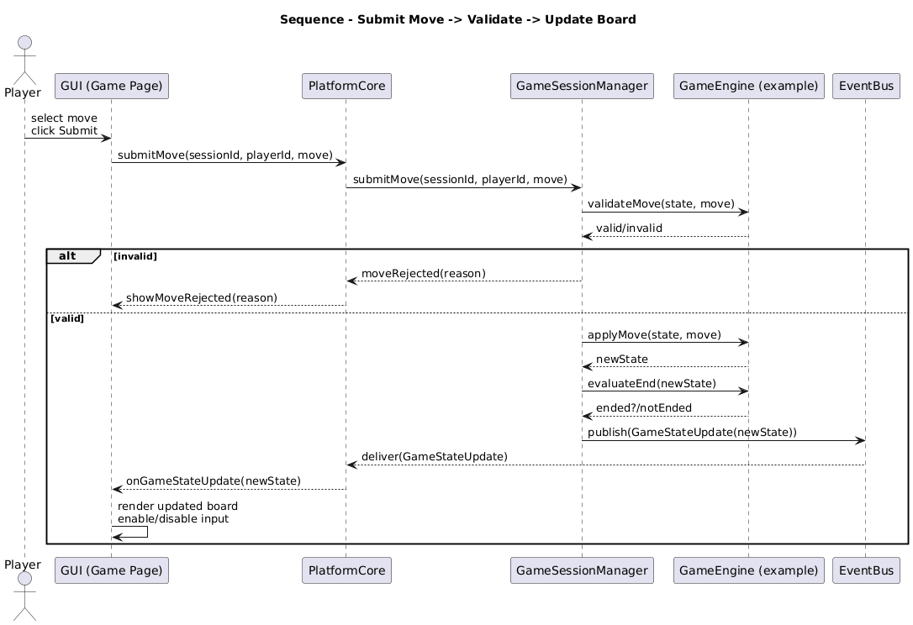
User Flow Sequence Diagrams
Matchmaking & Game Session
6.4 Join Game (Requirements Met)
6.5 Join Game (Requirements Not Met)
Submit Move

Slide 20
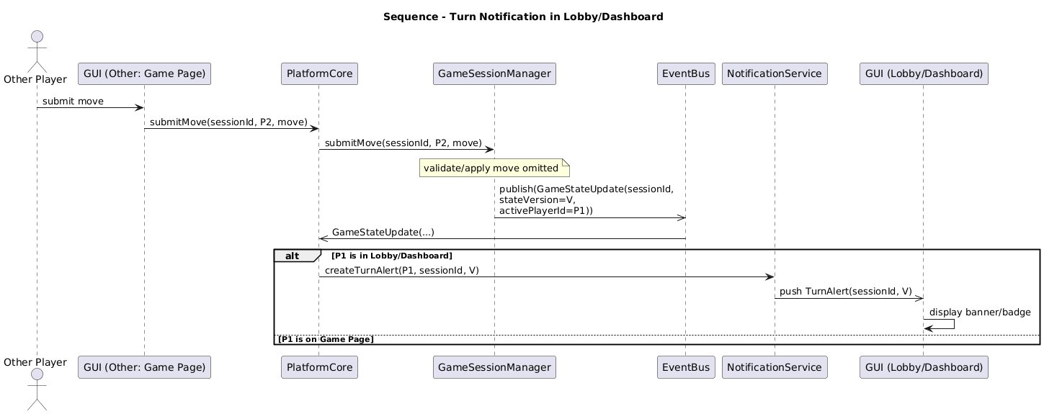
User Flow Sequence Diagrams
Matchmaking & Game Session
Turn Notification — Original Design
ORIGINAL

Slide 21
User Flow Sequence Diagrams
Matchmaking & Game Session
Turn Notification — Design Critique
CRITIQUE
Overall design is sound. The core event-driven notification design using EventBus + NotificationService is correct and well-structured. Most issues are minor.
P1 on Game Page branch is empty. The [P1 is on Game Page] alternate branch is labelled but left entirely empty. A reviewer cannot tell whether nothing happens, or whether the board updates. Should be annotated or linked to the Submit Move diagram.
No stateVersion conflict handling. The stateVersion=V parameter is included in the publish call, but there is no note on what happens if the delivered version is stale or out of order — this edge case should at minimum be acknowledged.

Slide 22

User Flow Sequence Diagrams
Matchmaking & Game Session
6.4 Join Game (Requirements Met)
6.5 Join Game (Requirements Not Met)
Turn Notification

Slide 23
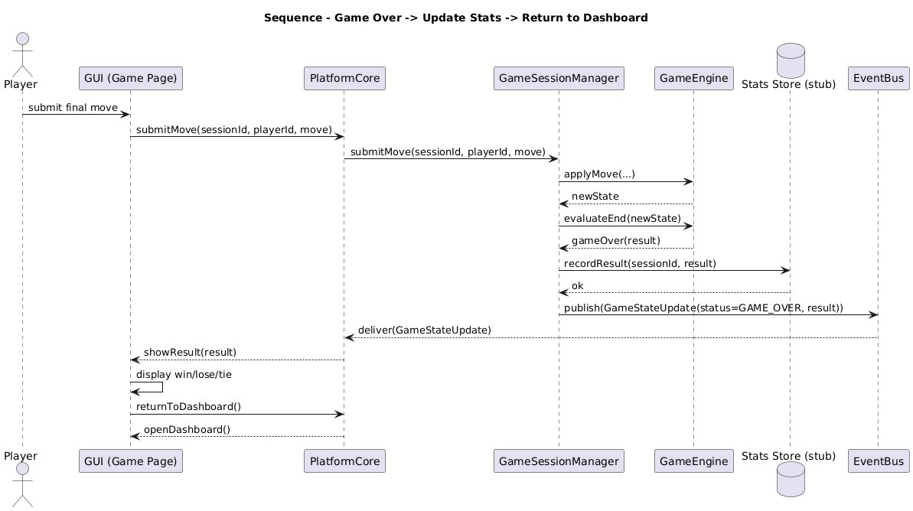
User Flow Sequence Diagrams
Game Over & Statistics
Game Ends — Original Design
ORIGINAL

Slide 24
User Flow Sequence Diagrams
Game Over & Statistics
Game Ends — Design Critique
CRITIQUE
1. DB publishes events. Stats Store calls publish(GameStateUpdate(...)) on EventBus directly. A data store should not own event publication — that is a platform responsibility, not a persistence concern.
2. No rank display. The diagram shows win/lose/tie but never displays the player's updated rank, which is a defined platform requirement (leaderboard and player stats are core features).
3. No ranking data fetch. There is no step where PlatformCore retrieves the player's new rank from the database after stats are recorded — the flow goes from recording to display with no read operation.
4. Vague 'Stats Store' naming. Stats Store implies raw storage, not logic. Renaming to StatsManager better reflects that it computes and updates statistics, not just persists raw data.
5. Undifferentiated stat processing. All stat recording is collapsed into one recordResult call. The revised design separates parsing from persistence, improving clarity and testability.

Slide 25
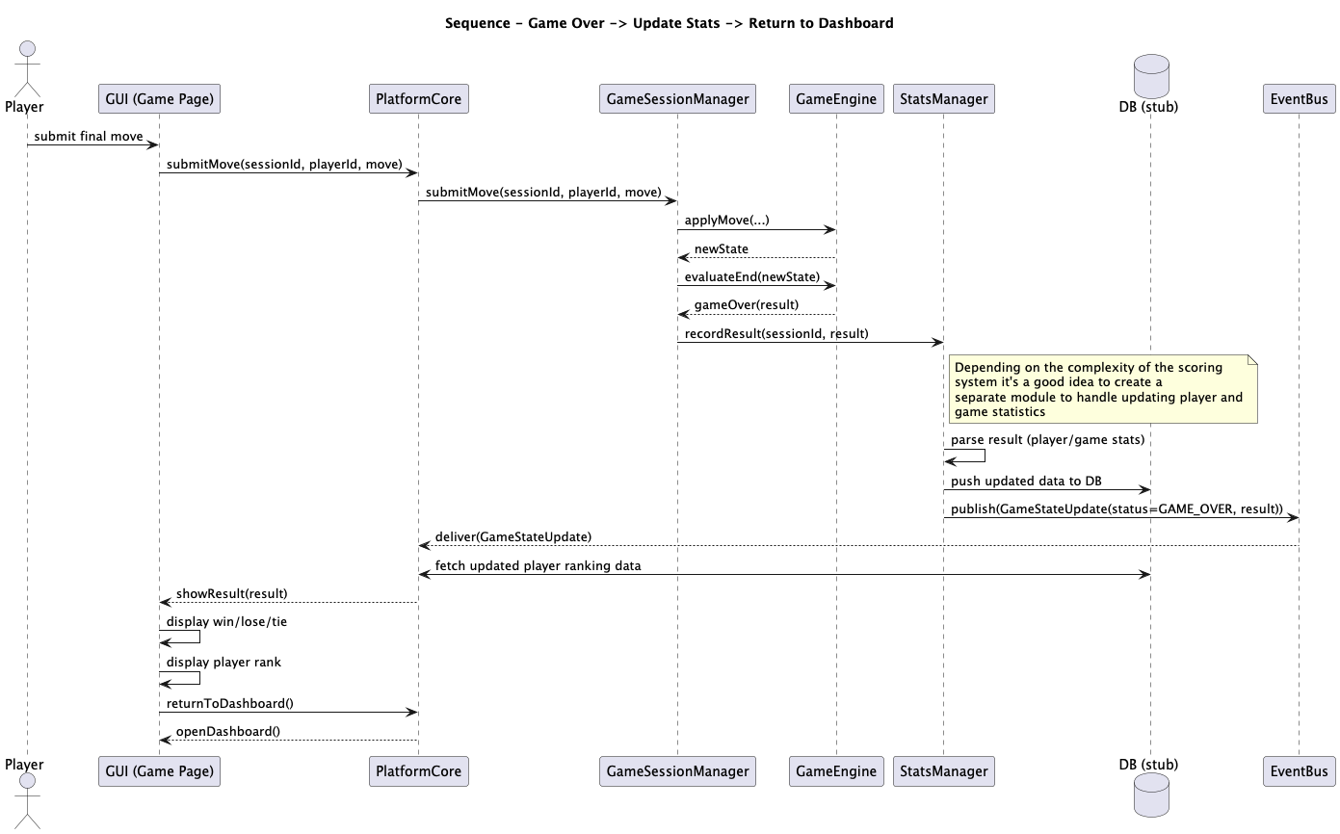
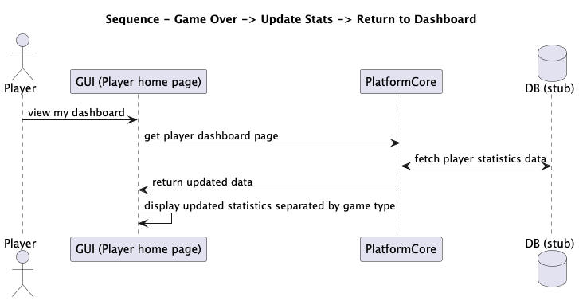
User Flow Sequence Diagrams
Game Over & Statistics
6.7 Game Over → Update Stats
6.8 View Player Statistics
Multiplayer Game Platform · Bogo Solutions

Slide 26
Project Plan — Sprint Overview
Sprint 1
Sprint 2
Sprint 3
Week 1 — Foundation
Week 2 — Core Features
Week 3 — Integration & Demo
Project structure & package layout
Core interfaces: Game, RuleValidator, PlayerAction
All four stubs (CredentialsDatabase, Database, GameServer, Networking)
Player domain model, GeneralStats, Rank enum
Authentication UI screens
Repo setup, README, test infrastructure
SessionManager + PlatformCore auth
MatchMaking + Lobby services
GameSessionManager (full move pipeline)
Both game implementations (Tic-Tac-Toe, Connect Four)
Primary UI screens (Dashboard, PlayGame, GameGUI)
Integration tests: login, register flows
Chat service + full notification routing
StatsManager + Leaderboard (complete)
Win detection for both games
Result screen, turn alerts, leaderboard UI
End-to-end integration tests
Demo script + final documentation
Multiplayer Game Platform · Bogo Solutions

Slide 27
Sprint 1 — Foundation & Core Abstractions
Week 1
Platform Core
Client / UI
Project structure setup
Define Game interface
Define RuleValidator interface
Define PlayerAction abstraction
Define GameStateUpdate + GameStatus
Implement EventBus
Stub: CredentialsDatabase
Stub: Database, GameServer, Networking
WelcomePage
AuthenticationScreen
LoginPage
State enum
Rules & Validation
QT & Integration
Player domain model
GeneralStats class
Rank enum
PlayerStats class
Settings class
GitLab repo setup
README + branching conventions
Test infrastructure (JUnit)
Unit tests: Player, GeneralStats, CredentialsDatabase
Multiplayer Game Platform · Bogo Solutions

Slide 28
Sprint 2 — Core Platform Features
Week 2
Platform Core
Client / UI
SessionManager
PlatformCore — auth delegation
PlatformCore — dispatch & routing
PlatformCore — queue & lobby proxies
PlatformCore — move proxy
MatchMaking service
Lobby service
GameSessionManager
Leaderboard (skeleton)
HomePage
MainGameDashboard
ProfileDashboard
PlayGame
GameGUI
ChatboxGUI
Rules & Validation
QT & Integration
TicTacToeGame + PlayerAction + RuleValidator + GameState
ConnectFourGame + PlayerAction + RuleValidator + GameState
Merge Sprint 1 branches
End-to-end smoke test
Update architecture doc
Unit tests: validators, GameSessionManager, MatchMaking
Integration tests: login & register flows
Multiplayer Game Platform · Bogo Solutions

Slide 29
Sprint 3 — Integration, Notifications & Demo
Week 3
Platform Core
Client / UI
Chat service (sendMessage, filterMessage)
PlatformCore — notification routing (complete)
StatsManager
Leaderboard (complete)
Game-over pipeline (complete)
Settings UI
Win/loss/tie result screen
Turn alert display
Player statistics view
Leaderboard view
UI polish & navigation wiring
Rules & Validation
QT & Integration
Win detection — Tic-Tac-Toe
Win detection — Connect Four
Valid actions delivery
Validation failure reason propagation
Merge all branches + final README
Integration tests: full game flow, turn notification, game-over stats
Unit tests: StatsManager, win detection
Demo script verification + end-to-end demo run
Stub documentation + architecture doc final revision
Multiplayer Game Platform · Bogo Solutions

Slide 30
Questions?
High-Level Architecture — component map, layers, principles
User Flow Sequence Diagrams — auth, matchmaking, game session
Project Plan — three sprints, product backlog
Bogo Solutions · Multiplayer Game Platform

