Slide 1
Comments on
“Revisiting Overborrowing and its Policy Implications”
By Gianluca Benigno, Huigang Chen, Christopher Otrok, Allesandro Rebucci, and Eric R. Young
Haiping Zhang
Singapore Management University
41st Konstanz Seminar
19-21 May 2010

Slide 2
Does an occasionally-binding borrowing constraint in a decentralized market economy with production lead to excessive external borrowing?
What are the policy implications?

Slide 3
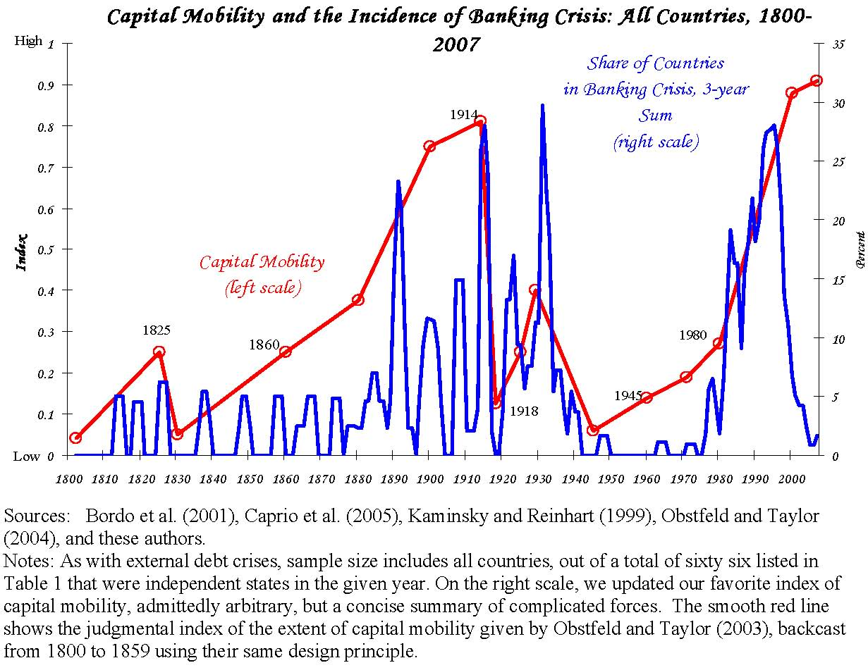
Source: Reinhart and Rogoff (2008)

Slide 4
Related Literature
Pecuniary externality and the first theorem of welfare economics
Incomplete and imperfect markets
Stiglitz (1982), Geanakoplos and Polemarchakis (1986)
Single good vs. multiple goods
Kehoe and Levine (1993)
Pecuniary externality and endogenous borrowing constraints
Lorenzoni (2008), Korinek (2009, 2010), Bianchi (2009)

Slide 5
Main Features
Occasionally vs. always binding borrowing constraints
DSGE model vs. static model (Korinek, 2009)
Production economy vs. endowment economy (Bianchi, 2009, Korinek, 2010)
Underborrowing and overborrowing

Slide 6
Three Key Elements in This Paper
Pecuniary externality
Borrowing constraints with debt dollarization
Endogenous labor supply

Slide 7
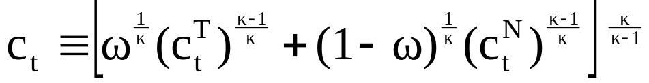
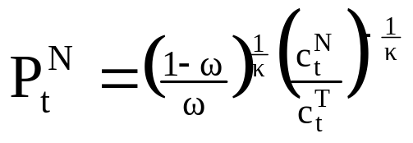
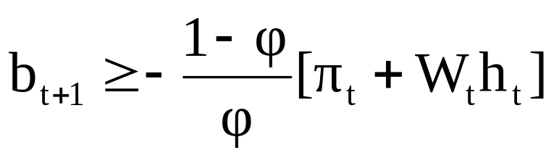
The Model
1. Tradable goods (numeraire) vs. non-tradable goods
Individual consumption basket:
Optimal individual consumption pattern:
2. Stochastic endowment in the tradable sector
Production in the non-tradable sector
Endogenous borrowing constraints (debt dollarization)
Foreign borrowing is denominated in units of tradable good, while the collateralized income is generated in the non-tradable sector.

Slide 8
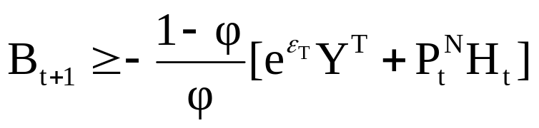
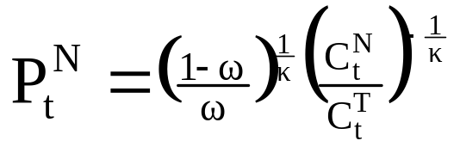
Decentralized Market vs. Social Planner
Decentralized market equilibrium
Optimization of individual agents
maximize the utility function
subject to
Individual budget constraints
Individual borrowing constraints
Social planner equilibrium
Optimization of the social planner
maximize the social welfare function
subject to
Aggregate resource constraints
Aggregate borrowing constraints
Relative price determination

Slide 9
Overborrowing or Underborrowing?
Pecuniary externality on the collateral value (Bianchi, 2009)
Since the social value of collateral is higher than the private one, the social planner tends to save more or borrow less than in the decentralized economy.
Endogenous labor supply: (Benigno et. al. 2010)
Expecting that borrowing constraints may bind in the future raises the marginal utility of tradable consumption in the social planner equilibrium. It also implies a higher marginal utility of nontradable consumption. As a result, labor supply and non-tradable production are higher than in the decentralized economy.
In other words, inefficiently low labor supply may lead to inefficiently high savings in the decentralized economy.
Under certain parameter values, the second effect may dominate the first one.

Slide 10
Relevance for the Current Crisis
After the 1997 Asia crises, emerging economies learned the lesson and accumulated huge foreign reserves to avoid the binding borrowing constraints. Thus, overborrowing was not a big issue for these countries in the past decade..
However, such policies in emerging economies have a pecuniary externality on the world capital market. The resulting low interest rate creates space for asset price bubbles in developed economies.
This line of research are indeed of great importance for emerging economies now. Since growth perspectives in US and Europe are still subdued in the near future, capital flows to emerging economies has started since mid-2009.

Slide 11
Remarks
Promising research framework to address various issues
Labor market flexibility
Nonlinear relation between financial development and macro volatility
Aghion, Bacchetta, and Banerjee (2004)
4. Decompose EIS and CRRA (Epstein-Zin Preference)
5. Binding borrowing constraints vs. endogenous default
Arellano (2008), Kim and Zhang (2010)

