Slide 1
Comments on “Migration and Business Cycles Dynamics”
By Christie Smith and Christoph Thoenissen
Discussant: Haiping Zhang, University of Auckland
Australasian Conference on International Macroeconomics
22 February 2019

Slide 2
Overview of the Results
Very topical issue
Two Approaches:
Structural VAR Model
DSGE model: difference between migrants and local newborns <=> human capital
Impacts of migration shocks on the variability of macro variables
per capita income, consumption
Capital investment
Residential investment, real house prices
The human capital heterogeneity matters! If the average migrants has higher levels of human capital relative to locals, Impacts of migration shocks are larger and a migration shock has an expansionary effect on per capita GDP and its components.

Slide 3
Comments
Modeling the Land Supply
How to interpret the preference shock for housing service
how about endogenizing the land supply?
Decomposing Migration Flows

Slide 4
Table 5: Variance Decomposition at the Posterior Mean
preference shock for housing services
migrant shock
How to interpret the preference shock for housing service?

Slide 5
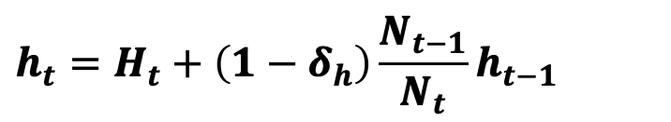
Residential Investment and Housing Services
$$h_{t}=H_{t}+\left(1−δ_{h}\right)\frac{N_{t−1}}{N_{t}}h_{t−1}$$
Rezoned Land Supply ${ l}_{t}=1$=> a deterministic SS for the linearization.
Any change in the land demand is absorbed by the land rezoning.
Migration shocks have little impacts on the variation of the real house price.

Slide 6
Slow-Moving New Dwelling Consents in New Zealand
Source: NZ Stats Infoshare

Slide 7
Slow-Moving New Dwelling Consents in New Zealand
How about a supply-side story?
make the land supply a slow-moving process by assuming some adjustment costs, e.g., subject to the approval of the local council.
Add a stochastic process for the land supply. Time for approval?
Source: NZ Stats Infoshare

Slide 8
Comments
Modeling the Land Supply
How to interpret the preference shock for housing service
how about endogenizing the land supply?
Decomposing Migration Flows
The country of residence matters: immigration policy shock
Gross vs. Net Flows: Heterogeneous human capital flows

Slide 9
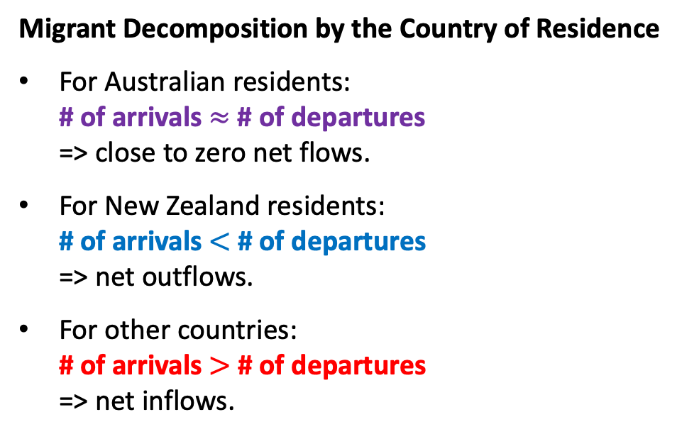
Immigration Policy as An Exogenous Migration Shock
Migrant Decomposition by the Country of Residence
For Australian residents: # of arrivals $≈$ # of departures => close to zero net flows.
For New Zealand residents: # of arrivals $<$ # of departures => net outflows.
For other countries: # of arrivals $>$ # of departures => net inflows.
Why do we make such a decomposition?
Visa for immigrants from other countries
Immigration policy => migration shock
Heterogeneous impacts on the housing market
Source: NZ Stats Infoshare

Slide 10

Migration and Human Capital Flows
Distinguish between Gross vs. Net Flows
As mentioned by the authors, immigrants have on average higher human capital than the locals, which is key to their results.
How about the human capital heterogeneity between immigrants and emigrants?
If immigrants have on average higher human capital than emigrants, using net inflows (when positive) may underestimate human capital inflows.
$d_{t}^{A}N_{t}^{A}−d_{t}^{D}N_{t}^{D}=d_{t}^{A}$($N_{t}^{A}$-$N_{t}^{D}$)+$(d_{t}^{A}−d_{t}^{D})N_{t}^{D}$
Source: NZ Stats Infoshare

