Slide 1
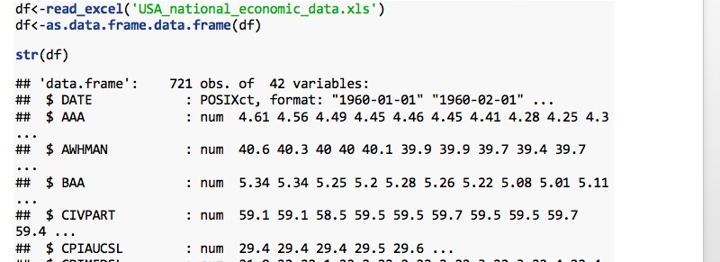
Regression Analysis on Unemployment Rate
Data
1. data: USA national economic monthly data. xls (06/1960-01/2020)
Observation : n=721
Variables: p=42 , numerical
2. data source: https://fred.stlouisfed.org (FRED Economic Data)

Slide 2
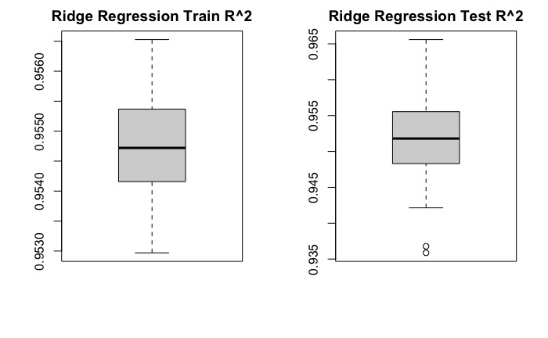
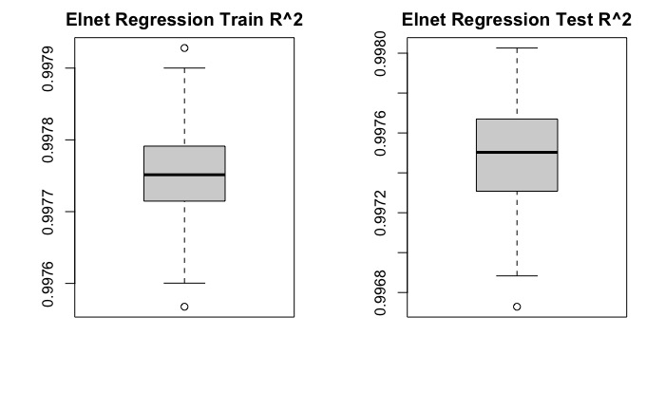
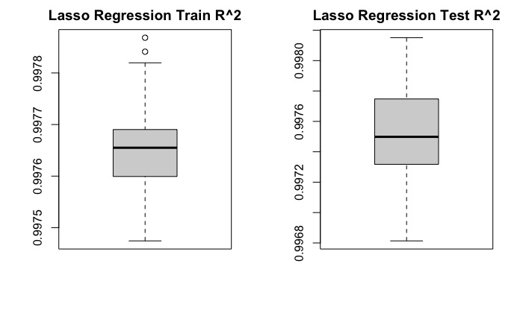
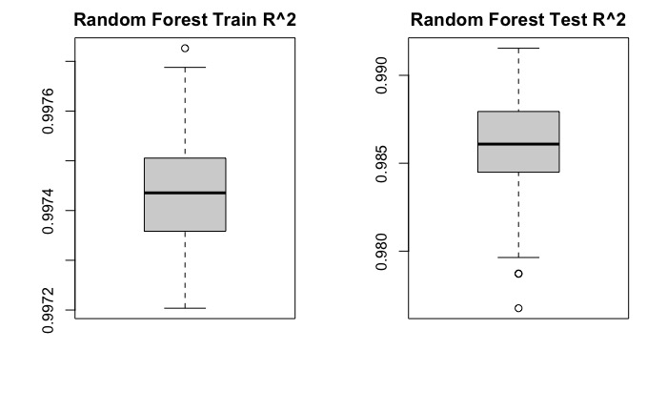
Boxplots of R²_{test} & R² _{train}.

Slide 3
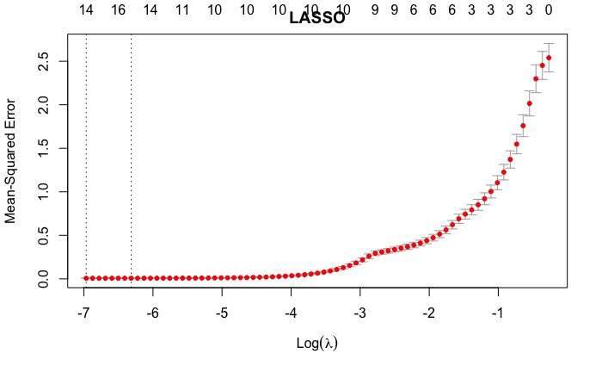
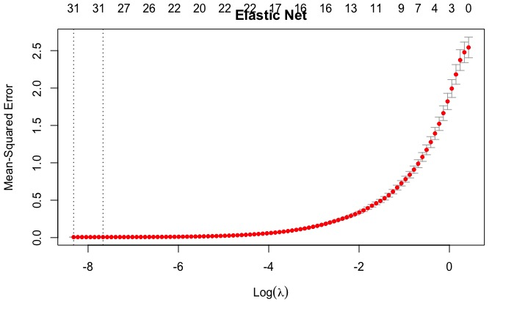
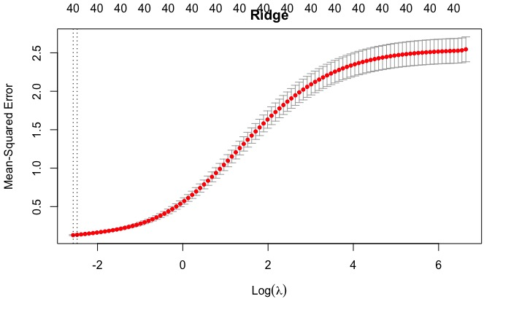
10-fold CV curves
Notes:
Both Lasso and Elastic net do pretty well. The model with the minimum cross validation error often has relatively small test error.

Slide 4
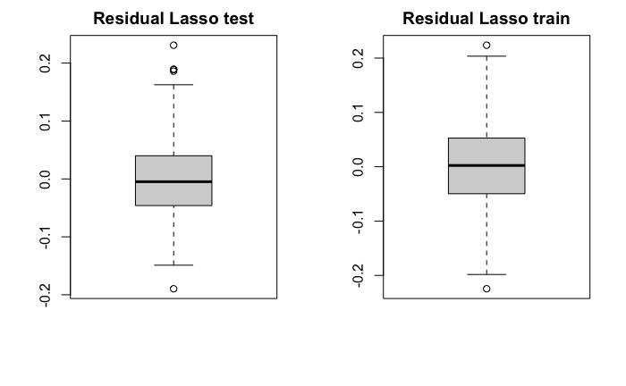
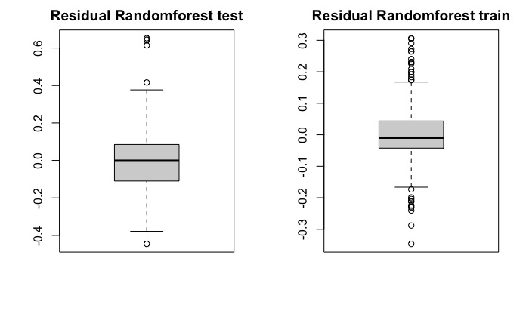
Residuals For Test Model and Train Model

Slide 5
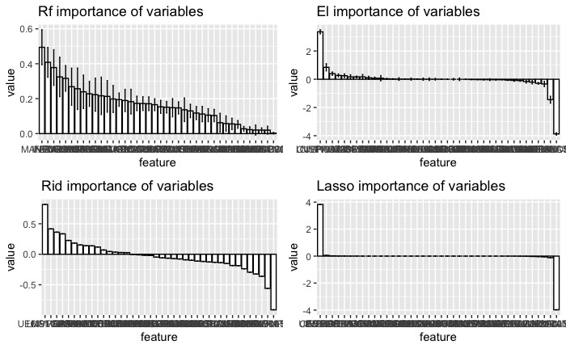
Boxplot With Bootstrapped Error Bars

Slide 6
Performance and Time
Performance:
Both Lasso and Elastic model have relatively smaller cross-validation error(k=10)
Elastic model does better job based on residual residual boxplot
Running Time:
Ridge regression:20
Lasso regression:10
El regression:12
Random forest:214
Comment:
Random forest is more time consuming compared with other models.

