Slide 1
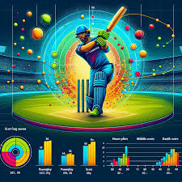

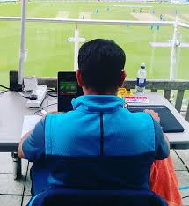
\ SQL Project Focused On Cricket Data Analysis Using MySQL
Where I Analyzed Various Player And Team Performance Metrics Based On Match Data. This Project Involved Querying, Filtering, And Analyzing A Dataset Of Match Information, Aiming To Extract Valuable Insights For Cricket Teams And Organizations.

Slide 2
🔍Project Overview
The project focused on answering key questions related to player and team performance. Some of the queries tackled included:
Total matches played by each team.
Player performance, identifying top run-scorers and consistent performers.
Identifying players who played fewer matches but scored more runs.
Venue analysis and team preferences and Provides insights into team and player performances, helping teams make better decisions regarding player selection, match strategy, and resource allocation.
This project emphasizes the importance of data in decision-making processes in sports, marketing, and performance analysis.
Answered 15+ critical business questions using SQL aggregates, JOINs, CTE and subqueries.

Slide 3
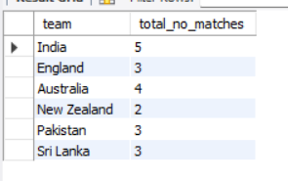
Q1 Find The Total Number Of Matches Played By Each Team?
with cte as (select team_1 as team , count(*) as matches_played from matches group by team_1 union allselect team_2 as team , count(*) as matches_played from matches group by team_2)select team,sum(matches_played) as total_no_matches from cte group by team;

Slide 4
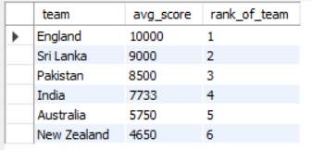
Q2 Calculate The Average Runs Scored By Players From Each Team And Rank Based On Their Average Runs Scored?
with cte as (select team,round(avg(total_runs),0) as avg_score from players group by team)select *,dense_rank() over(order by avg_score desc) as rank_of_team from cte;

Slide 5
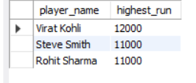
Q3 List The Top 3 Players With The Highest Runs?
select player_name,sum(total_runs) as highest_run from players group by player_name order by highest_run desc limit 3;

Slide 6
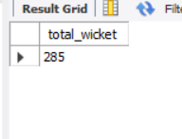
Q4 Find The Total Wickets Taken By All Bowlers From Australia?
select sum(total_wickets) as total_wicket from players where team = "Australia";

Slide 7
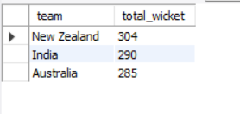
Q5 Find The Top 3 Team Who Take More Wicket?
select team,sum(total_wickets) as total_wicket from players group by team order by total_wicket desc limit 3;

Slide 8
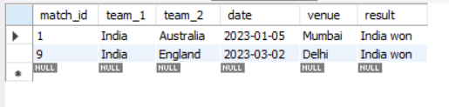
Q6 Show The Matches Where The Venue Was In "Mumbai" Or "Delhi"?
select * from matches where venue in ("mumbai","delhi");

Slide 9
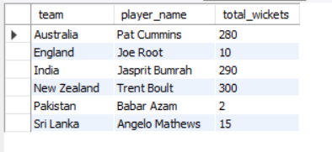
Q7 Find The Player With The Highest Number Of Wickets In Each Team?
select team, player_name, total_wickets from players p1 where total_wickets = (select max(total_wickets) from players p2 where p2.team =p1.team) order by team;
Or
select team, player_name, total_wickets from (select *,dense_rank() over(partition by team order by total_wickets desc) as rnk from players) sal where rnk =1 order by team;

Slide 10
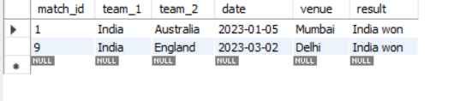
Q8 List The Matches Won By 'India' Where They Played As Team_1?
select * from matches where team_1 = "india" and result = "india won";

Slide 11
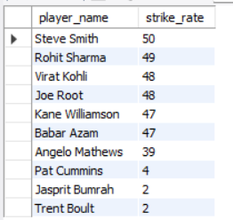
Q9 Calculate The Strike Rate Of Players (Runs Per Match) And Order By Strike Rate?
select player_name, round(total_runs/matches_played,0) as strike_rate from players order by strike_rate desc;

Slide 12
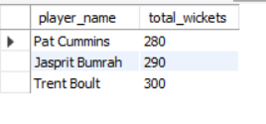
Q10 Find Players Who Have Taken More Than 200 Wickets?
select player_name,total_wickets from players where total_wickets >200;

Slide 13

Q11 Identify Teams That Won More Than 2 Matches?
select result as team_name,count(*) as won_matches from matches where result like "%won%" group by result having won_matches >2;

Slide 14
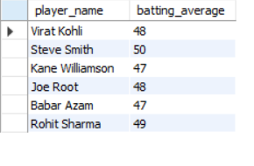
Q12 Find Players With A Batting Average (Runs Per Match) Above 40?
select player_name , round((total_runs/matches_played),0) as batting_average from players having batting_average > 40;

Slide 15
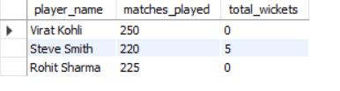
Q13 Show The List Of Players Who Have Played More Than 200 Matches But Have Less Than 10 Wickets?
select player_name,matches_played,total_wickets from players where matches_played >200 and total_wickets <10;

Slide 16
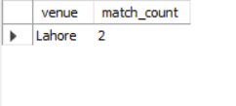
Q14 Find The Most Common Venue For Matches?
select venue ,count(*) as match_count from matches group by venue order by match_count desc limit 1;

Slide 17
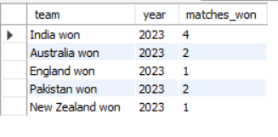
Q15 Based On Year Find The Number Of Matches Won By Each Team?
select result as team,year(date) as year ,count(*) as matches_won from matches where result like "%won%" group by result,year;

Slide 18
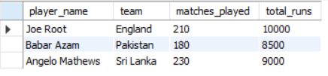
Q16 Find The Player From Each Team Who Played The Fewest Matches But Scored The Most Runs?
with cte as (select *,dense_rank() over( partition by team order by matches_played asc) as matches_rnk , dense_rank() over( partition by team order by total_runs desc) as runs_rnk from players)
select player_name,team,matches_played,total_runs from cte where matches_rnk = 1 and runs_rnk = 1;
Or
select player_name,team,matches_played,total_runs from players p1 where (matches_played,total_runs) in (select min(matches_played),max(total_runs) from players p2 where p1.team = p2.team);

Slide 19
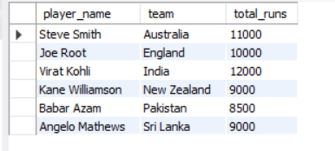
Q17 Find The Player From Each Team Who Scored The Most Runs?
with cte as (select *,dense_rank() over(partition by team order by total_runs desc) as rnk from players)select player_name,team,total_runs from cte where rnk =1;

