Slide 1
Time series plots
S. Haire

Slide 2
Trends in SPEI 2002-2017
747 Complex (Oregon)
Roberts Creek (Oregon)
Hayman (Colorado)
Missionary Ridge (Colorado)
Ponil Complex (New Mexico)
Rodeo (Arizona)

Slide 3
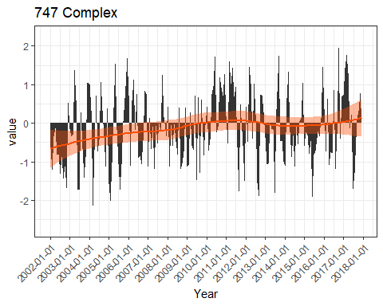

Slide 4
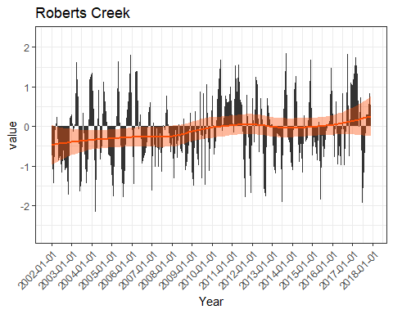

Slide 5
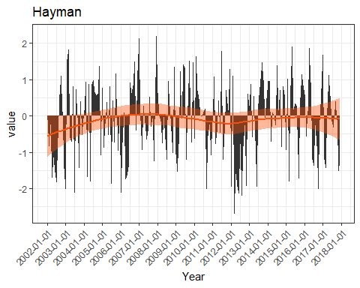

Slide 6
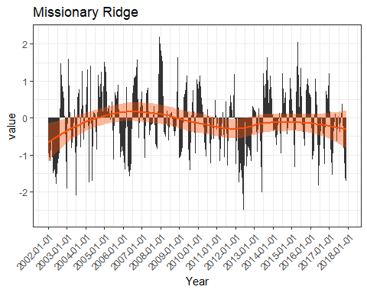

Slide 7
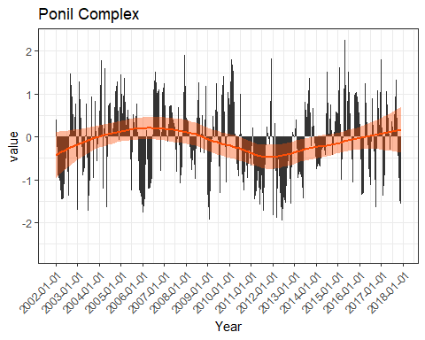

Slide 8
