Slide 1
spei.time.series all 13 sites
S. Haire

Slide 2
Trends in SPEI 2002-2017
747 Complex (Oregon)
Roberts Creek (Oregon)
Hayman (Colorado)
Missionary Ridge (Colorado)
Ponil Complex (New Mexico)
Rodeo (Arizona)

Slide 3
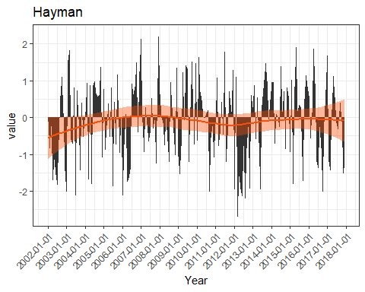
Two notable drought periods:
2002 and 2012

Slide 4
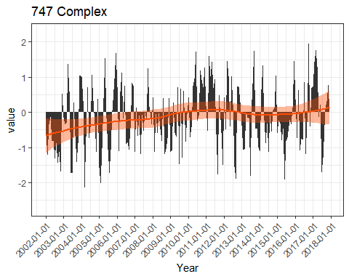
Drought gradually lessened between
2002 and 2010 with several spikey drought periods thereafter

Slide 5
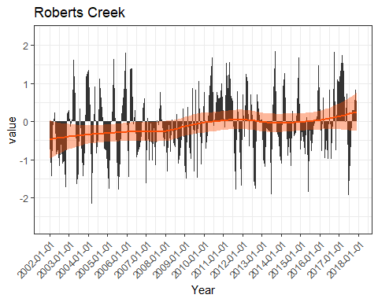
Early postfire years more droughty than later

Slide 6
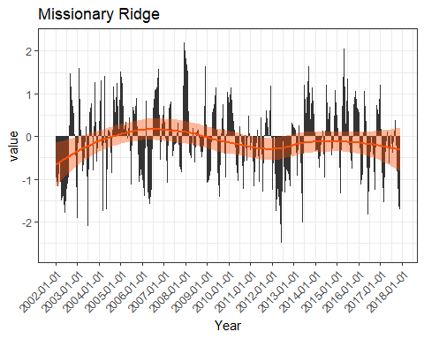
Fairly wide fluctuations with major drought swings again in 2002 and 2012

Slide 7
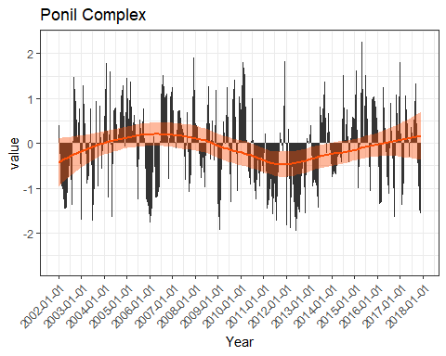
Drought gradually lessened from early postfire but notable predominance of drought from ~ 2006 and from 2010-2014

Slide 8
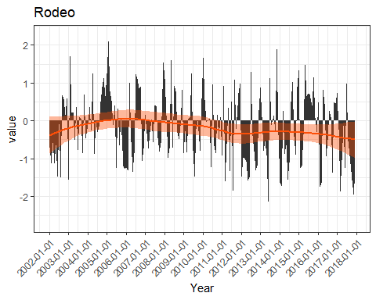
More obvious drought periods than not with increasingly extreme large negative values in later years

Slide 9
Trends in SPEI 2000-2017
Hash Rock (Oregon)
Outlet (Arizona)
Cerro Grande (New Mexico)
Pumpkin (Arizona)

Slide 10
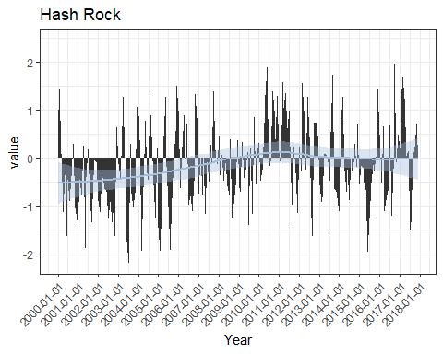
Most extreme drought occurred in early postfire years, gradually lessening until ~2010

Slide 11
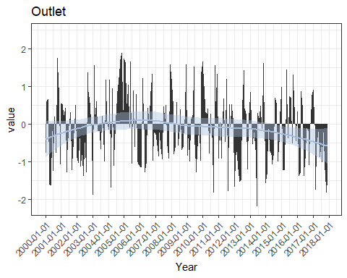
Drought gradually lessened from
2000 to 2004. Overall increase in drought spikes in later years

Slide 12
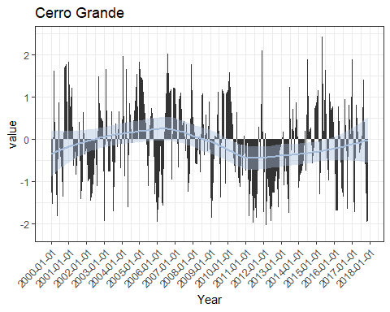
Drought gradually lessened from
2000 to ~2008. Big period of extreme drought from 2011 to 2014

Slide 13
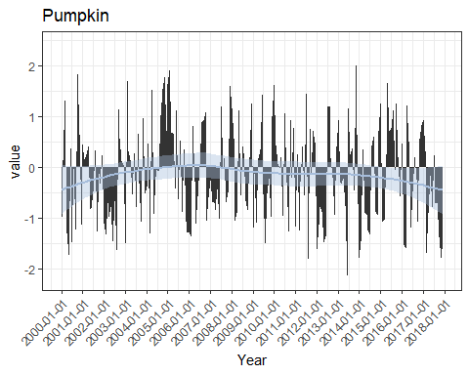
Drought gradually lessened in early postfire years with increased frequency of negative peaks in later years

Slide 14
Trends in SPEI: last three sites!
2000-2018 Clear Creek Divide (Idaho)
2003-2017 Poplar Complex (New Mexico)
2005-2017 Burnt Cabin (Oregon)

Slide 15
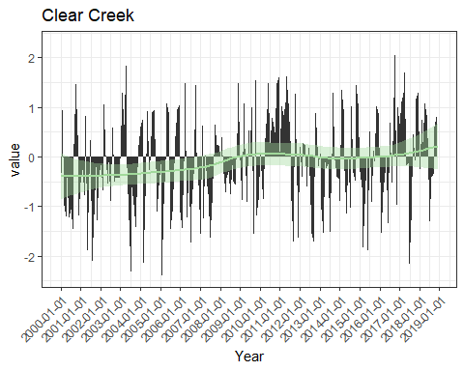
Lessening of negative values/spikes across years

Slide 16
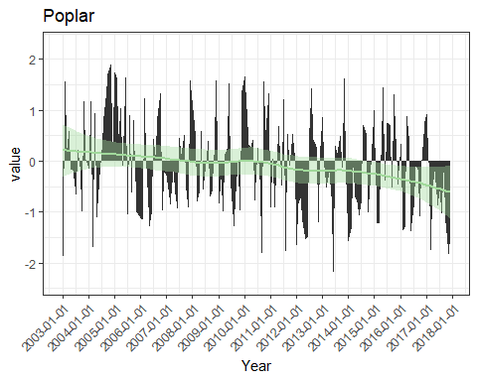
Increased drought episodes across years

Slide 17
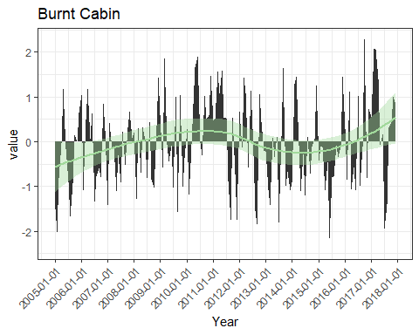
Drought lessened in middle years then increased but this trend reversed ~ 2016

