Slide 1
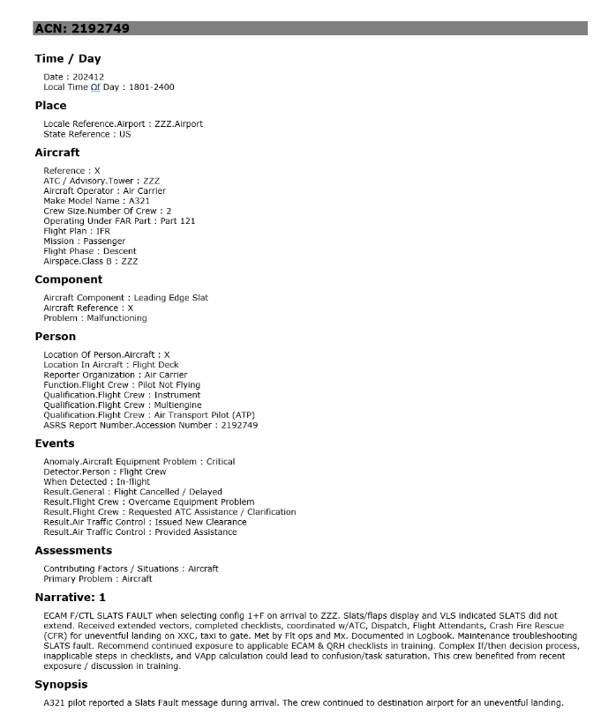

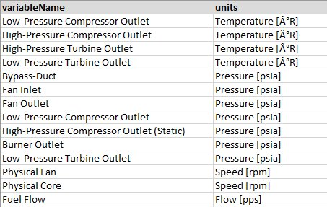


Enterprise Intelligent Mainteance
Asset Management
Events Management
Event report details and AI Summary for maintenance operations
OCI Functions
Gen AI - LLM
OCI Streaming
Text-Based Event Reports
Incident Management
Signal anomaly integration for Event diagnosis
SAM Biz Analytics
(Oracle Analytics Cloud)
Numerical Telemetry Data
Things Board
IoT Streaming
OCI SAM (MSET2)
Autonomous Data Warehouse

Slide 2
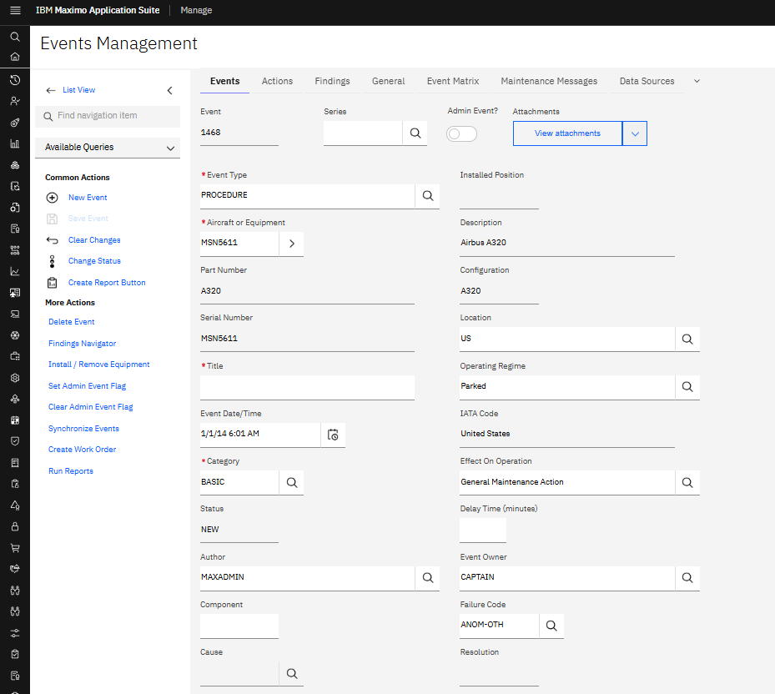
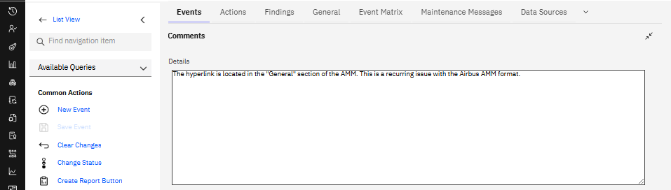
Deliver event report data to enterprise asset management solution
Agentic Incident Report
Collect descriptive event reports and auto-trigger processing
AI-generated summarization of narratives and key details
GenAI - LLM
REST API
OCI GPU
OCI GPU
OCI Events
REST API
JSON Message Producer
Stream Consumer
OCI Functions
OCI Streaming
Orchestrator Node
Text-Based Event Reports
4,000+ Incident Reports from passenger airline
User-submitted text narratives describing event
Uploaded to OCI Object Storage
Route data reliably through streaming stages
Format reports for AI analysis and user consumption

Slide 3
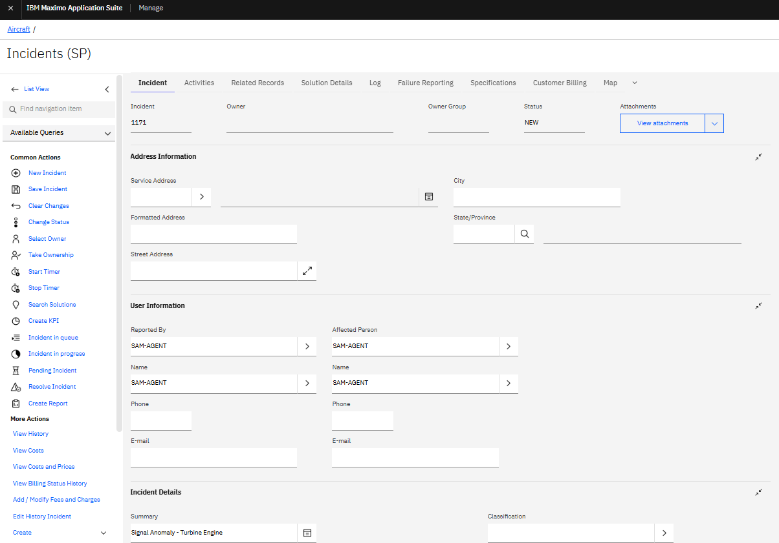
Agentic Anomaly Report
Real-time telemetry data streaming for fast issue detection
Efficiently track and resolve issues for operations teams
IoT Protocol
OCI Stream
Event
Trigger
REST API
ThingsBoard
OCI SAM
(MSET2)
Autonomous Data Warehouse
Numerical Telemetry Data
Aerospace signal data related to Jet Engine equipment signals on various aircrafts
Stored in Virtual Devices (OCI VM)
OAC-Native Direct Connection
OCI Data
Science
OCI VM
SAM Biz Analytics
(Oracle Analytics Cloud)
Apply advanced AI to detect abnormal behavior proactively
Visualize maintenance and business data for better decision-making

Slide 4

What’s Next?
Agentic AI for Intelligent Maintenance
Service Query
Asset Management Applications
User
Document
Understanding
IoT Signal Streaming
Anomaly Detection
Query Routing AI
Operations Manager AI
Communication & Collaboration Apps
Response
Audio & Video
Transcription
Digital
Assistant
Multimodal Documents
Team Collaboration AI
Planning & Critique
Issue Tracker & Ticketing Apps
Project
Requirements
Workflow & Task AI
Automation Agent
Project Manager AI

