Slide 1
Docker, Windows and Azure
Ross Gardler, Microsoft
@rgardler

Slide 2
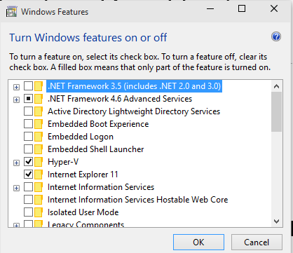
Reboot needed!
If you want to follow along with the Hyper-V example please ensure Hyper-V is turned on
It requires a reboot, so we can do that now while I introduce the demo
Hyper-V does not co-exist with VirtualBox
You can use Virtual Box instead of Hyper-V if you want
Ensure Hyper-v is turned on
Windows key -> ’Turn Windows Features On or Off’

Slide 3
Microsoft’s Commitment to the Docker Community
Integrating the open-source Docker Engine with the next release of Windows Server
Support the Docker client natively on Windows
Docker for Windows Server container images will be available in the Docker Hub alongside the Docker for Linux container images
Integrate Docker Hub with the Microsoft Azure Gallery and Azure Management Portal
Aligning with Docker’s Open Orchestration APIs for containers

Slide 4
Hyper-scale
Why Azure Cloud?
Enterprise Grade
Open & Hybrid

Slide 5
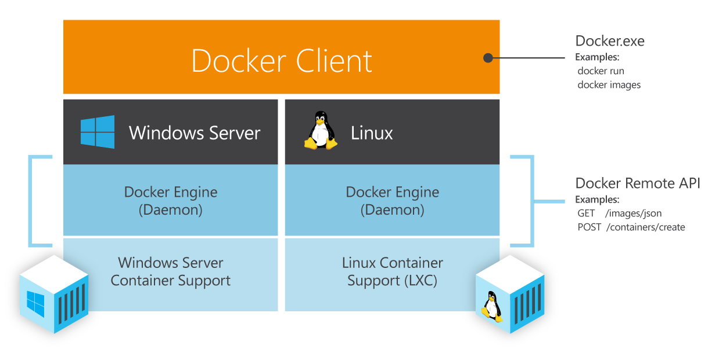
Common Orchestration API

Slide 6
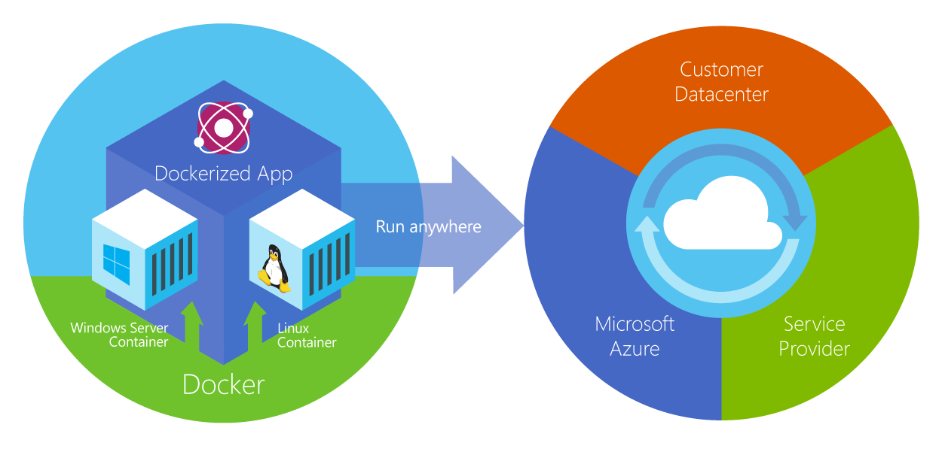
Choice

Slide 7
Status
Docker 1.0 -> Azure CLI
‘azure create vm docker …’
‘docker …’
Linux only
Windows port
‘docker …’ on windows
Docker Machine
‘docker-machine create –d hyper-v …’
‘docker-machine create –d azure …’
Compose and Swarm

Slide 8
Docker and Windows Server
Demo of Docker containers on Windows Server
Docker CLI on Windows
Nano Server
Hyper-V Containers

Slide 9
Azure Portal
Screenshot of CoreOS and Ubuntu + Docker

Slide 10
Kitematic
Screenshot of Kitematic

Slide 11
Demo Time
Build a two container “Hello World” App
ASP.Net Web front end
Java REST API
Run on local (Windows) dev machine using Docker Machine
Of course will also work on Linux and OSX
Run on Azure staging or production machines using Docker Machine
Of course will also work on other cloud providers
Source
http://github.com/rgardler/AzureDevTestDeploy

Slide 12
Demo
REST API: http://FIXME
Web: http://FIXME
Source: http://github.com/rgardler/AzureDevTestDeploy

Slide 13
Want to try?
Some prep needed…

Slide 14
Get the source
Install Git for Windows from http://msysgit.github.io
Git
Bash shell
OpenSSH
‘git clone https://github.com/rgardler/AzureDevTestDeploy.git’
This deck is in ‘docs’
Alongside two explanatory docs, one for Hyper-V and one for Azure

Slide 15
Environment Setup
environmentSetup.md
Configuring Windows Client
Creating Dev container host on Windows Client
Creating Staging container host on Microsoft Azure
Let’s step through now
Suggest you have the environmentSetup.md file open
Cut and paste commands from there

Slide 16
Install Docker and Docker Machine (Windows)
In bash shell (Windows Key -> Unix Bash)
curl -L https://get.docker.com/builds/Windows/x86_64/docker-latest.exe > /bin/docker
curl -L https://github.com/docker/machine/releases/download/v0.2.0/docker-machine_windows-amd64.exe > /bin/docker-machine
Other platforms see: http://docs.docker.com/machine/

Slide 17
Build and Run the Application on Client
‘docker-machine create -d hyper-v dev’
Where ‘dev’ is the name of the docker host
For convenience there are scripts to build and run the containers in ‘scripts’
Copy ‘scripts/config.tmpl/ to ‘scripts/config.sh’
No need to edit this if you use the example machine names in this deck
Run ‘scripts/dev.sh’
Will build and run both containers on your dev client

Slide 18
Get an Azure Subscription and Create a Cert
Free Trial
http://azure.microsoft.com/en-us/pricing/free-trial/
Create a management cert
openssl req -x509 -nodes -days 365 -newkey rsa:1024 -keyout mycert.pem -out mycert.pem
openssl pkcs12 -export -out mycert.pfx -in mycert.pem -name "My Certificate"
openssl x509 -inform pem -in mycert.pem -outform der -out mycert.cer
Upload mycert.cer to https://portal.azure.com
In the "Settings" section select "Management Certificates“
Grab subscription ID from portal and record it somewhere

Slide 19
Build and deploy on Azure host
‘docker-machine create -d azure --azure-location="Central US" --azure-subscription-id="AZURE_SUBSCRIPTION_ID" --azure-subscription-cert="mycert.pem" MACHINE_NAME’
Replace AZURE_SUBSCRIPTION_ID with the subscription ID retrieved from the Azure portal
Replace MACHINE_NAME with your preferred name, e.g. ‘stage’
‘scripts/stage.sh’
Will build and run both containers in Azure
Open necessary ports on Azure VM
80 for he Web interface
5050 for the REST API (optional)

