Slide 1
Docker, Windows and Azure
Ross Gardler, Microsoft
@rgardler

Slide 2
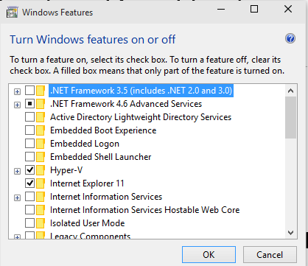
Reboot needed!
If you want to follow along with the Hyper-V example please ensure Hyper-V is turned on
It requires a reboot, so we can do that now while I introduce the demo
Hyper-V does not co-exist with VirtualBox
You can use Virtual Box instead of Hyper-V if you want
Ensure Hyper-v is turned on
Windows key -> ’Turn Windows Features On or Off’

Slide 3
Microsoft’s Commitment to the Docker Community
Integrating the open-source Docker Engine with the next release of Windows Server
Support the Docker client natively on Windows
Docker for Windows Server container images will be available in the Docker Hub alongside the Docker for Linux container images
Integrate Docker Hub with the Microsoft Azure Gallery and Azure Management Portal
Aligning with Docker’s Open Orchestration APIs for containers

Slide 4
Hyper-scale
Why Azure Cloud?
Enterprise Grade
Open & Hybrid

Slide 5
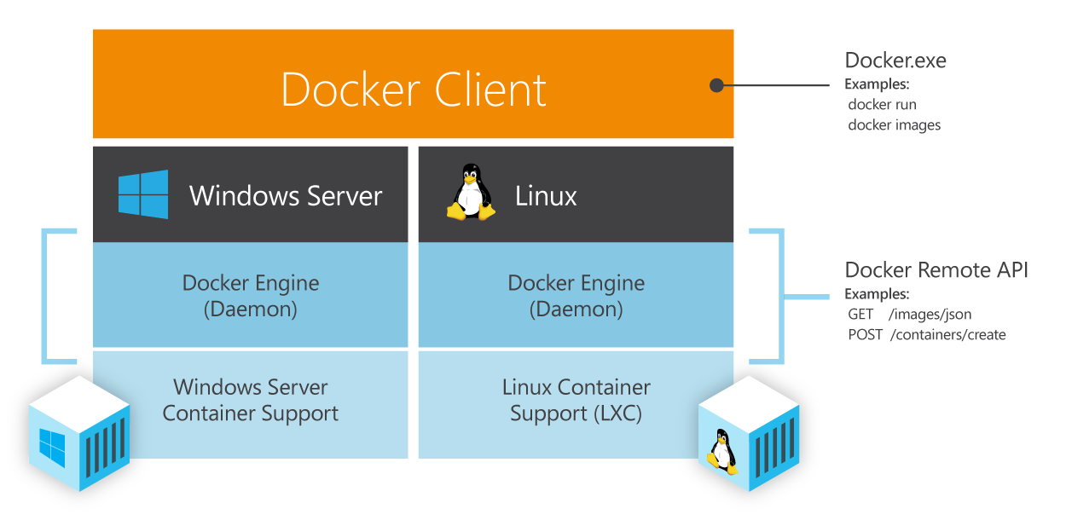
Common Orchestration API

Slide 6
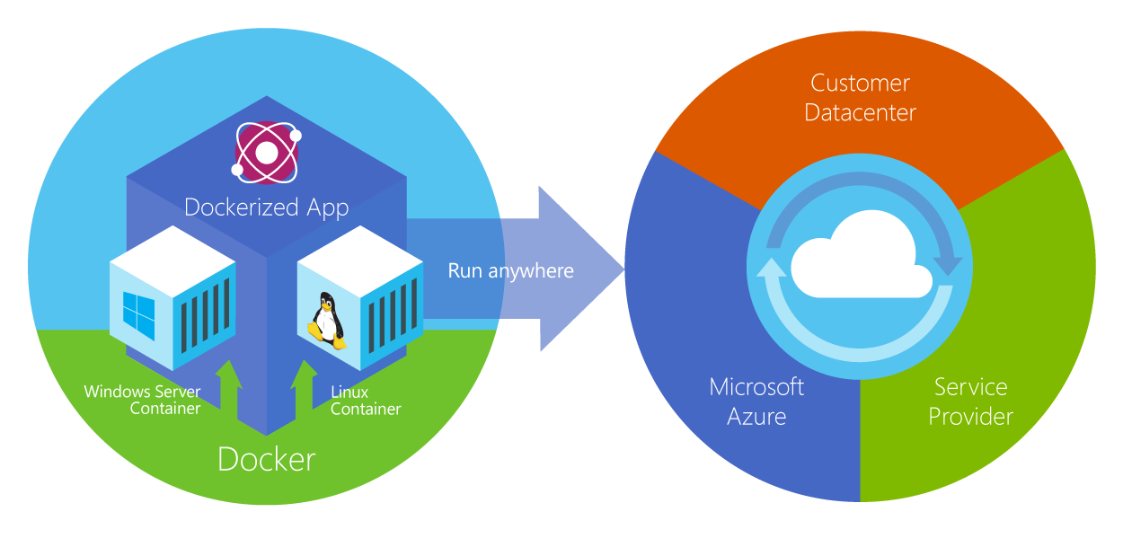
Choice

Slide 7
Status
Docker 1.0 -> Azure CLI
‘azure create vm docker …’
‘docker …’
Linux only
Windows port
‘docker …’ on windows
Docker Machine
‘docker-machine create –d hyper-v …’
‘docker-machine create –d azure …’
Compose and Swarm

Slide 8
Docker and Windows Server
Demo of Docker containers on Windows Server at Build in April
Docker CLI on Windows
Nano Server
Hyper-V Containers

Slide 9
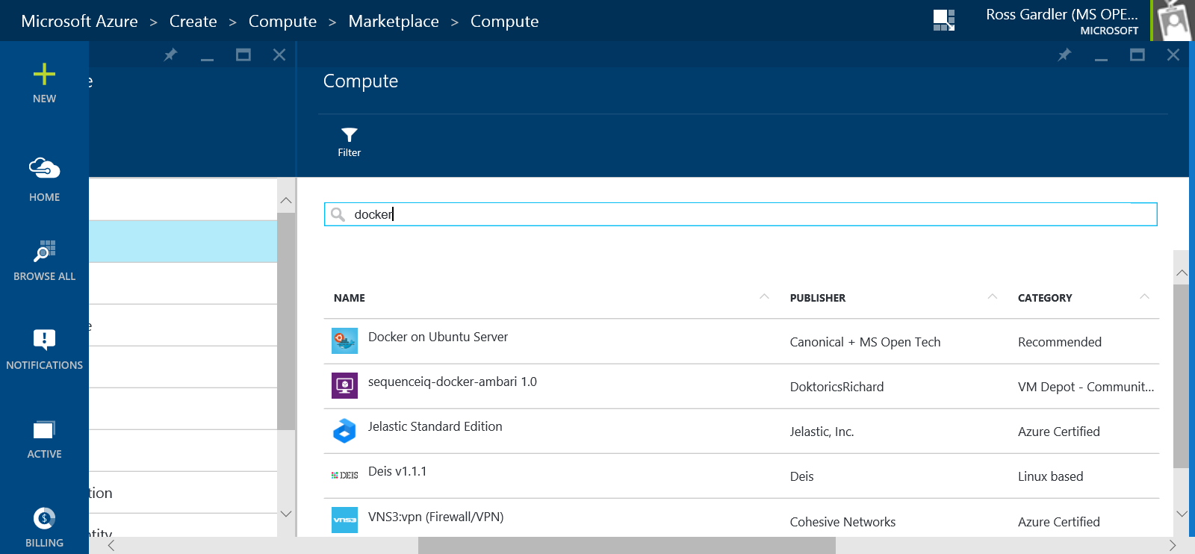
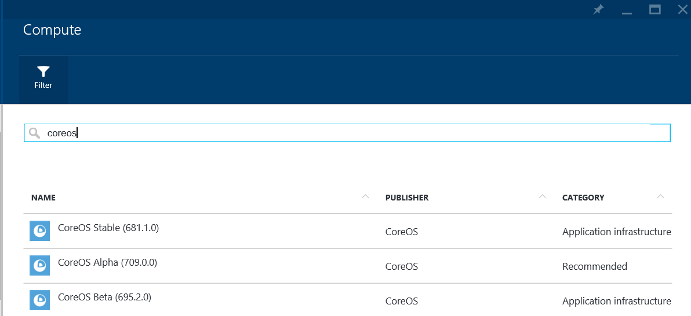
Azure Portal

Slide 10
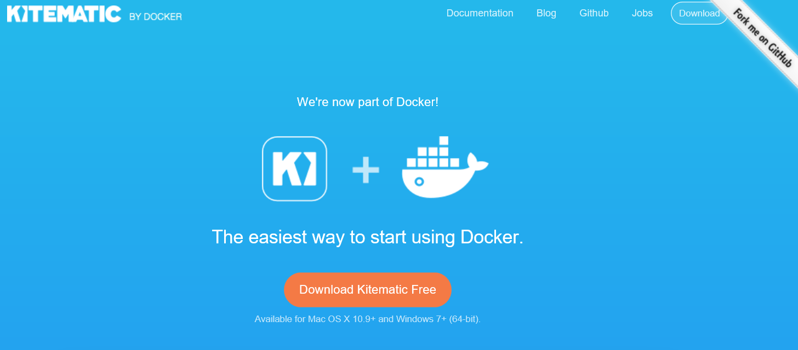
Kitematic
Screenshot of Kitematic

Slide 11
Lets Get to Work
Build a two container “Hello World” App
ASP.Net Web front end
Java REST API
Run on local (Windows) dev machine using Docker Machine
Of course will also work on Linux and OSX
Run on Azure staging or production machines using Docker Machine
Of course will also work on other cloud providers
Source
http://github.com/rgardler/AzureDevTestDeploy

Slide 12
Demo
REST API: http://tutorialstage.cloudapp.net:5050/JerseyHelloWorld/rest/helloworld
Web: http://tutorialstage.cloudapp.net/
Source: http://github.com/rgardler/AzureDevTestDeploy

Slide 13
Want to try?
Some prep needed…

Slide 14
Get the source
Install Git for Windows from http://msysgit.github.io
Git
Bash shell
OpenSSH
‘git clone https://github.com/rgardler/AzureDevTestDeploy.git’
This deck is in ‘docs’
Alongside two explanatory docs, one for Hyper-V and one for Azure

Slide 15
Environment Setup
See environmentSetup.md
Configuring Windows Client
Creating Dev container host on Windows Client
Creating Staging container host on Microsoft Azure
Let’s step through now
Suggest you have the environmentSetup.md file open
Cut and paste commands from there

Slide 16
Install Docker and Docker Machine (Windows)
In bash shell (Windows Key -> Unix Bash)
curl -L https://get.docker.com/builds/Windows/x86_64/docker-latest.exe > /bin/docker
curl -L https://github.com/docker/machine/releases/download/v0.2.0/docker-machine_windows-amd64.exe > /bin/docker-machine
Other platforms see: http://docs.docker.com/machine/

Slide 17
Setup Helper Scripts
Copy ‘script/config.tmpl’ to ‘script/config.sh’
Edit ‘script/config.sh’
At least change STAGE_MACHINE_NAME
Must be world unique, e.g. stageMyInitials123
This will be the machine name and DNS name for your Docker host in azure

Slide 18
Get an Azure Subscription and Create a Cert
Free Trial
http://azure.microsoft.com/en-us/pricing/free-trial/
In project root, create a management cert
openssl req -x509 -nodes -days 365 -newkey rsa:1024 -keyout mycert.pem -out mycert.pem
openssl pkcs12 -export -out mycert.pfx -in mycert.pem -name "My Certificate"
openssl x509 -inform pem -in mycert.pem -outform der -out mycert.cer
Upload mycert.cer to http://manage.windowsazure.com
In the "Settings“ (at bottom of left menu) section select "Management Certificates“ (on tabs across top)
Grab subscription ID from portal and record it somewhere
See the “Subscriptions” tab of the “Settings” section

Slide 19
Now for the real stuff…
It’s just Docker all the way down

Slide 20
Build and deploy on Azure host
‘docker-machine create -d azure --azure-location="Central US" --azure-subscription-id="AZURE_SUBSCRIPTION_ID" --azure-subscription-cert="mycert.pem" MACHINE_NAME’
Replace AZURE_SUBSCRIPTION_ID with the subscription ID retrieved from the Azure portal
Replace MACHINE_NAME with whatever you used for STAGE_MACHINE_NAME in config.sh
‘eval “$(docker-machine env MACHINE_NAME)”’
‘scripts/stage.sh’
Open necessary ports on Azure VM (via http://manage.windowsazure.com)
80:80 for the Web interface
5050:5050 for the REST API (optional)

Slide 21
REST API
http://MACHINE_NAME.cloudapp.net:5050/JerseyHelloWorld/rest/helloworld
Web
http://MACHINE_NAME.cloudapp.net/

Slide 22
Build and Run the Application on Client
‘docker-machine create -d hyper-v dev’
Must be run as an Administrator
‘eval “$(docker-machine env dev)”’
Run ‘scripts/dev.sh’
Will build and run both containers on your dev client

Slide 23
Pointers
environmentSetup.md
how to set up your client machine
docs/Getting Started with Hyper-v.md
Step by step instructions for starting a Hyper-V host and deploying the application to it
docs/Getting Started with Azure.md
Step by step instructions for starting an Azure host and deploying the application to it

