Slide 1
Introduction to Spectral Estimation

Slide 2
Outline
Introduction
Nonparametric Methods
Parametric Methods
Conclusion

Slide 3
Introduction
Estimate spectrum from finite number of noisy measurements
From spectrum estimate, extract
  Disturbance parameters (e.g. noise variance)
  Signal parameters (e.g. direction of arrival)
  Signal waveforms (e.g. sum of sinusoids)
Applications
  Beamforming and direction of arrival estimation
  Channel impulse response estimation
  Speech compression

Slide 4
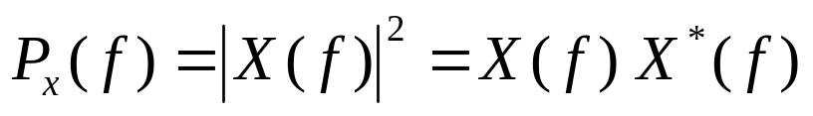
Power Spectrum
Deterministic signal x(t)
  Assume Fourier transform X(f) exists
  Power spectrum is square of absolute value of magnitude response (phase is ignored)
  Multiplication in Fourier domain is convolution in time domain
  Conjugation in Fourier domain is reversal and conjugation in time
autocorrelation

Slide 5
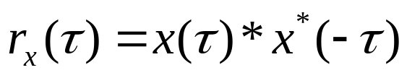
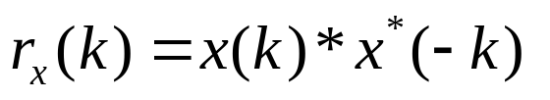
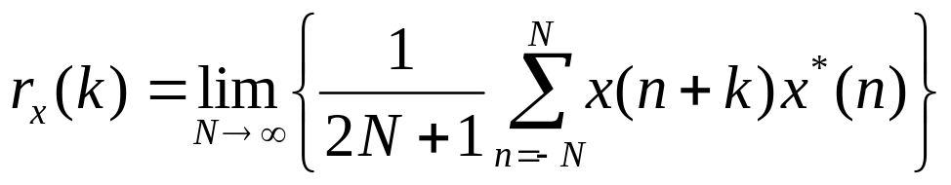
Autocorrelation
Autocorrelation of x(t):
  Slide x(τ) against x*(τ) instead of flip-and-slide
  Maximum value at r_{x}(0) if r_{x}(0) is finite
  Even symmetric, i.e. r_{x}(τ) = r_{x}(-τ)
Discrete-time:
  Alternate definition:
x(t)
r_{x}(τ)
1
T_{s}
0
T_{s}
t
-T_{s}
T_{s}
τ

Slide 6
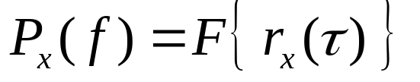
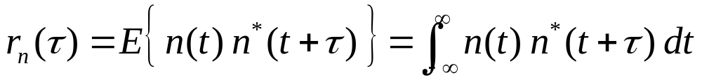
Power Spectrum
Estimate spectrum if signal known at all time
  Compute autocorrelation
  Compute Fourier transform of autocorrelation
Autocorrelation of random signal n(t)
  For zero-mean Gaussian random process n(t) with variance σ²

Slide 7
Spectral Estimation Techniques
Spectral Estimation
Non Parametric
Parametric
Ex: Periodogram and Welch method
AR, ARMA based
Subspace Based
(high-resolution)
Model fitting based
Ex: MUSIC and ESPRIT
Ex: Least Squares
AR: Autoregressive (all-pole IIR)
ARMA: Autoregressive Moving Average (IIR)
MUSIC: MUltiple SIgnal Classification
ESPRIT: Estimation of Signal Parameters using Rotational Invariance Techniques
Slide by Kapil Gulati, UT Austin, based on slide by Alex Gershman, McMaster University

Slide 8
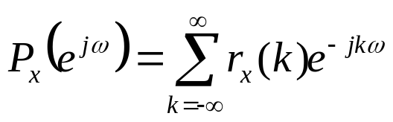

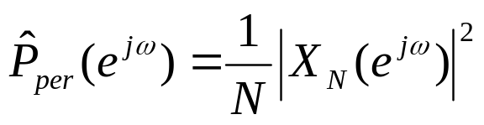
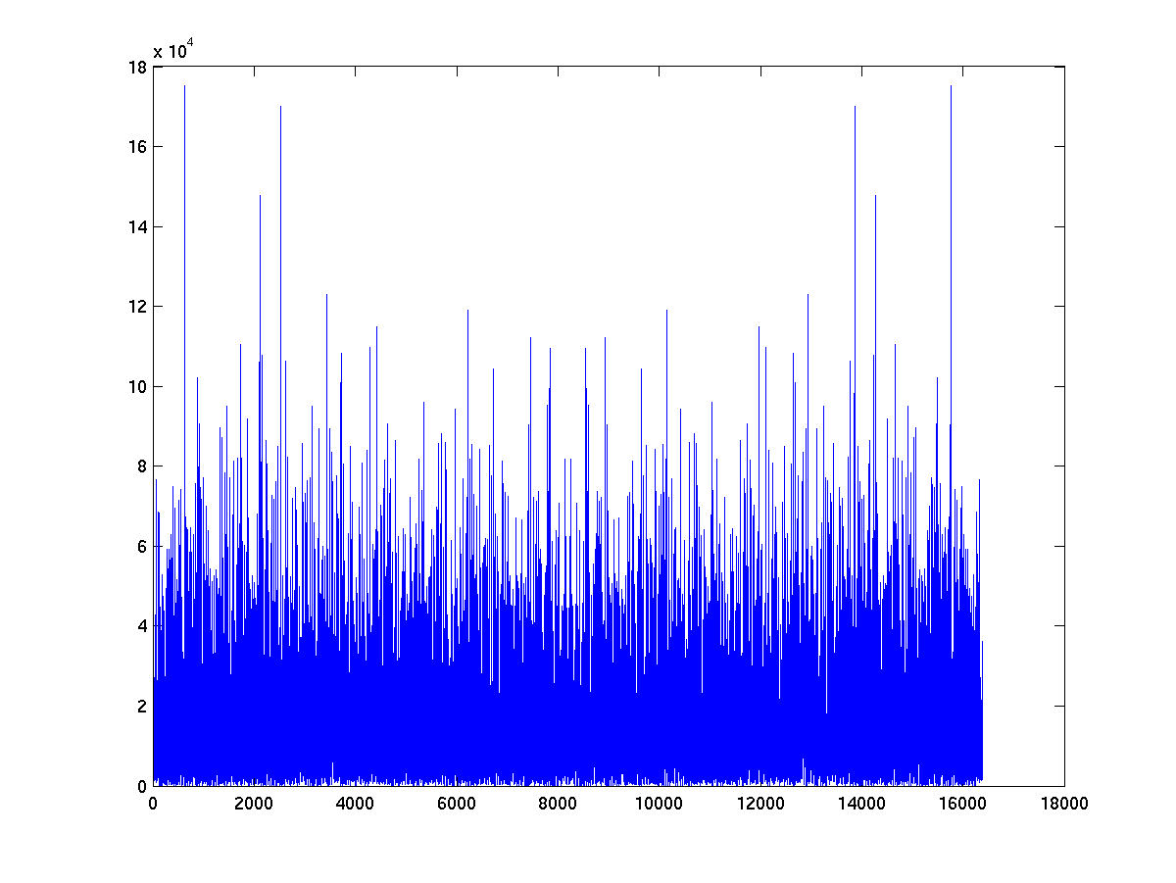
Periodogram
Power spectrum for wide-sense stationary random process:
For ergodic process with unlimited amount of data:
Truncate data using rectangular window
  N number of samples
  w_{R}(n) rectangular window
approximate noise floor
N = 16384; % number of samples
gaussianNoise = randn(N,1);
plot( abs(fft(gaussianNoise)) .^ 2 );

Slide 9
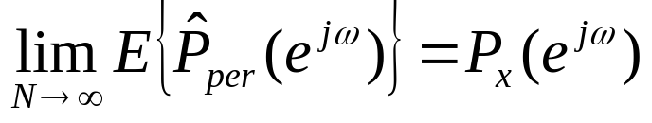
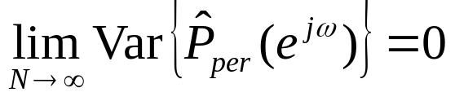
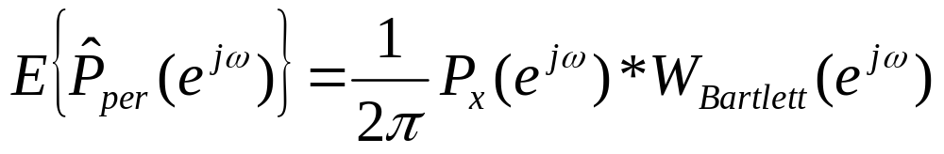
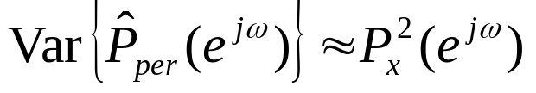
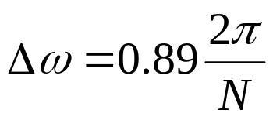
Evaluating Spectrum Estimators
As number of samples grows, estimator should approach true spectrum
  Unbiased:
  Variance:
Periodogram (unbiased)
  Bias
  Variance
  Resolution
Barlett window is centered at origin and has length of 2N+1 (endpoints are zero)

Slide 10
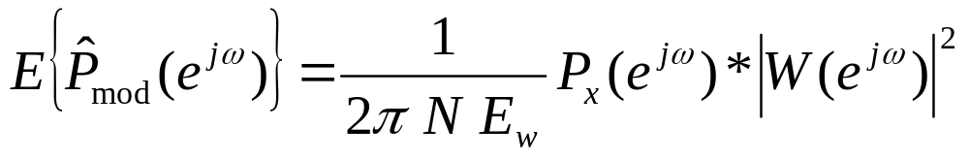
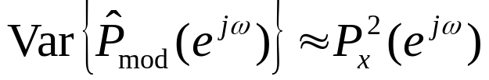
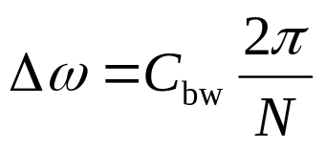
Modified Periodogram
Window data with general window
  Trade off main lobe width with side lobe attenuation
  Loss in frequency resolution
Modified periodogram (unbiased)
  Bias
  Variance
  Resolution
  C_{bw} is 0.89 rectangular, 1.28 Bartlett, 1.30 Hamming
E_{w} is normalized energy in window

Slide 11
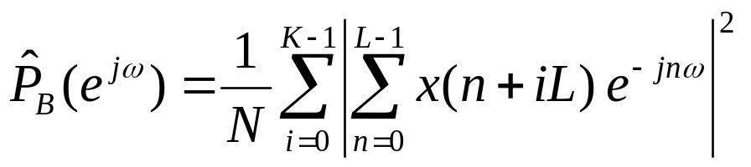
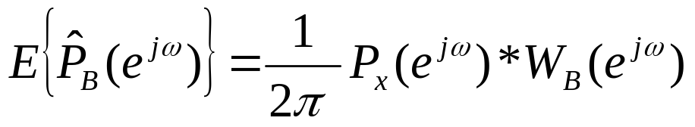
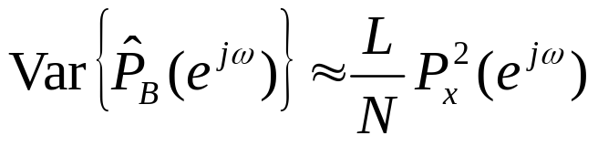
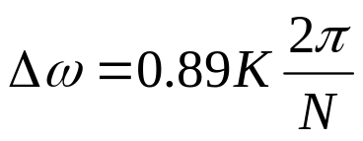
Averaging Periodograms
Divide sequence into nonoverlapping blocks
  K blocks, each of length L, so that N = K L
  Average K periodograms
  of L samples each
  Trade off consistency for frequency resolution
Periodogram averaging (consistent)
  Bias
  Variance
  Resolution

Slide 12
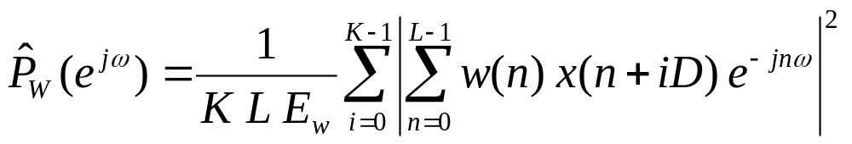
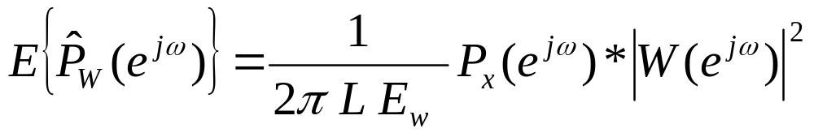
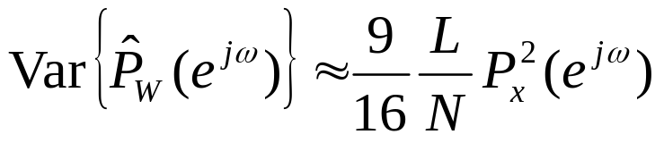
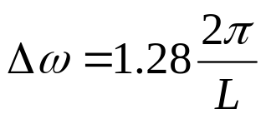
Averaging Modified Periodograms
Divide sequence into overlapping blocks
  K blocks of length L, offset D: N = L + D (K - 1)
  Average K modified periodograms of L samples each
  Trade off variance reduction for decreased resolution
Modified periodogram averaging (consistent)
  Bias
  Variance
  Resolution
Assuming 50% overlap and Bartlett window

Slide 13
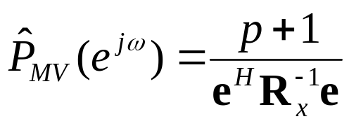
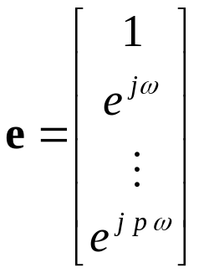
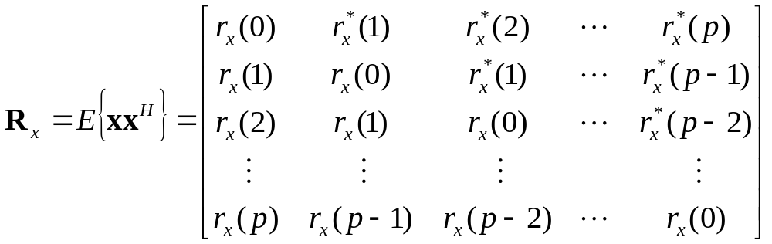
Minimum Variance Estimation
For each frequency ω_{i} computed in spectrum
  Apply pth-order narrowband bandpass filter to signal
    No distortion at center frequency ω_{i} (gain is one)
    Reject maximum amount of out-of-band power
  Scale result by normalized filter bandwidth Δ / (2 π)
Estimator

Slide 14
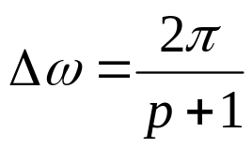
Minimum Variance Estimation
Data dependent processing
  FIR filter for each frequency depends on R_{x}
  R_{x} may be replaced with estimate if not known
Resolution dependent on FIR filter order p and not number of samples:
Filter order p
  Larger means better frequency resolution
  Larger means more complexity as R_{x} is (p+1) × (p+1)
  Upper bound is number of samples: p ≤ N

