Slide 1
AssetManager
IT Department —
Built to track every asset, every move.
May 2026

Slide 2
Before AssetManager
The Pain Points
0
📋
No central record of who has what
Centralized Records
🔄
Assets lost between check-in and check-out
Manual
❌
No confirmation from engineers
Tracking Method
No Visibility
📊
No reports or history
Asset Status

Slide 3
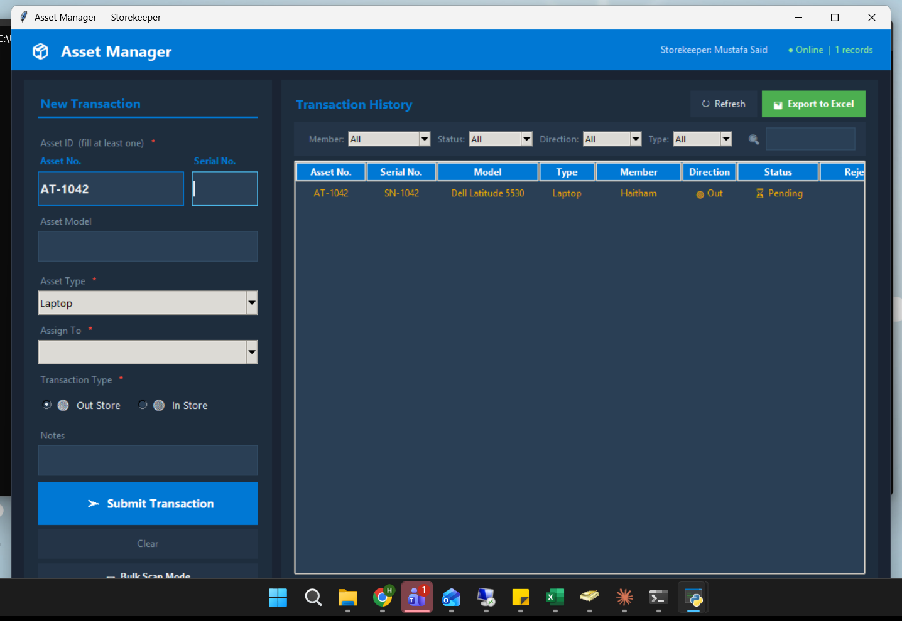
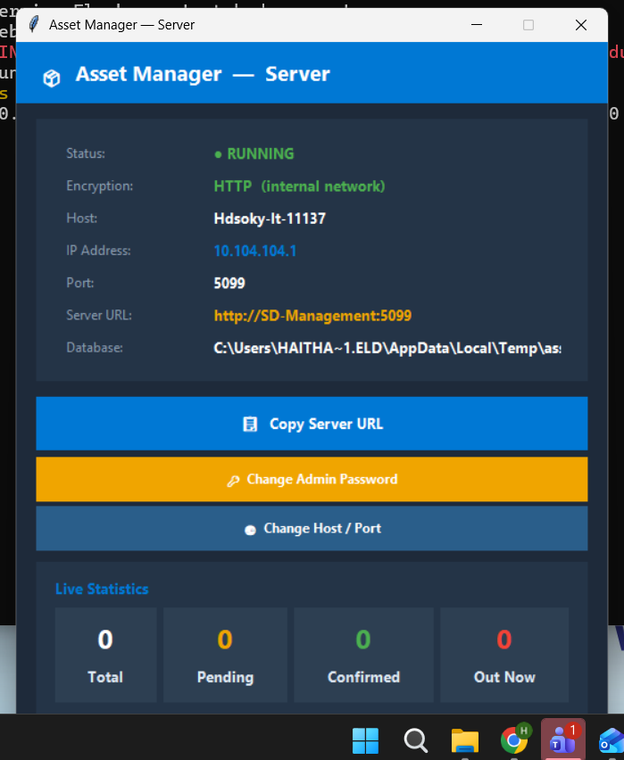
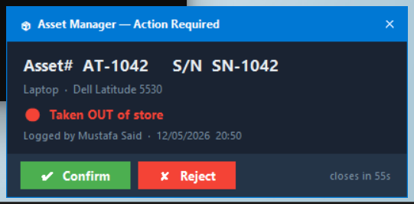
Three Apps. One System.
🖥️
📦
🔔
Server
Storekeeper App
Notifier App
Flask API + SQLite DB.
Runs as Windows Service on the server computer.
Admin GUI included.
Used by Storekeeper User.
Log assets in and out.
Lookup, history, bulk scan, export.
Used by engineers.
Receives transaction alerts.
Confirm or reject in one click.

Slide 4
The Flow
1
2
3
4
Storekeeper Logs
Server Records
Engineer Notified
Confirmed/Rejected
▶
▶
▶
Scans asset,
selects engineer,
submits
Transaction saved,
duplicate check
runs
Popup appears
on engineer's
screen
Status updated
in real time

Slide 5
Type In. Auto-Fill Out.
1 field
Asset Number:
1042
Type:
Enter asset number or serial —
✅ Laptop (auto)
Type AND Model fill in automatically and lock.
Model:
✅ Dell Latitude 5530 (auto)
Powered by asset_lookup.xlsx — editable anytime

Slide 6
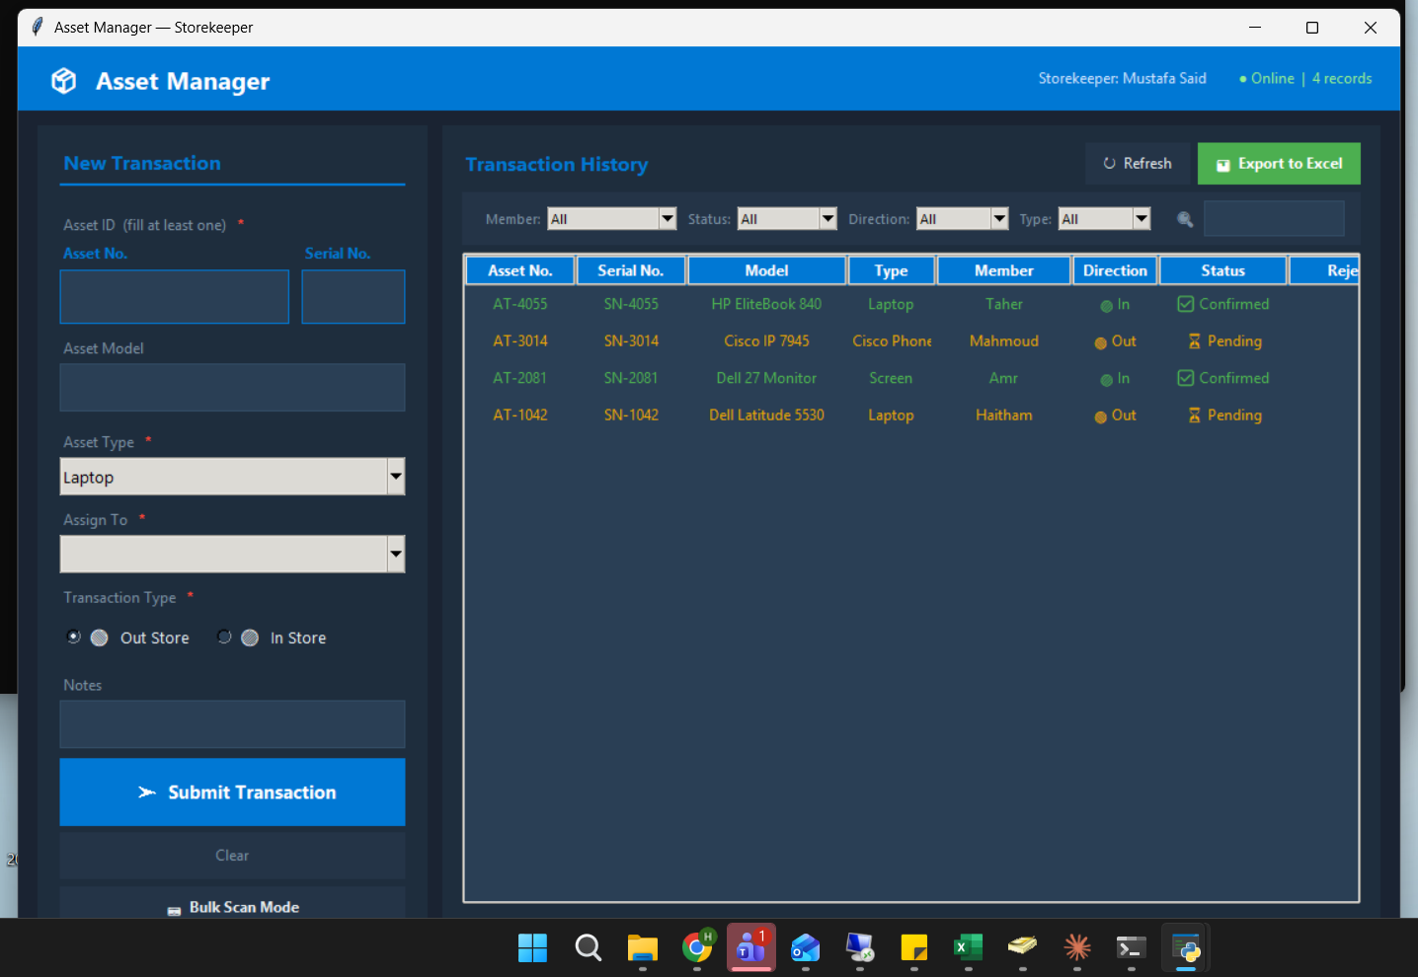
No More Double-Dipping
Asset already pending?
409
The server blocks re-submission until the first
transaction is confirmed or rejected.
✅ After Confirm → can re-submit
✅ After Reject → can re-submit

Slide 7
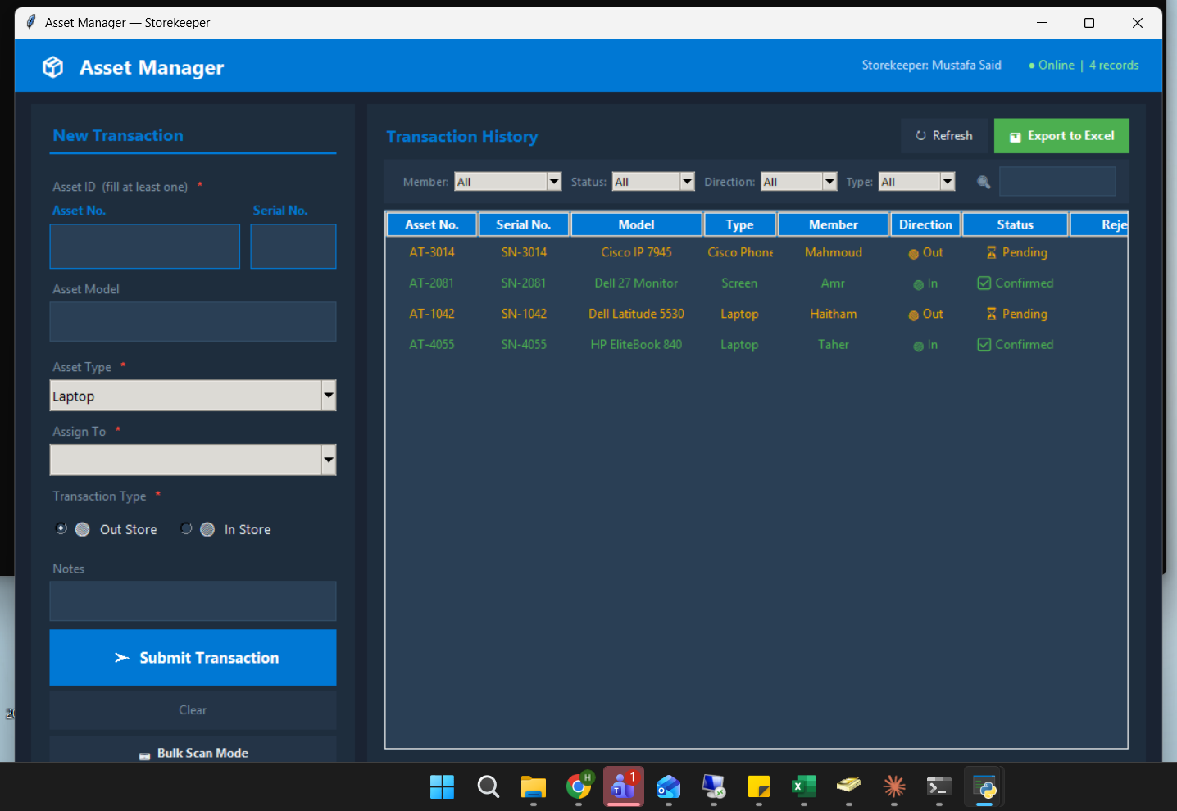
Export That Actually Looks Good
Transaction Sheet
Charts included:
📄
Full history, color-coded by status
(green / orange / red)
• Status bar chart
• Per-engineer bar chart
• In vs Out pie chart
Summary Sheet
📊
Includes the new Model column
Status breakdown, per-engineer counts,
3 auto-generated charts

Slide 8
Admin Has Full Control
🔐
🌐
📋
🗑
Change Password
Change Host / Port
Update Lookup File
Clear All Records
SHA-256 protected.
Update anytime from
the server GUI.
Move to any port.
Default is 80. Saved to
config, applied on restart.
Edit asset_lookup.xlsx directly.
Changes apply immediately,
no restart needed.
Delete all records from the database.
Admin password + confirmation required.

Slide 9
What's New
Asset Model Field
Duplicate Guard
🆕
🛡️
Stored, displayed, exported
409 blocks re-submission
Better Export
Port Config
📊
⚙️
3 charts in Summary sheet
Change host/port via GUI
4 New Types
Windows Service
📱
⚡
Cisco Phone, Printer, Scanner, Switch
Starts at boot. No login needed.
SSL Certificate
Clear All Records
🔒
🗑
HTTPS encryption on port 8081
Admin-protected database wipe
System Tray
🖥️
Server minimises to tray — click X to hide, right-click to show or exit

Slide 10
Demo — Logging an Asset Out
1
[ Demo / Screenshot here ]
Open Storekeeper App
2
Select direction: Out Store
3
Enter Asset Number or Serial
4
Type + Model auto-fill → locked
5
Select engineer from dropdown
6
Click Submit
7
Engineer receives notification instantly

Slide 11
Demo — Engineer Side
1
[ Demo / Screenshot here ]
Launch NotifierApp.exe -- runs in system tray
2
Popup appears automatically
3
Shows: Type, Model, Asset No., Direction
4
Click Confirm or Reject
5
Status updates in real time for storekeeper

Slide 12
Keeping the Lookup Up to Date
Asset No.
Serial No.
Type
Model
Edit Directly
📄
1042
SN-4829A
Laptop
Dell 5530
Open asset_lookup.xlsx on asset-server.
Add/edit rows. 4 columns:
Asset Number, Serial Number, Type, Model.
2013
SN-7731B
Monitor
LG 24MK
3305
SN-1102C
Cisco Phone
CP-8851
Instant Effect
⚡
No restart needed.
Changes are live immediately.

Slide 13
Questions?
AssetManager — IT Department,
Built with Python · Flask · SQLite · Tkinter

