Slide 1
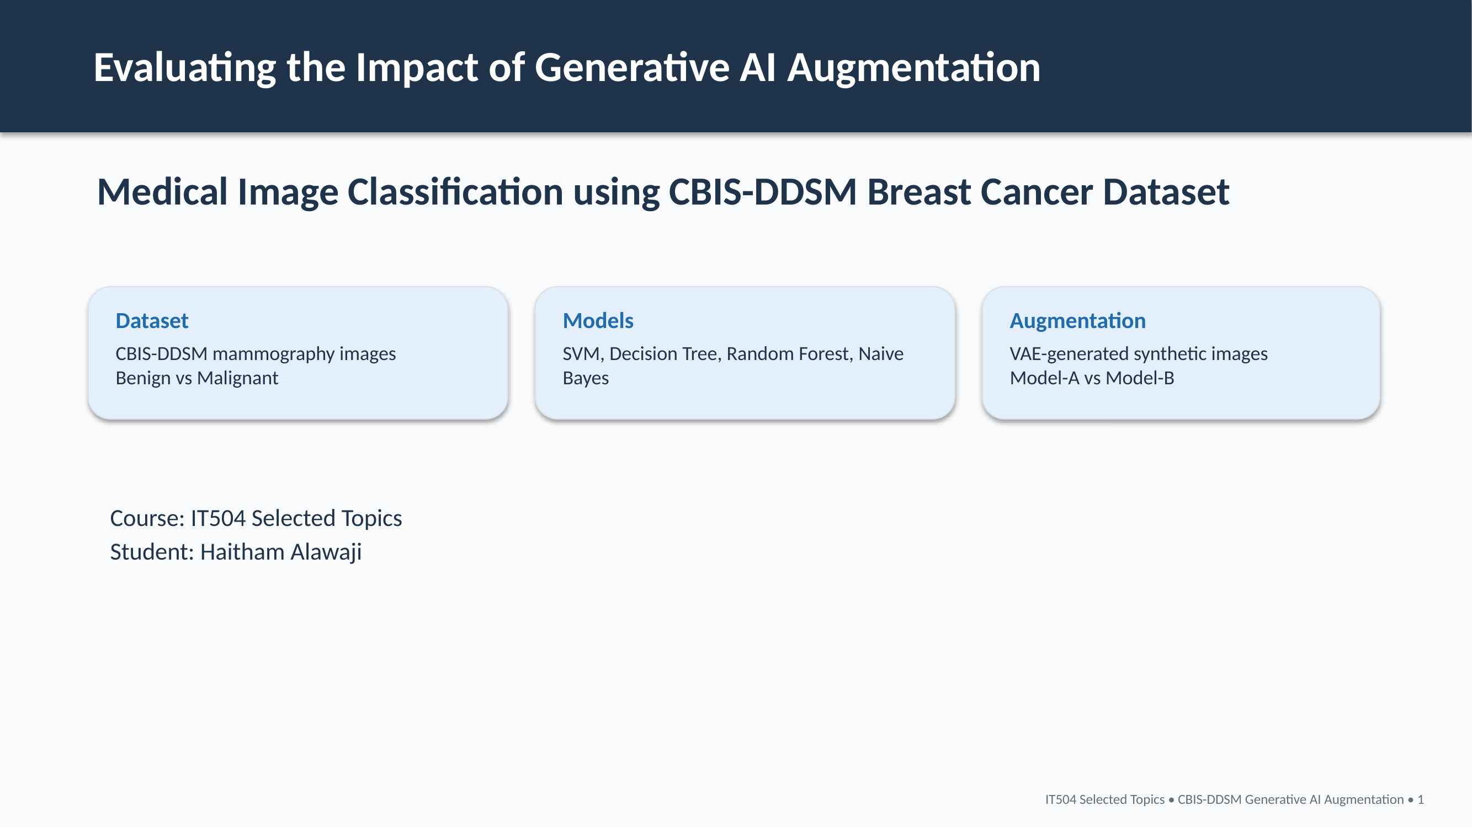

Slide 2
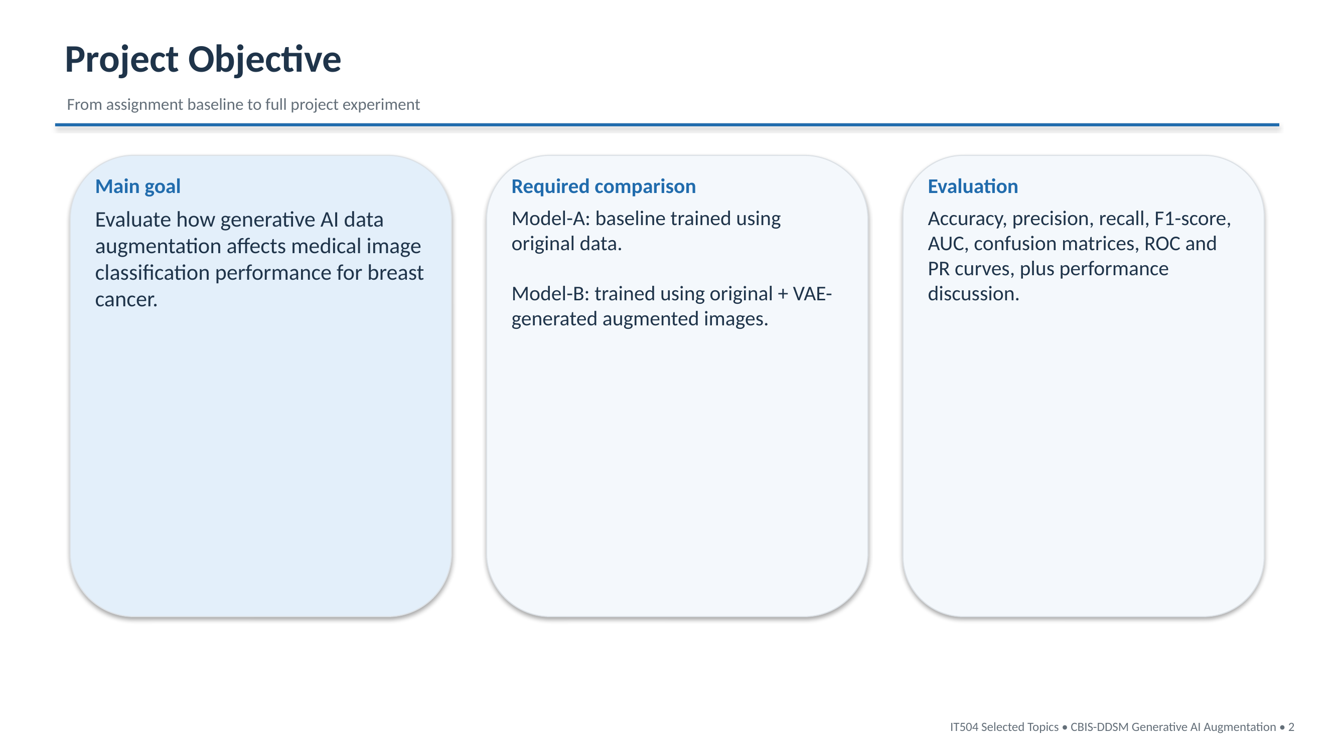

Slide 3
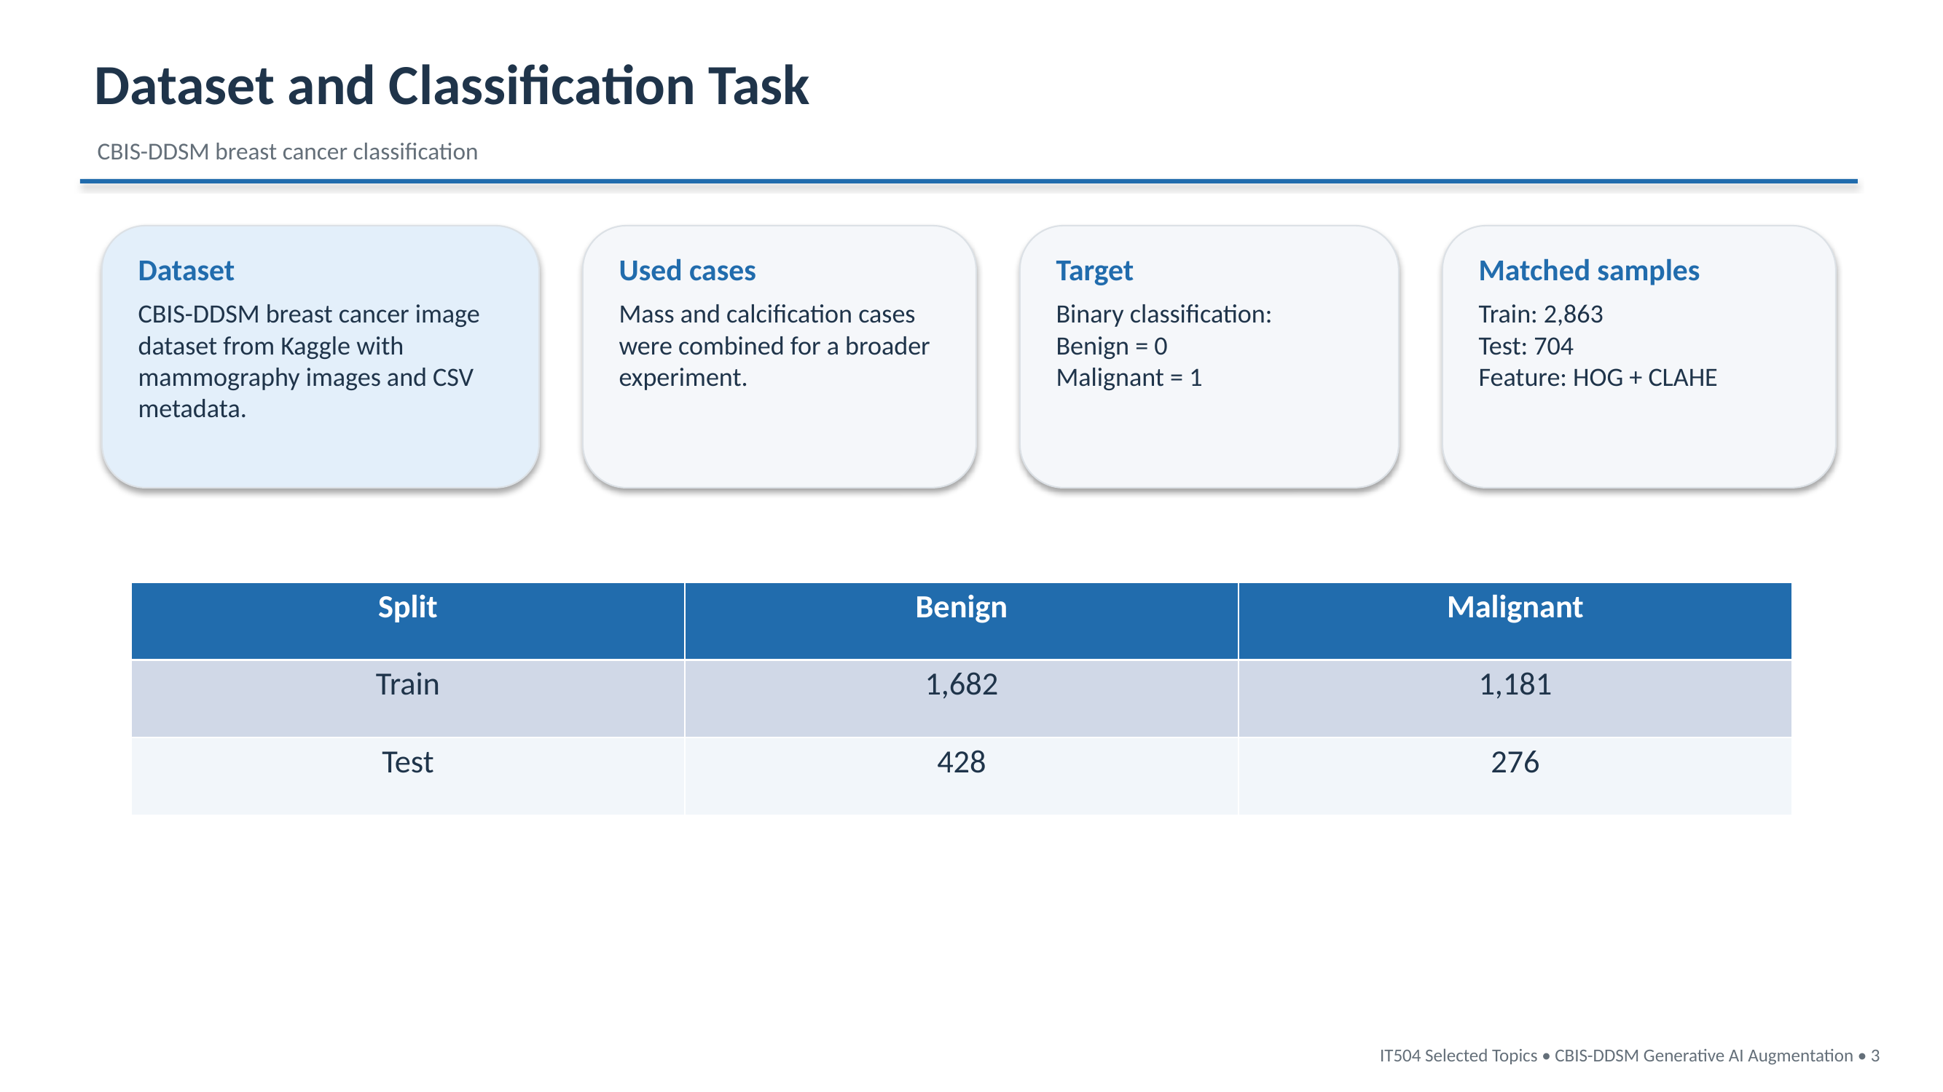

Slide 4
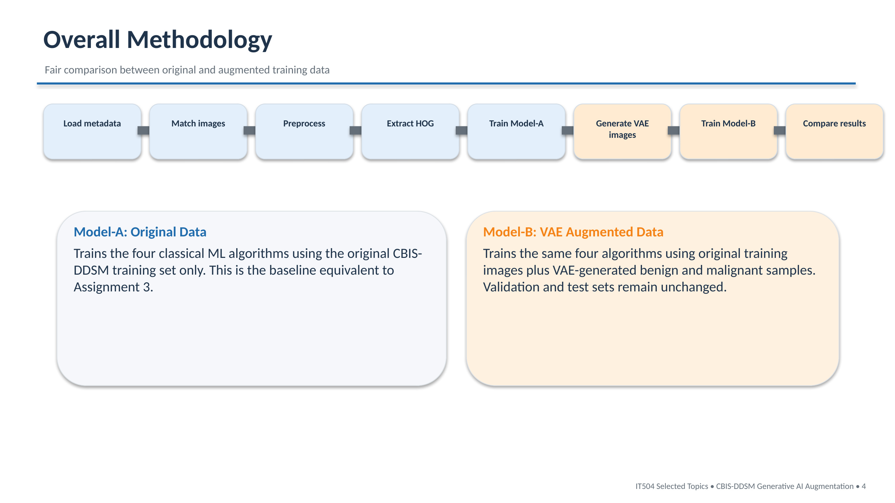

Slide 5
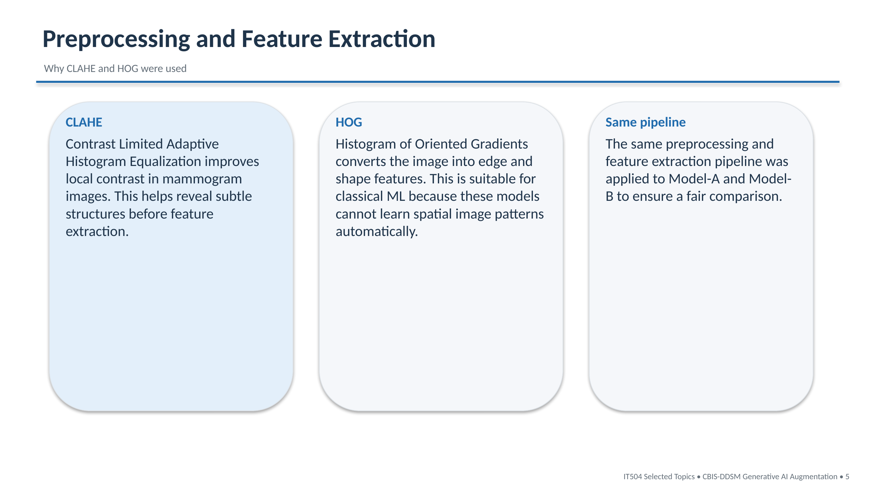

Slide 6
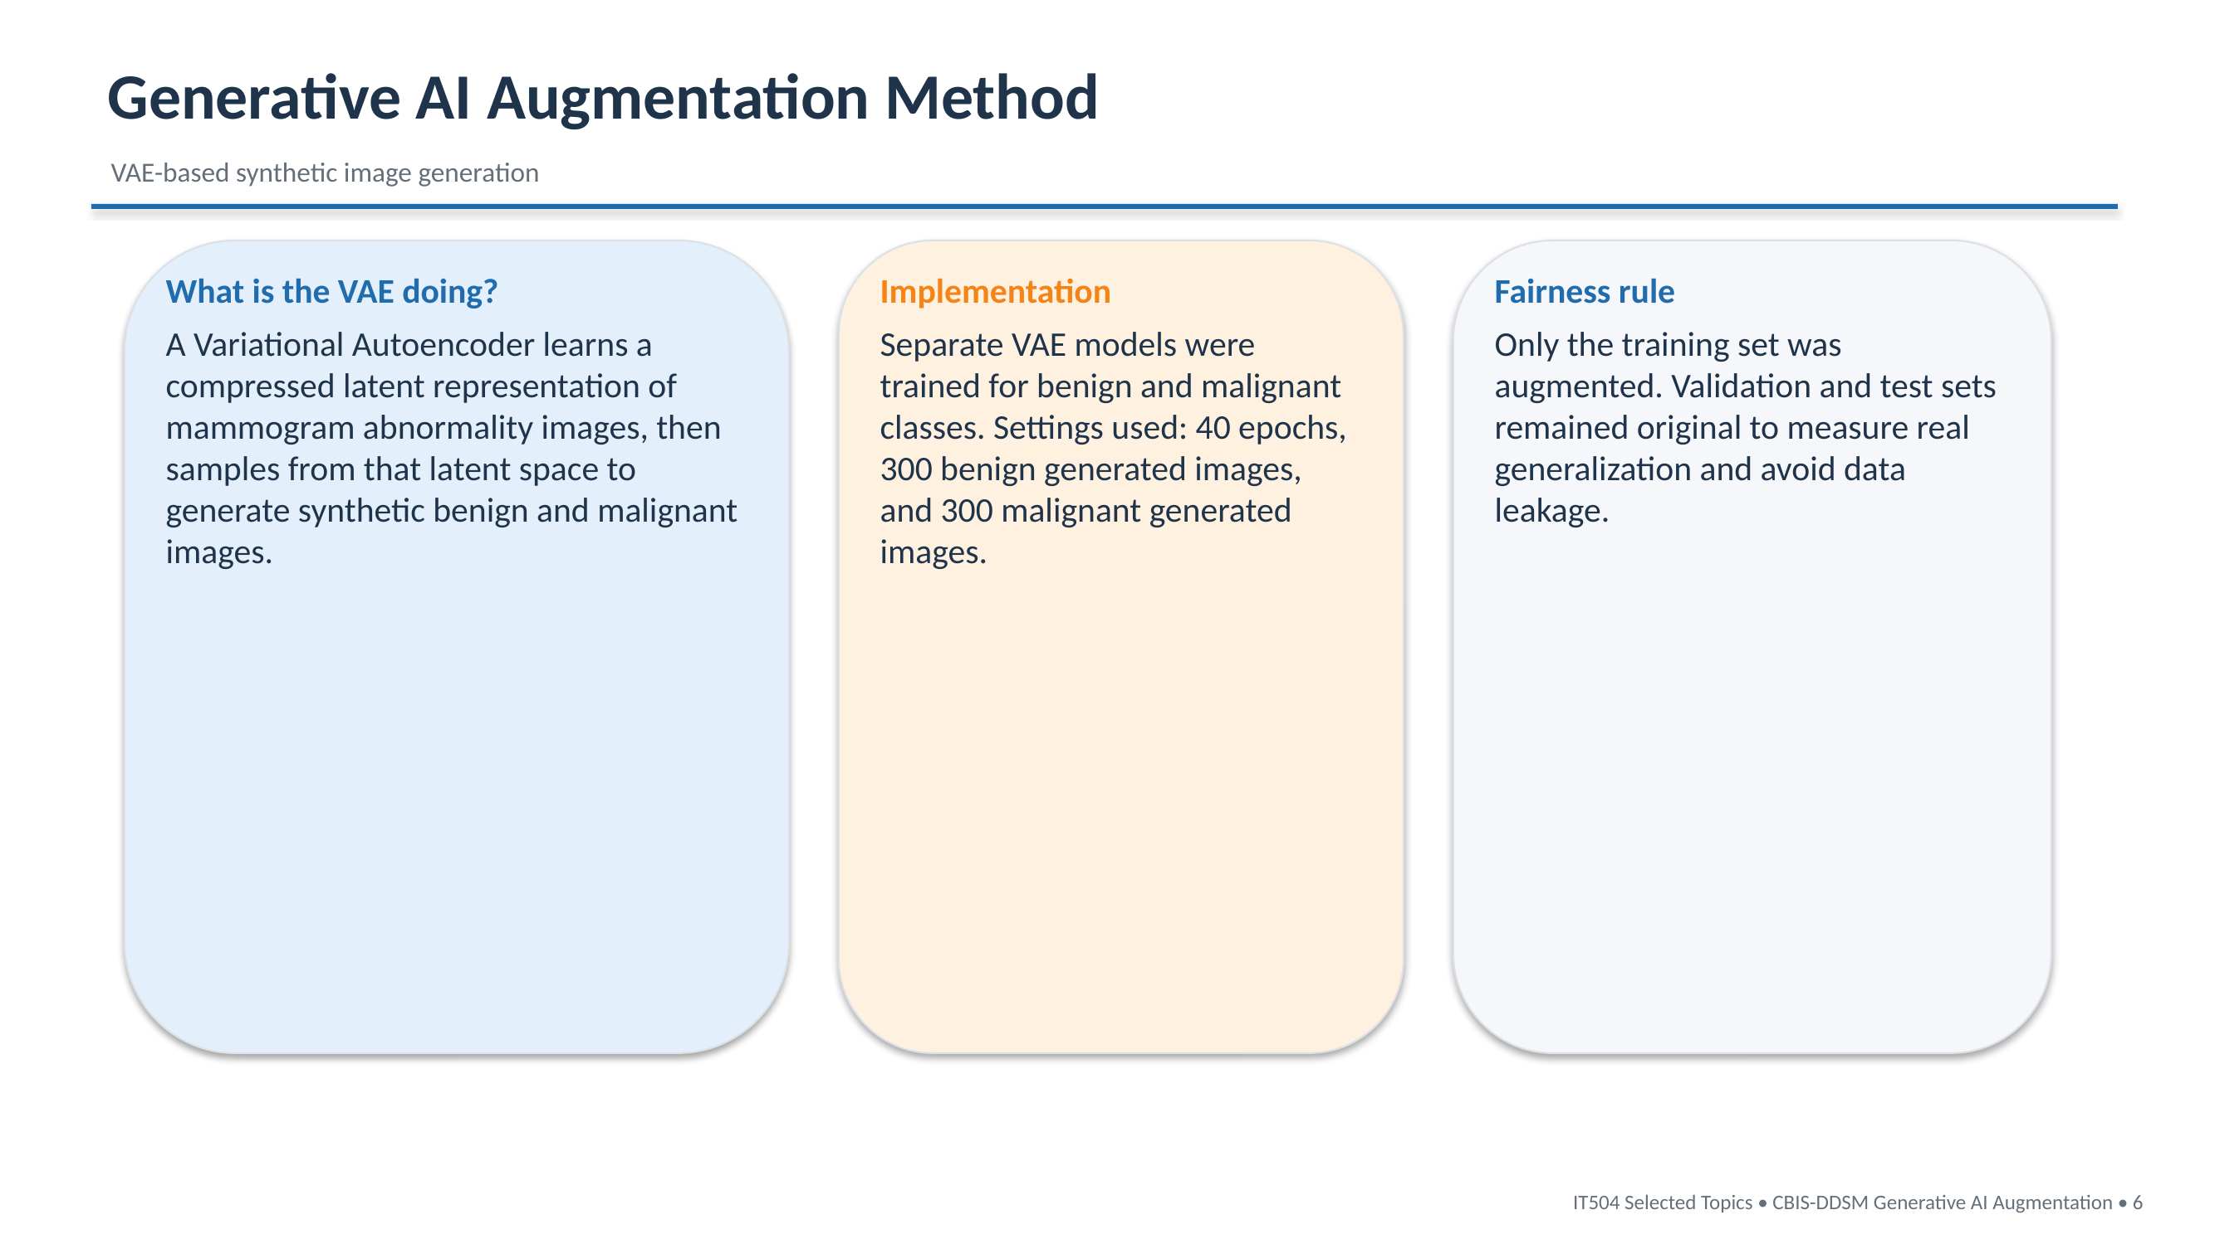

Slide 7
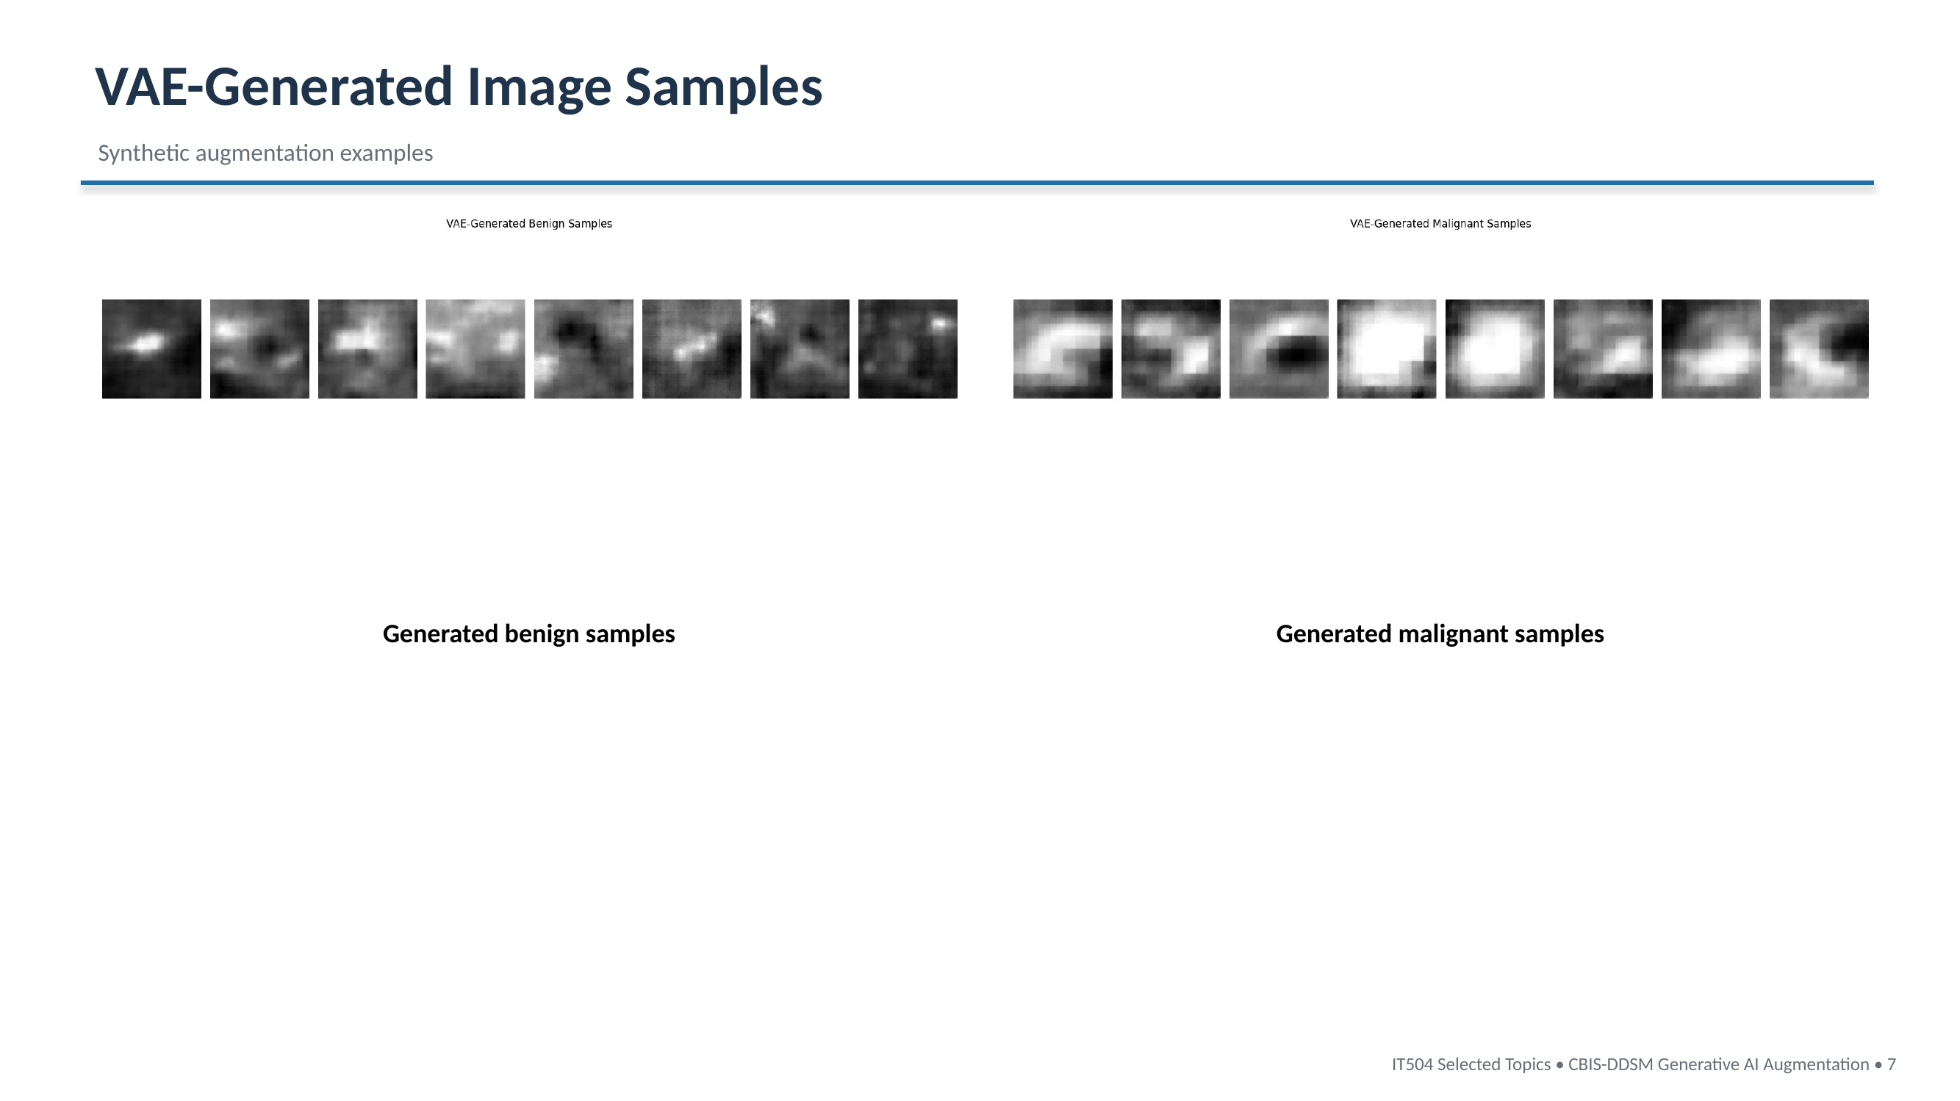

Slide 8
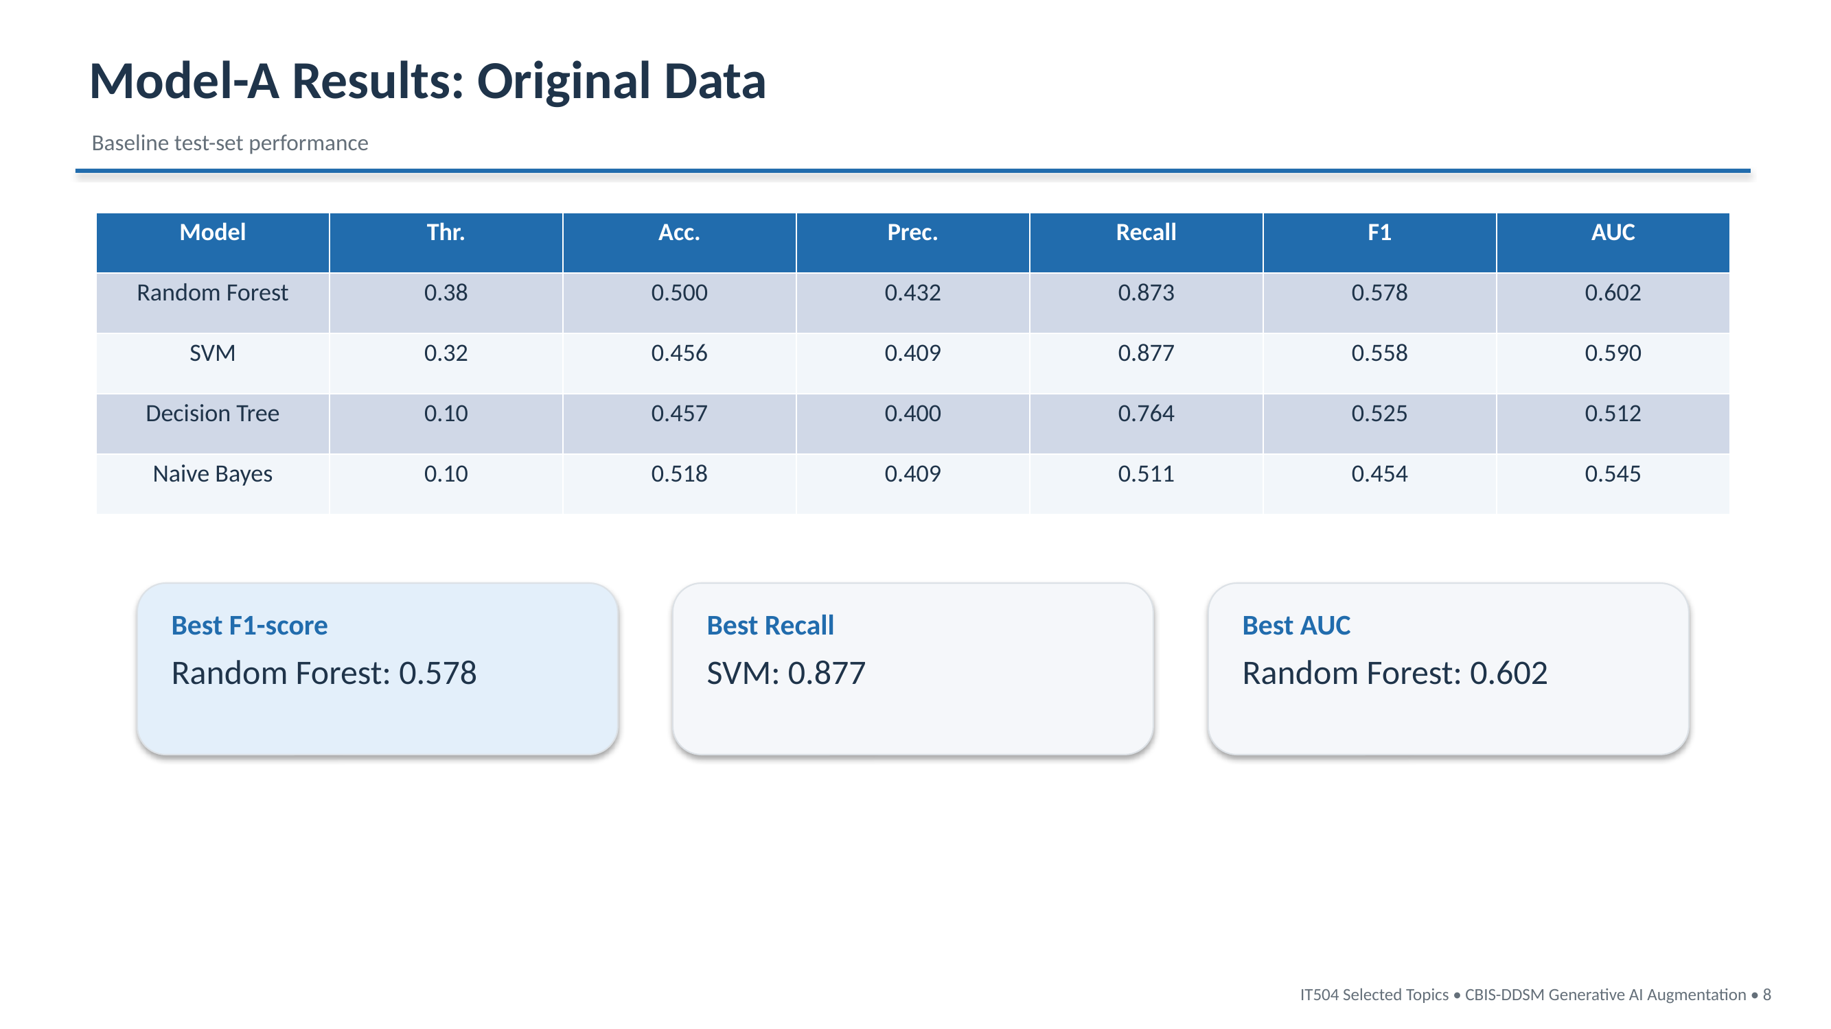

Slide 9
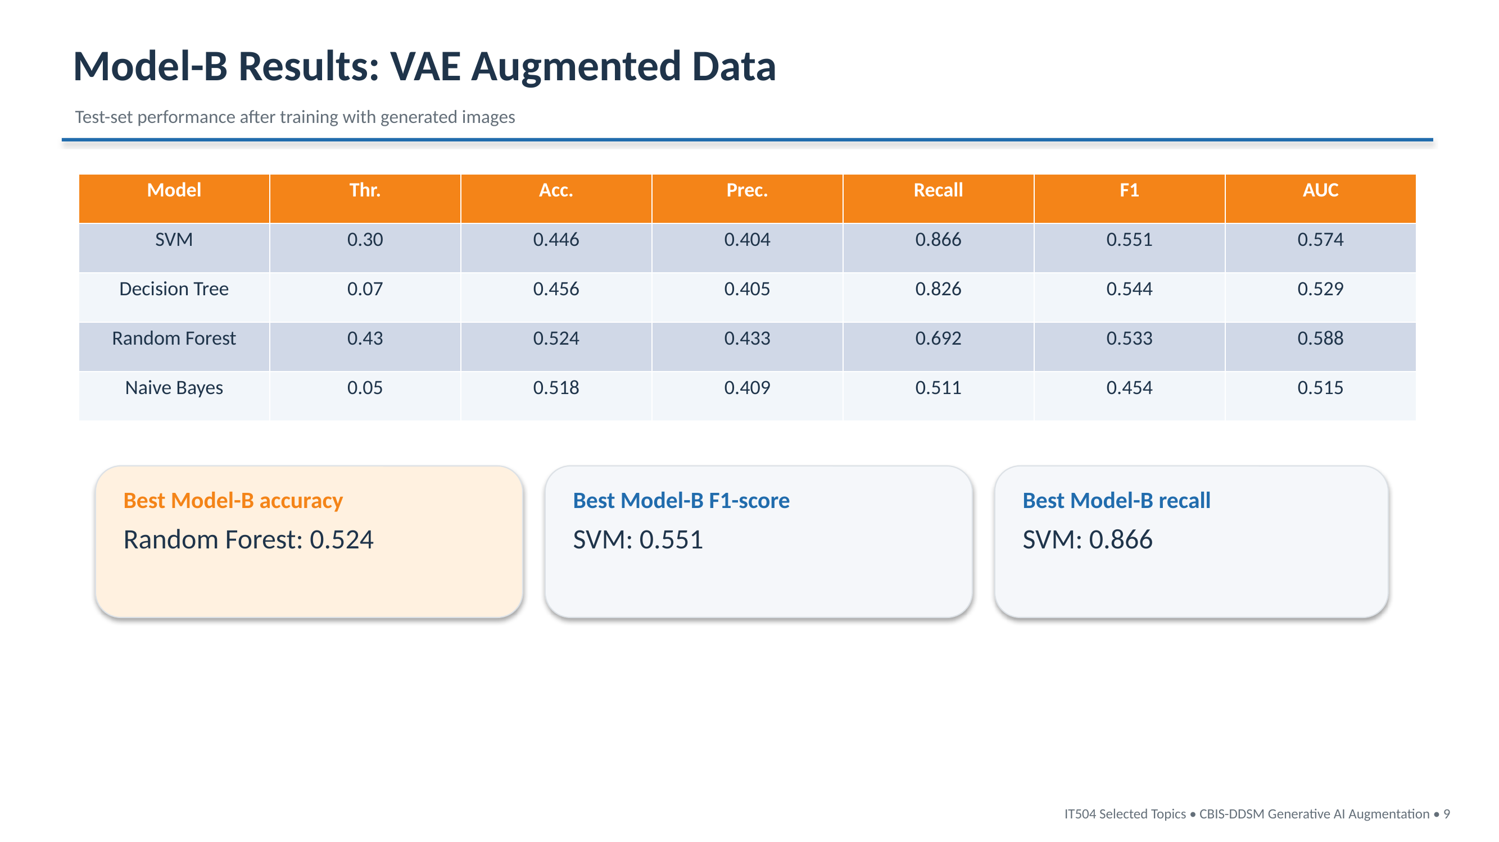

Slide 10
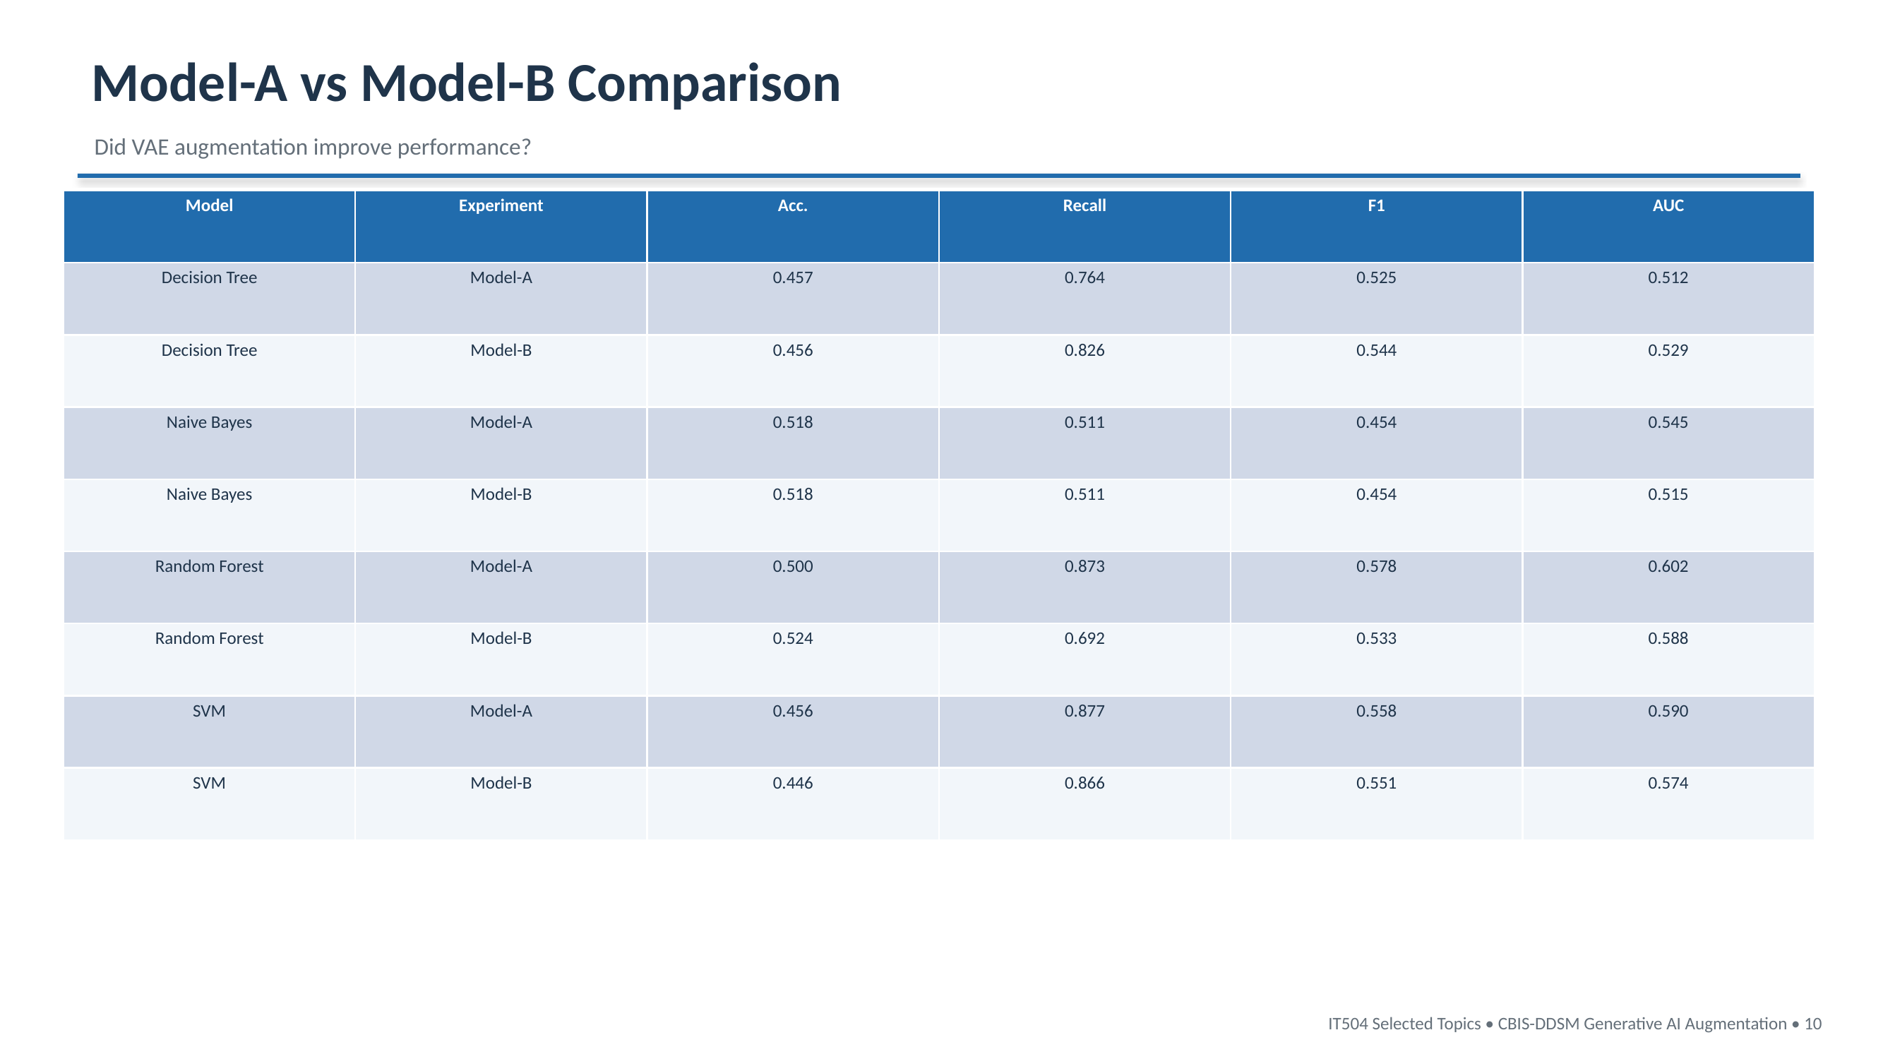

Slide 11
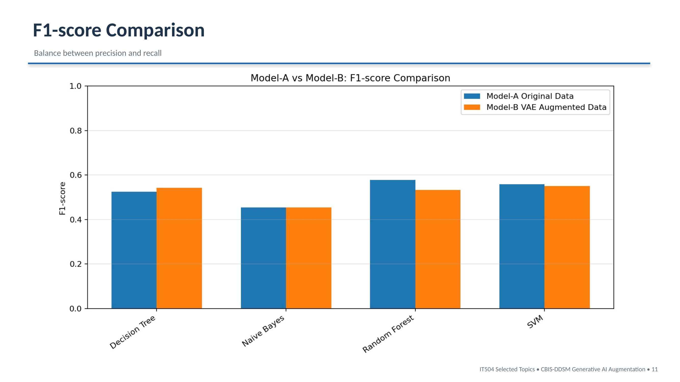

Slide 12
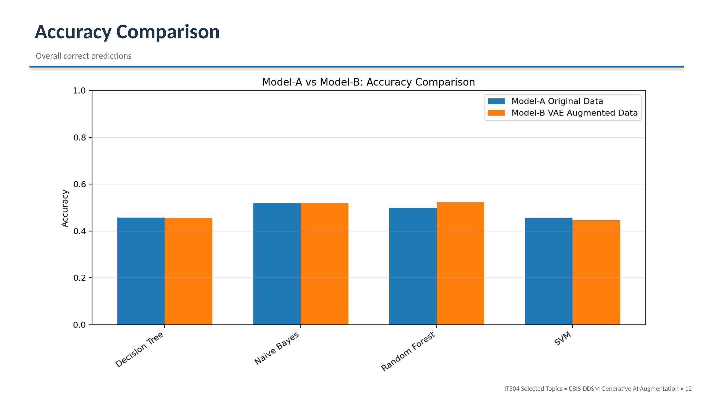

Slide 13
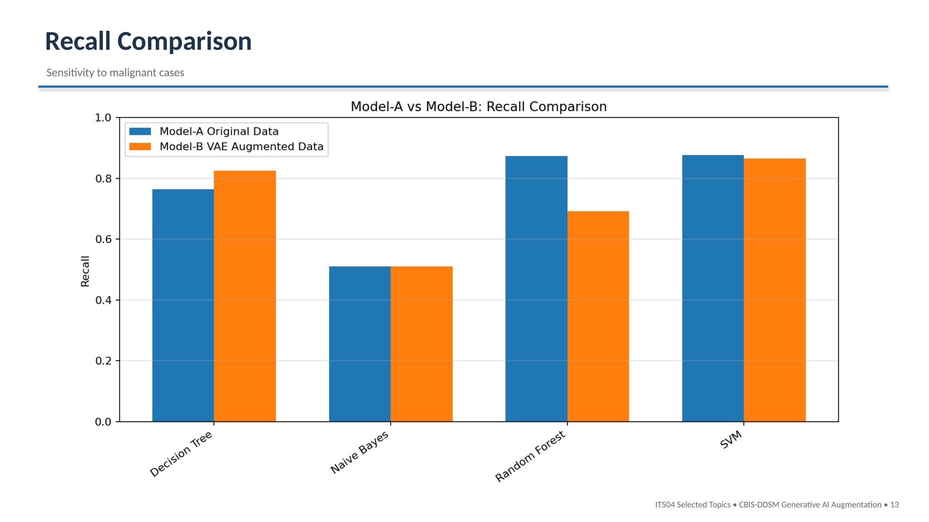

Slide 14
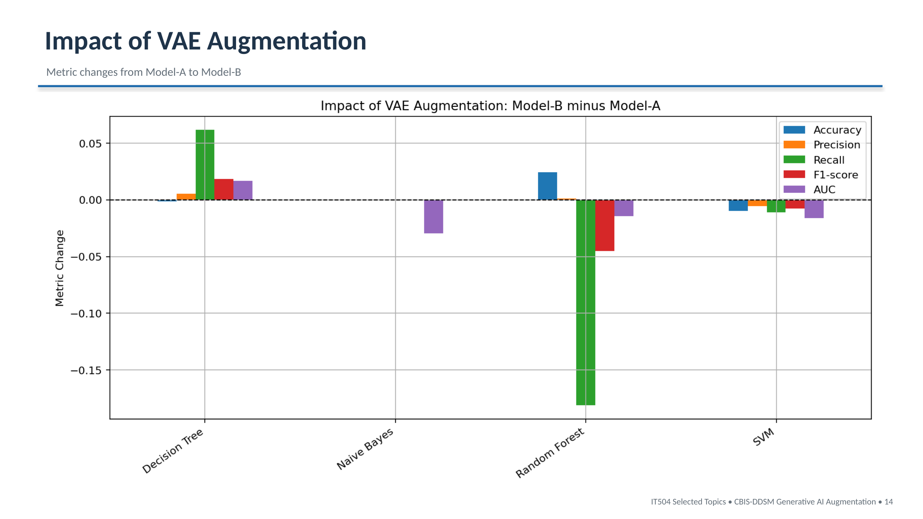

Slide 15
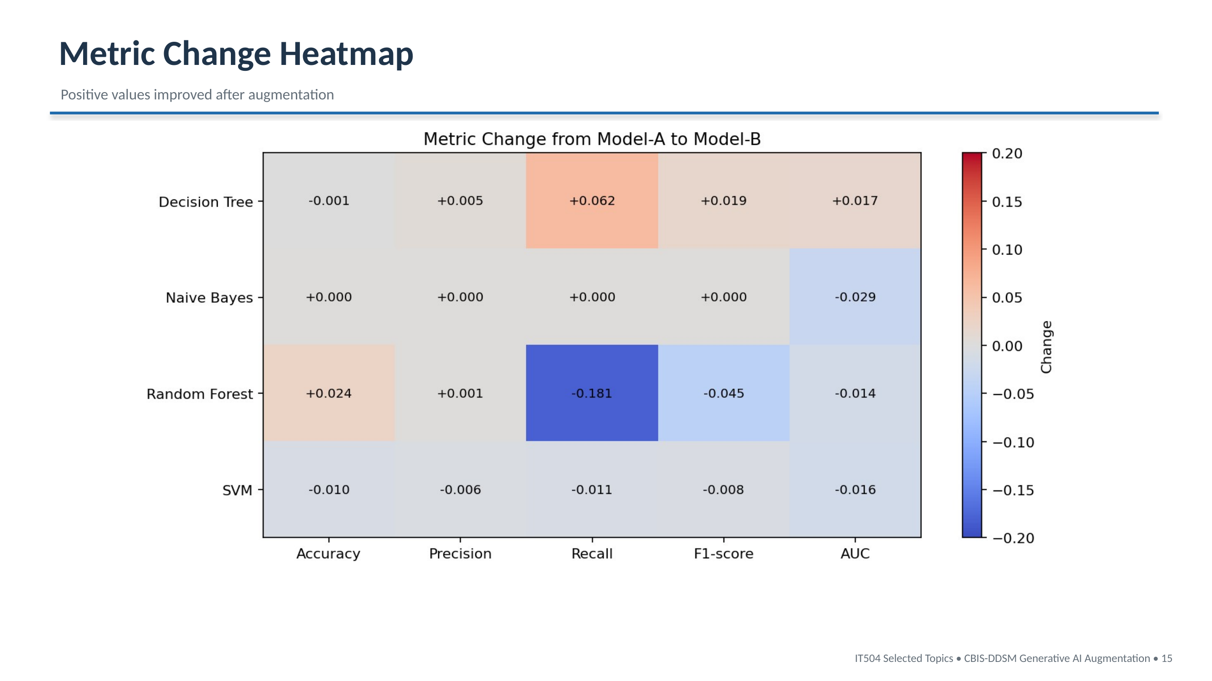

Slide 16
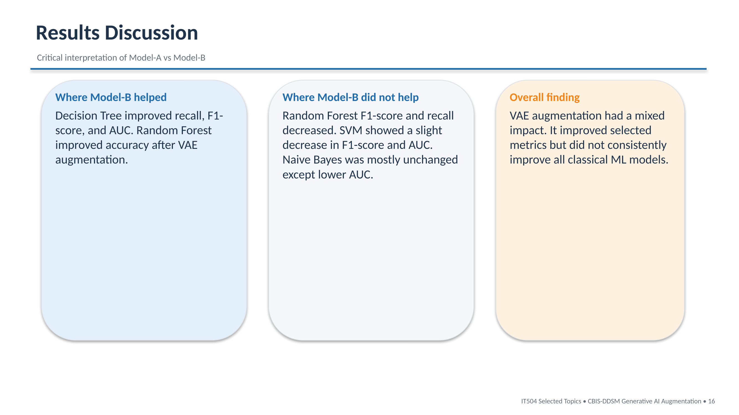

Slide 17
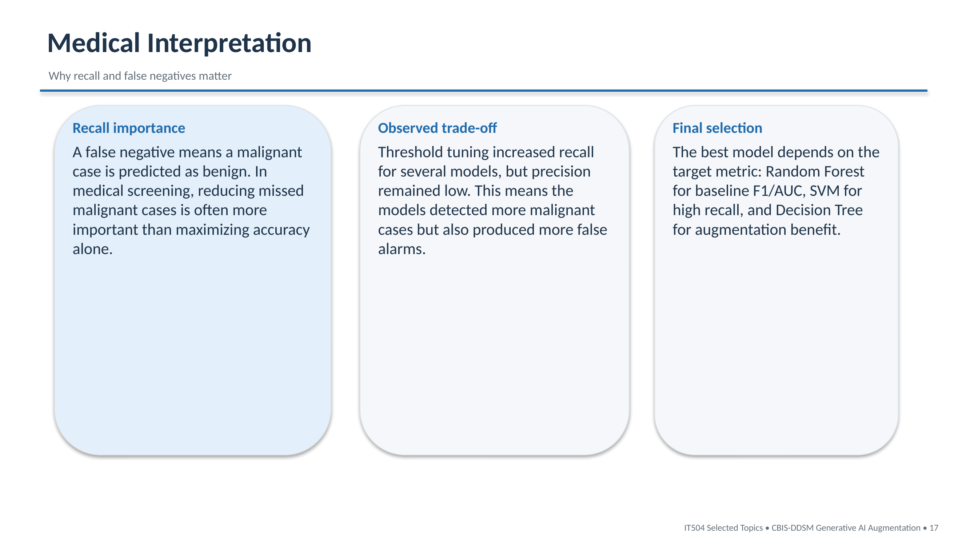

Slide 18
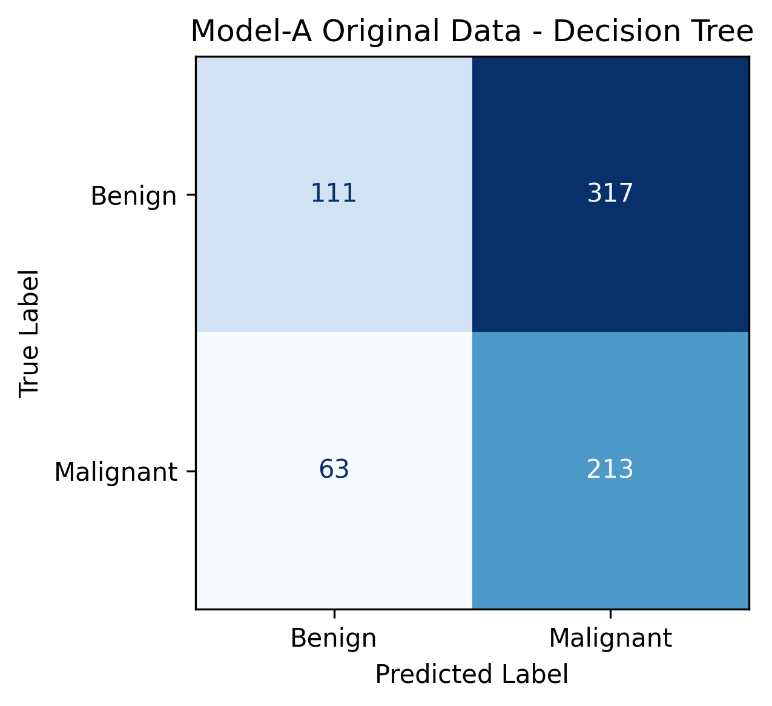
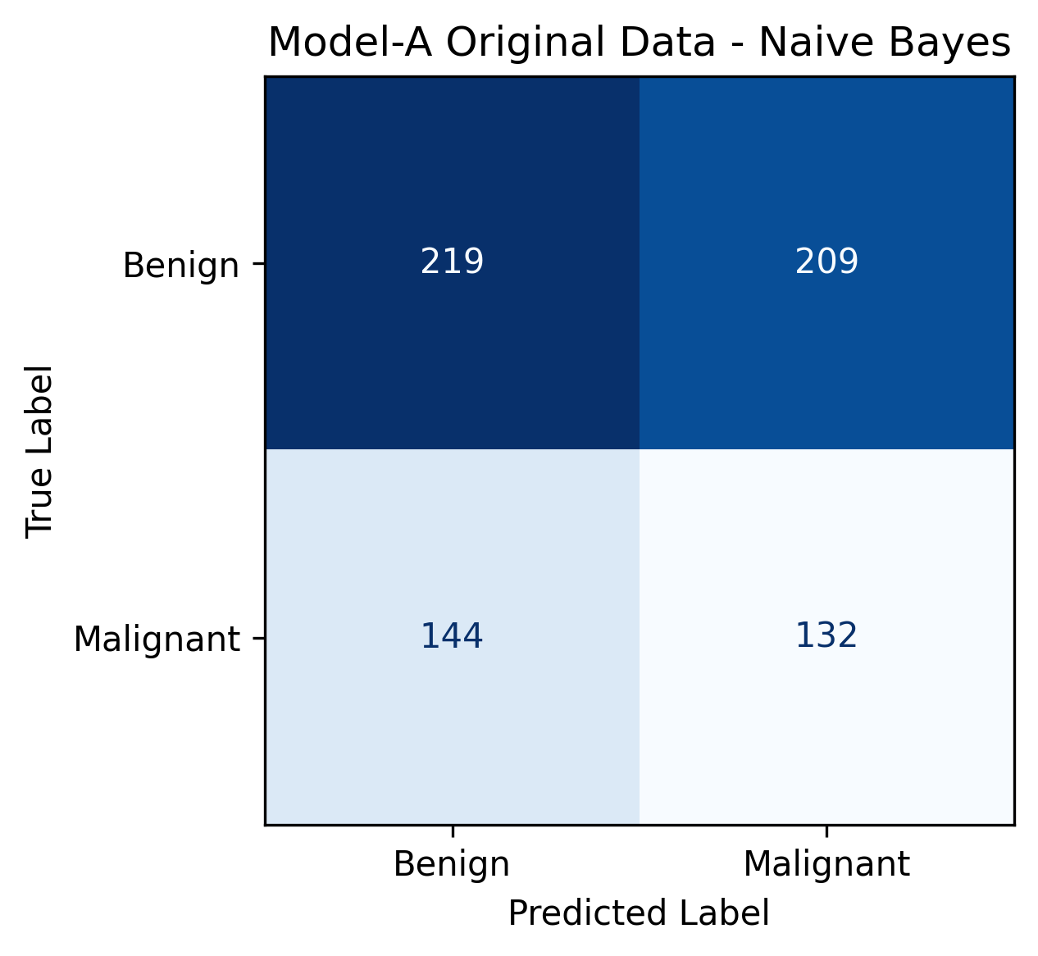
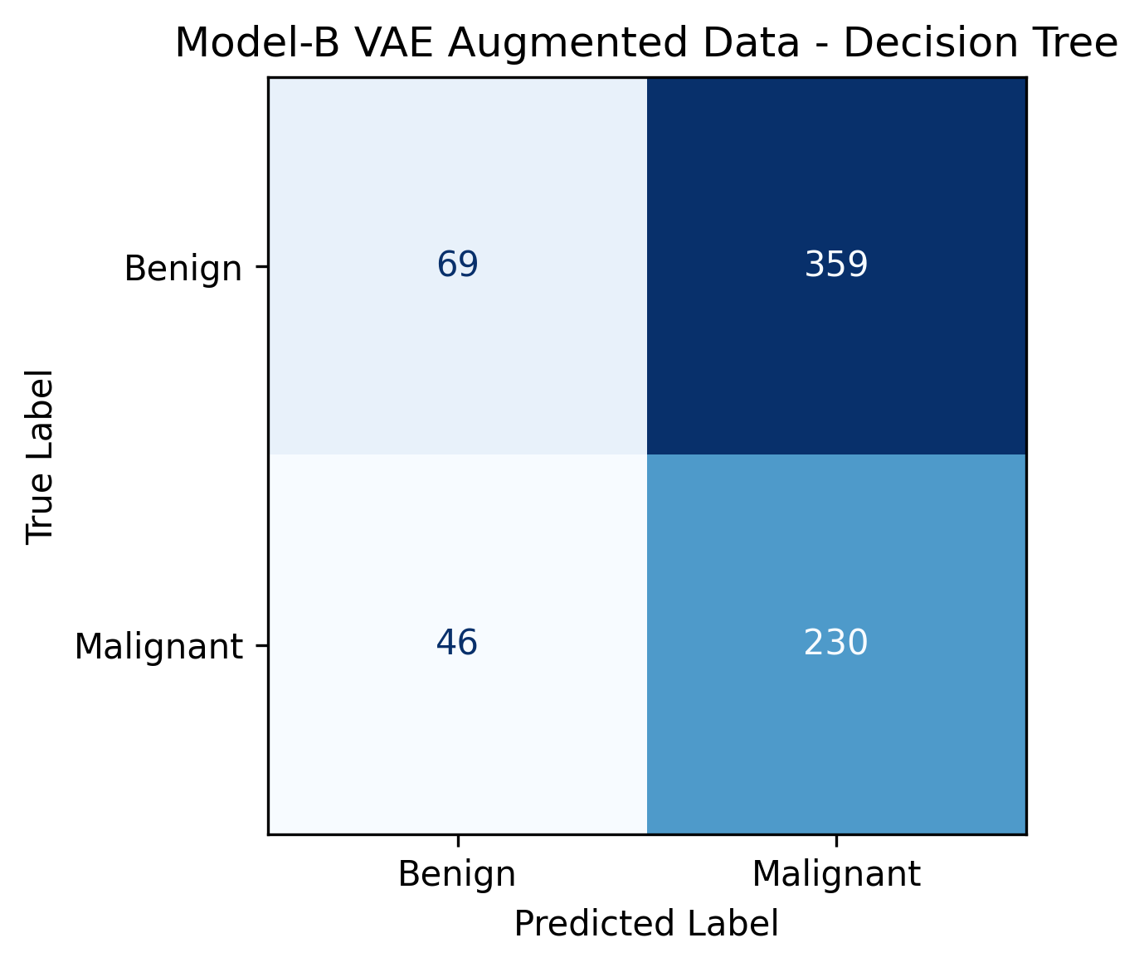
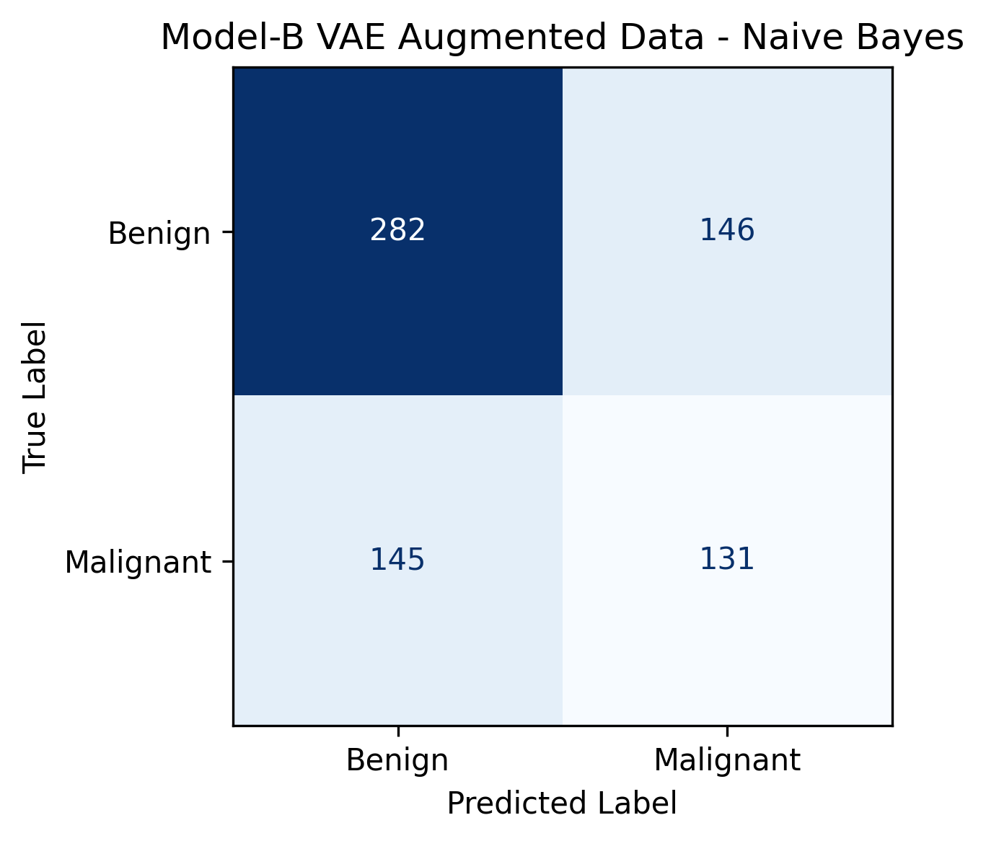
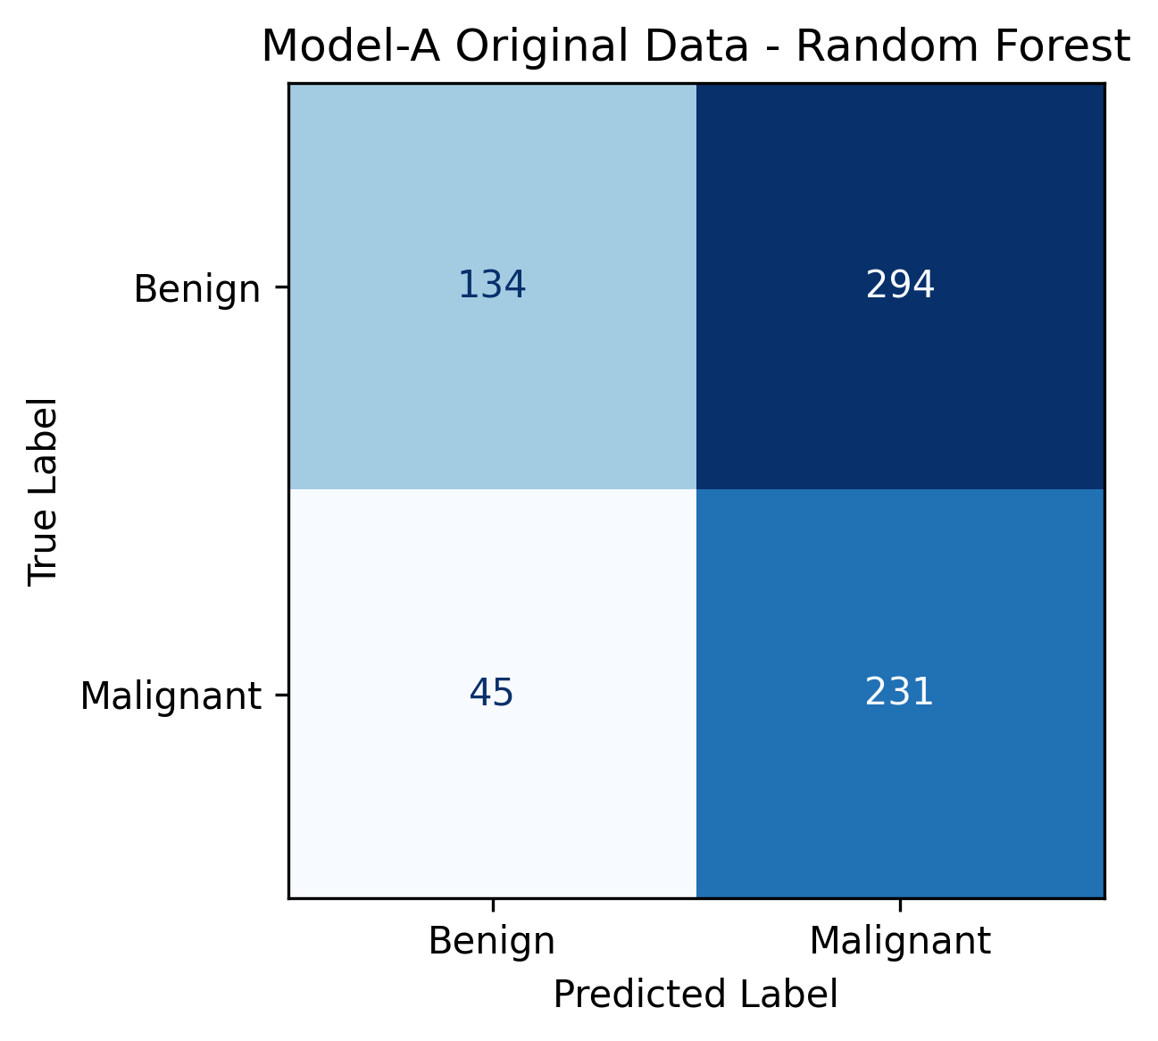
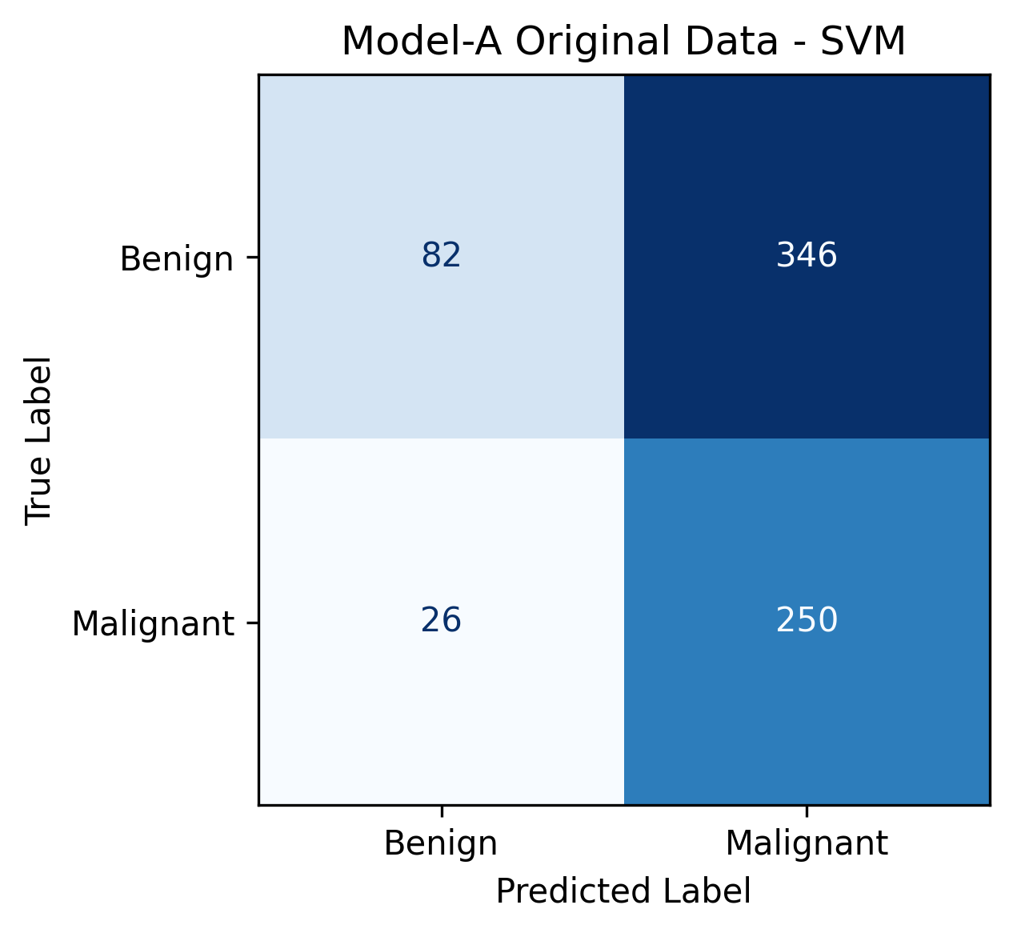
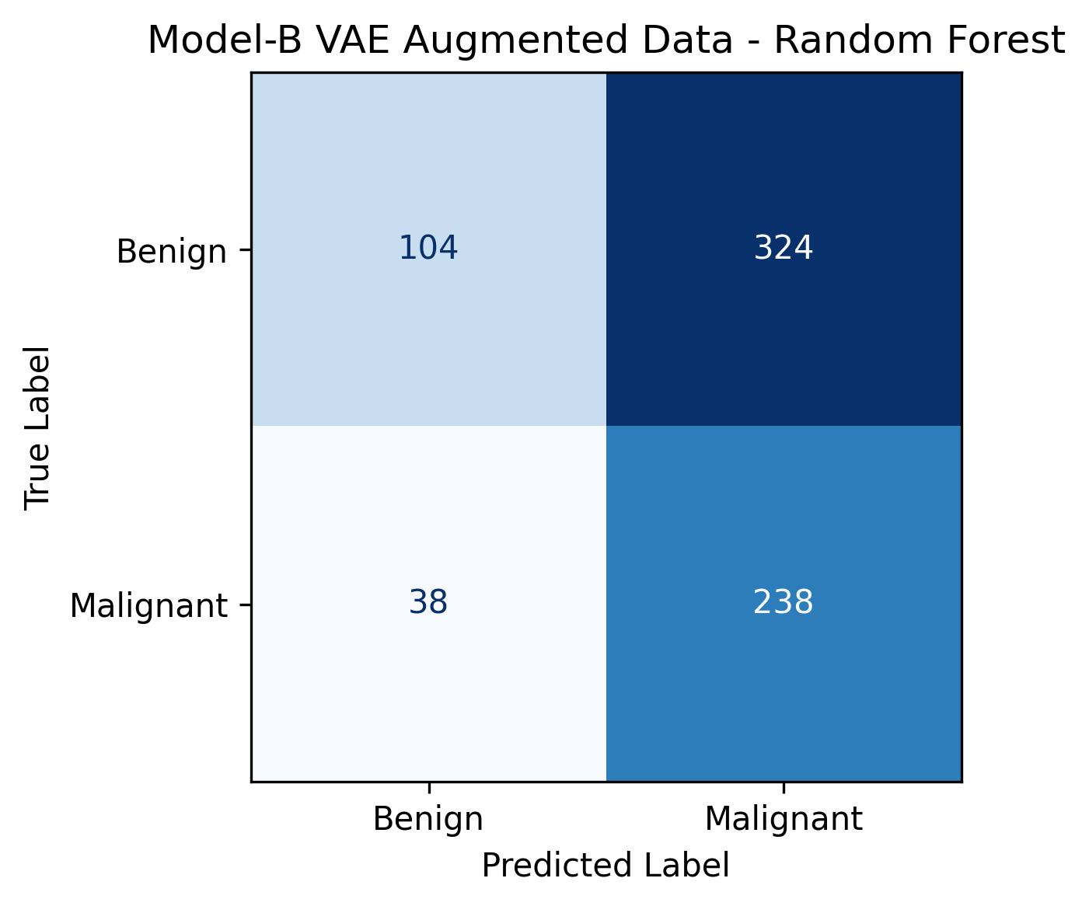
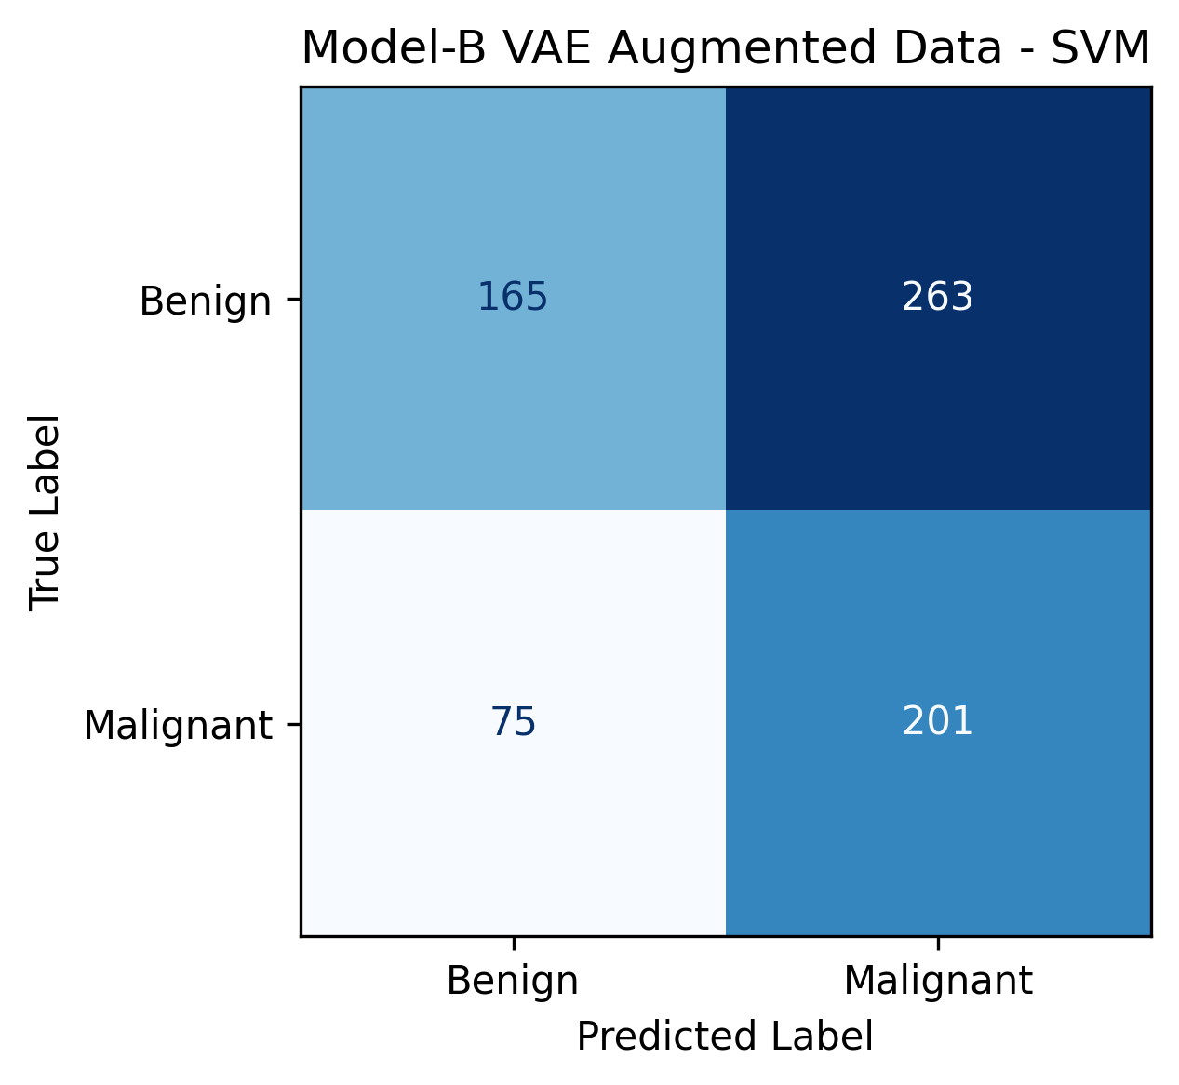
Confusion Matrices
Model-specific classification errors and false negatives
Model-A Confusion Matrices
Model-A Confusion Matrices
Presentation note
False negatives are especially important in breast cancer classification because they represent missed malignant cases.
IT504 Selected Topics • CBIS-DDSM Generative AI Augmentation

Slide 19
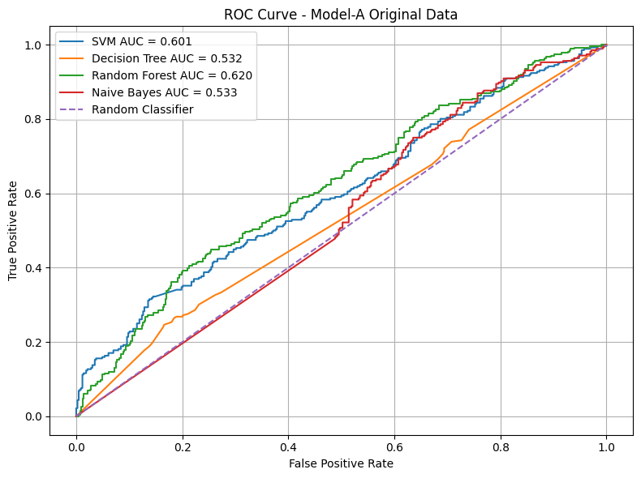
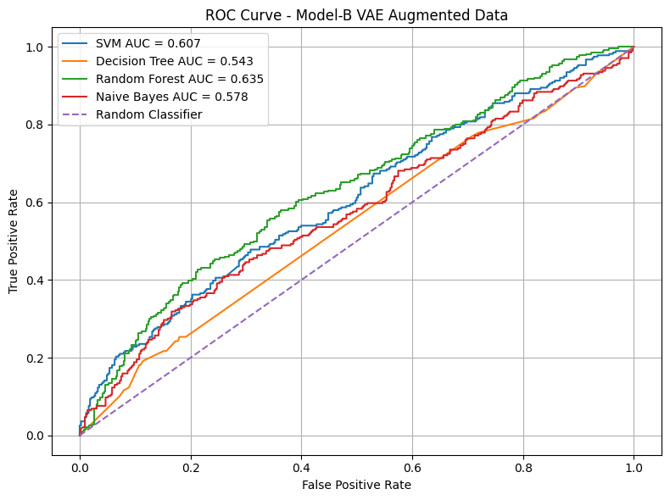
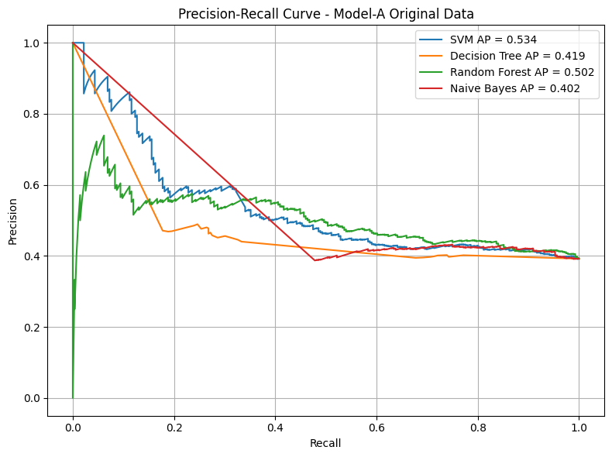
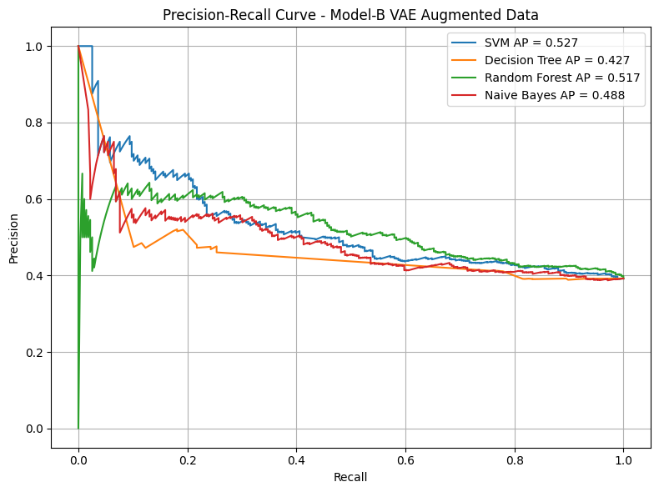
ROC and Precision–Recall Curves
Separation ability and sensitivity trade-off
ROC CURVES
Precision-Recall CurveS
Key interpretation
VAE augmentation changed model behavior, but did not consistently improve all metrics across all classifiers.
IT504 Selected Topics • CBIS-DDSM Generative AI Augmentation

Slide 20
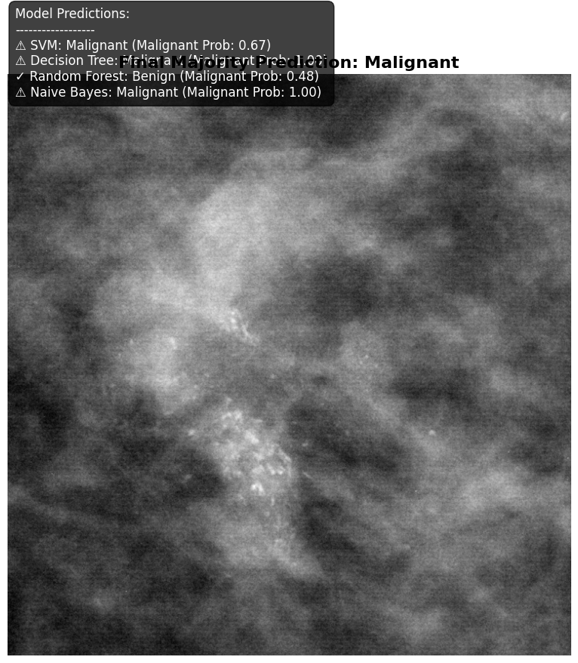
Single Image Demo
Example prediction on one selected/random test image
Prediction table
Model | Prediction | Malignant Prob.
SVM | Malignant | 0.67
Decision Tree | Malignant | 1.000
Random Forest | Benign | 0.48
Naive Bayes | Malignant | 1.00
Interpretation
This is an educational model output, not a medical diagnosis. The selected image is classified as Benign or Malignant based on model probabilities and the selected threshold.
IT504 Selected Topics • CBIS-DDSM Generative AI Augmentation

Slide 21
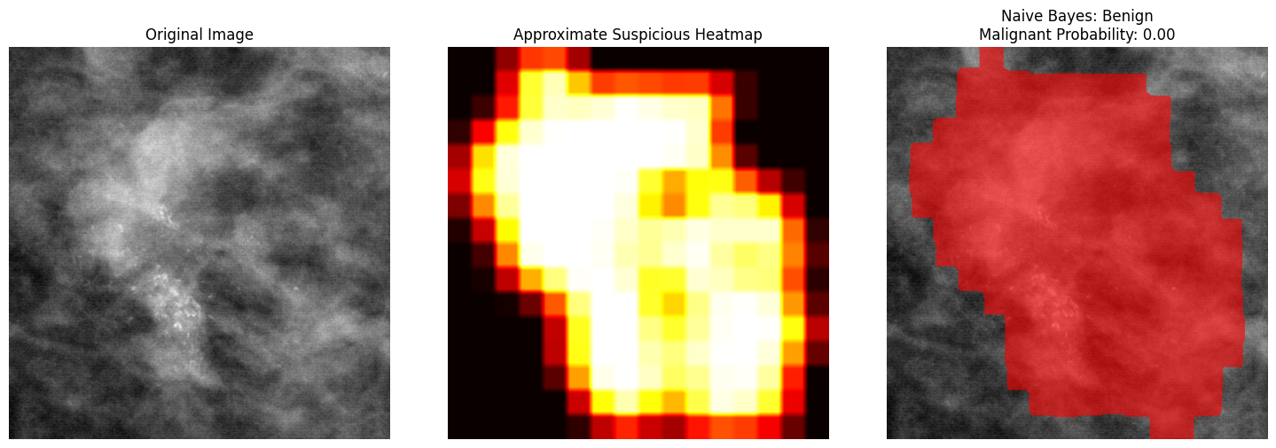
Explainability Demo
Occlusion-sensitivity red overlay
How it works
Small image patches are hidden one by one. If hiding a region reduces the malignant probability, that region is highlighted as influential.
Important limitation
The red overlay is not clinical tumor segmentation. It only shows regions that influenced the classifier prediction.
IT504 Selected Topics • CBIS-DDSM Generative AI Augmentation

Slide 22
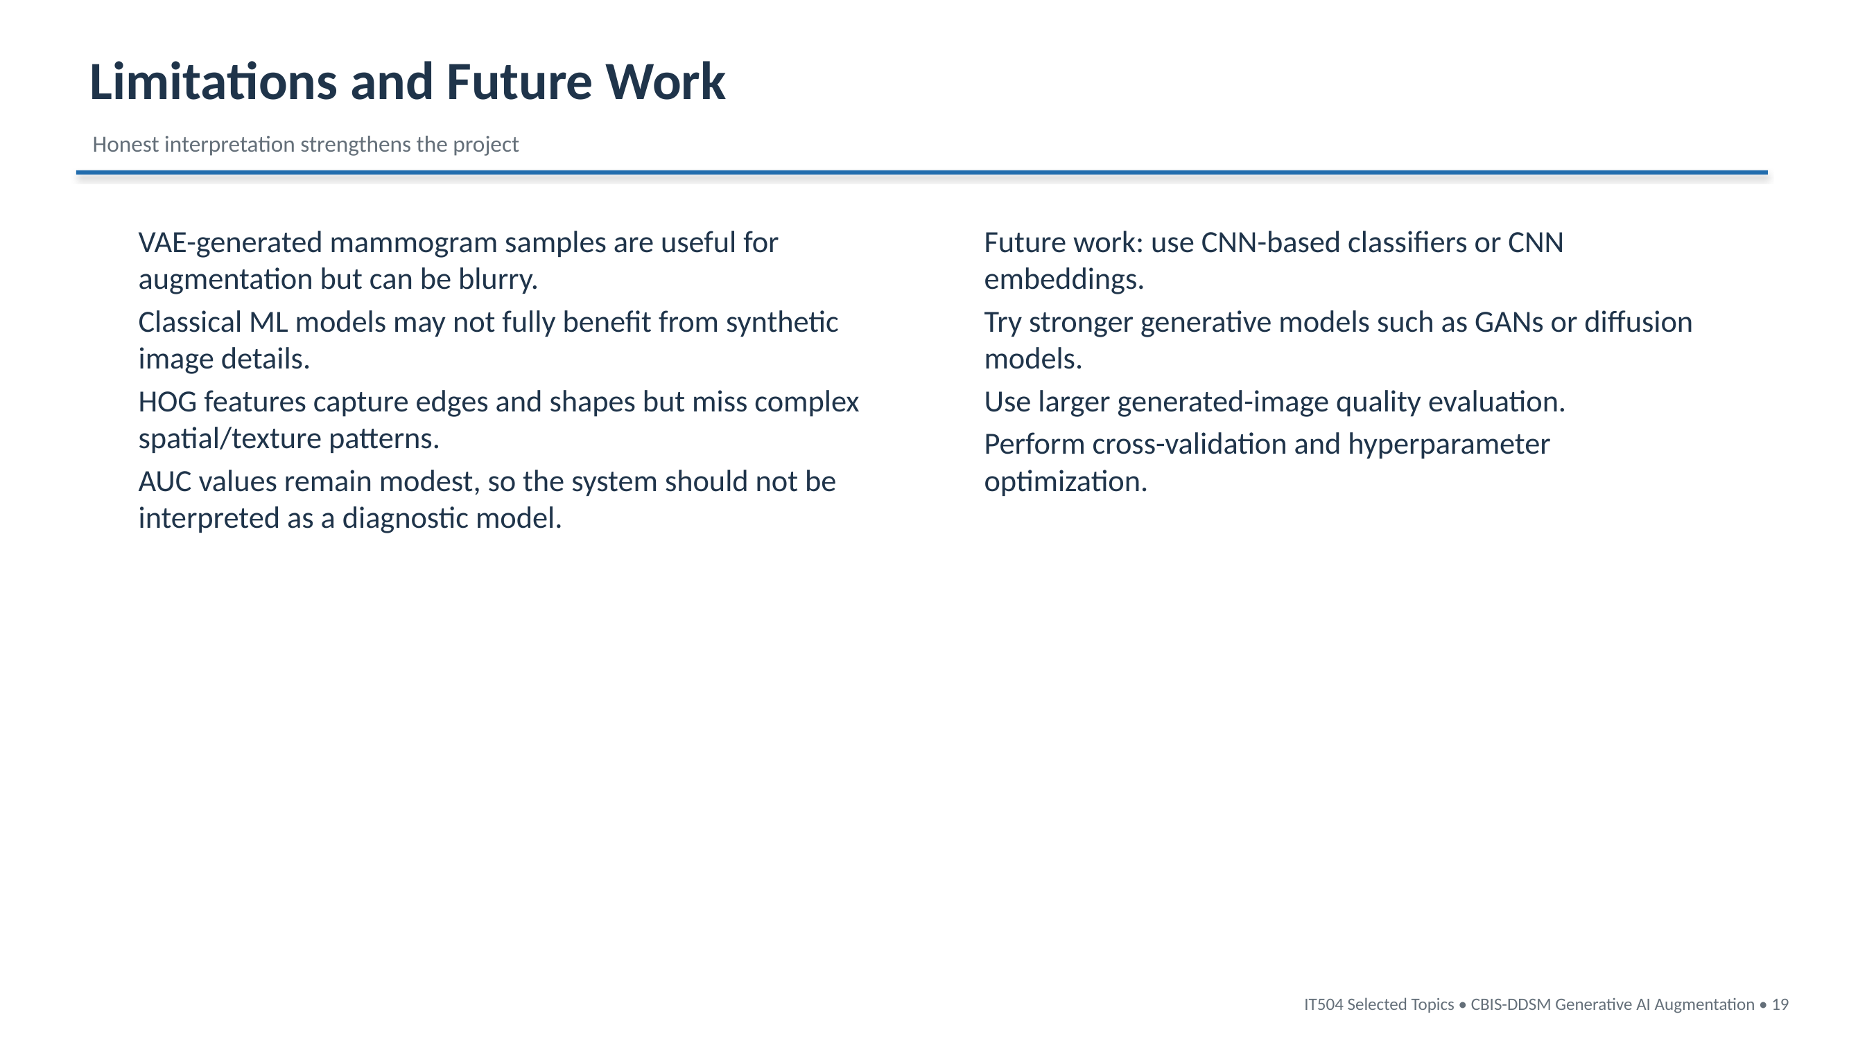

Slide 23
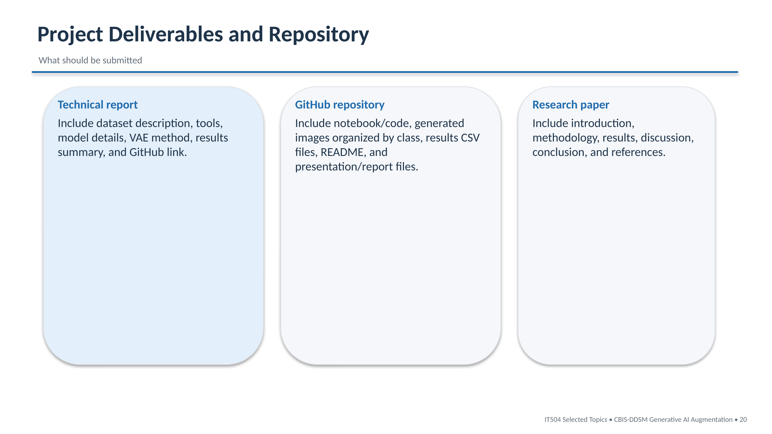

Slide 24
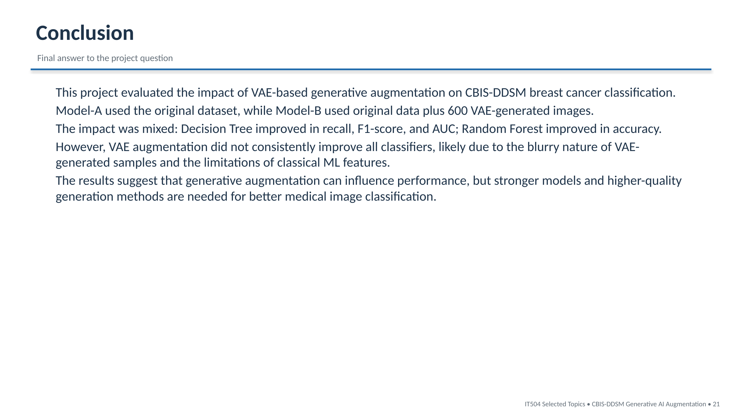

Slide 25
