Slide 1
Arbitrary Style Transfer with Style-Attentional Network

Slide 2
Dae Young Park and Kwang Hee Lee
Artificial Intelligence Research Institute, Korea
23 May 2019

Slide 3
Agenda
NETWORK ARCHITECTURE
DEMO

Slide 4
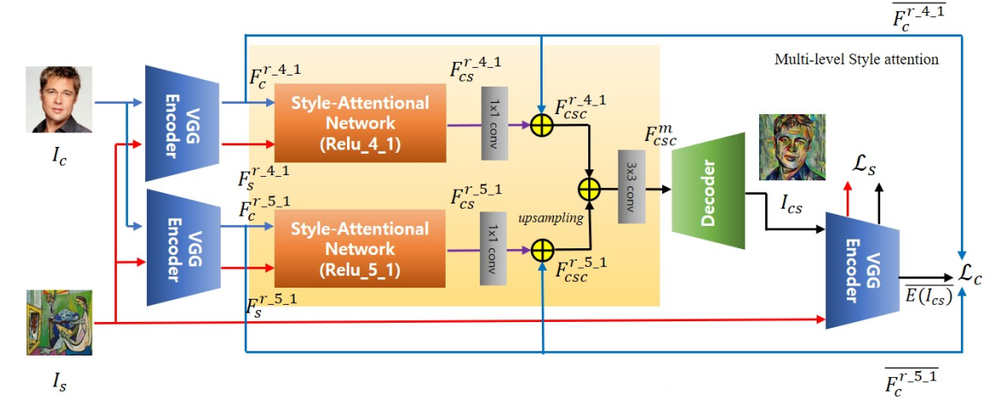

Slide 5







$$F_{c}=E(I_{c})$$
$$F_{s}=E(I_{s})$$
$$F_{cs}=SANet(F_{c}, F_{s})$$
$$F_{cs}=conv_{1x1}(F_{cs})$$
$$F_{csc}=F_{c}+W_{cs}F_{cs}$$
$F_{csc}^{m}=conv_{3x3}$($F_{csc}^{r_4_1}$ + $upsampling$($F_{csc}^{r_5_1}$))
$$I_{sc}=D(F_{csc}^{m})$$

Slide 6
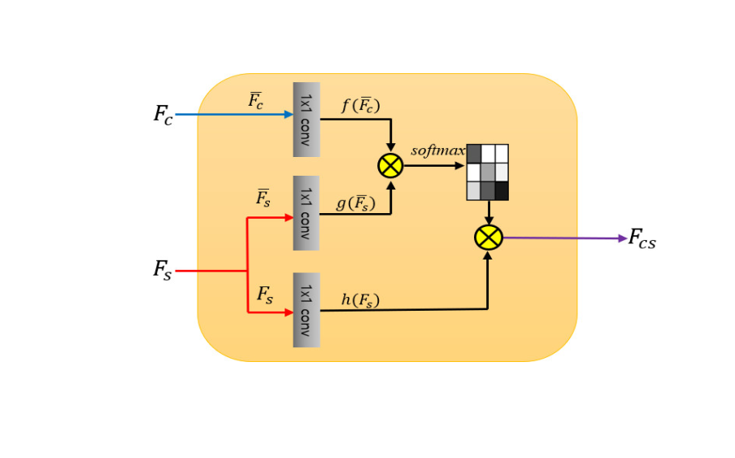

Slide 7


$${Attention between F}_{c}^{i} and F_{s}^{j}$$
$$F_{cs}^{i} =\frac{1}{C(F)}\sum_{any j}{\exp\left\{ f{\left(std\left(F_{c}^{i}\right)\right)}^{T}g\left(std\left(F_{s}^{j}\right)\right)\right\}h(F_{s}^{j})}$$
$$std\left(F\right) is mean−variance channel−wise normalized version of F$$
$$f\left(std(F_{c}\right)=W_{f} std(F_{c})$$
$$g\left(std(F_{s}\right)=W_{g} std(F_{s})$$
$$h\left(F_{s}\right)=W_{h} F_{s}$$
$$C\left(F\right)=\sum_{any j}{\exp\left\{ f{\left(std\left(F_{c}^{i}\right)\right)}^{T}g\left(std\left(F_{s}^{j}\right)\right)\right\}}$$

Slide 8
$$System loss$$
$$L= λ_{c}L_{c}+ λ_{s}L_{s}+L_{identity}$$
$$L_{c}={\left\|std(E{\left(I_{cs}\right)}^{r−4})−std(F_{c}^{r−4})\right\|}_{2}+{\left\|std(E{\left(I_{cs}\right)}^{r−5})−std(F_{c}^{r−5})\right\|}_{2}$$
$$L_{s}=\sum_{i=0}^{L}{ ‖μ\left(φ_{i}\left(I_{cs}\right)\right)−μ\left(φ_{i}\left(I_{s}\right)\right){\left.​\right\|}_{2}+‖σ\left(φ_{i}\left(I_{cs}\right)\right)−σ\left(φ_{i}\left(I_{s}\right)\right){\left.​\right\|}_{2}}$$
$$φ is: relu_{1−1},relu_{2−1,}relu_{3−1}, relu_{4−1}, relu_{5−1} of VGG_19$$

Slide 9
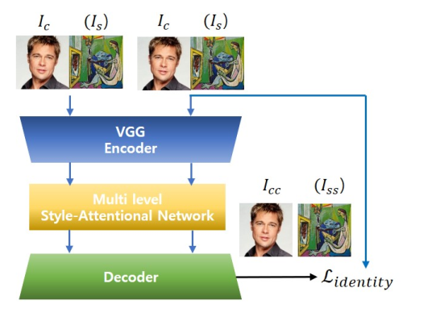

$$Identity loss$$
$$λ_{identity1}\left({\left\|I_{cc}−I_{c}\right\|}_{2}+{\left\|I_{ss}−I_{s}\right\|}_{2}\right)+$$
$$λ_{identity2}\sum_{i=0}^{L}{( {\left\|φ_{i}\left(I_{cc}\right)−φ_{i}\left(I_{c}\right)\right\|}_{2}}+$$
$${\left\|φ_{i}\left(I_{ss}\right)−φ_{i}\left(I_{s}\right)\right\|}_{2})$$

Slide 10
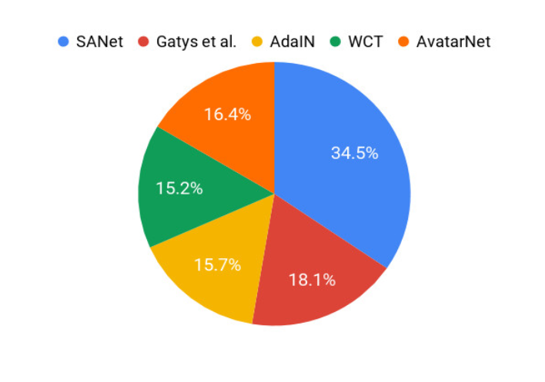

Slide 11
DEMO

