Slide 1
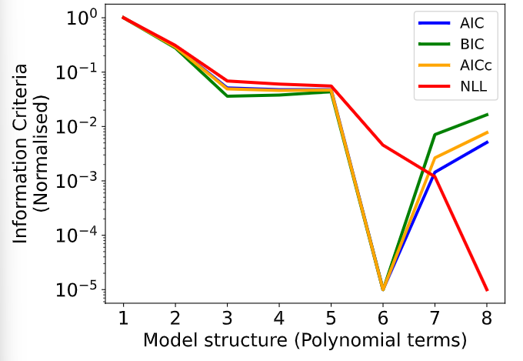
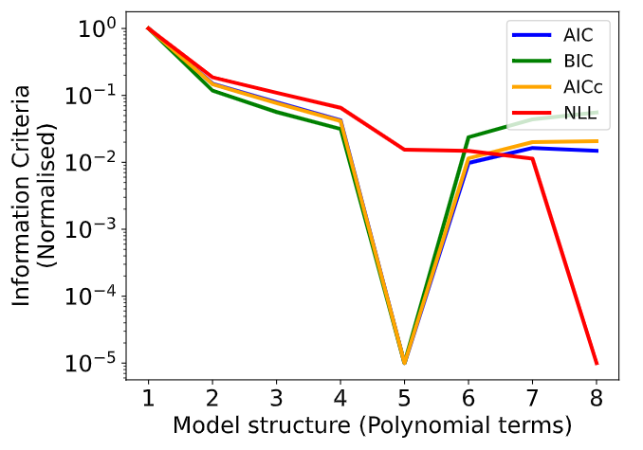
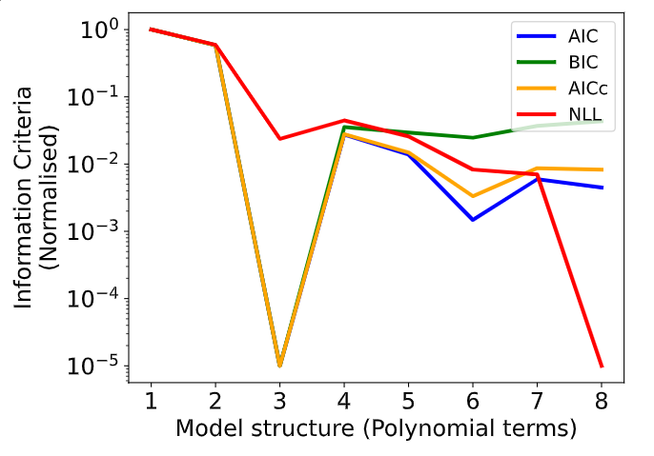
Hybrid-poly model (simple case study) Benchmark
multistart
4 experiments, 17 datapoints each
Control variable: initial concentration of 2 state variable & 4 feeding rates
Estimate the whole NLL function
Operating con:0.18293033, 154.88439029, 6.42037903, 9.99223432, 9.9582475 , 8.72956481
Final award:-977194.2773722738
Operating con:1.59921309e-01, 1.83241587e+02, 9.77290846e+00, 9.63945811e+00, 9.74587486e+00, 9.35473639e+00
Final award:-1.6195668249653203
Operating con:0.19487701, 187.87009525, 9.27636698, 9.24107181, 9.46676749, 9.89014329Final award:-81197.46224688503

Slide 2
Assume initial volume, make sure the flow added in total does not exceed 10% of the initial volume.
Hybrid-ANN model (microalgae case study) Benchmark
4 experiments, 26 datapoints each ( is this too many data points)? Collect every 24 hours (240 in total)
Control variable: initial concentration of 1 state variable (N) & 4 feeding rates & 4 Light intensity
Data generation:
Fn,in [0,2]. I0 [100,200], verying both control variables 4 times during the whole experiment.
No dilution effect being considered.
No bio constrained experiments included (how should we adjust the constrained reason?)
With Fn,in higher than 2, the production concentration of some experiments becomes negative.
With Fn,in as 2 for the whole feeding scheme and N0 at the upper bound, the production the experiment becomes negative.
The script has been debugged, going to run the benchmark for this week.

Slide 3
Do we have a benchmark case?
What’s the story: we are making hybrid model (if emphasis hybrid model, should we compare with a pure data-driven model?) with information criteria so we don’t loss information from limited data (so the data sets should be small? Should we compare with 1 left out cross validation?) and the model we constructed is good (so we do dynamic optimization and compare with mechanistic model? But this feels like our goal is to prove our hybrid model is as good as a mechanistic model, but in this way it doesn’t align with the purpose of using IC)
Benchmark with the model that take mu as a parameter

Slide 4
Removed all writing from escape paper to the draft
How to write problem statement:
I found 2 examples to follow:
https://www.sciencedirect.com/science/article/pii/S0098135422004410#:~:text=This%20work%20proposes%20a%20method,nonlinear%20programming%20(MINLP)%20problem.
https://link.springer.com/article/10.1007/s00449-019-02181-y
Tim’s is better

Slide 5
What do people expect to see on cover letter?
Interested to apply ML to the real world. That’s why Applying ML to engineering system. I did LSTM (with details), say I do RL, BO, trained in optimization, (under uncertainty), has lots of different points!!!! Joined Trading society.
meetup

Slide 6
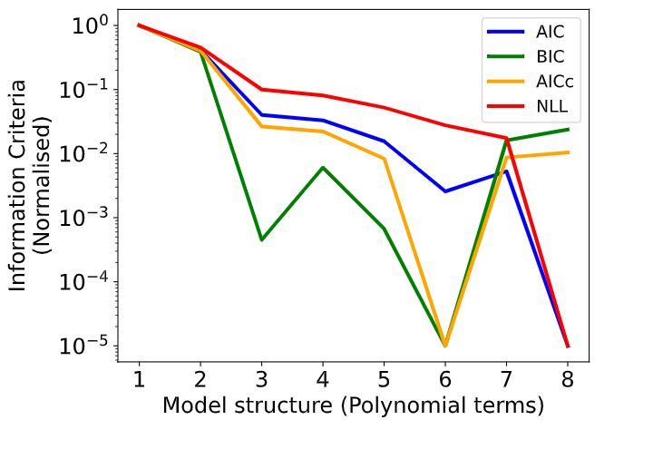
Data point:10

Slide 7
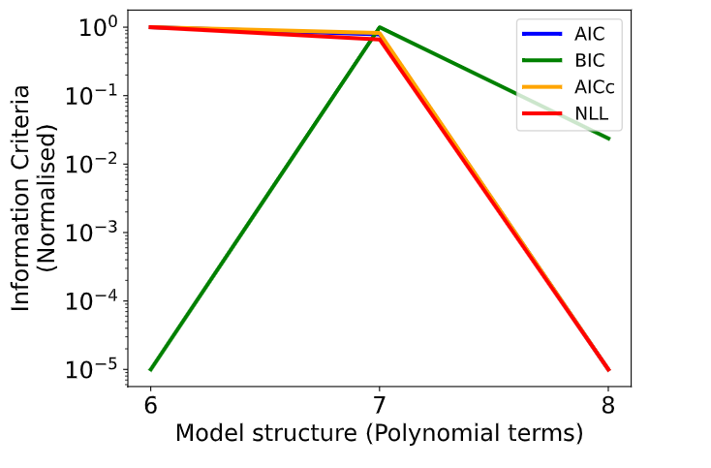
Data 20
Better initial guess? More polynomial terms? Take the model structure from less datapoints case? Change to scipy optimize?
With more than 20 points for each experiments, ipopt is not able to find solution for many models. (for models with less then 6 parameters, some model can be solved; more than 6 parameters most model can be solved). Too many constraints for the solver?

