Slide 1



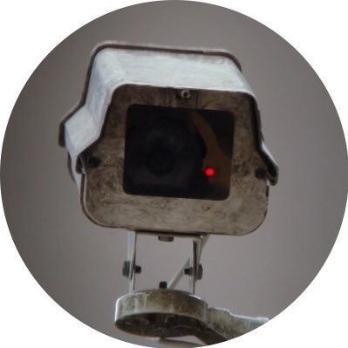
Mouse of Interest:
The Mouse Dangerous Action Recognition System (MADRS)
by MiumiuMickey (pod-rundown mandrills)
Maven Kong, Shaopeng Jiang, Zhen Wei, Ziqi Xiong

Slide 2

Overall Goal
We plan to establishe a model system to detect the actions of mice, called the Mouse Dangerous Action Recognition System (MADRS).
Dataset
we used Caltech Mouse Social Interactions (CalMS21) Dataset,which includes over 70 hours of tracked poses from pairs of mice, and over 10 hours of manual, frame-by-frame annotation of animals’ actions.
MiumiuMickey (pod-rundown mandrills)
Project Presentation

Slide 3
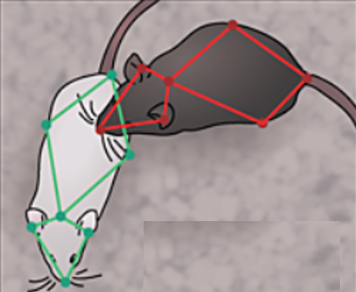

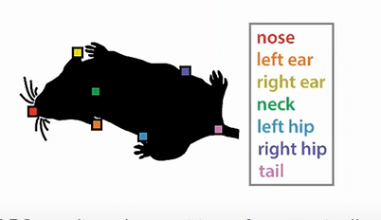
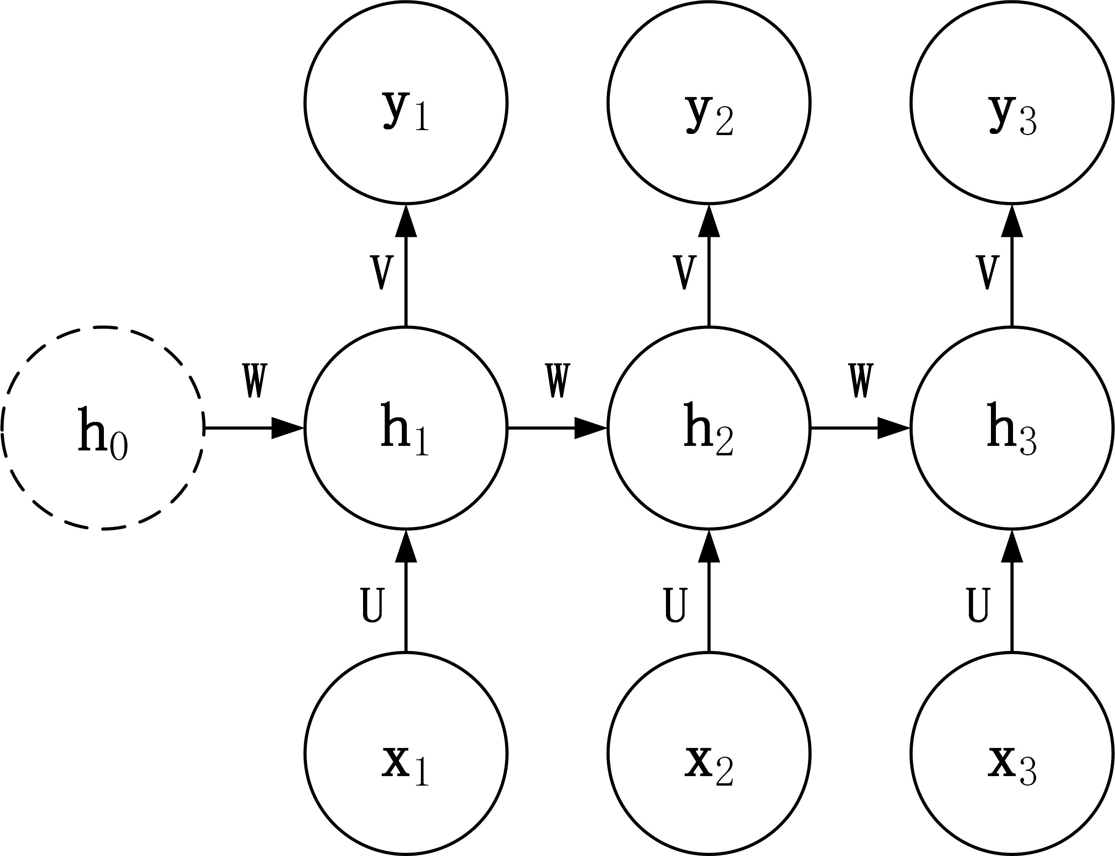
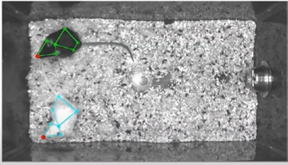
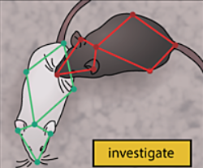
Method
RNN
input
output
MiumiuMickey (pod-rundown mandrills)
Project Presentation

Slide 4
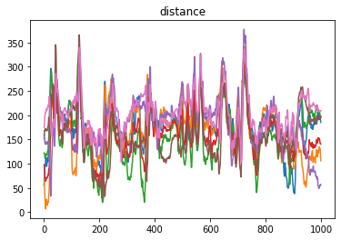
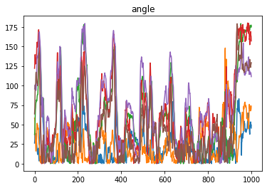
Input :

Slide 5
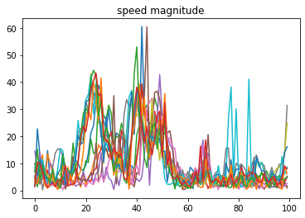
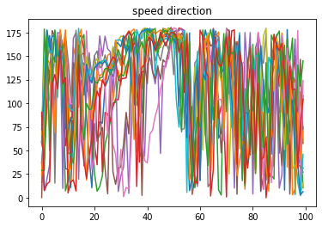
Input :

Slide 6
Input :
frame(x)~f(x+60): The state of the next frame is predicted by the features of the data form the previous 60 frames
Mouse_1 position
Mouse_2 position
……
each frame
x11 | x12 | … | y17 | x21 | x22 | … | y27 | … | … | …
features (In order)：The coordinates of the mice、distance、angle、speed、direction

Slide 7
RNN:
out_1
out_2
out_60
out_ 60 is the final output result after training an epoch,and the shape is 1 x 4.
one-hot: It solves the problem that the classifier can't deal with attribute data.
softmax processing:
map the result to real numbers between 0 and 1, and normalizes them to ensure that the sum is 1
linear
linear
linear
h2,1
h2,2
h2,60
h2,0
layer2
h2,1
h2,59
layer2
layer2
……
h1,1
h1,2
h1,60
h1,0
h1,1
h1,59
layer1
layer1
……
layer1
frame(x)
(1 , 41)
frame(x+1)
(1 , 41)
frame(x+59)
(1 , 41)

Slide 8
Training:
Label: ‘attack’: 0 , ’investigation’: 1, ’mount’: 2, ’other’: 3
output
Label
the predicted results and the actual results in one hot form are used to calculate the cross entropy loss.
adjust the parameters by SGD.
softmax
One-hot
cross entropy loss
optimize

Slide 9
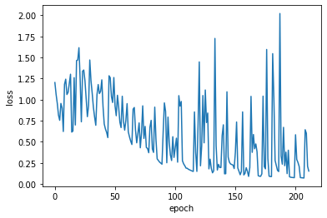
Result:
Training Sample = 53626
Test Sample = 23810
lr | 0.0002
momentum | 0.00006
accuracy | 69%
MiumiuMickey (pod-rundown mandrills)
Project Presentation

Slide 10
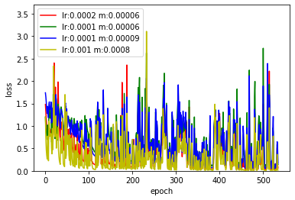
Result:
lr | 0.0002 | 0.0001 | 0.0001 | 0.001
momentum | 0.00006 | 0.00006 | 0.00009 | 0.0008
accuracy | 69% | 77% | 77% | 68%
MiumiuMickey (pod-rundown mandrills)
Project Presentation

Slide 11
Future Goal
By combining continuous tracking data with machine learning, we can summarize and predict the interactions among animals, and further discover and understand the social behaviors among animals, which can affect or help animals survive and reproduce to a certain extent. And ultimately we can also extrapolate to the prediction and evaluation of human behavior
MiumiuMickey (pod-rundown mandrills)
Project Presentation

Slide 12

𝐓𝐡𝐚𝐭′ 𝐬 𝐀𝐥𝐥.
𝐓𝐡𝐚𝐧𝐤 𝐲𝐨𝐮 𝐟𝐨𝐫 𝐚𝐭𝐭𝐞𝐧𝐭𝐢𝐨𝐧.
MiumiuMickey
pod-rundown mandrills
MiumiuMickey (pod-rundown mandrills)
Project Presentation

