Slide 1
optimized In-memory indices
Li Liu, Jin Yu, Guohao Dai, Wei Wu, Yu Qiao, Yu Wang, Lingzhi Liu
Kuaishou Technology and Tsinghua University

Slide 2
Agenda
1. overall review
2. avx512 based distance counter
3. int8 hnsw
4. pq error correction
5. furture plans

Slide 3
overall review – FAISS IVFPQ based
1B float datapoints
Kmeans clustering
1M centroids ---> HNSW-based
IVF based
1B product quantized datapoints

Slide 4
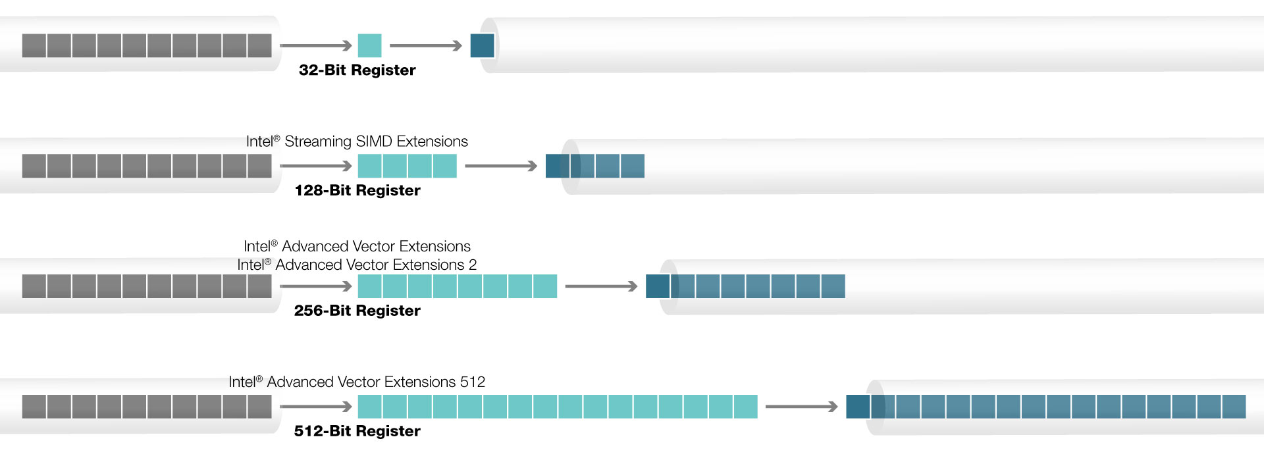
accelecrate with avx512

Slide 5
Accelerate with avx512
sub_dim = 8
avx2 256bits ---> 8 floats
loop for 16 times:
sub_ = sub(part_vec1, part_vec2)
res += mul(sub_, sub_)
avx512 512bits ---> 16floats
loop for 8 times:
sub_ = sub(part_vec1, part_vec2)
res += mul(sub_, sub_)
avx512 is 2x faster
vec1, dim = 128
vec2, dim = 128
sub_dim = 16
vec1, dim = 128
vec2, dim = 128

Slide 6





int8 hnsw
the first level index concerns more about recall@50
uniform quantize is good enough
default scale quantize in FAISS uniform quantize
…… ……
each dim has a different scale one scale for all values
$$s_{1}$$
$$s_{2}$$
$$s_{3}$$
$$s_{dim}$$
$${scale}_{ }$$

Slide 7
product quantize error correction
a end-to-end training method
strongly data dependence
Query
search results
Neg/Pos Samples
IVFPQ index
ground truth
Ranking Loss
Flat index
Update PQ Centroids

Slide 8
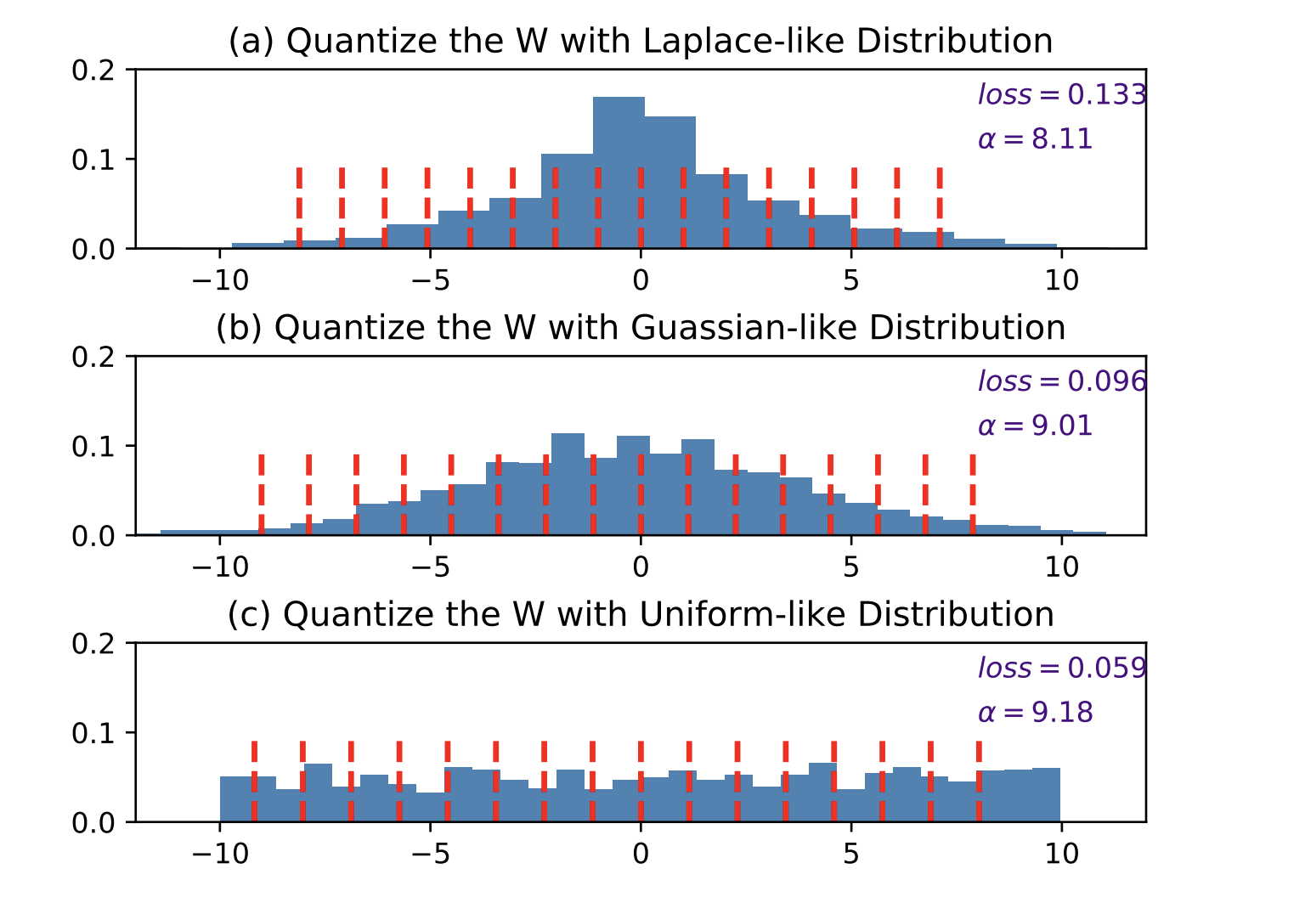
Future plans
int8 based graph search
pay more attention to data distribution

