Slide 1
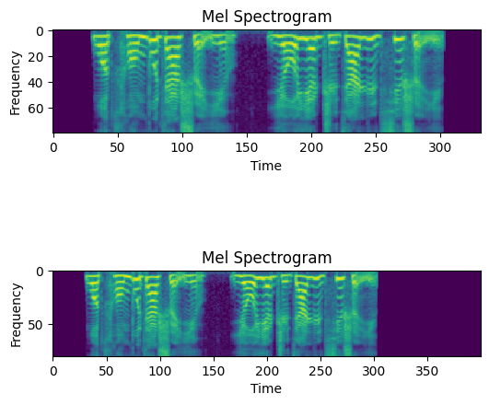
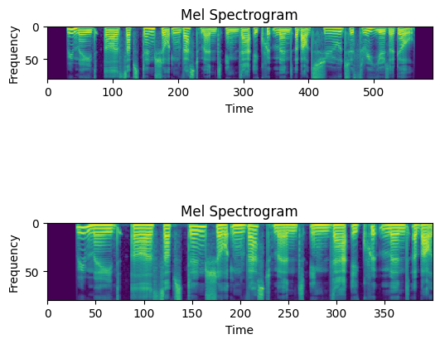
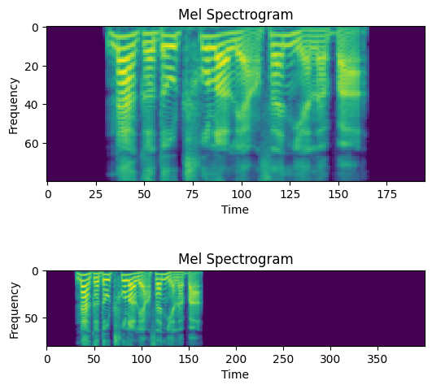
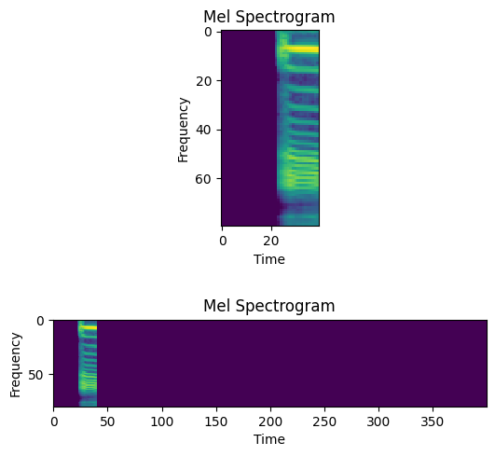
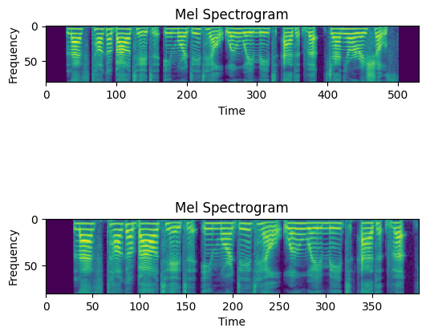









Preprocess
Fully Connected
Feature Map
Conv 3×3 k3 s1+ ReLU + MaxPool k2 s2
ReLU
Fully Connected Layer
Flatten
$$∗∗∗ ×80×1$$
$$400×80×1$$
$$50×10×64$$
$$200×40×16$$
$$100×20×32$$
$$\left(50×10×64\right)×1$$
$$128×1$$
$$128×1$$
$$2×1$$

